Slide 1
Hormone replacement therapy supply workshop
Regulatory processes
16 May 2022

Slide 2
Workshop 1
Hormone replacement therapy – Supply - Regulatory

Slide 3
Agenda
Introduction
Regulatory processes to manage supply disruptions
Support to manage supply disruptions for community pharmacies and wholesalers
Q&A

Slide 4
Temporary exemptions to labelling requirements

Slide 5
Temporary exemption to labelling requirements
Legal basis:
Regulation 266 of the Human Medicines Regulations 2012 and Article 63.3 of Directive 2001/83/EC permit supply of packs that:-
Do not meet the relevant legislative requirements for labelling and/or leaflet
Do not present the required label and/or leaflet information in English
An exemption can be applied when there are severe problems in respect of the availability of a medicine. Exemptions can be requested for national, MR/DC and centrally authorised medicines.

Slide 6
When can an exemption be applied?
An exemption can be applied for, to supply packs intended for another market, provided that the product is identical to that licensed for use in the UK. The only difference to the UK product should be the packaging.
Packs supplied to Great Britain (GB) require an exemption under Regulation 266 of the Human Medicines Regulations 2012
Packs supplied to Northern Ireland (NI) require an exemption under Article 63.3 of Directive 2001/83/EC
An exemption is intended as a temporary measure to mitigate a supply issue and will be for a defined period of time (no more than 6 months) or to cover specified batches

Slide 7
What documents are required?
Submissions should include:
Cover letter
Justification for exemption request
Mock ups of current UK labelling and leaflet
Mock ups of labelling and leaflet for packs intended for supply
Supporting evidence that the product is identical to the UK licenced medicine
DHPC letter and communication plan

Slide 8
Provision of information in English
A hard copy of the UK leaflet must be provided for supply with each pack
These do not have to be provided inside the carton but details of how they will be supplied with each order should be made clear.
The DHPC letter must direct the healthcare professional to an electronic version of the UK leaflet
If over-labelling is proposed or re-packing with the UK leaflet then a Batch Specific Variation (BSV) will be required.

Slide 9
Expedited assessment of marketing authorisation applications

Slide 10
Expedited assessment of marketing authorisation applications
An overview of the process for fast tracking an application
Steps to facilitate the fast tracking of an application
Timeframe for assessing fast tracked marketing authorisations
Any questions

Slide 11
An overview of the process for fast tracking an application
The MHRA can fast track marketing authorisation applications:
if there is compelling evidence of benefit in a public health emergency
or
if there is a shortage of supply of an essential medicine that has been verified by the Department of Health and Social Care (DHSC).

Slide 12
An overview of the process for fast tracking an application
The letter should include:
the justification for fast tracking
a brief description of the major clinical properties of the product
evidence supporting the claimed benefits of the product for the proposed indication(s)
If you want to fast track your application because of a shortage of supply we recommend you discuss this with DHSC. The MHRA will also liaise with DHSC to verify the need
No additional fee for fast-tracking marketing authorisation applications.

Slide 13
Steps to facilitate the fast tracking of an application
The applicant should avoid the pit falls that result in the rejection of a submission as this can considerably delay assessment:
All UK and Great Britain (England, Scotland and Wales) national applications should be submitted through the MHRA Submissions Portal. Questions about the Submissions Portal, you should email submissions@mhra.gov.uk.

Slide 14
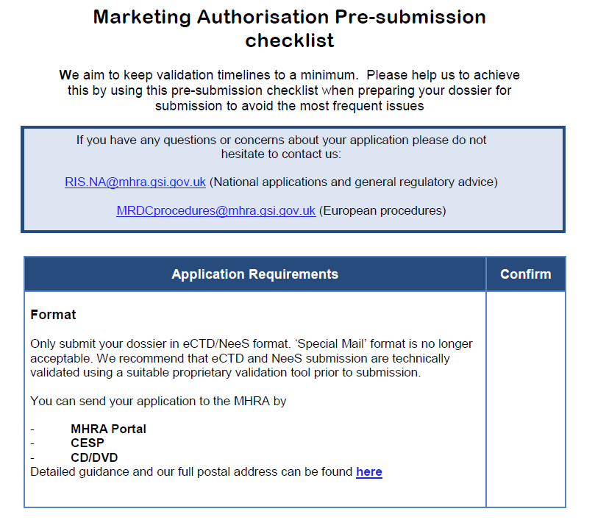
Steps to facilitate the fast tracking of an application
Recommended to use the pre-submission checklist (PDF, 129KB, 7 pages) to help you with your application.

Slide 15
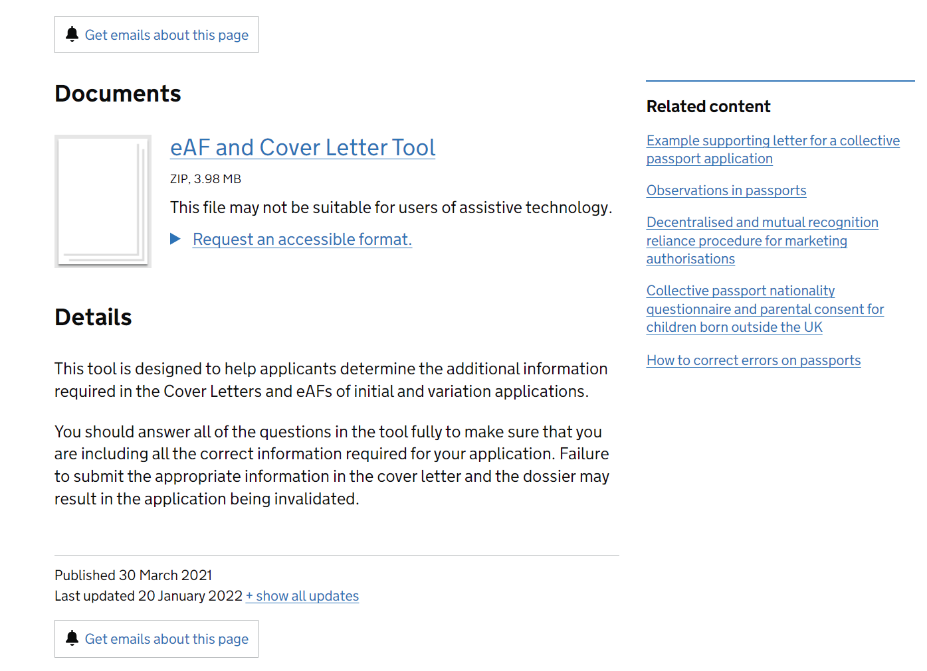
Steps to facilitate the fast tracking of an application
You are also recommended to use our eAF and cover letter tool to determine what information you need to include in your application to ensure it passes validation.

Slide 16
Steps to facilitate the fast tracking of an application
We recommend that you use a validation tool to check your submission as we will check that eCTD and NeeS submissions are technically valid using the Extedo Eurs is Yours (EiY) validation tool.

Slide 17
Steps to facilitate the fast tracking of an application
Active substance master files (ASMFs)
ASMFs holders must submit their dossier to the MHRA.
It is the MA applicant’s responsibility to make sure that the ASMF is submitted either before you submit your application or at the same time, as your application will not be valid without it.

Slide 18
Steps to facilitate the fast tracking of an application
Active substance master files (ASMFs)
Submission of a new ASMF and any update to an ASMF should be made by the ASMF holder using MHRA Submissions portal.
You can read our guidance about the submission of ASMFs.
Certificates of Suitability (CEPs) continue to be acceptable in support of UK and GB national authorisations.

Slide 19
Steps to facilitate the fast tracking of an application
Summary of product characteristics (SmPC)
The summary of product characteristics (SmPC) should be submitted to the MHRA in the correct format using the SPC template (MS Word Document, 36KB).
If you do not use this template your submission will be rejected. These templates should not be altered in any way, other than inserting the relevant information.
Any submission that does not meet the requirements will be rejected.

Slide 20
Steps to facilitate the fast tracking of an application
Rejection
If a submission is rejected, we will email you the reasons for the rejection. You must then resend the entire submission with the errors corrected. Do not send the corrected deficiencies by email.
You will not be charged if your submission is rejected for technical reasons.

Slide 21
Timeframe for assessing fast tracked marketing authorisations
The assessment process runs in two phases.
Assessment phase I will be completed as soon as possible after clock start.
Concerns arising from the initial assessment will be raised with the applicant as a letter requesting further information (RFI).
MHRA will seek advice from CHM and/or therapy area experts (specialty expert groups) during the assessment process, as required.

Slide 22
Timeframe for assessing fast tracked marketing authorisations
All concerns must be fully addressed in the clock off period. Requests for extension of the clock off may be granted under exceptions only.
Applicants may contact the assessment team for discussing issues raised in the RFI letter. You are encouraged to do this where something is unclear to ensure the responses are correct first time.
Phase II assessment begins on receipt of the applicant’s responses.
The MHRA will assess phase II as fast as we can based on the criticality of the situation with a view to issuing approval of the MA as soon as possible.

Slide 23
Assessment of variations and batch specific variations

Slide 24
Assessment of variations and batch specific variations
What is a batch specific variation
Submitting a batch specific variation (BSV)
Expediting variations including batch specific variations
Timeframe for assessing all expedited variations
Any questions

Slide 25
What is a batch specific variation
All products released to market must comply with the relevant marketing authorisation.
A batch-specific variation is a variation to release a single or small number of batches outside the usual conditions of the marketing authorisation.
Procedure is intended to be used only in exceptional circumstances where an unexpected or unavoidable situation has arisen (e.g. a production problem) and approval is needed to maintain stock on the market.

Slide 26
What is a batch specific variation?
Variation | Assessment days | Expedited assessment
Type IA | 14 | Not necessary as “Do and tell”
Type IB | 30 | Assessed as quickly as possible based on criticality of situation
Type II | 60
BSV Type II | 60
Type II complex | 90

Slide 27
What is a batch specific variation?
Examples of expedited batch specific variations
To allow the release of two batches of stock from the French market in order to alleviate an out of stock situation in the UK, arising from unexpected production problem on the packaging line.
To allow the release of 1 batch of drug product into the UK market, which is Spanish stock (60,034 units), in order to avoid an out of stock situation

Slide 28
What is a batch specific variation?
Examples of expedited variations
To release a batch which had exceeded the hold time up-to 37 days of the bulk filled capsules due to the plant shut down. Therefore, blistering could not be completed within the approved hold time of 4 weeks, to maintain supply of this product to the market.
To add an additional manufacturing site for the drug product to increase production capacity to meet increase demand and mitigate against the risk of an out of stock situation.

Slide 29
Submitting a batch specific variation
The MAH should provide evidence that the quality, safety and efficacy of the product are unaffected by the deviation in the batch/batches concerned.
The change code which matches closest should be selected from the application form.
All batch specific variations follow normal Type II timelines and fees.
Batch specific variations may be used for products licenced via DCP provided the batches are intended only for release to the UK market.

Slide 30
Expediting variations including batch specific variations
Where it is in the interest of public health it is possible to expedite the assessment to help maintain supply levels of the product (for example where there are no alternative suppliers).
The intention is to avoid an adverse impact on public health which would otherwise arise from interruption to supply if the normal assessment timeframe was applied.
In these cases justification is needed as to why the variation application is considered urgent and requires expedited assessment.

Slide 31
Expediting variations including batch specific variations
In the request we would expect information to be provided on:
The nature of the non-compliance
An explanation of the public health impact if there was an interruption to supply including how the product is of major clinical significance
Information about the supply and demand situation including:
  actual or potential out of stock situation
  prescription volumes or sales demand,
  current stock levels, including current stock on the market

Slide 32
Expediting variations including batch specific variations
  to know whether the Marketing Authorisation Holder is the only or a major supplier including percentage market share
  information about the availability of alternative products or presentations
  number of weeks/months of stock ready to release if the variation is approved
In the case of a potential interruption to supply Marketing Authorisation holders are also obliged to contact DHSC to advise of that risk. Before agreeing to expedite a variation MHRA will usually also discuss the situation with DHSC.

Slide 33
Expediting variations including batch specific variations
To help us handle requests for expedited assessment:
Following your submission; if the request is agreed you will be advised of the name of the relevant assessment team manager.
If submitting the variation via the MHRA Portal or CESP, please give us the reference number and the date of submission as soon as this information is known as this helps us to locate the submission.
If you have not already submitted the batch specific variation, please attach a copy of the agreement to expedite (usually an e-mail) to the cover letter of your submission.

Slide 34
Timeframe for assessing all expedited variations
We aim to validate and begin assessment of any expedited variation on the day of submission or the following day and to determine as soon as possible.
However it may be that further information is required during the assessment.
Please also remember that our agreement to expedite any variation does not necessarily mean that we will be able to approve it as submitted and it may even be refused - but public health issues arising from an interruption to supply will always be taken into account.

Slide 35
The supply of unlicensed medicinal products

Slide 36
The supply of unlicensed medicinal products
Unlicensed medicines (ULMs)
Legal basis
MHRA Guidance Note 14
UK made ULMs
Imported ULMs
  Conditions
  The process
  Notifying MHRA to import ULMs

Slide 37
Unlicensed medicines (ULMs)
Human Medicines Regulations (HMRS 2012)
Reg 46 – A medicinal product must be the subject of a marketing authorisation or product licence before being placed on the market.
Reg 167 – Exemption from the need for a marketing authorisation for a medicinal product.
An unlicensed medicinal product should not be supplied where an equivalent licensed medicinal product can meet the special needs of the patient.
Responsibility for deciding whether an individual patient has “special needs” which a licensed product cannot meet should be a matter for the prescriber responsible for the patient’s care.

Slide 38
Unlicensed medicines (ULMs)
MHRA Guidance Note 14 – The supply of unlicensed medicinal products (“specials”) has comprehensive detailed information on the supply of unlicensed medicinal products in the UK
https://assets.publishing.service.gov.uk/government/uploads/system/uploads/attachment_data/file/373505/The_supply_of_unlicensed_medicinal_products__specials_.pdf
NOTE: Investigational Medicinal Products (IMPs) used in the context of a clinical trial are not subject to Regulation 167.

Slide 39
Unlicensed medicines (ULMs)
Manufactured in the UK
Manufacturer’s “Specials” Licence
Good Manufacturing Practices (GMPs)
manufacture or assembly is carried out under the supervision of appropriately qualified staff, including a named quality controller and production manager
Minimum labelling requirements → must comply with British Pharmacopoeia (BP)

Slide 40
Unlicensed medicines (ULMs)
Imported ULMs – Conditions:
Special need for the product;
UK importer - needs to be licenced (WDA(h) or MSL);
The unlicensed product should have been manufactured under UK GMP expectations;
The MHRA must be notified of the intent to import the ULM;
The MHRA must not object to the importation of the ULM;

Slide 41
Unlicensed medicines (ULMs)
Imported ULMs– The process:
Submit the notification;
MHRA acknowledges the notification within 2 weeks (may go up to 6 weeks in very busy times) and issues an “Acknowledgement Letter” – This starts the 28 day clock. No import is allowed until 28 days have passed from the date of the letter or we state otherwise.
Within the 28 day period started by point 2 the importer will receive a “Final letter” which usually is one of the below:
No Objection – import from date of the letter allowed;
No Objection with Reason – import from date of the letter allowed;
Further Information Requested – No import is allowed until we say otherwise;
Objection with Reason – No import is allowed.
MHRA may expedite notifications in the interest of Public Health.

Slide 42
Unlicensed medicines (ULMs)
Notifying MHRA to import ULMs
Importer and their Licensing status:
if the product is to be imported from an EEA member state, the importer will need a valid UK Wholesale Dealer’s Licence (WDA(H));
if the product is to be imported from outside the EEA, the importer will need a valid UK Manufacturer’s “Specials” Licence (MSL).

Slide 43
Unlicensed medicines (ULMs)
Notifying MHRA to import ULMs
Name of the exporting country
Information about the facilities where the product is manufactured
Full address of the facilities where the finished product was manufactured;
Evidence of GMP compliance of the manufacturing site of the finished product;
Without suitable GMP compliance importation may not be allowed on public health safety grounds.

Slide 44
Unlicensed medicines (ULMs)
Notifying MHRA to import ULMs
Information about the product to be imported
  Licenced status of the product proposed for import anywhere in the world;
  Active substance name;
  Product name (brand and/or generic);
  Product strength;
  Product pharmaceutical form;
  Pack size (number of dosage forms in a pack; for liquids, also provide volume of each container);
  Number of packs to be imported per notification.

Slide 45
Unlicensed medicines (ULMs)
Notifying MHRA to import ULMs
The submission form can be found here: https://www.gov.uk/government/publications/notification-of-intent-to-import-an-unlicensed-medicinal-product

Slide 46
Unlicensed medicines (ULMs)
Submission form
Unique ref (no more than 16 characters max) | Product Code (no more than 16 characters max) | Quantity (No. of Packs) | Country Imported From | Supplier (if not manufacturer) | Country of Manufacture | Manufacturer | Generic Name (English INN) | Brand Name | Form/Strength | Pack Size (As no. of items per pack, i.e. tabs, amps, bottles etc.) | Special Clinical Need
This is your reference number that is unique for the individual notification. It cannot be repeated. Ideally these would be numerical and sequential. | A product code should define: -Generic name (of drug substance(s)) -Brand name, strength, -pharmaceutical form and pack size (for a single pack, as number of items in pack) -Manufacturer name and address -Exporting country If any of these differ, a new code will be required. The code must be less than 16 characters in length, including spaces. Please avoid special characters and keep the code alphanumerical. | This is the total number of packs (usually 25) | Country where the product is imported from and country where it is licensed | You can list multiple suppliers here but do not forget that all other particulars of the product code must remain the same, ie, same manufacturing sites, strengths, pack sizes, country of import, etc… | Country of the manufacturing site of the product. | Name and full address of the manufacturing site. If this is a new product code you will have to insert the full address. | This is the active substance name. This must be in English and UK versions of them. Please be mindful of incorrect spellings such as final “e”, “f” vs “ph”, adrenaline vs epinephrine, etc… | The commercial brand name of the product. If there is none, you can use the generic name. | You must include the pharmaceutical dosage form (tablet, capsule, ointment, solution for injection, solution for infusion, eye drops, nasal spray, etc…) | Unitary dosage form – total number of individual dosage forms in a single pack (eg 30 tablets) If it is not a unitary dosage form, like a syrup, cream, etc, you need to provide the total volume/weight of a single container and the total number of containers per pack, for eg: a pack with a single bottle of 50mL should be expressed as 1x50mL; 6 tubes of 5g of ointment per single pack, should feature as 6x5g

Slide 47
HRT Medicines Shortages – Pharmacy Supplies
The MHRA guidance on the Repeal of Section 10(7) of the Medicines Act 1968 is available on GOV.UK
https://www.gov.uk/government/publications/repeal-of-wholesale-dealer-licence-exemption-for-pharmacists
What was Section 10(7)? It was that part of the professional exemption for pharmacists (Section 10) that provided for registered pharmacies to supply small quantities of medicines wholesale, without the need for a Wholesale Dealer’s Licence.
Why was it repealed? It was repealed as part of the consolidation project of the medicines legislation project.

Slide 48
HRT Medicines Shortages – Pharmacy Supplies
What was the issue with the repeal? Pharmacists in registered pharmacies had historically relied on the exemption for the supply of small quantities of medicines to third parties. For example, supply of a medicine from one pharmacy to another if there was a shortage and there was a patient need to fill a prescription.
There was significant concern from the pharmacy sector about the repeal and the potential adverse impact. This was evident during the consultation. There was much stakeholder engagement to find a solution.

Slide 49
HRT Medicines Shortages – Pharmacy Supplies
MHRA shared these concerns and did not want the repeal to have a negative impact on the supply of medicines to healthcare professionals (HCPs) and patients. We recognised the important role that pharmacists played in the healthcare system, ensuring that patients’ timely access to medicines was maintained.
Working collaboratively with the relevant stakeholders the guidance was developed in 2012 and widely shared by MHRA and others.

Slide 50
HRT Medicines Shortages – Pharmacy Supplies
What does it cover:
the supply of small quantities of medicines by community and hospital pharmacies to other HCPs
the supply of small quantities of medicines amongst community and hospital pharmacies to meet a patient’s individual needs
There are criteria:
it takes place on an occasional basis
the quantity of medicines supplied is small
the supply is made on a not for profit basis
the supply is not for onward wholesale distribution

Slide 51
HRT Medicines Shortages – Pharmacy Supplies
If all of the criteria are met MHRA would not consider such supplies as commercial wholesale dealing and pharmacies would not require a wholesale dealer’s licence.
So in the current situation - Pharmacy A may supply Pharmacy B with e.g. Oestrogel to meet a patient need (and the other criteria), without holding a licence.
Those pharmacies who wish to engage in commercial trading must hold a wholesale dealer’s licence (and there are a number that do).

Slide 52
Use of quotas by wholesalers
Regulation 43 (2) The licence holder must ensure, within the limits of the holder’s responsibility, the continued supply of medicinal products to pharmacies, and other persons who may lawfully sell medicinal products by retail or supply them in circumstances corresponding to retail sale, so that the needs of patients in the United Kingdom are met.
It is recognised that wholesalers and MAHs are required to use demand management to ensure fair distribution of medicines between pharmacies and doctors’ dispensaries to maintain supply to all customers.

Slide 53
Use of quotas by wholesalers
A wholesaler should use best endeavours to put in place measures and controls that ensure the equitable distribution of available medicines amongst all pharmacies and doctors’ dispensaries.
It is essential that wholesalers communicate with pharmacies and doctors’ dispensaries, clearly, consistently and in a timely way. If a product cannot be delivered as requested, wherever possible, the dispenser should be provided with details of any contingency supply arrangements, where these are known. The reason an order cannot be met should be made clear to the pharmacy/doctor dispensary

Slide 54
Q&A
Follow up e-mail queries for the MHRA should be directed to MHRA Customer Services:
email info@mhra.gov.uk using the subject line – 'HRT supply workshop enquiry’
Main Telephone (weekdays 9am to 5pm): 020 3080 6000
and/or DHSCmedicinesupplyteam@dhsc.gov.uk

Slide 55

© Crown copyright 2022
Open Government Licence
Produced by the Medicines and Healthcare products Regulatory Agency.
You may re-use this information (excluding logos) free of charge in any format or medium, under the terms of the Open Government Licence. To view this licence, visit http://www.nationalarchives.gov.uk/doc/open-government-licence or email: psi@nationalarchives.gsi.gov.uk.
Where we have identified any third-party copyright material you will need to obtain permission from the copyright holders concerned.
The names, images and logos identifying the Medicines and Healthcare products Regulatory Agency are proprietary marks. All the Agency’s logos are registered trademarks and cannot be used without the Agency’s explicit permission.

