Slide 1
COVID-19 Specialist Advice Service Scheme (CSASS)
Summary of Key Findings
August 2021
Emma-May Heppell and Richa Sharma
Legal Support Research, Access to Justice Experimentation and Evaluation Team
This summary pack is informed by the CSASS end of grant report based on financial and monitoring data gathered from grantees

Slide 2
Context
A lack of legal advice leads to ‘cycles of decline’
According to data from legal needs surveys:
45% of adults with a legal problem reported one or more: stress, mental health issues, loss of income or finances
11% reported experiencing physical illness
Legal advice prevents a ‘cycle of decline’ which otherwise creates substantial financial pressures on government and negative impact on society.
Unresolved legal issues cluster and grow in complexity
Encounter with formal justice system & increased demand on public services/ finances
Mental, physical & financial distress, breakdown of relationships

Slide 3
Context
The COVID-19 Specialist Advice Service Scheme (CSASS)
The not-for-profit legal advice sector is the most frequent source of advice for legal problems.
It was anticipated that the advent of COVID-19 would exacerbate the scale of legal issues faced and increase demand for advice in a sector with constrained capacity.
Funding was made available by HMT/DCMS and the MoJ through the COVID -19 Specialist Advice Service Scheme (CSASS) for not-for-profit legal advice providers to:
Avert their closure and remain operational, providing specialist advice services throughout COVID-19;
Procure equipment and training to enable remote delivery of services, and adapt their operations accordingly;
Increase their capacity to meet the significant rising demand for advice services.
The MoJ invested part of the CSASS fund into the Community Justice Fund (CJF) – a pooled fund across several funders. MoJ investment was leveraged by the CJF to obtain further investment across additional funders maximising the financial support available across the advice sector at a critical time (see slide 3 for details).

Slide 4
Summary of Grant Funding
Covid-19 Specialist Advice Service Scheme (CSASS)
In April 2020, the MOJ contributed
£5.4m
Community Justice Fund (CJF)*
£2.4m
(37)
Law Centres Network
£2m
(35)
Managed by the Access to Justice Foundation (ATJF
72 frontline organisations providing legal advice across all regions in England and Wales were supported with an average grant size of
£71,000
(51% of organisations operated in some capacity out of Greater London area)
*179 specialist legal advice organisations were supported through the £11.59m CJF delivered in collaboration with Independent Funders, the MoJ, and The National Lottery Community Fund maximising the impact of the grant on the legal advice sector. While the MOJ funded ATJF and LCN separately under the CSASS, the CJF application portal was used by all 72 grantees.

Slide 5
Summary of Grant Funding
Funds were used responsibly & flexibly by grantees at a time of reduced income
To remain operational during the pandemic
To pay staff wages and limit use of the furlough scheme
To hire or retain specialist staff
To procure equipment to deliver services remotely
To implement early intervention measures for clients with characteristics of vulnerability
Feedback from beneficiaries
“
[the funding] will make a significant difference to so many lives at this crucial time, enabling charities to continue to provide early intervention that prevents people becoming unemployed, destitute or homeless.”
“
We are grateful to receive this funding lifeline as our income has ceased due to courts not operating.”
“
The funding has been central to sustaining our specialist Housing advice… and helped us to re-establish our Immigration (advice) services...”

Slide 6
Overall, there was increased activity in organisations during funding period
While there was an overall upward trend in the number of clients supported, this differed across months with aggregate increases of 9% in March to decreases of 18% in August.
Reasons for increases were linked to changes in financial circumstances often from new clients who had experienced a sudden change in employment or benefits.
Reasons for decreases in activity were linked to government policies (eviction ban and furlough), delay of events that trigger advice seeking behaviour, and the reduced capacity of organisations to deliver services.
To note: grantee data was highly diverse which is not reflected in the aggregate figures presented.
*
Highest increase in support was seen for areas related to: | Highest decrease in support was seen for areas related to:
Asylum & Immigration | Debt
Complex & clustered with other issues that increased during pandemic including domestic violence, housing, No Recourse to Public Funds | Decrease in employment was likely due to suspension on bailiff action
Employment | Welfare Benefits
Likely due to Government restrictions leading to staff furlough and redundancies | Likely due to fewer benefit appeal cases over funding period
*The table reflects changes in support levels of organisations & should not be read as increase/decrease in issues or demand. Moreover, changes in support levels could be temporary & driven by circumstances around COVID-19.
Notes:
* Asylum & Immigration support have been combined as some secondary grantees were unable to split client support between the two areas of law
- Reduction in Debt/housing support cases may be temporary. Eg:One grantee reported expecting rent arrears in and around £20k and mortgage arrears in and around £50k, much higher than pre-pandemic levels when clients would have approached for support.

Slide 7
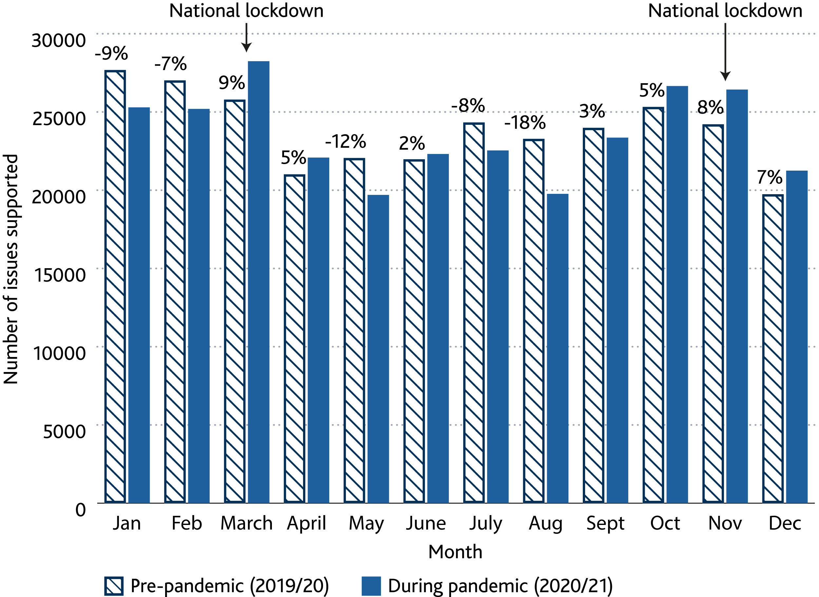
Overall, there was increased activity in organisations during funding period
‘Issues’ refers to individual client support across an area of civil law. If a person received support on both debt and housing, they would be captured against each. As understanding of term ‘issues’ differed among organisations, numbers to be interpreted with caution.

Slide 8
Vulnerability was a key factor affecting organisations’ approach to client needs and approach to delivery
Profiles of clients with characteristics of vulnerability
Age: older clients
Ethnicity and socio-economic conditions: BAME groups, multigenerational families
“We had to organise an interview with a client facing coercive control by her son…I was tasked with setting up the laptop at her home... and had to setup all this while socially distanced.”
“A lot of this demographic are in multiple housing...in shared, overcrowded housing and with multi-generational families…a higher risk of spreading the virus meant we had few clients who were severely ill.”
Health and Disability: long term health conditions, accessibility/mobility issues, communication and language barriers
Age: Younger/Newer clients facing change in financial situation or rental issues due to pandemic, often seeking one-off advice
“Some clients with health problems…would want to stay at home and get help from there. Others with language barriers or mental health problems will easier be helped face to face.”
“New clients were younger, more technically able and more literate. But no one can self-serve. There’s a power imbalance between a landlord and a tenant - they need support to know their rights.”
No Recourse to Public Funds: clustered with other issues
“We had vulnerable people on spouse visas, subject to domestic violence and needed protection. We needed to get them rehoused and then get restrictions lifted.”
*Quotes are based on anecdotal data from interviews with a sub-sample of 7 grantees, thus must be interpreted with caution.

Slide 9
Blended delivery methods were used throughout the funding period
Although organisations predominantly shifted to remote (telephone and online) service delivery during the pandemic, in-person support continued throughout to a lesser degree.
There were patterns amongst client groups that influenced delivery methods: Remote delivery worked better for some, while face-to-face for others *
* based on anecdotal data from interviews with a sub-sample of 7 grantees, thus must be interpreted with caution.
Remote
Face-to-Face
Digitally savvy
Younger clientele
Preferable for certain areas of law (e.g. immigration)
Mobility issues
Familiarity with online tools by using Gov support services
Long term health conditions
Recognising distress
Accessibility to technology
Funding to continue digital services
Uploading documentation/court hearing evidence
Older people
Those in difficult situations at home
Hearing impairments
Communication/language barriers
Inability to travel
Financial difficulties (i.e. travel fare)

Slide 10
Blended delivery methods were used throughout the funding period
Principally we delivered services through phone as everyone had one. And then we were able to modify our access and allow some safe interview rooms...we provided a blend of both so someone could travel and safely come in when the work required...”
“
Options were imperative given the diversity of client profile and nature of services offered by organisations.
Organisations reported sustaining a blended delivery in the future.

Slide 11
There were three key challenges faced by organisations during the pandemic
Rising levels of legal need across issues
Organisations witnessed a broader client base and higher volumes of complex and clustered issues than before the pandemic.
In some cases, this led to expansion of services into other areas of law such as immigration/asylum.
Organisations also reported the need to undertake early action to prevent complex cases escalating into areas such as destitution and homelessness.
Rush to deliver services remotely
The move to remote delivery happened overnight for many organisations and was particularly challenging where systems were not in place prior to the pandemic.
Clients were informed directly, via website, signs on building doors, redirected reception phone lines, and extended service hours.
Telephone delivery was most commonly used as a result of client accessibility and existing systems. Organisations with hard copy documentation continued using office premises throughout.
Increasing capacity with short term/ reduced funding
Organisations largely used funding to remain operational rather than increasing capacity. Increasing staff, services, and tools was challenging in the absence of certainty around longer-term funding and reduced revenue from other streams.
Staff shortages due to sickness and furlough exacerbated pressures on capacity along with winding down of Govt. support measures which led to increased demand for services. The impact of fund was not seen until much later therefore leading to underrepresentation of support and issues covered.
Grantees anticipate further instability going forward due to these pressures, a weakened advice sector, and the sustained negative effects of the pandemic.

Slide 12
Implications and Next Steps
Clients:
Delivery:
Higher levels of support needs are anticipated as events that trigger advice seeking behaviour continue to rise such as increased court capacity and the winding down of government measures in housing and employment.
Face-to-face delivery will continue to be used due to proportion of clients with vulnerable characteristics, limited accessibility to technology, and technology affordability for organisations.
“
“
There has been a 35% drop in matters start and cases opened and that’s because the courts had been locked down…Anything substantive was all put back so there were a lot of postponed hearings.”
Most (of our) clients didn’t have a smart phone, or the data (to engage with online tools)…Some didn’t have credit to even make a phone call…affordability and digital confidence were the biggest drivers of who was using technology.”

Slide 13
Implications and Next Steps
Recognising the foreseen further instability due to the sustained impact of the pandemic and reduced income, the MoJ has renewed a seed investment of £2m into the Community Justice Fund (CJF) over the financial year 2021/22.
This 2nd wave of funding under the CJF, called the Sector Sustainability Grant (SSG), is targeted to fill data gaps and support particular geographical areas and areas of law, based on evidenced demand and lack of provision, and better meet legal need.
The improved access to insight and data through SSG will serve as a vital tool for MOJ in directing policy interventions within the Early Legal Support and Advice programme in 2021/22

Slide 14
Appendix

Slide 15
Data Points
Deadline | Data Provided | Period covered
15 September 2020 | Actual spend by secondary recipients Online surveys with performance data (covering current quarter and historical data) Forecasts of further secondary grants to be awarded in the remainder of the grant period | April – end of August 2020 (plus the relevant historical data)
December 2020 | Actual spend by secondary recipients Online surveys with performance data | September - November 2020
March 2021 | Actual spend by secondary recipients Online surveys with performance data | December 2020 – February 2021
May 2021 | Actual spend by secondary recipients Online surveys with performance data Details of any unspent funds (if relevant) Details of any funding clawed-back (if relevant) | March – end of April 2021
May - June 2021 | Interviews with 7 secondary grantees

Slide 16
Data Points
All funds received by the 72 secondary grantees were subject to monitoring and evaluation. Given the pressures organisations were under as a result of the pandemic, a key principle of the evaluation work was to generate insight whilst minimising additional burdens on grantees and any user of the support services.
Data was gathered via standardised templates, developed by MoJ analysts, at four points across the funding period. Using excel workbooks, an online survey and interviews with a subsample of seven grantees, grantees provided:
Information of organisations who have been supported
Award amounts
Expenditure data across each month of funding
The number of issues supported by the organisation during the grant period, within specific areas of law
The number of issues supported by the organisation prior to the grant period, within specific areas of law
The delivery methods used to provide clients legal support throughout the funding period
Website traffic data during the funding period and in the year prior
Learnings on how the intervention was delivered September and November 2020 and February and March 2021

