Slide 1
Results Highlights PowerPoint Set UK-VARSS 2020
Published November 2021

Slide 2
UK-VARSS 2020
The following selected PowerPoint slides provide the core for a presentation on antibiotic sales, antibiotic use and bacterial susceptibility/resistance.
These slides are based on the UK-VARSS 2020 Report which provides further details.
VARSS REPORT 2020
2

Slide 3
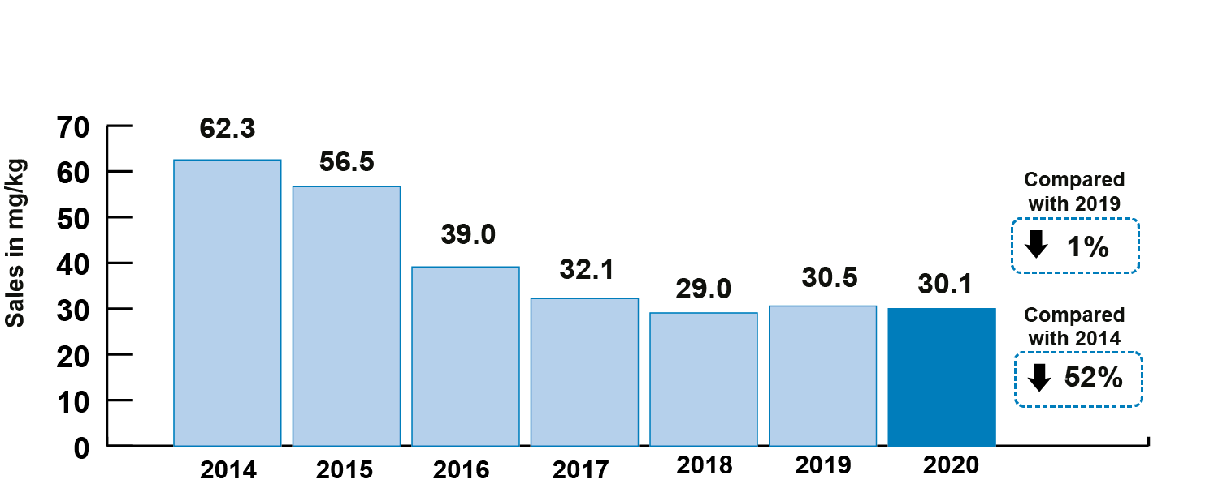
Antibiotic Sales
Sales of veterinary antibiotics for use in food-producing animals, adjusted for animal population, were 30.1 mg/kg; a 0.3 mg/kg (1%) decrease since 2019 and a 32.2 mg/kg (52%) decrease since 2014.
© 2021 VMD
Source: p. 7
VARSS REPORT 2020

Slide 4
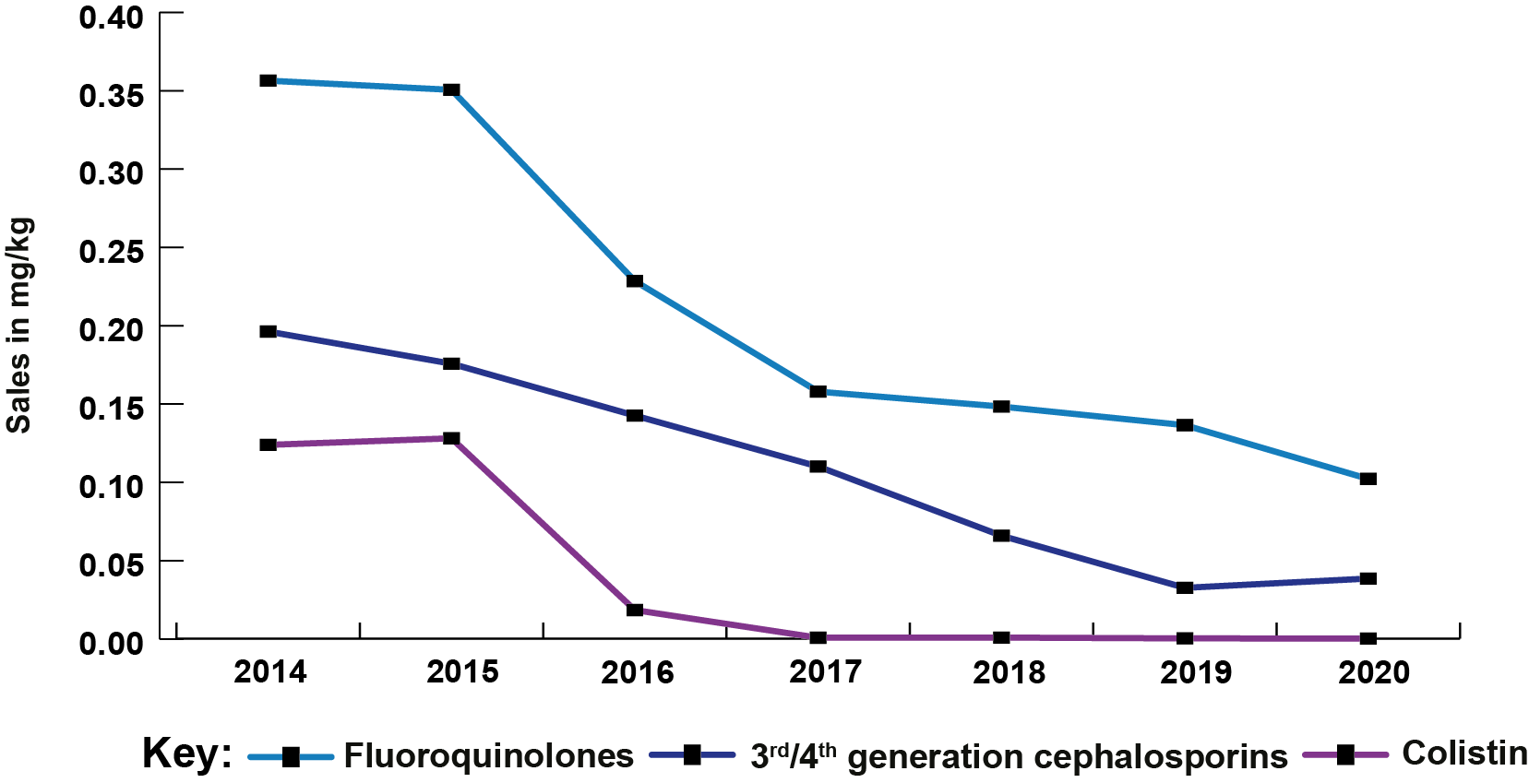
Antibiotic Sales
Sales of Highest Priority Critically Important Antibiotics (HP-CIAs) in food-producing animals account for 0.5% of total sales and have dropped by 0.03 mg/kg since 2019 and 0.5 mg/kg (79%) since 2014.
© 2021 VMD
Source: p. 7
VARSS REPORT 2020

Slide 5
Antibiotic Sales
Harmonised primary total sales of veterinary antibiotics in mg/kg and secondary (sales in mg/kg for third and fourth generation cephalosporins, quinolones and polymyxins) outcome indicators for antibiotic consumption in food-producing animal species in the UK, 2014 to 2020
© 2021 VMD
Source: Fig 1.16; p. 30
VARSS REPORT 2020

Slide 6
Antibiotic Sales
Active ingredient (mg/kg) of antibiotics sold for use in dogs and cats, 2014 to 2020
© 2021 VMD
Source: Fig 1.8; p. 22
VARSS REPORT 2020

Slide 7
Antibiotic Sales
Active ingredient (% weight) of antibiotics sold for all animal species by antibiotic class, 2020
© 2021 VMD
* Amphenicols, lincomycin, pleuromutilins, polymyxins (excluding colistin), steroidal antibiotics and imidazole derivatives
Source: Fig. 1.2; p. 17
VARSS REPORT 2020

Slide 8
Antibiotic Sales
Active ingredient (% weight) of antibiotics by antibiotic class and route of administration sold for all animals, 2020
^ HP-CIAs: Highest Priority Critically Important Antibiotics
* Oral powders, oral pastes, oral solutions and bolus preparations
** Intramammary and intrauterine preparations
*** Amphenicols, lincomycins, pleuromutilins, polymyxins (including colistin), steroidal antibiotics and imidazole derivatives
Source: Fig. 1.15; p. 28
VARSS REPORT 2020

Slide 9
Antibiotic Sales
In 2020 the total quantity of antibiotic active ingredient sold in the UK was 226.0 tonnes.
© 2021 VMD
Source: p. 8
VARSS REPORT 2020

Slide 10
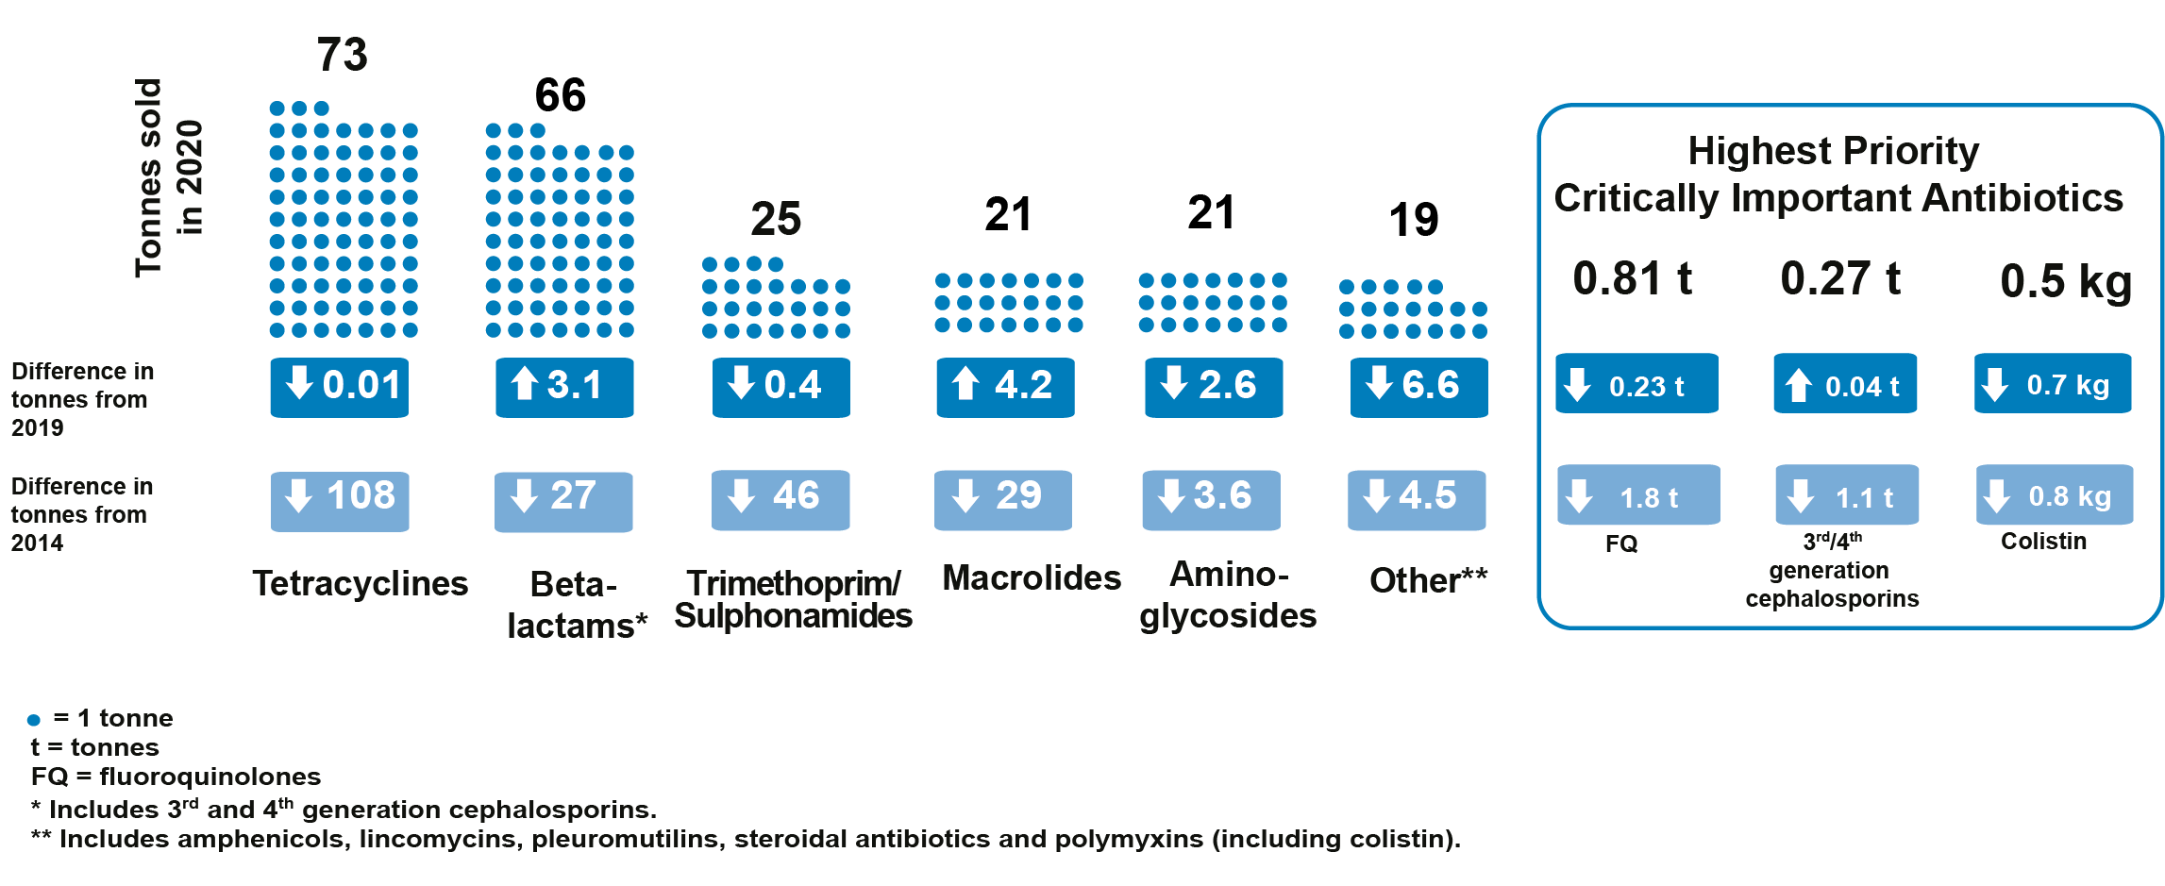
Antibiotic Sales
Total sales (tonnes) of active ingredient for all animal species by antibiotic class, 2020
© 2021 VMD
Source: p. 8
VARSS REPORT 2020

Slide 11
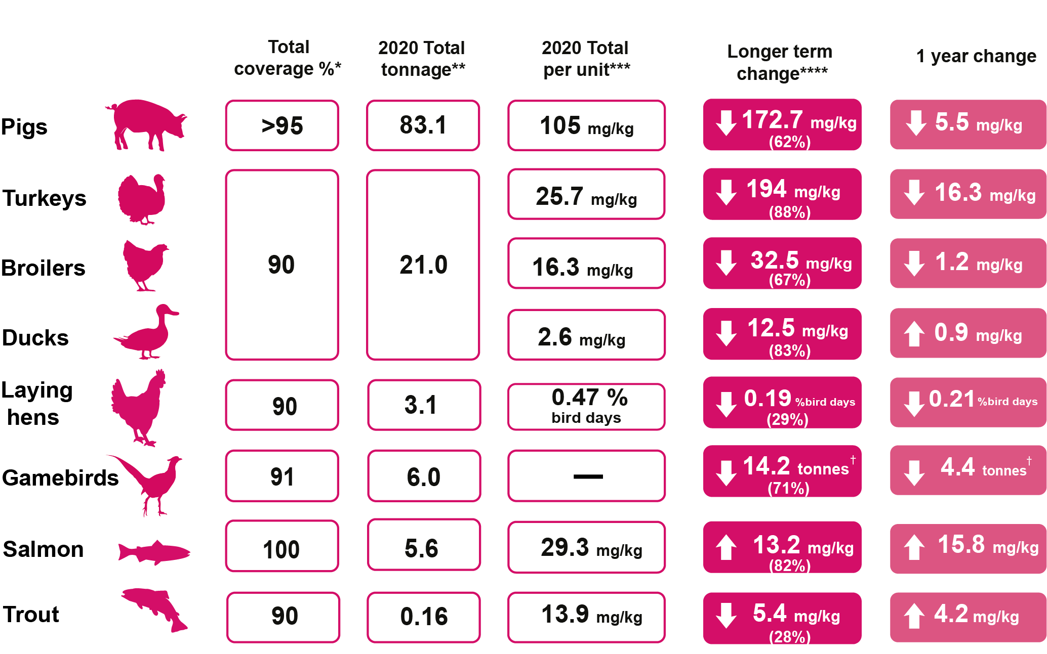
Antibiotic Usage Data
Antibiotic usage refers to the amount of antibiotics prescribed and/or administered per sector. The data have been collected and provided to the VMD by the animal industry on a voluntary basis
© 2021 VMD
Source: p. 9
VARSS REPORT 2020

Slide 12
Antibiotic Usage Data
Antibiotic usage refers to the amount of antibiotics prescribed and/or administered per sector. The data have been collected and provided to the VMD by the animal industry on a voluntary basis
© 2021 VMD
Source: p. 9
VARSS REPORT 2020

Slide 13
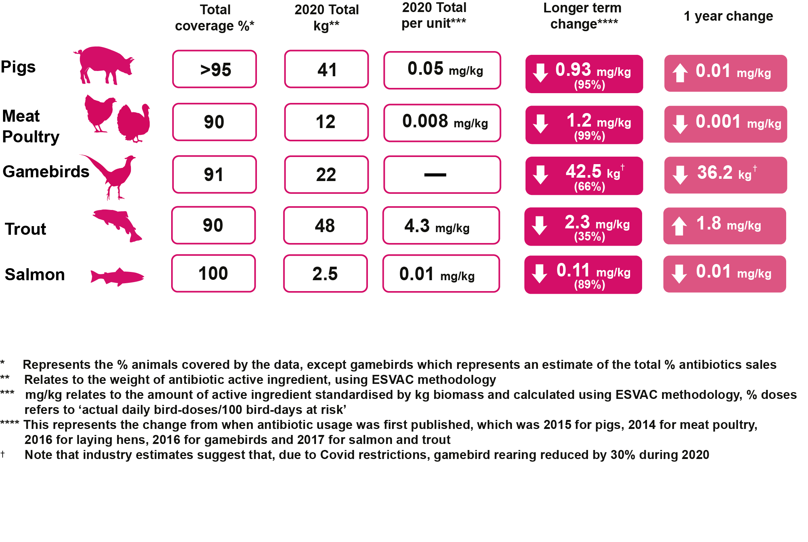
Antibiotic Usage Data
Usage of Highest Priority Critically Important Antibiotics by food-producing animal species
© 2021 VMD
Source: p. 9
VARSS REPORT 2020

Slide 14
Antibiotic Usage Data
Active ingredient (mg/kg) of antibiotics reported in eMB pigs, 2015 to 2020
© 2021 VMD
Source: Fig. 2.1; p. 35
VARSS REPORT 2020

Slide 15
Antibiotic Usage Data
Active ingredient (mg/kg) of Highest Priority Critically Important Antibiotics
(HP-CIAs) reported in eMB Pigs, 2015 to 2020
Source: Fig. 2.5; p. 38
VARSS REPORT 2020

Slide 16
Antibiotic Usage Data
Active ingredient (mg/kg) of antibiotics by species used by members of BPC Antibiotic Stewardship, 2014 to 2020
Source: Fig. 2.7; p. 40
VARSS REPORT 2020

Slide 17
Antibiotic Usage Data
Antibiotic use (% bird days) by members of the British Egg Industry Council Lion Code alongside the sector target, 2016 to 2020
© 2021 VMD
Source: Fig. 2.11; p. 43
VARSS REPORT 2020

Slide 18
Antibiotic Usage Data
Active ingredient (tonnes) of antibiotics used in gamebirds, collected by the GFA and BVPA data collection programme, 2016 to 2020
© 2021 VMD
Source: Fig. 2.14; p. 45
VARSS REPORT 2020

Slide 19
Antibiotic Usage Data
Active ingredient (mg/kg) of antibiotics by antibiotic class used in salmon, 2017 to 2020
© 2021 VMD
Source: Fig. 2.17; p. 49
VARSS REPORT 2020

Slide 20
Antibiotic Usage Data
Active ingredient (mg/kg) of antibiotics by antibiotic class used in trout, 2017 to 2020
© 2021 VMD
Source: Fig 2.18; p. 51
VARSS REPORT 2020

Slide 21
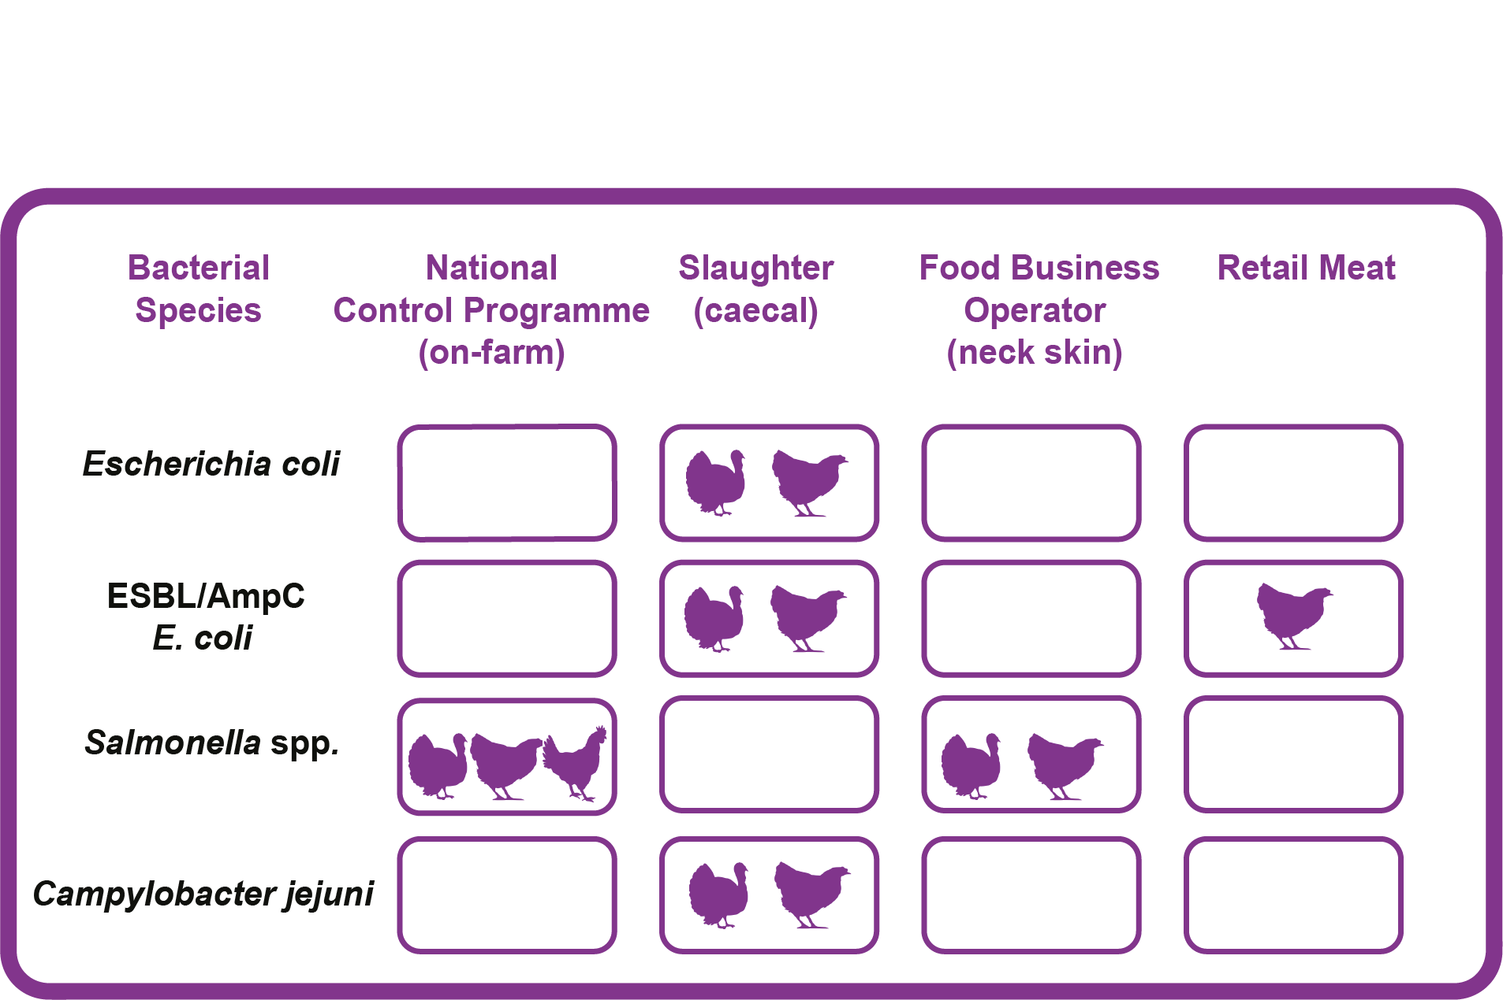
Harmonised Monitoring of AMR
Harmonised AMR monitoring requirements in 2020
Key:
© 2021 VMD
Source: Fig. 3.1; p. 61
VARSS REPORT 2020

Slide 22
Harmonised Monitoring of AMR
Resistance to non-HP-CIAs (A) and HP-CIAs (B) in Escherichia coli isolates from broilers at slaughter. Interpreted using EUCAST CBPs unless otherwise indicated. Note scale differs between graphs.
(A) (B)
Key
○ 2014
○ 2016
○ 2018
○ 2020
© 2021 VMD
.* Interpreted using EUCAST ECOFF values
HP-CIAs: Highest Priority Critically Important Antibiotics
AG: aminoglycosides, AP: amphenicols, BL: beta-lactams, PX: polymyxins, QU: quinolones,
TC: tetracyclines, TS: trimethoprim/sulphonamides
Source: Fig. 3.2; p. 66
VARSS REPORT 2020
22

Slide 23
Harmonised Monitoring of AMR
Resistance to non-HP-CIAs (A) and HP-CIAs (B) in Escherichia coli isolates from turkeys at slaughter. Interpreted using EUCAST CBPs unless otherwise indicated. Note scale differs between graphs.
(A) (B)
Key
○ 2014
○ 2016
○ 2018
○ 2020
© 2021 VMD
.* Interpreted using EUCAST ECOFF values
HP-CIAs: Highest Priority Critically Important Antibiotics
AG: aminoglycosides, AP: amphenicols, BL: beta-lactams, PX: polymyxins, QU: quinolones, TC: tetracyclines, TS: trimethoprim/sulphonamides
Source: Fig. 3.3; p. 67
VARSS REPORT 2020
23

Slide 24
Harmonised Monitoring of AMR
ESBL-/AmpC- and carbapenemase-producing Escherichia coli cultured on selective agars, from caecal samples from healthy (A) broilers and (B) turkeys at slaughter in the UK. Note scale differs between graphs
(A) (B)
Key:  2016  2018  2020
© 2021 VMD
ESBL: Extended-spectrum beta-lactamase
Source: Fig. 3.4 and 3.5; p. 68 and 70
VARSS REPORT 2020

Slide 25
Harmonised Monitoring of AMR
Proportion of harmonised monitoring indicator Escherichia coli isolates from broilers,
fattening turkeys and fattening pigs, weighted by Population Correction Unit (PCU), averaged over two years.
© 2021 VMD
Key:  2014/15  2015/16  2016/17  2017/18  2018/19  2019/2020
* Data not available for 2014/15.
Source: Fig. 3.11; p. 79
VARSS REPORT 2020

Slide 26
Harmonised Monitoring of AMR
Resistance in Campylobacter jejuni isolates from (A) broilers and (B) turkeys at slaughter.
(A) (B)
© 2021 VMD
Key:  2014  2016  2018  2020
^ HP-CIAs: Highest Priority Critically Important Antibiotics
AG: aminoglycosides, ML: macrolides, QU: quinolones, TC: tetracyclines
Source: Fig. 3.9 and 3.10; p. 76 and 77
VARSS REPORT 2020

Slide 27
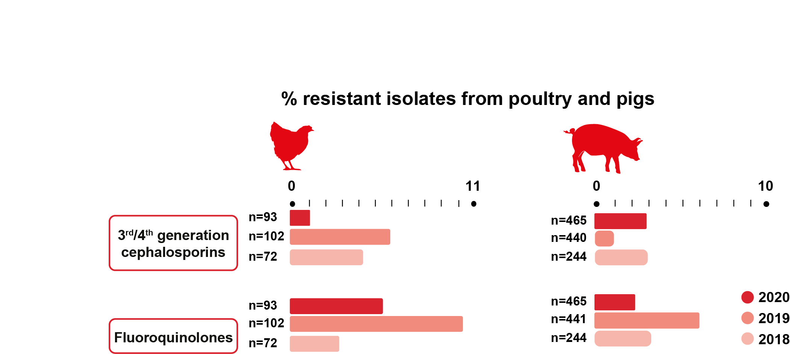
Clinical Surveillance of AMR
Resistance to Highest Priority Critically Important Antibiotics (HP-CIAs) in Escherichia coli isolated from clinical surveillance, 2018-2020
%
%
n = number of isolates tested
© 2021 VMD
Source: p. 11
VARSS REPORT 2020

Slide 28
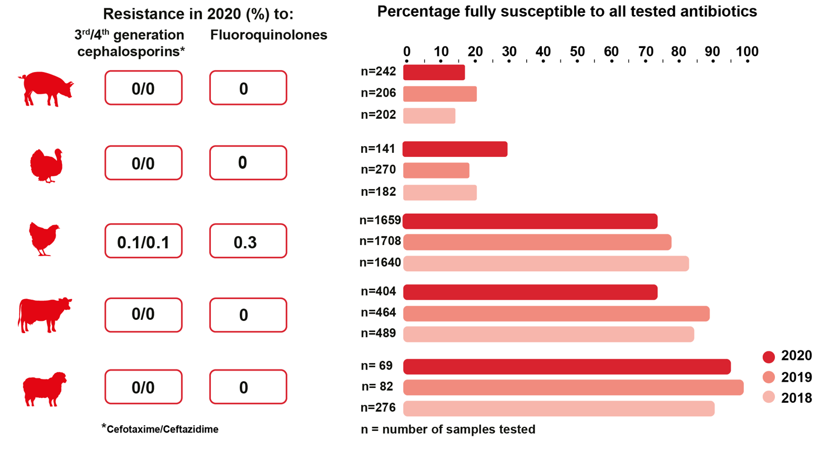
Clinical Surveillance of AMR
Resistance in Salmonella spp. from clinical surveillance, 2018-2020
© 2021 VMD
Source: p. 11
VARSS REPORT 2020

Slide 29
Clinical Surveillance of AMR
Salmonella spp. susceptible to all tested antibiotics, from different sources and animal species, 2018-2020
© 2021 VMD
Ducks, horses, dogs, other non-avian species, other avian species, feed and farm environment.
Key:  2018  2019  2020
Source: Fig. 4.19; p. 111
VARSS REPORT 2020

Slide 30
Clinical Surveillance of AMR
Antibiotic resistant isolates of Mannheimia haemolytica isolates from respiratory infections of cattle in 2020 (interpreted using cattle CLSI veterinary breakpoints unless indicated otherwise).
© 2021 VMD
* Interpreted using EUCAST human CBP for P. multocida
⁺ Interpreted using CA-SFM veterinary CBP
AG: aminoglycosides, AP: amphenicols, BL: beta-lactams, ML: macrolides, QU: quinolones, TC: tetracyclines, TS: trimethoprim/sulphonamides
Source: Fig. 4.1; p. 85
VARSS REPORT 2020

Slide 31
Clinical Surveillance of AMR
Antibiotic resistant isolates of Mannheimia haemolytica isolates from respiratory infections of sheep in 2020 (interpreted using cattle CLSI veterinary breakpoints unless indicated otherwise)
© 2021 VMD
* Interpreted using EUCAST human CBP for P. multocida
⁺ Interpreted using CA-SFM veterinary CBP
AG: aminoglycosides, AP: amphenicols, BL: beta-lactams, ML: macrolides, QU: quinolones, TC: tetracyclines, TS: trimethoprim/sulphonamides
Source: Fig. 4.2; p. 86
VARSS REPORT 2020

Slide 32
Clinical Surveillance of AMR
Antibiotic resistant isolates of Pasteurella multocida isolates from respiratory infections of pigs in 2020 (interpreted using CLSI veterinary breakpoints unless indicated otherwise).
© 2021 VMD
*Interpreted using EUCAST human CBP for P. multocida
⁺ Interpreted using CA-SFM veterinary CBP
˄ Spectinomycin and gamithromycin breakpoint for bovine isolates applied.
AG: aminoglycosides, AP: amphenicols, BL: beta-lactams, ML: macrolides, QU: quinolones, TC: tetracyclines, TS: trimethoprim/sulphonamides
Source: Fig. 4.4; p. 88
VARSS REPORT 2020

Slide 33
Clinical Surveillance of AMR
Resistance to non-HP-CIAs (A) and HP-CIAs (B) of Escherichia coli isolated from mastitis samples from cattle in England and Wales. Note scale differs between graphs.
(A) (B)
Key
○ 2018
○ 2019
○ 2020
© 2021 VMD
HP-CIAs: Highest Priority Critically Important Antibiotics
AG: aminoglycosides, BL: beta-lactams, QU: quinolones, TC: tetracyclines, TS: trimethoprim/ sulphonamides
Source: Fig. 4.6; p. 92
VARSS REPORT 2020

Slide 34
Clinical Surveillance of AMR
Antibiotic resistance of Streptococcus uberis isolated from mastitis samples from cattle in
England and Wales.
© 2021 VMD
Key:  2018  2019  2020
* No data available for 2018
AG: aminoglycosides, BL: beta-lactams, ML: macrolides TC: tetracyclines
Source: Fig. 4.8; p. 94
VARSS REPORT 2020

Slide 35
Clinical Surveillance of AMR
Non-susceptibility of (A) Escherichia coli (n=559); (B) Streptococcus uberis (n=555) isolated from bovine mastitis samples submitted to Vale Veterinary Laboratories in 2020.
(A) (B)
© 2021 VMD
AG: aminoglycosides, BL: beta-lactams, TC: tetracyclines, TS: trimethoprim/sulphonamides
Note:
The Private Laboratory Initiative is a new public-private data-sharing project, currently in proof-of-concept stage. Due to methodological differences, results are not directly comparable to those generated by government labs, but they demonstrate the potential of this data to enhance AMR surveillance.
Source: Fig. 4.10; p. 97
VARSS REPORT 2020

