Slide 1
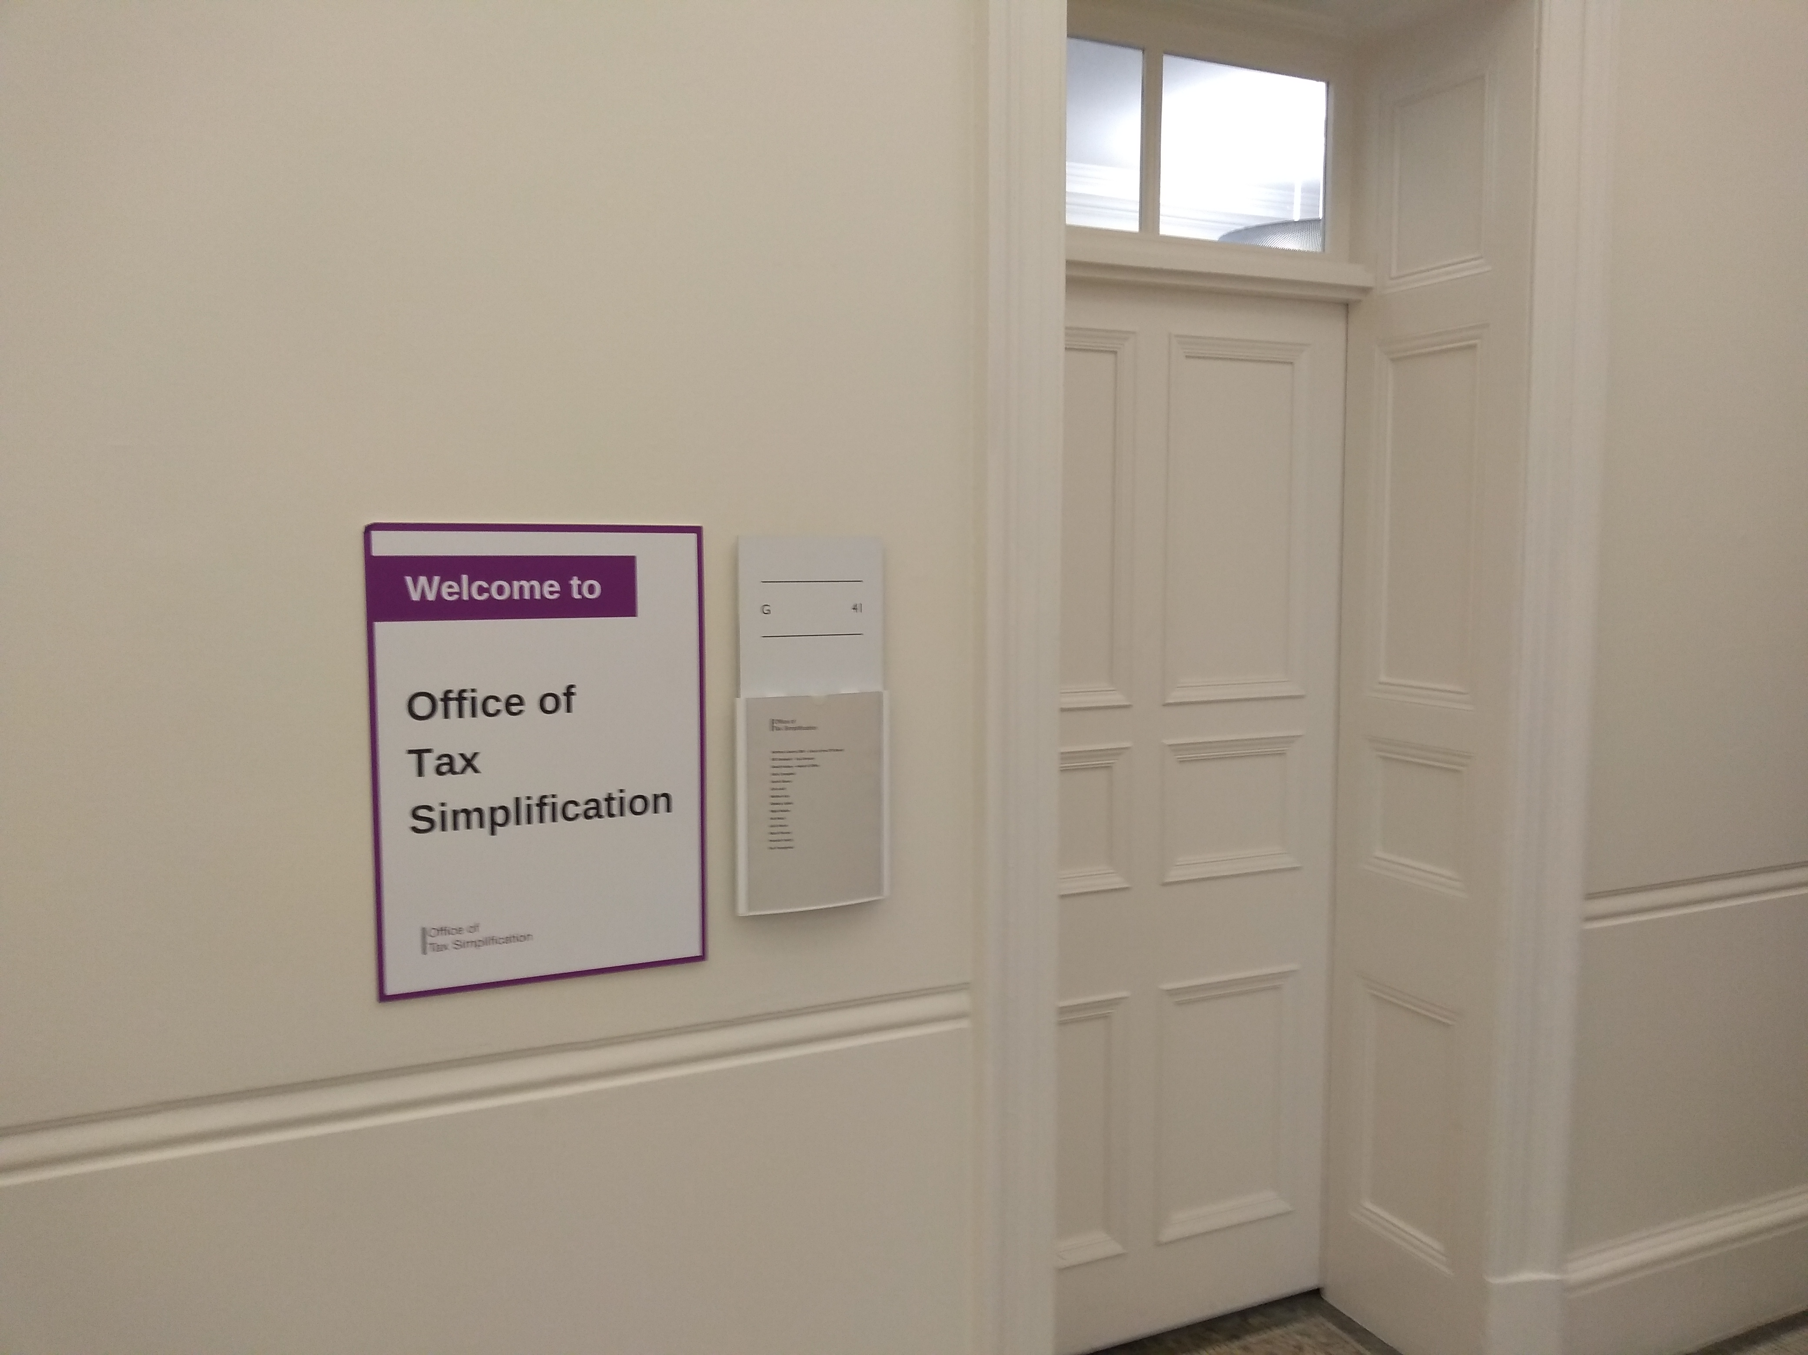
Welcome to the OTS webinar
The webinar will get going in a minute or two
When it does, please look out for the online Q&A facility. We’ll be picking up as many of your questions as we can as we go along – especially the ones which are ‘upvoted’ the most.
Please tweet about the event at #OTStax.

Slide 2
Agenda
Please tweet about the event at #OTStax.
Welcome
Introduction Bill Dodwell – OTS Tax Director
Capital Gains Tax Review David Halsey
Making better use of third party data Bethan Kay
Potential for moving the end of the tax year Hannah Smith
Q&A, led by Bill Dodwell

Slide 3
CGT review - Simplifying by design
Please tweet about the event at #OTStax.

Slide 4
Capital Gains Tax review
Chancellor’s letter 13 July 2020
“This review should identify opportunities relating to administrative and technical issues as well as areas where the present rules can distort behaviour or do not meet their policy intent. In particular, I would be interested in any proposals from the OTS on the regime of allowances, exemptions, reliefs and the treatment of losses within CGT, and the interactions of how gains are taxed compared to other types of income.“

Slide 5
First report: Rates and thresholds
– a framework for policy choice

Slide 6

First report: Annual Exempt Amount
Frequency of net gains up to £15,000 for tax year 2017-18

Slide 7
First report: other areas
The government should consider removing the capital gains uplift on death and instead provide that the recipient is treated as acquiring the assets at the historic base cost of the person who has died.
There is a policy judgement for government to make about the extent to which Capital Gains Tax reliefs should be used to seek to stimulate business investment and risk-taking.
The OTS considers that Business Asset Disposal Relief is mistargeted if its objective is to stimulate business investment and risk-taking. The government should, having regard to pensions policy more broadly, consider replacing Business Asset Disposal Relief with a relief more focused on retirement.
The government should abolish Investors Relief.
Source: OTS

Slide 8
  Second Report: selected areas of interest
Administration and Awareness
Awareness of CGT and HMRC guidance
Standalone capital gains tax return, integrated into the single customer tax account
30 day reporting for UK residential property disposals
Technical Issues
Main residence relief – review practical operation of nominations, improve guidance on use of home
Separation and divorce – longer period needed
Treatment of debt instruments
Business sales – link tax payments to receipt of proceeds
Tenant-owned freeholds and lease extensions
Review EIS rules to ensure admin issues do not prevent the reliefs

Slide 9
Making better use of third party data: a vision for the future
Please tweet about the event at #OTStax.

Slide 10
Making better use of third party data
This review explores the opportunities set out in the government and HMRC’s ten year tax administration strategy for
‘smarter use of data on taxpayers and their activities – pre-population of tax returns, including with data from third-parties – to reduce the need for taxpayers and agents to submit additional information that HMRC either already holds or could verify itself’.
The review looks at the principles that should apply in relation to third-party data and taxpayers generally. And considers sources of third-party data that it could be helpful to individuals for HMRC to receive, with a focus on savings and investment income and gains, pension contributions and gift aided charity contributions.

Slide 11
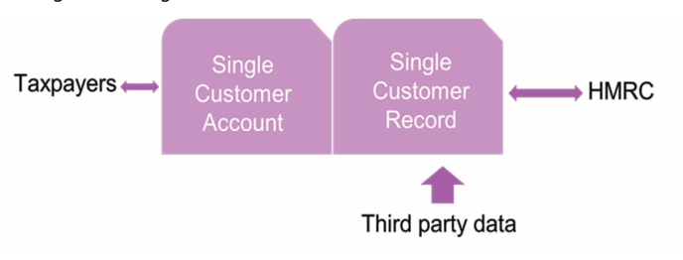
The forthcoming Single Customer account

Slide 12
Making better use of Third Party Data: a vision
Extend the use of third party data, by adding to the Single Customer Account
Unique identifier
Roadmap and specification for data providers
Consult on balance of responsibilities between data providers, agents, taxpayers and HMRC
Safeguards – error correction, present data to taxpayers for validation
Start with:
Bank and Building Society interest and other interest
Listed company/OEIC dividends and other income
Pension contributions
Voluntary
Gift Aid, capital gains on listed securities

Slide 13
The UK Tax Year End Date:
Exploring the potential for change
Please tweet about the event at #OTStax.

Slide 14
The UK Tax Year End date
– exploring the potential for change
5 April tax year end date for individuals has raised questions for many years
OTS has explored what a change would entail, and what benefits it would bring (looking at 31 March and 31 December)
Publication of scoping note in early June generated a lot of interest
Despite short timeframe, OTS engaged with a wide variety of stakeholders within both public and private sector

Slide 15
Long term outcome
Long term best outcome would be 31 December:
- Much easier for any form of reporting to go to a month end
International alignment
Data exchange (including platforms)
Better for those with international income and internationally mobile
Possible advantages for businesses
BUT – transition much more complicated than 31 March
High level of support for changing from 5 April
But split between 31 March and 31 December

Slide 16
Transitioning from 5 April…
Many people underestimate scale of change for public and private sectors
Substantial investment and lead time required, including extensive scoping and consultation
Affects systems that pay out to all employees, pension recipients and benefits claimants (most people).
Given scale, and potential impacts beyond tax, no formal recommendation Yes/No
However, any change should not take place until major new systems had been delivered e.g. Single Customer Account
Next steps, if government wanted to take further: further scoping work and early planning for longer term implementation

Slide 17
Short term outcomes
Short term recommendation to enable self-employed and landlords to use 31 March for 5 April in all cases:
Makes accounting easier
Assists transition to Making Tax Digital for Income Tax
Achievable before April 2023
HMRC’s proposed basis period changes achieve this for self-employed but do not currently cover landlords and go much further with additional changes

Slide 18
Question and Answer session
Please tweet about the event at #OTStax.

Slide 19
The OTS webinar

