Slide 1
Shared Services
Top Data Standards (Summarised)
Compiled by
Government Business Services
Ref: DS1 - V1.01 (August 2021)

Slide 2
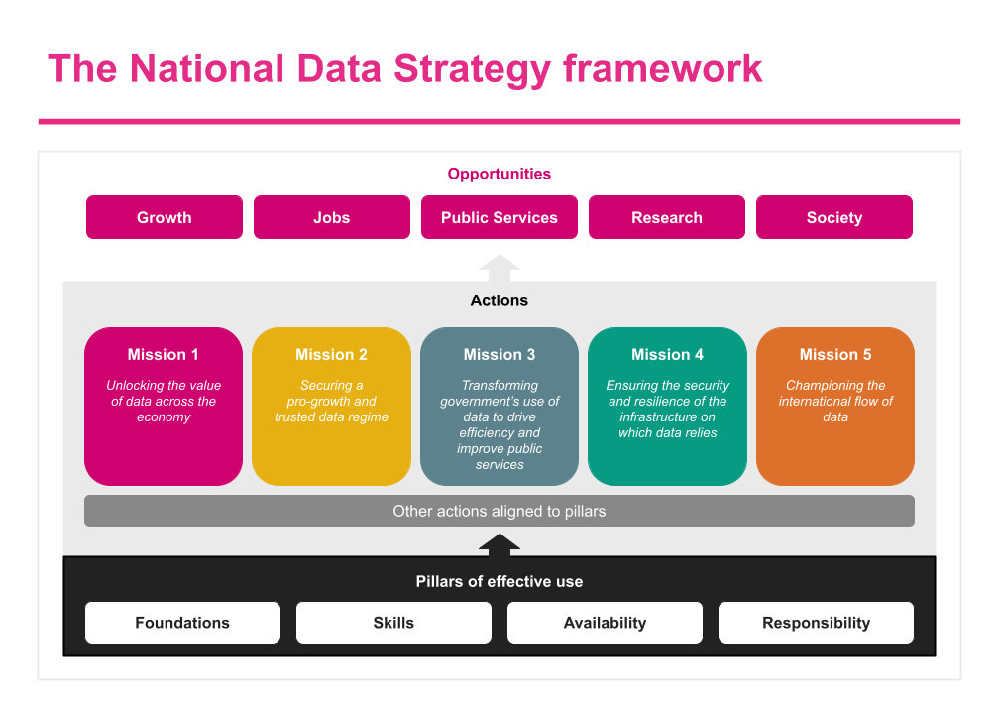
Context
The National Data Strategy was published in December 2020 here. A core element of the strategy is the transformation for government usage of data to drive efficiency under Mission 3. Government Shared Services adopted the National Data Strategy recommendations in to its new Shared Services strategy published in March 2021 here , forming the Data Convergence workstream within the implementation programme.
Data Convergence sets out the need to establish and implement standards for data, data flows, interoperability and analytics in order to achieve slicker processes across the systems and services in use within Government. Through this will come the unlocking of the power of data available across the Civil Service, delivering greater insights and increasing levels of automation, to enable efficiencies in our workforce that bring about greater focus on value-add services and public delivery.
This presentation will guide those working on data for the convergence of Government systems and services, helping all to move towards an interoperability ecosystem. The datasets contained will evolve based on the constraints of technology and process, with cross Government functions defining the standards in collaboration with Government Business Services (GBS) and the Data Standards Authority (DSA) best-practice guidance, continuing to provide support and updates in to this pack, as well as through their own function specific online guidance pages.
This pack focuses specifically on the priority datasets that will form the cornerstone for achieving greater interoperability across the back-office of Government, especially in the formation of the new Shared Service Centres.

Slide 3
Data Convergence Priorities
Insight-driven decision making from accurate data for the whole of the Civil Service, through applying data definitions and standards set and monitored by the GSS Design Authority, to give common datasets in HR and Finance. Improving data sharing within departments through integration, and between departments with interoperability.
Current Landscape
Slow and cumbersome workforce planning, taking 3 months to collate and validate data requests e.g. analysis of the SCS workforce and recruitment
Inconsistent implementation of CSHR Global Design Principles and recruitment policies resulting in divergent data sets
Data first entered by candidates, reused for downstream services such as vetting, pension etc., often requires revalidation, rekeying and checking
Candidates find it cumbersome to track the application and onboarding process, with multiple different information points
Future Landscape
Automated data requests delivering real time insights via expanded reporting systems such as the GBS GRID platform
Standardised onboarding data and processes to build a common employee experience
Using information input once to create a digital wallet in a single consistent and accessible format for staff
A single real time dashboard through which applicants and recruiters can track progress for onboarding
Market Research
In their 2019 report on Analytics and AI-driven Enterprise, Deloitte surveyed 1,000 executives revealing that most do not believe their companies are insight-driven, with 63% lacking infrastructure, working in silos or expanding just ad-hoc analytics.
Organisations with the strongest data-driven insights and decision making culture were 2x more likely to have exceeded business goals.
Data Standards (DS)
Data Integration (DI)
Data Interoperability (DO)
Data standards will help eliminate siloed working, enabling effective and efficient sharing of information, securely and consistently across Centres and functions
Best practice standards for the data flow processes will be highlighted and maturity assessments will be carried out against the Common Core Datasets.
Departments will work according to the standards set by the functions to ensure accurate data is available for processing without intervention.
Data Analytics & Insights (DA)
1.
Of the 100s of data definitions, we will work with functions to define 50 Core Standards for HR, Finance & Commercial, e.g. the way employee status is recorded by depts.
1.
Define 6 classifications of Data flow best practice, comparing manual methods like email or CSV export to automated methods like API integration to drive optimisation.
1.
Proposal for the design and delivery of an integration HUB service across Government, including HR Employee Data to automate end-to-end services.
1.
Define dashboard, modelling and analytical capabilities to enable efficient decision-making across Government.
2.
Analyse and identify ownership for current datasets, categorising, defining and agreeing those in functional scope to determine the actions for departments.
2.
Create an integration blueprint for use by departments, conducting maturity assessments to ensure they deliver integration capabilities.
2.
Promote full adoption of Finance and Commercial data convergence in Source to Pay processes to improve efficiency and transparency in cross-Government sourcing.
2.
Work with departments and functions to identify improvements in technology tooling for shared services analytics.
3.
Create and define usage of a Single Employee ID for use across the Civil Service by all departments.
3.
Use and adopt frameworks to inform departments on integration products and inclusion in their Bills of Materials to promote compliance and adoption.
3.
Improve the flow of HR and Finance data to Estates to help deliver better insight into occupation and facility strategies.
3.
Use cross-government BI working groups to deliver analytical models and templates to drive insights via a central sharing platform.

Slide 4
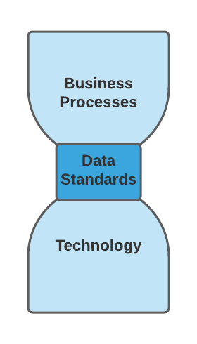
Data Standards - Core Data standards
Data standards will help eliminate siloed working, enabling effective and efficient sharing of information, securely and consistently across Centres and functions. Of the 100s of data definitions, we will work with functions to define c. 50 Core Standards for HR, Finance & Commercial, Security and Estates (Property), e.g. the way employee status is recorded by depts. The deliverables of the individual data standards and their metadata criteria are reliant on the expertise of the functions for full definition and ongoing maintenance (contacts listed in Appending 3).
Scope of discovery
The Top 50 Data Standards relevant to Shared Services and Interoperability are assessed against the following principles:
If data is used across the civil service for sharing with another department then a standard must be used (or created and shared with the head of the function)
If data is used across a Shared Service Centre / Cluster of multiple departments for insight (analysis, data science, ad hoc or regular reporting) and management purposes then a standard must be used
If data is to be shared externally then the the standard must be aligned to both internal standards above, and external international standards if available
Selected using a scenario based assessment technique providing Insight, improving Process or improving Data Quality
Status
56 priority Data Standards identified
Of these, 24 are under further development.
Next step: Reduce gaps and variance iteratively.
Contents
Hourglass model
1.
HR
6.
Property
Each Data Standard can run on one or many Technologies and be used in one or many Business Processes. By conceptually constraining the complexity through enforced Data Standards, optimised Interoperability between a network of complex systems becomes possible.
Data Standards are the constraints that deconstrain.
2.
Finance & Commercial
7.
Cross Cutting
3.
Finance
8.
Future Standards
4.
Commercial
9.
References
5.
Security (vetting)
10.
Appendices

Slide 5
ANNEX
The summarised data standards relevant for Shared Services

Slide 6
Human Resources
The following data standards are core as identified by the Civil Service Human Resources Function (CSHR), via analysis of the core processes:
Central Employee ID
Civil Service Grade
Job Role
Position
Gender
Date of Birth*
Basic Salary
Pensionable Allowances
Home Address*
Home Postal Code*
Civil Service Reckonable Service Start Date*
Organisation Date of Entry*
NI number (NINO)
Sickness Absence Record
Full Time Equivalent (FTE) Position
*Data standard is cross cutting and will require agreement from all functional areas

Slide 7
Human Resources
The Data standards have been defined within the HR function as eligible due to their use in central Enterprise Resource Planning (ERP) systems and other central Government systems such as:
MyCSP/ Compendia pensions Management system
3rd Party payroll systems
HMRC system
The standards are required in key processes that use an interface for exchange of data, such as:
Other Government Department (OGD) transfers
Joiners, Movers, Leavers (JML) processes
Government Pass processes.
Where a Human Resources standard has been identified as being a candidate for cross cutting normalisation, it is defined in the Cross Cutting section instead (marked by an asterisk below).

Slide 8
2. Finance & Commercial
The data standard list for Finance & Commercial compiled sources from both Government Finance Function (GFF) and Government Commercial Function (GCF) with considerable existing cross-over between them.
The full Source to Pay (S2P) lifecycle can be viewed split between Source to Contract (S2C) and Purchase to Pay (P2P). Of the two, both GFF and GCF have published aligned Data Standards for S2C, but P2P remains to be inferred from process documentation.
Activities are ongoing to make available for publication data standards for all elements identified by GFF, as part of GFF having developed a mature library of process documentation.
The Data Standards published by GCF align with the P2P elements from GFF but have used a different format, using an approach that provided a useful template for this document.
The proposed standards are presented under Commercial and Finance subsections below. Where top Cross Cutting standards have been identified, they are included under the Cross Cutting section instead.

Slide 9
3. Finance
The following data standards are core from Government Finance Function (GFF) processes:
Record to Report
Purchase to Pay
Order to Cash
Expenses
Payroll
Chart of Accounts^:
Entity, Cost Centre,
Account, Objective,
Analysis, Project,
Intercompany
Procurement Category^
AR Invoice^
Employee Name*
PAYE Reference^
Customer ID^
Expenditure FTE^
Expense Type^
PO Number^
Customer Name^
Budget Holder^
AP Invoice^
Dual Workplace^
NI Category^
Customer Type^
PAYE Tax code^
Fiscal Period^
GRN^
Bank Account
Fiscal Year*
Main Supplier ID
Non-Current Assets
Project Accounting
Tax
Grants
Supplier Name*
VAT Number
Asset ID/Tag^
Project Name^
Grant Agreement^
*Data standard is cross cutting
Asset Category^
Project Type^
VAT Rate^
Grant ID ^
^ Detailed data formats are under development with GFF
Refer to GCF standards for Main Supplier ID
Notes:
@a

Slide 10
Finance: OSCAR & COA
The Online System for Central Accounting and Reporting (OSCAR) prescribes a formatted structure for Chart of Account (COA) submissions to Treasury.
Chart of Accounts (COA) comprises:
Entity
Cost Centre
Account Code
Objective
Analysis
Project
Intercompany
Information on the previously published OSCAR/CoA is available here. This information is being developed further by GFF.

Slide 11
4. Commercial
The following data objects from the Government Commercial Function (GCF) summary are proposed for inclusion in the top standards:
Contract ID
Contract Title
Contract Start Date*
Contract End Date*
Contract Value
OCID
Main Supplier ID
Main Supplier Name*
Buying organisation
Category Code
*Data standard is cross cutting and will require agreement from all relevant functional areas
Main Supplier ID is also listed in GFF section

Slide 12
5. Security
These data standards have been defined within the Government Security Group (GSG) National Security Vetting function.
These are defined as core standards due to their use in central ERP systems and their future potential use in the Joiners, Movers and Leavers (JML) Process, and vetting reform transformation, to include ongoing interfaces of HR data in to security and risk management.
Clearance Reference
Clearance Level
Clearance Outcome
Clearance Expiry Date*
*Data standard is cross cutting and will require agreement from all relevant functional areas

Slide 13
6. Property
Government Property Agency (GPA) have published Data Standards as part of the new Insite Property Asset Register replacing EPIMS, within which they’ve identified certain fields as the minimum information required for GPA operations.
Organisation identifier
OS Grid Reference #
Unique Property Reference #
Occupancy Agreement Start Date*
Occupancy Agreement End Date*
Location Address*
Location Postcode*
Earliest Occupancy Break Date*
Landlord Name*
Organisation Contact Name*
Organisation Contact Email*
Occupier Contact Email*
*Data standard is cross cutting and will require agreement from all relevant functional areas.
Note: More detail on data elements required for property functions across government will only be completed at a later stage (due end of March 2022).

Slide 14
7. Cross Cutting Data types
It’s proposed that cross cutting data types should share the same data definitions for improved interoperability. This is already the case for some.
Address
Postcode
Legal Name
Date
Email
*Data standard is cross cutting and will require agreement from all relevant functional areas

Slide 15
Cross Cutting Data types
Many data standards are of a type with shared attributes and data definitions such as:
Address & Postcode
Home Address
Supplier Address
Delivery Address
Building Address
Alternatively, the same data type can also have different definitions such as with:
Date
DDMMYYYY Date of Birth, Passport expiry, Order date, Contract Start/End Date
MMYY (Partial) Card expiry, approximate date
Calculated “3 months before retirement”, “4 days from now”

Slide 16
Cross cutting data types - matrix
The following matrix shows some examples of cross cutting data types as they are are mapped across different areas. The listing is not exhaustive.
Standard | Functional Area | Source Data Type Examples
Address | HR Finance Commercial Property | CS Employee Home Address CS Employee Work Address Delivery Address Supplier Address Location Address
Postcode | Paired with Address | Paired with Address
Email | HR Finance Commercial Property | CS Employee Email Address Organisation Email Occupying organisation Email

Slide 17
Cross cutting data types - matrix
Standard | Functional Area | Source Data Type Examples
Date | HR Finance Commercial Property | CS Employee DOB CS Reckonable Service Start Date Passport Expiry Date Fiscal Year Contract Start/End Date Occupancy Start/End Date
Name | HR Finance Commercial Property | CS Employee Legal Name Landlord Name

Slide 18
8. Future Standards
Central Employee Identifier
Legal Entity Identifier
New types of identifiers are being developed which may transform some data that is shared. They don’t exist yet, nut are included here due to their potential impact on interoperability. They are:
Central Employee identifier - A collaboration across Government under initiatives such as Employee Wallet and Joiners/Movers/Leavers process improvements. The exact nature of the solution to this problem is not yet clear, but a potential ID is anticipated.
Legal Entity identifier - An initiative by Central Digital and Data Office to improve on existing ways to uniquely identify legal entities. There is an existing cross-cutting Government Legal Entity.

Slide 19
9. References
Functional Standards
https://www.gov.uk/government/collections/functional-standards
Government Functional Standard GovS 003: Human Resources
Government Functional Standard GovS 004: Property
Government Functional Standard GovS 006: Finance
Government Functional Standard GovS 007: Security
Government Functional Standard GovS 008: Commercial
Data Standards
GovS004-PDS010 Government Property Data Standard
Government Commercial Function (GCF) Data Standards - July 2020
GFF Government Finance function website (partial - commercial)
Industry Standards
RFC 6854 (email Addresses)
Ordnance Survey

Slide 20
10. Appendices
Implementation and Operation
Continued Development
Contact Us
Appendix 1 - Implementation and Operational Maintenance
Appendix 2 - Standards under development
Appendix 3 - Help us to improve and our Contact details

Slide 21
Appendix 1 - Operational Maintenance
This pack of standards will be maintained and updated quarterly, with a new version number issued on each update.
Standards will be updated after the approval from a functional governance group and the design authority for shared service implementations.
Government employees within shared service programmes can access this data pack, discussions, and best practice guides, combined with our other data convergence initiatives on the Shared Services OneGov Cloud portal here.
Departments and Shared Service Centres are recommended to include these data standards within their requirements specification of new systems, and to impact assess the benefits of implementation to existing systems.
On any implementation please ensure to make a note of the version implemented

Slide 22
Appendix 2 - Continued Development
To continue with the next set of definitions, a number of the Finance (and some joint Finance & Commercial) standards identified above do not yet have explicitly defined Data Standards that are published and available. Based on their names there’s a high likelihood that they are already implicitly defined via the systems that use them.
There is already work underway analysing processes and technologies, and we anticipate that the Data Standards for these remaining top standards will be discovered as part of that work. We recommend that their definitions are captured where present, defined where not present and that they are published when available.
To save space on one full slide per standard, they are listed below instead.

Slide 23
Appendix 2 - Standards Under Development
The following standards are not yet published in detail and are under development with the functions. Future updates of the standards will be published in due course.
Budget Holder
Fiscal Period
Grant Agreement
Grant ID
Customer ID
Customer Name
Customer Type
Procurement Category
Asset ID/Tag
Asset Category
Expense Type
Dual Workplace
Project Name
Project Type
PAYE reference
Expenditure FTE
NI category
PAYE Tax code
VAT rate

Slide 24
Appendix 3 - Contact
For help and assistance in the usage of these data standards in your shared services implementation
please see Government Business Services
One Gov Cloud Portal located here
Contact: gssdataimprovement@cabinetoffice.gov.uk

