Slide 1
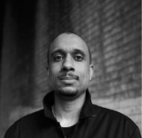
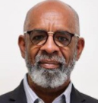
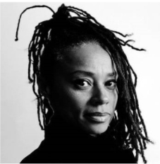
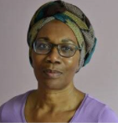
Engaging With The Windrush Monument Shortlisted Artists
Aims of the session:
Who are the Windrush generation?
Why is a monument about the Windrush Generation being built?
What do you think makes a good monument?
Feedback on the shortlisted designs

Slide 2
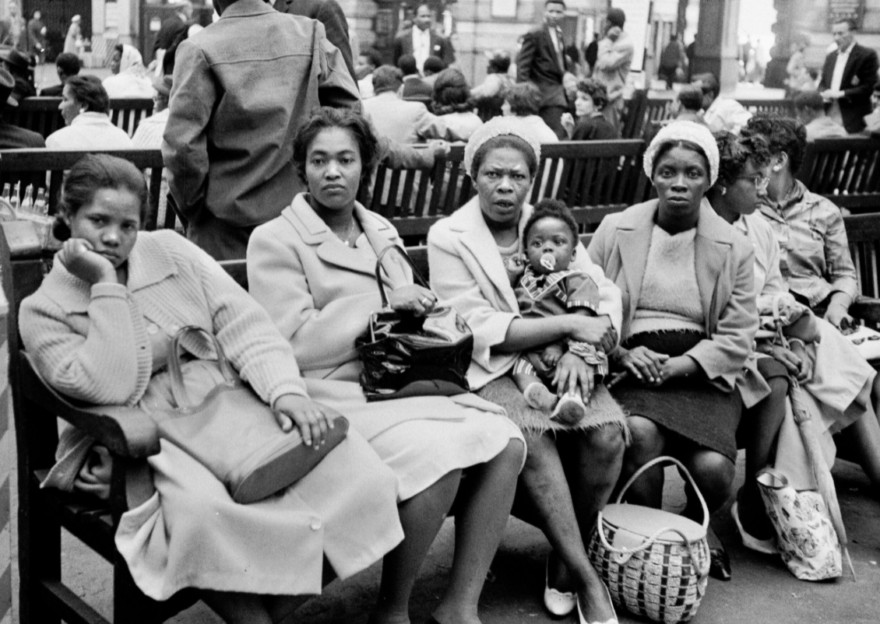
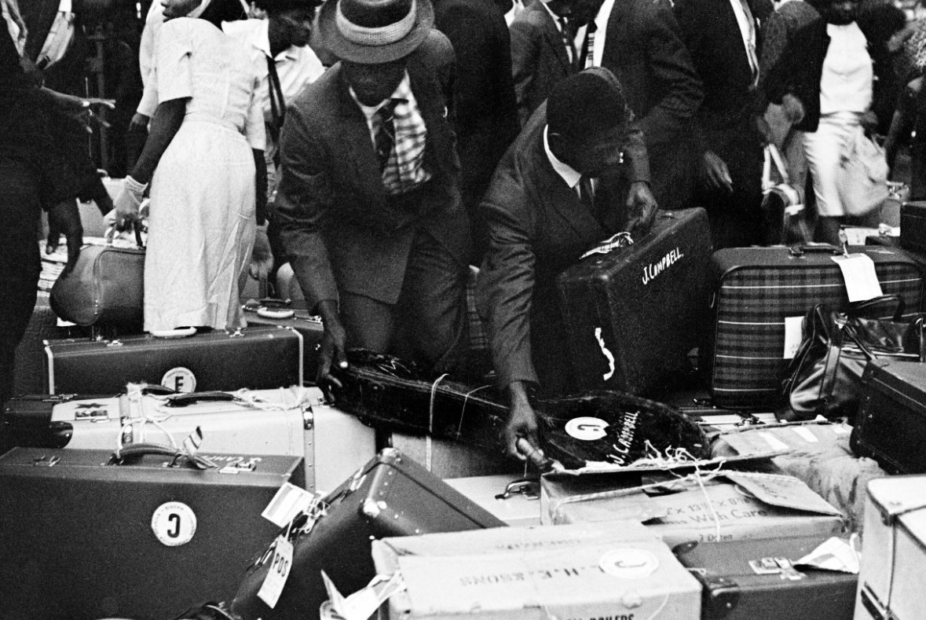
1. Who were the Windrush Generation?
Thousands of men, women and children moved from the Caribbean to the UK in the 1950s, 60s and 70s.
These individuals are known as the Windrush Generation after one of the ships that sailed from the Caribbean to England in 1948, the MV Empire Windrush.
Many Caribbean people had also served during the war in the British armed forces. After World War II ended in 1945, Britain needed help to rebuild, so asked people from Caribbean Commonwealth countries to move to the UK to help rebuild Britain and start a new life.
Today there are about one million people of Caribbean descent living in the UK.
There are 54 Commonwealth countries around the world. This means they used to be under British rule.
Caribbean arrivals in Waterloo station. Photographs taken by Howard Grey in 1962.

Slide 3
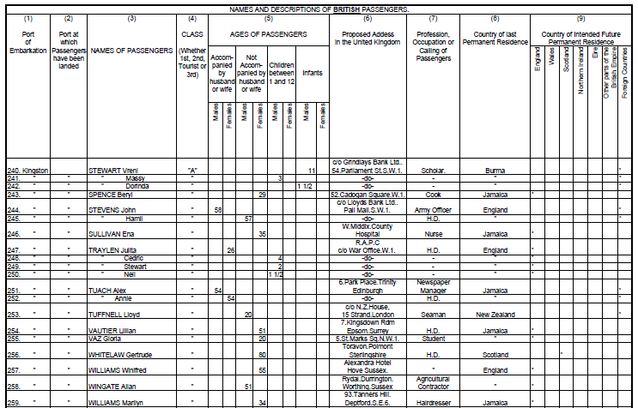
The Windrush Generation helped make Britain what it is today. They worked in a range of areas, helping to rebuild the country. The most common sectors in which people from the Caribbean, both men and women, found jobs in towns and cities were in construction, public transport, factories and manufacturing. Many Caribbean women found employment as NHS nurses and nursing aides in hospitals across the country. The image on the right is a transcript of a page from the Empire Windrush passengers list. This provides an insight into the professions of those on board

Slide 4
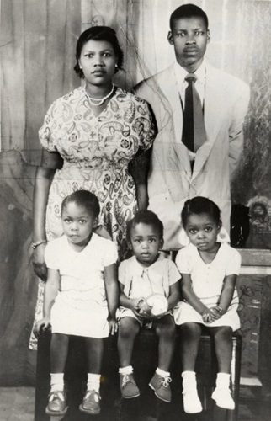
Not everyone was happy about Caribbean people setting in the UK, many of them faced discrimination due to the colour of their skin.
Many white Britons treated black people unfairly, employing them to do menial tasks, paying them less than their white co-workers and refusing to rent accommodation to black people. This meant that many Caribbean arrivals were forced to live in run down areas and live with very little money. Some individuals also faced serious violence and in certain areas, white people attacked black people in the streets and vandalised their homes. Despite this horrible discrimination, the Windrush Generation continued to work hard to help Britain, which they were told was the Motherland.
"But life still remained a struggle. Every day was a battle and whenever I left the safety, comfort and security of my loving home knowing I would have to face insults and abuse, from adults and children alike, as I walked the streets. When Marmie sent me shopping I knew the person behind the counter would ignore me, as though I was invisible and serve customers behind me in the queue. There was no question of going home without the shopping because my mum would say ‘Go back to the shop until they serve you’. That taught me resilience, persistence and determination."
Baroness Floella Benjamin shares her experience of coming to England as a child. She is seen here with her family sitting bottom right.
Notes:
Words by Floella Benjamin for The British Library - https://www.bl.uk/windrush/articles/floella-benjamin-on-coming-to-england

Slide 5
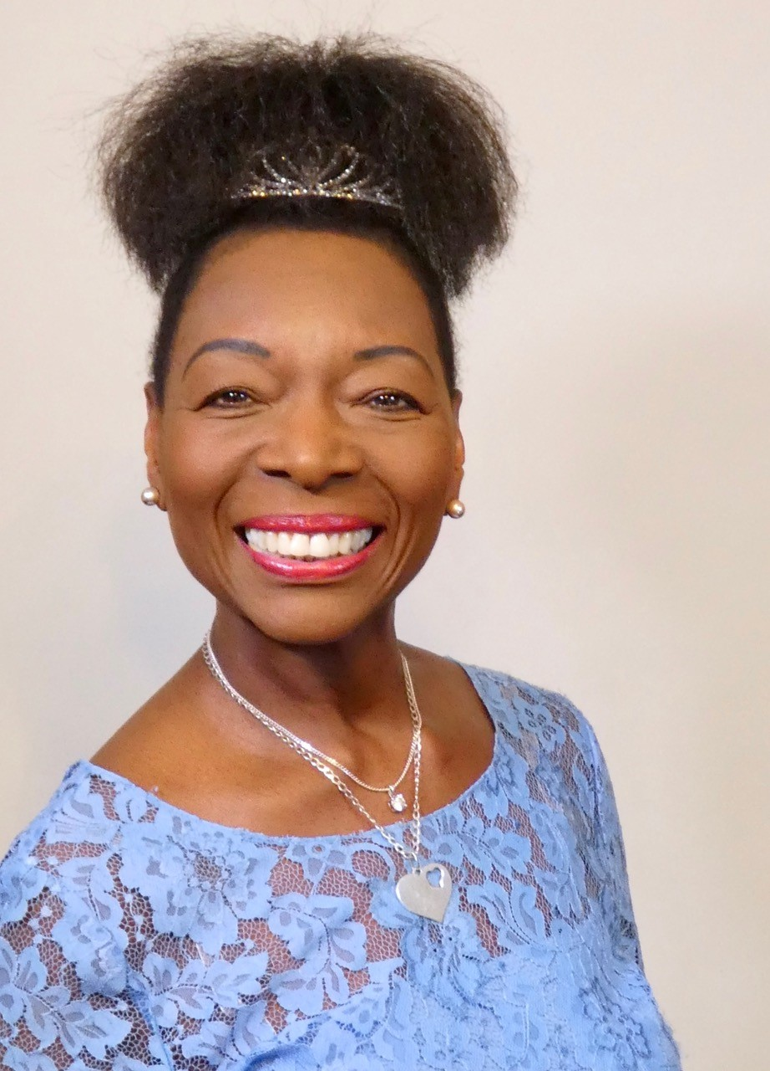
2. Why is a monument about the Windrush Generation being built?
The Windrush Generation, despite facing challenges, continued to succeed. Not only did they work in the NHS, transport and manufacturing industries, they also made the UK a more diverse and interesting place. Through starting businesses, creating new communities and achieving in politics, television, film, music and sports, the Windrush Generation changed our culture forever. Here are just some examples of these inspiring individuals, all of whom sit on the Windrush Commemoration Committee, chaired by Baroness Floella Benjamin. The individuals in this Committee represent all aspects of society in fields such as art, music and business. Click through the slides to learn more about the Committee members who are part of the Windrush Generation.
Baroness Floella Benjamin DBE DL was born in Trinidad in 1949 and came to England as a 10 year old child in 1960 as a Windrush child. She left school at 16 with the aim of becoming Britain’s first ever black woman bank manager but changed direction and became an actress, presenter, writer, independent producer, working peer and an active advocate for the welfare, care and education of children throughout the world. She has also headed a successful award winning film and television production company.
She has been in show business for over 50 years appearing on stage, film, radio and television. She became a household name through her appearances in the iconic children’s programmes 'Playschool' and 'PlayAway'. She has written over 30 books and in 2016 the 20th anniversary edition of her book ‘Coming to England’ was chosen as a ‘Guardian Children’s Book of the Year’. For over 2 decades it has used in schools and universities as a tool to explore the Windrush journey.
Her broadcasting work has been recognised with numerous awards, including an OBE in 2001, a Special Lifetime Achievement BAFTA Award in 2004 and the J.M Barrie Lifetime Award in 2012 for her lasting cultural legacy. In 2013 she was made a Fellow of the Shakespeare Birthplace Trust and in 2017 she was appointed as President of the Society of Women Writers and Journalists. She was appointed a Deputy Lieutenant of Greater London in 2012 and in 2020 she received a Damehood for her charitable work.
To celebrate the 70th anniversary of the arrival of Empire Windrush she created a Royal Horticultural Society (RHS) Chelsea Windrush Garden which won a gold medal and she is now a Vice President of the RHS. She was Chancellor of the University of Exeter for 10 years and became famous for hugging every graduate imploring them to ‘change the world’. In 2016 when she stepped down as Chancellor the university put up a statue of her in recognition of her contribution to the City of Exeter.
She was the first woman Trinidadian to be elevated to the House of Lords in 2010 and speaks on children’s, diversity and media issues and recently was successful in getting the government to bring in legislation for commercial broadcasters to provide UK made television programmes. In 2018 she was granted Honorary Freedom of the City of London for her outstanding contribution to the capital and the Prime Minister appointed her Chair of the Windrush Commemoration Committee to create a lasting memorial to celebrate the contribution to Britain made by the Windrush Generation.

Slide 6
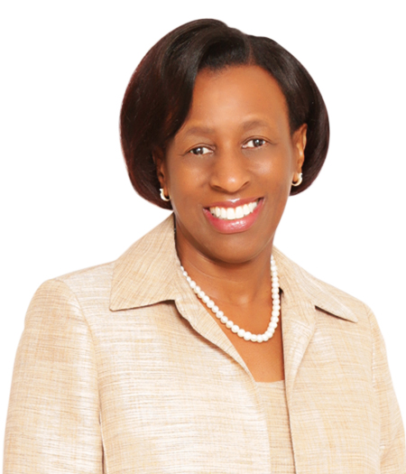
Paulette Simpson CBE is the Executive Director of the Voice Newspaper, a Black-owned newspaper that has served the Black British community for over 35 years, and also Deputy Chief Executive Officer – Corporate Affairs, of JN National Bank. JN Bank UK is Britain's first Caribbean owned bank. Alongside these roles, Paulette is Deputy Chair of the Windrush Commemoration Committee and Chair of the Windrush Community Funds and Windrush Schemes Sub-group. She is incredibly active in her community and assists various charities across the UK with their work to improve the lives of Jamaicans in the UK and Jamaica.
Born in England, Paulette spent part of her childhood in Jamaica. As an undergraduate she returned to the UK and studied at the University of Stirling, earning a BA in Business Studies and later completing an MBA at the University of Westminster.
Paulette was recognised three times as one of Britain’s most influential people of African and African-Caribbean heritage in the annual UK Powerlist published by Powerful Media. Due to her incredible passion and hard work, in 2020 she was honoured for services to the Caribbean community in the UK by Her Majesty Queen Elizabeth II, and was conferred with the highest ranking order of Commander of the British Empire.

Slide 7
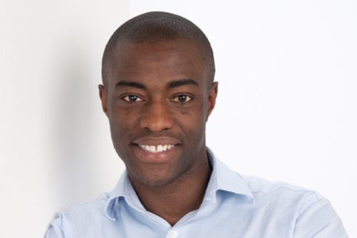
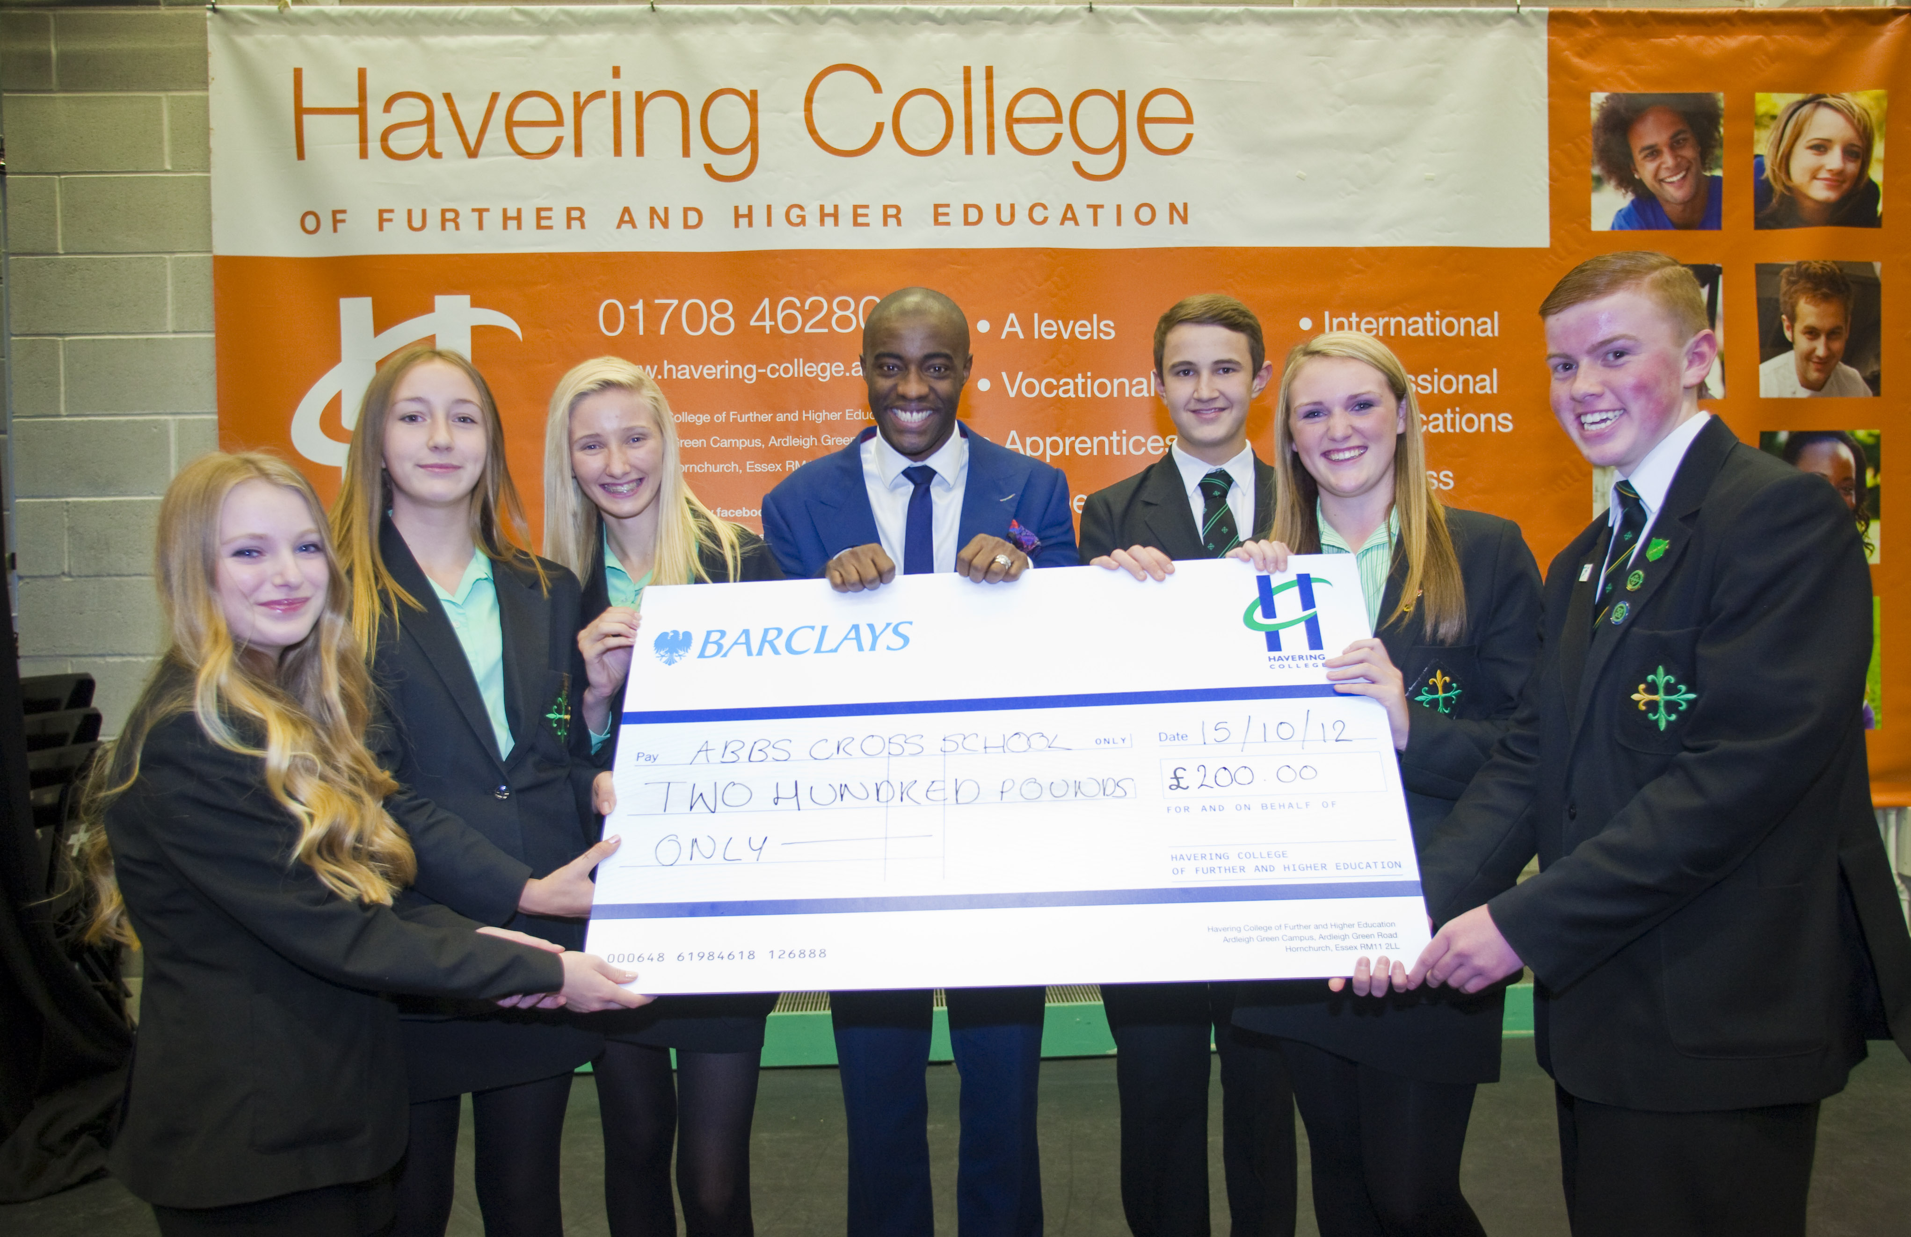
Tim Campbell, MBE who was awarded the MBE for Enterprise Culture in the 2012 New Year’s Honours List, is the founder of his own entrepreneurial social enterprise, Bright Ideas Trust. He is also a small business owner and co-author of one of Amazon’s Top 10 business books for 2010, ‘What’s Your Bright Idea?’. He is widely known for being the winner of the first series of BBC's 'The Apprentice'.
With a firm belief in education as a facilitator of social mobility, he currently sits on the City of London Education board and is Chair of Governors at St Bonaventure's school in Newham. Tim is also a member of the Windrush Commemoration Committee:
"As the proud son of a Jamaican mother who benefitted from the Windrush generation’s pioneering efforts, I am extremely committed to ensuring everyone respects the legacy of those who were called to better the country many of us now call home. Those efforts are rarely acknowledged or reflected upon. The work of the committee is to share the stories, good and bad, so that their endeavours, and ours to inspire the next generation, were not in vain."

Slide 8
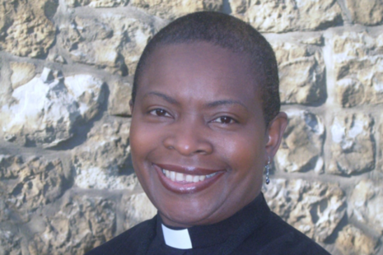
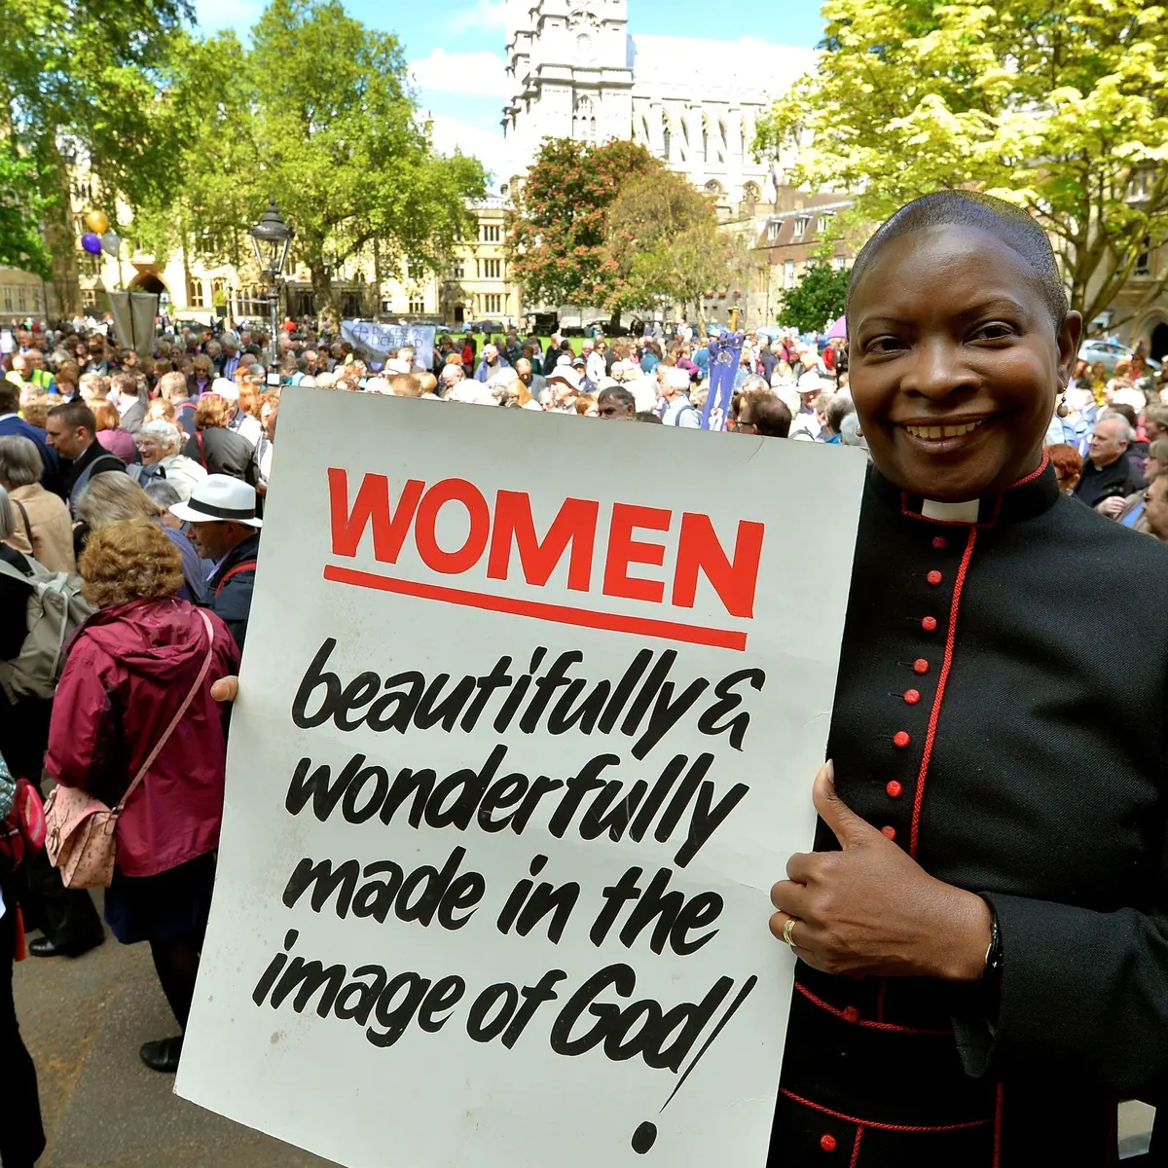
The Rt Reverend Rose Hudson-Wilkin, CD, MBE
Bishop of Dover in the Canterbury Diocese ( East Kent) was born and grew up in Montego Bay, Jamaica. She was ordained deacon in 1991 and priest in 1994.​ For 16 and a half years she served as a priest in Hackney. In 2007 she was appointed as a Chaplain to Her Majesty the Queen and in 2010, she became the 79th (and first female) Chaplain to the Speaker of the House of Commons, leading the prayers in the House of Commons daily and pastorally caring for members and staff of the Palace of Westminster. In 2014, she additionally became the Priest in Charge of the City Church, St Mary-at-Hill. ​
She was consecrated a bishop in the church of England on the 19th November 2019 in a service at St Paul’s Cathedral – the first female black bishop in the Church of England. On the 30th November 2019 she was installed as the Bishop of Dover in Canterbury Cathedral. She administers the historic diocese of Canterbury on behalf of the Archbishop of Canterbury.
She is often seen and heard on various media outlets discussing relevant social issues including flagship programmes like Question Time (BBC1), Any Questions (Radio 2) and also guest edited the radio 4 Today Programme, having previously guest edited Woman’s Hour. She is regularly invited to do Speaking Engagements nationally and internationally. She holds Patronages for several organisations including:- City YMCA; The World Reimagined (a ground-breaking, national art-education project seeking to transform how we understand the Transatlantic Slave Trade and its impact on all of us) and BIMA (Belief in Mediation and Arbitration).
In the summer of 2019, she was awarded the Order of Distinction in the rank of Commander (CD) from the Jamaican Government and the MBE in the New Year’s Honour’s list at the end of 2019. She also presently serves on the Windrush Commemoration Committee seeking to create a lasting legacy to that generation.
​She has served as a member of the General Synod of the Church of England and also as one of the Panel of Chairs of the Synod. She represented the Church of England at the World Council of Churches in Zimbabwe and Brazil and served as its priest representative on the Anglican Consultative Council.​
She is also a Fellow Emeritus in Public Theology at Virginia Theological Seminary, USA.
​
“My mother had siblings who travelled to Britain inspired by the Windrush group. She also later made the journey to England. I have heard from them first-hand, of the many challenges they faced but, in particular of their determination to keep going and to make Britain their home. I am personally inspired by their resilience and proud to be a child of the Windrush generation.”

Slide 9
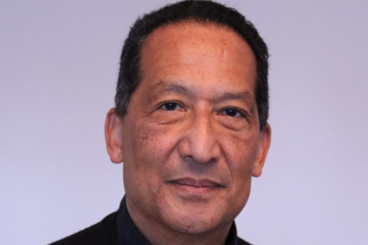
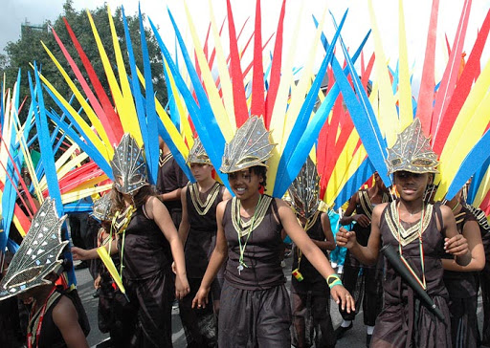
Ansel Wong CBE is a cultural and political activist. His work in the arts has played a vital role in transcending racial boundaries and highlighting Caribbean culture across Britain. He has worked for and with diverse communities for decades breaking down barriers and helping them share their cultural heritage.
Ansel was born in San Fernando, Trinidad and Tobago. His father was an immigrant from China and his mother was of African, Carib and Spanish heritage. After growing up in the West Indies, he moved to Britain in the mid 1960s where he attended Hull University and studied for his Bachelor of Arts Degree in English and American studies. In an era of activism, Ansel was heavily involved in student politics and moved from the student scene to larger scale movements such as the Black Liberation Front.
After graduating Brunel University with a Master of Education he began teaching at Sydenham Girls Secondary School as an English teacher. During this time, he started lunchtime educational classes and engaging with the Black children at the school. He shared Caribbean culture through food, history and dance.
This first job was the start of a very successful career in education, equality and diversity, taking on roles such as Head of the Race Equality Policy Group for the Greater London Council, Chairing the Notting Hill Carnival and founding the Elimu Mas band. Ansel was also instrumental in establishing October as Black History Month in the UK and this was first celebrated in October 1987. He is a member of the Windrush Commemoration Committee and was appointed Commander of the Order of the British Empire in the 2020 Birthday Honours for services to arts and culture.

Slide 10
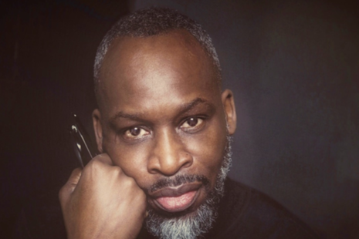
Simon Frederick
Simon Frederick is a self-taught artist, photographer, filmmaker and broadcaster who was born in London to Grenadian parents. His photographs made history when his collection entitled ‘Black Is The New Black’ became the largest acquisition of African-Caribbean sitters by the National Portrait Gallery, becoming part of the Gallery’s prestigious permanent collection.
He produced and directed the award-winning documentary series for the BBC, ‘Black is the New Black’ (2016) which became a huge symbol of recognition of the contribution of African Caribbean people to British life and followed that up with ‘They’ve Gotta Have Us’ (2018), which charts the revolutionary rise of black people in the film industry.
Frederick has served as chief judge on the Sky Arts series Master of Photography and the annual World Photo Awards. He has also been profiled as one of 2019’s 100 ‘Most Influential Black Britons’ in the category of Media, Publishing and Entertainment. Simon is also a member of the Windrush Commemoration Committee and when asked about what he is looking for in the artist he said:
“I’m looking for is someone who can capture the emotion, the sentiment and the pride that we as people from the Caribbean have in what we created here.
“We’ve had to reinvent ourselves in Britain and in reinventing ourselves, we’ve reinvented Britain and we don’t get credit for that. What I’m looking for in a sculpture, artist or architect is someone who can galvanise all of that.”

Slide 11
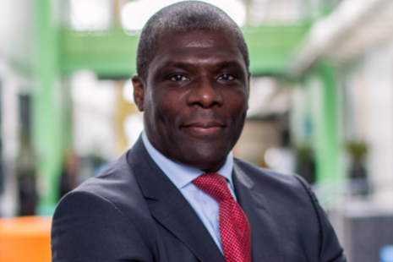
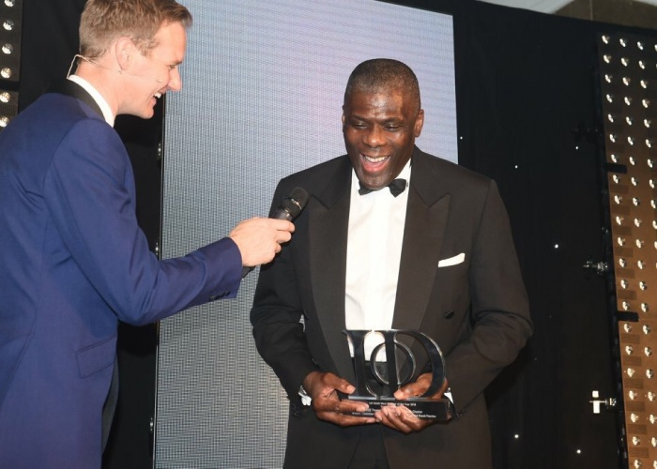
Geoff Thompson MBE DL
Geoff Thompson is a former five times World Karate gold medallist and the holder of over 50 national and international titles. He is the Founder and Chair of the Youth Charter, a UK-based international charity and United Nations Non-Governmental Organisation that has for twenty-eight years used the ethics of sport and artistic excellence to tackle the problems of educational non-attainment, health inequality, anti-social behaviour and crime in some of the most troubled communities nationally and internationally. He is Deputy Chair of the Birmingham 2022 Commonwealth Games and a member of the Windrush Commemoration Committee and in his own words, charts part of his and his family’s journey as members of the Windrush Generation:
“Stanley Beresford Thompson and Violet Adriana Thompson migrated from Barbados and Guyana respectively as part of the post-war rebuilding of the mother country. My father fought in the second world war and distinguished himself with medals of valour. My mother came over as a nurse as so many who were encouraged to improve their life chances and one day return back home.
Settling in Wolverhampton, my brother, sister and I were to be the product of their union and we lived just over half a mile away from where Enoch Powell wrote his ‘Rivers of Blood’ speech at the Conservative Social Club (now ironically the West Indies Social Club).
As a leader in the community my father helped many settle and overcome the mis-treatment of racial indifference and ignorance that characterised the fear that would reflect so much of the Windrush post war migration experience."
Geoff's father sadly passed away when he was 45.
"My journey from streets to stadium to rostrum and into public life is reflective of my father having fought for this country, me having competed for this country and now serving in public life.
As we celebrated my mother’s 92nd birthday last month and her dream to go back home many years ago should not be defined by those who feel in today’s polarised views that the Windrush generation should go back home. She has earned the right to enjoy a peace of mind and quality of life characterised by her children, grandchildren and great grandchildren.”

Slide 12
Many of the people who came to the UK in the 50s and 60s are now grandparents. After years of living in the UK, people from the Windrush Generation started to face problems again. Over the last 10 years members of the Windrush Generation were told they were not British citizens after all and might be forced to go back to the Caribbean. After living and working in the UK for decades, this was incredibly hurtful, upsetting and unexpected as they had worked so hard to help the UK.
Eventually the government apologised for their actions which were harming the Windrush Generation and promised that they would help anyone who was affected.
As part of this promise, the government wanted to make sure they were properly celebrating the Windrush Generation for the all the contribution they had made to Britain, so a National Windrush Day was created. This would be on the 22nd June each year.

Slide 13
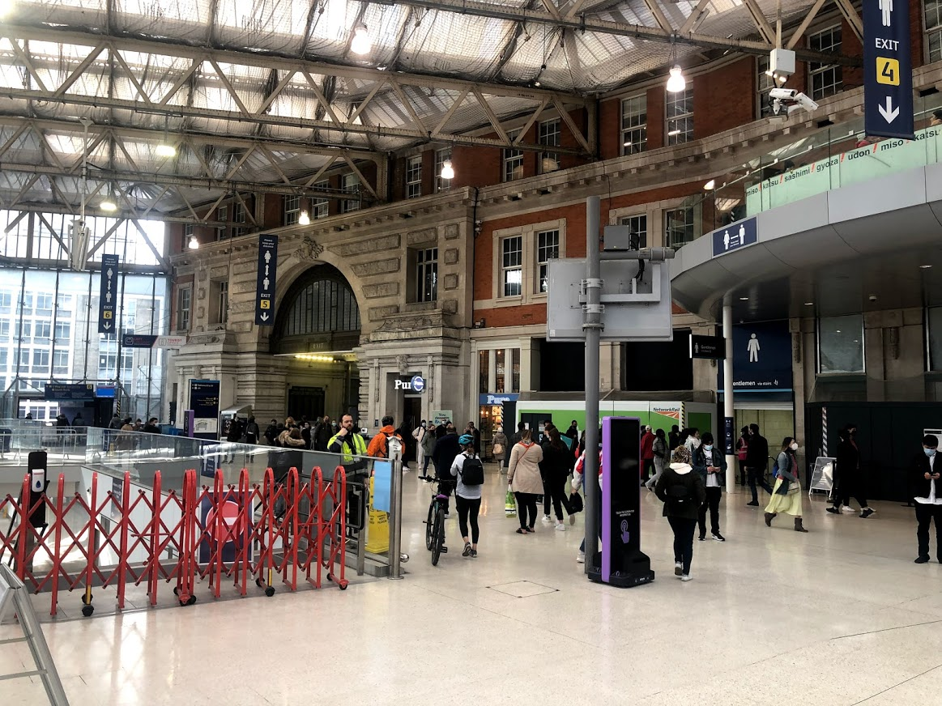
Also as part of this celebration, a National Windrush Monument is being created. It will be at Waterloo Station in London to honour the Windrush Generation. Millions of people pass through Waterloo Station every year and when they see the monument, they will be reminded of the incredible impact the Windrush Generation has had on the UK and our British history.
Four artists have been chosen to design what they think the monument should look like and one will be chosen in September.
In 2018 the Prime Minister asked Baroness Benjamin to lead the project and she has put together the Windrush Commemoration Committee who will decide which artist will create the Windrush Monument.
This is where the Windrush monument will be
A monument is a statue or building to celebrate a person, group of people or an event.

Slide 14
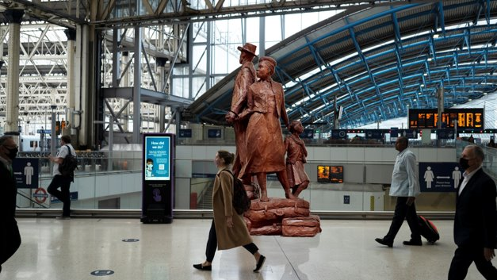
Each artist has made a video about their design. You will now get to watch each of these four videos. Click here to watch video number 1 and answer the questions below in groups.
Questions to answer for design 1.
What are the key features of this monument?
Why do you think the artist chose this design?
Would you like to go and visit this monument if it was built?
Do you think children and adults would like this monument?
Do you think the Windrush Generation would be proud of this monument?
Notes:
Basil Watson - proposed Windrush Monument in situ at Waterloo Station, London (image rendering by Maël Hénaff)

Slide 15
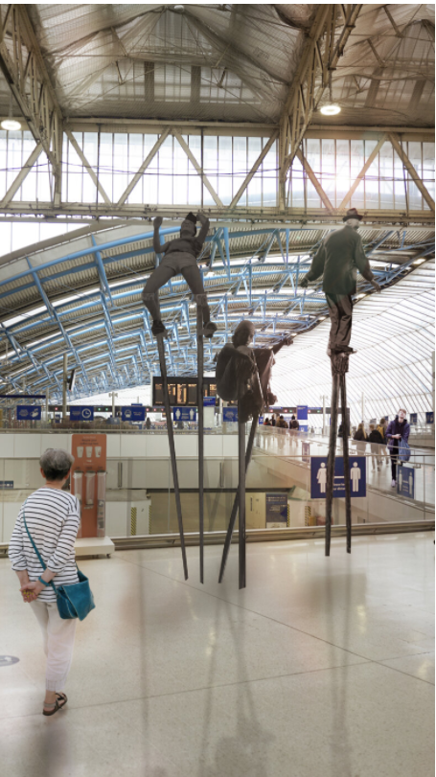
Click here to watch video number 2 and answer the questions below in groups.
Questions to answer for design 2.
What are the key features of this monument?
Why do you think the artist chose this design?
Would you like to go and visit this monument if it was built?
Do you think children and adults would like this monument?
Do you think the Windrush Generation would be proud of this monument?
Notes:
Jeannette Ehlers - proposed Windrush Monument in situ at Waterloo Station, London (image rendering by Maël Hénaff)

Slide 16
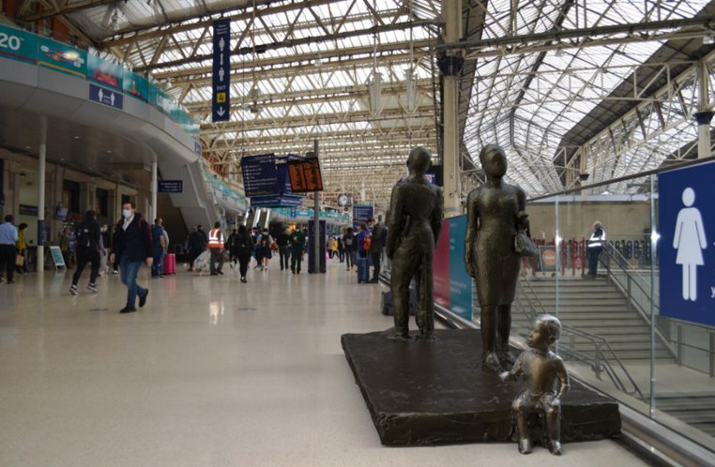
Click here to watch video number 3 and answer the questions below in groups.
Questions to answer for design 3.
What are the key features of this monument?
Why do you think the artist chose this design?
Would you like to go and visit this monument if it was built?
Do you think children and adults would like this monument?
Do you think the Windrush Generation would be proud of this monument?
Notes:
Thomas J Price - proposed Windrush Monument in situ at Waterloo Station, London (image rendering by Thomas J Price)

Slide 17
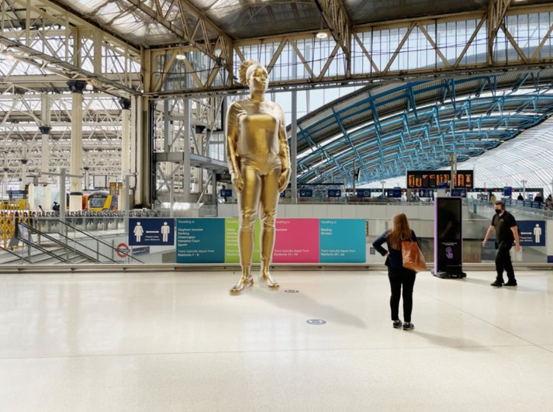
Click here to watch video number 4 and answer the questions below in groups.
Questions to answer for design 4.
What are the key features of this monument?
Why do you think the artist chose this design?
Would you like to go and visit this monument if it was built?
Do you think children and adults would like this monument?
Do you think the Windrush Generation would be proud of this monument?
Notes:
Valda Jackson - proposed Monument in situ at Waterloo Station, London (image rendering by Pangolin Editions)

Slide 18
3. What do you think makes a good monument?
ACTIVITY:
In groups, discuss what you think makes a good monument. Use the questions below as prompts for your discussion.
Once you are finished nominate one speaker to present back to the other groups.
Do you have a current favourite monument or one you dislike? Why is it so good/bad?
Location
Story
You should think about…..
Accessibility
Design
Materials used
Who is the Monument for? Is it inclusive?
Notes:
Different options

Slide 19
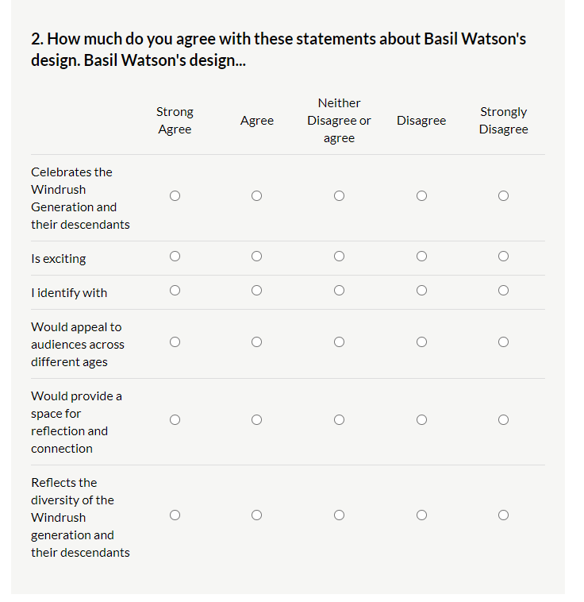
Before the final artist is chosen in September the Windrush Commemoration Committee would really value your views on the shortlisted artists. They have put together a short questionnaire to understand your impressions of each design. You have already watched their videos, so log onto our website and fill out the survey.

Slide 20
Thank you so much for taking time to complete the activities and fill in the survey.

