Slide 1
Engaging With The Windrush Monument Shortlisted Artists
An activity plan for children
Aims of the session:
1. Who are the Windrush Generation?
2. Why is a monument about the Windrush Generation being built?
3. What do you think the monument should look like?
Notes:
Insert logo

Slide 2
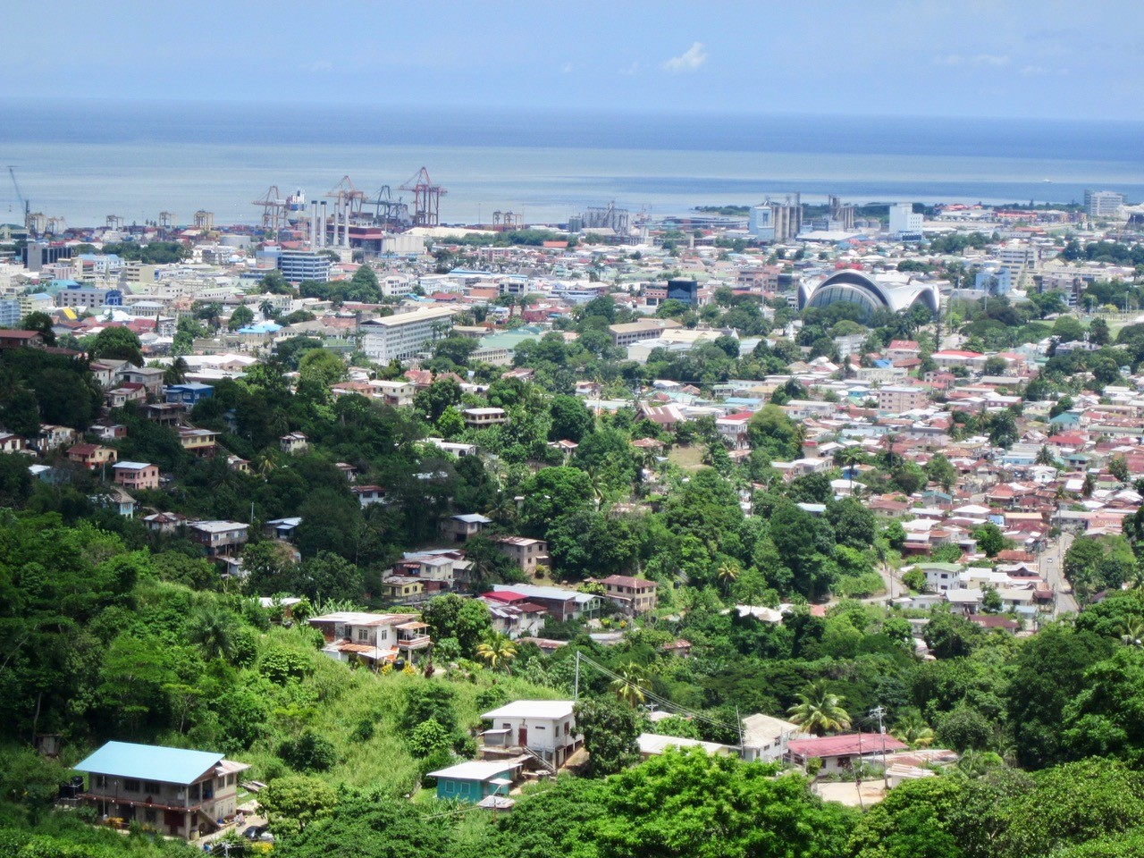
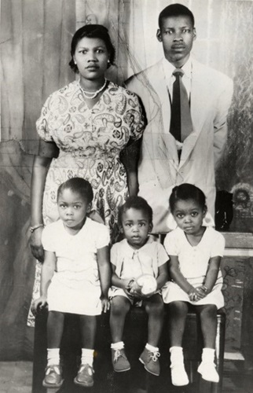
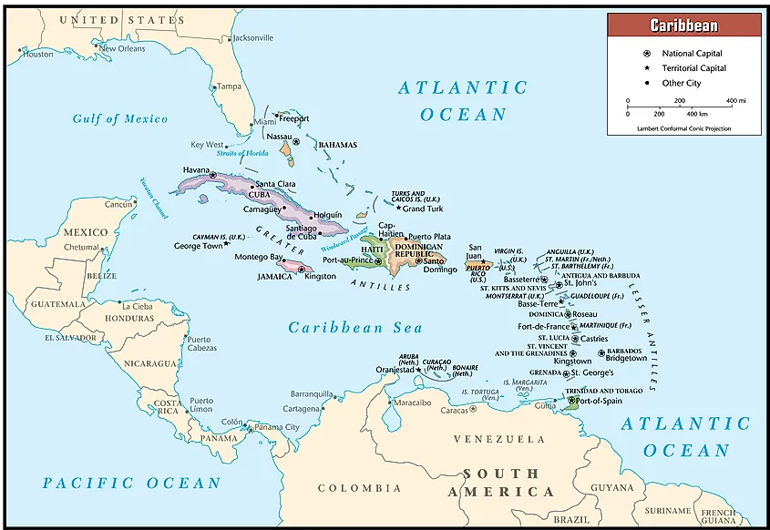
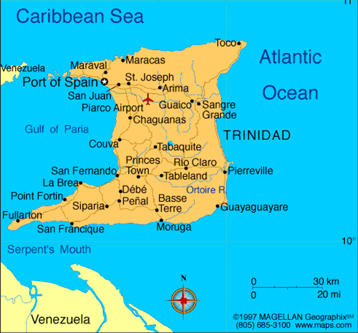
1. Who are the Windrush Generation?
This is Floella. She lived on the island of Trinidad.
Click here to watch her story.
Trinidad

Slide 3
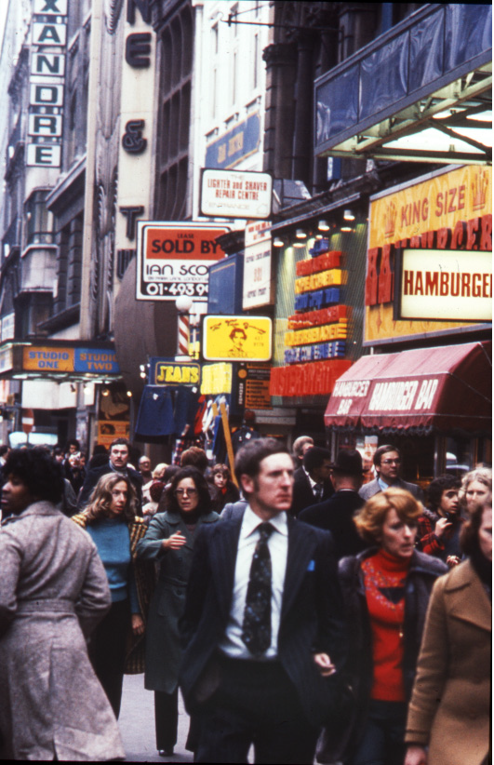
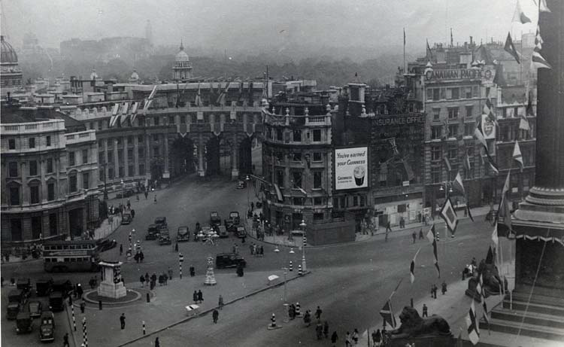
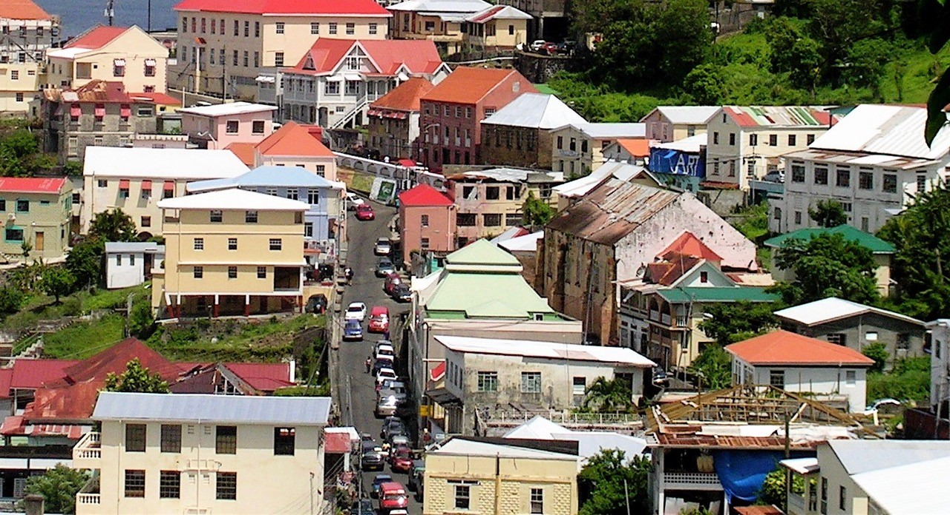
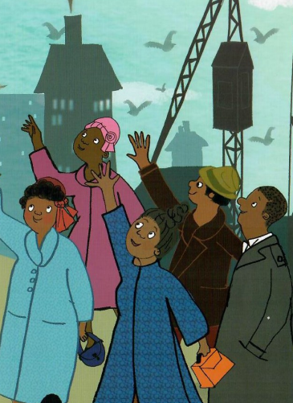
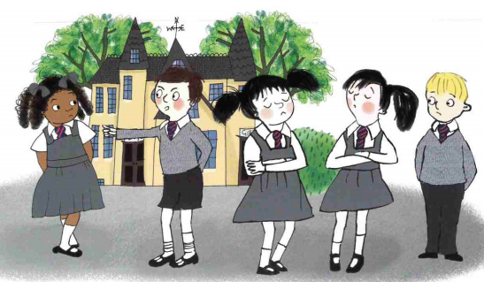
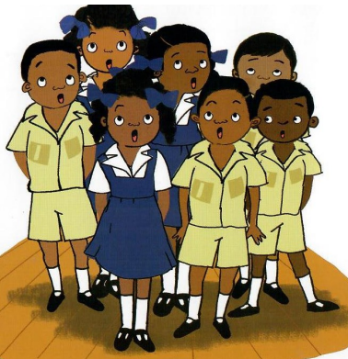
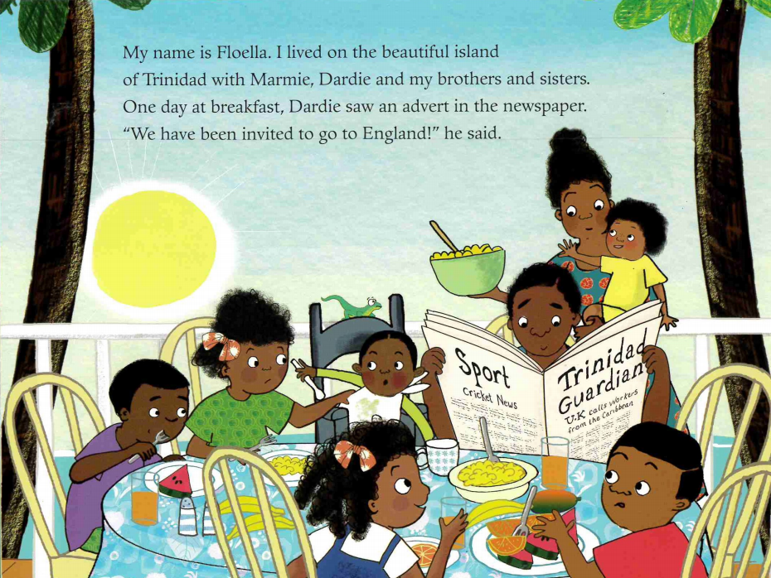
Coming to England was exciting but scary for Floella. What do you think would have been different between the Caribbean and England in the 1960s?
Coming to England Illustrations copyright © Diane Ewen 2020 by permission of Macmillan Children's Books.
Notes:
Coming to England Illustrations copyright © Diane Ewen 2020 by permission of Macmillan Children's Books.

Slide 4
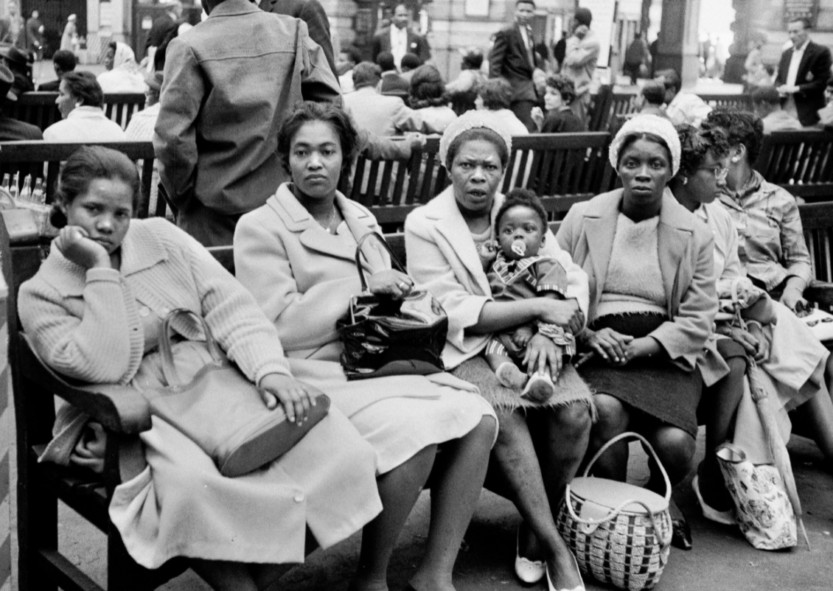
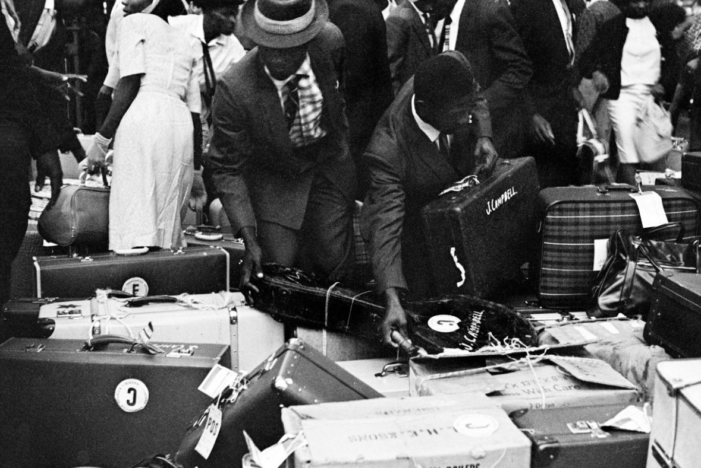
1. Who were the Windrush Generation?
Thousands of men, women and children moved from the Caribbean to the UK in the 1950s, 60s and 70s. These individuals are known as the Windrush Generation. This is because one of the large ships that sailed from the Caribbean to England in 1948 was called the MV Empire Windrush.
Many Caribbean people had also served during the war in the British armed forces, and after World War II ended in 1945, Britain needed help. Thousands of buildings had been bombed, lots of houses had been destroyed and many people had died in the fighting, so Britain asked people from Caribbean Commonwealth countries to move to the UK to help rebuild Britain and start a new life. Today there are about one million people from the Caribbean living in the UK.
There are 54 Commonwealth countries around the world. This means they used to be under British rule.
Caribbean arrivals in Waterloo station. Photographs taken by Howard Grey in 1962.

Slide 5
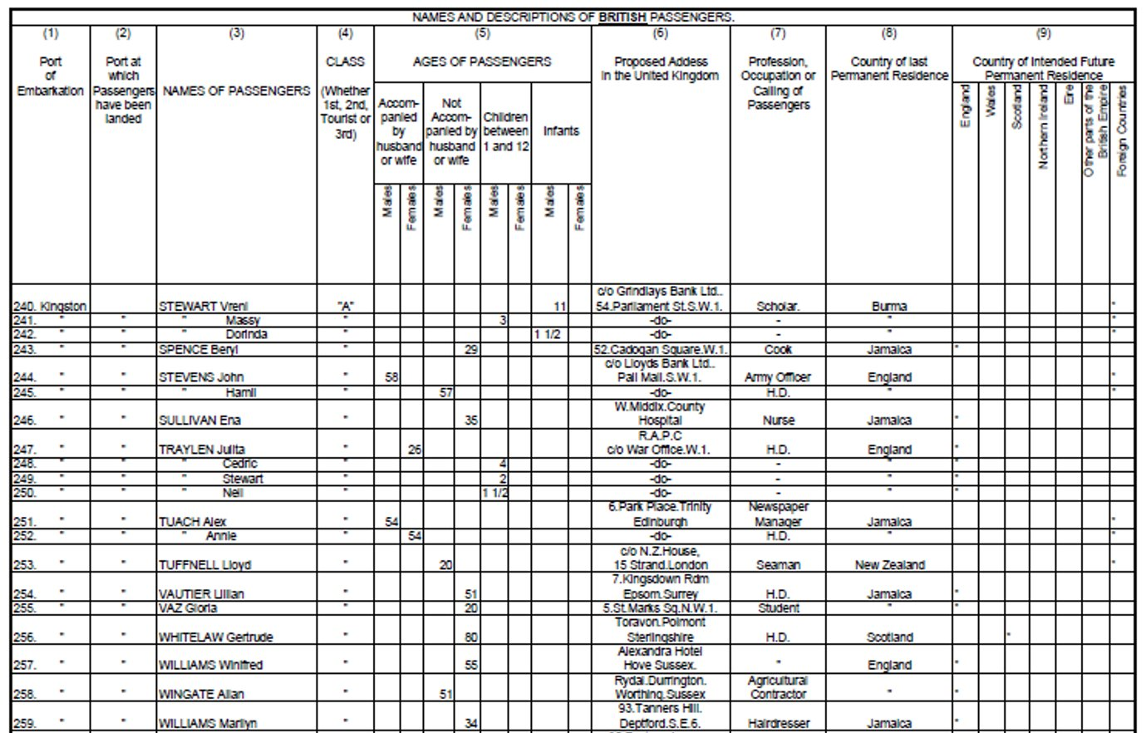
The Windrush Generation helped make Britain what it is today. They took jobs in many different areas and helped the UK rebuild after the war.
The image on the right is a transcript of a page from the Empire Windrush passengers list. This shows some of the differerent jobs the Windrush passengers were coming to England to do.
What jobs can you see in the photograph?
Notes:
Notes: The most common sectors in which people from the Caribbean, both men and women, found jobs in towns and cities were in construction, public transport, factories and manufacturing. Many Caribbean women found employment as NHS nurses and nursing aides in hospitals across the country.

Slide 6
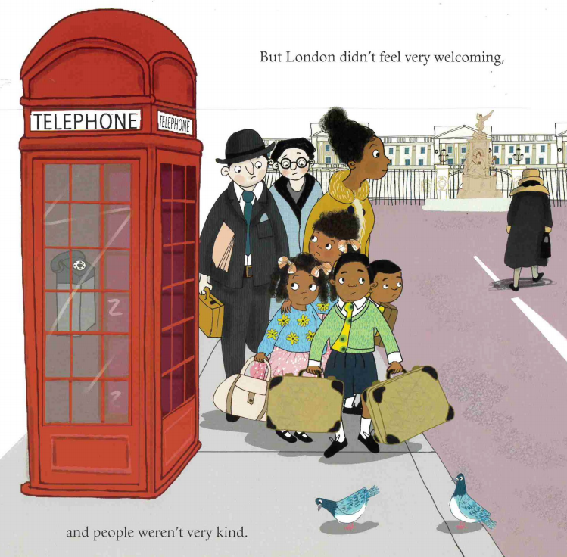
Not everyone was happy about Caribbean people setting in the UK and like Floella experienced, many of them faced discrimination due to the colour of their skin.
Many white Britons treated black people unfairly, employing them to do menial tasks, paying them less than their white co-workers and refusing to rent accommodation to black people. This meant that many Caribbean arrivals were forced to live in run down areas and live with very little money. Some individuals also faced serious violence and in certain areas, white people attacked black people in the streets and vandalised their homes. Despite this horrible discrimination, the Windrush Generation continued to work hard to help Britain, which they were told was the Motherland.
Imagine you grew up in the Caribbean and were invited to come to England for work. You were so excited but when you arrived, people weren't very kind. How would this make you feel?
A menial task is one that is usually very boring, takes little skill and is poorly paid. An example of a menial task is washing dishes in a restaurant.
Coming to England Illustrations copyright © Diane Ewen 2020 by permission of Macmillan Children's Books.
Coming to England Illustrations copyright © Diane Ewen 2020 by permission of Macmillan Children's Books.
Notes:
Coming to England Illustrations copyright © Diane Ewen 2020 by permission of Macmillan Children's Books.

Slide 7
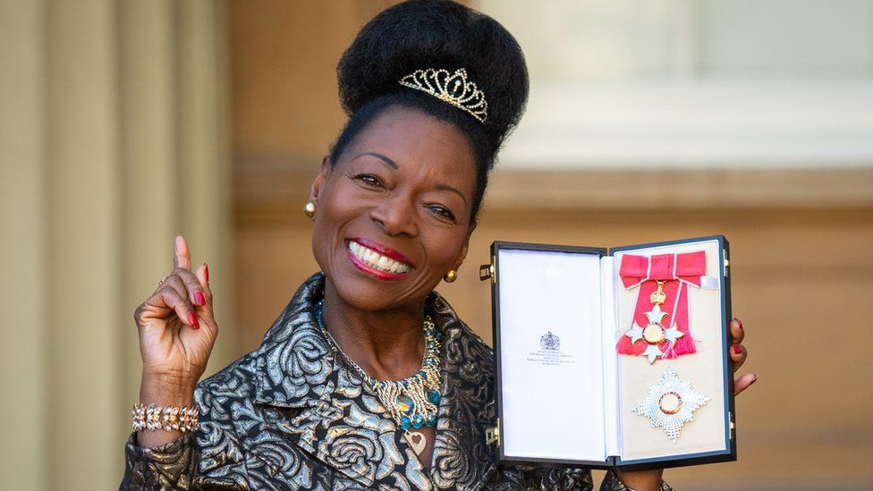
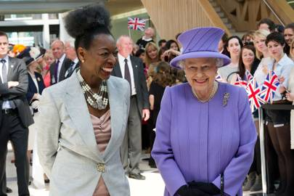
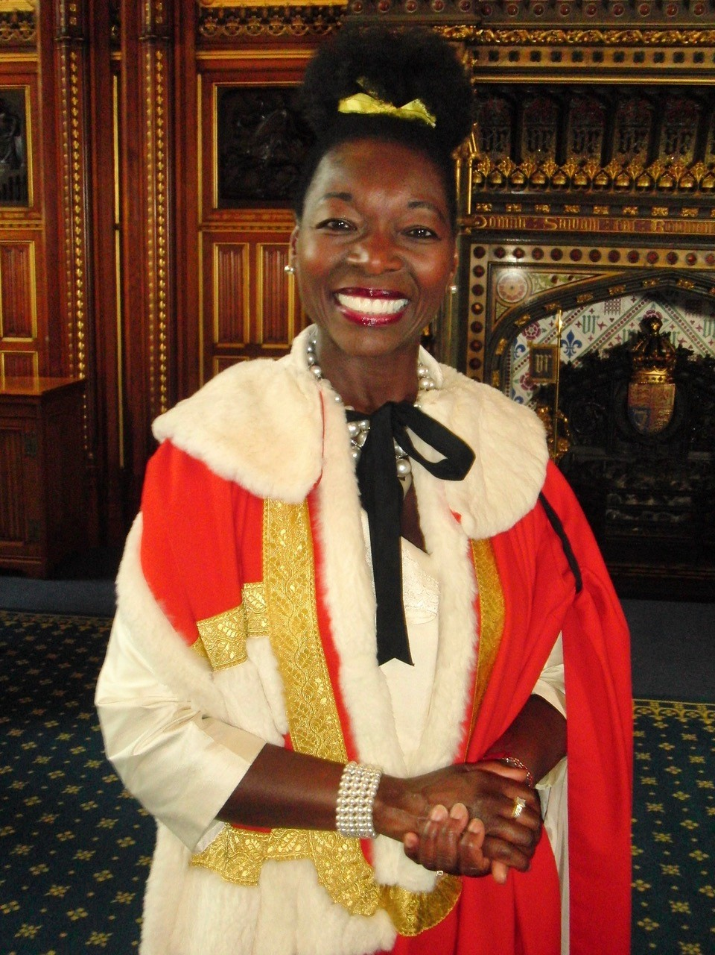
2. Why is a monument about the Windrush Generation being built?
The Windrush Generation, despite facing challenges, continued to succeed. Not only did they work in the NHS, transport and manufacturing industries, they also made the UK a more diverse and interesting place. Through starting businesses, creating new communities and achieving in politics, television, film, music and sports, the Windrush Generation changed our culture forever.
Floella grew up to become a Baroness in the House of Lords, an author, actor and children's television presenter - she even received awards from the Queen.

Slide 8
Many of the people who came to the UK in the 50s and 60s are now grandparents. After years of living in the UK, people from the Windrush Generation started to face problems again. Over the last 10 years members of the Windrush Generation were told they were not British citizens after all and might be forced to go back to the Caribbean. After living and working in the UK for decades, this was incredibly hurtful, upsetting and unexpected as they had worked so hard to help the UK.
Eventually the government apologised for their actions which were harming the Windrush Generation and promised that they would help anyone who was affected.
As part of this promise, the government wanted to make sure they were properly celebrating the Windrush Generation for the all the contribution they had made to Britain, so a National Windrush Day was created. This would be on the 22nd June each year.

Slide 9
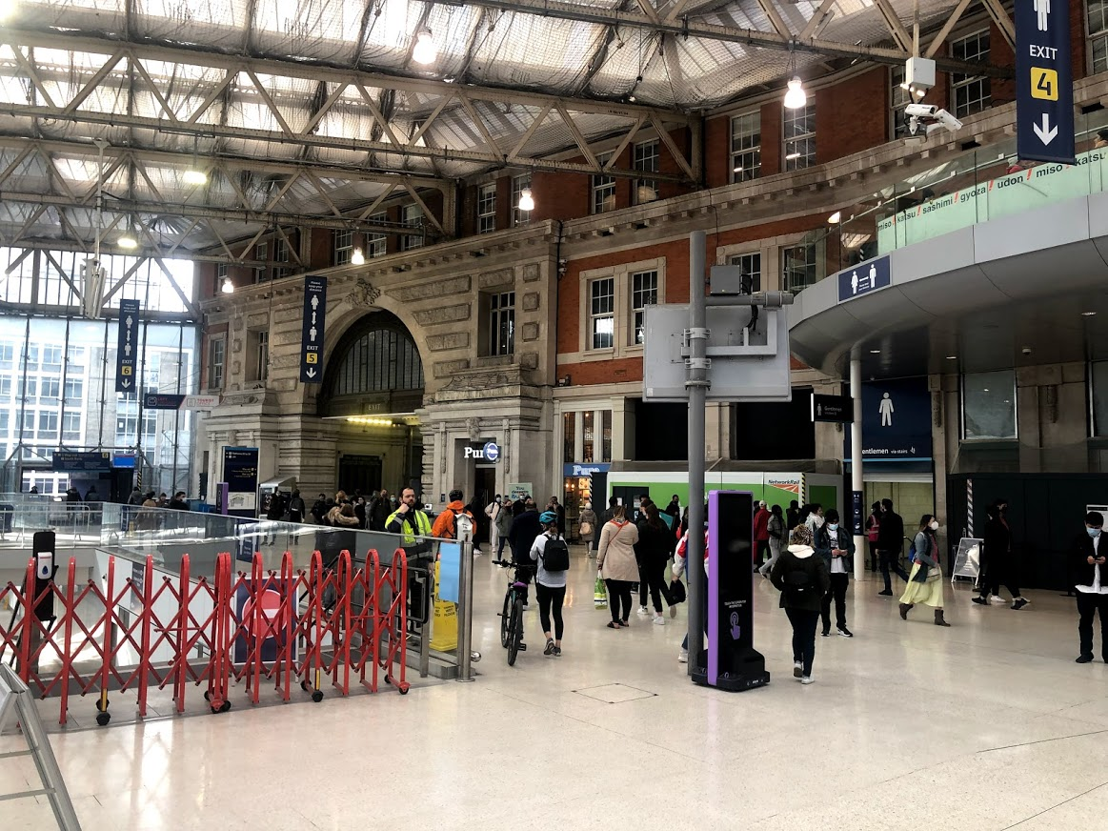
Also as part of this celebration, a National Windrush Monument is being created. It will be at Waterloo Station in London to honour the Windrush Generation. Millions of people pass through Waterloo Station every year and when they see the monument they will be reminded of the incredible impact the Windrush Generation has had on the UK and our British history.
Four artists have been chosen to design what they think the monument should look like and one will be chosen in September.
In 2018 the Prime Minister asked Floella to lead the project and she has put together a team who will decide which artist will create the Windrush Monument.
This is where the Windrush monument will be
A monument is a statue or building to celebrate a person, group of people or an event.
Notes:
The Monument will be in Waterloo Station because it was one of the stations that many Caribbean migrants arrived at when coming into the UK, before settling in London and other communities across the country. Waterloo station is also a very popular location with over 99 million individual visits each year and the owners will help protect the Monument from vandalism.

Slide 10
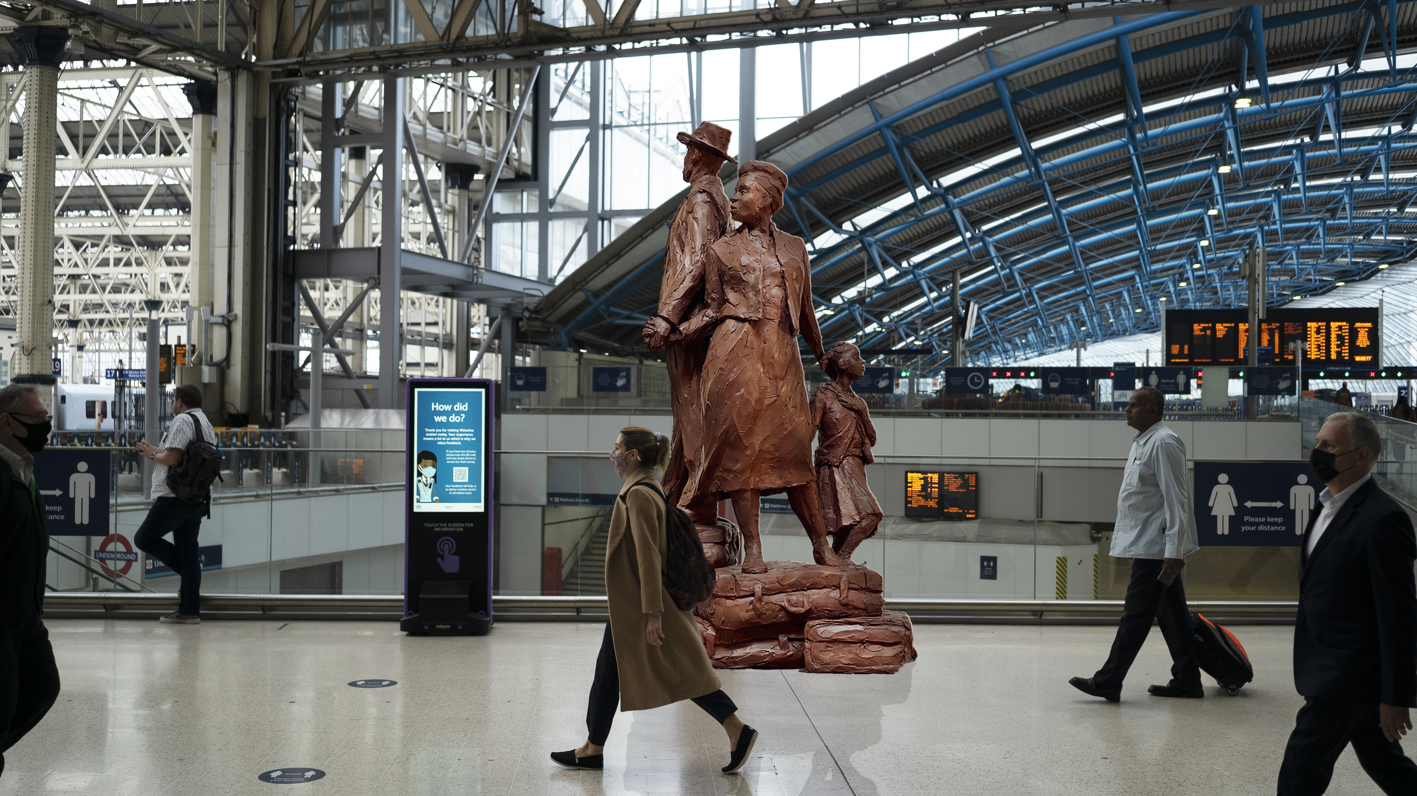
Each artist has made a video about their design. You will now get to watch each of these four videos. Click here to watch video number 1 and answer the questions below in groups.
Questions to answer for design 1.
What does this monument look like?
Why do you think the artist made the monument look like this?
Would you like to go and visit this monument if it was built?
Do you think children and adults would like this monument?
Do you think the Windrush Generation would be proud of this monument?

Slide 11
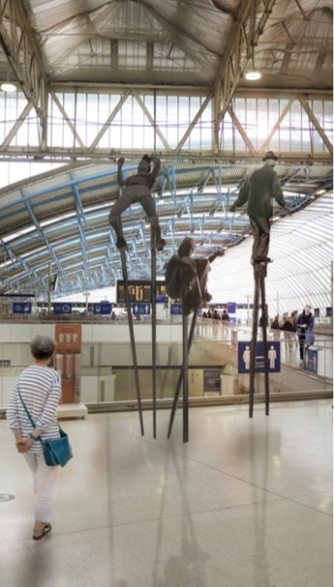
Click here to watch video number 2 and answer the questions below in groups.
Questions to answer for design 2.
What does this monument look like?
Why do you think the artist made the monument look like this?
Would you like to go and visit this monument if it was built?
Do you think children and adults would like this monument?
Do you think the Windrush Generation would be proud of this monument?

Slide 12
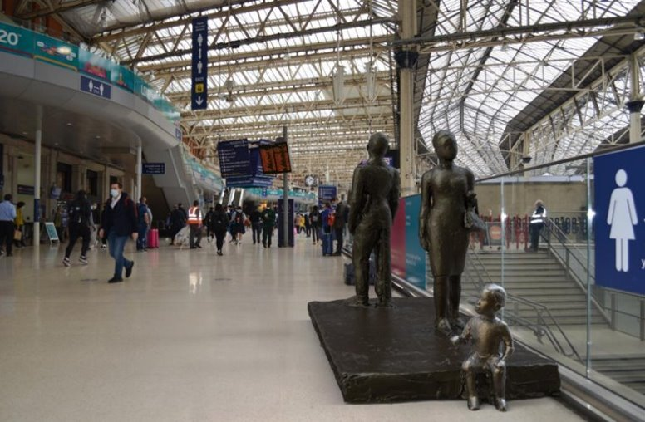
Click here to watch video number 3 and answer the questions below in groups.
Questions to answer for design 3.
What does this monument look like?
Why do you think the artist made the monument look like this?
Would you like to go and visit this monument if it was built?
Do you think children and adults would like this monument?
Do you think the Windrush Generation would be proud of this monument?

Slide 13
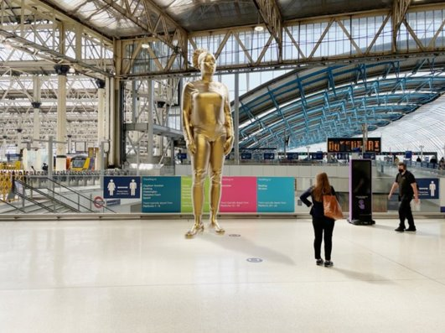
Click here to watch video number 4 and answer the questions below in groups.
Questions to answer for design 4.
What does this monument look like?
Why do you think the artist made the monument look like this?
Would you like to go and visit this monument if it was built?
Do you think children and adults would like this monument?
Do you think the Windrush Generation would be proud of this monument?

Slide 14
3. What do you think the monument should look like?
ACTIVITY:
In groups you need to design your own monument which celebrates the Windrush Generation.
Before you start you might want to answer the below questions.
Once you are finished you should present your design to the other groups
What do you think makes a good monument?
Where will the monument be?
How did the Windrush Generation help the UK?
You should think about…..
Is the monument for everyone?
Why is the monument being built?
What do you want the monument to look like?
Would you like to visit the monument?

Slide 15
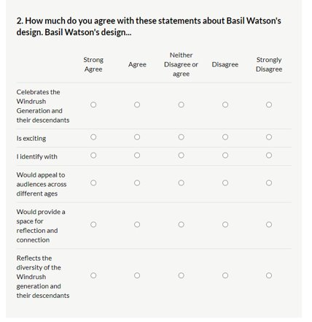
4. Feedback on the shortlisted designs
Before the final artist is chosen in September, Floella wants your help. She wants to hear what you think about the four artist designs. You have already watched their videos, so log onto our website and fill out the survey.

Slide 16
Thank you so much for taking time to complete the activities and fill in the survey.

