Slide 1
Promoting gender smart manufacturing through Manufacturing Africa
Nicole Pitter Patterson, Rachel Lock

Slide 2
Agenda
    Talking the talk: introduction to key terms
    The business case for gender smart manufacturing
    The cost of disregarding social safeguarding
    Q&A / BREAK
    The importance of GESI due diligence – Group exercise
    Gender smart investing in practice
    BREAK
    Role of GESI in Manufacturing Africa – Group exercise
    So what?

Slide 3
Talking the talk: introduction to key terms
“
SOCIAL INCLUSION
GENDER EQUALITY
INTERSECTIONALITY
PERSONS WITH DISABILITIES
MINIMUM COMPLIANCE
GENDER INCLUSIVE VALUE-CHAIN APPROACH
EMPOWERMENT
ACCESS / AGENCY
TRANSFORMATION
GENDER SMART MANUFACTURING
3 | Promoting gender smart manufacturing through Manufacturing Africa
Notes:
CALL OUT
GLOSSARY
Access / agency in women’s empowerment means that a woman’s access has been enhanced when she has the capacity to obtain greater economic resources. In other words, she has been able to access the opportunities, services, and assets required to upgrade her economic position. A woman’s agency has been enhanced when she has the capacity to make decisions and act on opportunities that lead to economic advancement. Agency is also about a woman’s ability to influence decision-making at various levels, such as within the household, in business, and government.
Access and agency are interconnected and are jointly essential for women’s economic empowerment.
https://www.enterprise-development.org/wp-content/uploads/WEE_in_Market_Systems_Framework_final.pdf
Empowerment (MA GeSI Framework)
Interventions that build assets, capabilities and opportunities for women and marginalized groups.
Source: MA GeSI Action Plan Report Final Updated
Gender Equality Requires equal enjoyment of socially-valued goods, opportunities, resources, and rewards
regardless of gender (UNFPA). Generally, where inequality exists, women are excluded or
disadvantaged in relation to decision-making and access to economic and social resources.
https://gendertoolkit.cdcgroup.com/wp-content/uploads/2020/11/Gender-smart-Investing-Guide-for-Fund-Managers.pdf
Gender inclusive value-chain approach
This approach ensures that gender issues are taken into consideration in value chain-related interventions, in order to include benefits for both women and men. Value chain as a concept describes the full range of activities that firms, farms and workers do to bring a product from its conception to its end use and beyond. This includes activities such as design, production, marketing, distribution and support to the final consumer.
https://www.oecd.org/derec/denmark/45670567.pdf
This approach is important to the MA project to achieve the maximum potential of its impact on inclusive growth and poverty reduction.
Gender smart manufacturing
Means being intentional in terms of integrating a gender lens across all manufacturing operational decision making. As per the MA GESI Framework this is evident through measures at the Minimum Compliance level to address basic needs and vulnerabilities of women, through Empowerment using interventions that build assets, capabilities and opportunities for women, and through Transformation measures which seek institutional and societal change.
Intersectionality
Is the interconnected nature of social categorizations such as race, class, and gender, regarded as creating overlapping and interdependent systems of discrimination or disadvantage. Kimberlé Crenshaw, law professor and social theorist, first coined the term intersectionality. Intersectional theory asserts that people are often disadvantaged by multiple sources of oppression: their race, class, gender identity, sexual orientation, religion, and other identity markers.
https://www.ywboston.org/2017/03/what-is-intersectionality-and-what-does-it-have-to-do-with-me/
It is important to factor these overlapping elements to assess the multiple sources of discrimination that women face in the manufacturing industry.
Minimum compliance (MA GeSI Framework)
Interventions that address basic needs and vulnerabilities of women and marginalized groups
Source: MA GeSI Action Plan Report Final Updated
Persons with disabilities
The term is used to apply to all persons with disabilities including those who have long-term physical, mental, intellectual or sensory impairments which, in interaction with various attitudinal and environmental barriers, hinders their full and effective participation in society on an equal basis with others. In most parts of the world there are deep and persistent negative stereotypes and prejudices against persons with certain conditions and differences. Source: UN Convention on the rights of persons with disabilities and optional protocol 2006
The social model of disability sees disability as created by the social environment, which excludes people with impairments from full participation in society as a result of attitudinal, environmental and institutional barriers.
https://www.un.org/development/desa/disabilities/
Social inclusion
Social inclusion is the process of improving the terms on which individuals and groups take part in society—improving the ability, opportunity, and dignity of those disadvantaged on the basis of their identity.
https://www.worldbank.org/en/topic/social-inclusion
Social safeguarding
Protection from violence, exploitation, and abuse through involvement, directly or indirectly, with DFID programmes. This includes sexual exploitation and abuse, but this should also be understood as all forms of physical or emotional violence or abuse and financial exploitation.
It is important to ensure 100% minimum compliance in terms of social safeguarding across 100% of all MA interventions.
Source: MA GeSI Action Plan Report Final Updated
Transformation (MA GeSI Framework)
Interventions that address unequal power relations and seek institutional and societal change
Source: MA GeSI Action Plan Report Final Updated

Slide 4
THE BUSINESS CASE
FOR GENDER SMART MANUFACTURING

Slide 5
There is a Growing Tide of Gender Lens Investing
USD $ Billion
$17B
Public markets
Private markets
$2.23B
$4.8B
$8.18B
$30.7 T
Sustainable
Investment
2017
18
19
2020
*Red dashed line denotes forthcoming data for private markets in 2020
Note: Private markets data for 2020 forthcoming
Source: Data sourced from Catalyst at Large, Parallele Finance, Sagana, and Veris Wealth Partners
5 | Promoting gender smart manufacturing through Manufacturing Africa
Notes:
NOTE:
Red dashed line denoted forthcoming data for private markets in 2020

Slide 6

Investing in workplace gender equality (WGE) yields a ‘diversity dividend’
Improved commercial outcomes
Companies with gender diverse boards are 28% more likely to outperform their peers, while gender diversity in executive teams increases the chance of outperformance by 25%. Companies with good gender performance have higher market valuations than their peers and are more attractive to investors.
Increased innovation and resilience and reduced risk
Women are involved in 80% of purchasing decisions worldwide. Strategies that
help manufacturing companies reach the women’s market can help increase their resilience to lower overall demand and shifting business models.
Building positive brands—attracting investors, consumers, partners and top talent
Companies without strong gender values are finding it increasingly difficult to recruit the best talent from an increasingly values-driven workforce.
Creating a competitive advantage
When women and men work together, they receive continuous visible cues that people are different, and those cues motivate employees to ask more questions,
dig deeper and explore more options as they work on problems. Gender-diverse workgroups generate a wider range of innovative solutions than all-male or
all-female groups.
Source: https://investinginwomen.asia/wp-content/uploads/2020/09/IW-WGE-Business-Case-FINAL-190820.pdf

Slide 7
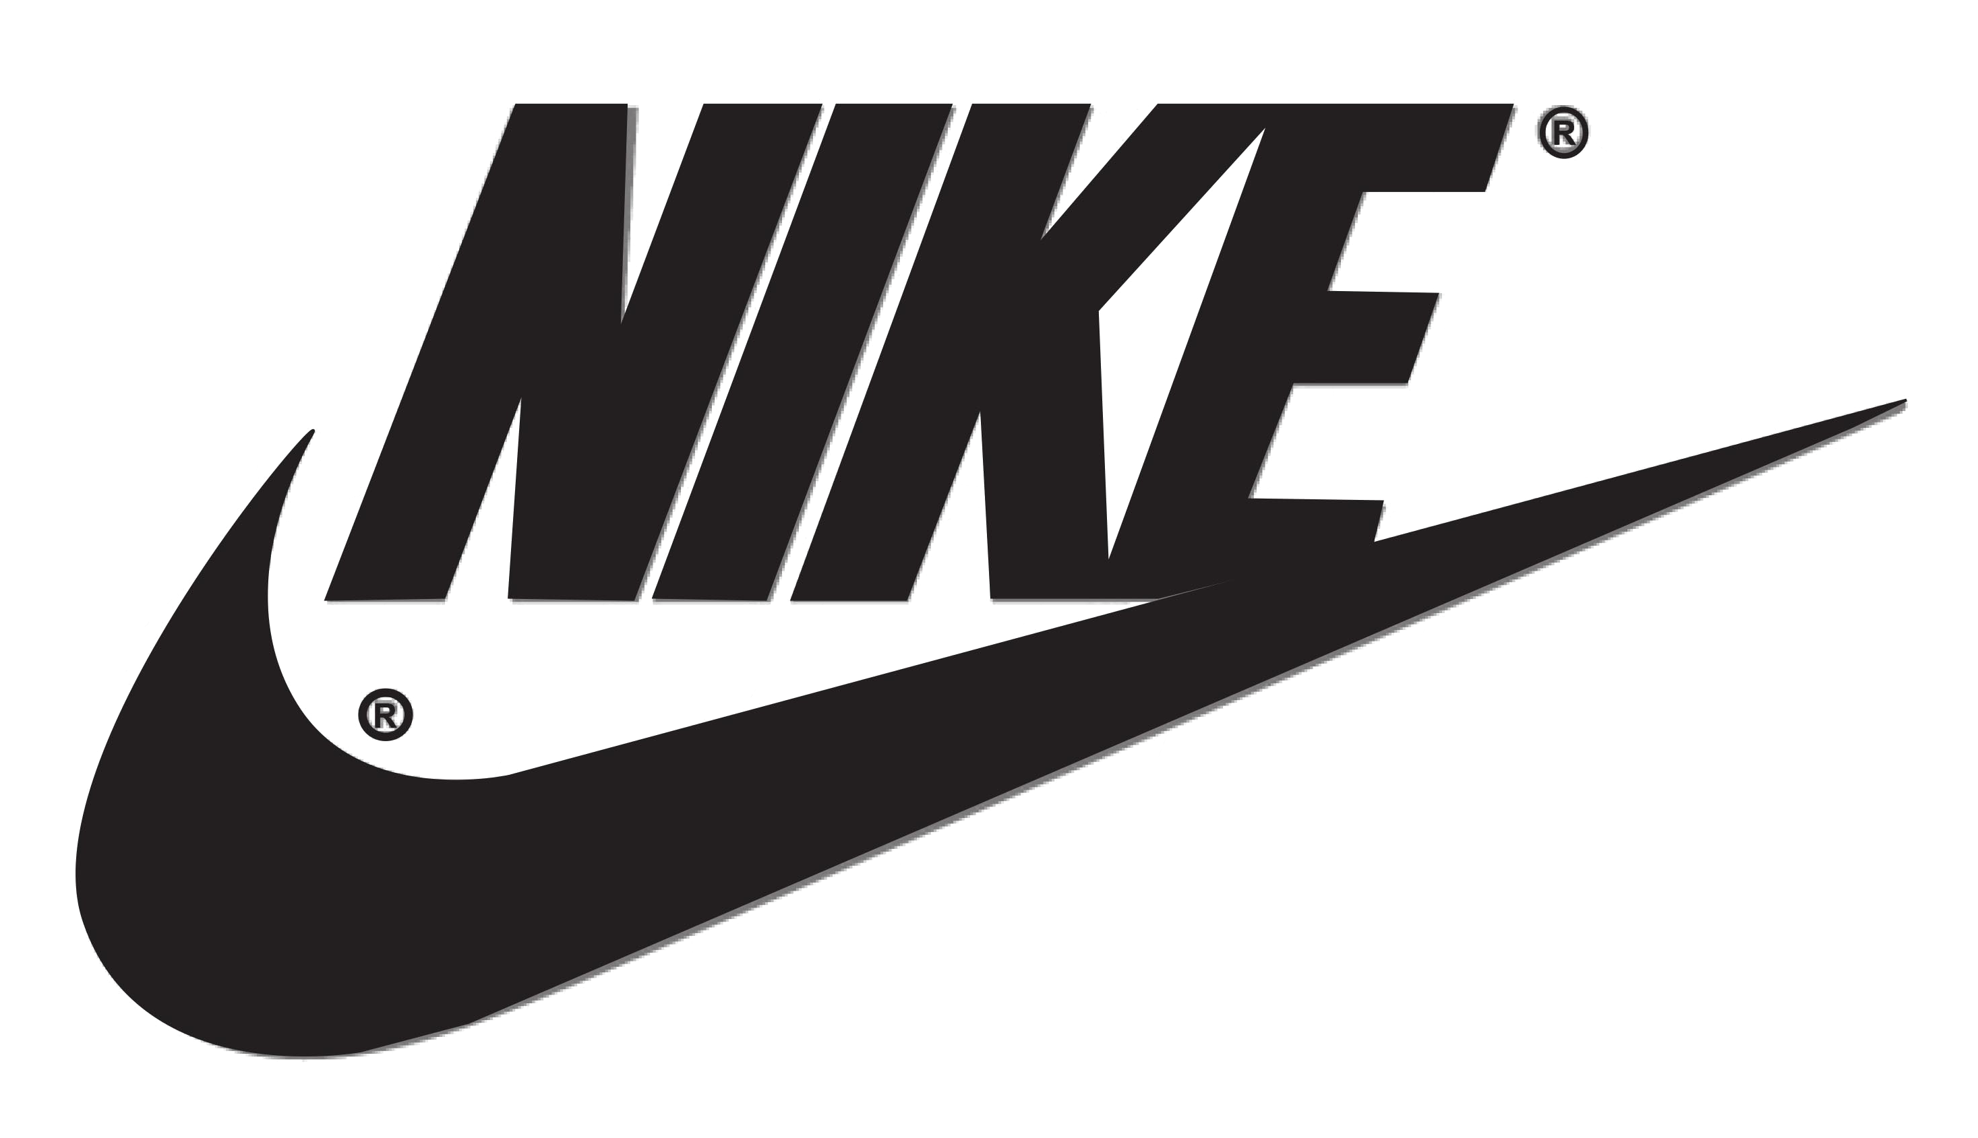
Companies are using the increased focus on ESG to leverage gender smart outcomes
Nike Launches Broad Set of 2025 Sustainability Targets
and ties Exec Comp to ESG Goals
In March 2021, Nike announced the launch of its Purpose 2025 Targets, a broad range of sustainability goals encompassing the company’s environmental, social and governance commitments.
As part of this new initiative, the company will for the first-time link executive compensation to its performance on ESG goals.
Nike set a broad set of targets within its Purpose 2025 Targets including:
Reaching 50% representation of women in the company’s
global corporate workforce;
Reaching 45% representation of women in leadership
positions; and
Ensuring that 100% of facilities in Nike’s extended supply
chain meet the company’s labour, health, safety, and environmental standards.
Source: https://www.esgtoday.com/nike-launches-broad-set-of-2025-sustainability-targets-ties-exec-comp-to-esg-goals/
7 | Promoting gender smart manufacturing through Manufacturing Africa

Slide 8
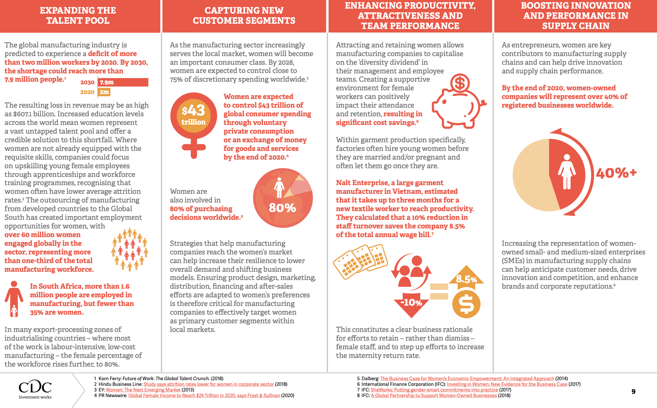
Applying a gender lens to manufacturing operations
Notes:
Stats are helpful but we need to build the evidence base

Slide 9
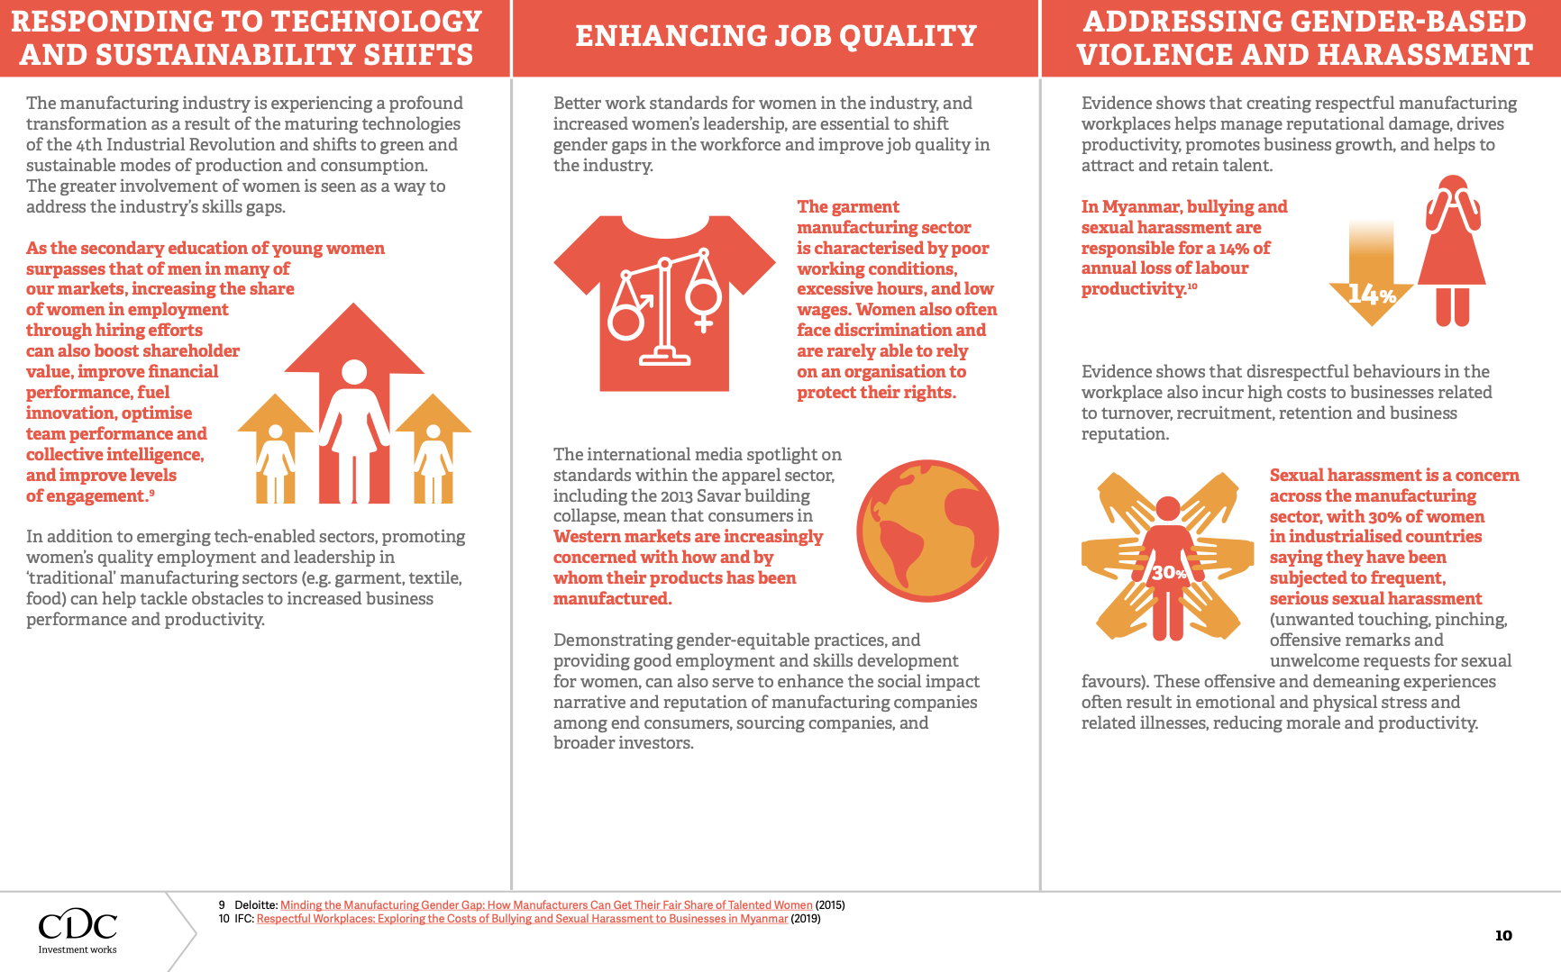
Applying a gender lens to manufacturing operations contd.
Notes:
Stats are helpful but we need to build the evidence base

Slide 10

Gender smart investing makes business sense
  UNLOCK THE OPPORTUNITY
  Apply a gender lens to unlock the multi-trillion-dollar
  economic opportunity that women represent:
    Women have a multiplier effect, by reinvesting their income
    for their families and to grow their businesses
    Estimates show that women control 70-80% of consumer
    spending decisions, estimated at $40 trillion globally
  ACCESS SIGNIFICANT INVESTMENT FUNDS
  Increased access to $3 billion of investment funds committed
  to gender-smart investing by DFIs, as evidenced by:
    The first ever 2X Flagship Fund – the African Development
    Partners III Fund by Development Partners International increases
    the focus on gender for its portfolio companies. The European Investment Bank has invested $50 million in the Fund.
    The Advans Group 2X challenge secured 10M Euro investment
    from FinnFund, committed to improving financial inclusion for
    women with a total percentage of female borrowers of 63%.
  ‘WALK THE TALK’
  Investment funds with gender-balanced senior investment
  teams generated 10 - 20 % higher returns compared with
  funds that are not gender diverse.
    IFC data shows publicly-available investment vehicles
    with a gender lens UP 300% (2015-2019)
    2019 Assets under management +> $3.4 billion
    2018 Assets under management $2.4 billion
ESTIMATES SHOW THAT
WOMEN CONTROL 70-80%
OF CONSUMER SPENDING DECISIONS, ESTIMATED AT
$40 TRILLION GLOBALLY
70-80%
Sources:
https://www.advansgroup.com/en/media/news/advans-signs-a-eur-10-million-long-term-loan-agreement-with-finnfund/
https://www.devex.com/news/q-a-a-case-for-gender-smart-investment-98835.
    Gender-smart-Investing-Guide-for-Fund-Managers.pdf
    https://www.2xchallenge.org/new-blog/2020/11/26/development-solutions-credit-where-its-overdue
Silverstein and Sayre, 2009: The Female Economy, Harvard Business Review
Notes:
Setting the context for Senior Management:
Its important to look at both the firm level and the portfolio level.
Notes on DPI: DPI a leading Pan-African equity group invests in some of Africa’s biggest companies – HomeChoice S. Africa, Food Concepts (Chicken Republic), Nigeria

Slide 11
Gender Smart Operations deliver impressive results
I. ARISE INTEGRATED AND INDUSTRIAL PLATFORMS & ARISE PORTS AND LOGISTICS, GABON
Initiative: Improving a gender-balanced workforce by training women to operate heavy machinery
- a non-traditional role.
Result: The initiative contributed to the increased prioritization of gender issues at ARISE, with the
CEO being appointed as Board Gender and Diversity Representative at its parent company OLAM group, which has since designed its first Gender and Diversity Action Plan.
II. GROFIN INVESTMENT FUND OPERATES IN AFRICA AND THE MIDDLE EAST
Initiative: GroFin Gender Lens Investment Strategy provides $69 million (USD) investments
to 196 women-owned & managed businesses.
Result: GroFin qualifies for the 2X Challenge. To date, 33% direct women jobs sustained and
48% of new investments in 2019 were women-owned businesses.
Sources:
https://www.cdcgroup.com/en/gender-investment/empowering-women-entrepreneurs/
https://assets.cdcgroup.com/wp-content/uploads/2021/03/02112712/Arise-IIP-ComElles-Impact-Report.pdf
https://grofin.com/tag/gender-lens-investment/
Notes:
Note:
GroFin is funded by FMO, NorFund and the Dutch Good Growth Fund.

Slide 12
THE COST OF DISREGARDING
SOCIAL
SAFEGUARDING

Slide 13

Disregarding social safeguarding has costs
Camellia Plc UK settlements
Camellia Plc, owners of subsidiary Eastern Produce Malawi tea estates paid out £2.3 million in February 2021, in response to lawsuits over alleged sexual abuse at the tea estate (without admitting liability).
In 2020, Camellia Plc which is the majority shareholder of Kakuzi Plc Kenya, also paid out £4.6 million to settle sexual harassment and human rights abuse claims at the Kakuzi avocado farms (without admitting liability). Kakuzi Plc is an agricultural cultivation and manufacturing company.
ACTION:
A new EPM Women's Empowerment Initiative introduced to improve the skills, employment opportunities, and educational attainment of women and girls in and around EPM's operations, benefiting the claimants and the wider community.
Kakuzi has introduced gender equality measures such as the recruitment of about 200 new female guards and the promotion of 12 female guards to lead guards.
Kakuzi has established an Independent Human Rights Advisory Committee and set up an Operational-level Grievance Mechanism
Camellia has been reviewing its governance and safeguarding oversight arrangements and is setting up a Safeguarding and Stewardship Committee of Camellia’s Board of Directors.
Camellia is also pushing the Boards of the companies where they invest in to look at their own procedures and make operational changes.
Source: Settlement of claims against Camellia Plc of allegations of serious human rights abuses in Kenya | Leigh Day
Sources: https://www.thetimes.co.uk/article/5799a1d6-8f06-11eb-ab4d-f4c45359834c?shareToken=07b9060b3c0fb782d02b64f5d432845f
https://www.freshplaza.com/article/9293916/uk-firm-pays-ps4-6-million-to-settle-human-rights-abuse-claims-at-kenyan-avocado-farm/
https://www.camellia.plc.uk/2021-more-female-guards-at-kakuzi
https://www.camellia.plc.uk/2020-regulatory-news-announcement-0752
http://www.easternproduce.com/files/eastern-produce/uploads/Settlement-of-claims-in-Malawi.pdf
13 | Promoting gender smart manufacturing through Manufacturing Africa
Notes:
Important note on country context in Kakuzi Kenya:
Kakuzi is a Kenyan agricultural and manufacturing company employing around 3,000 Kenyans and has been trading on the Nairobi Securities Exchange for over 50 years. It is managed by its own board of directors on behalf of its 1,300 shareholders. It will be interesting to see if there have been Due Diligence reviews by Camellia as investor in the 1990s, which may have revealed human rights abuses in the past.
Camellia information on legal & governance online indicates ‘these claims (in Kenya and Malawi) have now been resolved.
NOTE on EPM:
Eastern Produce has agricultural and horticultural operations in Kenya, Malawi and South Africa and is part of Camellia Plc group company. http://www.easternproduce.com/about-us/corporate

Slide 14
Social safeguarding increases productivity
Experience in the garment manufacturing
sector in Cambodia
Workplace sexual harassment in Cambodia costs the
garment sector an estimated $89 million a year due to
staff turnover, absenteeism and presenteeism.
Presenteeism incurred the highest cost of lost productivity, with an estimated 13.5% of workers saying sexual harassment meant they worked less effectively.
Experience in the food processing industry
in the Solomon Islands
Nine of the largest companies in the Solomon Islands
found that bullying and sexual harassment led to absenteeism, low productivity, and reduced concentration which posed increased safety risks.
SolTuna, processing facility worked with IFC to implement initiatives to reduce bullying and sexual harassment.
SolTuna introduced first responder training to handle GBV disclosures, strengthened grievance procedures, and implementation of a workplace policy. This reduced absenteeism from an average of 18% to 15%, which is estimated to have gained $1.58 million USD through increased productivity. SolTuna’s comprehensive approach on gender issues also doubled the jobs for women in higher paying,
non-traditional roles, provided financial literacy training, expanding production and opening new export markets.
$89
million
WORKPLACE SEXUAL HARASSMENT IN CAMBODIA COSTS THE GARMENT SECTOR AN ESTIMATED
$89 MILLION A YEAR
Sources:
CARE Cambodia & Garment Manufacturers Association of Cambodia (GMAC) Report 2016).
https://gendertoolkit.cdcgroup.com/fund-managers-guide-to-gender-smart-investing/
IFC (2019) ‘The Impact of Domestic and Sexual Violence on the Workplace in Solomon Islands’. Washington D.C.: IFC, Australian Aid, New Zealand Foreign Aid and Trade Programme
https://www.ifc.org/wps/wcm/connect/news_ext_content/ifc_external_corporate_site/news+and+events/news/tackling-gender-inequality-solomon-islands
14 | Promoting gender smart manufacturing through Manufacturing Africa
Notes:
Presenteeism refers to the lost productivity that occurs when employees are not fully functioning in the workplace because of an illness, injury, or other condition. Even though the employee may be physically at work, they may not be able to fully perform their duties and are more likely to make mistakes on the job.
https://www.investopedia.com/terms/p/presenteeism.asp
Notes:
Findings from an IFC 2019 study in the Solomon Islands.Furthermore , the ripple effect has extended to 15 of the largest companies which altogether employ 6000 workers, now committed to promoting gender equality. The IFC initiative with the Solomon Islands Chamber of Commerce and Industry, recognizes the many benefits of empowering women. It is supported by the governments of Australia and New Zealand.

Slide 15
Break

Slide 16
Women face barriers to equality
Unconscious bias in the workplace
Business leaders in Africa are predominantly men resulting in few female role-models
and exacerbating issues relating to unconscious bias
Lack of social safeguarding (and appropriate infrastructure) within the workplace and for suppliers within the supply-chain
Limited sourcing from women-owned businesses in the supply chain, many of whom are predominantly in the informal economy and are ill-equipped for formal business trade.
LEADERSHIP
SUPPLY CHAIN
Limiting mind-set among women, who
are reluctant to take risks, network with colleagues, and advocate for their own advancement
Limited career guidance counselling for women limits their understanding of opportunities available to them and prevents them from breaking through the glass ceiling
Lack of sponsorship for women. Women typically have access to mentors for guidance, but lack adequate sponsors who advocate for their promotion, introduce them to key stakeholders, and give them exposure to senior roles.
EMPLOYEES
Products are not designed to target
women as consumers or solve problems
that women experience despite their significant contribution to voluntary consumer spending.
Women face greater barriers in accessing finance than men.
PRODUCTS/
SERVICES
Do no harm, should be a key consideration
by companies to ensure that women in
their local communities are not negatively impacted as they grow / expand / extend
to new communities
COMMUNITY
Source: https://www.mckinsey.com/featured-insights/gender-equality/the-power-of-parity-advancing-womens-equality-in-africa
Notes:
CALL OUT EXERCISE on slide 17 for further discussion beyond the examples cited on this slide 16
Senior women interviewed for the McKinsey Advancing women’s equality in Africa report (2019) highlighted five main barriers to gender equality in the formal workplace:
LEADERSHIP / EMPLOYEES - Lack of sponsorship for women. Women typically have access to mentors for guidance but lack adequate sponsors who advocate for their promotion, introduce them to key stakeholders, and give them exposure to senior roles.
- Lack of investment in skills building for women
Lack of role models / negative perceptions
EMPLOYEES - Unconscious bias in the workplace. Business leaders in Africa are typically mostly men. Although there has been progress on getting women into the top echelons of business, the fact remains that only about 6 percent of CEOs and 22 percent of executive committee members are women and about 25 percent of board members are female. Having few women decision makers entrenches bias that shows up in the way women are compensated, rewarded, spoken to, and treated in their workplace.
- Unhelpful workplaces. A significant number of workplaces do not account for needs that are specific to women by, for instance, providing flexible working arrangements and spaces for nursing mothers. They are typically more attuned to male needs because the culture expects men to be the primary workers. Interviewees highlighted today’s “anytime, anywhere” performance model, which penalises women carrying the double burden more than men.
- Unequal pay
- Sexual harassment
- Transportation / access
- basic infrastructure
- Policy enforcement
- Accessibility for PWDs
SUPPLY CHAIN – Combination of many factors but also…. Lack of access to finance, lack of access to entrepreneurship skills, lack of access to information on opportunities, lack of time (unpaid care work), perceptions around roles of women, male dominated sectors
PRODUCTS / SERVICES – not accessible to women (especially tech), not helpful to roles of women, HH decision-making
COMMUNITY - Societal and cultural expectations. In many African countries—and many countries around the world—the assumption that women are largely responsible for caring for children and the elderly, and household chores is widespread. Such attitudes are entrenched from childhood.
- Do no harm
CROSS-CUTTING - Limiting mind-set among women. Some women limit their own prospects, being reluctant to take risks, network with colleagues, and advocate for their own advancement.

Slide 17
How companies address barriers to gender equality:
LEADERSHIP
EMPLOYEES
SUPPLY CHAIN
PRODUCTS/
SERVICES
COMMUNITY
17 | Promoting gender smart manufacturing through Manufacturing Africa
Notes:
Call-out Activity slide to be completed with Jamboard exercise with participants

Slide 18
There are practical solutions to address barriers
GENDER-SMART
INVESTMENT STRATEGIES
Evidence shows that gender-smart investment strategies can help grow a company’s competitiveness, solidify its supply base, improve its human capital, and help build an overall enabling business environment. The five gender-smart investment strategies that drive gender equality are as follows:
Women represented
in leadership
Gender-diverse and
equitable workforce
Gender-inclusive value chain
Product or services that consider the distinct needs of women as a consumer agent.
Operations do no harm to women in the community.
Case Study: Food Concepts PLC Nigeria (Chicken Republic, Nigeria) received investment & support from Development Partners International to undertake the following solutions:
Launch of a Gender Strategy & Action Plan in 2019
Introduction of a Gender Equality Policy
Provision of training investments in women for advancement
& professional growth
Increasing the number of women in leadership roles; which
is strategically important to help the company make decisions
to strengthen commercial viability
Achieving a team composition of 51% female and 49% male
Providing products and services to meet womens needs, given that research shows 80% of consumer product buying decisions are made by women
The European Investment Bank is an investor in the DPI African Development Partners III fund, the first-ever 2X Flagship fund.
Sources:
http://foodconceptsplc.com/DPI 2X Challenge funding
https://www.eib.org/en/videos/2x-challenge-financing-for-women-initiative-food-concepts-plc#
18 | Promoting gender smart manufacturing through Manufacturing Africa
Notes:
https://assets.cdcgroup.com/wp-content/uploads/2020/11/17181326/Summary-page_Gender-smart-Investing-Guide-for-Fund-Managers_correct.pdf

Slide 19
THE IMPORTANCE
OF GESI
DUE DILIGENCE

Slide 20
GESI due diligence considerations
Does the organisation have any written Safeguarding Policies such as anti-labour exploitation, anti-human trafficking and
anti-harassment policy in place?
Does the organisation have any written
policy on Diversity or Equal Opportunities
in employment, training and/or promotion
in place?
Does the organisation have a Whistleblowing Policy and Procedure in place?
Does ​the organization have a mechanism/committee to address grievances?
Does ​the organization have any gender
and social inclusion-related schemes, programmes or targets?
Does the organisation have an identified staff responsible to implement, monitor and report on progress related to the schemes, programmes or targets listed?
✓
20 | Promoting gender smart manufacturing through Manufacturing Africa

Slide 21
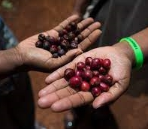
CASE STUDY: PROJECT COFFEE OVERVIEW
Business model: Farmer Ownership Model (FOM), which enables farmers to take ownership of their coffee within the coffee value chain and earn 2.5x or more than they would by selling their coffee through the traditional middleman model
Most coffee in Uganda is grown by 1.7mm households - 73% of the population
over 10 years of age is directly employed in agriculture (83% of all women and
71% of all men)
The Uganda Coffee farming community loses at least $2Bn annually as a result of selling unprocessed coffee
Customer base is severely underserved by the Farmer Ownership Model (FOM), due to lack of a smallholder financing mechanism to fund advance payments to farmers. As a result, only 1% of PROJECT COFFEE members currently benefit from the FOM
Solution: to provide advance payments (60%) to farmers against delivery of coffee so that they are able to meet their immediate needs while their coffee is processed and marketed directly to international buyers
PROJECT COFFEE is looking to raise $10mm mainly for smallholder financing and capex to
    …to activate and serve more of their members by offering them advance payments
    …capex will be used to expand its processing capacity to meet the resulting increase in demand
COFFEE Project recognises GESI as critical to defining who and what they are in achieving their purpose. This includes ensuring the meaningful representation and participation of women, youth and marginalized groups at all levels of the coffee supply chain as well as across the organisation.
21 | Promoting gender smart manufacturing through Manufacturing Africa
Notes:
What do we learn about women from this?

Slide 22
How the Coffee Project responded to the
GESI due diligence responses:
Does your organisation have any written Safeguarding Policies such as anti-labour exploitation, anti-human trafficking and
anti-harassment policy in place?
✓ HR policy
Does your organisation have any written policy
on Diversity or Equal Opportunities in employment, training and/or promotion in place?
✓ HR policy
Does your organisation have a Whistleblowing
Policy and Procedure in place?
✓ Terms of reference (Extract from HR policy)
Does ​your organization have a mechanism
/committee to address grievances related to
✓ Terms of reference (Extract from HR policy)
Does ​your organization have any gender and social inclusion-related schemes, programmes or targets?
✓ Organisational gender planning, mainstreaming and monitoring guidelines (very detailed but out of date)
✓ Sex-disaggregated KPIs
Does your organisation have an identified staff responsible to implement, monitor and report
on progress related to the schemes, programmes
or targets listed?
✓ Gender Based Business Development Officer
  What else do we know about gender
  from these excerpts from the investment committee application?
  What don’t we know?
  And what can be improved?
22 | Promoting gender smart manufacturing through Manufacturing Africa
Notes:
Add comments on other areas highlighted in proposal
E.g. management / employees, targeted activities etc

Slide 23
GESI Needs Assessment and Gap Analysis Report
A GESI Needs Assessment to develop a GESI Action Plan in collaboration with senior management that includes both short and long term GESI mainstreaming entry points, related MA and other resourcing required and a long list of potential funding/implementation partners.
The GESI Action Plan will be developed keeping gender lens investors and their requirements in mind so that they can reach a wider set of impact investors e.g.,
DFIs and other signatories to the 2X Challenge.
Gender Lens Investing: The company needs help articulating their mission to address gender issues and how their services will substantially improve the lives of women
23 | Promoting gender smart manufacturing through Manufacturing Africa
Notes:
Add comments on other areas highlighted in proposal
E.g. management / employees, targeted activities etc

Slide 24
GENDER SMART INVESTMENT
IN PRACTICE

Slide 25
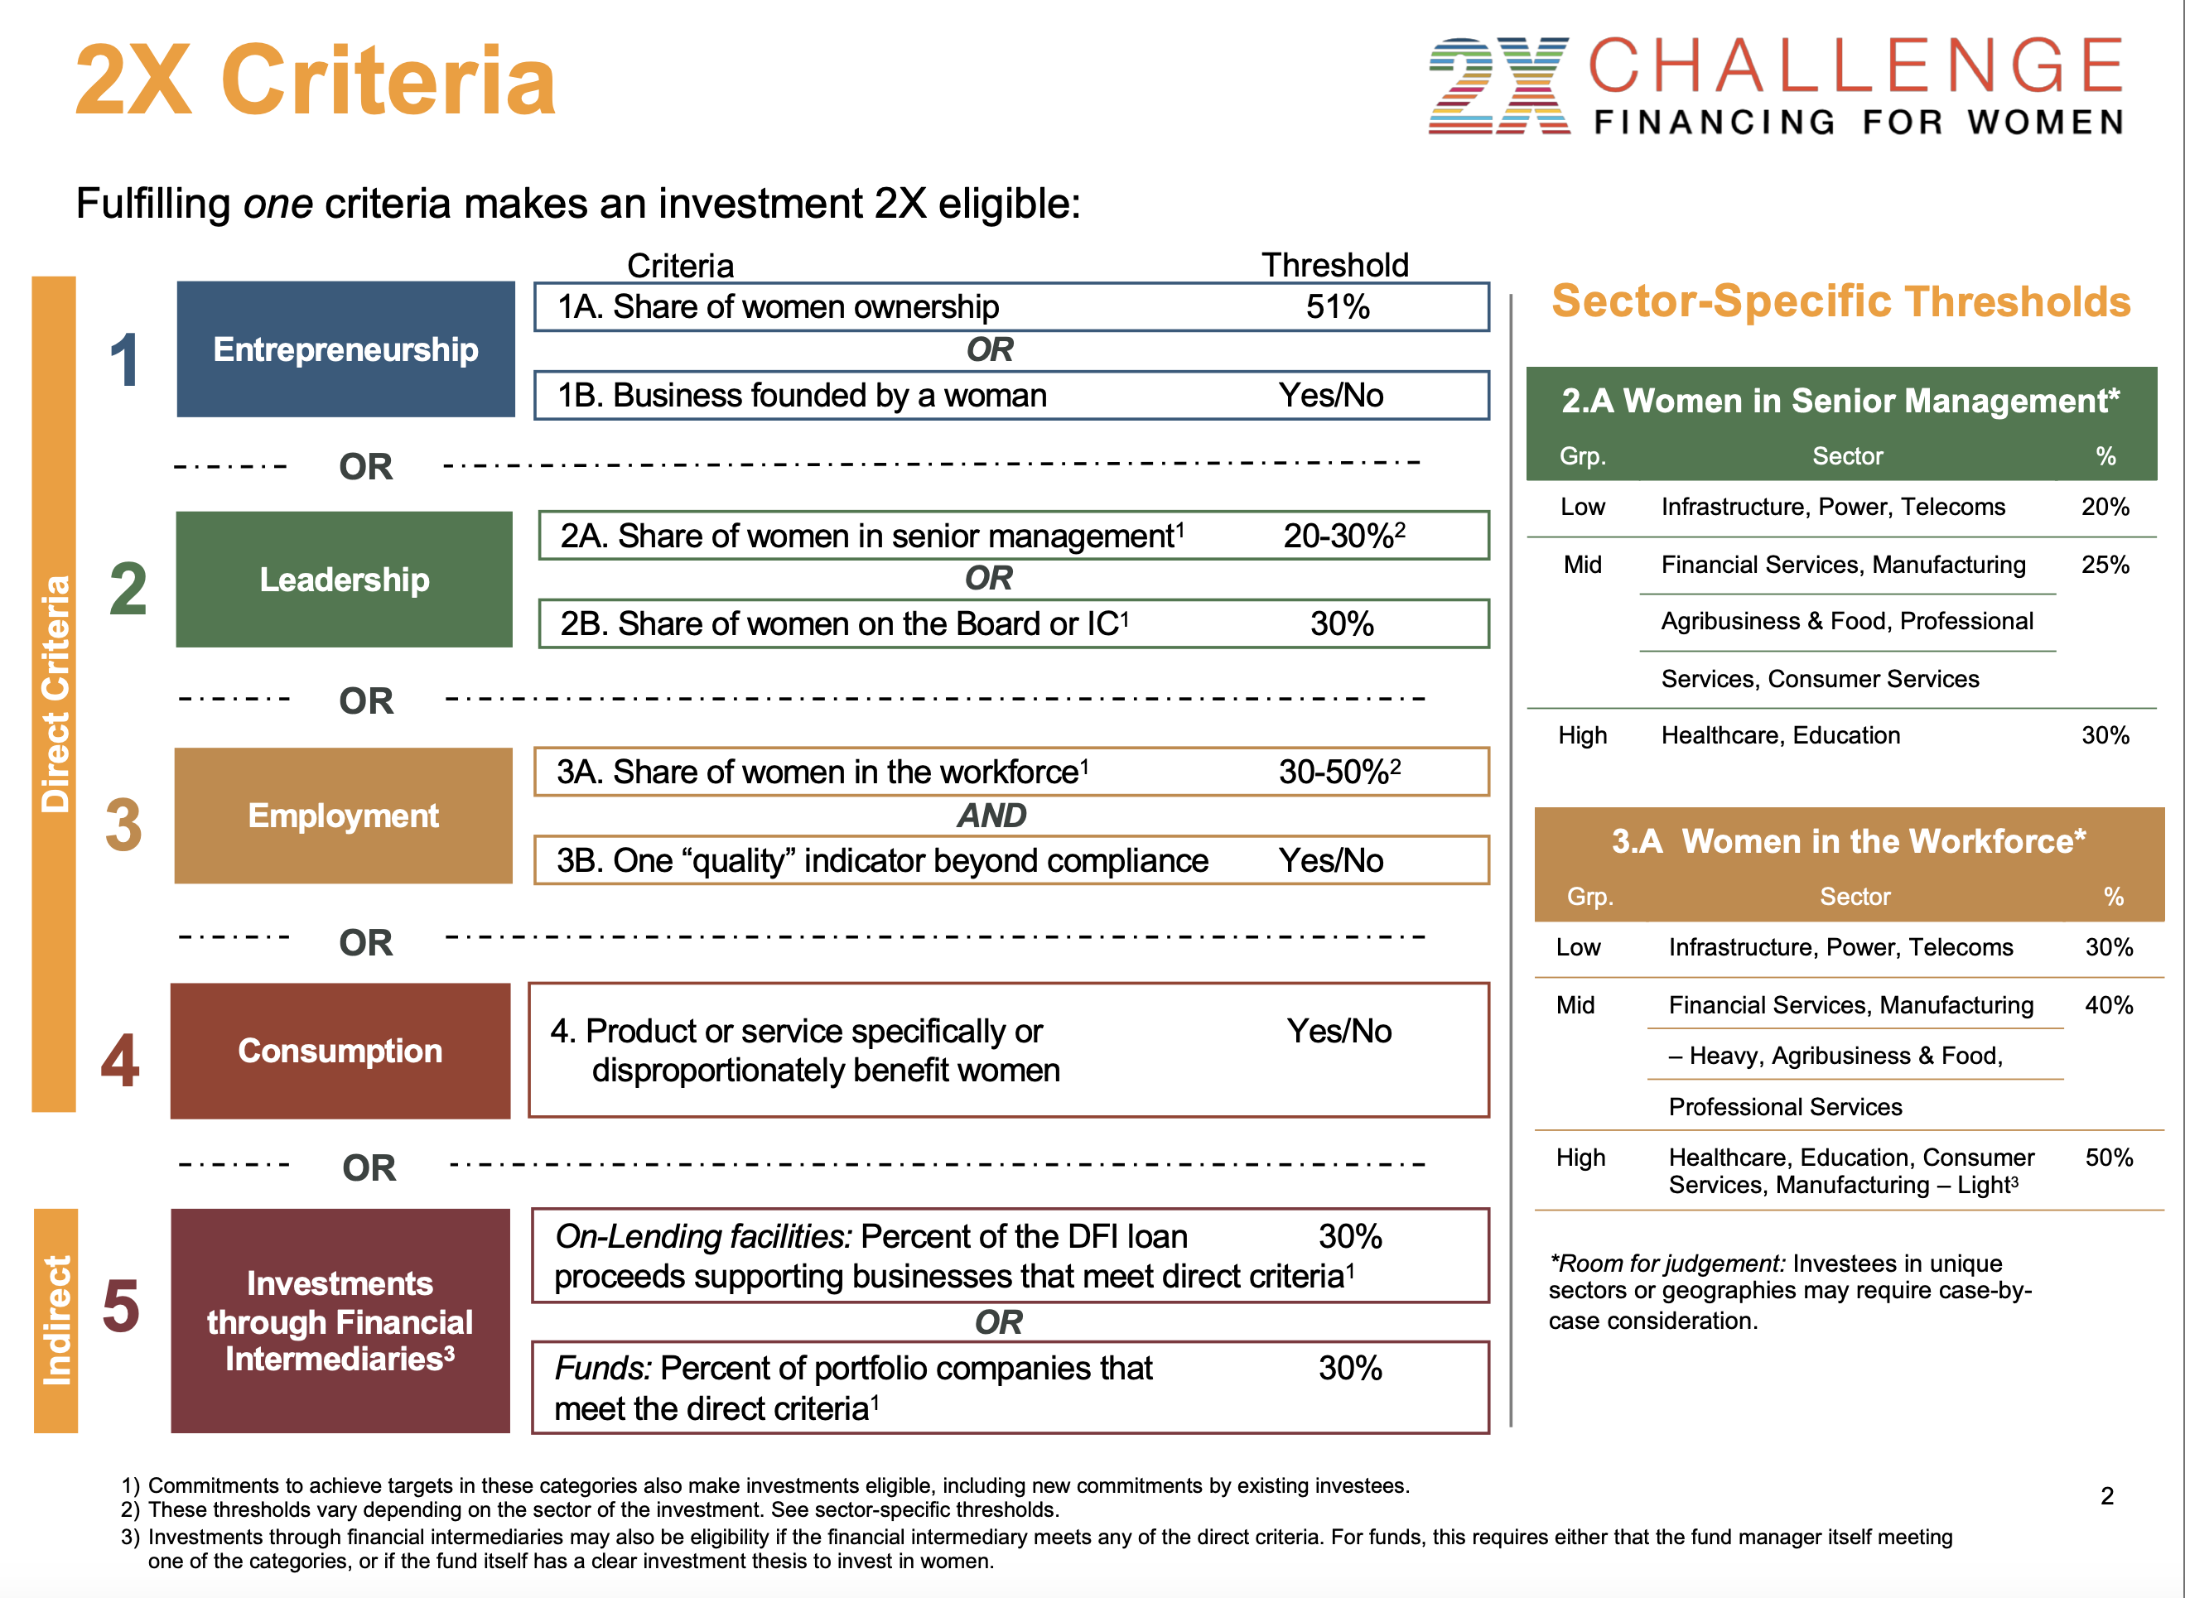
25 | Promoting gender smart manufacturing through Manufacturing Africa
Notes:
17 DFIs have signed up

Slide 26
Case study of investment using 2X criteria
Case Study: General Partner, Development Partners International, a leading
pan-African PE/VC firm managing over $1.7 billion of assets across 3 PE funds.
DPI applies a gender lens investing strategy at both the firm and portfolio level, with gender as one of 3 main areas for its Impact & Environmental, Social, and Corporate Governance (ESG) agenda
At the firm level
  The Equality and Diversity Policy clearly identifies EEO measures, the zero-tolerance policy on discrimination and harassment, career advancement principles, monitoring of the policy and collective responsibility by all staff
  Gender-balanced teams: over 45% of the team is represented by women
At the portfolio level
  DPI investments in 21 companies, employ 40,000 people, across 29 countries
  All investments employ a proprietary corporate governance toolkit with gender practices, which has been highlighted in the Private Equity International Responsible Investment Report 2021
OVER 45%
OF THE TEAM
IS REPRESENTED
BY WOMEN
21 COMPANIES
EMPLOY 40,000 PEOPLE ACROSS 29 COUNTRIES
Sources:
https://www.dpi-llp.com/
https://www.dpi-llp.com/equality-and-diversity-policy/
https://lnkd.in/gHsD_Hm
26 | Promoting gender smart manufacturing through Manufacturing Africa
Notes:
PEI Responsible Investment Feb 2021
A corporate governance toolkit: Development Partners International
The challenge: Building good governance is a complicated task for managers operating across borders in markets where practices and regulations can differ vastly.
The approach: The African investor has tackled this challenge head on by devising a proprietary corporate governance toolkit that can be applied across its portfolio to improve board culture and behaviour, controls and processes, disclosure and transparency, and share/stakeholder practices. Including terms, templates and diagnostic questions, the toolkit offers a standardised and repeatable means to boost good governance, and is a basis for ongoing appraisal.
DPI says: “The toolkit allows LPs to follow a standardised format to corporate governance for existing and new portfolios, regardless of their territory or corporate governance system.”
PEI highlights this as - A practical approach to a difficult issue.

Slide 27
Gender smart investing in practice
Alitheia Identity Fund is a woman-led investment fund that advances gender equity and economic growth, seeded with $12.5M from the African Development Bank. The fund has raised $72M in 2019. They identified a gap in the financial market where African women represent the highest rate of female entrepreneurship at 25.9%, yet they faced a funding gap across business value chains estimated at $42 Billion (2018)
Alitheia is a value-add investor, providing financing, facilitating access to networks, mentorship, and markets for its investments in SMEs operating
in sectors with a significant percentage of women business owners and employees. Investments which validate high multiplier effects for women’s economic gain include:
Reelfruit, Nigeria which began in 2012, is a woman-owned manufacturer of health snacks, with 100% women managers and 64% women employees. Today the product is sold in over 350 stores nationwide, with 11 products and exports to 4 international markets. In February 2021 the company finalized its series A fundraising round, with institutional funding of $2 million.
AV Light Steel, South Africa which began in 2013 is a leading female
owned manufacturer of lightweight steel for innovative building systems construction and energy efficient building products. Today the company employs 100 people and exports to 9 SADC countries.
FinDev Canada's investment in AIF qualifies under the
2X Challenge Criteria.
Sources:
Alitheia and FinDev Canada
https://www.crunchbase.com/organization/alitheia-idf/investor_financials
Global Entrepreneurship Monitor (GEM) 2016/17 Women’s Report(link is external)
https://www.howwemadeitinafrica.com/an-uphill-battle-entrepreneur-explains-how-she-built-a-dried-fruit-snacks-brand-in-nigeria/97848/
https://www.news24.com/citypress/business/how-trailblazer-lebogang-zulu-is-changing-the-construction-industry-20190906
https://avlightsteel.co.za/products.html
Notes:
Because women are the backbone of the African economy. The African continent has the highest percentage of women entrepreneurs in the world. According to the Global Entrepreneurship Monitor (GEM) 2016/17 Women’s Report(link is external), the female entrepreneurship rate in sub-Saharan Africa is 25.9% of the female adult population, meaning that one in four women starts or manages a business.
Because women typically reinvest up to 90% of their income in the education, health and nutrition of their family and community - compared to up to 40% for men. This means that investing in women’s businesses can transform societies.
Because women entrepreneurs face multiple challenges to access finance, with an estimated $42 billion financing gap for African women across business value chains. The challenges include:
Finance: lending to women is seen as riskier, so they face prohibitive interest rates. In addition, women often lack traditional collateral and guarantees.
Capacity: financial institutions lack the capacity to understand and respond appropriately to women entrepreneurs, who also often lack the financial and business acumen to respond to the needs of financial institutions.
Business environment: in many countries, legal and regulatory frameworks hinder women’s full participation in private sector growth.

Slide 28
Break

Slide 29
ROLE OF GESI
IN MANUFACTURING AFRICA

Slide 30



The MA framework for Gender,
Economic & Social Inclusion
Interventions that address basic needs and vulnerabilities of women and marginalised groups
Interventions that build assets, capabilities and opportunities for women and marginalised groups
Interventions that address unequal
power relations and seek institutional
and societal change
Minimum compliance
Empowerment
Transformation
  Anti-sexual exploitation, abuse and harassment policies
  Whistleblowing process
  Workplace safety including safe
  lighting, transport
  Mapping of and safe conditions across the supply chain
  Equal Employment Conditions (wage, leave, benefits, etc.)
  Equal Access to training and promotion opportunities for women & excluded groups
  Flexible working policies
  Workplace facilities
  Supply Chain (Gender-inclusive sourcing & procurement)
  Mentorship/coaching programmes
  for women in decision making roles/senior management
  Engaging women in non-traditional
  roles in heavy manufacturing sectors
  Disrupting supply chains to achieve inclusion
30 | Promoting gender smart manufacturing through Manufacturing Africa

Slide 31
Gender and inclusion within MA’s Coffee project:
Pillars | Recommendations
Minimum Compliance: interventions that address basic needs and vulnerabilities of women and marginalised groups | Review and revise the HR policy handbook in conformity with statutory obligations and sector related good practices. Roll out and conduct tailored trainings for senior management and staff on the: Anti-Sexual Exploitation and Abuse Policy Whistleblowing Policy | Develop a GESI policy that conforms to national laws and establishes organisational mechanisms and practices to promote social safeguarding, gender quality and diversity that will provide a framework for decision-making and implementation of pro-GESI programmes.
Empowerment: interventions that build assets, capabilities and opportunities for women and marginalised groups | Enforce the affirmative action of 30% women representation in the leadership of farmer associations as stipulated in COFFEE COMPANY’s memorandum of understanding. GESI Policy that will involve and engage women to design and implement the longer-term GESI strategy that will promote and provide for equal opportunities. Access to financial support to promote the Farmer Ownership Model (FOM) in order to raise corporation fund for COFFEE COMPANY and to promote the MBO based model.
Transformation: Interventions that address unequal power relations and seek institutional and societal change | Design or develop formal structures that recognise and overcome women contribution to the COFFEE COMPANY supply chain despite not being titled landowners. Develop and implement a board governance manual. Women farmers are either encouraged and/or facilitated to have an equity shares in the company. GESI strategy to promote youth and women micro-enterprise development, introduction of both financial and non-financial incentives for mainstreaming GESI in supply chains. Revise board structure to reflect women board representation at 51%. Incorporate more women in the management and leadership teams.
31 | Promoting gender smart manufacturing through Manufacturing Africa
Notes:
Add comments on other areas highlighted in proposal
E.g. management / employees, targeted activities etc

Slide 32



Applying the framework: group exercise
Interventions that address basic needs and vulnerabilities of women and marginalised groups
Interventions that build assets, capabilities and opportunities for women and marginalised groups
Interventions that address
unequal power relations and seek institutional and societal change
LEADERSHIP
Minimum compliance
Empowerment
Transformation
EMPLOYEES
In two breakout groups, identify potential interventions for each level of the framework that would impact leadership, workplace operations and the supply-chain
SUPPLY CHAIN
32 | Promoting gender smart manufacturing through Manufacturing Africa
Notes:
■ Outreach visits and programmes in conjunction with schools and other educational establishments, to showcase the variety of careers in the sector
■ Tackling unconscious bias (stereotyping characteristics, roles and abilities of women and men, or unconsciously mirror-imaging in the recruitment or progression pipeline whereby candidates who display similar behaviours and skill sets to the interviewer or superiors are more likely to be chosen for a vacancy), with bespoke training for leadership teams, line managers and recruiting managers across the business
■ Targeted recruitment campaigns and working with expert diversity and inclusion focused bodies, to get guidance on how to improve recruitment and workplace culture
■ Reverse mentoring, also called reciprocal mentoring, involves the pairing of a senior person with a junior person of a different gender. This is a way of creating visibility of talent internally to top executives, as well as breaking down unconscious bias. The mentor/mentee meet regularly, each learning from the other.
■ “Returnships” to access a talent pool of high-calibre women who want to return to their profession following an extended break. Provision of additional training and support, which helps them to get up to speed, supported by coaching and mentoring, with the possibility of a permanent role at the end of the period.
■ Supporting ‘Women in Business’ events to drive positive change across the company, attract talented women into the industry and help them progress up the career ladder
■ Recruiting men at all levels to become allies and gender champions
■ Holding conferences and other events to celebrate and inspire women in the business and in industry more widely
■ Actively promote and encourage women to enter awards to overcome the perceived barriers to career progression.
■ Embed equality into company culture, via Code of Conduct and Values – and providing a mechanism of reporting any cases where these are not adhered to through helplines
■ Developing mentoring programmes matching senior management mentors to more junior employees to support their development.
■ Ensuring respect for the needs of female colleagues, for example, ensuring that there are female Personal Protective Equipment (PPE) options, female appropriate facilities, childcare arrangements etc.
■ Financial literacy and financial management training for employees around savings, and other financial matters
■ Procurement processes that require sourcing from women-led businesses or enterprises with GESI measures in place
■ Appropriate security and safeguarding measures within the workplace
■ GESI considerations clearly embedded within the business plan (throughout the value-chain)
Socio-cultural norms / perceptions
Burden of unpaid care work
Safety and security concerns
Transportation challenges
Childcare
Limited control over finances
Perceptions and control of male members of HH
Role in D-M at HH level
Role in D-M within the workplace
Accessible facilities
Enabling environment
Employment laws (e.g. equal pay, safeguarding)

Slide 33
SO WHAT?

Slide 34
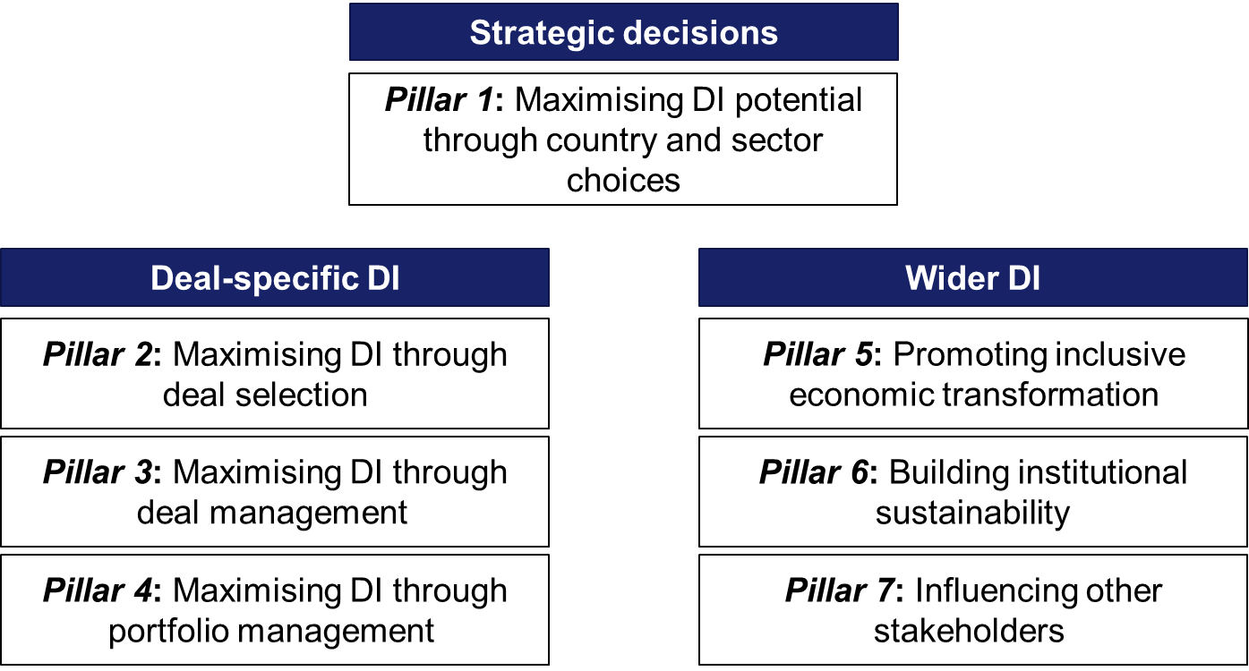
Development impact is mainstreamed across all programme targets and is a key focus of the Manufacturing Africa (MA) programme
7 pillar development impact strategy for MA
Mainstreaming DI
    MA is incentivized to maximise DI through 11 weighted Payment by Result (PbR) measures
    Mainstreaming Gender, Economic & Social Inclusion (GESI) is an essential component of MA’s Development Impact Strategy
    GESI is explicitly recognised through 5 of the 11 PbR measures including:
          Gender positive impact
          Use of local supply chain and
          Other economic and social impacts
          Consumer goods for poor
          Direct job creation

Slide 35
Mainstreaming GESI is everyone’s business involved in the delivery of Manufacturing Africa
It starts with you - becoming champions!

Slide 36
What does “mainstreaming GESI is everyone’s business” involved in the delivery of MA mean for you?
Enhanced screening of deals and TA applications to ensure “do no harm”
Requirement to develop GESI social safeguarding policies where not present – but this won’t affect deals’ budget
Availability of GESI team to consult on GESI matters for TF deals and TA – please consult early!
GESI team also a part of IC submission approval (alongside TF Portfolio Lead and M&E team)
Potential to improve Additionality and maximise Development Impact by going beyond “do no harm” and providing GESI focused support within MA’s wider TF or TA support
Transaction Facilitation (TF) | Technical Assistance (TA)
The current DD process in use by MA has been expanded to include additional social safeguarding risk related questions as part of MA’s overall risk assessment. Based upon the answers from the MA client company, GeSI related TA support will be provided by MA’s GESI budget through a national GESI expert. | Joint review of each TA ToR on a case by case basis with the GESI Lead to ensure that GESI mainstreaming is appropriately addressed through periodic “check-ins” and budgeted for

Slide 37
Key Aspects of GESI Mainstreaming in MA
100% minimum compliance screening to ensure social safeguarding & “do no harm”
Going beyond, the GESI Team works with MA’s TF/TA technical teams to identify GESI entry points, where the key role of the GESI Lead is to ask the right questions to the technical delivery team, resulting in:
  Effective mainstreaming measures identified by MA’s TF/TA technical delivery teams themselves, to maximise development impact and increase additionality
  Greater buy-in and ownership from MA’s TF/TA technical delivery teams to GESI mainstreaming
  A move away from a “siloed” approach to one where every TF/TA delivery lead is a GESI champion, at least for their own, specific transactions or TA studies
  Launch of MA’s “GESI offer flyer” today

Slide 38
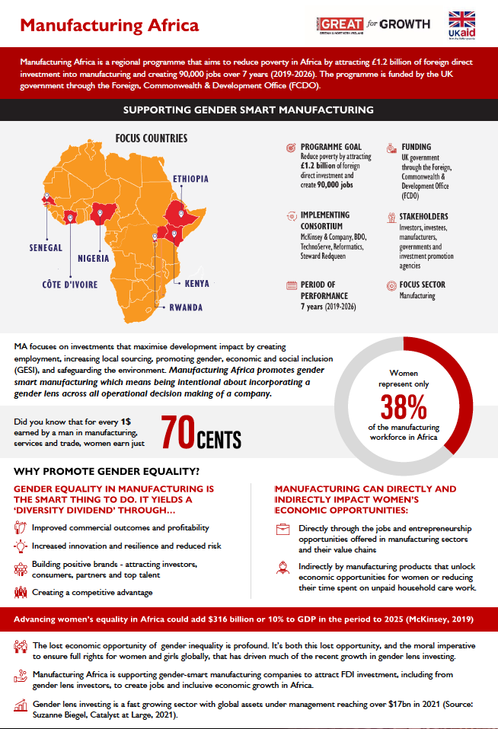
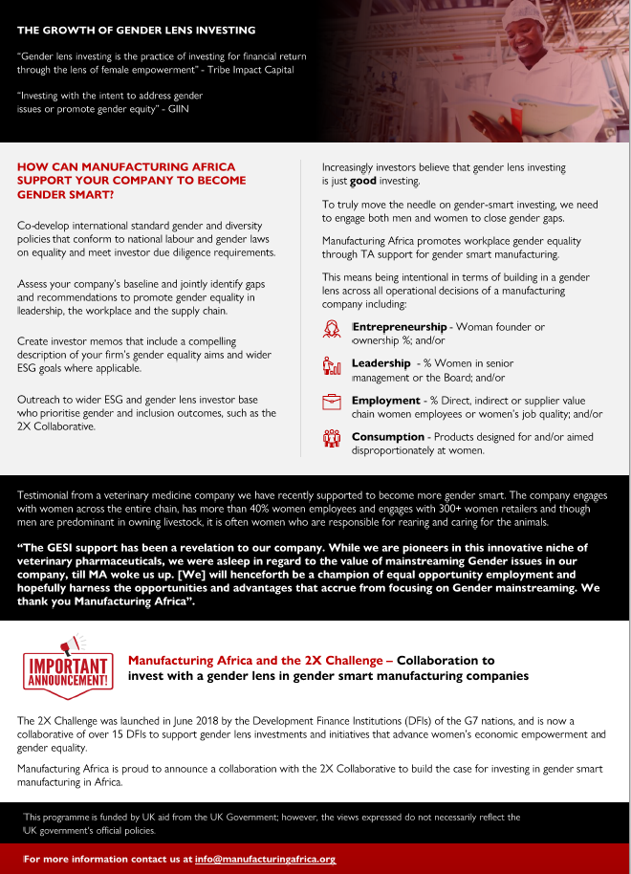

Slide 39
“This document is an output from a project funded by UK aid from the UK government. However, the views expressed and information contained in it are not necessarily those of or endorsed by the UK government who can accept no responsibility
for such views or information or for any reliance placed on them.
This publication has been prepared for general guidance on matter of interest only, and does not constitute professional advice. The information contained in this publication should not be acted upon without obtaining specific professional advice. No representation or warranty (express or implied) is given as to the accuracy or completeness of the information contained in
this publication, and, to the extent permitted by law, no organisation or person involved in producing this document accepts
or assumes any liability, responsibility or duty of care for any consequences of anyone acting, or refraining to act, in reliance
on the information contained in this publication or for any decision based on it.”

