Slide 1
Designing and Building Your Prevent Risk Assessment

Slide 2
Risk assessment
These slides are to support staff within RHEBs with responsibility for Prevent risk assessments and action plan. The advice covers:
what does a Prevent risk assessment and action plan achieve and what should be covered?
process and ownership
how to develop a Prevent risk assessment and action plan
sources of information and intelligence
components of a good risk assessment

Slide 3
What should a Prevent risk assessment look like?
There is no prescriptive format or style for a Prevent risk assessment or action plan & institutions have the flexibility to utilise existing corporate models or devise one to suit their own needs.
It is acceptable and often useful to combine the Prevent risk assessment with the action plan.
However, it should:
reflect the specifics of your institution and not obviously be a generic document
clearly identify when it was last updated, reviewed, authorship and importantly executive oversight and ownership
demonstrate how risks have been identified and level of risk determined
be part of a cycle not a one off event

Slide 4
What areas should your Prevent risk assessment cover?
The Prevent Statutory Guidance is a good starting point for this and outlines a number of areas that should be given consideration.
The Statutory Guidance is not intended to be prescriptive in its application and institutions are urged to consider it in a manner that is proportionate to risk and personal to their institution.
The higher education guidance covers:
risk Assessment
Prevent action plan
Partnership
staff training
welfare & pastoral care
safety online
speakers & events

Slide 5
Process and ownership
It is good practice to establish a cycle of review and refresh for risk assessments and action plans. Whilst no formal timeline for this exists it is suggested that reviews should be linked to publishing of CTLPs* and risk briefings
Operational responsibility and executive ownership should be clearly defined
Published (and adhered to) reporting timetables should be established to allow accountability and transparency
Internal forums (existing or Prevent specific) to manage oversight and reporting and to provide transparency
Consultation amongst students, staff, external stakeholders and communities should be a key strand of annual process
OfS submission timelines
Once you have the risk assessment and action plan in place it is important you use them and regularly update them

Slide 6
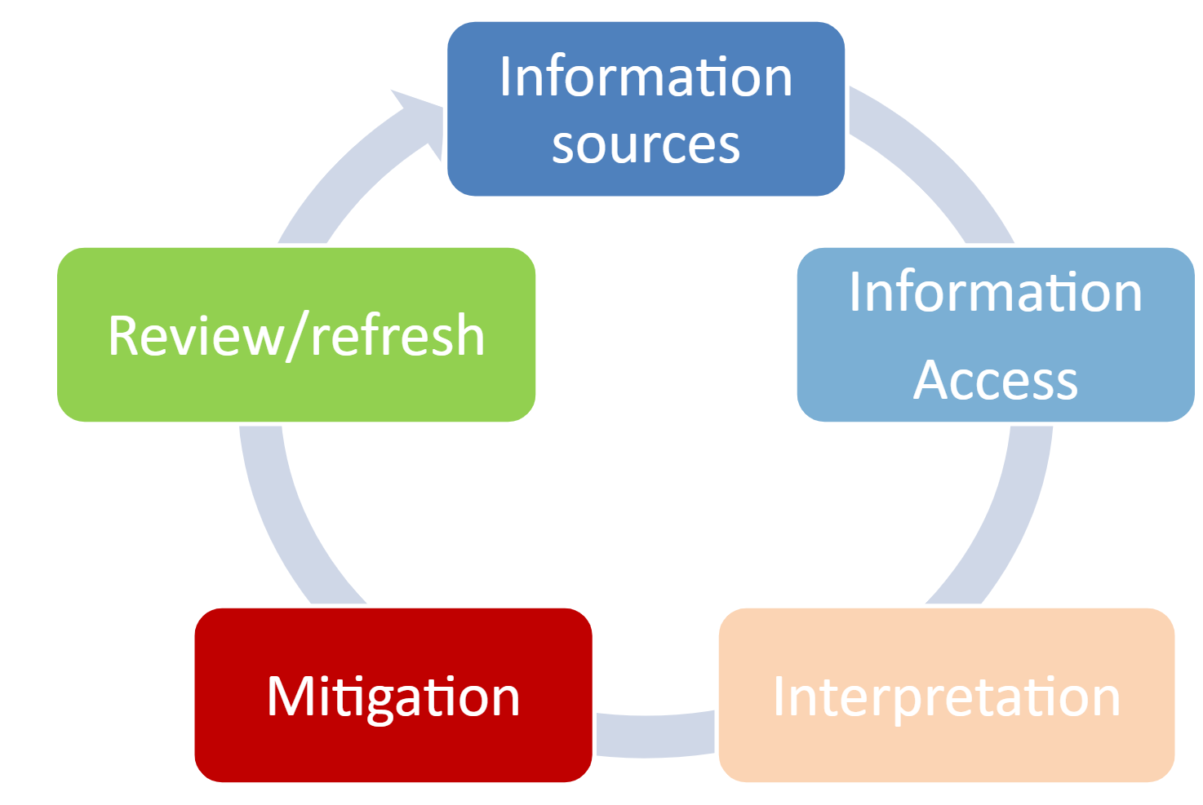
Risk assessment cycle
Notes:
A process chart demonstrating that risk assessment is not a one off activity but needs to a cyclical process repeated over time.

Slide 7
Risk and the organisation
Planning and management of risks and their impacts requires cross-department and trans-organisational planning and consultation.
Linking between management and planning efforts.
Prevent risk planning cannot be conducted in isolation.
Considering the organisation’s needs, context and the need to maintain it’s normal functions (a proportionate response)
External and internal forces, security and information management, human capital and training, risk management strategy, culture, demographics and organisational “character”
Prevent management and planning must ensure and include consultation with internal and external stakeholders.
No one-size “tick-box answer” - every organisation is unique!

Slide 8
Risk assessment and action planning model
Notes:
A hierarchical chart explaining the different tiers of information to build a Prevent risk assessment

Slide 9
Risk assessment information sources
Risk assessments must be based on a broad range of information and intelligence to ensure all potential risks are identified and understood in the context of your institution and it’s community
This might include consideration of differing risks on different campuses/sites and risks to specific communities, groups or events
Remember the Prevent Statutory Guidance states that your risk assessment is expected to:
“assess where & how students might be at risk of being drawn into terrorism …. campus and student welfare, including equality and diversity and the safety and welfare of students and staff …. assess the physical management of the university estate” (Paragraph 19, Prevent statutory guidance for higher education)

Slide 10
Sources of information and intelligence: high-level sources
Police Counter-Terrorism Local Profiles (CTLP)
Published partnership intelligence reports
OfS Prevent Review feedback and sector good practice sharing
Other sector intelligence

Slide 11
Sources of information and intelligence:
local sources
Local Authority Prevent Plans
Local Policing intelligence
Regional Prevent Coordinators
Channel trends
Extremist speakers/groups activity
Anti-Prevent/CT lobbying/activism
TACT convictions/releases/travellers/returnees

Slide 12
Components of a good risk assessment/action plan
Component | Description
Clear identification of risk area & specific hazards | These may be national/local, geographic, institution or sector specific
Rank the Severity & Likelihood of risks | Usually based on a 1-5 scale
Clear rating of risks | Severity x Likelihood = assessment of risk. High/Medium/Low categories allows prioritisation actions
Identification of existing mitigations should identify future actions & areas of weakness | Required mitigation will establish new or ongoing actions for action plan
Clearly established (& communicated) ownership & timelines for completion/review of actions | Link to organisational business processes, CTLP updates & OFS timelines

Slide 13
An example of a risk assessment matrix
Probability | Rating | Severity of impact | Rating
Almost certain | 5 | Catastrophic | 5
Very likely | 4 | Major | 4
Likely | 3 | Moderate | 3
Unlikely | 2 | Minor | 2
Improbably | 1 | None or trivial | 1
Low risk | 1 to 6
Medium risk | 7 to 11
High risk | 12 +

Slide 14
Questions and discussion…

