Slide 1
Women’s Economic Empowerment in Côte d’Ivoire
WOW Helpdesk Query 55
Kavita Kalsi, Social Development Direct
4th December 2020

Slide 2
Query objective and questions
Objective
To increase understanding of the reasons behind economic disparity between men and women in Côte d’Ivoire - as well as the country’s economic policies – to inform HMG work with the government of Côte d’Ivoire on the design and roll-out of WEE-sensitive interventions.
Questions
What are the critical issues for women’s economic empowerment in Côte d’Ivoire?
What analysis has been conducted on economic growth and key economic policies in Côte d’Ivoire, and their application and impact on women’s economic empowerment?
What entry points are there for strengthening women’s economic empowerment in Côte d’Ivoire from a policy influencing, legislative and programming perspective, considering the government’s core objective of fostering a demographic transition and dividend?

Slide 3
FCDO Women’s Economic Empowerment Conceptual Framework

Slide 4
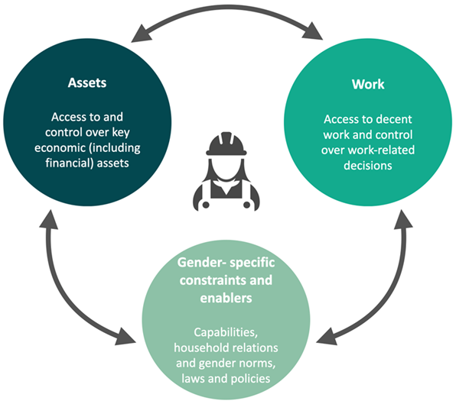
FCDO Women’s Economic Empowerment Conceptual Framework

Slide 5
Question 1: Critical issues for women’s economic empowerment in Côte d’Ivoire

Slide 6
Overview: One of the fastest growing economies but some of the highest gender inequality in the world
8% of women compared to 22% of men with land titles
Workforce comprises 49.3% women and 66.9% men
Primary completion is 75.1% for girls to 82.3% for boys
36% of women report experience of domestic violence
Women hold 11% of seats in the National Assembly
Score of 83/100 on Women Business and Law indicators
Fertility rate is 5.1 births and 18% of women access contraceptives

Slide 7
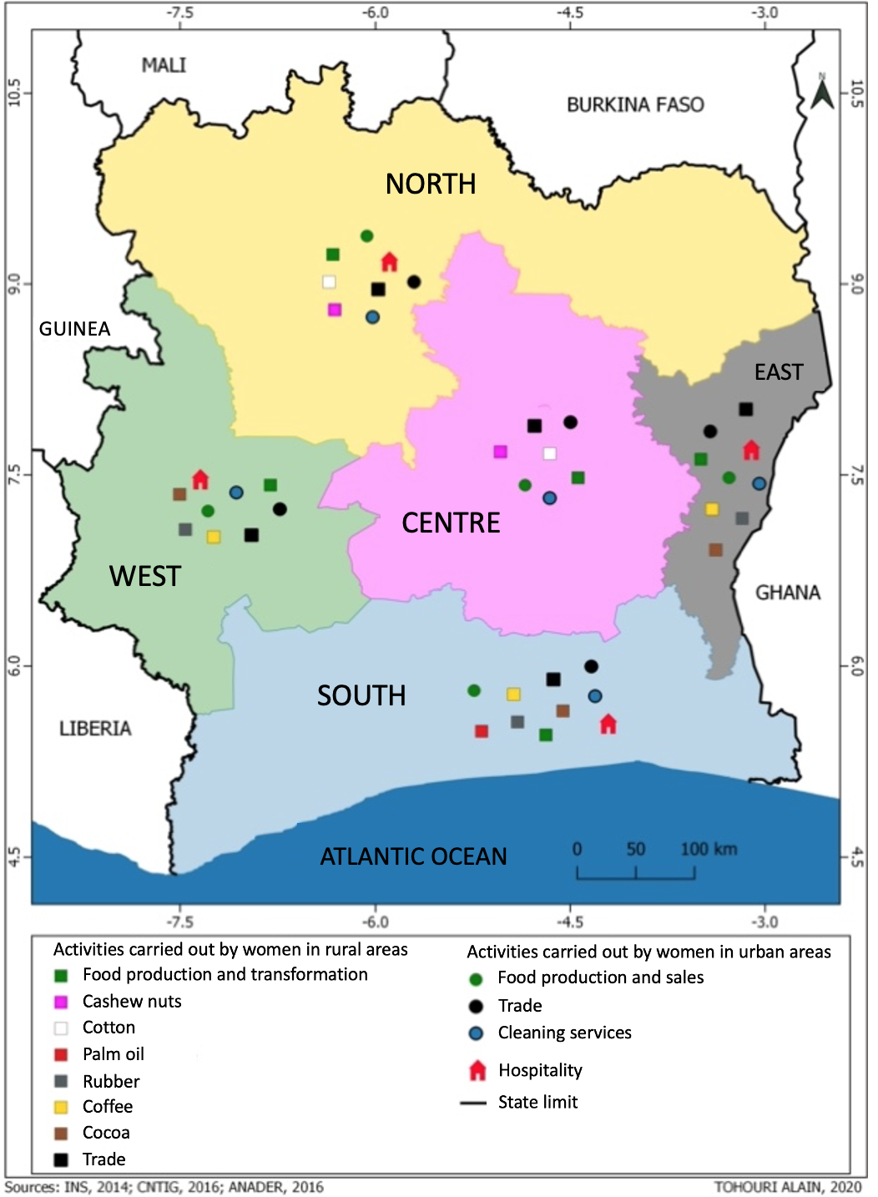
Sector analysis
The largest proportion of women work in agriculture (42.9%) then retail (31.6%) then domestic work (9.6%).
Manufacturing currently engages only a small proportion of women (1.8% in the garment sector and 1.0% in other industrial sectors).
But industrial development is a core element of Côte d’Ivoire’s National Development Plan 2016- 2020.

Slide 8
Breakdown of sectors by gender
 | Men |  | Women |  | Proportion of women | TOTAL
Agriculture | 2,586,158 | 47.8% | 1,751,601 | 42.9% | 40.4% | 4,337,759 | 45.7%
Forestry, fodder activities | 92,827 | 1.7% | 21,335 | 0.5% | 18.7% | 114,162 | 1.2%
Breeding, hunting, fishing | 73,252 | 1.4% | 6,709 | 0.2% | 8.4% | 79,961 | 0.8%
Agrifoods industries | 37,851 | 0.7% | 15,357 | 0.4% | 28.9%. | 53,208 | 0.6%
Garment production | 80,240 | 1.5% | 74,538 | 1.8% | 48.2% | 154,778 | 1.6%
Other industrial activities | 241,982 | 4.5% | 39,418 | 1.0% | 14.0% | 281,400 | 3.0%
Construction | 147,662 | 2.7% | 3,551 | 0.1% | 2.3% | 151,213 | 1.6%
Retail | 663,000 | 12.3% | 1,290,090 | 31.6% | 66.1% | 1,953,090 | 20.6%
Wholesale | 101,218 | 1.9% | 155,596 | 3.8% | 60.6% | 256,814 | 2.7%
Repair services | 168,162 | 3.1% | 4,638 | 0.1% | 2.7% | 172,800 | 1.8%
Hospitality | 63,767 | 1.2% | 136,816 | 3.3% | 68.2% | 200,583 | 2.1%
Transport et communication | 327,486 | 6.1% | 24,235 | 0.6% | 6.9% | 351,721 | 3.7%
Domestic services | 284,534 | 5.3% | 393,259 | 9.6% | 58.0% | 677,793 | 7.1%
Administration, social services | 538,698 | 10.0% | 168,169 | 4.1% | 23.8% | 706,867 | 7.4%
Total | 5,406,838 | 100.0% | 4,085,312 | 100.0% | 43.0% | 9,492,150 | 100.0%
About WOW Helpdesk reports: The WOW Helpdesk is funded by the UK Department for International Development (DFID). WOW Helpdesk services are provided by the Work and Opportunities for Women (WOW) Programme alliance. For any further request or enquiry, contact enquiry@WOWHelpdesk.org.uk
Suggested citation: Kalsi, K. and Memon, F. (2020) Women’s Economic Empowerment in Côte d'Ivoire, WOW Helpdesk Query No. 55. London, UK: WOW Helpdesk

Slide 9
Agriculture
Access to land
Lack of access to land is a critical barrier to women’s economic empowerment
Lack of access to land restricts access to credit
Widows are vulnerable to losing land access upon the death of their husband
Migrant women (both foreign and from other regions of Côte d’Ivoire) face barriers to land access
Productivity
Women dominate in food crops
But are often excluded from cash crops
Cashew nuts and cotton are grown in the North and Centre. Some women produce these but are limited by labour and land needs
Cocoa, coffee, rubber and palm oil are grown in the South, East and West. Women represented 6% of cocoa growers in 2015-2020, though they carry out unpaid labour as wives of growers
32% reduction in the gender gap in productivity in both crop types between 2008 and 2016 – due to women farmers’ increased use of fertilizer/pesticide

Slide 10
Entrepreneurship
Women comprise 20% of business directors and 20 out of 430 directors of large companies
Women make up 62% of self-employed individuals – mainly in rural and informal economies
Women entrepreneurship is seen as a motor for growth – contributed approx. 62.4m West African CFA to the economy in 2014. Government financing instruments are in place but have led to repayment debts for women entrepreneurs
Barriers restricting women entering the formal economy:
lack of training in financial management
high rates of female illiteracy
failure to institutionalise gender-sensitive budgeting
weakness of finance mechanisms for women’s empowerment projects
insufficient approach to gender and development in national and local planning

Slide 11
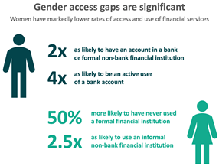
Access to finance
Financial inclusion is weak for both men and women – in 2017, 14.8% of the population had an account with a financial institution
Mobile money services are increasing women’s access to financial services but gender gaps remain – women are 45% less likely than men to have a mobile money account
Barriers to women’s access to mobile money services include lack of mobile phone access and financial innumeracy

Slide 12
Service sector
Informal retail:
Is a principal source of employment for women – particularly migrant women due to fewer barriers to entry
Targeting informal retail would be an effective way to reach migrant women excluded from other sectors
Domestic work:
High participation amongst 18-35 year-olds – across all ethnicities and a key driver of rural to urban migration and immigration from surrounding countries
Hospitality:
Access depends on education level – poorer and migrant women are less well represented.
.

Slide 13
Manufacturing
Women’s participation is currently low, but industrialisation is a key growth area
Opportunities vary by region:
North and Centre: cashew nuts, mangos, yams, cassava, honey, and shea butter processing are likely to be prioritised;
West and South: consumer electronics, palm oil, cassava, bananas, fish and snail farming
The snail market is thriving as it is a reliable source of protein and requires low farming inputs (and can be done from home) – potential for further investment

Slide 14
Question 2: Review of analysis of economic growth and key economic policies in Côte d’Ivoire and their application and impact on women’s economic empowerment

Slide 15
Economic growth and development plans
Before COVID-19, Cote d’Ivoire had one of the most robust growth rates in Africa and the world – its economy has grown by 8% every year since 2012 (projections are now 1.8% due to the pandemic)
The Côte d’Ivoire National Development Plan 2016-2020 highlights priorities for structural reforms:
Creation of a world class business environment, including institutional reform;
Increased involvement of international actors in the economy;
Formalising the informal economy;
Modernising micro- and small/medium enterprises, particularly to boost opportunities for youth.

Slide 16
Economic growth gains have been uneven
Gains have not translated into gains in women’s economic empowerment:
Côte d’Ivoire scores 0.545 on the Global Gender Gap economic participation and opportunity sub-index – lower than the Sub-Saharan African average (0.666)
It has closed only 54.5% of its gender gap in this sub-index – in contrast to regional counterpart Benin (84.7%) and the Sub-Saharan African average (68.0%)
Labour force participation rate is 49.3% for females compared to 66.9% for males, whilst women face higher rates of unemployment (9.4%) compared to men (4.5%)

Slide 17
Limited focus on women’s economic empowerment
The National Development Plan 2016-2020 highlights women’s empowerment, autonomy and decision making:
Helped build support for the passing of the 2019 Marriage Law that gives women equal property rights;
Put in place the FAFCI support fund for all Ivorian women who have a project to develop;
Requires all political parties to have 30% female representation in decision-making role – although this has not yet been implemented
The government also provides support to women to access pesticide – but only for groups of women farmers, not individuals – unless they are land owners (only 1% of women, usually widows)
The government is criticised for its level of response to the Beijing Platform for Action +25 agenda – with insufficient gender in local and national planning and budgeting as well as insufficient access to finance for women

Slide 18
Question 3: Entry points for strengthening women’s economic empowerment in Côte d’Ivoire

Slide 19
Key recommendations
Domain | Examples
Work Challenge occupational segregation in agriculture Support women’s entrepreneurship Support Côte d’Ivoire’s drive towards industrialisation whilst promoting women’s economic empowerment | Policies that encourage women to enter the cash crop sector – eg by facilitating access to cash crop markets Policies that provide more flexible economic support to women entrepreneurs Ensure consultation with women’s organisations to understand their needs regarding industrialisation and economic empowerment during the drafting of the 2021-2025 National Development Plan
Assets Support women’s access to and control over land | Policies that encourage women from different ethnic groups to form inter-ethnic women’s organisations which work together to access land

Slide 20
Key recommendations
Domain | Examples
Gender specific constraints and enablers Ensure consultations with women representative organisations and focus on priorities for women in the National Development Plan 2021-2025 Challenge harmful social norms around women’s land rights Reduce women’s domestic chores and unpaid care | A focus on improving outcomes for women via gender-friendly audit/analysis Consider funding the employment and training of paralegals to assist rural women in asserting and securing their land rights Support programmes that challenge social norms around the allocation of care to reduce women’s unpaid care work – thereby giving women more time for farming/other profitable work

Slide 21
Questions?

Slide 22
For further information, please contact:
For further information, please contact:
Kavita Kalsi, Senior Technical Specialist
Social Development Direct
m: 00 44 203 948 1985
e: kavita.kalsi@sddirect.org.uk
WOW Helpdesk
e: enquiry@WOWHelpdesk.org.uk
t: +44 (0)203 735 6416
The WOW Helpdesk is available 9:30am – 17:30pm (UK time) Monday to Friday.
Disclaimer to go in here

Slide 23
“This document is an output from a project funded by UK aid from the UK government. However, the views expressed and information contained in it are not necessarily those of or endorsed by the UK government who can accept no responsibility for such views or information or for any reliance placed on them.
This publication has been prepared for general guidance on matter of interest only, and does not constitute professional advice. The information contained in this publication should not be acted upon without obtaining specific professional advice. No representation or warranty (express or implied) is given as to the accuracy or completeness of the information contained in this publication, and, to the extent permitted by law, no organisation or person involved in producing this document accepts or assumes any liability, responsibility or duty of care for any consequences of anyone acting, or refraining to act, in reliance on the information contained in this publication or for any decision based on it.”

