Slide 1

Ethnic Disproportionality in Remand and Sentencing in the Youth Justice System
Analysis of administrative data
Appendix 1: Graphs illustrating the results of descriptive analyses pertaining to ethnicity

Slide 2
Notes
The following slides display the results of crosstabulations carried out between ethnicity and a wide set of variables, including legal outcomes, remand decision, offence-related factors as well as practitioner-assessed factors.
The analyses are based on administrative data held by YJB and collected between October 2017 and December 2019. This includes case management records and AssetPlus assessments.
Prior to this analysis the data was recompiled and cleaned to help ensure the robustness of the analysis. The data preparation procedures are outlined in the Technical Note.
The graphs present information on how the various factors vary within each ethnicity.
Some graphs report as base those children with a ‘substantive outcome’. In the terminology used in this report, substantive outcomes include being sentenced at court or receiving an OOCD.
Significance testing is not carried out on these results. Tests of statistical significance are carried out using multivariate statistics in later stages of the research.
Care should be taken when small differences are identified as these might not be substantially significant or notable.
Care should also be taken in interpreting findings that are based on small and very small numbers of children. The number of observations each analysis is based on is included in each graph, under each bar in parentheses. For data obtained from AssetPlus (except MAPPA) we excluded from graphs ethnicities where the total sample size was below 100.

Slide 3
Legal outcomes
Demographic characteristics
Offence-related factors
Practitioner-assessed factors

Slide 4
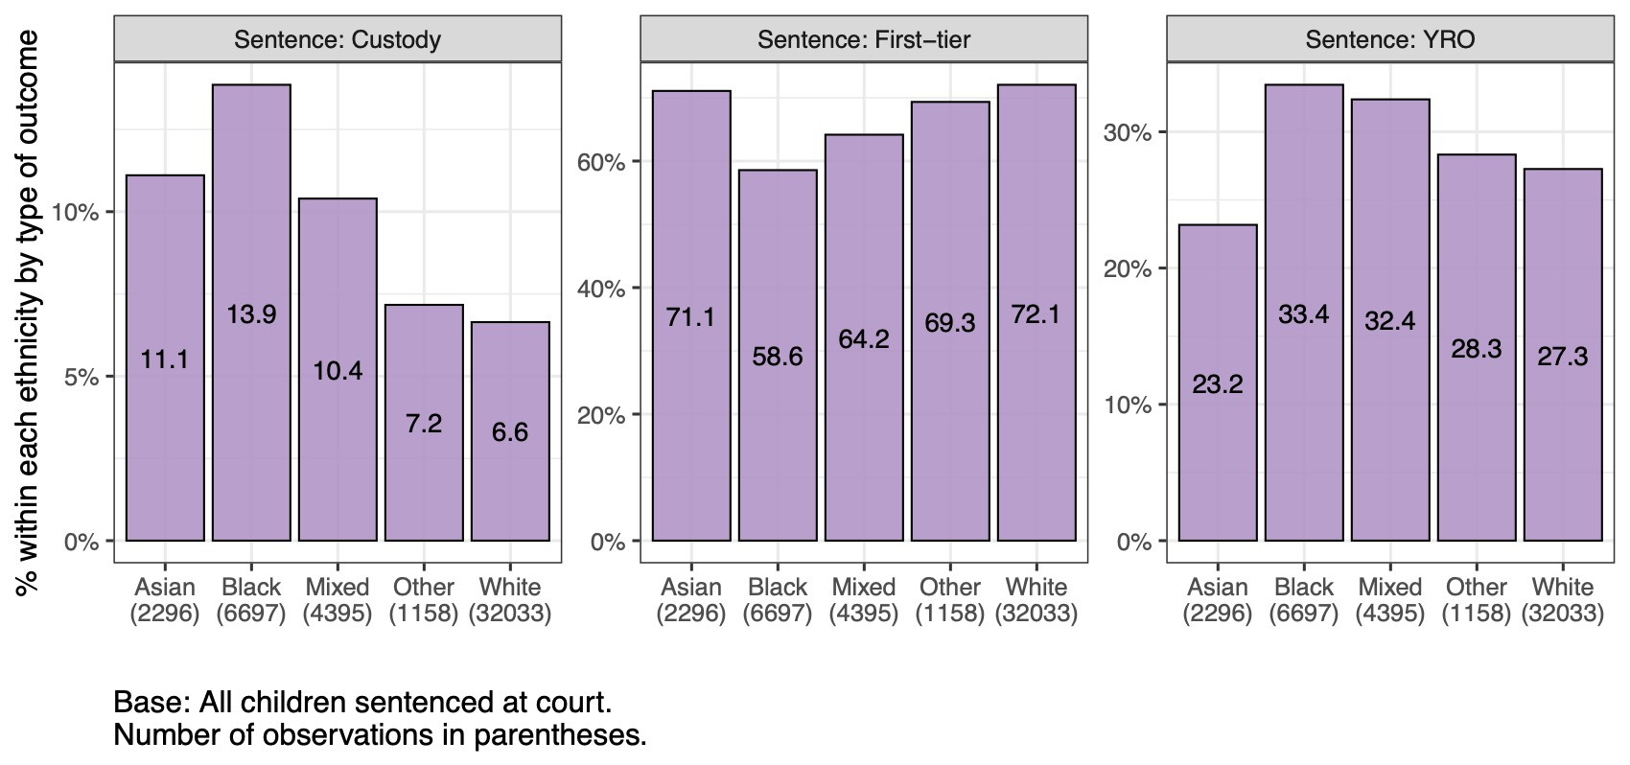
Legal outcome: sentenced at court

Slide 5
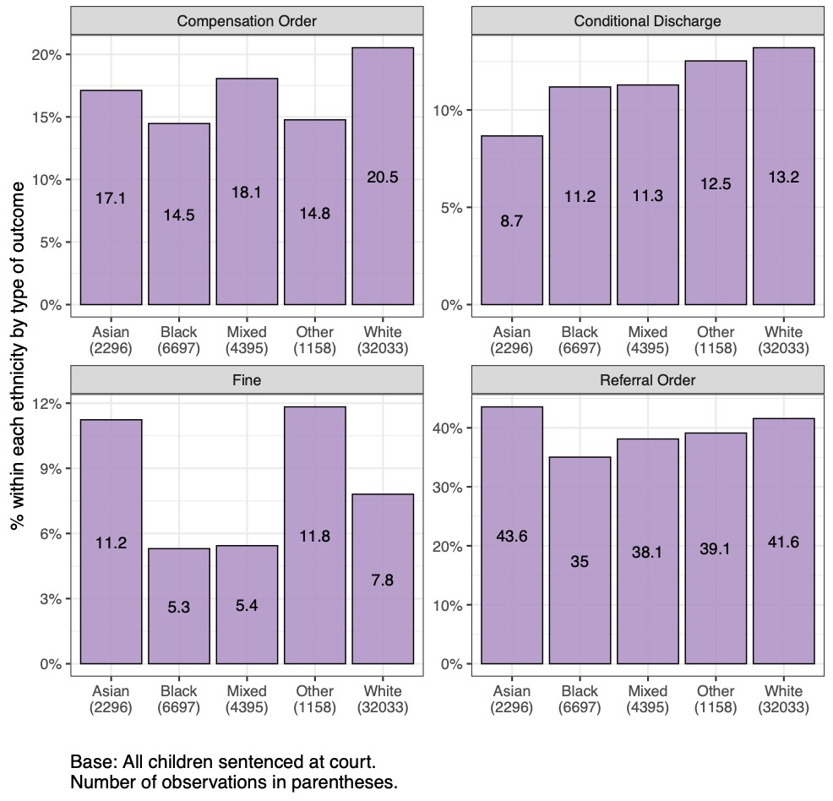
Legal outcome: first tier outcomes

Slide 6
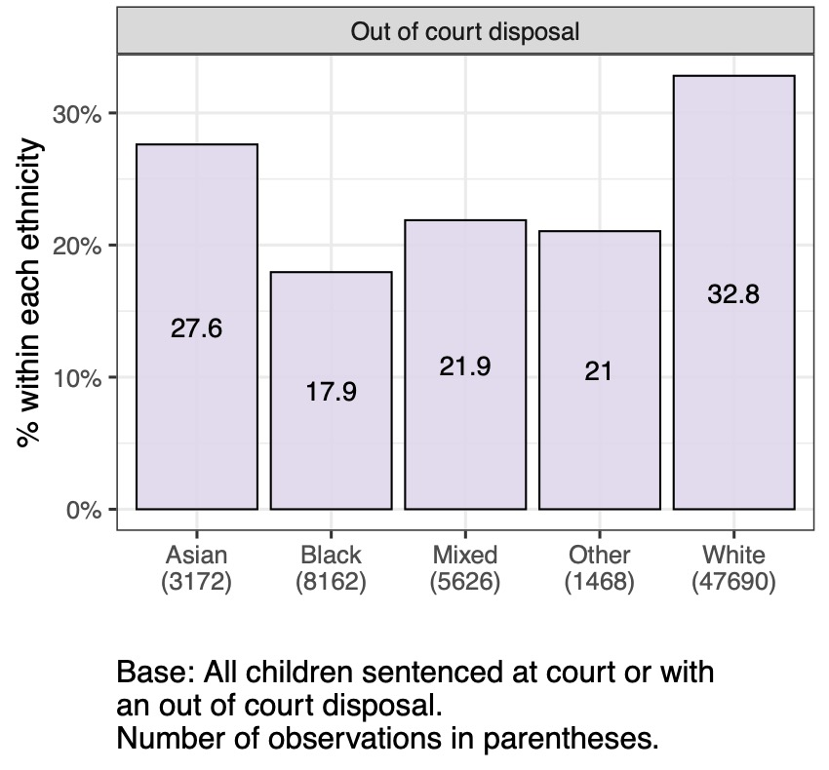
Legal outcome: out of court disposal

Slide 7
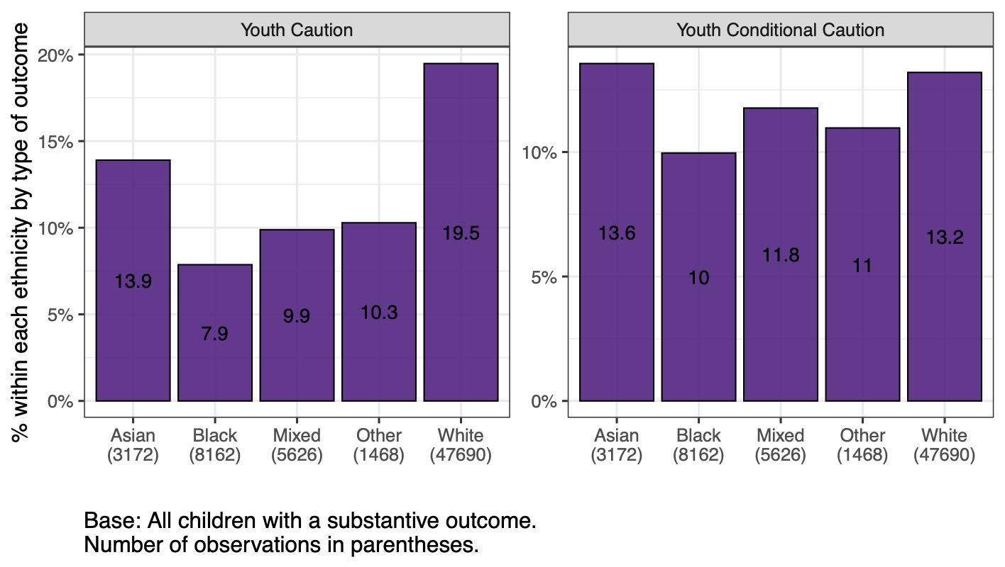
Legal outcome: out of court disposal, detail

Slide 8
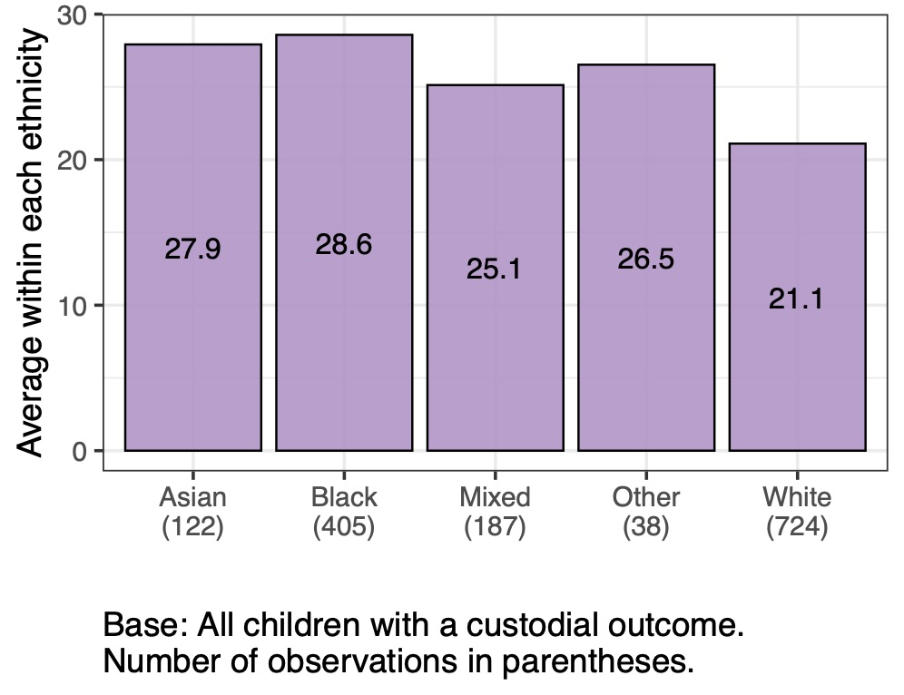
Legal outcome: length of sentence for custodial sentences (in months)

Slide 9
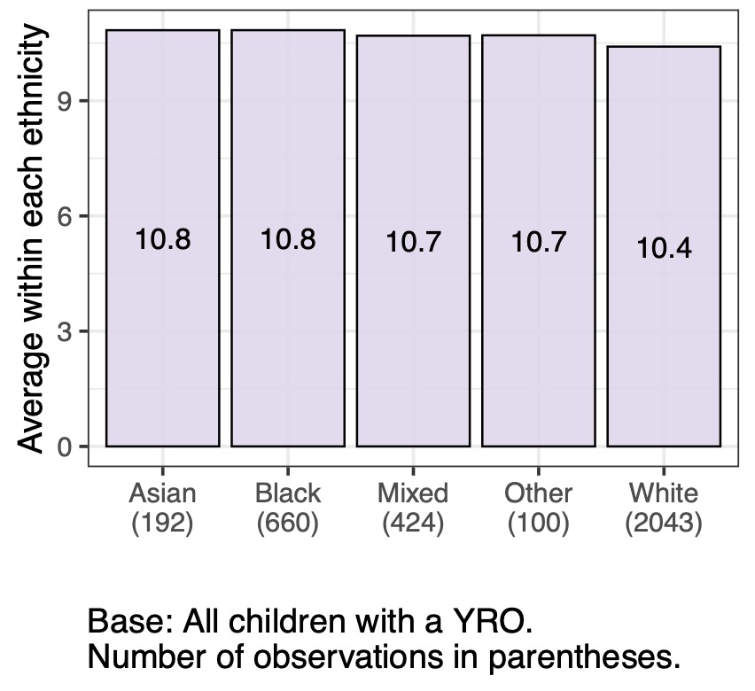
Legal outcome: length of sentence for YROs (in months)

Slide 10
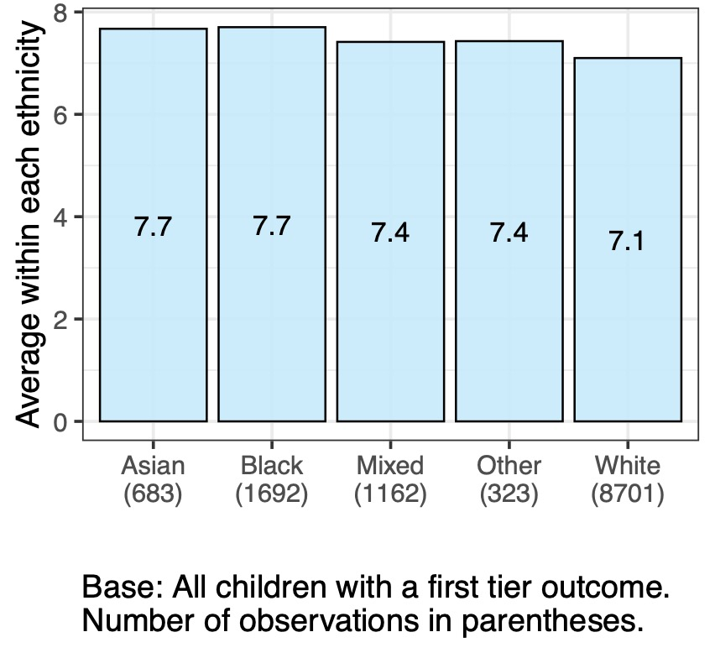
Legal outcome: length of sentence for first-tier sentences (in months)

Slide 11
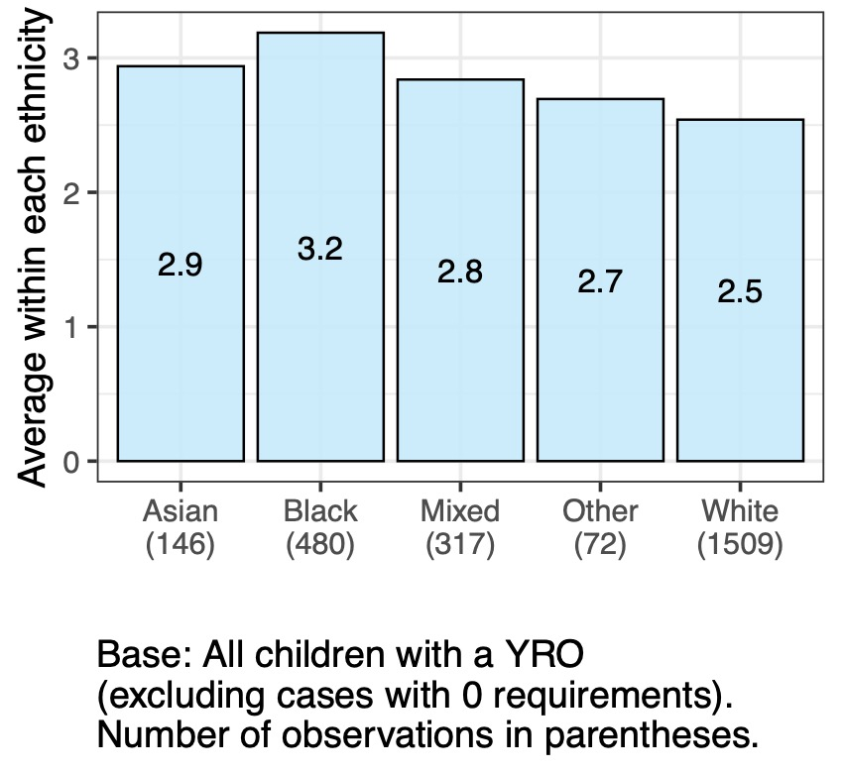
Legal outcome: number of requirements for YROs

Slide 12
Legal outcomes
Demographic characteristics
Offence-related factors
Practitioner-assessed factors

Slide 13
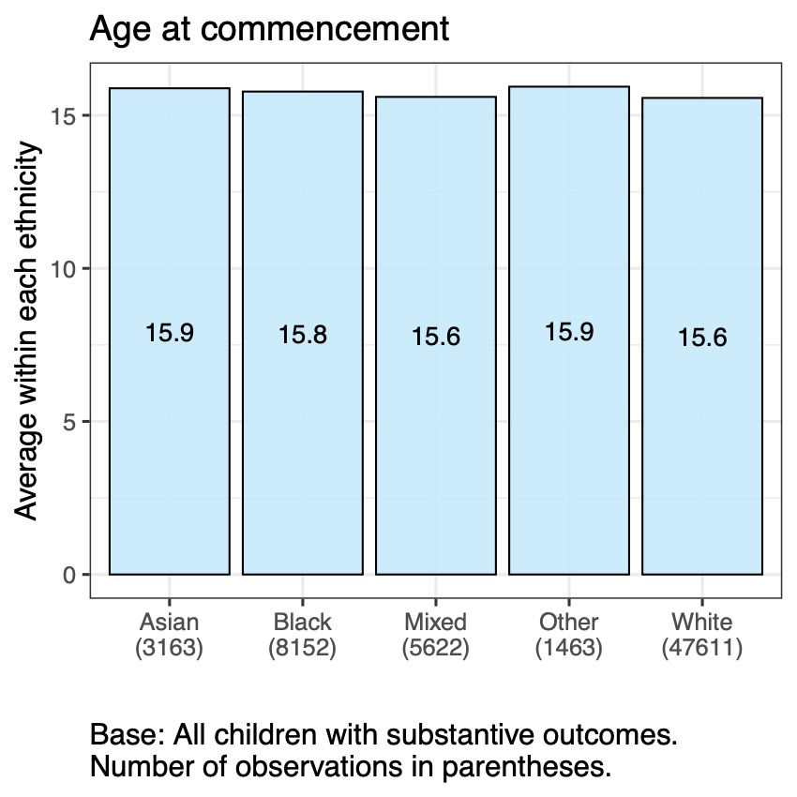
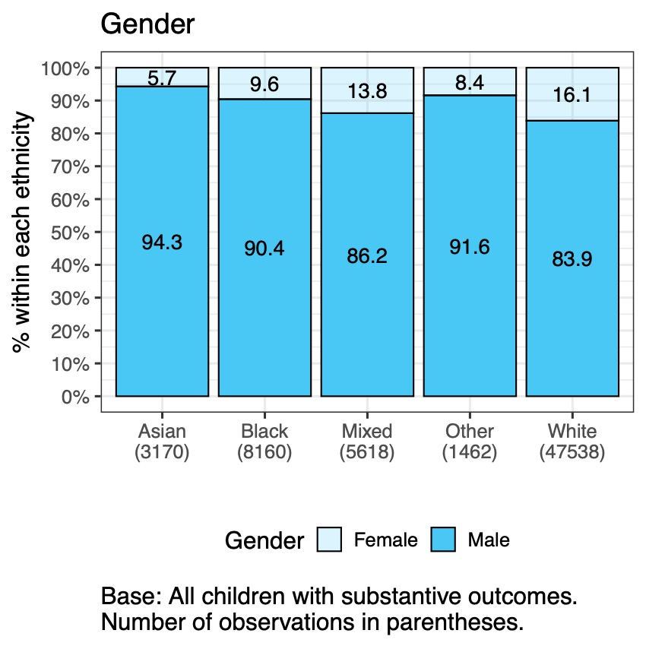
Demographic characteristics

Slide 14
Legal outcomes
Personal characteristics
Offence-related factors
Practitioner-assessed factors

Slide 15
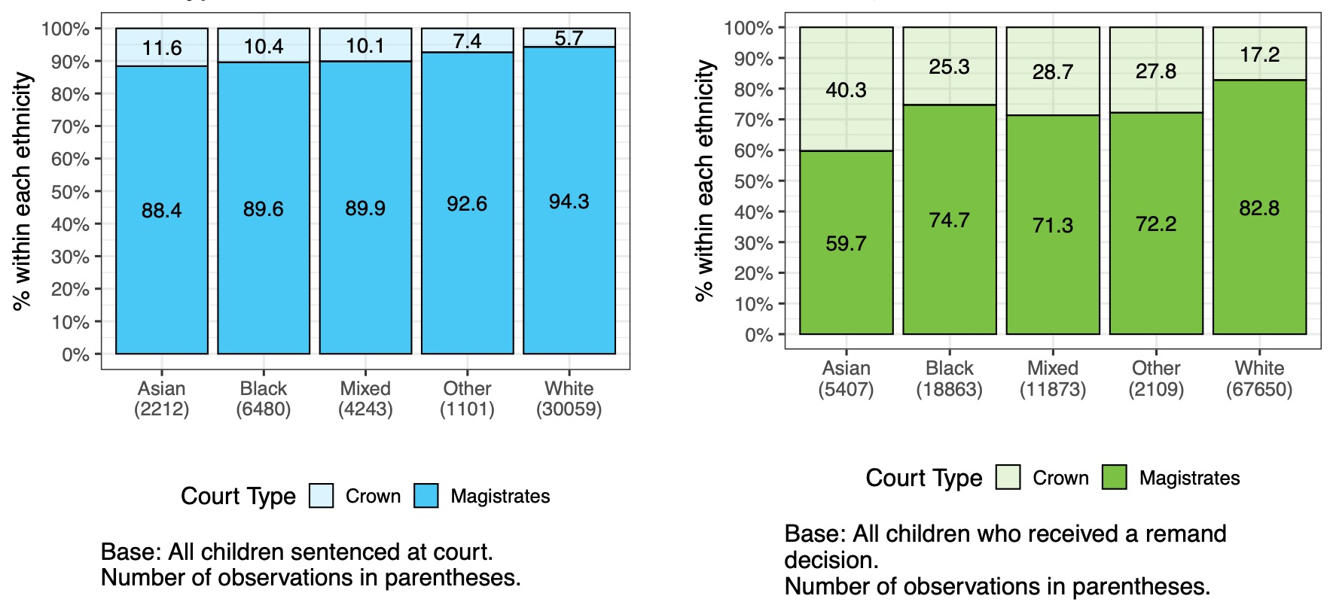
Court type

Slide 16
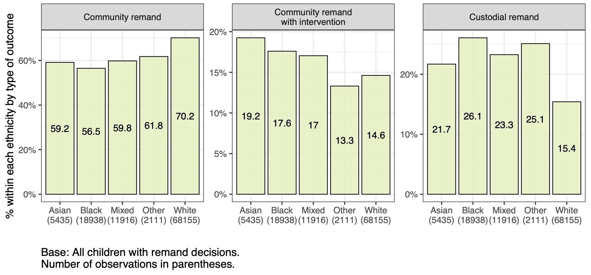
Remand decisions

Slide 17
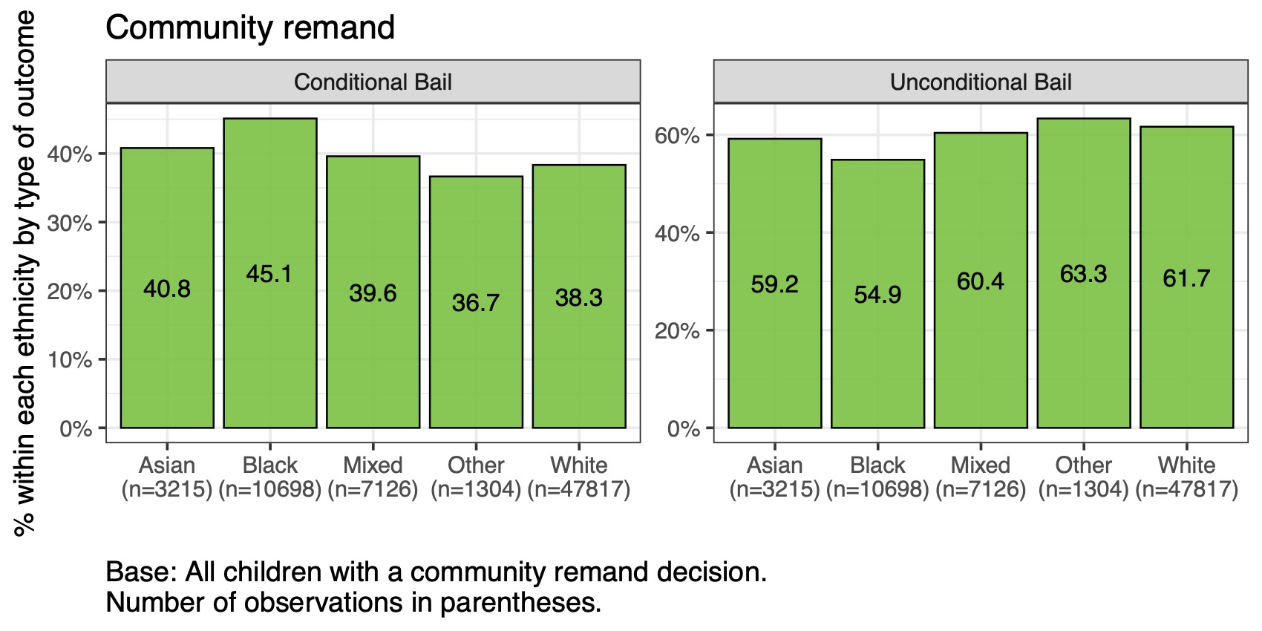
Remand decisions: community remand, detail

Slide 18
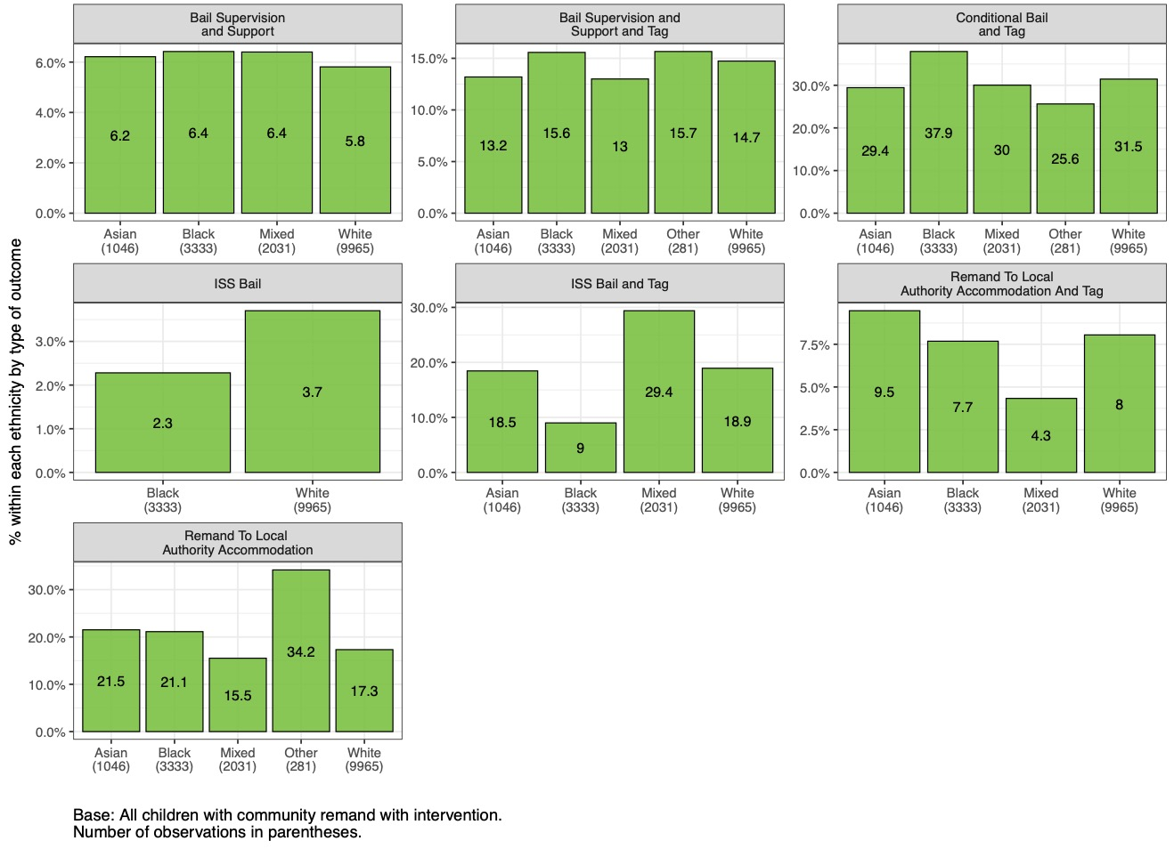
Remand decisions: community remand with intervention, detail

Slide 19
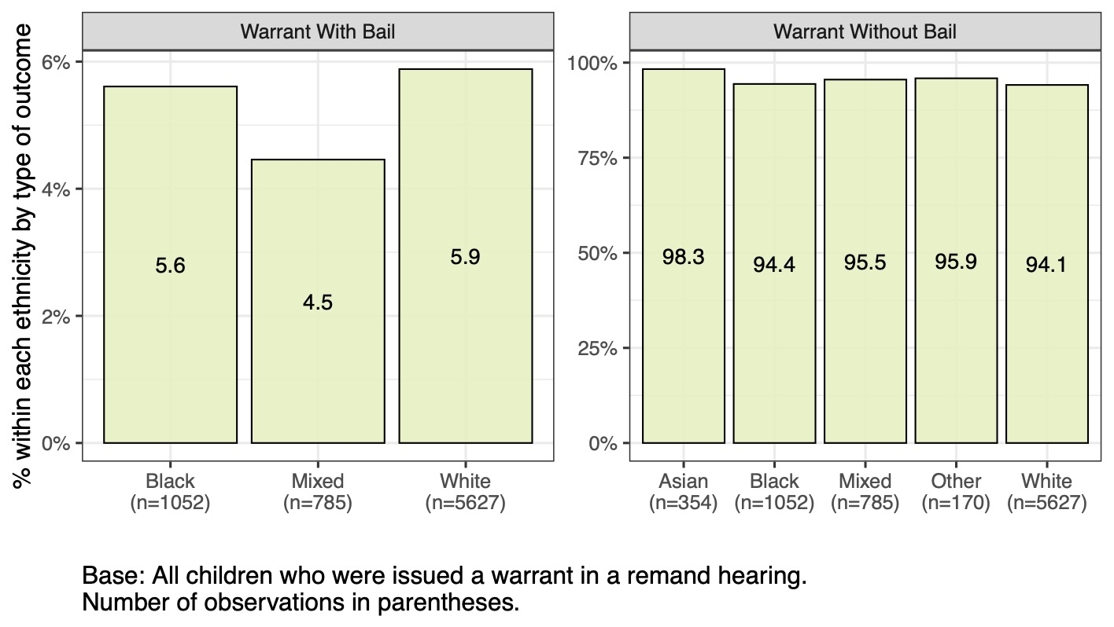
Remand hearing: warrants issued

Slide 20
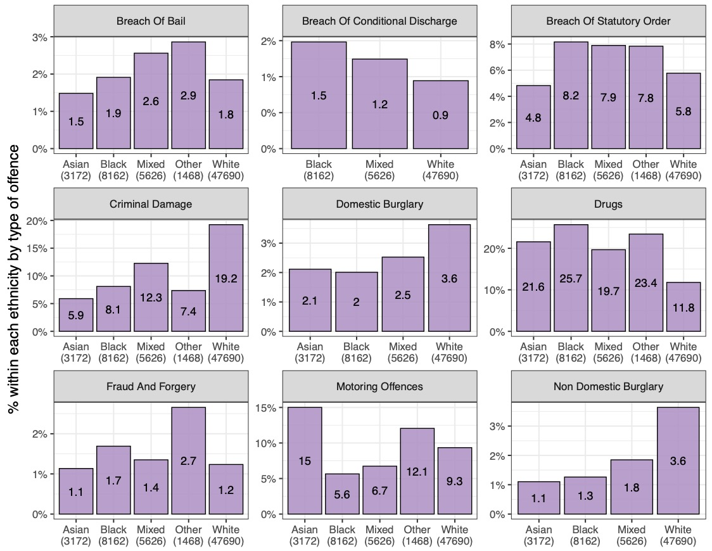
Offence type

Slide 21
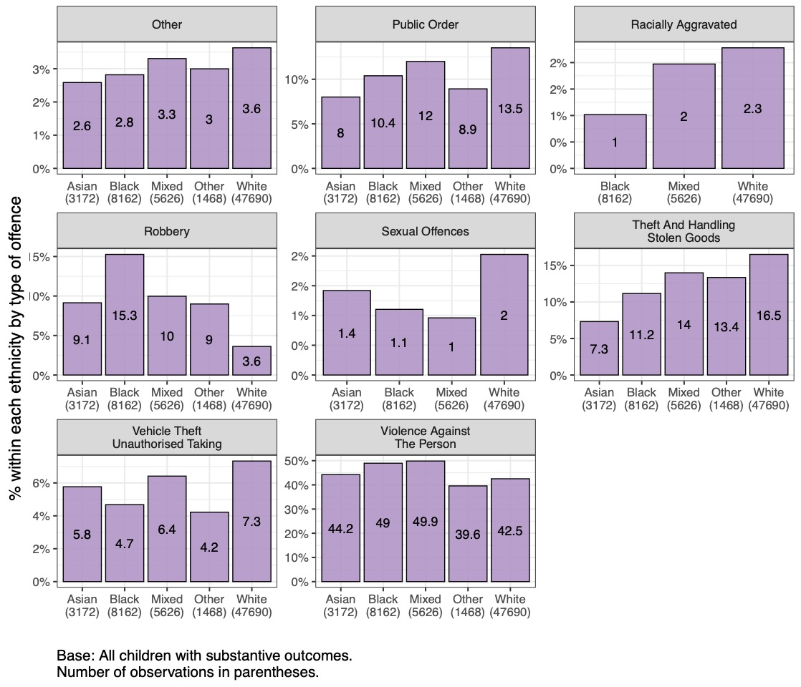
Offence type (continued)

Slide 22
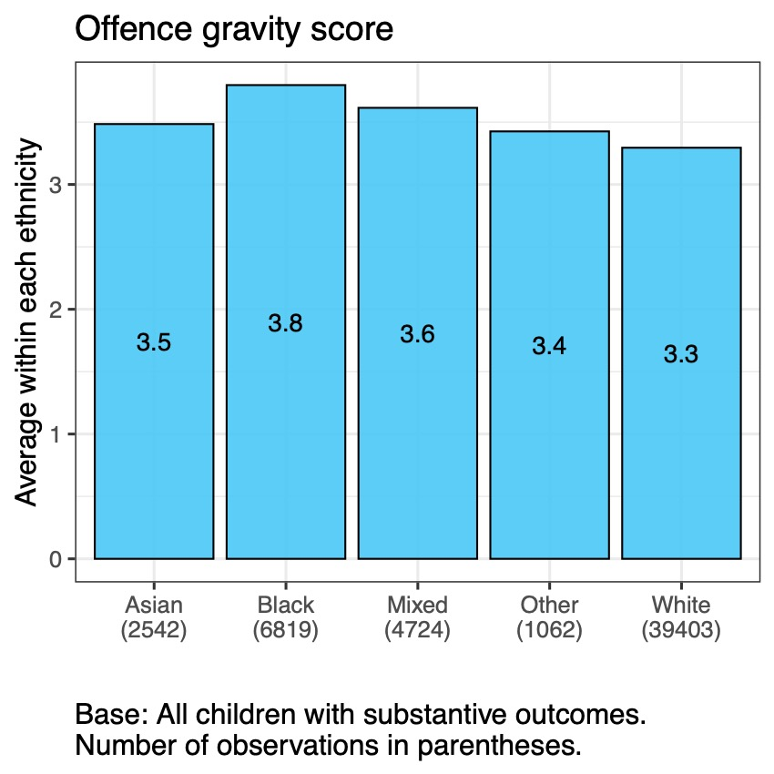
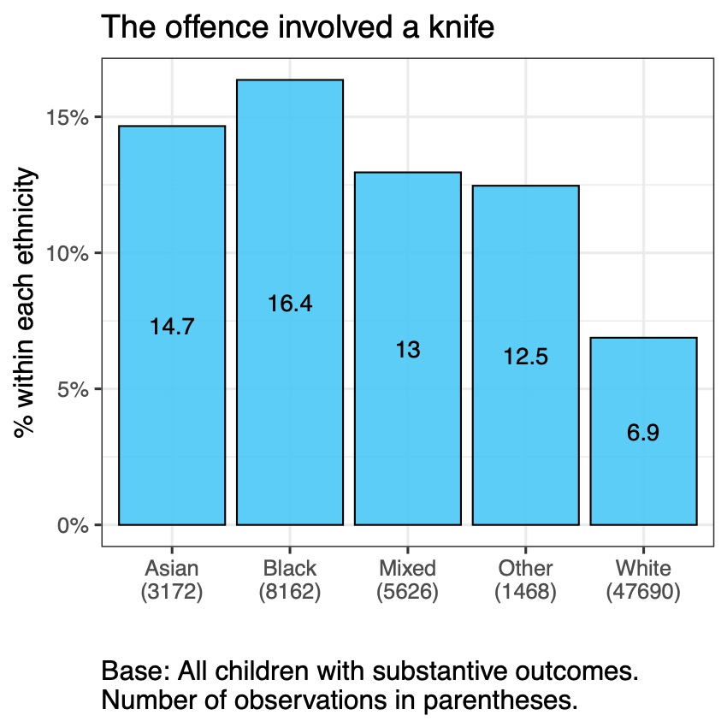
Gravity score and use of knife

Slide 23
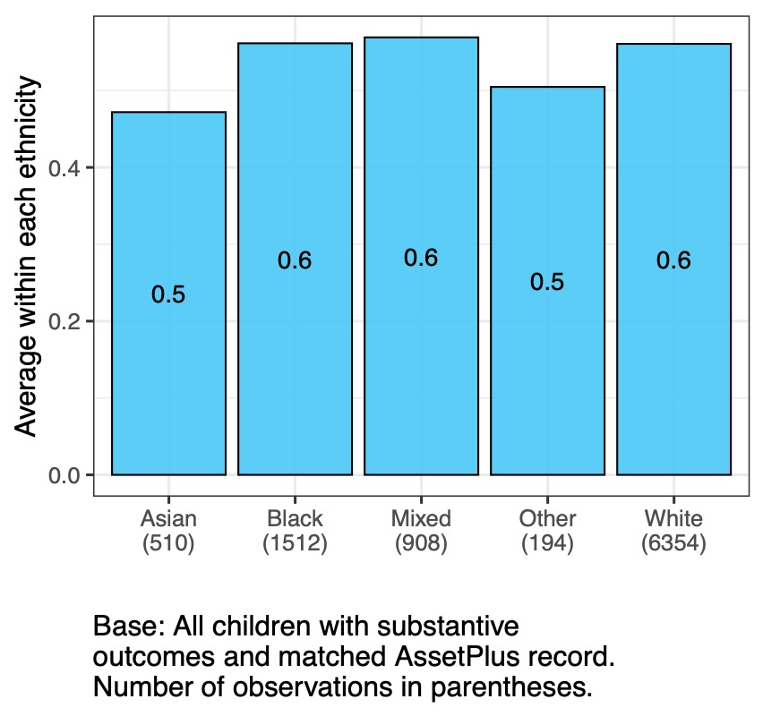
YOGRS

Slide 24
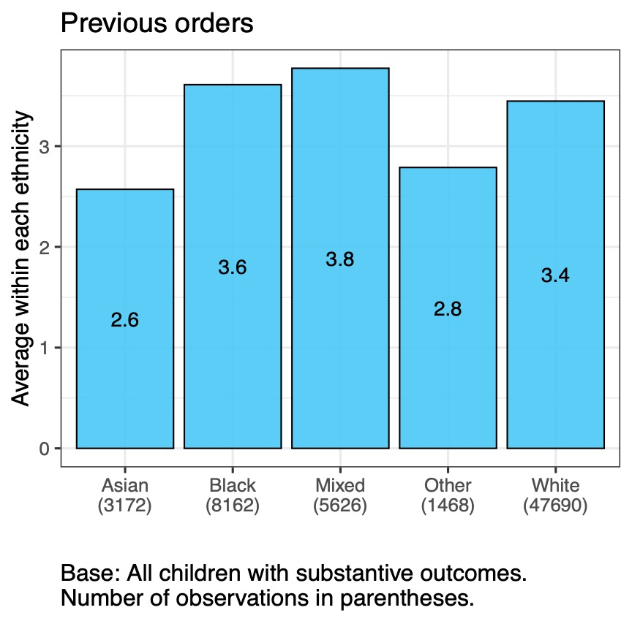
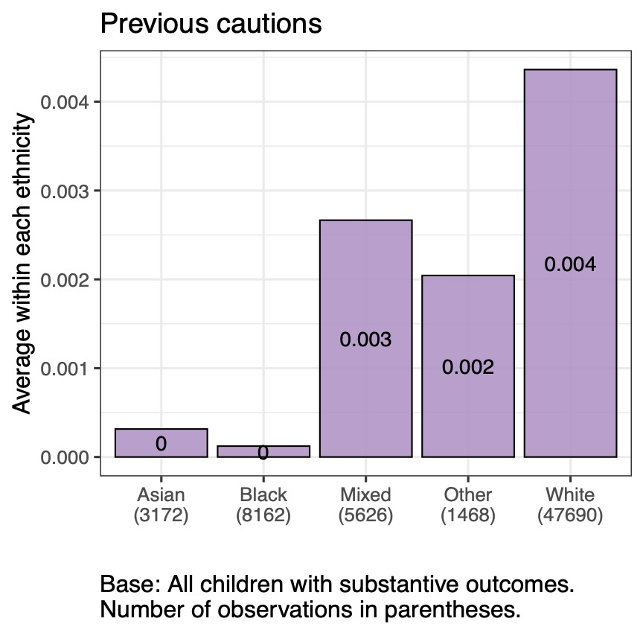
Previous orders and cautions

Slide 25
Legal outcomes
Demographic characteristics
Offence-related factors
Practitioner-assessed factors

Slide 26
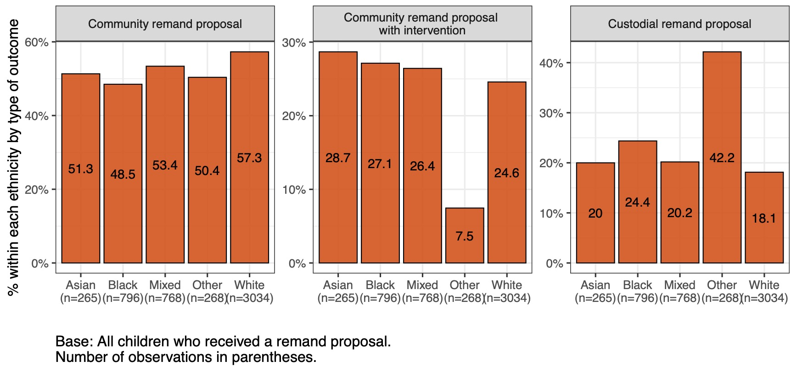
Remand proposal

Slide 27
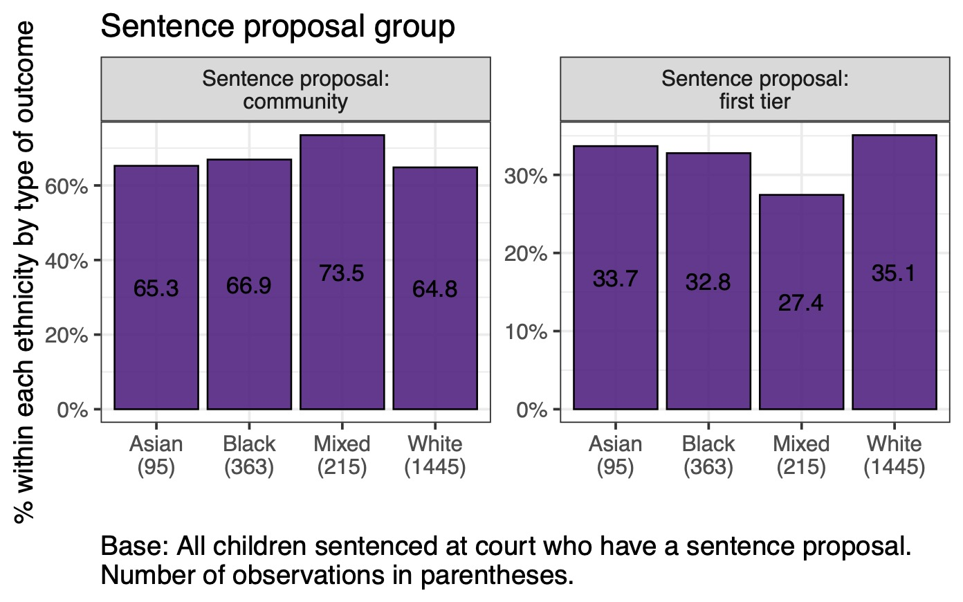
Sentence proposal

Slide 28
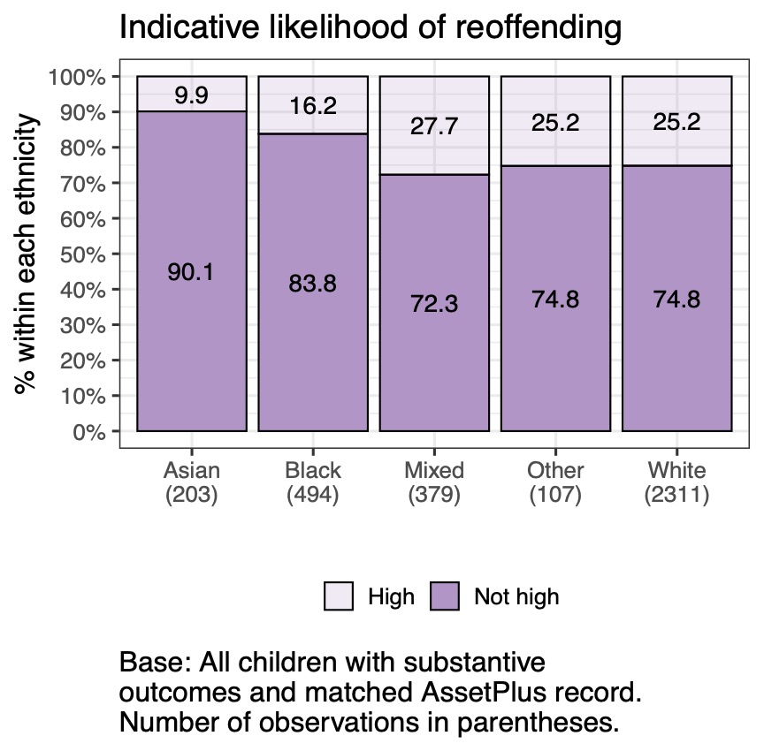
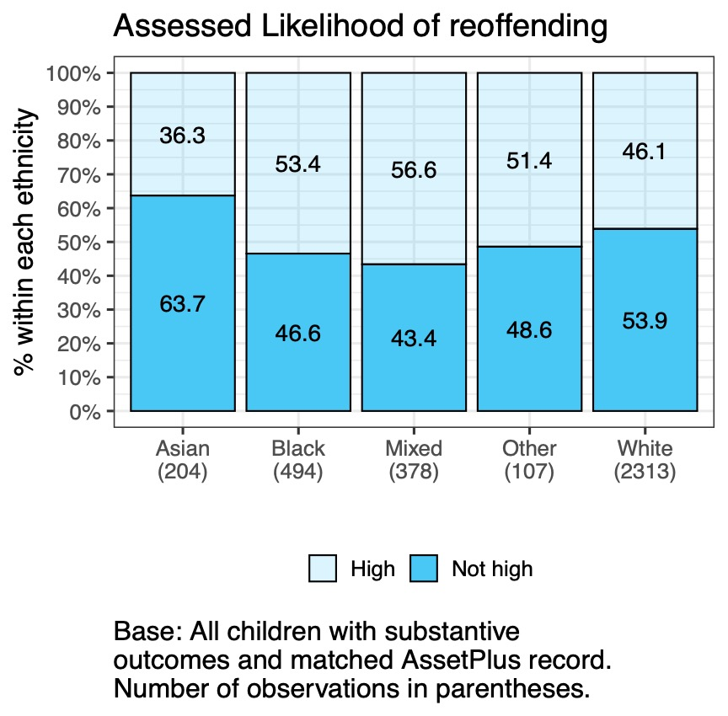
Likelihood of reoffending

Slide 29
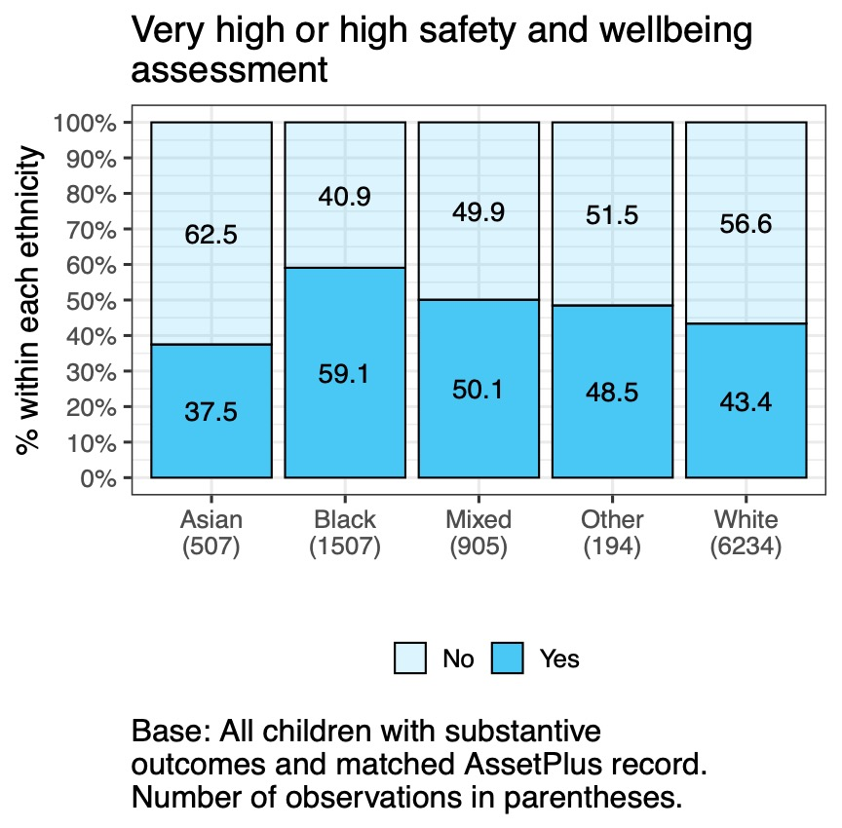
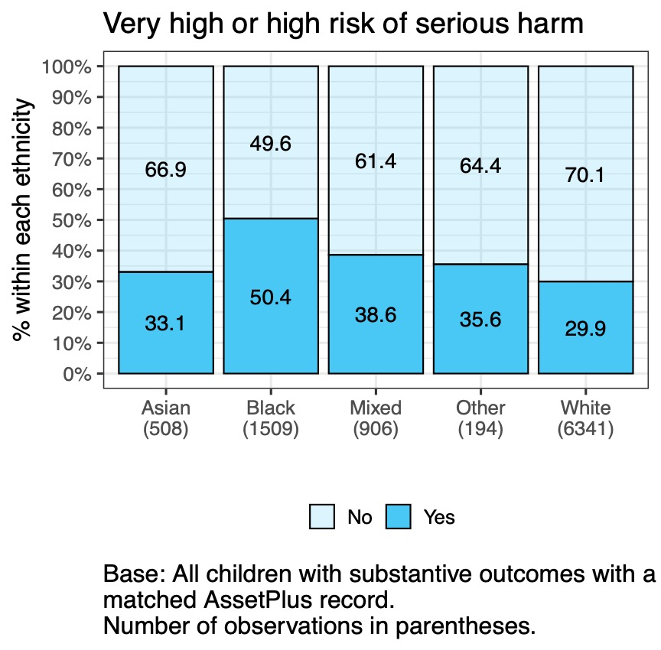
Risk of serious harm and safety and wellbeing judgements

Slide 30
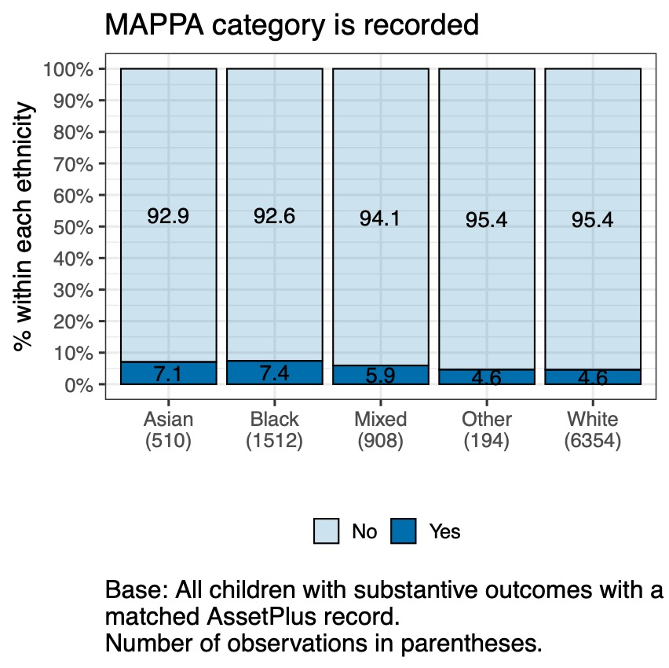
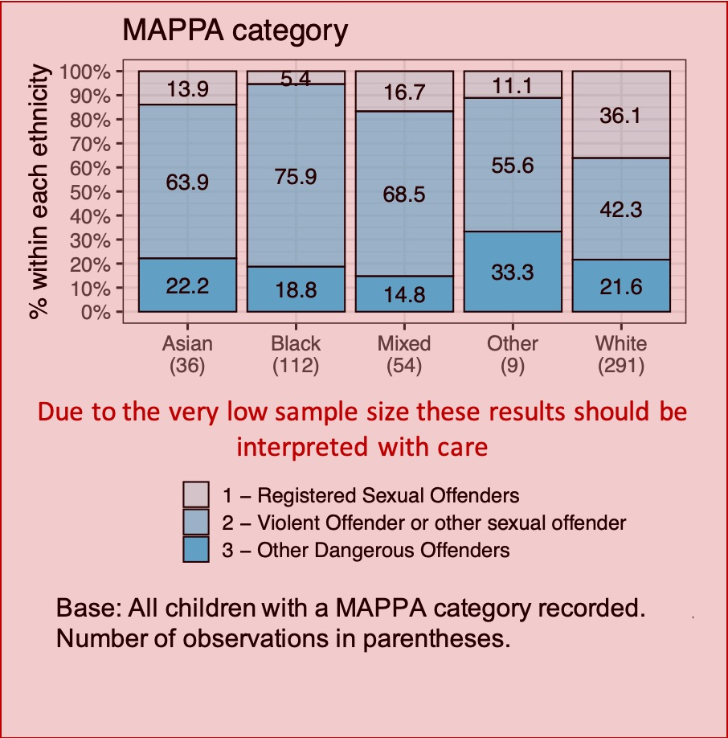
MAPPA category

Slide 31
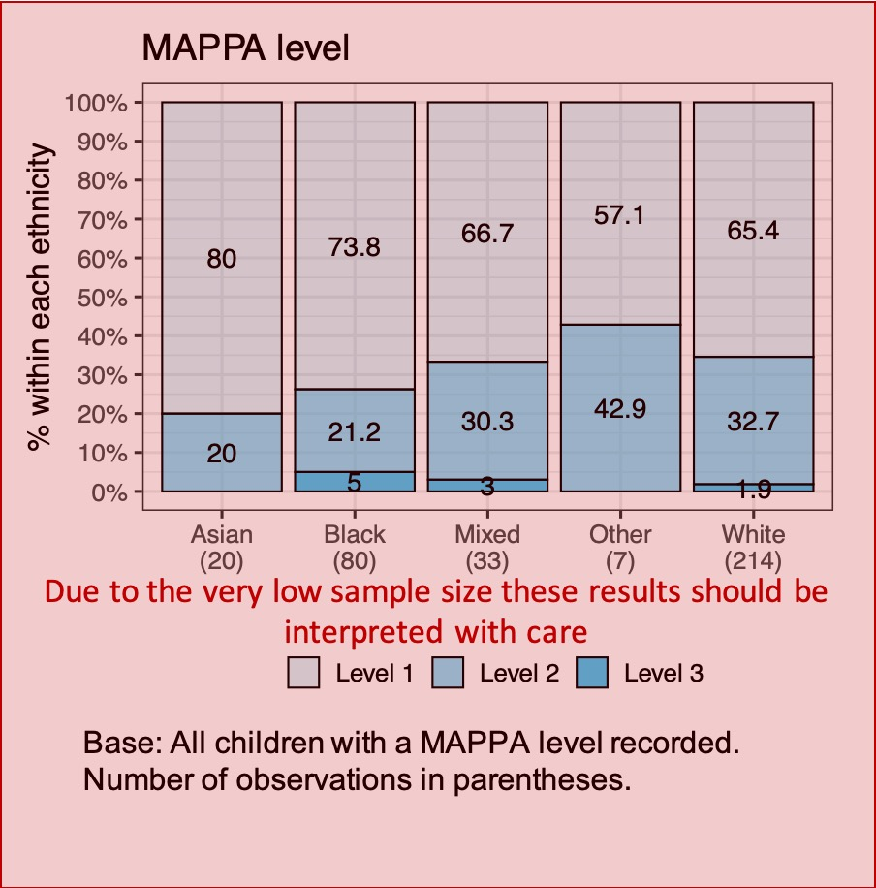
MAPPA level

Slide 32
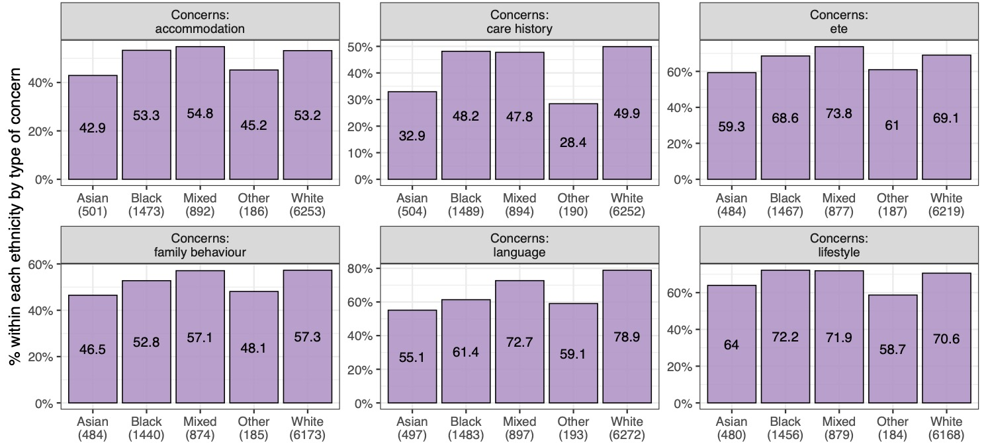
Concerns identified by the practitioner

Slide 33
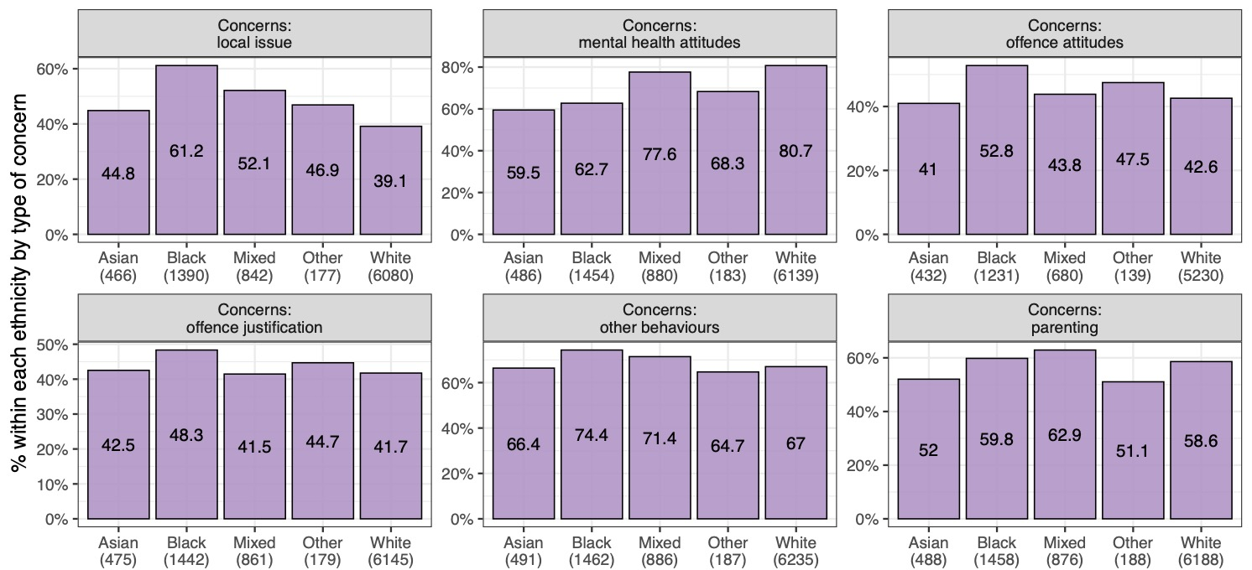
Concerns identified by the practitioner (continued)

Slide 34
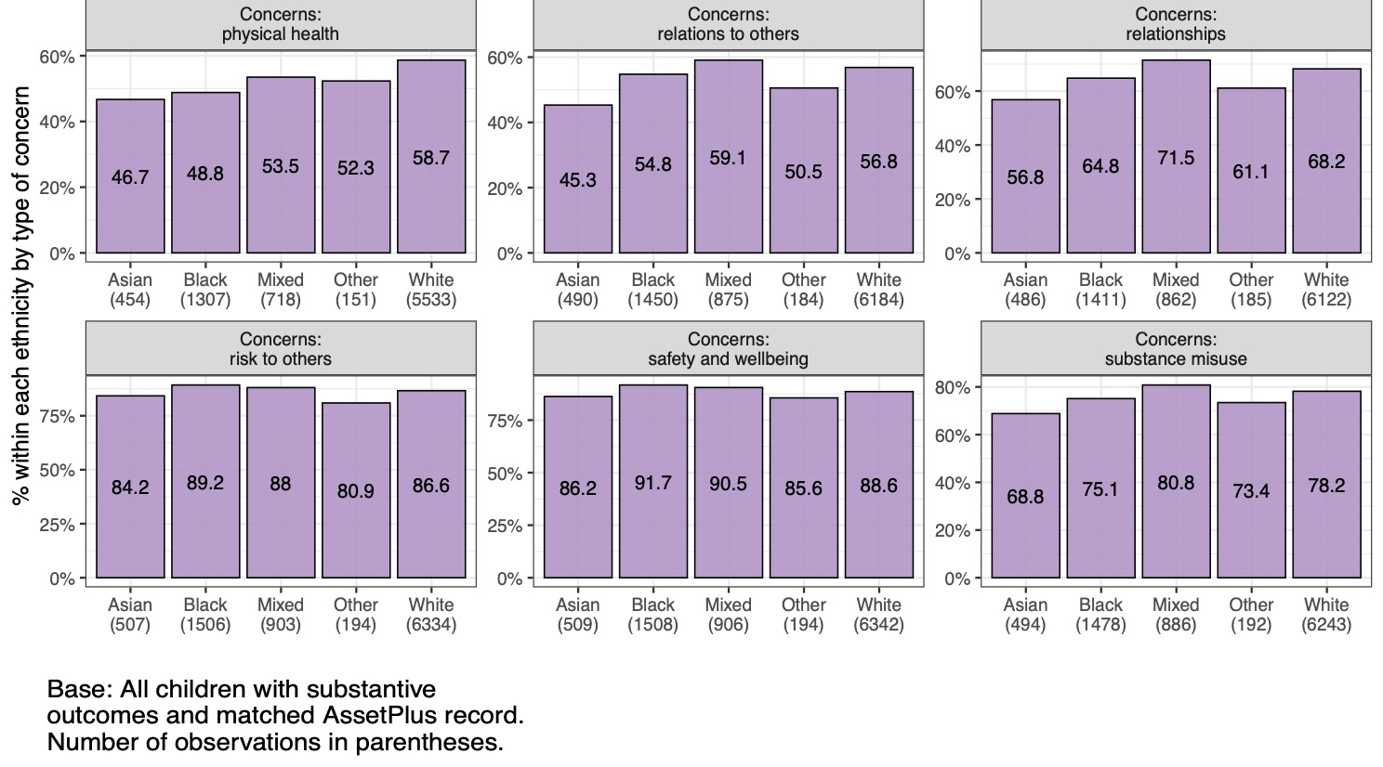
Concerns identified by the practitioner (continued)

Slide 35
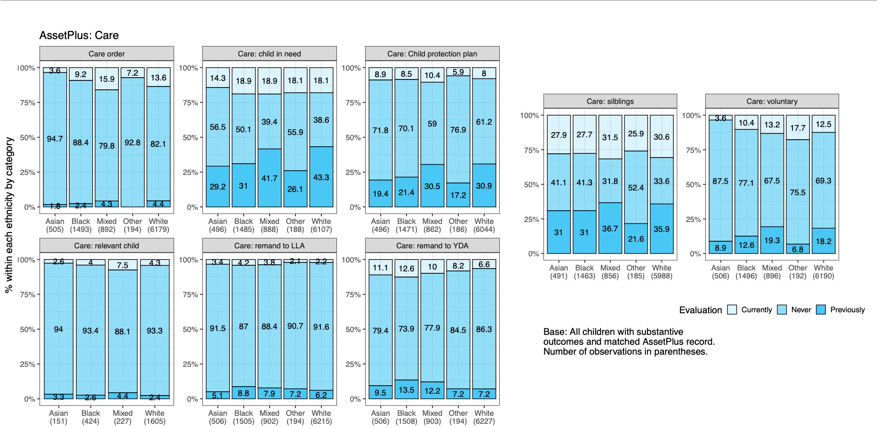
Care status

Slide 36
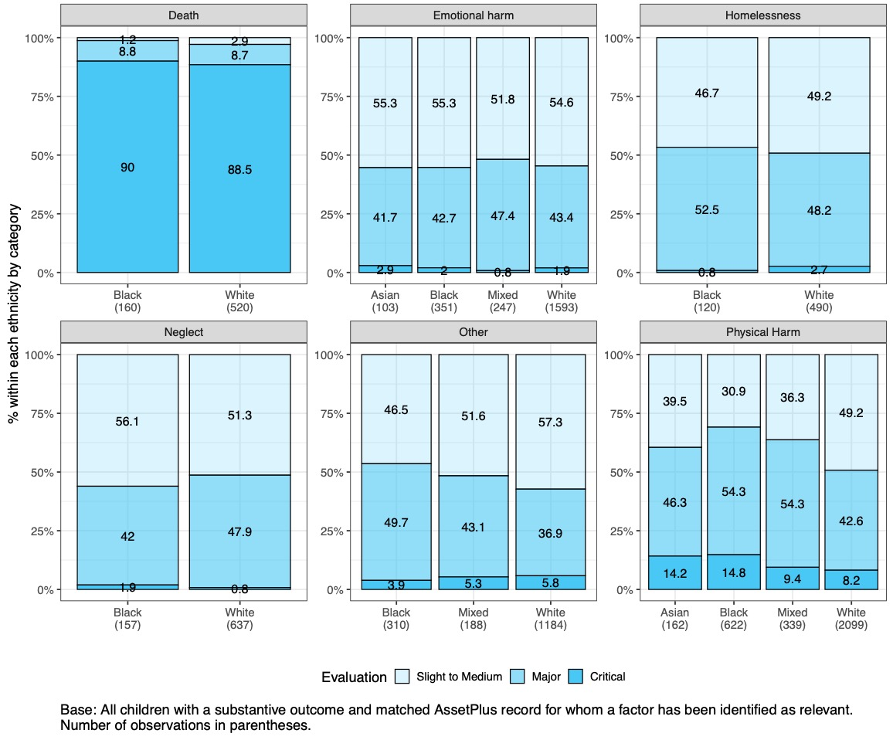
Severity of adverse impacts identified by the practitioner

Slide 37
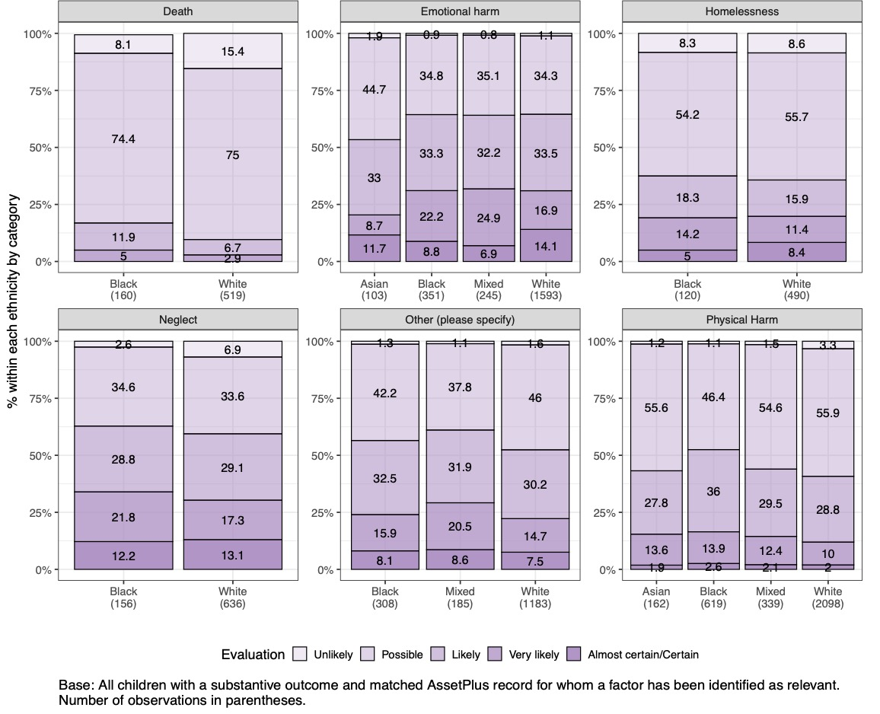
Likelihood of adverse impacts identified by the practitioner

Slide 38
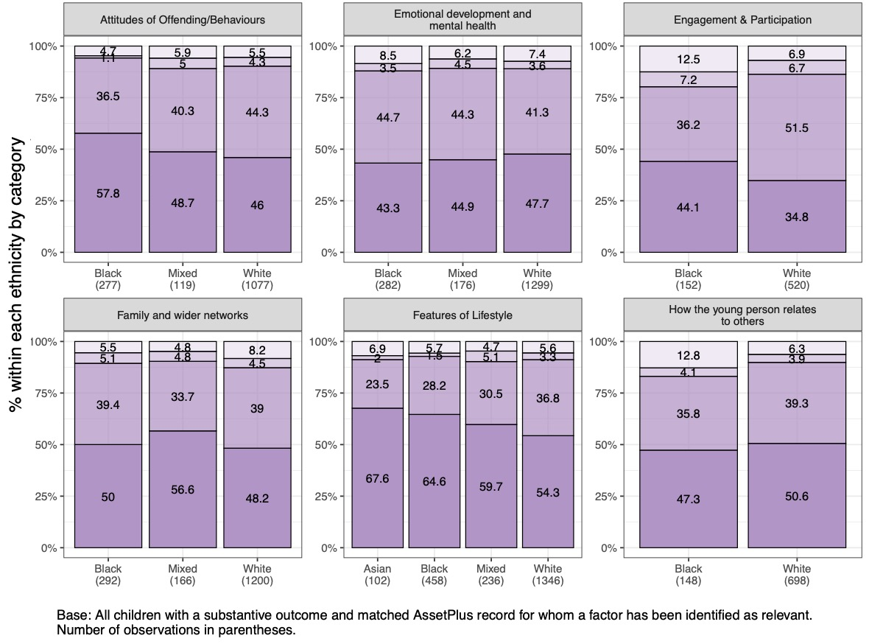
Factors against desistance

Slide 39
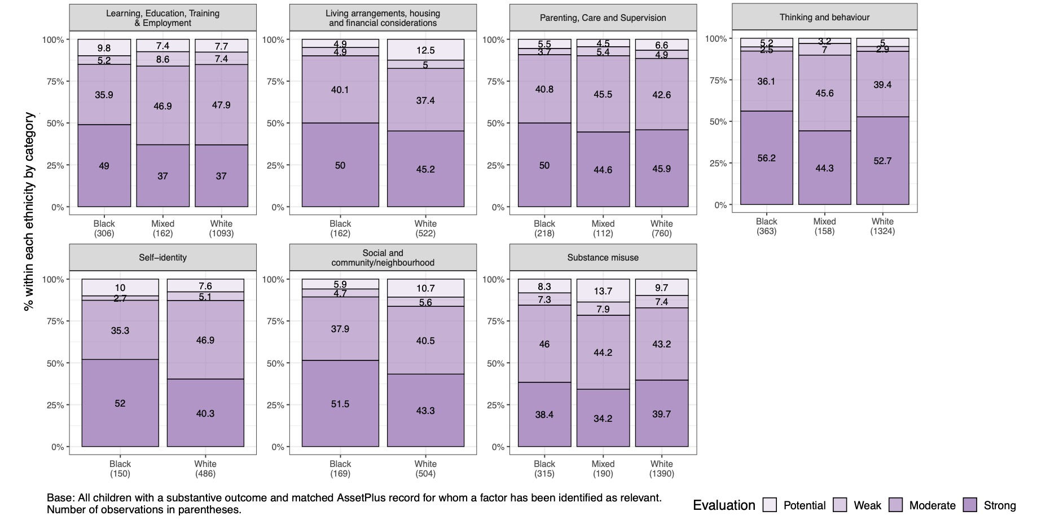
Factors against desistance (continued)

Slide 40
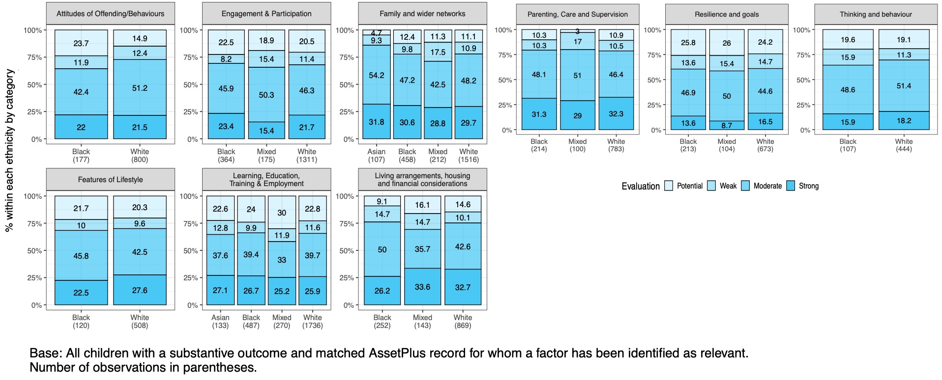
Factors for desistance

Slide 41
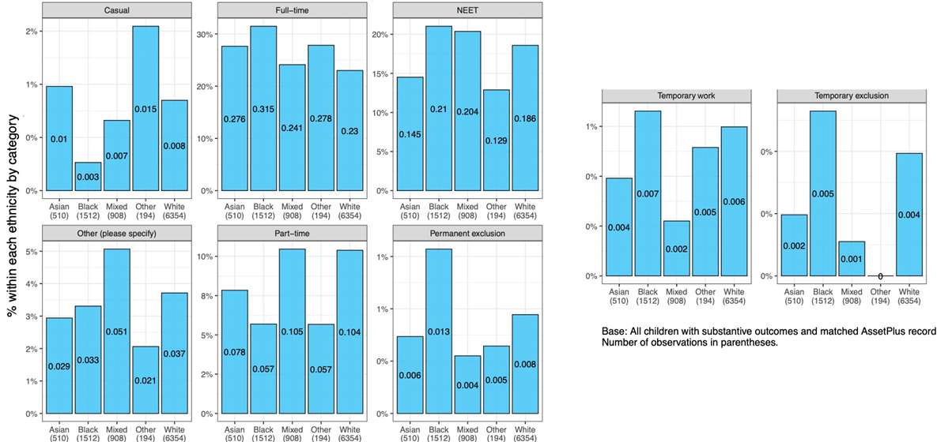
Education, training and employment

Slide 42
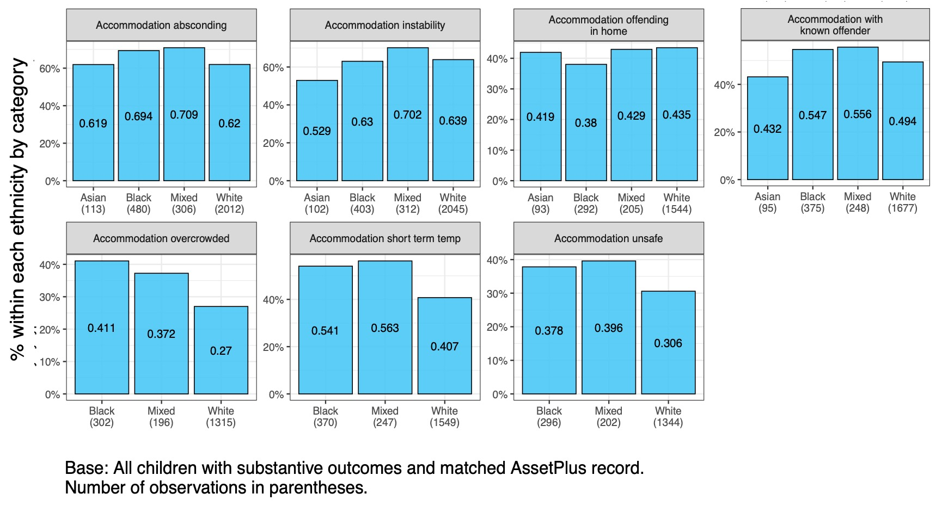
Accommodation

