Slide 1
Results Highlights PowerPoint Set UK-VARSS 2019
Published November 2020

Slide 2
UK-VARSS 2019
The following selected PowerPoint slides provide the core for a presentation on antibiotic sales, antibiotic use and bacterial susceptibility/resistance.
These slides are based on the UK-VARSS 2019 Report which provides further details.
VARSS REPORT 2019
2

Slide 3
Sales of Antibiotics
Sales of antibiotics for use in animals (tonnes), 2015-2019
Source: p. 7
VARSS REPORT 2019

Slide 4
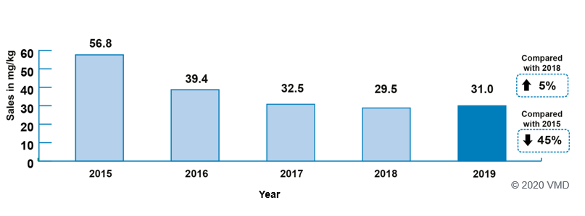
Sales of Antibiotics
Sales of antibiotics for use in food-producing animals, adjusted for animal population (mg/kg), 2015-2019
Source: p. 7
VARSS REPORT 2019

Slide 5
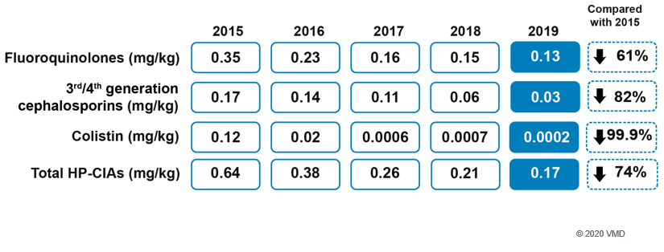
Sales of Antibiotics
Trends of antibiotic sales by highest priority critically important antibiotic for use in food-producing animals and adjusted for animal population (mg/kg), 2015-2019
Source: p. 7
VARSS REPORT 2019

Slide 6
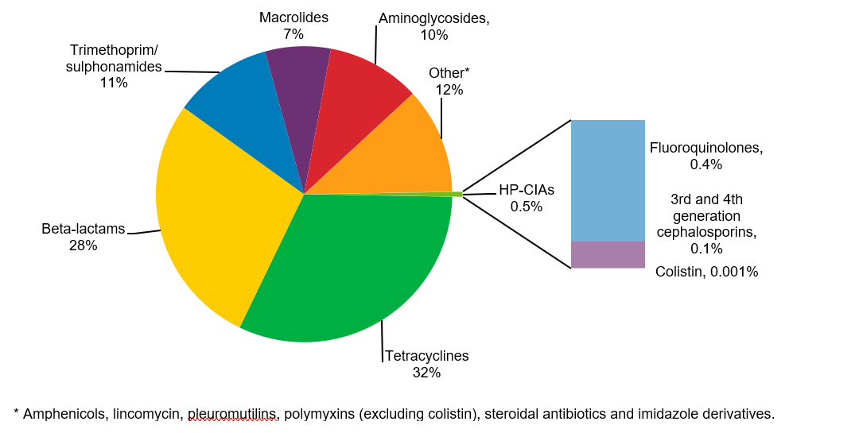
Sales of Antibiotics
Active ingredient (% weight) of antibiotics sold for all animal species by antibiotic class; 2019
© 2020 VMD
Source: Fig. 1.6; p. 19
VARSS REPORT 2019

Slide 7
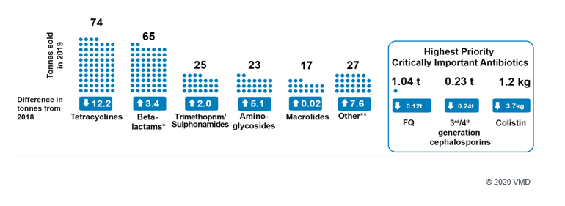
Sales of Antibiotics
Total sales (tonnes) of active ingredient for all animal species by antibiotic class, 2019
Source: p. 7
VARSS REPORT 2019

Slide 8
Sales of Antibiotics
Active ingredient (tonnes) of antibiotic sold for all animal species by route of administration; 2015–2019
© 2020 VMD
Source: Tab 1.1; p. 15
VARSS REPORT 2019

Slide 9
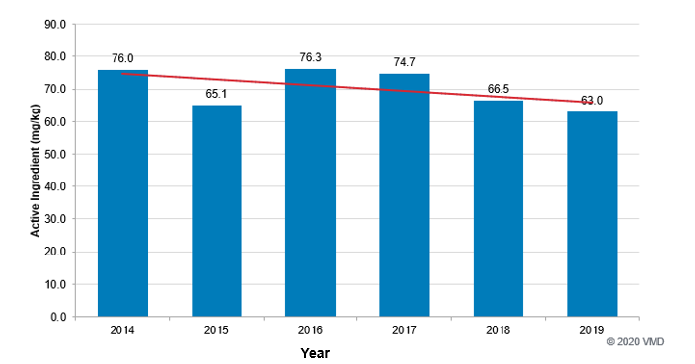
Sales of Antibiotics
Active ingredient (mg/kg) of antibiotics sold for use in dogs and cats; 2014–2019
Source: Fig 1.10; p. 26
VARSS REPORT 2019

Slide 10
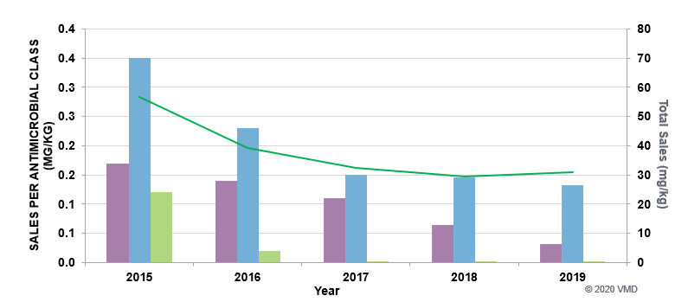
Sales of Antibiotics
Harmonised primary (total sales of veterinary antibiotics in mg/kg (―) and secondary (sales in mg/kg for 3rd and 4th generation cephalosporins (), quinolones () and polymyxins ()) outcome indicators for antibiotic consumption in food-producing animal species in the UK; 2015–2019
Source: Fig 1.12; p. 27
VARSS REPORT 2019

Slide 11
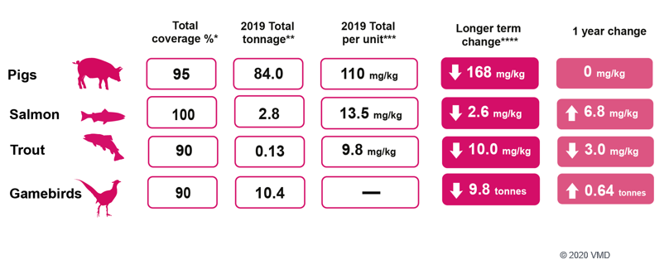
Antibiotic Usage Data
Antibiotic usage by food-producing animal species,
2019 compared with 2016, 2017 and 2018
© 2020 VMD
Source: p. 8
VARSS REPORT 2019

Slide 12
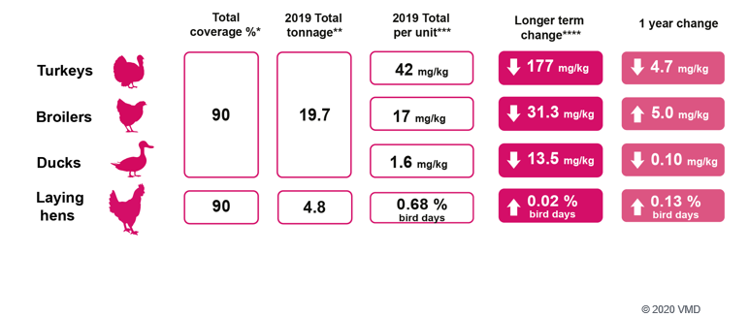
Antibiotic Usage Data
Antibiotic usage by food-producing animal species,
2019 compared with 2016, 2017 and 2018
Source: p. 8
VARSS REPORT 2019

Slide 13
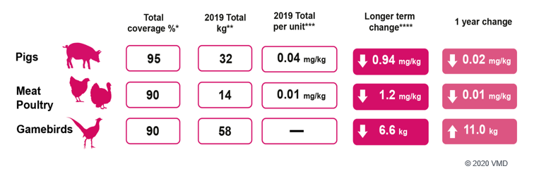
Antibiotic Usage Data
Usage of Highest Priority Critically Important Antibiotics by food-producing animal species, 2019 compared with 2016, 2017 and 2018
© 2020 VMD
Source: p. 8
VARSS REPORT 2019

Slide 14
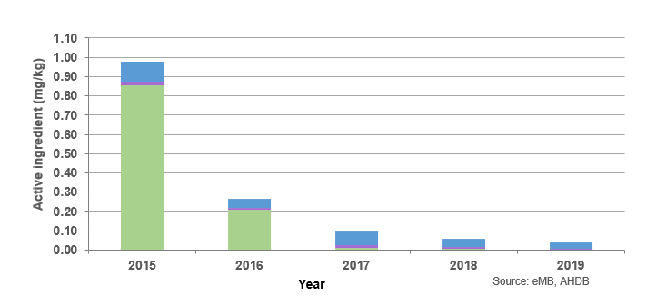
Antibiotic Usage Data
HP-CIA usage recorded for active ingredient (mg/kg) of antibiotics in eMB Pigs: colistin (), 3rd and 4th generation cephalosporins () and fluoroquinolones (); 2015–2019
Source: Fig 2.1; p. 32
VARSS REPORT 2019

Slide 15
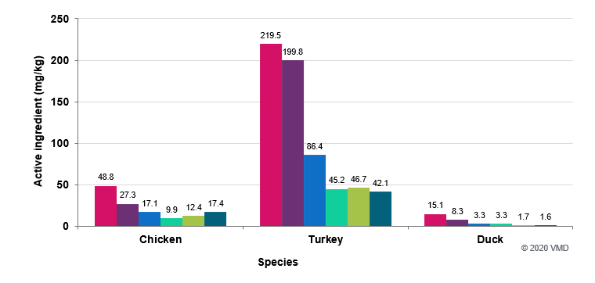
Antibiotic Usage Data
Active ingredient (mg/kg) of antibiotics used by all members of British Poultry Council
Antibiotic Stewardship by species (chicken, turkey and duck);
2014 (), 2015 (), 2016 (), 2017 (), 2018 () and 2019 ()
Source: Fig 2.5; p. 35
VARSS REPORT 2019

Slide 16
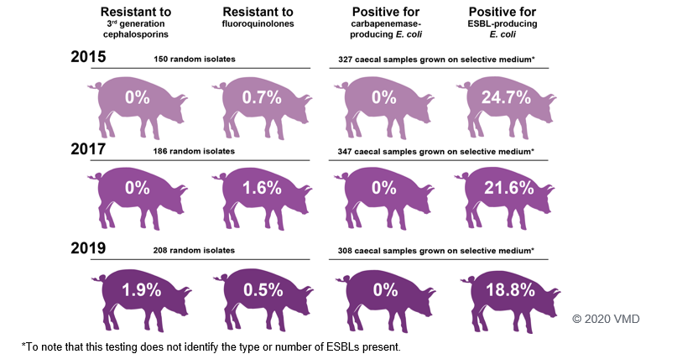
Harmonised Monitoring of AMR
Testing carried out on E. coli isolates as part of the Harmonised Monitoring Scheme, 2015, 2017 and 2019
Source: p. 9
VARSS REPORT 2019

Slide 17
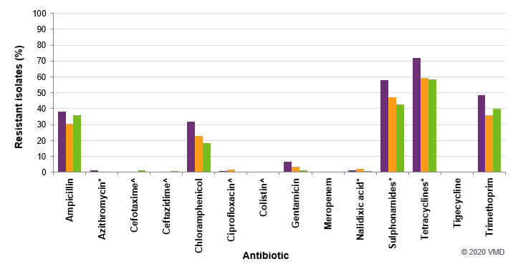
Harmonised Monitoring of AMR
Percentage resistance (interpreted using EUCAST CBPs) in E. coli isolates from pigs at slaughter; 2015 (; n=159), 2017 (; n=190) and 2019 (; n=183)
^ HP-CIA; * Interpreted using EUCAST ECOFF values as no CBP value is available.
Source: Fig 3.1; p. 54
VARSS REPORT 2019
17

Slide 18
Harmonised Monitoring of AMR
Harmonised AMR outcome indicators; 2014/15 (), 2015/16 (), 2016/17 (), 2017/18 () and 2018/2019 ()
© 2020 VMD
* Data not available for 2014/15.
Source: Fig. 3.2; p. 57
VARSS REPORT 2019

Slide 19
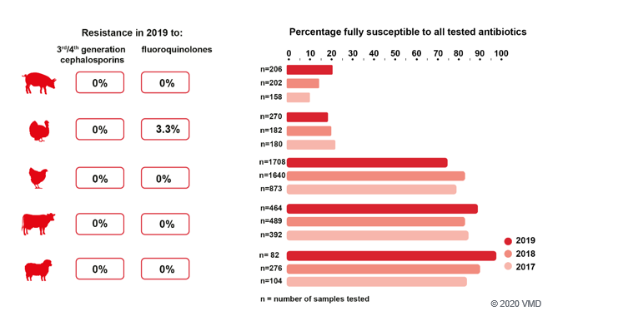
Clinical Surveillance of AMR
Resistance in Salmonella spp. from clinical surveillance, 2017-2019
Source: p. 10
VARSS REPORT 2019

Slide 20
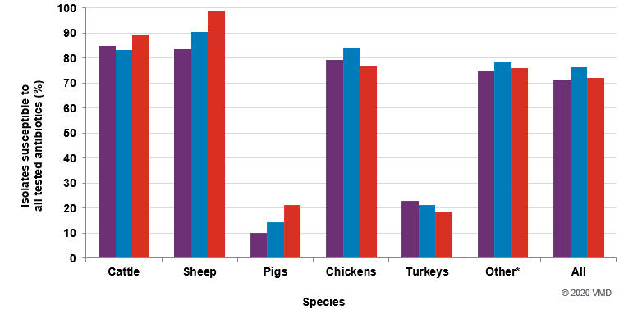
Clinical Surveillance of AMR
Percentage of Salmonella spp. isolates susceptible to all tested antibiotics, from different sources and animal species; in 2017 (), 2018 () and 2019 ()
Ducks, horses, dogs, other non-avian species, other avian species, feed and farm
environment.
Source: Fig. 4.16; p. 80
VARSS REPORT 2019

Slide 21
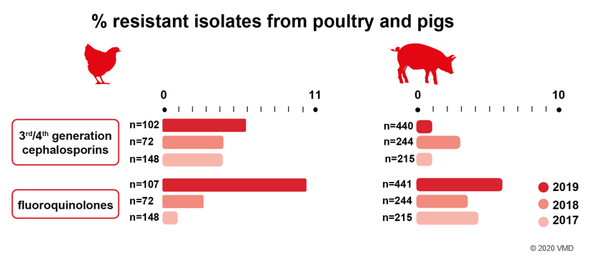
Clinical Surveillance of AMR
Resistance in E. coli from clinical surveillance, 2017-2019
Source: p. 10
VARSS REPORT 2019

