Slide 1
Transitions to the Labour Market within Girls Education Challenge
15th November 2019, IRC Office Islamabad
Narmeen Adeel
Notes:
Note that this PowerPoint summarises key findings from a full report titled ‘Transitions to the Labour Market within Girls Education Challenge’ and written by Narmeen Adeel and Divya Nambiar

Slide 2
Introduction
This report addresses the following questions:
What are the potential entry points to supporting older girl adolescents (15+) in transitioning from education to gaining better jobs and transitions to adulthood in FATA (newly merged districts of KP), Sindh, and Baluchistan provinces?
How can the design of Closing the Gap and TEACH be strengthened to maximise the potential for transformative and sustainable outcomes for girl’s/women’s economic empowerment?
What indicators could be used in Closing the Gap and TEACH to measure ”successful” transitions from education to the labour market and adulthood, and what are the pathways to impact?

Slide 3
Overview of Women’s Economic Empowerment (WEE)
Women’s economic empowerment is a key component in DFID’s Strategic Vision for Gender Equality (2018)
The concept is commonly associated with skills and capacities that make it possible to progress economically, as well as the power to act and make economic decisions.
WEE lays the foundation for educated, confident and well-rounded adulthood
The role of social and human capital becomes more pronounced since young girls are less likely to own physical assets
Notes:
Young girls are at a ‘tipping point’ in their lives adolescence “magnifies the difference between girls and boys [and] entrenches norms that disproportionately create negative experiences for girls” (Modi, 2017)

Slide 4
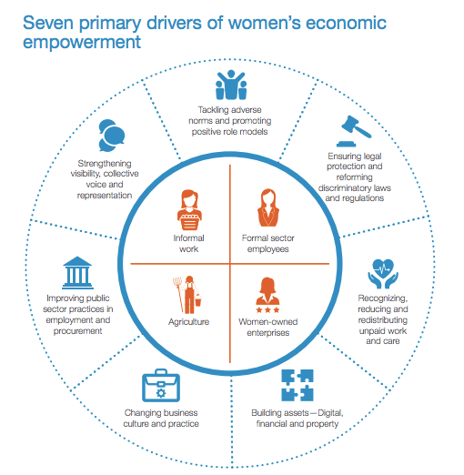
Drivers of WEE

Slide 5
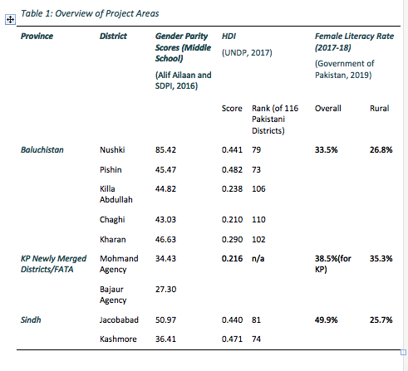
Regional Context
Notes:
The regional context is one of low gender parity, low HDI, low female literacy etc.
Across these districts, there are high rates of out of school children, low female literacy rates, and low HDI scores. As the table below shows, these problems are exacerbated in rural areas that are more remote, and the gender parity remains low as well. According to ASER (2018), 27.8% of children aged 6-16 are Out of School in rural Baluchistan – comparable figures for KP Newly Merged Districts (NMDs)/FATA and Sindh are 27.6% and 14% respectively (ASER, 2018). Moreover, female labor force participation rates are extremely low; 4.90% in Baluchistan, 7.98% in KP, and 8.59% in Sindh (Pakistan Bureau of Statistics, 2018).
Cultural Context:
These societies are strongly patriarchal; women have extremely limited mobility and are often expected to remain at home and thus have limited opportunities for education or economic activity. Female education and empowerment is not generally encouraged in these regions owing to the underlying socio-cultural dynamics. Decision-making authority, even on aspects of women’s lives, lies predominantly with male members of the household . Early marriages (before the age of 18) are extremely common and become a key reason for women dropping out of school, and not joining the labor force . The practice of honor killing is still commonly reported in many of these areas.

Slide 6
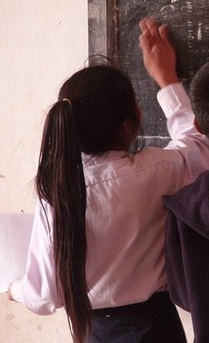
GEC Projects in Pakistan
Closing the GAP (ACTED) and TEACH (IRC)
Focus on adolescent girls aged 10-19
Accelerated Learning Program for younger girls
Short courses that include literacy and numeracy training, life skills and technical training for 13/14+ girls
Courses for technical skills have not been finalized yet and depend on local needs assessments
Notes:
Introduction to GEC:
The Girls’ Education Challenge (GEC) programme is a global initiative,; launched by DFID-UK in 2012 as a commitment to reach the most marginalised girls around the world. Presently GEC is the largest global fund dedicated to girls’ education. Through the GEC, the idea is to transform the lives of over one million of the world’s most marginalised girls through quality interventions including formal and non-formal learning. Access to a good quality education and learning opportunities will empower these girls to secure a better future for themselves, their families and their communities.
(source: https://girlseducationchallenge.org/#/about)
While the first phase of the GEC (2012-2017) focused on provision of quality education, the GEC is now in its second phase (2017-2025), which enables existing GEC beneficiary girls transition to secondary education and technical vocational training or employment. An additional cohort of girls is also being supported through the Leave No Girl Behind (LNGB) funding window, which consists of interventions for highly marginalized, adolescent girls (15+) who are out of school.
In Pakistan there are two GEC LNGB projects – TEACH and Closing the Gap
Concept of Skills
ALP component in both programmes aims to develop ‘foundational skills’ or ‘core skills’, which serve as the basis on which new skills are acquired
short term training programme component of both interventions have a strong focus on developing a combination of technical skills and life skills (also known by the term ‘transferable skills’), which aim to provide adolescent girls with a complex skills set, which will not only enable them to continue to acquire new skills and perform effectively at the workplace, but also empower them to become active citizens and exercise agency in their personal lives.

Slide 7
Closing The Gap
Objective: The overall objective is to support out-of-school adolescent girls (aged between 10 and 19, who were dropped out of the education process or never attended a school) to receive non-formal education, gainful skills training, and relevant employment opportunities for improving quality of their family lives and linking with formal education process.
The project aims to address two basic barriers for girls to education: 1) lack of access to education; and 2) social and cultural barriers.
Target Beneficiaries and Areas: 5,500 girls between 10-19 years of age in Sindh (Jacobabad and Kashmore districts) and Newly Merged Districts of KP/Previously FATA region (Mohmand and Bajaur agencies).
Partners: Right to Play, Adult Based Education Society (ABES)
Current Status: The project is set to initiate field activities by November 2019 including baseline, teachers’ identification, training and centre establishment for first set of literacy and numeracy centres in Sindh under first short-term learning stream cohort.

Slide 8
Closing the Gap
Program Design:
The Closing the Gap program has two components: the Accelerated Learning Program (ALP), and short term skills based courses.
Cross cutting activities:
Learning Centres
School Management Committees

Slide 9
TEACH
Objective: to bring lasting improvement in learning outcomes for girls, to transition them to formal schools wherever possible and appropriate, and to enable them to gain market-relevant livelihood and life skills
The project aims to address two basic barriers for girls to education: 1) lack of access to education; and 2) social and cultural barriers.
Target Beneficiaries and Areas: 35,000 girls in Baluchistan (Nushki, Kharan, Chaghi, Pishin, Killa Abdullah districts).
Partners: Baluchistan Education Foundation (BEF), Developments in Literacy (DiL Pakistan), Tameer-e-Khalq Foundation
Current Status: TEACH project has just started its implementation phase. Community mobilization has started and consortia partners are in the process of identification and selection of clients, villages and centres.

Slide 10
TEACH
Program Design:
The TEACH program has two components: the Accelerated Learning Program (ALP), and employment skills based courses.
Cross cutting activities:
Awareness and Outreach
Village Support Groups
Support to Public Education Department

Slide 11
What are the potential entry points to supporting older girl adolescents (15+) in transitioning from education to gaining better jobs and transitions to adulthood in FATA (newly merged districts of KP), Sindh, and Baluchistan provinces?

Slide 12
Entry Points to Supporting Older Girl Adolescents (15+) in Transitioning
The term ‘transition’ refers to a progressive shift in an individual’s personal or professional life.
A successful transition therefore, is one where an individual is capable of taking a step forward towards realising her potential.
There are two key indicators of successful transitions, in the context of this presentation.
Access to better jobs and new economic opportunities for adolescents.
Enhanced agency of girls and young women.
It is important to note that the onus for ensuring both these outcomes cannot be entirely on the individual.
Notes:
Transition pathways are not rigidly defined, in either of the programmes. There also seems to be an acknowledgement from programme implementation team members that transition pathways need not be linear. For example, a school dropout who has attended a short-term vocational training programme and has been sewing garments can also return to complete formal schooling and either pursue higher education, or a new livelihood. Both programmes seek to provide adolescent girls with an array of options – to enhance their skills so that they can realise their potential.
Some examples of successful transition pathways, as envisaged in project guidelines and interactions with programme staff, include: returning to higher education, obtaining a job (in the formal or informal sector), starting a small business, or becoming a trainer or a teacher. An important transition pathway which was not mentioned (but could be considered) includes, becoming community health workers or volunteers.
‘Better jobs’ are jobs that are ‘productive, delivers a fair income, security in the workplace, prospects for personal development and social integration, freedom for people to express their concerns, organise and participate in the decisions that affect their lives and equality of opportunity and treatment for all women and men’ (based on ILO, 2019).
Better jobs can occur in the formal or informal sector. It could refer to both self-employment opportunities, entrepreneurship, public sector employment or even employment in the private sector. Given that in these contexts, the very act of women seeking to engage in social or economic activities outside the home, is itself a big step – it is also important to consider other transition pathways which could lead to empowerment. This includes, social work or community service (for example, as frontline health workers), voluntary jobs and apprenticeships – as these opportunities help catalyse the transition to better jobs.
Importance of building aspirations
Nussbaum (2000) uses the term ‘adaptive preferences to refer to how marginalised groups seem to have low expectations from themselves, due to their limited life expectations. A key feature of both interventions is that they seek to broaden the aspirational horizons of adolescent girls,
Aspiration acts as a map – providing individuals (particularly those who are vulnerable) new routes to empowerment. Given that adolescent girls who participate in these programmes are often first-generation learners, with few female role models, a crucial component of both programmes is that they seek to teach adolescents to imagine a new kind of future – one that would have been impossible for the older generation of women.

Slide 13
Challenges to Transition Pathways
Older adolescent girls in these provinces face four key challenges which could hinder their transition pathways:
skills gaps
information gaps
aspiration gaps
adverse social norms
There are three key entry points, to support older adolescent girls to make successful transitions
Individual level
Enhancing access to education and training
Outreach to motivate girls to learn
Coaching and mentorship support to improve learning outcomes and transitions
Successful transitions
Enhanced agency of adolescents and girls
Enhanced access to economic opportunities
Peer learning support
Safe spaces for girls to communicate and interact
Peer networks to connect adolescent girls to new economic opportunities
Peer to peer
Family and community based organisations for girls/women, by girls
Education/training institutions
Local government
Institutional
Notes:
The term ‘entry point’ is used to refer to specific domains or levels in which specific interventions could be introduced, to ensure successful transitions
The individual level: This includes interventions to enhance access to education and training for adolescent girls and shaping their ‘capacity to aspire’. This could include outreach and mobilisation programmes to motivate girls to learn new skills. It could also involve coaching and mentorship support to help girls improve their learning outcomes and provide access to counselling and information on possible transition pathways. Interventions at this level are focused on enabling individual girls to overcome specific challenges, so that they can be tracked into a transition pathway which aligns with their personal aspirations.
Peer to peer level : This includes initiatives to create peer-to-peer networks for adolescent girls where they can share information on future plans, aspirations, training needs and requirements and find collective solutions to achieve them. For such peer-to-peer interventions to be successful, it is vital for adolescent girls to have safe spaces, within their communities where can gather together and express their opinions freely.
Institutional level : family and community, Community based organisations (SMC), Education and training institutions, Local government support

Slide 14
How can the design of Closing the Gap and TEACH be strengthened to maximise the potential for transformative and sustainable outcomes for girl’s/women’s economic empowerment?

Slide 15
Overview of Existing Program Design Elements Contributing to Economic Empowerment of Adolescent Girls:
Tackling adverse norms and promoting positive role models
Building assets - digital, financial and property
Changing business culture and practice
reducing discriminatory practices through education
enhancing agency and empowerment of adolescent girls through the life skills curriculum
encouraging greater awareness for gender equality and empowerment through media outreach
identification of positive role models as 'mentors’
public deliberation on social norms through quarterly meetings with the community
provision of business grants and toolkits to select girls
financial literacy and life skills training
linkages with MFIs and VSLAs
reaching out to local business owners and industry to conduct a needs assessment of required skills
job placement assistance

Slide 16
Strengthening the Program Design to Maximize Potential
1
Tackle adverse norms and promote positive role models
Emphasize the development of agency for adolescent girls through the curriculum and extra-curricular activities
Introduce outreach activities targeted specifically toward male members of the community
Explore the involvement of male mentors to supplement female role models
Introduce (or in the case of TEACH expand the scope of) media outreach through low-cost measures (radio, SMS etc.) to generate awareness
Create a community mapping of support services for women and provide all beneficiaries information
Create a formal role/agreement for beneficiary girls to become ‘mentors’ within the community after graduation
2
Enable legal protection
For beneficiaries that are 18 or older, the program should encourage registration for the Computerized National Identity Card (CNIC).

Slide 17
Strengthening the Program Design to Maximize Potential
3
Recognize unpaid work and care
introduce formal courses and certification for these roles, such as skills training for housekeeping, childcare and elderly care
Conduct a needs assessment to explore whether offering child care facilities at the centre would encourage greater attendance
4
Build digital and financial assets
Incorporate and emphasize digital literacy within the curriculum
Emphasize the procedure and advantages of opening a physical bank account
Build stronger linkages with and exposure to MFIs
5
Change business culture and practice
Explore opportunities with local industry and business owners whereby beneficiary girls can seek employment along with a male member of their family
Explore the introduction of formal skills courses in local trades conventionally done by women (such as carpet-weaving, embroidery, bangle-making, cotton-picking) and expand the scope to develop greater female participation in the value chain
6
Strengthen visibility, collective voice and representation
Form Self Help Groups (SHGs) in collaboration with the BISP Beneficiary Committees (BBC) wherever possible
Explore the development of work collectives

Slide 18
What indicators could be used in Closing the Gap and TEACH to measure ”successful” transitions from education to the labour market and adulthood, and what are the pathways to impact?

Slide 19
Defining Success
An analysis of programme documents and interviews with programme staff brought out the point that defining ‘success’ is complex.
During initial discussions, ‘success’ was defined in numerical terms, using indicators such as: achieving specific learning outcomes, transition rates, etc. While there was recognition that empowerment of girls and women was a key intended outcome of the programme – there were few indicators to measure this.
Existing indicators measure indicators revolving around three key areas i.e. learning, transitions and sustainability.

Slide 20
Enhancing Program Evaluation
Impact evaluation approach can be strengthened by incorporating measures of the reduction of vulnerability and enhancement of agency within beneficiary girls through
Socio-emotional behavioural survey
Tracer study
Value Addition of these tools
Captures girls’ own understanding of empowerment
Captures changes in social and behavioral norms (if any)
Qualitative studies provide opportunity to explore social dynamics and causes of change in detail
Tracer study helps see change over long term and gauge sustainability
Notes:
Components of Socio-Emotional Behaviour Survey:
Social and Economic Behaviour – To track the social skills, support and environment for beneficiary girls.
Emotional Behaviour – To track the emotional health and vision of self that beneficiary girls develop.
Aspirations – To track aspirations and goals of beneficiary girls

Slide 21
Contacts
For further information, please contact:
Narmeen Adeel, Research and Evaluation Consultant
m: +92 307 4444088
e: narmeen.adeel@gmail.com

Slide 22
“This document is an output from a project funded by UK aid from the UK government. However, the views expressed and information contained in it are not necessarily those of or endorsed by the UK government who can accept no responsibility for such views or information or for any reliance placed on them.
This publication has been prepared for general guidance on matter of interest only, and does not constitute professional advice. The information contained in this publication should not be acted upon without obtaining specific professional advice. No representation or warranty (express or implied) is given as to the accuracy or completeness of the information contained in this publication, and, to the extent permitted by law, no organisation or person involved in producing this document accepts or assumes any liability, responsibility or duty of care for any consequences of anyone acting, or refraining to act, in reliance on the information contained in this publication or for any decision based on it.”

