Slide 1
ESFA 16 to 19 revenue funding allocation statement 2019 to 2020
A look at your statement
Sarah Downes
February 2019

Slide 2
Video outline
This video will cover:
Where to find your 16 to 19 revenue funding allocation statement
What the statement contains
Overview of changes to 16 to 19 revenue funding allocation statements, including
Changes to Table 1a: student numbers
Renaming of Industry Placement Capacity and Delivery Funding table
Addition of advanced maths premium table

Slide 3
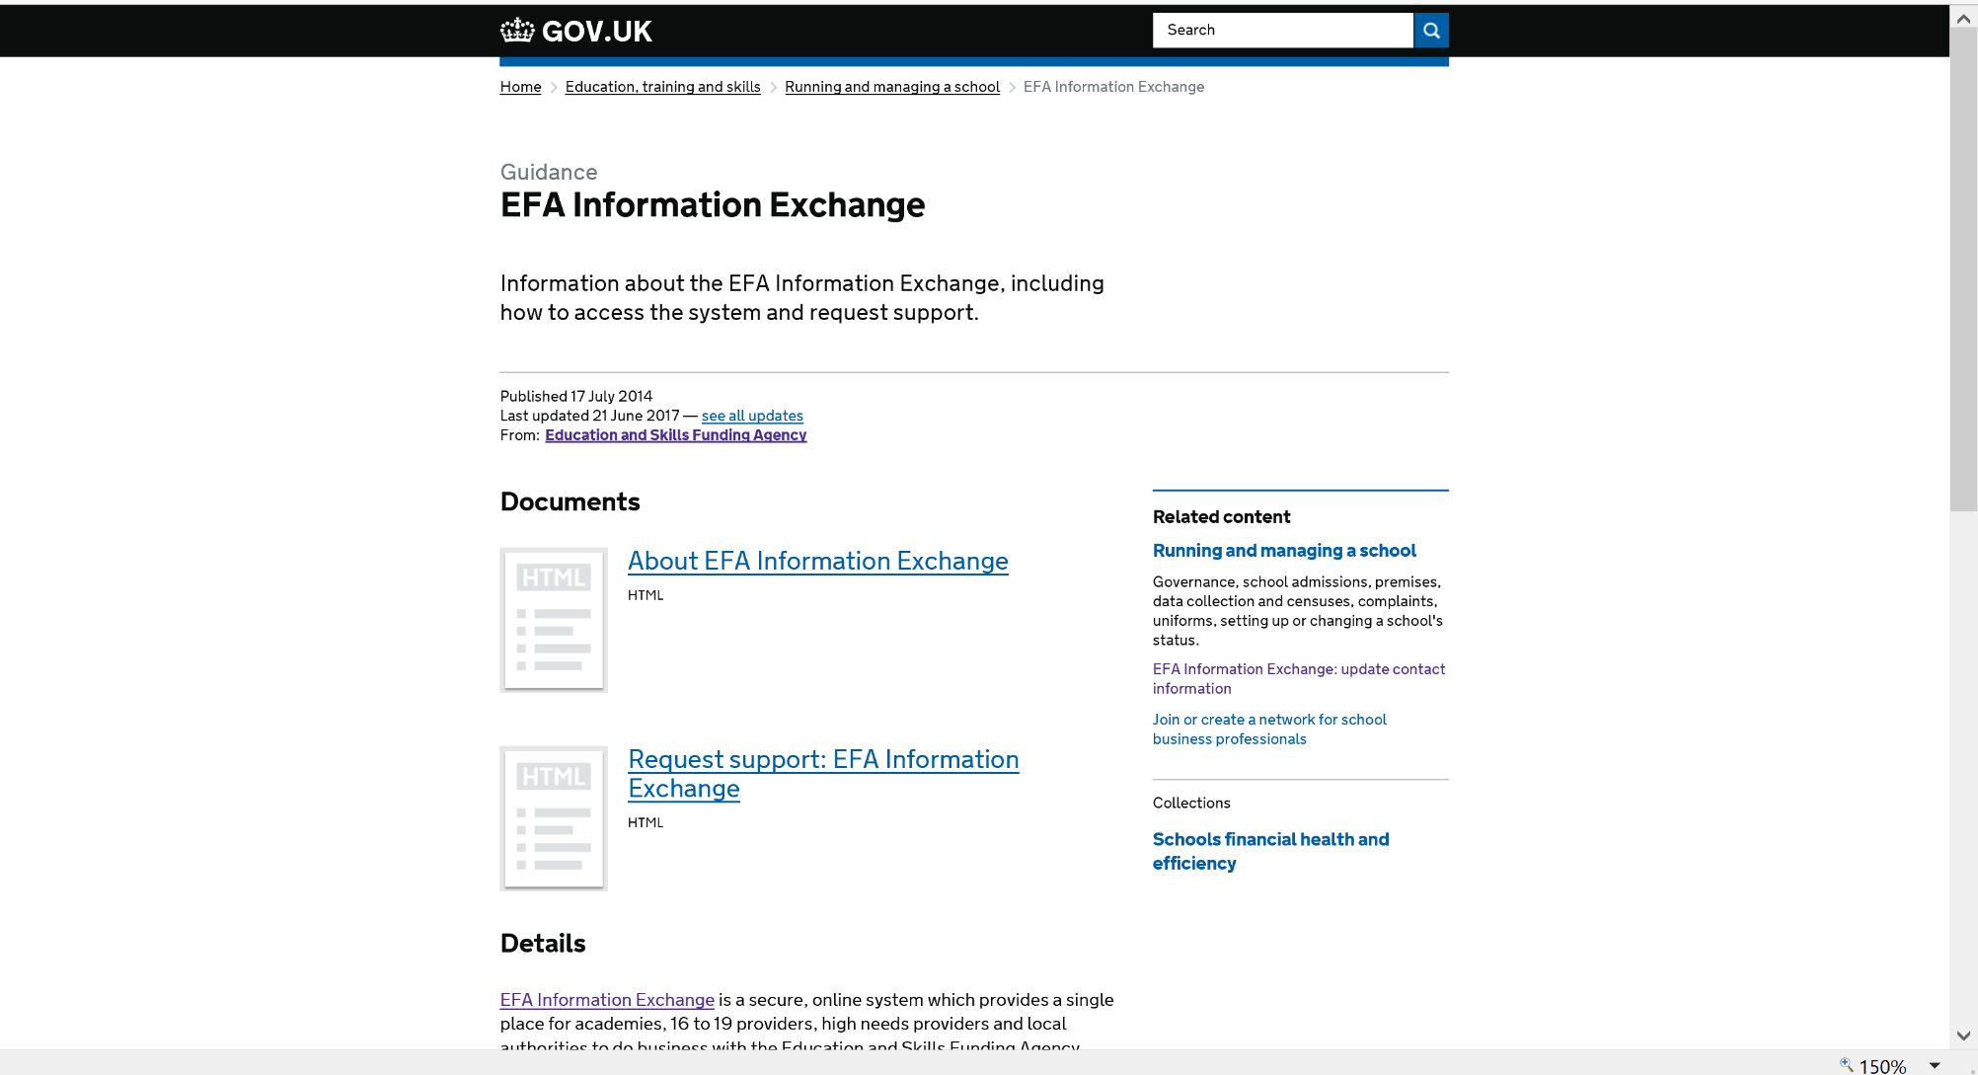
Where to find your statement
We upload statements to the Information Exchange
You can find the file in the document exchange, ‘revenue funding’ folder for ‘AY 2019-20’

Slide 4
A look at your statement

Slide 5
Table 1a: Student Numbers
Table 1a shows how we have calculated your student numbers. This table will look different for different providers.
This year you will see the methodology we have used, including the ratio if this is applicable

Slide 6
Industry Placement Capacity and Delivery Funding
16 to 19 allocations for 2019 to 2020 will again include allocations for capacity and delivery funding (CDF)
To bring the allocation statements in line with policy this table now shows on your statement as Industry Placements: Capacity and Delivery Funding (CDF)

Slide 7
Advanced maths premium
In 2019 to 2020 we will issue payments to institutions for the advanced maths premium for the first time
There is a new table in the statement for advanced maths premium
The table shows the figures we’ve used to calculate the allocation

Slide 8
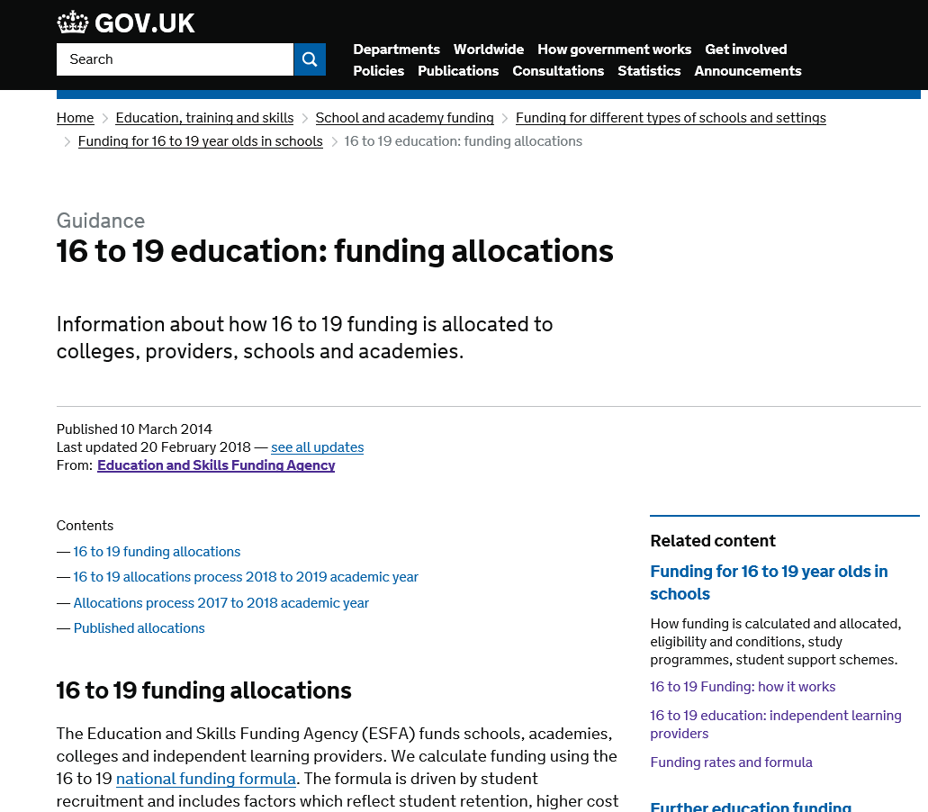
Further information on 16 to 19 revenue funding allocations
More information about
16 to 19 funding allocations
https://www.gov.uk/guidance/16-to-19-education-funding-allocations
Useful links are available in the description box

Slide 9
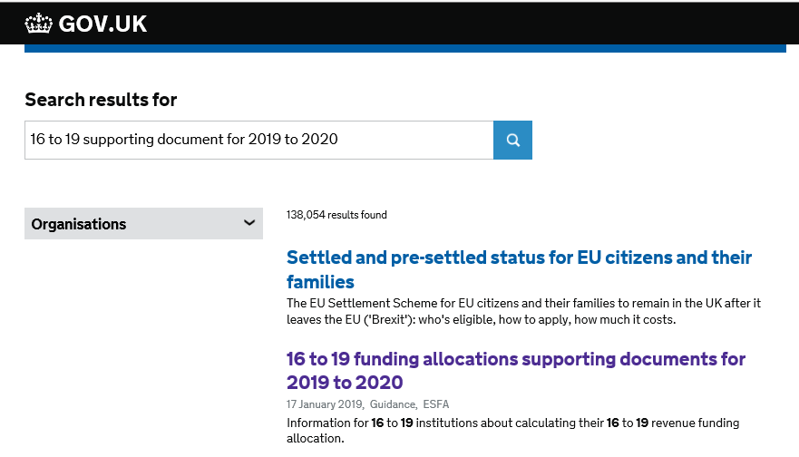
Documents to help you understand your statement
Simply search GOV.UK for ‘16 to 19 supporting documents for 2019 to 2020’ and select the second link.

Slide 10
For more information
Contact us
Using our online enquiry form http://bit.ly/KCenquiryform
Visit the website
http://www.gov.uk

