Slide 1
Renal Stones And Their Investigation In Assessing Fitness To Practice To Work At Sea
Matthew Bultitude
Consultant Urological Surgeon and Clinical Lead for Urology
Associate Editor, BJUI

Slide 2
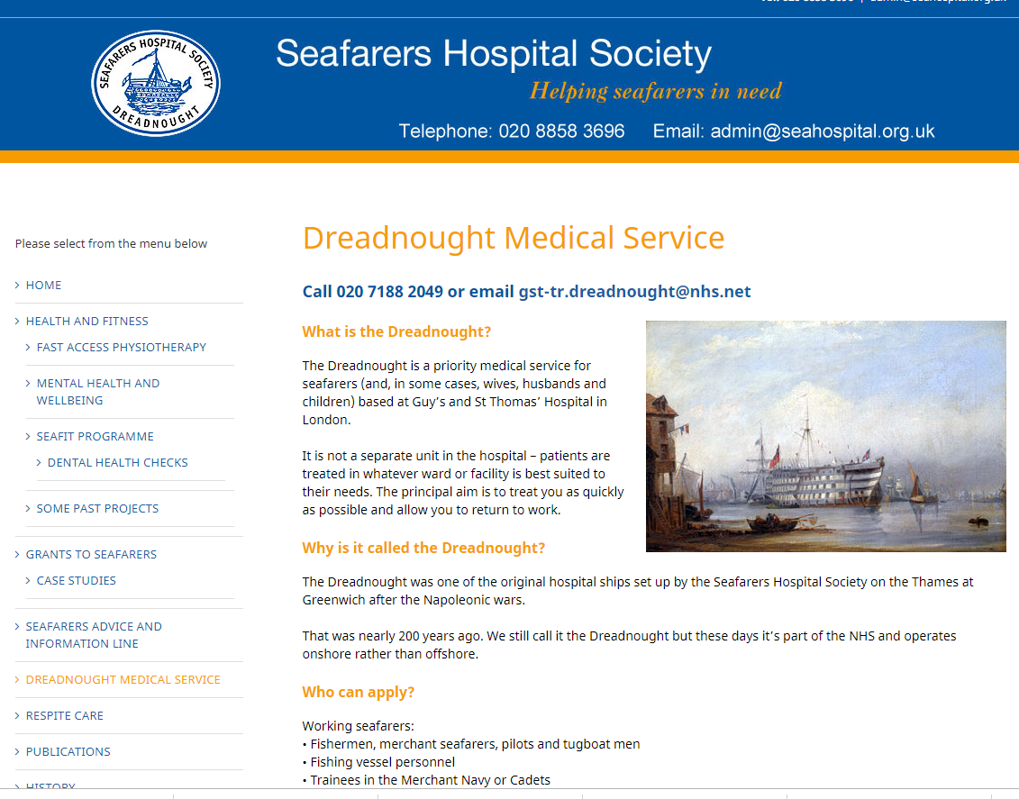
Notes:
Merchant seafarers are given priority treatment at the Dreadnought Unit so that they can return to work quickly. Because of the nature of their job, they are not allowed to work if they have certain medical conditions, in case of an emergency whilst at sea.
Our Dreadnought Unit is the continuation of a tradition of special hospital care for seafarers dating from 1821. The Seamen’s Hospital Society originally established a hospital on a ship moored at Greenwich, and in 1870 it came ashore to the banks of the Thames at Greenwich. In 1986 it moved again to St Thomas’ Hospital.
It is not a separate unit in the hospital - patients are treated in whatever ward or facility is best suited to their needs.
Referrals come into the administration office. Prospective patients are sent a form which asks whether their treatment is urgent or routine, and when the patient is available for an appointment. This is very important as seafarers are often away at sea and are unable to cancel appointments. Due to the distances travelled by seafarers from home and from ships around the world, accommodation is also arranged for them.

Slide 3
Outline
Stone Disease
Prevalence
Aetiology
Diagnosis
Treatments
Metabolic Evaluation
Prevention
Maritime guidance assessment
Pilots / CAA
Maritime Health Seminar 2018
@mattbultitude

Slide 4
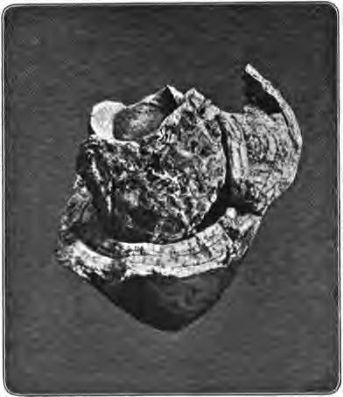
History of Stone
3 Earliest ‘elective’ operations known:
Circumcision
Trephination of skull
Cutting for stone
Earliest Bladder Stone ~4800BC
Cemetery in upper Egypt
16 year old boy – pure uric acid
Specimen at RCS Eng – destroyed in WW2
Maritime Health Seminar 2018
@mattbultitude

Slide 5
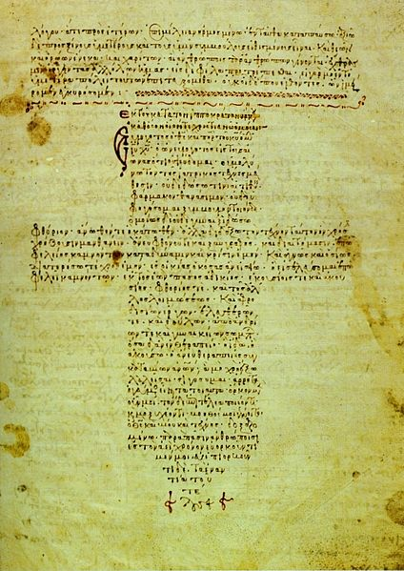
Treatment for Stone
Ancient Greece ~4⁻5th Century BC
Hippocratic Oath
Describes that specialists only should treat stone !
“I will not covet persons labouring under the stone, but will leave this to be done by men who are practitioners of this work”
Maritime Health Seminar 2018
@mattbultitude
Notes:
At least as early as 4-5th century BC
Alternative translations:
I will not use the knife, not even on sufferers from stone, but will withdraw in favor of such men as are engaged in this work.
I will not cut for stone, even for patients in whom the disease is manifest; I will leave this operation to be performed by practitioners, specialists in this art.

Slide 6
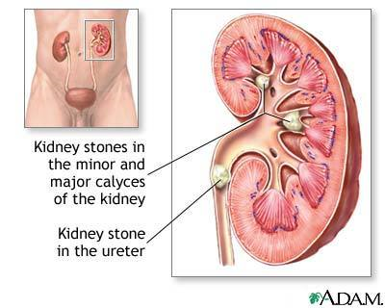
Prevalence
Lifetime Risk
Men ~ 10%
Women ~ 6%
Risk is increasing
Gender gap narrowing 1.7 →1.3 : 1
High recurrence rates
Significant cause of morbidity
... and death
Maritime Health Seminar 2018
@mattbultitude

Slide 7
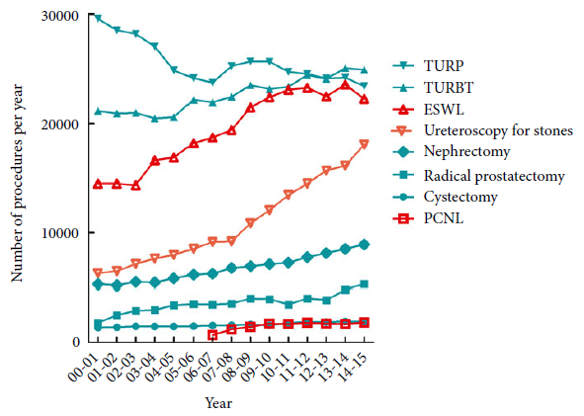
Trends in stone disease in England 2010-15
4.4% increase in upper tract stones
Treatments:
Lithotripsy and PCNL stable
50% increase in ureteroscopy
Decline in open stone cases
Maritime Health Seminar 2018
BJUI 2016; 118: 785-9
@mattbultitude

Slide 8
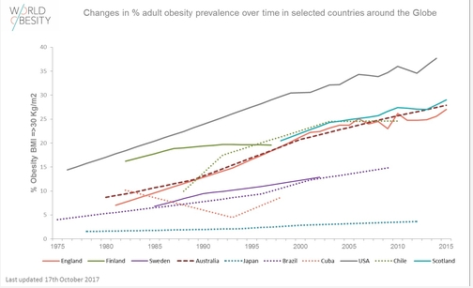
Obesity
Maritime Health Seminar 2018
@mattbultitude

Slide 9
Main Stone Types
Calcium containing stones ~ 80%
Oxalate ~ 60%; phosphate ~ 20%
Infection Stones ~ 7%
Uric Acid ~ 7%
Radiolucent
17% if overweight
28% if obese
Maritime Health Seminar 2018
@mattbultitude

Slide 10
Why ?
Supersaturation
Excess solutes vs. Not enough fluid vs. Lack of inhibitors
Causes
Genetic e.g. Cystinuria
Geographical
Dehydration – 2 litres of urine per day
Familial (2.5x)
Anatomical causes
Medical disorders eg. Hyperparathroid/ diabetes/ gout
Chronic diarrhoeal syndromes
Short gut / bypass surgery / Crohn’s disease
Maritime Health Seminar 2018
@mattbultitude
Notes:
USA lifetime incidence: men 12%; women ?7%

Slide 11
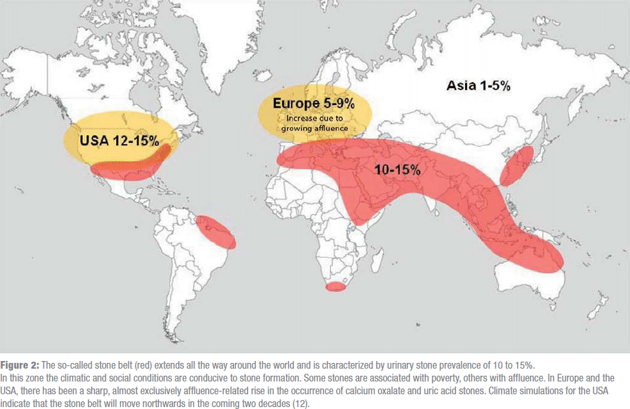
Maritime Health Seminar 2018
@mattbultitude

Slide 12
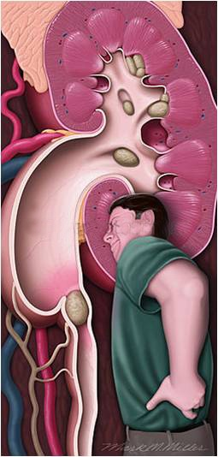
Symptoms
Severe pain ~ child birth
Dull ache
Infection
Bleeding
Urinary symptoms
Maritime Health Seminar 2018
@mattbultitude

Slide 13
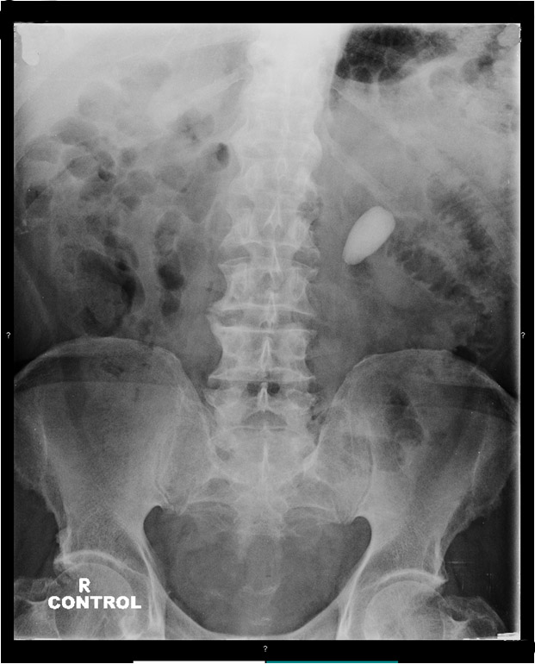
Diagnosis
Plain x-ray KUB
Sensitivity 44-77%
Specificity 80-87%
Maritime Health Seminar 2018
@mattbultitude

Slide 14
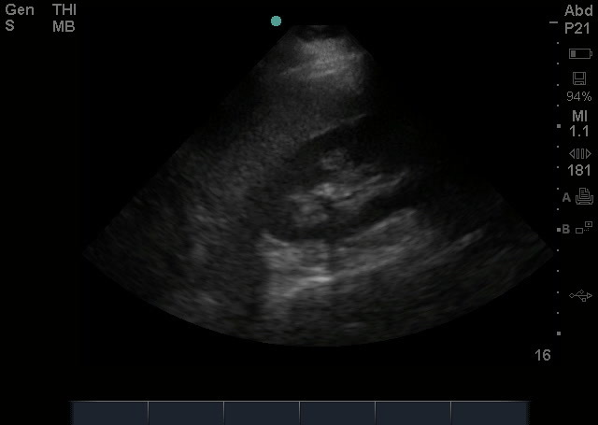
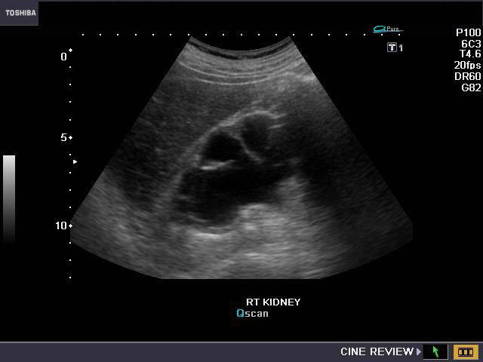
Diagnosis
Ultrasound
User dependent
Bad for ureteric stones
Good cheap screening tool
Sensitivity 45%
Specificity 88%
Maritime Health Seminar 2018
@mattbultitude

Slide 15
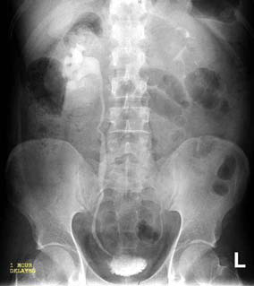
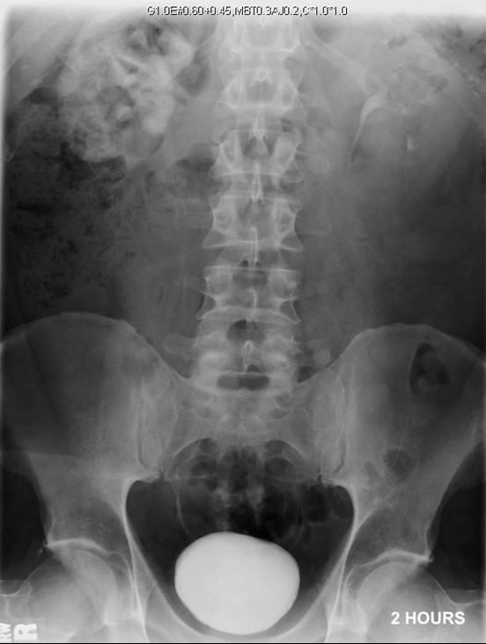
Diagnosis
Intravenous urogram (IVU)
Sens. 51-87%
Spec. 92-100%
Maritime Health Seminar 2018
@mattbultitude

Slide 16
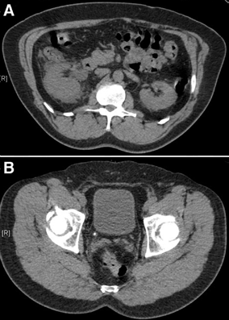
Diagnosis
CT KUB (NCCT)
Sensitivity 95-98%
Specificity 97-99%
Maritime Health Seminar 2018
@mattbultitude

Slide 17
What is chance of spontaneous stone passage ?
Overall 80% pass spontaneously
Stone Size | Passage Rates
2-4 | 76%
5-7 | 60%
7-9 | 48%
9-10 | 25%
Stone Location | Passage Rates
Proximal | 48%
Mid | 60%
Distal | 75%
VUJ | 79%
Maritime Health Seminar 2018
@mattbultitude

Slide 18
Management
Emergency
Elective
If pain settles – conservative
If sepsis:
JJ stent
Nephrostomy
Shock wave lithotripsy
Ureteroscopy
Percutaneous surgery (PCNL)
Maritime Health Seminar 2018
@mattbultitude

Slide 19
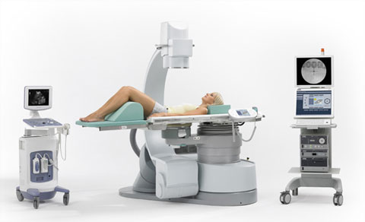
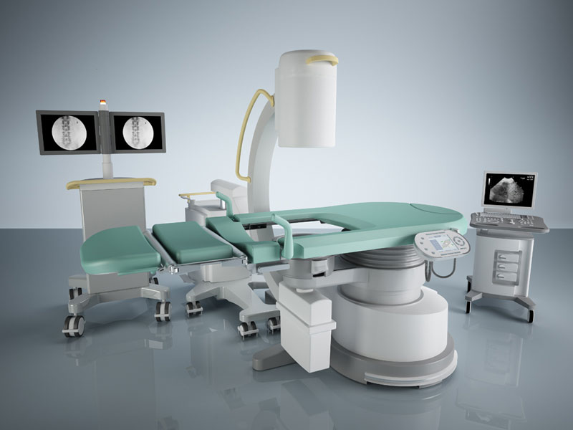
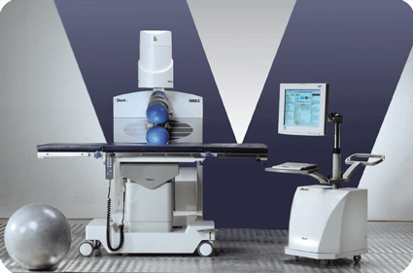
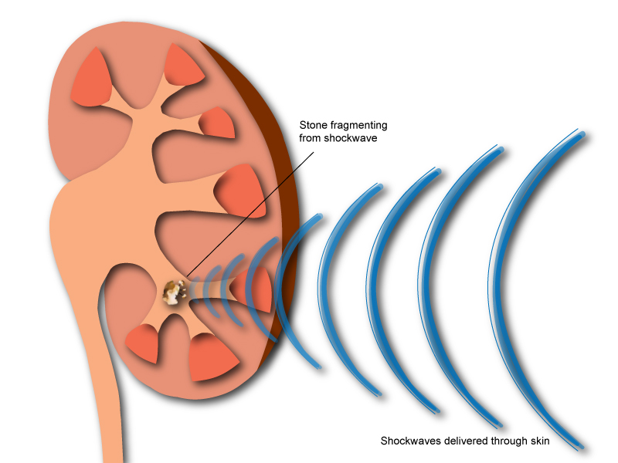
Shockwave lithotripsy (ESWL)
Day case
No GA
No ‘operation’
Multiple procedures
Not all stones break
Maritime Health Seminar 2018
@mattbultitude

Slide 20
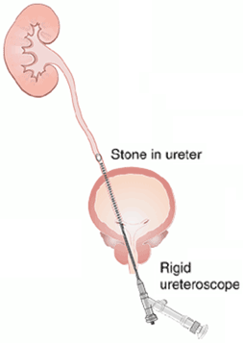
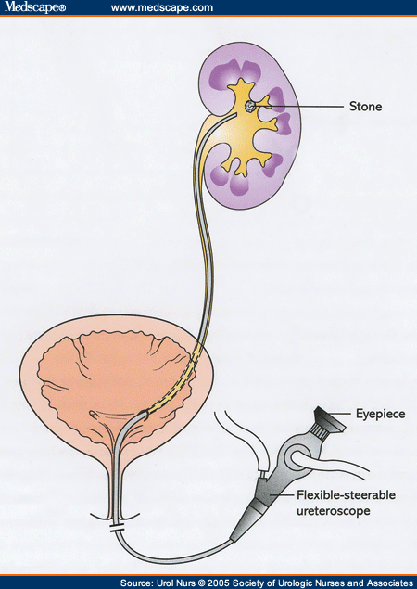
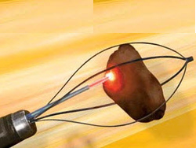
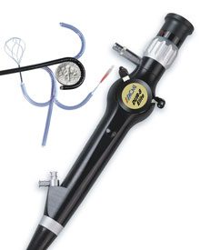
Ureteroscopy Rigid vs. Flexible
Maritime Health Seminar 2018
@mattbultitude

Slide 21
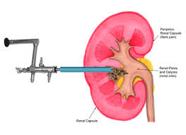
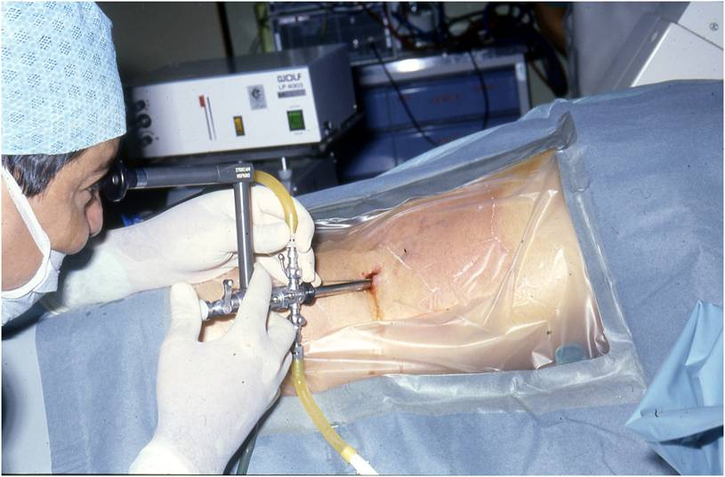
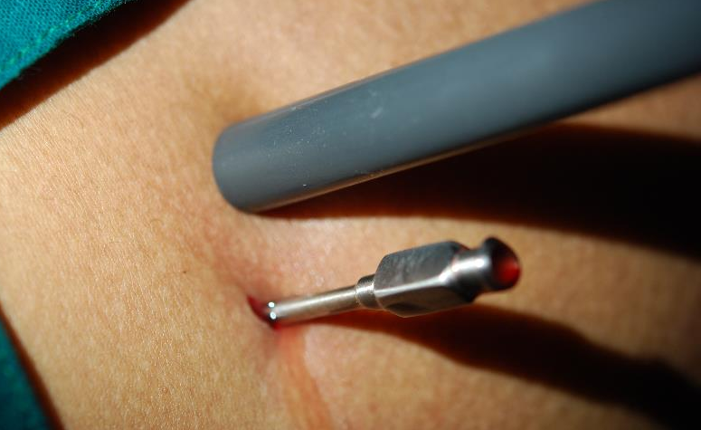
Percutaneous Nephrolithotomy (PCNL)
1st report 1976
Rapidly replaced open surgery
New techniques - miniaturised
Maritime Health Seminar 2018
@mattbultitude

Slide 22
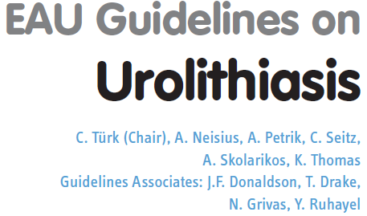
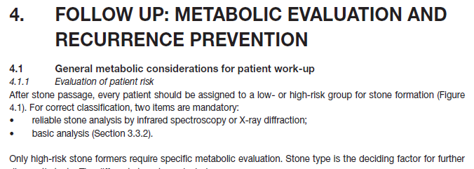
Prevention
Who needs metabolic evaluation ?
EAU Guidelines 2018
Basic:
Everyone !
Complex:
Recurrent stone formers
Age < 30
Bilateral stones
Non-calcium stones
Maritime Health Seminar 2018
@mattbultitude

Slide 23
Metabolic Evaluation
Basic
Stone analysis (if available)
Urine pH measurement
Serum calcium and urate
Complex
24 hour urine collection
Maritime Health Seminar 2018
@mattbultitude

Slide 24
Dietary Advice
Lifestyle measures and fluid – 2L+ urine/ day
Sodium – low salt diet
Fat – low fat diet
Animal protein – sensible amounts
Calcium – normal, not low
Fibre - high
Limit oxalate rich foods (ca oxalate stones)
Limit purine intake (uric acid stones)
Maritime Health Seminar 2018
@mattbultitude
Notes:
Fluid availability, time and toilets

Slide 25
Risk of Recurrence
“50% over 5 years; 70% over 10 years”
Is that correct?
Recurrent stone formers
~ 50% only get one lifetime recurrence
~ 10% of stone formers are highly recurrent
Maritime Health Seminar 2018
@mattbultitude

Slide 26
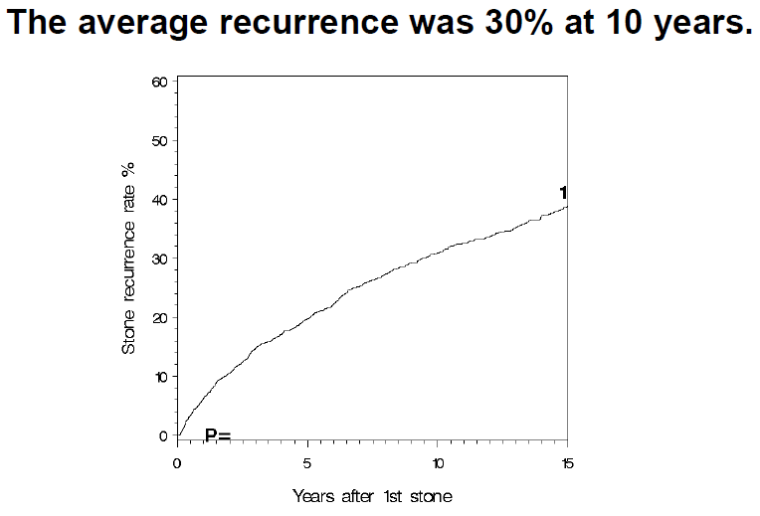
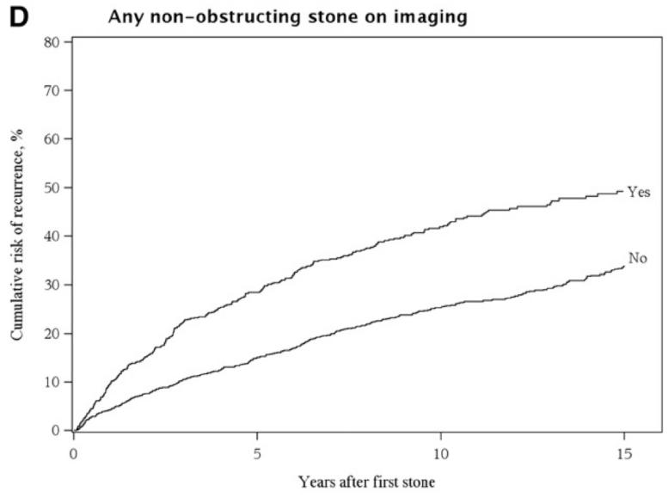
Risk of Recurrence
Study from USA (1984-2003)
2311 first time stone formers
Mean age 43; Male 62%; BMI 28.3 kg/m²
This study showed clinical and lab characteristics could predict those at highest risk using a nomogram
Maritime Health Seminar 2018
JASN 2014; 25: 2878-86
@mattbultitude

Slide 27
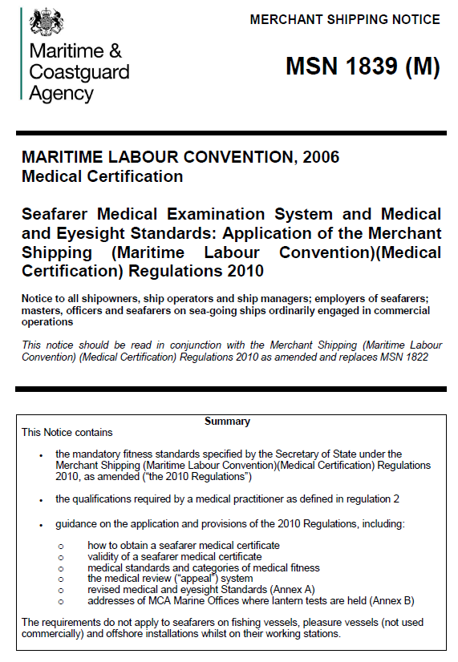
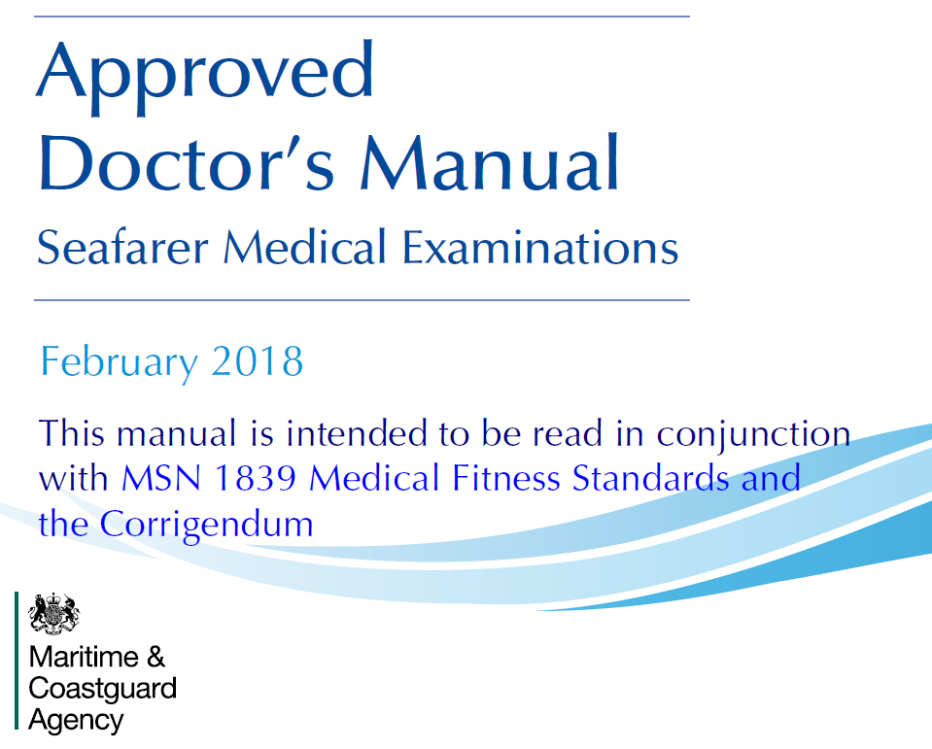
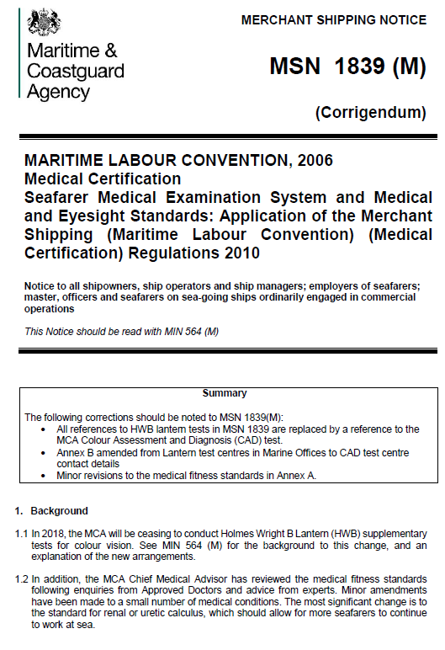
Maritime Assessment
Maritime Health Seminar 2018
@mattbultitude

Slide 28
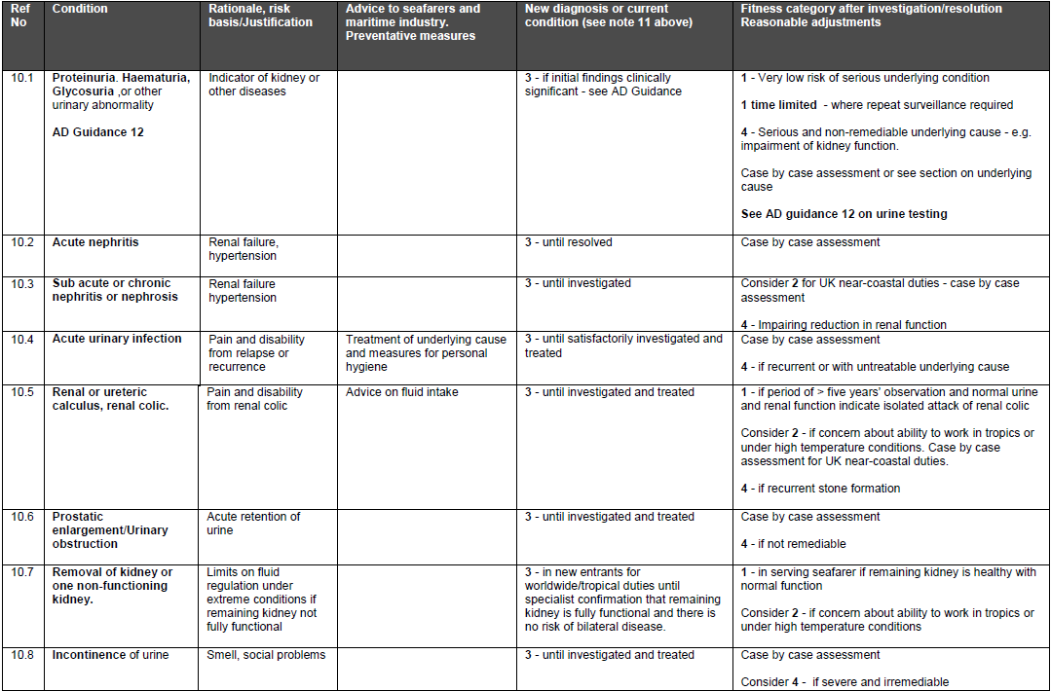
Maritime Health Seminar 2018
@mattbultitude
Notes:
Fitness category 1 – fit no restrictions
2- fit with restrictions
3 – Temp unfit
4- permanently unfit

Slide 29
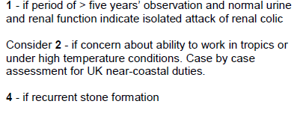
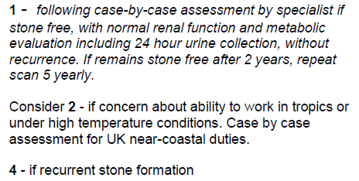
Renal or ureteric calculus, renal colic.
Maritime Health Seminar 2018
@mattbultitude
Notes:
Why change? 5 yrs doesn’t make any sense. The risk is later on. 50% risk but that means 50% don’t

Slide 30
Issues for discussion
Different trigger for metabolic evaluation from the guidelines
Should probably say 2 functioning kidneys
Timing of imaging
Type of imaging
Ultrasound
KUB x-ray
CT scan
Maritime Health Seminar 2018
@mattbultitude

Slide 31
Type of imaging
 | Ultrasound | KUB x-ray | CT KUB
Cost | + | + | ++
Availability | +++ | +++ | ++
Specificity | 80-90% | 80% | 98%
Radiation | 0 | 1 mSV | 2.5 mSV
Background radiation: ~2.5mSV / year
Nuclear industry limit: 20mSv / year
Maritime Health Seminar 2018
@mattbultitude

Slide 32
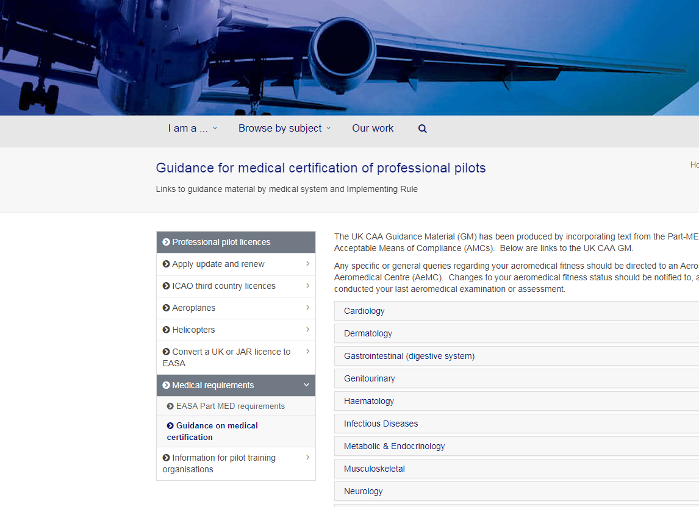
Civil Aviation Authority (CAA)
Maritime Health Seminar 2018
@mattbultitude

Slide 33
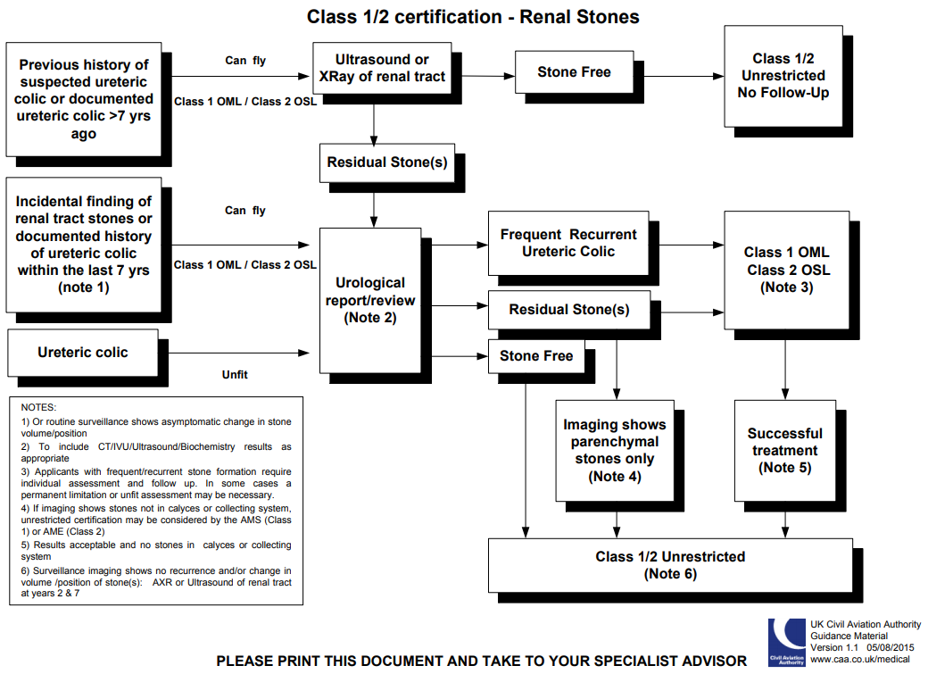
Notes:
Aeromedical examiner (AME)
Class 1 OML – operational multi-pilot (with a co-pilot)
Class 2 OSL – Operational safety pilot restriction (dual controls and other person is able to be pilot in command)

Slide 34
Summary
Stones are common
Highly recurrent but many patients don’t recur or have a single recurrence
Questions remain:
What type of imaging to do for follow-up?
How often should this occur?
What about parenchymal stones?
What about infrequent recurrent stone former?
(2 stones passed 15 years apart)
Email: matthew.bultitude@gstt.nhs.uk; Twitter: @mattbultitude

