Slide 1

ADHD and Autism
& Their Effect on Fitness to Work at Sea
Dr. Michael Craig PhD FRCOG FRCPsych
Clinical Lead National Autism Unit, SLAM NHS Foundation Trust
Reader in Neurodevelopmental Psychiatry, IoPPN, Kings College London
Pinero House, 115A Harley Street, London
E: mc@craigclinic.com

Slide 2
Neurodevelopmental Disorders (DSM V)
Autism Spectrum Disorder (1%)
ADHD (5%)
Intellectual Disability
Communication Disorders
Motor Disorders (including tic disorders)
Specific Learning Disorder

Slide 6
Disorders of psychological development
‘Autism and Asperger’s syndrome impair interpersonal interactions.
As these are critical to work at sea individual assessment is needed but the more severe forms of these conditions are incompatible with fitness for seafaring’.

Slide 7
Autism Spectrum
Disorder
Qualitative Impairment of Social Interaction
Early Onset
Qualitative Impairment in Communication
Restricted/Stereotyped Patterns of Behaviour, Interests and Activities

Slide 8
Autism Spectrum Disorders
Autism
HFA
Asperger
Difficulties with reciprocal interaction & behaviour
Ritualistic & stereotyped behaviour
Language delay
Learning disability

Slide 9
Autism Clinical Characteristics
1. Social Deficits
Difficulties with eye contact, gesture and expression
Lack of interest in others/avoidance
Few friends
Difficulties sharing excitement
Not seeking or given comfort

Slide 10
Autism Clinical Characteristics
2. Communication Deficits
Limited social chat/two-way conversation
Language delay without non-verbal compensation
Stereotyped, repetitive use of language
Reduced social and imaginative play

Slide 11
Autism Clinical Characteristics
3. Restricted Repetitive Interests/Behaviour
Difficulties with Change
Rituals / Compulsions
Sensory sensitivities / interests
Circumscribed Interests
Unusual Preoccupations
Motor Stereotypies

Slide 12
Alison C et al 2012 J Am. Acad. Child & Adol. Psychiatry 51(2), 202-12

Slide 13

ADULT ADHD

Slide 14
Hyperkinetic disorders - Attention Deficit Hyperactivity Disorder (ADHD)
‘It is cared for within a paediatric framework and there is often a discontinuity in care in the mid-teens.
Where it is severe it is unlikely to be compatible with work in any senior jobs at sea where vigilance is needed.
Individual assessment is needed.
As the commonly used medication (ritalin) is also used as a drug of abuse, safe custody on board may be a problem’.

Slide 15
DSM-V diagnostic criteria
Onset Before 12y
Pervasive Impairment in 2 or more settings
Inattention At least 5 symptoms and/or
Hyperactivity/impulsivity At least 5 symptoms
Subtypes Combined type
Predominantly inattentive type (ADD)
Predominantly hyperactive-impulsive type

Slide 16
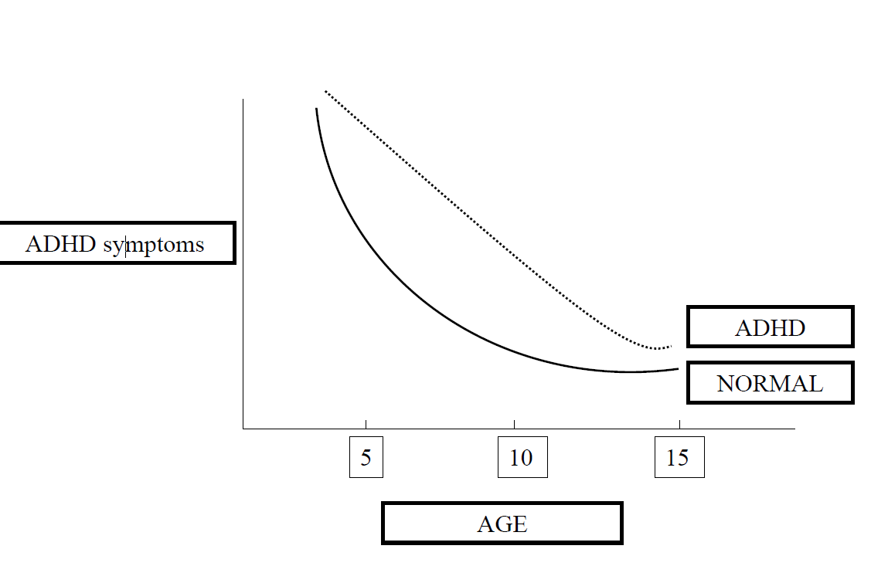
Developmental Delay
‘It is cared for within a paediatric framework and there is often a discontinuity in care in the mid-teens’

Slide 17
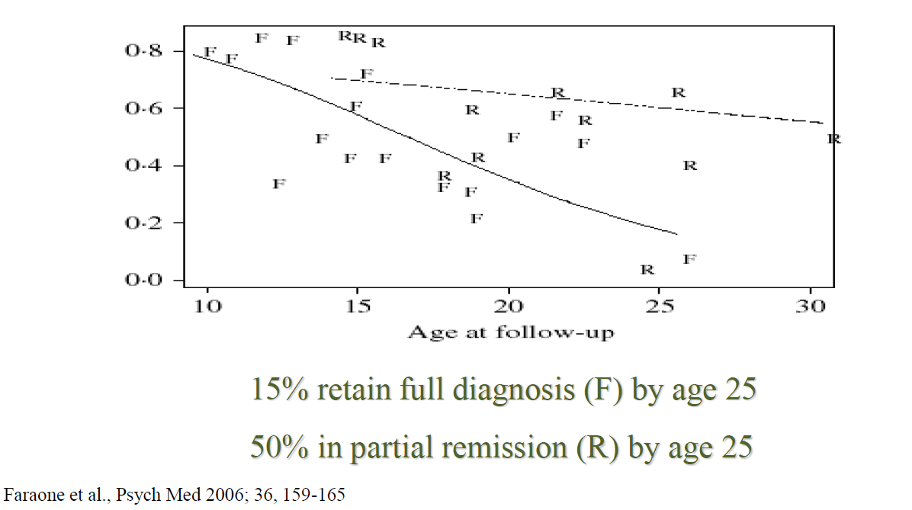
Persistence of ADHD: meta-analysis of longitudinal follow-up studies

Slide 18
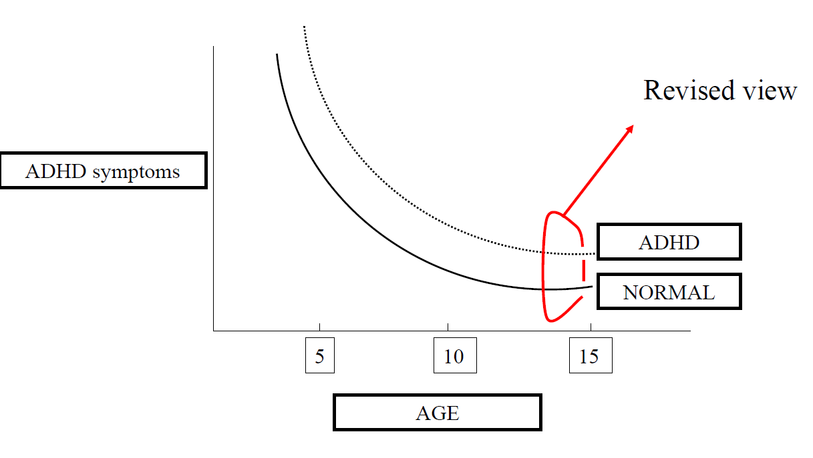
Developmental Deficit

Slide 19
UNTREATED
Stimulant prescriptions 2001-2005
2001
2002
2003
2004
2005
Predicted decrease (2005)*
16
14
13.78
12
11.44
10
9.88
9.49
Prevalence (per 1000 patient years)
8
7.88
6
6.54
5.72
5.43
4
4.51
3.31
2
1.63
0.84
0.61
0
15
16
17
18
19
20
21
Age (years)
Faraone et al., Psych Med 2006; 36, 159-165

Slide 20
Co-morbidity
78% had one or more co-occurring disorders
Kooij JJ, PhD thesis, 2006

Slide 21
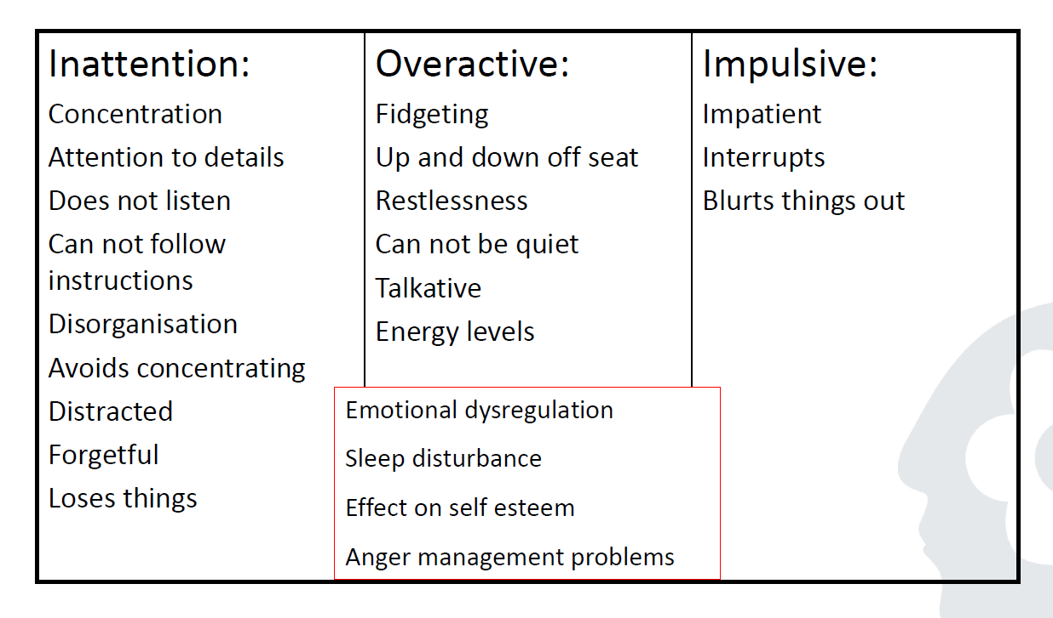
Attention Deficit Hyperactivity Disorder (ADHD)

Slide 22
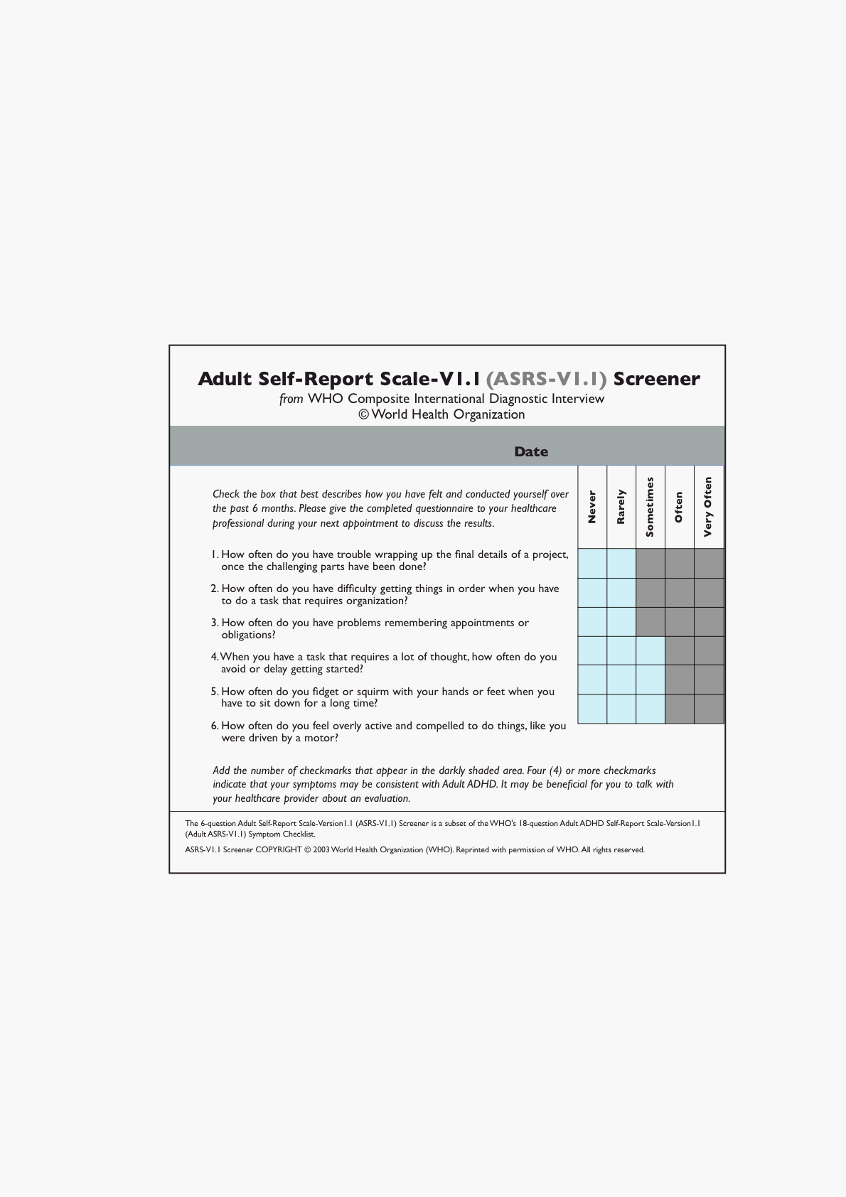

Slide 25
CONCLUSION
1. ASD: Spectrum – will depend on which specific symptoms and severity.
2. ADHD: Screen if evident in childhood
Check for co-morbidity
Medication successful in 40-80% of cases

Slide 26

QUESTIONS?

