Slide 1
When things go right: A wider perspective of the exams system

Slide 2
Today’s webinar
Part of a series of engagements with exam officers
Informed by what you told us
Topics:
The wider exam system, who does what and what we know about your role
The summer series and what it looks like to us
Reducing opportunities for things to go wrong
What to do if/when things go wrong
Short break to reflect and capture questions and issues – but ask them as they occur
Questions and feedback – and we’ll launch a number of polls as we go through
Notes:
A quick run-down of the things we will be talking about in today’s webinar

Slide 3
What you told us and what we’d like to know

Slide 4
What you told us
784 responses to our survey (at least 97% from exams staff) – Thank you!
You told us:
A video on the rules you could show to students would be valued (57%)
99.9% of respondents say they take steps to keep mobile phones out of exam room
Some of you feel that other teachers and senior leaders don’t always understand what is involved in your role
We’ve got time in this webinar to capture your thoughts and reflections – do tell us what else you think we need to know at any point as we go through.
We want to launch another poll at this point…

Slide 5
What we’d like to know
What’s important to you. So, please ask questions throughout.
We will also ask some of our questions. For example:
Securing mobile phones – innovative solutions
Facilitating access arrangements – use of separate rooms
Two people present to open papers – standard practice.
We will also launch a few quick polls throughout discussion.
If there is anything you think we’ve missed in understanding your key issues.

Slide 6
Your role
We recognise the importance of your role.
An all-year-round job.
You make a vital contribution to the effective working of the exam system.
When things go wrong that can have significant effects – for individuals, schools and sometimes the wider system.
There are particular challenges that many of you experience.
At this point, we’d like to launch another poll…
Notes:
We recognise that exams officers are an integral part of centre staff. Generally speaking, you manage the largest budgets and teams of staff in most and are highly accountable both internally and externally for the smooth running of exams, which have a big impact on school accountability and all the implications associated with that. We understand this and want to help you run successful exam series, and address challenges when they arise.
We know that your work is never done, despite what many think. We know that even during the summer holidays after results days plenty of you get calls or emails or requests to come into your school or college and you interact a lot with parents of candidates to explain systems and processes.
We have been doing some work to engage with you. We have a guest blog post written by and exams officer, we wrote to heads highlighting this post and we have conducted a snapshot survey.
We had a whopping 784 responses, which we were hugely encouraged by as it demonstrated a willingness by EOs to engage with Ofqual, so thank you to everyone who took part in that.
It has told us, and perhaps you could help to reaffirm some of these things by using your questions panel to send us comments and views as you wish, that

Slide 7
The wider exam system and who does what

Slide 8
The wider exam system
Notes:
You will already be familiar with all of these phases as you have a role to play in all of them, but this just gives you an idea of scale of the system in England

Slide 9
Our role
Independent, non-ministerial government department
Set rules to ensure regulated qualifications will deliver valid and reliable outcomes
Regulate exam boards to ensure they develop, deliver and award qualifications that meet our requirements
Oversee summer series and monitor how exam boards deal with any issues and ensure that they prioritise fair outcomes for all candidates
Publish reports and research to explain our approach
Collect and publish data (official statistics e.g. entries, malpractice etc) to provide transparency about how the system is operating
Notes:
9 to 1 grade scale

Slide 10
Exam Boards’ role
Develop qualifications that meet government policy (curriculum) and our regulatory rules (assessment design)
Deliver high quality exam papers to all centres
Provide reasonable adjustments and special consideration to candidates (where necessary)
Monitor how centres administer examinations
Recruit, train and monitor markers (capability, quality & capacity)
Set grade boundaries in line with statistical and qualitative evidence
Issue accurate results on time
Correct any errors
Operate an appeals service
Investigate malpractice and, where proven, issue proportionate sanctions

Slide 11
The summer series and what it looks like to us

Slide 12
Summer series
How we see the summer series play out
Notifications
Social media monitoring
Whistleblowers
Complaints
When we might get involved
Monitoring
Intervention strategy
Follow up
Prevention

Slide 13
Reducing opportunities for things to go wrong

Slide 14
Introduction
The following are based on real issues we have seen over the last few summers.
We know that you take these issues seriously and serious issues are relatively few in number.
However, the themes we’ve highlighted reflect the key trends we’ve seen and not isolated examples.
For those of you who have not seen these issues, they might highlight what can happen and illustrate what lies behind some of the rules.

Slide 15
Making entries
Encourage subject staff to ensure that entries are made on time
Encourage them to be realistic about their entries (eg tiers)
Encourage subject staff not to change entries late in process (tiers/options etc)
Example:
Some centres made a number of late changes to their combined science entries
A number of small packs (5 papers) for all three papers were sent in a separate dispatch to those centres
These were sometimes misfiled and/or incorrectly opened

Slide 16
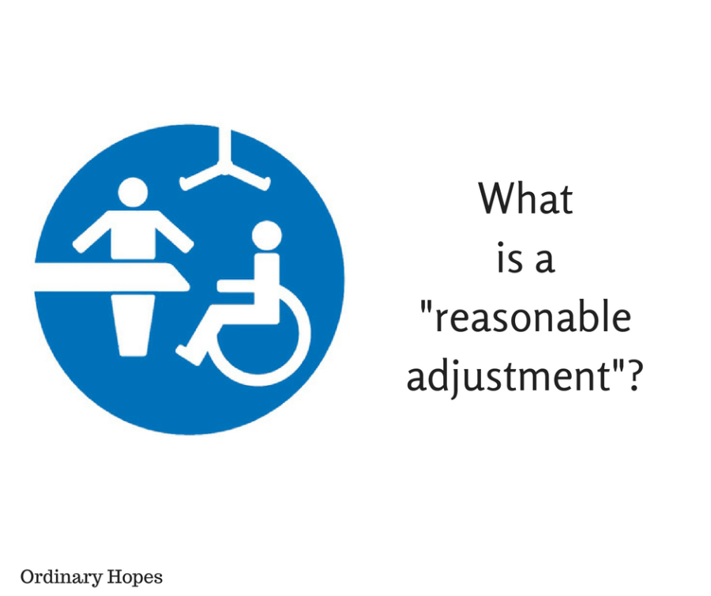
Access arrangements
Liaise with your SENCO who has responsibility in this area
Ensure an AA is only sought where it is necessary and where it directly addresses a student’s issue
Ensure you are only using separate rooms where it is necessary to do so.
We’d like to know what are the factors you consider when deciding if to use an additional room? And we have a poll on this issue.
Example:
Small number of students in a separate room
Only one person there to open question paper pack
Incorrect paper handed out, taken away & replaced
with correct paper
Students only assessed on a % of the assessments
Notes:
You told us extra rooms an issue
Managing AA is bureaucratic admin
Nor always clear why arrangements in place

Slide 17
Contingency planning
Make sure you have back up arrangements
should the centre become inaccessible
Identify who would step in if you were ill
Ensure that there are clear instructions for
anyone who might have to step in.
Example:
EO went off sick. Instruction to ‘stand-in’ to ‘check papers’ and file.
Stand-in opened every pack, looked through them to check correct and filed all papers in date order.
EO returned, identified that security compromised and had to escalate.
No breach resulted but centre warned about protocol.

Slide 18
Paper security
Check deliveries and query any apparent inconsistencies
Do NOT open the packages
Store packages securely
Ensure there are TWO people to open packages for each room
Do you evidence that they have opened the correct package?
Example:
A centre identified that a number of packages had either AM/PM on front cover for same exam
They checked with AO and were able to identify that some packages had been incorrectly labelled
By checking early, prevented incorrect paper potentially being handed out

Slide 19
Security and presentation of results
Early access of grade boundary information is given to centres as part of the embargo on results. Release of this information is a serious issue.
We’ve seen instances where students have gained access to results early – by logging into poorly controlled centre systems. This too is a matter of concern.
Presentation of results: we know that there have been issues with the way some results information (e.g. GCSE combined science grades) was presented to students and how accessible some of you find more granular information on students’ results to be. Exam boards are considering these issues ahead of next summer.

Slide 20
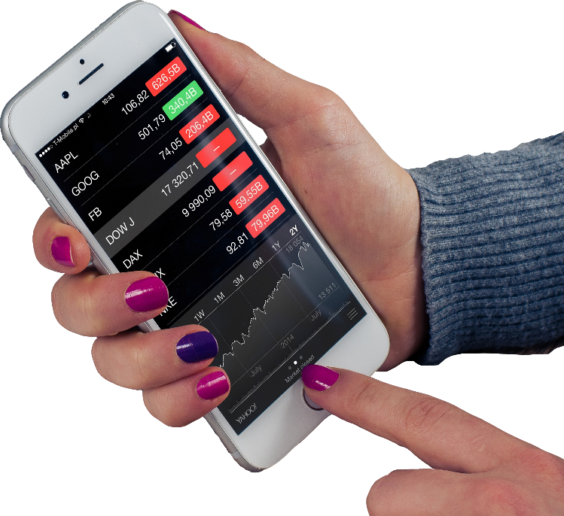
A note on mobile phones
Mobile phones are one area where we know centres face
difficulties.
Have any centres found an innovative way of dealing with this?
We commissioned behavioral research which found that:
Student attitudes and attachment to their phones is entrenched
Most precious, and expensive, item they own
Keeping their phone is unlikely to be ‘accidental’ (but nor is it in order to cheat)
The most successful school/college policies appear to be the ones that recognise the significant value of mobiles to students
Notes:
Suggestions you might find useful from our survey:
Bag and ticket systems
Leave mobiles in bag at the back/front of the hall
We appreciate that it must be difficult to handle this issue, particularly at large centres where you might have 800+ phones to collect. These suggestions are just things that other centres are doing that you may find helpful.

Slide 21
A note on mobile phones
This tallies with many comments you made in our survey:
“The problem is that they use their mobiles differently from the people making the rules and thus, there is a 'mentality gulf’.”
“Becoming more difficult to be certain no one has a phone. Students don't think they will get caught.”
“It is so hard to police as we can't physically search the learners.”
“It should be a requirement that detectors are used now as it is getting out of hand”
Have you identified any top tips for getting students to hand over their mobile phone?
Notes:
We are looking at creating a video specifically for the purpose of showing students in their learning environment, covering a broad range of rules and regs to help reinforce all the messages you are already communicating to them.
The reason I mention learning environment is that the behavioural insights we commissioned told us that students are unlikely to change their behaviour as a result of us targeting them with communications. What will impact their behaviour is their learning environment and the social norms around them. The trouble with us targeting students with anti-mobile messages is that this risks normalizing the idea that students routinely bring their phones into exams.

Slide 22
What to do if/when things go wrong

Slide 23
Prevention better than cure
Obviously priority should be given to preventing occurrences
Preparation – liaise with subject/SENCO re entries and necessary arrangements early on
Contingency – know who/what would happen in your absence
Processes – Check. Check…& check again.
Ensure other colleagues are clear about responsibility & consequences of tasks allocated to them, eg signing to say correct papers issued

Slide 24
When things do go wrong
Three primary concerns:
Security of assessment
Validity of assessment
Fairness to all students
Contain the issue
Keep students in room and supervised
Contact AO and check protocol
If any breach of secure materials then get confidentiality statements
Explain what they are signing
Ensure they know the serious consequences of any breach

Slide 25
Reflections!

Slide 26
Reflections
We noted you would value a video you can show learners about rules and regs. JCQ released one specifically on phones earlier this year and we are looking at what we can do. https://www.jcq.org.uk/media-centre/jcq-videos
What aspects of JCQs video do you think worked well, or could be improved?
Contingency plan – do you use this?
https://www.gov.uk/government/publications/exam-system-contingency-plan-england-wales-and-northern-ireland
Postcards – similar useful? Who for?
https://assets.publishing.service.gov.uk/government/uploads/system/uploads/attachment_data/file/537144/Postcard_-_Accreditation_Process.pdf
Where do you tend to go for advice/guidance on how to manage an issue?

Slide 27
Questions? And our final poll – and results

