Slide 1
Changes to the Meningococcal serogroup C conjugate (MenC) vaccine schedule 2014- first time university entrants aged 17 to under 25 years
An update for healthcare practitioners
Notes:
Rationale of resource
This resource is designed to support healthcare professionals (HCPs) to discuss the changes to the Meningococcal serogroup C conjugate vaccination (MenC) schedule including the reason behind the changes and what the changes include. This resource may also be of interest to other professional groups involved in supporting the Meningococcal serogroup C programme.
Note: Meningococcal serogroup C conjugate vaccination is commonly known as MenC. For the purpose of this resource MenC is used throughout this document.
This resource does not cover the actual administration techniques involved in vaccination against MenC. This information is available as part of the national minimum standards training. Information on immunisation by nurses and other health professionals is available in chapter 5 of Immunisation against infectious disease, Green Book ¹ available at http://immunisation.dh.gov.uk/category/the-green-book/

Slide 2
Key message
JCVI has advised that changes to the schedule will make the overall MenC immunisation programme more effective and offer greater protection to adolescents and young adults
Notes:
JCVI is the Joint Committee on Vaccination and Immunisation and is an independent expert advisory committee. JCVI was established to advise the secretaries of state for health for England, Scotland, Wales and Northern Ireland on all matters relating to communicable disease control, relating to immunisation.

Slide 3
Aims of resource
To raise awareness of current Meningococcal serogroup C epidemiology and the impact of the vaccination programme to date
To support healthcare professionals (HCPs) involved in discussing MenC vaccination with parents and young persons by offering evidence based information
To increase awareness of the changes among HCPs to ensure a smooth and effective transition to the new schedule

Slide 4
Learning outcomes
Describe the aetiology and epidemiology of Meningococcal serogroup C disease
Understand the HCP’s role in implementing the changes to the MenC vaccination schedule
Be able to advise and reassure parents and young people of the changes in the MenC vaccination schedule by providing evidence based information
Be aware of useful resources

Slide 5
Contents
What is Meningococcal serogroup C disease?
What, why and when are the changes happening?
Which vaccines are recommended?
The role of the health care practitioner (HCP)
Resources

Slide 6
What is meningococcal serogroup C disease?
Meningococcal disease occurs as a result of an invasive bacterial infection caused by Neisseria meningitidis
Transmission is by aerosol, droplets or direct contact and usually requires frequent or prolonged close contact
Incubation period 2 -7 days
Meningococcal infection most commonly presents as either meningitis or septicaemia, or a combination of both
Meningococcal C is one of 13 serogroups of Neisseria meningitidis
In the UK serogroups B&Y are currently the most common, less common serogroups include C&W
Notes:
Serogroups include A, B, C, E, H, I, K, L, W, X, Y, and Z
Since introduction of the routine meningococcal C conjugate vaccination programme, cases of invasive meningococcal disease in the UK from serogroup C have reduced dramatically, with serogroup B now accounting for the majority of cases.
Less commonly, individuals may present with pneumonia, myocarditis, endocarditis, pericarditis, arthritis, conjunctivitis, urethritis, pharyngitis and cervicitis.³

Slide 7
Clinical presentation of Meningococcal infection
Babies and toddlers | Children and young adults
Fever with poor peripheral perfusion | Fever with poor peripheral perfusion
Poor feeding, refusing food or vomiting | Vomiting
Tense, bulging fontanelle and photophobia | Severe headache and photophobia
Fretful, unusual cry, moaning or rapid breathing | Confusion and irritability
Neck stiffness | Neck stiffness and muscle pain
Pale blotchy complexion &/or non blanching rash | Pale blotchy complexion &/or non blanching rash
Drowsy & loss of consciousness | Drowsy & loss of consciousness
Symptoms can appear in any order, some may not appear at all.
Neck stiffness & muscle pain
Notes:
Please note that some or all symptoms may appear, in any order, and this list is not exhaustive. Table contents based on Meningitis Trust http://www.meningitis-trust.org/meningitis-info/signs-and-symptoms/
Onset of disease varies from fulminant with acute and overwhelming features, to insidious with mild prodromal symptoms.
Symptoms may be harder to identify in young infants particularly, the onset may be insidious and the signs be non-specific without classical features of meningitis.

Slide 8
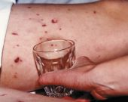
The meningococcal rash
The rash starts as a cluster of pinprick blood spots under the skin, spreading to form bruises. It can appear anywhere on the body
It can be distinguished from other rashes by the fact that it does not fade when pressed under the bottom of a glass (THE TUMBLER TEST)
A febrile illness and rash that does not fade under pressure is a sign of meningococcal septicaemia
The ‘tumbler’ test picture courtesy of Meningitis Research Foundation
http://www.meningitis.org/symptoms
Notes:
Absence of rash does not preclude the illness of meningitis

Slide 9
Potential complications of meningococcal disease
Overall mortality in the UK has reduced from 10% in 2005/6 to 5% in 2010/11
Mortality higher in cases with septicaemia than those with meningitis alone
Most common long term effects:
  -Skin scarring - Seizures
  -Limb amputation - Brain Damage
  -Hearing loss
Notes:
Mortality figures 2012 for England and Wales.^{4,5}
In those who survive, approximately 25% may experience a reduced quality of life, with 10–20% developing permanent sequelae.^{6,7}
The most common long-term effects are skin scars, limb amputation(s), hearing loss, seizures and brain damage.^{7,8}

Slide 10
Background to MenC vaccination programme
In 1999, children and adolescents under the age of 18 years were offered MenC vaccine over a two-year period
In January 2002, the campaign was extended to include all adults under 25 years
Following the campaign, the number of cases fell by over 90% in all age groups immunised
In 2006, studies showed that two doses of MenC provided good protection in the first year of life, although protection waned during the second year
The routine immunisation course was changed to two doses- administered at 3 and 4 months with additional booster at 12months
Notes:
The objective of the routine immunisation programme is to protect those under 25 years of age and individuals outside this age range who may be at increased risk from meningococcal serogroup C disease
Following the MenC vaccine campaign, the number of laboratory-confirmed serogroup C cases fell by over 90% in all age groups immunised.^{9,10}
Cases in other age groups fell by approximately two-thirds as a result of reduced carriage rates ¹¹ and therefore reduced risk of exposure.¹² This indirect protection has contributed to the number of cases falling to a very low levels.

Slide 11
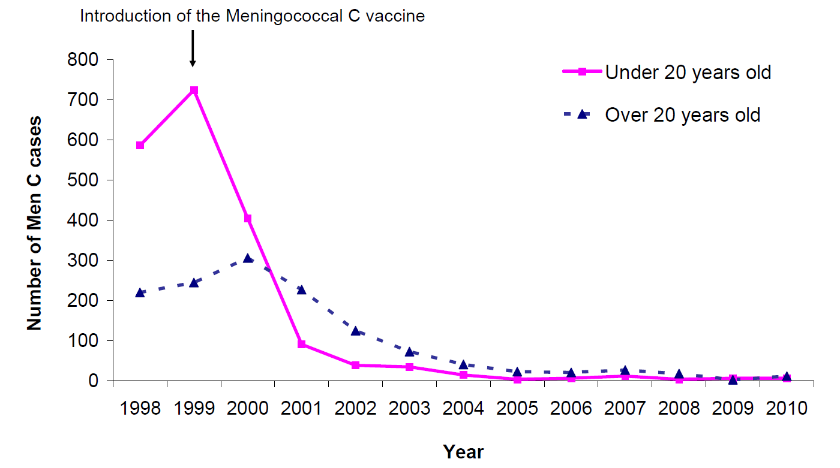
Impact of MenC vaccination programme
Number of laboratory confirmed serogroup C cases in England and Wales, 1998-2010 Source: Public Health England, Infectious Disease Epidemiological Data http://www.hpa.org.uk/webw/HPAweb&HPAwebStandard/HPAweb_C/1234859709051?p=1201094595391
Notes:
The above figures shows that meningococcal disease caused by serogroup C has fallen by 95% since the introduction of the MenC vaccination programme.

Slide 12
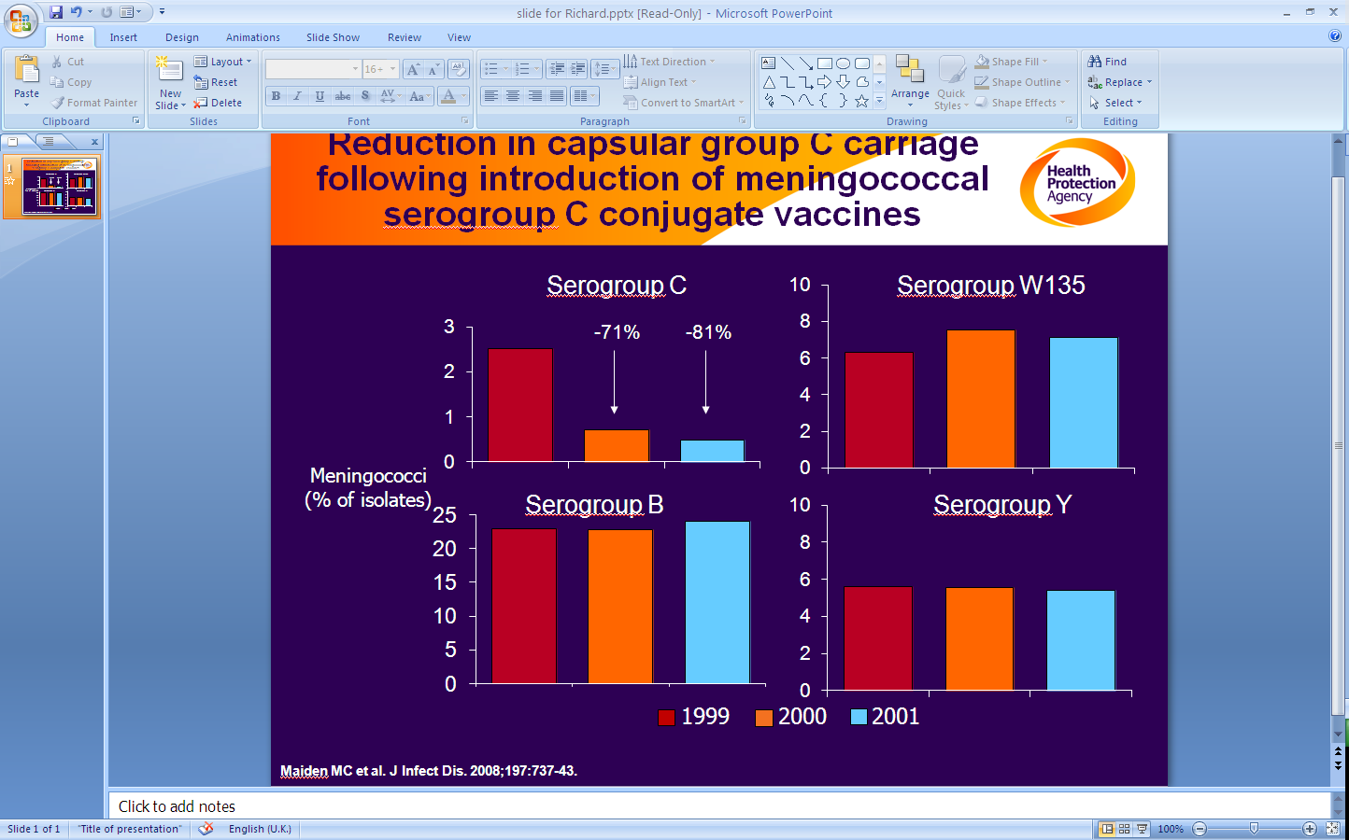
Reduction in capsular group C carriage following introduction of meningococcal serogroup C conjugate vaccines
Slide courtesy of Prof Ray Borrow
Notes:
Meningococci colonise the nasopharynx of humans and are frequently harmless commensals. Between 5 and 11% of adults and up to 25% of adolescents carry the bacteria without any signs or symptoms of the disease. In infants and young children, the carriage rate is low.¹³ Adolescence is the peak age for nasopharyngeal carriage of serogroup C meningococcus and rapid decline in rates of nasopharyngeal carriage were observed the year after the introduction of MenC vaccine.¹¹
The MenC vaccination campaign significantly reduced nasopharyngeal carriage of serogroup C meningococcus as seen in above slide.¹⁴ Approximately 60% of the organisms found in this Maiden 2008 study were not B,C,W or Y. These typically were bacteria which did not have a capsule . A capsule is required for bacteria to cause disease so carriage of these other bacteria is harmless to humans.
This reduction in carriage provides indirect protection to unvaccinated and susceptible vaccinated members of the population through herd immunity.¹⁵

Slide 13
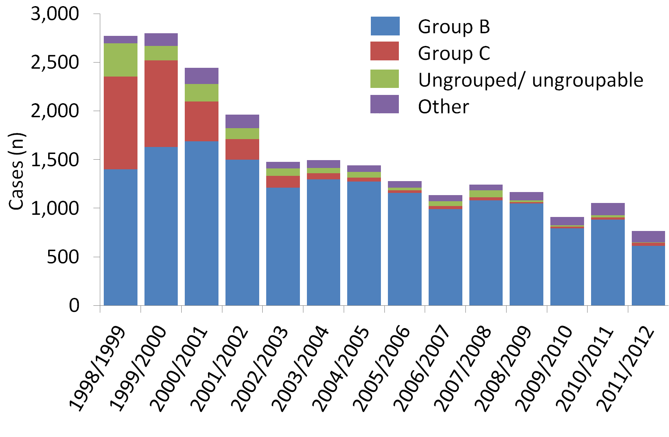
Meningococcal disease cases by group and epidemiological year in England and Wales
Source: Public Health England, Meningococcal Reference Unit, Invasive meningococcal infections laboratory reports, England and Wales, as at 14/09/2012
Notes:
This chart summarises laboratory confirmed cases of meningococcal disease in England and Wales since 1998/99 and only includes cases of invasive disease.
There has been a general decline in the numbers of invasive cases confirmed since 2000, with cases due to Neisseria meningitidis Group C becoming increasingly rare.
In England and Wales as a whole during the 2011/12 epidemiological year, 80.2% of invasive cases confirmed by the Manchester Reference Unit (MRU) were due to Neisseria meningitidis Group B and only 3.8% were due to Group C. This is in contrast to 1998/99 when 50.5% of invasive cases were due to Neisseria meningitidis Group B and 34.4% were due to Group C.

Slide 14
Risk factors
Age
  - Highest incidence in children under 5 years, peak incidence in those under 1 year of age.
  - A second peak in incidence is noted in young people aged 15-19 years of age
Season
  - Seasonal variation, peak levels in winter, declining to low levels by late summer
Social
  - Living in closed or semi–closed communities
  e.g. university halls of residence and military barracks
Smoking
  - Exposure to tobacco smoke increases the risk
Notes:
Age, season, smoking, preceding influenza A infection and living in closed or semi-closed communities, such as university halls of residence or military barracks, have been identified as risk factors.¹² The Ministry of Defence (MOD) offer MenC vaccine as part of their occupational health scheme.
The incidence of meningococcal disease is highest in children under five years of age, with a peak incidence in those under one year of age. There is a secondary peak in incidence in young people aged 15 to 19 years of age. In infants and young children, the carriage rate is low. ¹²
New entrants to university (freshers) who live in halls of residence have elevated risk of meningococcal disease compared to other college students. ^{6,17} Military recruits are at risk of acquiring meningococcal disease particularly in training camps and large scale mobilisations. ¹⁸
Fischer identified tobacco smoke as a risk factor in meningococcal disease. Tobacco smoke exposure independently increases the risk of developing meningococcal disease.¹⁹
The risk of meningococcal infection increases for students entering university compared with those of a similar age in the general population.¹⁶ The incidence of infection is:
5.1 cases per 100,000 in first year of university, and
1.4 cases per 100,000 in general population

Slide 15
What are the changes to the UK schedule for MenC vaccination?
Notes:
The changes affect three parts of the schedule. One change is for babies, one is for adolescents, and one is for young people planning to attend a higher education establishment – the freshers catch-up programme, commencing 1 August 2014.
JCVI Statement, January 2012²⁰ advises that in order to maintain low levels of disease and herd immunity there is evidence to support;
(i) one dose of serogroup C meningococcal vaccine offers protection to infants; and
(ii) Moving one dose of serogroup C meningococcal vaccine to adolescents will maintain herd protection for infants and younger children and extend protection for adolescents and young people.
*The term fresher is defined as those aged between 17 and under 25 years of age who are entering university for the first time and have not previously received a dose of MenC conjugate vaccine over the age of 10 years. For simplicity, if a prospective students immunisation history cannot be confirmed before attending university, it is acceptable to offer a dose of MenC conjugate vaccine. Ideally the dose should be administered at least two weeks before attending university to ensure timely protection. Students entering university for the first time, irrespective of age, who have never received a dose of MenC conjugate vaccine are also eligible to receive the vaccine.

Slide 16
Revised MenC vaccination schedule
Age | Dose
3 months (12 weeks) | 1 dose - MenC vaccine NeisVac-C® or Menjugate Kit®
12-13 months | 1 dose - Hib/MenC vaccine Menitorix®
Around 14 years | 1 dose- MenC vaccine Any MenC conjugate vaccine
Freshers* | 1 dose- MenC vaccine Any MenC conjugate vaccine
*Temporary catch up programme commencing 1 August 2014 for those aged 17 to under 25 years who are entering university for the first time and who have not received a dose of MenC conjugate vaccine over the age of 10 years
Notes:
The infant part of the schedule
Since 2006, the MenC vaccination programme for babies has included three vaccinations - one at three months, one at four months and one given between 12 and 13 months of age. From 2013, this changed to two MenC vaccinations during infancy- one at three months of age, and a second one between 12 and 13 months.
NeisVac-C (Baxter) or Menjugate Kit (Novartis) should only be used for the 3 month dose as they provide a good immune response after 1 dose in infants under 1 year of age , and strong immune responses when boosted with Hib/MenC (Menitorix) routinely offered at 12 -13 months. See “What vaccines are recommended” slide 22. Meningitec (Pfizer) should not be used to offer primary vaccination for infants as it is less immunogenic and a single dose of this will not be sufficient in infancy.
The adolescent part of the schedule
During the academic year of 2013/14, adolescents aged around 14 years of age were offered a MenC conjugate booster vaccination. In 2014/15, the MenC adolescent booster should be offered to those aged 13-14 years as part of the school leave booster. Any MenC conjugate vaccine can be used.
The freshers’ catch-up programme
Older adolescents who were too old to have received a MenC dose in year 10/11 and may only have received a single dose of MenC vaccine at a young age (under the age of 10) are at a higher risk of contracting meningitis C when they first go to university. Commencing on the 1 August 2014, there will be a time limited catch up campaign to offer vaccine to freshers. The term fresher is defined as those aged between 17 and under 25 years of age who are entering university for the first time and have not previously received a dose of MenC conjugate vaccine over the age of 10 years. For simplicity, if a prospective students immunisation history cannot be confirmed before attending university, it is acceptable to offer a dose of MenC conjugate vaccine. Ideally the dose should be administered at least two weeks before attending university to ensure timely protection. Students entering university for the first time, irrespective of age, who have never received a dose of MenC conjugate vaccine are also eligible to receive the vaccine.
If unsure of previous immunisation status follow guidelines set out in Vaccination of individuals with uncertain or incomplete immunisation status available from http://www.hpa.org.uk/Topics/InfectiousDiseases/InfectionsAZ/VaccinationImmunisation/Guidelines/²¹

Slide 17
Why is there a change to the MenC vaccination schedule?
      One dose of MenC in infancy has been shown to provide sufficient protection until booster at 12/13 months
      However, individual protection in young children wanes
      A booster dose for adolescents will provide longer-term protection and maintain herd protection to help protect infants and younger children
      1 August 2014, those aged 17 to under 25 years who are entering university for the first time will be offered an additional dose of MenC conjugate vaccine as part of a temporary catch up programme
      This is due to an elevated risk of disease and sub-optimal protection in those who received the MenC vaccine under the age of 10 years
Notes:
In view of this the JCVI have advised that an adolescent dose of serogroup C meningococcal conjugate vaccine (MenC) be introduced and a dose of MenC vaccine in infants be removed.
Following a study that showed a single priming dose in infancy at three months of age with either NeisVac-C (Baxter) or Menjugate Kit (Novartis) would be sufficient to prime infants against meningococcal serogroup C disease, and provide protection for the first year of life.²² JCVI has recommended that the second priming dose at 4 months of age be removed from the routine schedule.
Recently published studies show that vaccination against meningococcal serogroup C disease in early childhood provides a short-term protective immune response.²³⁻²⁵ Vaccination later in childhood provides higher levels of antibody that persist for longer.²⁶
*The term fresher is defined as those aged between 17 and under 25 years of age who are entering university for the first time and have not previously received a dose of MenC conjugate vaccine over the age of 10 years. For simplicity, if a prospective students immunisation history cannot be confirmed before attending university, it is acceptable to offer a dose of MenC conjugate vaccine. Ideally the dose should be administered at least two weeks before attending university to ensure timely protection. Students entering university for the first time, irrespective of age, who have never received a dose of MenC conjugate vaccine are also eligible to receive the MenC conjugate vaccines.
New starters to university (freshers) who live in halls of residence have elevated risk of meningococcal disease compared to other college students.^{16,17}

Slide 18
When will the change to the infant schedule be implemented?
Child Health systems stopped inviting infants for MenC vaccination at 4 months of age from 1st June 2013
Infants continue to be called for other primary immunisations at 2, 3 and 4 months of age as scheduled
Hib/MenC booster with MMR & PCV13 continues to be offered at 12/13 months
Notes:
From 1 June 2013, Infants were no longer called for MenC vaccination at 4 months of age. Routine immunisations continue to be offered as per 2014 schedule.
Further information on current UK routine schedule for childhood immunisation is available from the Green Book, chapter 11, The UK Immunisation Programme at http://immunisation.dh.gov.uk/green-book-chapters/chapter-11/ ¹

Slide 19
When will the change to the adolescent schedule be implemented?
Adolescents aged around 14 years were offered a booster dose of MenC conjugate vaccine from September 2013
In 2014/15 those aged 13-14 years should be offered a dose of MenC conjugate vaccine at the same time as the teenage school leaver booster (Td/IPV)
Delivered either through school based delivery model or primary care
HPV and MMR vaccines can be administered at the same time
Notes:
Vaccination later in childhood provides higher levels of antibody that persist for longer.²⁶
Should be delivered alongside Td/IPV from 13-14 years, dependent on local arrangements. Note MenC can be given at the same time as other vaccines such as HPV and MMR.

Slide 20
When will the change be implemented for fresher students?
The JCVI noted that older adolescents who will be beyond the age of the routine adolescent booster may only have received a single dose of Men C vaccine at a young age (under 10 years), leaving them susceptible to infection
Prospective students entering university for the first time are at increased risk of contracting MenC disease
From 1 August 2014 a time limited catch up programme will be offered to freshers
Freshers are defined as those aged 17 to under 25 entering university* for the first time and who have not received a dose of MenC conjugate vaccine over the age of 10 years
Notes:
Information for students will be provided with the offer of university place via UCAS and students will be advised to attend their GP prior to starting university. The increased risk has been found to be more pronounced in the first days or weeks²⁷ when students first start to live and socialise together in halls of residence/campus.^{16,17} As seroconversion can take between 2-3 weeks, vaccination should ideally take place at least two weeks prior to the student leaving for university
The freshers catch-up programme is of limited duration to offer the vaccine to those young people entering university who will not have been vaccinated as part of the adolescent booster dose at 13-15 years of age.
Evidence that the risk of meningococcal infection increases for students entering higher education compared with those of a similar age in the general population:
5.1 cases per 100,000 in first year of higher education
1.4 cases per 100,000 in general population¹⁶
The increased risk is in the first few days, weeks or months of entering higher education.²⁷⁻²⁹ It has been suggested that increased exposure to meningococcal bacteria occurring in the first year of higher education leads to asymptomatic carriage that boosts immunity to provide protection over subsequent years.^{16,30}
A booster dose is not required in those who received a MenC conjugate vaccine over the age of 10 years.²⁶

Slide 21
Cont’d…
Students entering university* for the first time, irrespective of age, who have never received a dose of MenC conjugate vaccine are also eligible to receive vaccine
Eligible prospective students will be informed through UCAS, although GP practices can offer the vaccine opportunistically from 1 April to those expecting to go to university for the first time
A booster dose is not required in those who received a MenC conjugate vaccine over the age of 10 years
*University is defined as any University or College that is a member of the Universities and Colleges Admissions Service (UCAS)
Notes:
For simplicity, if a prospective student’s immunisation history cannot be confirmed before attending university, it is acceptable to offer a dose of MenC conjugate vaccine.

Slide 22
Which vaccines are recommended?
Age | Primary/Booster | Product
3 months (12 weeks) | Primary | MenC NeisVac-C® or Menjugate Kit®
12-13 months | Booster | Hib/MenC Vaccine Menitorix®
Around 14 years | Booster | Any MenC conjugate vaccine
Freshers | Booster | Any MenC conjugate vaccine
Notes:
Meningitec (Pfizer) should not be used to offer primary vaccination for infants as it is less immunogenic. A single dose of this vaccine will not be sufficient in infancy. NeisVac-C (Baxter) or Menjugate Kit (Novartis) only should be used for the 3 month dose as they provide a good immune response after 1 dose in infants under 1 year of age , and strong immune responses when boosted with Hib/MenC (Menitorix) routinely offered at 12 -13 months.
During the academic year of 2014/15, the adolescent booster dose will be given from 13-14 years of age.
A time limited freshers catch up programme will commence on the 1 August 2014 for those aged 17 to under 25 years who are entering university for the first time and who have not received a dose of MenC conjugate vaccine over the age of 10 years.
All the available MenC conjugate vaccines are appropriate for the booster vaccination of adolescents and freshers programmes.
The MenC conjugate vaccines are made from capsular polysaccharide that has been extracted from cultures of serogroup C Neisseria meningitidis. In the UK, MenC vaccines have been used that have been conjugated with either CRM197 (a non-toxic variant of diphtheria toxin) or tetanus toxoid. The conjugation increases the immunogenicity, especially in young children in whom the plain polysaccharide vaccines are less immunogenic. The Monovalent MenC vaccine confers no protection against other serogroups of meningococcal disease, such as A, B, W, or Y.

Slide 23

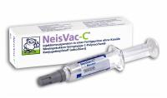
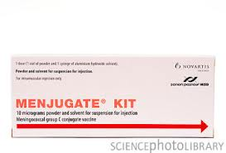
Vaccine products
X Primary under 1 year
PPrimary under 1 year
PPrimary under 1 year
© Docsimon
© Science photo library
©Baxter
USE THE CORRECT VACCINE
Meningitec® is less immunogenic - a single dose in infancy is not sufficient
Notes:
The MenC conjugate vaccine is available either as a lyophilised powder for reconstitution with a diluent or as a suspension in a syringe. After reconstitution of the lyophilised suspension, the vaccine must be used within one hour.
Given by intramuscular injection
May only be administered:
Against a prescription written manually or electronically by a registered medical practitioner or other authorised prescriber
Against a Patient Specific Direction (PSD)
Against a Patient Group Direction (PGD)
The vaccines do not contain thiomersal. They are inactivated, do not contain live organisms and cannot cause the diseases against which they protect.
Further information on the vaccine products is available from the Summary of Product Characteristics (SPC)
Meningitis and Menjugate are available from at: http://www.medicines.org.uk/emc/
NeisVac-C SPC is available from the Baxter website at: http://www.ecomm.baxter.com/ecatalog/loadResource.do?bid=53760

Slide 24
Different schedules for MenC vaccines
Summary of Product Characteristics (SPC) for MenC conjugate vaccines state that two doses should be given two months apart in those under 1 year of age
This is superseded by the Green Book recommendation to give a single dose of NeisVac-C® or Menjugate Kit® MenC vaccine in infancy
Consideration should be given to whether a quadrivalent meningococcal vaccine should be used if protection is required for travel
Notes:
The recommendations regarding vaccines given in the Green Book chapters may differ from those in the Summary of Product Characteristics (SPC) and Patient Information Leaflet (PIL) for a particular vaccine. When this occurs, the recommendations in the Green Book ¹ are based on current expert advice received from the JCVI and should be followed.
The Green Book ¹ states that evidence from a UK study shows that immunogenicity is adequate following a primary course of either NeisVac- C or Menjugate Kit as a single dose in infants.²² and the UK schedule for childhood vaccination has been amended to reflect this evidence.
The Green Book ¹ states MenACWY conjugate vaccine (Menveo) should replace the monovalent MenC vaccine if the infant requires protection for travel at the same time as the routine MenC

Slide 25
Contraindications and precautions
Contraindications
Confirmed anaphylactic reaction to a previous dose of the vaccine
Confirmed anaphylactic reaction to any constituent of the vaccine, including meningococcal polysaccharide, diphtheria toxoid or the CRM¹⁹⁷ carrier protein or tetanus toxoid
Precautions
Acute febrile illness (defer until recovered)
Unstable/evolving neurological conditions
Notes:
There are very few individuals who cannot receive meningococcal vaccines. When there is doubt, appropriate advice should be sought from a consultant paediatrician, immunisation co-ordinator or consultant in communicable disease control, rather than withhold immunisation.
Meningitec and Menjugate Kit vaccines are conjugated to Corynebacterium diphtheriae CRM¹⁹⁷ protein. NeisVac-C is conjugated to tetanus toxoid protein.
More detailed vaccine information and a full list of vaccine contents are contained in the Summary of Product Characteristics (SPC)
Meningitec and Menjugate Kit are available from at: http://www.medicines.org.uk/EMC/
NeisVac-C SPC is available from the Baxter website at: http://www.ecomm.baxter.com/ecatalog/loadResource.do?bid=53760
Minor illnesses without fever or systemic upset are not valid reasons to postpone immunisation. If an individual is acutely unwell, immunisation may be postponed until they have recovered fully. This is to avoid confusing the differential diagnosis of any acute illness by wrongly attributing any signs or symptoms to the adverse effects of the vaccine
Meningococcal vaccines may be given to pregnant women when clinically indicated. There is no evidence of risk from vaccinating pregnant women or those who are breast-feeding with inactivated virus or bacterial vaccines or toxoids. ⁷ In cases where meningococcal immunisation has been inadvertently given in pregnancy, there has been no evidence of fetal problems.

Slide 26
Adverse events
Pain, tenderness, swelling or redness at the injection site and mild fever
Infants and toddlers: crying, irritability, drowsiness, impaired sleep, reduced eating, diarrhoea and vomiting
Older children and adults: headaches, myalgia and drowsiness
Neurological reactions such as dizziness, febrile/afebrile seizures, faints, numbness and hypotonia are very rare
Notes:
Anaphylaxis is a very rare side effect of most vaccines and facilities for its recognition and management must be available.
Further information on adverse events are contained in the Summary of Product Characteristics (SPC)
Meningitis and Menjugate are available from at: http://www.medicines.org.uk/EMC/
Neisvac SPC is available from the Baxter website at: http://www.ecomm.baxter.com/ecatalog/loadResource.do?bid=53760

Slide 27

Reporting adverse events
Yellow Card Scheme
Voluntary reporting system for suspected adverse reaction to medicines/vaccines
Serious adverse events in adults or all suspected adverse reactions in children that may be attributable to the vaccine should be reported to the Medicines and Healthcare Products Regulatory Agency (MHRA) using the yellow card system
http://mhra.gov.uk/yellowcard
Chapter 8 of Green Book for details
© MHRA
Notes:
As with all vaccines and other medicines healthcare professionals and patients are encouraged to report suspected adverse reactions to the Medicines and Healthcare products Regulatory Agency (MHRA) using the yellow card reporting scheme

Slide 28
Supplies
Meningitis C Conjugate:
  -Menjugate® – manufactured by Novartis Vaccines
  -NeisVac-C® – manufactured by Baxter Healthcare
  -Meningitec® – manufactured by Pfizer
Supplies should be obtained in line with routine ordering for childhood vaccines
Supplied by Movianto UK as part of the national childhood immunisation programme
Notes:
Contact number for Movianto (Tel: 01234 248631)

Slide 29
Monitoring uptake
Vaccination against MenC should be recorded in the GP, patient and child health computer records as routine
Immunisation uptake data will be collected using the Child Health Information System for the infant and teenage doses
Notes:
The infant group monitoring uptake would be based on the same reporting measures for vaccines given as part of the routine childhood schedule.
The adolescent dose uptake will be monitored as teenage booster Td/IPV vaccination.
Monitoring of uptake in the freshers cohort will be according to local arrangements.

Slide 30
Resources
  Green Book Meningococcal chapter 22
  DH/PHE/NHS England Joint Letter
  Q&As for Healthcare Professionals on PHE website
  Leaflets/posters/factsheets on NHS Choices website
  JCVI minutes
Notes:
Add links to all when available

Slide 31
Key message
Changes to the schedule will make the overall MenC immunisation programme more effective and offer greater protection to adolescents and young adults
Notes:
Bibliography
1. Department of Health (2005) Immunisation against infectious disease. The Green Book . [Online]. Available at: http://immunisation.dh.gov.uk/category/the-green-book/ [Accessed 15th Mar 2013]
2. CMO letter /tripartite PH letter
3. Rosenstein NE et al. Meningococcal disease. N Engl J Med 2001; 344: 1378-88.
4. Goldacre MJ, Roberts SE, Yeates D. Case fatality rates for meningococcal disease in an English population, 1963-98: database study. BMJ 2003; 327: 596-7.
5. Ladhani SN et al. Invasive meningococcal disease in England and Wales: implications for the introduction of new vaccines. Vaccine 2012; 30: 3710-6
6. Erickson L, De Wals P. Complications and sequelae of meningococcal disease in Quebec, Canada, 1990-1994. Clin Infect Dis 1998; 26: 1159-64 .
7. Granoff DM, Harrison LH, Borrow R. Section 2: Licensed vaccines meningococcal vaccines. In: S Plotkin, W Orenstein, P Offit eds. Vaccines. 5th ed. London: Elsevier 2008; pp: 399-434.
8. Steven N, Wood M. The clinical spectrum of meningococcal disease. In: K Cartwright K ed. Meningococcal disease. Chichester: John Wiley & Sons; 2005. pp 177-206.
9. Miller E, Salisbury D, Ramsay M. Planning, registration, and implementation of an immunisation campaign against meningococcal serogroup C disease in the UK: a success story. Vaccine 2001; 20(Suppl 1):S58-S67
10. Trotter CL et al. Effectiveness of meningococcal serogroup C conjugate vaccine 4 years after introduction. Lancet 2004; 364: 365-7.
11. Maiden MC, Stuart JM. Carriage of serogroup C meningococci one year after meningococcal C conjugate polysaccharide vaccination. Lancet 2002; 359:1829-31
12. Trotter CL, Gay NJ. Analysis of longitudinal bacterial carriage studies accounting for sensitivity of swabbing: an application to Neisseria meningitidis. Epidemiol Infect 2003; 130: 201-5. Available at: http://www.ncbi.nlm.nih.gov/pmc/articles/PMC2869955/pdf/12729188.pdf [Accessed 15th Mar 2013]
13. Cartwright K. The clinical spectrum of meningococcal disease. In: K Cartwright ed. Meningococcal disease. Chichester: John Wiley & Sons; 1995. pp 115-46.
14. Maiden MC et al. Impact of meningococcal serogroup C conjugate vaccines on carriage and herd immunity. J Infect Dis 2008; 197: 737-43.
15. Ramsay ME et al. Herd immunity from meningococcal serogroup C conjugate vaccination in England: database analysis. BMJ 2003; 326: 365-6.
16. Bruce MG et al. Risk factors for meningococcal disease in college students. JAMA 2001;286:688-93.
17. Harrison LH et al. Risk of meningococcal infection in college students. JAMA 1999;81:1906-10. Available at: http://jama.jamanetwork.com/article.aspx?articleid=190081 [Accessed 15th Mar 2013]
18. Brundage JF, Zollinger WD. Evolution of meningococcal disease epidemiology in the US Army. In: NA Vedros ed. Evolution of meningococcal disease. Vol. 1. Boca Raton: CRC Press; 1987. pp. 6-23.
19. Fischer M et al. Tobacco smoke as a risk factor in meningococcal disease Pediatr Infect Dis J 1997; 16: 979-83
20. Joint Committee of Vaccination and Immunisation. Statement on the use of meningococcal C vaccines in the routine childhood immunisation programme. 29 January 2012. [Online]. 2012. Available at: http://webarchive.nationalarchives.gov.uk/+/www.dh.gov.uk/ab/JCVI/DH_094744 [Accessed 15th Mar 2013]
21. Health Protection Agency. Vaccination of individuals with uncertain or incomplete immunisation status. [Online]. 2012. Available at:http://www.hpa.org.uk/webc/HPAwebFile/HPAweb_C/1194947406156 [Accessed 15th Mar 2013]
22. Findlow H et al. Immunogenicity of a single dose of meningococcal group C conjugate vaccine given at 3 months of age to healthy infants in the United Kingdom. Pediatr Infect Dis J 2012; 31:616-22.
23. Borrow R et al. Kinetics of antibody persistence following administration of a combination meningococcal serogroup C and haemophilus influenzae type b conjugate vaccine in healthy infants in the United Kingdom primed with a monovalent meningococcal serogroup C vaccine. Clin Vaccine Immunol 2010; 17: 154-9.
24. Kitchin N et al. Antibody persistence in UK pre-school children following primary series with an acellular pertussis-containing pentavalent vaccine given concomitantly with meningococcal group C conjugate vaccine, and response to a booster dose of an acellular pertussis-containing quadrivalent vaccine. Vaccine 2009; 27: 5096-102.
25. Perrett KP et al. Antibody persistence after serogroup C meningococcal conjugate immunisation of United Kingdom primary–school children in 1999-2000 and response to a booster: a phase 4 clinical trial. Clin Infect Dis 2010; 50: 1601-10.
26. Snape MD et al. Seroprotection against serogroup C meningococcal disease in adolescents in the United Kingdom: observational study. BMJ 2008; 336:1487-91. Available at: http://www.bmj.com/content/336/7659/1487.reprint [Accessed 15th Mar 2013]
27. Neal KR et al. Changing carriage rate of Neisseria meningitidis among university students during the first week of term: cross sectional study. BMJ 2000; 20:846-9.
28. Ala’Aldeen DA et al (2011) Carriage of meningococci by university students, United Kingdom. Emerg Infect Dis 2011; 17:1762-3.
29. Bidmos FA et al. Persistence,replacement and rapid clonal expansion of meningococcal carriage isolates in a 2008 university student cohort. J Clin Microbiol 2010; 49:506.
30. Butler KM. Meningococcal meningitis prevention programs for college students: A review of the literature. Worldviews Evid Based Nurs 2006;3:185-93.

Slide 32
Acknowledgement
    This resource was developed by the Vaccine Preventable Disease Programme, Public Health Wales. Their permission to adapt it for use in England is gratefully acknowledged.
    This resource has been adapted for use in England by
    Public Health England
    Immunisation, Hepatitis and Blood Safety Department
    PHE-Colindale

