Slide 1
Awareness of Online Safety
Welcome to
[X] Libraries
Staying Safe Online

Slide 2
Awareness of Online Safety
Aim
To raise staff awareness of online safety issues
Objectives
Increase awareness of the implications of online safety issues as an individual, as a member of staff and as a library volunteer
Understand the role of CEOP (Child Exploitation and Online Protection))
Consider how to respond to online safety incidents
Be aware of service-wide online safety procedures and policies

Slide 3
Awareness of Online Safety
Online safety
is about being safe from risks to personal safety, security and privacy when using devices that allow access to the Internet
encompasses not only internet technologies but also electronic communications via mobile phones, games consoles and wireless technology
emphasises learning to understand and use new technologies in a positive way
is less about restriction and more about education, about the benefits as well as the risks so that we can feel confident when online

Slide 4
Awareness of Online Safety
Why should a 21st century library service offer free IT access to their community??

Slide 5
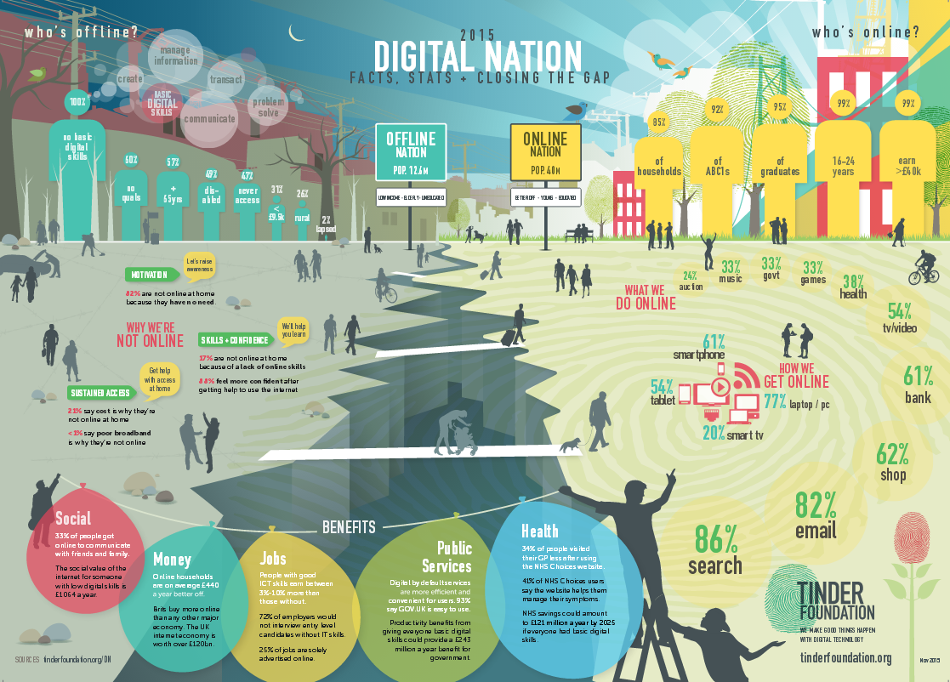
Awareness of Online Safety
The internet has changed many of the ways in which we live, work and play
Notes:
http://www.tinderfoundation.org/sites/default/files/digitalnation-2015-webb.pdf

Slide 6
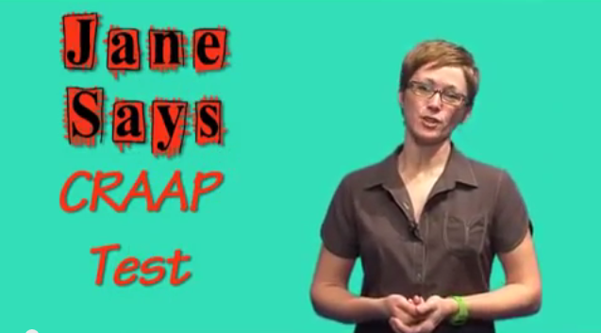
C.R.A.A.P.
But not all the information on the internet can be trusted
Notes:
http://www.youtube.com/watch?v=PbvqKaVZxUw

Slide 7
Awareness of Online Safety
Reliable, not reliable or just plain bizarre?
www.bookyourtheorytestonline.co.uk
www.passportdirect.org.uk
petroldirect.com
zapatopi.net
Notes:
http://www.philb.com/fakesites.htm

Slide 8
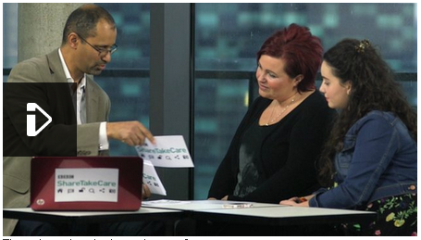
Awareness of Online Safety
Click the image to play the video
Notes:
http://www.bbc.co.uk/webwise/0/21259413

Slide 9
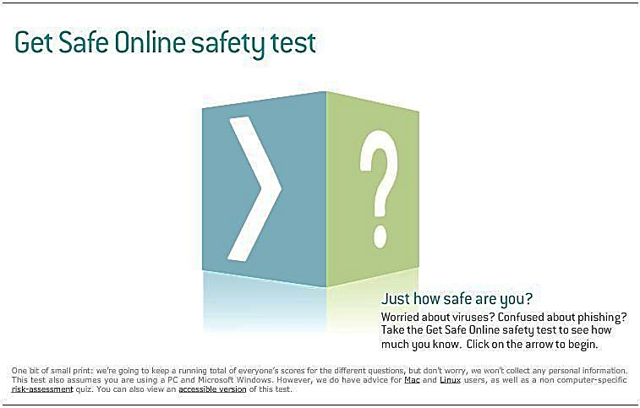
Awareness of Online Safety
Click the image to take the test
Notes:
https://www.getsafeonline.org/quiz/

Slide 10
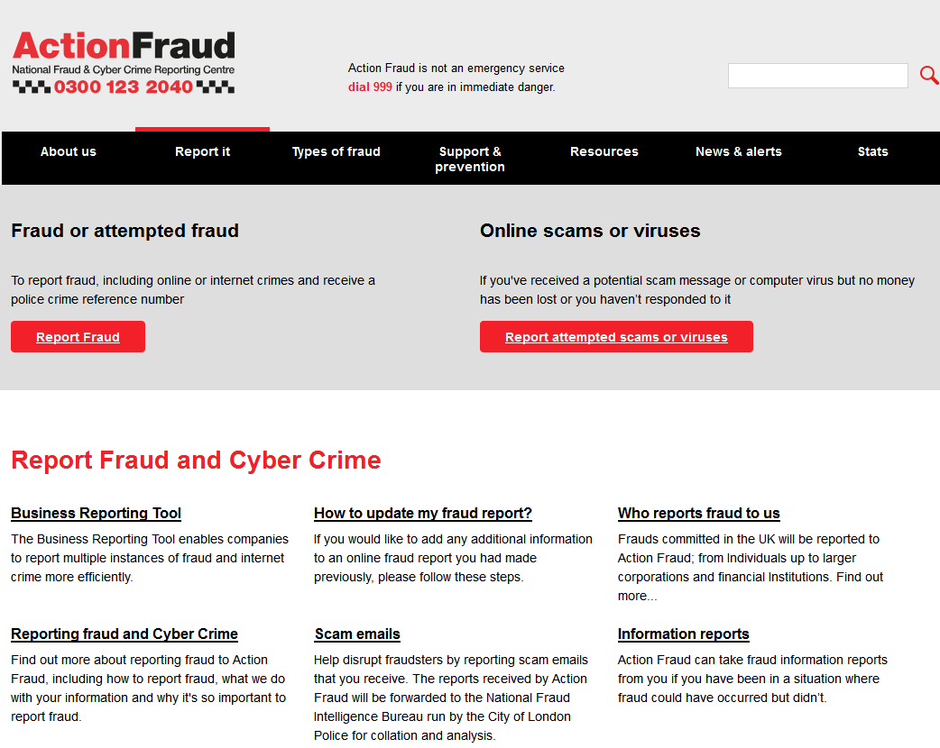
Awareness of Online Safety
Use Action Fraud to report online scams and hoaxes
Notes:
http://www.actionfraud.police.uk/report_fraud

Slide 11
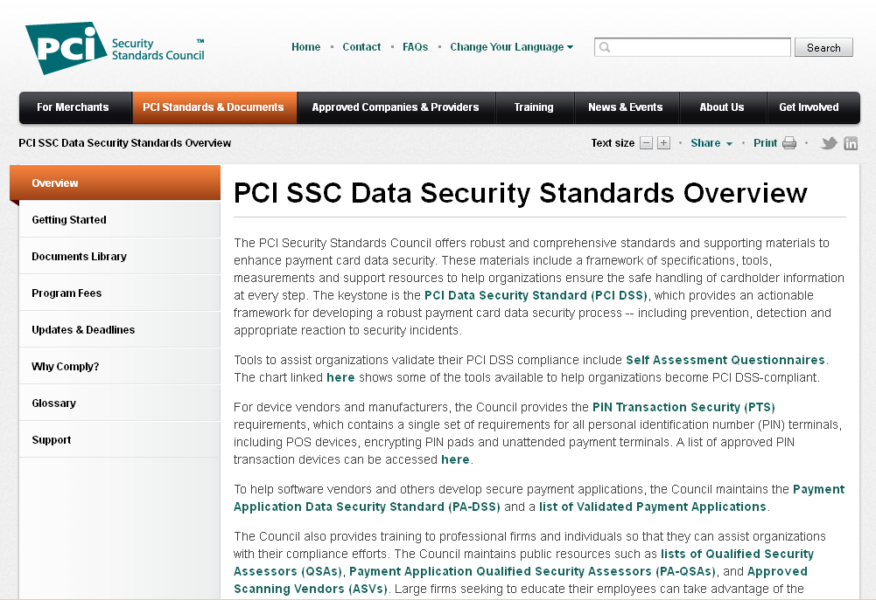
Awareness of Online Safety
Notes:
https://www.pcisecuritystandards.org/security_standards/index.php

Slide 12
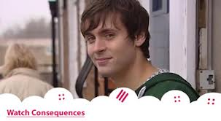
Awareness of Online Safety
Click the image to play the video
Notes:
https://www.youtube.com/watch?v=hK5OeGeudBM

Slide 13
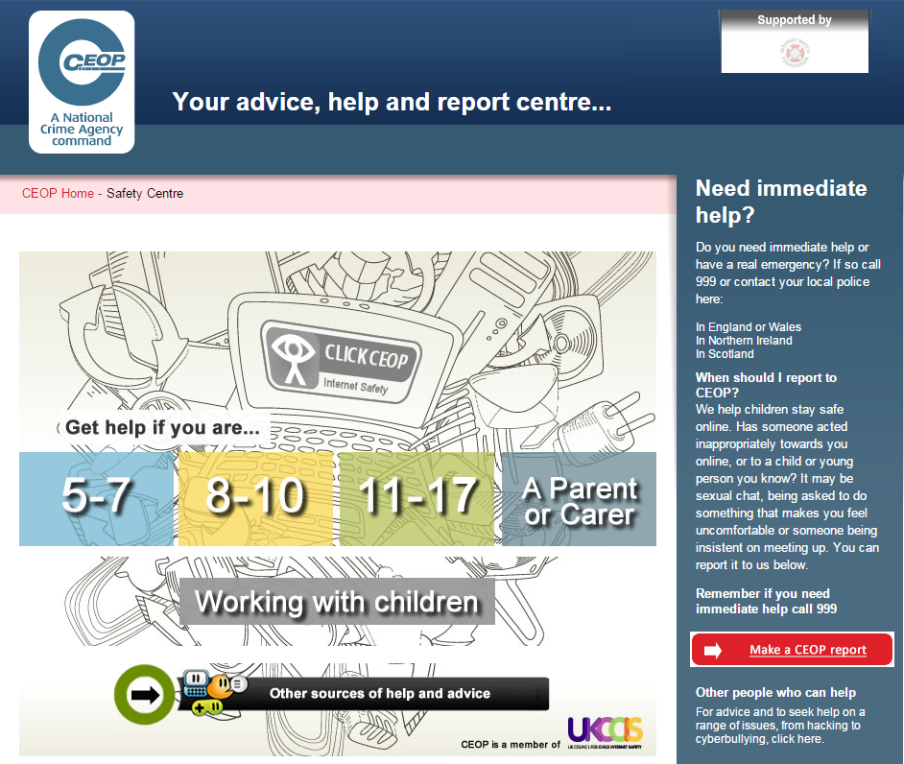
Awareness of Online Safety
Use CEOP to report online safety concerns
Notes:
http://www.ceop.police.uk/safety-centre/

Slide 14
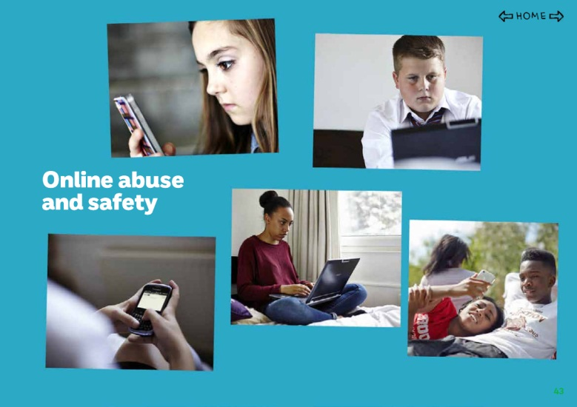
Awareness of Online Safety
Childline / NSPCC (2014)
over last 3 years there has been a 73% increase in the number of counselling sessions about online bullying and safety
over half of these have been with girls and 75% of those were between
12 to 15 year olds
60% of 13 to 18 year olds had been asked for a sexual image or video of themselves

Slide 15
Awareness of Online Safety
Social networking sites
Facebook (minimum age requirement - 13)
Probably the largest social networking site with approximately 750 million active users.
Tumblr (minimum age requirement - 13)
This is a blogging platform where users can upload posts, text, images, videos and other media from the internet.
Instagram (minimum age = 13)
Enables its users to take pictures and videos, and share them on a variety of other social networking platforms, such as Facebook and Tumblr.
Tinder (minimum age = 13)
Is a dating app, using messages and previously uploaded photos, for browsing photos of potential ‘matches’ within a certain mile radius of the user's location.

Slide 16
Awareness of Online Safety
Scenarios
A. A member of the public advises you that another customer is viewing inappropriate material. The customer who has been reported is still on the computer in the library. You look at the screen and see a dating website with images of scantily clad people.
B. A 12 year old girl, that you consider vulnerable, comes every evening without her parents to access Facebook
C. A customer asks you to help them make an online purchase and hands over their credit card.
D. A computer user asks you for help in setting up a Paypal account after receiving an email informing them that they have just won a lottery.
Notes:
1. What’s the problem?
2. How would you deal with the situation?
3. What might we have done to help our customers keep themselves safe online?

Slide 17
Awareness of Online Safety

Slide 18
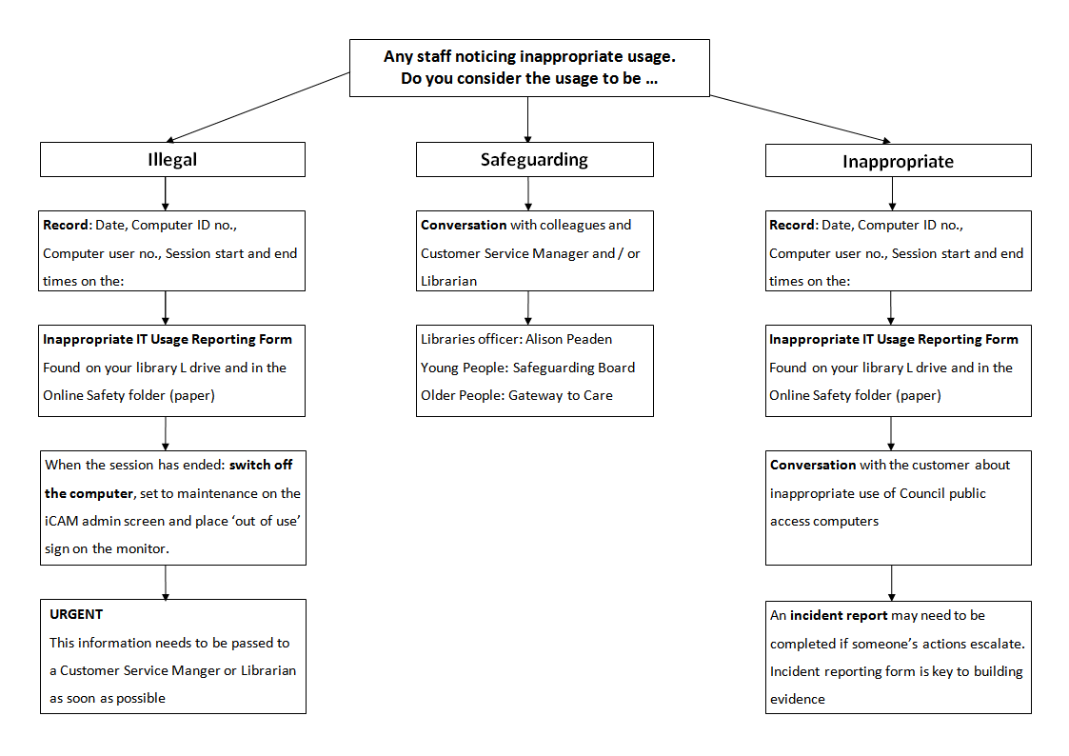
Awareness of Online Safety

Slide 19
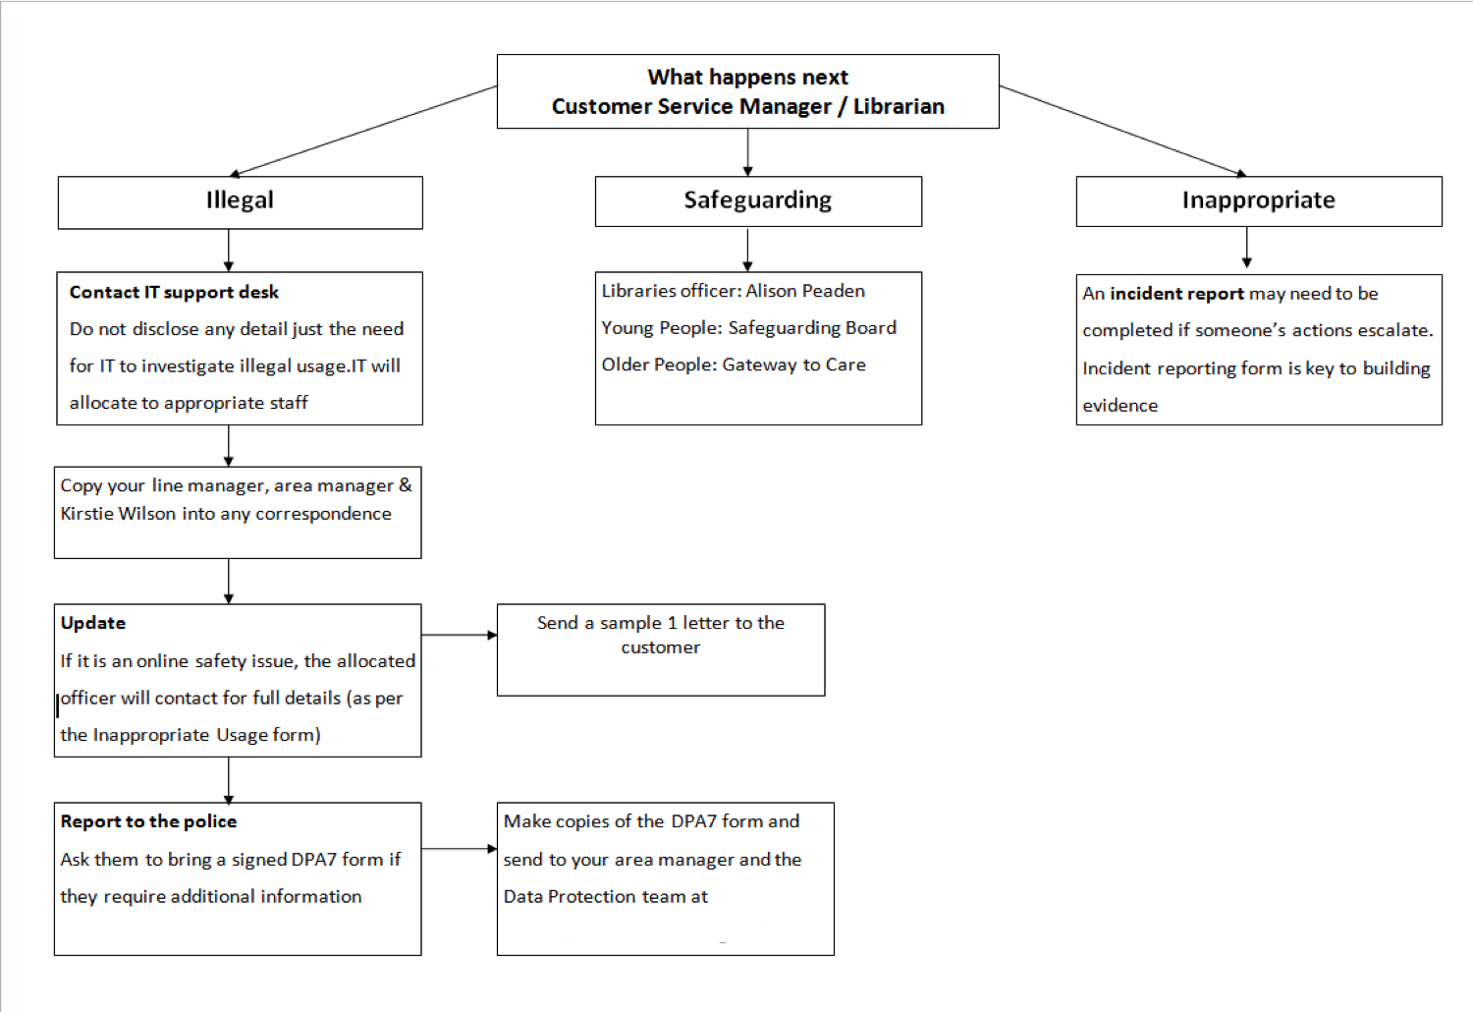
Awareness of Online Safety

Slide 20
Awareness of Online Safety
References
Slide 5 - http://www.tinderfoundation.org/sites/default/files/digitalnation-2015-webb.pdf
Slide 6 - http://www.youtube.com/watch?v=PbvqKaVZxUw
Slide 7 - http://www.philb.com/fakesites.htm
Slide 8 - http://www.bbc.co.uk/webwise/0/21259413
Slide 9 - https://www.getsafeonline.org/quiz/
Slide 10 - http://www.actionfraud.police.uk/report_fraud
Slide 11 - https://www.pcisecuritystandards.org/security_standards/index.php
Slide 12 - https://www.youtube.com/watch?v=hK5OeGeudBM
Slide 13 - http://www.ceop.police.uk/safety-centre/
Useful websites
Action Fraud: http://www.actionfraud.police.uk/
CEOP: http://www.ceop.police.uk/
Digital Unite: http://digitalunite.com/
Get Safe Online: https://www.getsafeonline.org/
Thinkuknow: http://www.thinkuknow.co.uk/
Contacts
email: [insert email address]
twitter: [insert Twitter handle

