Slide 1
CompeteFor
UK’s national supply chain portal Phil Kinnell
Duncan Reid

Slide 2
Introduction
CompeteFor is an online portal designed to engage and develop the supply chains of major infrastructure buying programmes
A living legacy – created for the London 2012 Olympic and Paralympic Games to connect buyers and suppliers
Encourages equality and transparency in the buying process
Promotes visibility of local opportunities for local suppliers and SME businesses, supporting economic development and job creation

Slide 3
Key Objectives
Promote transparency and competition in supply chains
Help SMEs benefit from supply chain opportunities
Drive innovation and value for buying organisations
Ensure supplier diversity, positive economic impact and measurable community benefits
Provide effective supply chain visibility, reporting and monitoring

Slide 4
Supply Chain & SME Development

Slide 5
Supplier Features
FREE to register and respond to CompeteFor opportunities
Build and publish a Business Profile to promote your business
Create an Alert Profile to find relevant business opportunities
Respond to opportunities to win business
FREE researched, relevant supply chain opportunities in local area
Register
Business Profile
ALERTS
Respond
Supply Chain Opportunities

Slide 6
Accessing Opportunities
Suppliers register on www.competefor.com for free
Buyers e.g. HS2, Tideway, Horizon Nuclear Power, Balfour Beatty and National Grid, publish their contract opportunities on CompeteFor
Suppliers respond to relevant opportunities
Successful suppliers are shortlisted into a tender process
Buyers award the contract to suppliers

Slide 7
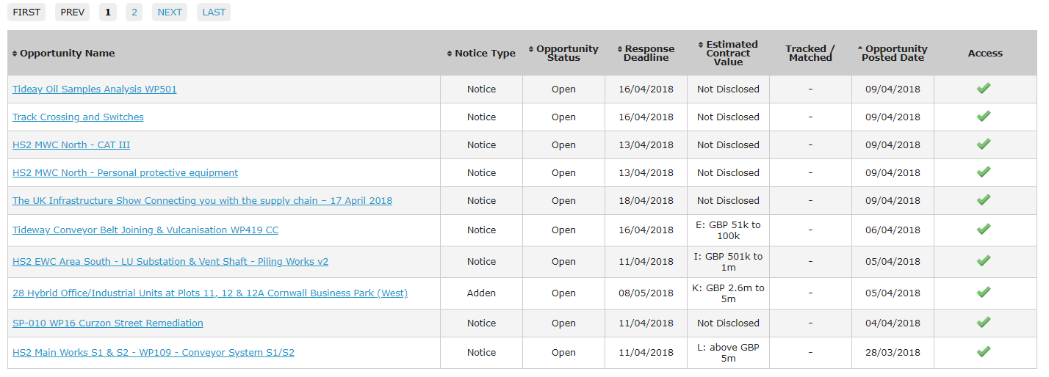
CompeteFor Opportunities

Slide 8
CompeteFor Partners

Slide 9
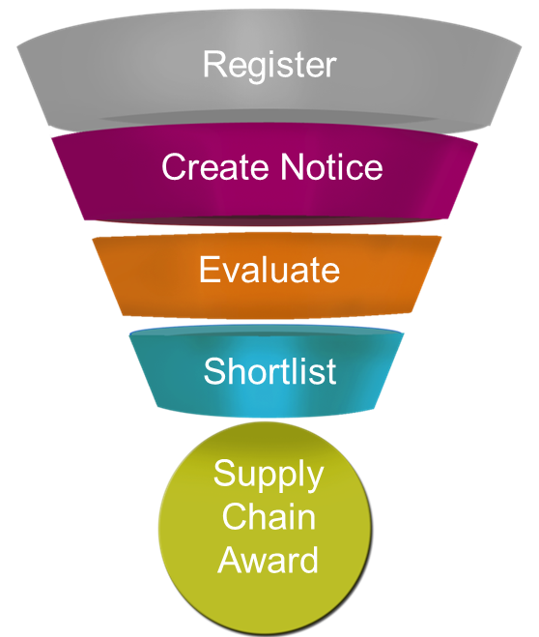
Buyer Features
Access to a large database of new potential suppliers
Automated reporting which can demonstrate success in meeting key targets and objectives
Enhanced competition giving buyers’ a better deal
Increases buyers’ corporate social responsibility through the practise of sustainable procurement

Slide 10
The Cabinet Office announced in April 2018 that suppliers will shortly need to advertise subcontracting opportunities via the Contracts Finder website.
This is in line with CompeteFor’s stated aim of ensuring that more small businesses benefit from public sector supply chain opportunities.
We’re working with Crown Commercial Service (CCS) to ensure CompeteFor supply chain opportunities link to Contracts Finder.
Users of CompeteFor will meet the above requirements as well as benefitting from the additional CompeteFor functionality.

Slide 11
Next Steps
Register on www.competefor.com for free
Create and Publish your Business Profile
Search for opportunities
Create an Alert Profile to automate your searches
Respond to Opportunities

Slide 12
For further information
and to register today
please come and
visit us at our stand.

