Slide 1
Employer Skills Survey 2015
UK Slide Pack
May 2016

Slide 2
Contents
Background
3
Employers’ experiences of skill shortages
8
Retention difficulties
19
The internal skills challenge
24
Under-utilisation of skills
37
Employer investment in training and skills
43
High Performance Working Practices and Product Market Strategies
59
Conclusions
65

Slide 3
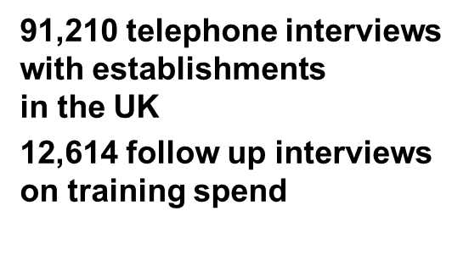
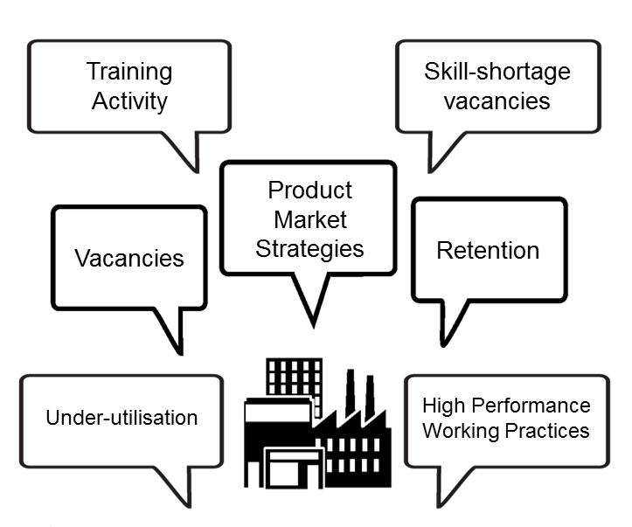
ESS 2015 – overview
ESS 2015 is the third time the survey has been run at UK-level
The 2015 survey covers establishments with 2 or more people working at them
The 2011 survey included establishments with one employee – these were not covered in 2013 or 2015.
Where comparisons are made with 2011 or 2013 findings, these are based on re-weighted 2011 data (configured to represent the 2+ employment business population used in 2013 and 2015).

Slide 4
Achieved interviews / confidence intervals
‘For a question asked of all respondents where the survey result is 50%, we are 95% confident that the true figure lies within the range 49.68% to 50.32%’
 | Population | Number of interviews | (Maximum) Sampling Error
UK | 1,766,838 | 91,210 | +/-0.32
By country
England | 1,488,171 | 75,129 | +/-0.36
Northern Ireland | 54,518 | 4,019 | +/-1.55
Scotland | 142,947 | 6,035 | +/-1.26
Wales | 81,202 | 6,027 | +/-1.26
By size of establishment
2-4 | 907,944 | 20,527 | +/-0.68
5-24 | 668,618 | 49,584 | +/-0.44
25-49 | 101,082 | 11,657 | +/-0.91
50-99 | 50,432 | 5,836 | +/-1.28
100-249 | 26,900 | 2,689 | +/-1.89
250+ | 11,812 | 917 | +/-3.24
 | Population | Number of interviews | (Maximum) Sampling Error
By sector
Agriculture | 97,359 | 3,632 | +/-1.63
Manufacturing | 100,262 | 6,998 | +/-1.17
Electricity, Gas and Water | 10,151 | 1,041 | +/-3.04
Construction | 158,790 | 7,474 | +/-1.13
Wholesale and Retail | 371,231 | 16,126 | +/-0.77
Hotels & Restaurants | 159,893 | 8,920 | +/-1.04
Transport and Communications | 128,789 | 8,936 | +/-1.04
Financial Services | 38,259 | 2,549 | +/-1.94
Business Services | 363,790 | 13,143 | +/-0.85
Public Administration | 19,814 | 947 | +/-3.18
Education | 58,124 | 5,515 | +/-1.32
Health and Social Work | 132,505 | 8,556 | +/-1.06
Arts and Other Services | 127,871 | 7,373 | +/-1.14
Population counts taken from IDBR March 2014

Slide 5
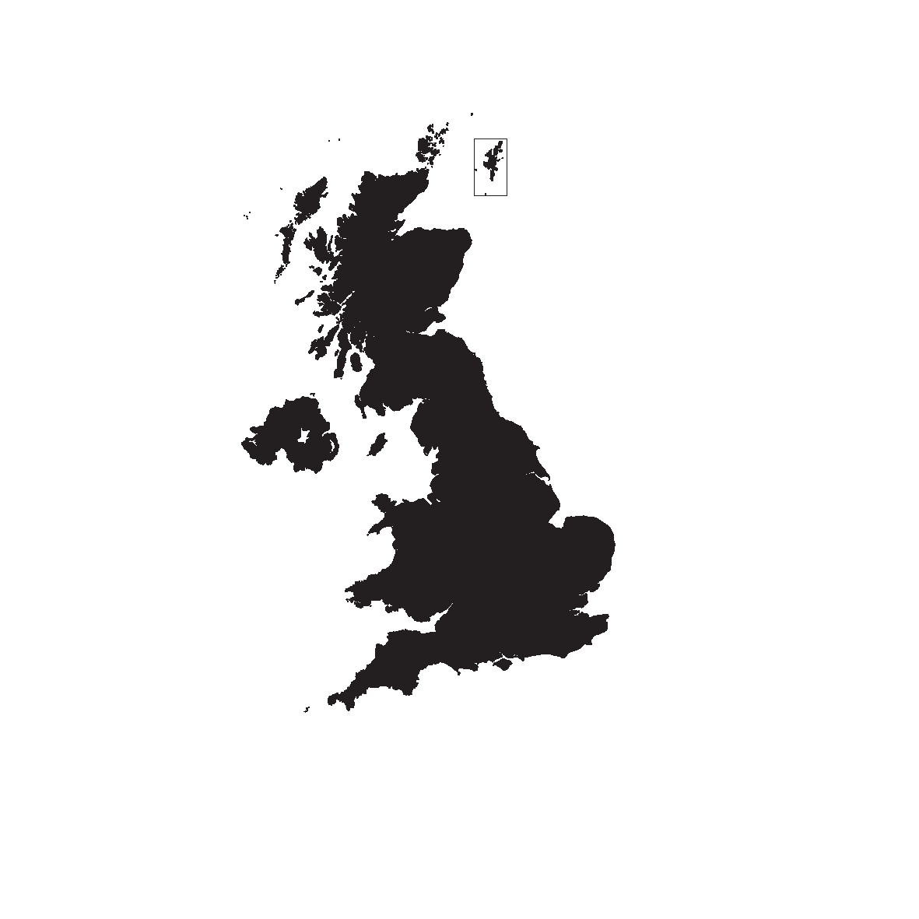
Profile of survey population
Establishments vs. Employment – UK Wide*
33%
2-4
5-24
MULTISITE
67%
25-49
SINGLE
SITE
50-99
Data taken from ESS 2015
Base: All establishments (91,210)
100+
*Data based on IDBR March 2014 counts

Slide 6
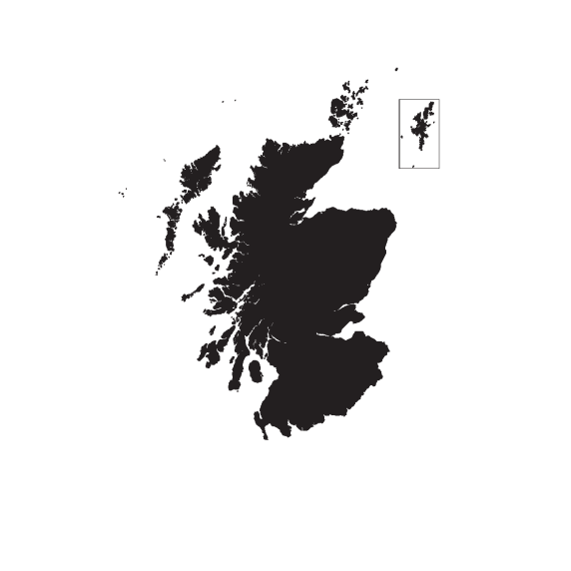
Profile of survey population
Establishments vs. Employment – by country
ENGLAND
NORTHERN IRELAND
SCOTLAND
WALES
PRIVATE
SECTOR
3RD
SECTOR
PUBLIC
SECTOR
Base: All establishments: England (75,129), Northern Ireland (4,019), Scotland (6,035), Wales (6,027)

Slide 7
Key definitions
Establishment base
Proportions are based on the number of establishments, defined here as a single location of an organisation, where at least two people work.
Employment base
Proportions are based on the total number of employees and working proprietors across establishments.
Vacancies
Skill-shortage vacancies
Skills gaps
Under-utilisation
Proportion of establishments reporting at least one vacancy
Proportion of establishments reporting at least one skill-shortage vacancy
Proportion of establishments with at least one employee deemed by their employer to be not fully proficient in their role
Proportion of establishments with at least one employee with skills and qualifications more advanced than required for their current job role
Incidence
Vacancies as a proportion of all employment
Skill-shortage vacancies as a proportion of all vacancies
The number of staff reported as not fully proficient as a proportion of all employment
The proportion of all staff with skills and qualifications more advanced than required for their current job role
Density

Slide 8
Section 1: Employers’ experiences of skill shortages

Slide 9
Incidence and density of vacancies by country
Incidence of vacancies
Density (vacancies as % of employment)
2011
2013
2015
2011
2013
2015
2011
2013
2015
2011
2013
2015
2011
2013
2015
UK
England
N. Ireland
Scotland
Wales
Base: All establishments (2011: UK: 86,522; England: 74,156; NI: 3,921; Scotland: 2,487; Wales: 5,958;
2013: UK: 91,279; England: 75,255; NI: 4,014; Scotland: 6,014; Wales: 5,996
2015: UK: 91,210; England: 75,129; NI: 4,019; Scotland: 6,035; Wales: 6,027)

Slide 10
Incidence and density of vacancies by sector
Incidence of vacancies
Density (vacancies as % of employment)
Employers with at least one vacancy (2015)
19,100 | 6,200 | 39,200 | 41,700 | 27,900 | 2,200 | 19,600 | 67,800 | 24,400 | 7,000 | 62,800 | 18,700 | 5,100
Education
Public Administration
Health & Social Work
Hotels & Restaurants
Arts & Other Services
Electricity, Gas & Water
Manufacturing
Business Services
Transport & Comms
Financial Services
Wholesale & Retail
Construction
Agriculture
2013:
(5,796)
(942)
(8,460)
(8,888)
(7,358)
(1,148)
(7,560)
(14,011)
(6,890)
(2,330)
(17,287)
(7,202)
(3,407)
2015:
(5,515)
(947)
(8,556)
(8,920)
(7,373)
(1,041)
(6,998)
(13,143)
(8,936)
(2,549)
(16,126)
(7,474)
(3,632)
Base: All establishments (as shown)

Slide 11
Incidence and density of skill-shortage vacancies by country
SSV Density (SSVs as % of Vacs)
16%
22%
23%
15%
22%
23%
21%
19%
14%
15%
25%
24%
18%
20%
24%
Incidence of establishments with vacancies
Incidence of establishments with skill-shortage vacancies
2011
2013
2015
2011
2013
2015
2011
2013
2015
2011
2013
2015
2011
2013
2015
UK
England
N. Ireland
Scotland
Wales
Base: All establishments (2011: UK: 86,522; England: 74,156; NI: 3,921; Scotland: 2,487; Wales: 5,958;
2013: UK: 91,279; England: 75,255; NI: 4,014; Scotland: 6,014; Wales: 5,996
2015: UK: 91,210; England: 75,129; NI: 4,019; Scotland: 6,035; Wales: 6,027)

Slide 12
Density of skill-shortage vacancies by sector
2,100
12,000
23,700
14,800
50,600
2,100
6,600
25,600
13,400
26,200
19,400
9,100
3,900
(221)
(1,173)
(1,993)
(1,605)
(3,859)
Number of SSVs (2015)
(207)
(472)
(3,152)
(2,102)
(3,753)
(3,420)
(2,073)
(276)
Base: All establishments with vacancies (only 2015 shown)

Slide 13
Density of skill-shortage vacancies by occupation
Number of SSVs (2015)
4,300
41,500
29,300
9,800
37,800
26,800
15,800
19,600
18,100
2011:
(2,844)
(987)
(3,025)
(3,179)
(2,648)
(2,219)
(2,556)
(2,275)
(2,129)
(3,171)
2013:
(1,168)
(3,594)
(3,406)
(2,760)
(2,600)
(2,232)
(2,578)
(1,197)
(4,491)
2015:
(1,335)
(4,047)
(4,010)
(3,231)
(3,814)
(4,309)
(2,971)
(1,780)
Base: All establishments with vacancies in each occupation (as shown)

Slide 14
Density of skills-shortage vacancies by occupation and sector
Electricity, Gas & Water
(221)
= SSV density 30% or above
Construction
(1,173)
= SSV density between 15% and 29%
Transport, Storage & Comms
= SSV density between 1% and 14%
(1,993)
52%
51%
53%
Manufacturing
(1,605)
44%
42%
Business Services
(3,859)
38%
37%
Managers
Agriculture
(207)
41%
Professionals
Wholesale and retail
Manufacturing
Business services
41%
Transport & Comms
Hotels & Restaurants
Construction
Arts and other services
Health & Social Work
37%
Associate
Professionals
(3,152)
32%
Public Administration
Arts & Other Services
(2,102)
38%
Financial Services
Administrative /
Clerical staff
Transport & Comms
Wholesale & Retail
Construction
47%
Financial Services
(472)
37%
35%
50%
Health & Social
Business Services
Skilled Trades
occupations
Wholesale & Retail
36%
Elec. / Gas / Water
(3,753)
Transport & Comms
Construction
Construction
Transport & Comms
Hotels & Restaurants
Manufacturing
Caring, Leisure
and Other Services
28%
Sales and
Customer Services
Education
(2,073)
Manufacturing
32%
Base: All establishments with vacancies within each occupation by sector
Construction
Public Admin
(276)
Machine Operatives
Elementary staff

Slide 15
Technical and practical skills lacking among applicants
Base: All with skill-shortage vacancies that received the new lists of skills descriptors (3,244)

Slide 16
People and personal skills lacking among applicants
Base: All with skill-shortage vacancies that received the new lists of skills descriptors (3,244)

Slide 17
Impact of skill-shortage vacancies
2015
2013
Base (2013/2015): All establishments with hard-to-fill vacancies that are all as a result of skill shortages (4,675 / 6,469)

Slide 18
Action taken to fill skill-shortage vacancies
Base (2013 / 2015): All with hard-to-fill vacancies (6,133 / 9,223)

Slide 19
Section 2: Retention difficulties

Slide 20
Incidence of retention difficulties –
by country and size
8%
of establishments reported retention difficulties
Size
10%
7%
9%
8%
Base: All establishments in Module 2: England (37,792), N. Ireland (2,014), Scotland (3,031), Wales (2,981)
Base: All establishments in Module 2: 2-4 (10,339), 5-24 (24,835), 25-49 (5,907), 50-99 (2,950), 100-249 (1,332), 250+ (455)

Slide 21
Incidence of retention difficulties by sector
(4,530)
(459)
(2,808)
(4,189)
(3,713)
(514)
(3,477)
(4,501)
(6,629)
(1,853)
(3,713)
(8,164)
(1,268)
Base: All establishments in Module 2 (as shown)

Slide 22
Occupation most affected by retention difficulties
Base: All establishments with retention difficulties (4,924)

Slide 23
Reasons why it is difficult to retain staff
Base: All establishments experiencing retention difficulties (Module 2: 4,924)

Slide 24
Section 3: The internal skills challenge

Slide 25
Incidence and density of skills gaps by country
Incidence of skills gaps
Density (% of all staff with a skills gap)
UK
England
N. Ireland
Scotland
Wales
Base: All establishments (2011: UK: 86,522; England: 74,156; NI: 3,921; Scotland: 2,487; Wales: 5,958;
2013: UK: 91,279; England: 75,255; NI: 4,014; Scotland: 6,014; Wales: 5,996
2015: UK: 91,210; England: 75,129; NI: 4,019; Scotland: 6,035; Wales: 6,027)

Slide 26
Incidence and density of skills gaps by establishment size
Incidence of skills gaps
Density (% of all staff with a skills gap)
2011
2013
2015
2 to 4
5 to 24
25 to 49
50 to 99
100 to 249
250+
2011: (17,905) (47,770) (10,239) (5,712) (3,270) (1,626)
2013: (19,058) (51,565) (10,947) (5,584) (2,938) (1,187)
2015: (20,527) (49,584) (11,657) (5,836) (2,689) (917)
Base: All establishments (as shown)

Slide 27
Incidence and density of skills gaps by sector
Incidence of skills gaps
Density (% of all staff with a skills gap)
Number of skills gaps (2015)
86,000 | 140,100 | 103,700 | 173, 400 | 242,200 | 36, 400 | 122,700 | 13,900 | 108,900 | 249,300 | 47,400 | 44,500 | 11, 800
2013
2015
2013:
(942)
(8,888)
(5,796)
(7,560)
(17,287)
(2,330)
(8,460)
(1,148)
(6,890)
(14,011)
(7,358)
(7,202)
(3,407)
2015:
(947)
(8,920)
(5,515)
(6,998)
(16,126)
(2,549)
(8,556)
(1,041)
(8,936)
(13,143)
(7,373)
(7,474)
(3,632)
Base: All establishments (as shown)

Slide 28
Skills gaps density by occupation
Number of skills gaps (2015)
1.4m | 129,400 | 102,100 | 88,300 | 187,000 | 108,100 | 119,400 | 228,400 | 161,700 | 255,800
2013
2015
2013:
(91,279)
(87,946)
(17,407)
(12,577)
(53,759)
(23,644)
(14,017)
(27,417)
(14,059)
(32,192)
2015:
(14,105)
(91,210)
(87,590)
(17,483)
(13,309)
(53,622)
(24,025)
(15,310)
(25,940)
(31,970)
Base: All establishments with staff in each occupation (as shown)

Slide 29
Density of skills gaps by occupation and sector
Hotels & Restaurants
Manufacturing
Public Administration
13%
Wholesale & Retail
Business Services
10%
Managers
Transport & Comms
Professionals
Associate
Professionals
Business services
Electricity, Gas & Water
Public Administration
Education
Administrative /
Clerical staff
Construction
11%
Arts & Other Services
Skilled Trades
occupations
10%
Manufacturing
Financial Services
Hotels & Restaurants
Caring, Leisure
and Other Services
Health & Social Work
Sales and
Customer Services
9%
Hotels & Restaurants
Agriculture
Machine Operatives
Elementary staff
Base: All establishments (92,210)

Slide 30
Main causes of skills gaps
Base (2013/2015) : All establishments with skills gaps - up to 2 occupations followed up (20,228 / 18,265)
Figures are shown as a percentage of all gaps (not a percentage of all establishments)

Slide 31
Impact of skills gaps by establishment size
Staff not fully proficient has a minor impact on establishment performance
Staff not fully proficient has a major impact on establishment performance
(18,265)
(1,240)
(10,084)
(3,530)
(1,948)
(1,064)
(399)
Base: All with skills gaps (as shown)

Slide 32
Impact of skills gaps
Base: All establishments with skills gaps (18,265)

Slide 33
Technical and practical skills that need improving among staff with skills gaps
Base: All with skills gaps followed up with the new lists of skills descriptors (9,119)

Slide 34
People and personal skills that need improving among staff with skills gaps
Base: All with skills gaps followed up with the new lists of skills descriptors (9,119)

Slide 35
Action taken to overcome skills gaps
Base (2013 / 2015): All establishments with skills gaps (20,228 / 18,265)

Slide 36
Changes in density of SSVs and skills gaps over time
Construction
Financial Services
Transport & Comms
Wholesale & Retail
Education
Electricity, Gas & Water
Hotels & Restaurants
Agriculture
Health & Social Work
Manufacturing
Business Services
Arts & Other Services
Public Admin
2013:
2015:
(7,474)
(2,549)
(8,936)
(16,126)
(5,515)
(1,041)
(8,920)
(3,632)
(8,556)
(6,998)
(13,143)
(7,373)
(947)
Base: All establishments (as shown)

Slide 37
Section 4: Under-utilisation

Slide 38
Incidence and density of skills under-utilisation by country and size
(91,210)
(75,129)
(4,019)
(6,035)
(6,027)
Base: All establishments (as shown)

Slide 39
Incidence and density of skills under-utilisation by establishment size
(20,527)
(49,584)
(11,657)
(5,836)
(2,689)
(917)
Base: All establishments (as shown)

Slide 40
Incidence and density of skills under-utilisation by sector
(8,920) | (5,515) | (947) | (8,556) | (7,373) | (16,126) | (2,549) | (1,041) | (8,936) | (13,143) | (7,474) | (6,998) | (3,632)
Base: All establishments (as shown)

Slide 41
Occupations where under-utilisation is most prevalent
9% Elementary staff
2% Machine operatives
37% Managers
9% Sales and customer services
7% Caring, leisure and other
6% Skilled trade occupations
7% Professionals
14% Admin. / clerical staff
8% Associate Professionals
Base: All establishments with under-utilised staff (28,159)

Slide 42
Reasons why staff are working in roles for which they have excess qualifications and skills
Base: All establishments with under-utilised staff (28,159)

Slide 43
Section 5: Employer investment in training and skills

Slide 44
Proportion of employers providing training in the last 12 months by country
(75,129)
(4,019)
(6,035)
(6,027)
Base: All establishments (as shown)

Slide 45
Proportion of employers providing training in the last 12 months by size
(20,527)
(49,584)
(11,657)
(5,836)
(2,689)
(917)
Base: All establishments (as shown)

Slide 46
Proportion of employers providing training in the last 12 months by sector
Public Admin.
Health & Social Work
Electricity, Gas & Water
Financial Services
Arts and Other Services
Business Services
Manufacturing
Hotels & Restaurants
Transport and Comms
Wholesale & Retail
Construction
Agriculture
(5,515)
(947)
(8,556)
(1,041)
(2,549)
(7,373)
(13,143)
(6,998)
(8,920)
(8,936)
(16,126)
(7,474)
(3,632)
Base: All establishments (as shown)

Slide 47
Training Equilibrium: employers’ interest in providing more training than they were able to
don’t train
Among those
who train
Among those
who don’t train
(Base: 69,541)
(Base: 21,669)
Wanted to train more
Do sufficient training
Wanted to train
Did not want to train
of employers want to train more
of employers in training equilibrium (no desire to increase training)
*Note training employers responding ‘Don’t know’ have been included in the group ‘Wanted to undertake more training’ on final measure

Slide 48
Types of Training and Workforce Development provided
Any induction
68%
Base (2013/2015): All establishments that train (69,842/ 69,541)

Slide 49
Proportion of staff trained by country
Total number of staff trained
14.7m
16.8m
17.4m
12.3m
14.1m
14.7m
0.4m
0.4m
0.5m
1.4m
1.5m
1.5m
0.7m
0.7m
0.8m
2013:
(91,279)
(72,255)
(4,014)
(6,014)
(5,996)
2015:
(91,210)
(75,129)
(4,019)
(6,035)
(6,027)
Base: All establishments (as shown)

Slide 50
Proportion of staff trained by size
2011: (17,905) (47,770) (10,239) (5,712) (3,270) (1,626)
2013: (19,058) (51,565) (10,947) (5,584) (2,938) (1,187)
2015: (20,527) (49,584) (11,657) (5,836) (2,689) (917)
Base: All establishments (as shown)

Slide 51
Staff trained by sector
Total number of staff trained 2015
0.2m
1.2m
0.2m
0.6m
2.5m
1.3m
1.2m
0.7m
2.9m
1.0m
2.0m
2.9m
0.8m
2011:
(939)
(7,892)
(1,426)
(6,654)
(15,340)
(8,471)
(7,885)
(1,881)
(14,488)
(1,617)
(5,439)
(8,61)
(7,379)
2013:
(3,407)
(7,560)
(1,148)
(7,202)
(17,287)
(8,888)
(6,890)
(2,330)
(14,011)
(942)
(5,769)
(8,460)
(7,358)
2015:
(3,632)
(6,998)
(1,041)
(7,474)
(16,126)
(8,920)
(8,936)
(2,549)
(13,143)
(947)
(5,515)
(8,556)
(7,373)
Base: All establishments (as shown)

Slide 52
Proportion of staff trained by occupation
80%
2011:
(83,138)
(16,360)
(13,753)
(50,780)
(20,540)
(12,731)
(26,790)
(13,381)
(30,663)
2013:
(87,946)
(17,407)
(12,577)
(53,759)
(23,644)
(14,017)
(27,417)
(14,059)
(32,192)
2015:
(87,590)
(17,483)
(13,309)
(53,622)
(24,025)
(15,310)
(25,940)
(14,105)
(31,970)
Base: All establishments with staff in each occupation (as shown)

Slide 53
Training Days
 | Days per person trained |  |  | Total training days
 | 2011 | 2013 | 2015 | 2011 | 2013 | 2015 | 2015 as a % of 2013
UK | 7.8 (66,916) | 6.7 (69,842) | 6.8 (69,541) | 115m | 113m | 118m | +4.1%
England | 7.9 (57,117) | 6.7 (57,787) | 6.8 (57,422) | 97m | 95m | 100m | +5.2%
Northern Ireland | 6.3 (2,941) | 6.3 (2,894) | 5.6 (2,869) | 3m | 3m | 3m | -3.7%
Scotland | 7.3 (2,177) | 6.7 (4,884) | 6.7 (4,894) | 10m | 10m | 10m | -1.5%
Wales | 7.5 (4,681) | 7.7 (4,277) | 7.2 (4,356) | 5m | 6m | 5m | -2.3%
Base: All establishments (as shown)

Slide 54
Reasons for not providing any training
of employers report barriers relating to (perceived) low demand
Base: All establishments that do not provide training (excluding DK) (20,719)

Slide 55
Reasons for not providing further training
Base : All establishments who would have provided more training in the past 12 months if they could (33,281)

Slide 56
Training and Workforce Development - Summary
UK figures | 2011 | 2013 | 2015
% of employers that train | 65% | 66% | 66%
% of employers that train off-the-job | 47% | 49% | 49%
% that only train on-the-job | 19% | 17% | 17%
% of staff trained over the last 12 months | 55% | 62% | 63%
Days training per person trained | 7.8 days | 6.7 days | 6.8 days
Total training days provided | 115m | 113m | 118m
Base (2011/2013/2015): All establishments (86,522 / 91,279 / 91,210)

Slide 57
Investment in training
 | 2011 |  | 2013 |  | 2015
Unweighted Base: | (11,027) |  | (12,522) |  | (12,614)
 | £bn | % | £bn | % | £bn | %
Total training expenditure | £43.8bn | 100 | £43.0bn | 100 | £45.4bn | 100
Off-the-job training: total | £21.1bn | 48 | £21.3bn | 50 | £22.9bn | 50
Off-the-job training: Course-related: total | £17.6bn | 40 | £17.9bn | 42 | £19.7bn | 43
Trainee labour costs | £4.7bn | 11 | £5.2bn | 12 | £5.4bn | 12
Fees to external providers | £2.7bn | 6 | £2.4bn | 6 | £2.2bn | 5
On-site training centre | £2.9bn | 7 | £2.7bn | 6 | £3.0bn | 7
Off-site training centre (in the same company) | £0.6bn | 1 | £0.5bn | 1 | £0.7bn | 2
Training management | £6.1bn | 14 | £6.5bn | 15 | £7.7bn | 17
Non-training centre equipment and materials | £0.4bn | 1 | £0.4bn | 1 | £0.4bn | 1
Travel and subsistence | £0.4bn | 1 | £0.4bn | 1 | £0.4bn | 1
Levies minus grants | -£0.3bn | -1 | -£0.2bn | -* | -£0.2bn | -*
Off-the-job training: other (seminars, workshops etc.): total | £3.5bn | 8 | £3.4bn | 8 | £3.2bn | 7
Trainee labour costs | £2.5bn | 6 | £2.5bn | 6 | £2.3bn | 5
Fees to external providers | £1.0bn | 2 | £0.9bn | 2 | £0.8bn | 2
On-the-job training: Total | £22.7bn | 52 | £21.7bn | 50 | £22.6bn | 50
Trainee labour costs | £14.2bn | 32 | £14.0bn | 33 | £13.9bn | 31
Trainers' labour costs | £8.6bn | 20 | £7.7bn | 18 | £8.7bn | 19
Base: All establishments that train (Investment in Training follow up survey, as shown)

Slide 58
Training expenditure by size
Total training expenditure (£bn)
43.8
43.0
45.4
5.5
5.6
5.9
12.0
12.7
14.1
6.1
6.4
6.3
5.5
5.5
6.5
14.7
12.7
12.7
Spend per person trained
Spend per employee
2011
2013
2015
2011
2013
2015
2011
2013
2015
2011
2013
2015
2011
2013
2015
2011
2013
2015
UK
2 to 4
5 to 24
25 to 49
50 to 99
100+
2011:
2013:
2015:
(11,027)
(12,522)
(12,614)
(1,774)
(2,317)
(1,963)
(6,542)
(6,953)
(7,661)
(1,452)
(1,722)
(1,779)
(708)
(928)
(782)
(551)
(602)
(429)
Base: All establishments that train (Investment in Training follow up survey; as shown)

Slide 59
Section 6: High Performance Working practices and Product Market Strategies

Slide 60
Overlap between High Performance Working employers and those that adopt High/Very High Product Market Strategies
All private sector employers
1,514,000
HPW
& PMS
108,000
High/Very High PMS only
595,000
HPW
only
54,000
Base: All private sector establishments (75,639)

Slide 61
Characteristics of HPW employers
HPW employers are more active in the recruitment market and find it easier to fill their vacancies…
…yet are more likely to have skills gaps among their workforce…
…and are much more likely to train their staff…
Have skills gaps
Train
Base for all charts: All establishments in Module 1 by HPW classification (HPW: 8,792; non-HPW: 36,600)

Slide 62
Product Market Strategy
Wholly price dependent
Not at all price dependent
Rarely leads the way
Often leads the way
Standard or basic quality
Premium quality
No difference in product/service offering
Substantial customisation
Overall composite Product Market Strategy scores
Aggregate PMS score | % of private sector UK establishments | % of private sector UK employment
Very low (1 to 7) | 4 | 2
Low (8 to 10) | 13 | 9
Medium (11 to 13) | 25 | 22
High (14 to 16) | 29 | 31
Very high (17 to 20) | 16 | 22
Base: All establishments in the private sector (75,639)

Slide 63
Characteristics of High PMS employers
Base:
(2,673)
(8,771)
(18,544)
(22,832)
(13,385)
Base: All establishments in the private sector, in each PMS group

Slide 64
Characteristics of High PMS employers
Base:
(2,673)
(8,771)
(18,544)
(22,832)
(13,385)
Base: All establishments in the private sector, in each PMS group

Slide 65
Section 7: Conclusions

Slide 66
Developments in the UK economy and the changing nature of work
The UK has witnessed job creation at a faster rate than any other EU country over the last 2 years. Reflecting this growth, there has been a steep rise in vacancy levels among employers - from 655,000 vacancies at the time of the survey in 2013 to 927,000 in 2015.
Approaching a quarter (23 per cent) of these vacancies were due to applicants lacking the requisite skills.
However, this growth has been accompanied by stalling productivity levels - the number of skills gaps among existing staff has remained relatively stable, at 1.4 million employees (5.0% of the total workforce).
The nature of work is evolving at a rapid rate - new technology is driving change in the workplace, with complex analytical skills and basic IT skills lacking in a number of applicants and existing staff.
The survey also highlights the ongoing challenge of soft, people and personal skills, in particular time management and prioritisation of tasks. This points to the growing complexity of job roles, across all occupations, requiring individuals to juggle multiple strands of work and responsibility.
Employers are responding through training, with increased use of e-learning, but there is clear demand for training that is geared more specifically to the requirements of an evolving workplace.

Slide 67
Leadership and management
Just over a third of training employers (37%) were investing in the skills of their Managers through the provision of management training.
Businesses do not face particular difficulties in retaining management talent but it is the occupational grouping whose skills are most likely to be under-used.
The survey provides a number of further indications that improving management practice should be a priority for UK business.
Management and leadership type skills (managing and motivating other staff, setting objectives/planning resources) accounted for over half of all skills gaps (58%) identified
Good leadership could in particular serve to support growth among small businesses, where the presence of poor managerial practices is more common.
Only one in eight of all businesses with fewer than 5 employees had arranged management training in the last 12 months. There is clearly more work to be done to ensure that small businesses have the support they need improve their managerial practices.

Slide 68
Skills for a productive workforce
Two in five establishments with skill-shortage vacancies reported a delay in developing new products or services and 35% reported difficulties in innovating working practices.
These impacts were reported less frequently for skills gaps (though were still cited by 17% and 24% respectively of establishments with skills gaps), perhaps reflecting the occupations in which skill-shortage vacancies and skills gaps are most likely to arise.
Skills that are required to drive forward innovation within businesses often appear to be lacking:
Two in five of all skill-shortage vacancies and skills gaps were attributed to individuals lacking the ability to solve complex problems. Within existing staff, this was particularly apparent for those in high-skill occupations, such as Managers and Professionals.
Just over one in ten employers (12%) were operating HPW practices and identified a clear benefit associated with the adoption of HPW, in that these employers were better able to fill their vacancies.

Slide 69
For more information contact UKCES Employer Surveys
0207 227 7800
Employer.surveys@ukces.org.uk
@ukces

