Slide 1
Board-level Briefing Pack
Senior Briefing Pack
Please download and amend as required.
The following slides have been kept clear of MOD branding to enable you to incorporate your own branding should you so wish.
Please note some slides have speaking notes.

Slide 2
Agenda
Context
Background
The DCPP
Implementation
Key documents
Additional information
Agenda

Slide 3
Context
Cyber attack is a Tier One risk to the UK (1)
Organisations, regardless of size or sector, need to take appropriate steps to protect themselves, and their customers, from the harm caused by cyber attacks (2)
The Defence Cyber Protection Partnership (DCPP) is a collaboration between government and industry
Industry is working with the MOD to improve the cyber resilience of the UK’s defence supply chain to ensure pragmatic, proportionate and effective controls are enforced.
National Security Strategy, 2015
National Cyber Security Strategy, 2016 - 2021
Context
Notes:
The threat of cyber attack has been identified as a tier 1 threat to the UK, on par with terrorism and international military conflict
Phillip Hammond introduced the National Cyber Security Strategy in 2016
He identified that failure to recognise and mitigate these threats potentially has serious and high profile consequences
such as the recent cyber attacks, for example the Wannacry attack which afflicted many government departments including the NHS recently
This means all organisations need to take steps to protect themselves and their customers
The DCPP is a collaboration between government and industry, working within the MOD to implement this strategy for the defence supply chain
MOD is currently unaware of the level of cyber risk across its supply chain
The DCPP addresses this by enabling assessment of the level of risk to MOD identifiable information (MODII) for each contract, and mandating appropriate cyber security controls from suppliers
Enables us to take a risk-based approach to securing MODII in the supply chain for the first time

Slide 4
Background
The Cyber Essentials Scheme is a set of measures the National Cyber Security Centre recommends all organisations should implement to protect against basic cyber threats.
DEFSTAN 05-138 was published by the MOD in 2015, updated version published October 2017.
In 2016 MOD and Industry agreed the terms of DEFCON 658 to implement the DEFSTAN
This had a soft launch in August 2016 to a small number of suppliers only, with no flow-down.
The DEFCON was published on the MOD’s AOF Commercial Framework in February 2017.
The DEFCON applied to all new contracts from April 2017 to the first tier of the supply chain only; it applied down the supply chain from October 2017.
The introduction of the DEFCON to extant contracts has already begun and will extend further during 2018.
Existing suppliers are advised to conduct a Risk Assessment on their own contract and complete an SAQ to establish a gap analysis if they have not yet received a Risk Assessment from their customer.
Background

Slide 5
What is the DCPP?
An executive group chaired by a senior business leader with the MoD’s head of information assurance in attendance.
Defence primes attend, SMEs are represented by ADS. Representatives from the NCSC, DE&S, DCMS and Defence Commercial also attend. Meets monthly.
A measurements and standards working group chaired by a civil servant attended by a number of defence related organisations and MOD representatives. Meets every other month.
A communications working group chaired by a civil servant attended by a number of defence related organisations and MOD representatives.
Meets every month to update on progress, received feedback and advertise further events.
Additional working groups are created and closed as needed to progress the programme.
There is a DCPP group on the Cyber Security Information Sharing Portal (CiSP) to share information.
The DCPP
Notes:
The DCPP is a sub-group of the Defence Suppliers’ Forum. It was initiated in 2012 and formally established in 2013.
The delivery element within the MOD is manned by the Cyber Industry Team who report progress to the DCPP’s Exec Group and to the Defence Suppliers’ Forum’s Exec Group.

Slide 6
DCPP’s 2018 objectives: Assuring the Defence Supply Chain
Vision | The defence supply chain understands the cyber threat and is appropriately protected against attack. The defence sector is proactively supporting the National Cyber Security Strategy
Goals | a. Assuring the cybersecurity of the UK defence supply chain through the application of a coherent, risk based set of widely recognised controls | b. Aligning DCPP activities to benefit from, and contribute to other national cyber security initiatives
Objectives
Agree an approach to applying the Cyber Security Model to extant contracts and commence its implementation.
Review appropriateness of current controls against changing threats and make improvements as required.
Agree the means to provide assurance to MOD which is supported by meaningful management information
Develop education and awareness materials to support implementation of DCPP Cyber Security Model and gain commitment to deliver to appropriate stakeholders
Agree an approach to defence product cyber security
Reduce the burden of multiple similar information assurance requirements within the defence sector supply chain
Agree an approach for MOD to provide equivalent protection of industry’s commercial information.
Proactively influence relevant authorities to promote a practical approach for international supply chains.
priority
Agree guidelines for Industry-MOD-NCSC incident response and an approach to joint Incident Response exercises.
Align DCPP activities with Defending Defence.
priority
“If the DCPP didn’t exist, we’d have to create it.”
Jacqui Chard, Director, NCSC.
The DCPP
Notes:
Let's be clear what the DCPP is not doing -- it’s not securing the supply chain. Rather it’s enabling a risk-based approach through the application of certain controls.
One may choose to take more risk, or less. But what the DCPP enables is an informed choice.
The objectives on this slide are to implement the work which has already been done, to build on the shared objectives of the MOD and industry to simplify information assurance within the sector.
After a period of consultation, industry representatives informed the DCPP there were too many standards, the amount of cyber controls was confusing and difficult to extend across international companies. Hence the DCPP chose Cyber Essentials, with additional controls if needed – the additional controls are detailed in DEFSTAN 05-138.
The DCPP is an example of government and industry working together, delivering a more collaborative approach and able to support the NCSC and the national cyber security strategy. The DCPP team has also briefed at an international level with our NATO partners and with the 5-eyes community.
The DCPP may be considered an extension of the CiSP (Cyber Information Sharing Partnership) a portal through which information may be shared, or it may also be considered a catalyst for change across the UK defence sector.
Let's move from the why to the how.
Put concrete actions in working with NCSC – note the NCSC’s director of defence and national security sits on the DCPP exec group and stated “if DCPP didn’t exist we’d have to create it”
Lastly, don’t keep this to ourselves… we hear that the defence sector is more advanced in the collaborative approach and thinking through how we address supply chain… let’s help the UK economy more widely if we can (this is done largely under the wing of the NCSC).

Slide 7
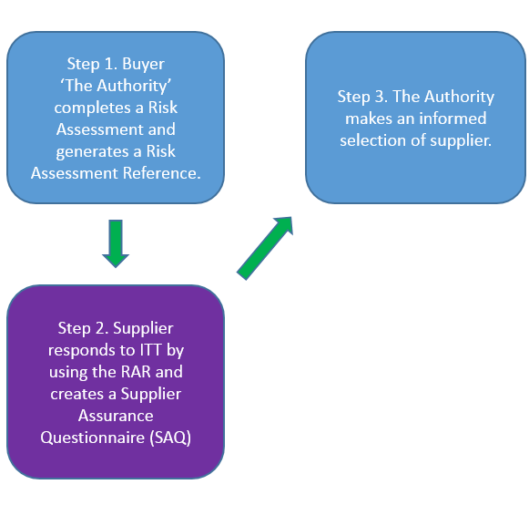
Implementation: what does it mean for me?
Buyers and suppliers will engage with the Cyber Security Model (CSM).
The CSM is a three stage process.
First, a Risk Assessment is conducted.
Each new contract requires a Risk Assessment (this assesses the cyber risk) and creates a Risk Assessment Reference (RAR).
Second, a Supplier Assurance Questionnaire (SAQ) is completed by suppliers (to demonstrate they can meet the requirements of this risk).
Those not able to demonstrate compliance are able to complete a Cyber Implementation Plan (CIP).
The third, and final, stage is an assessment by the buyer of the submitted SAQs and CIPs.
The first two stages are completed using the online tool, Octavian: https://suppliercyberprotection.service.gov.uk/
1
2
3
Implementation
Notes:
The MOD has defined the information it wishes to protect in DEFCON658 (see later) and it is termed MOD Identifiable Information or MODII. DEFCON658 remains the authority for the definition of MODII.
The process the MOD uses to guarantee its information has sufficient protection from a cyber threat is the Cyber Security Model (CSM). More detail on this three stage process is below:
For all new requirements, it is mandatory a Risk Assessment (RA) is completed using the online tool.
A unique Risk Assessment Reference (RAR) will be awarded and one of five cyber risk profiles will be arrived at. A risk profile details a series of controls necessary for a supplier to hold MODII, dependent upon the output of the RA.
The RAR will be used by potential future suppliers allowing them to react to the ITT and complete a Supplier Assurance Questionnaire (SAQ) in response.
It is essential the SAQ is filled out by buyers who are bidding for a contract using the online tool. Suppliers must input the RAR of the contract and will be required to answer specific questions which relate to the level of cyber risk for that contract.
If a supplier fails to fulfil the conditions of the cyber risk profile, they have an option to commit to obtain compliance before or at the start date of contract award using a CIP. The CIP, which is detailed in DEFSTAN 05-138, will provide evidence as to how suppliers will be achieve compliance, and when they will achieve it.
From October 2017 DEFCON 658 will apply to all suppliers down the supply chain, who are processing MODII, and therefore a RA will be completed by suppliers for sub-contracts for suppliers who wish to bid for a contract. A newly generated RAR will then be distributed to potential sub-contractors and this will generate further SAQs which may be considered prior to contract award. This process proceeds down the supply chain up to a point where MODII is neither moved, saved nor electronically retrieved.
Also the Cyber Risk Profile may be issued prior to the ITT,

Slide 8
DEFCON 658
The DEFCON (Defence Condition) sets out the obligations of the parties and defines MOD Identifiable Information, which the Cyber Security Model aims to protect.
Each buyer must determine the Cyber Risk Profile appropriate to the ITT / contract and notify their supplier; from 1 October each supplier will need to complete the same process for each sub-contractor where MOD Identifiable Information flows down the supply chain.
Not strict liability – recognised that cyber security incidents will happen, but obligation to inform MOD and co-operate with MOD on mitigation.
From October 2017, must flow-down provisions to sub-contractors. Able to rely on their self-certification but must report any areas of known non-compliance to MOD and act on MOD’s instructions to address non-compliance.
Extensive audit provisions and record keeping obligations (until 6 years after the contract end date) regarding MOD Identifiable Information relating to Contract Deliverables and copies of documents used to comply with DEFSTAN 05-138.
Breach of the DEFCON may lead to contract termination and / or damages.
If the Cyber Risk Profile is changed by the MOD, the supplier can request more time to comply which could incur additional cost.
Key documents

Slide 9
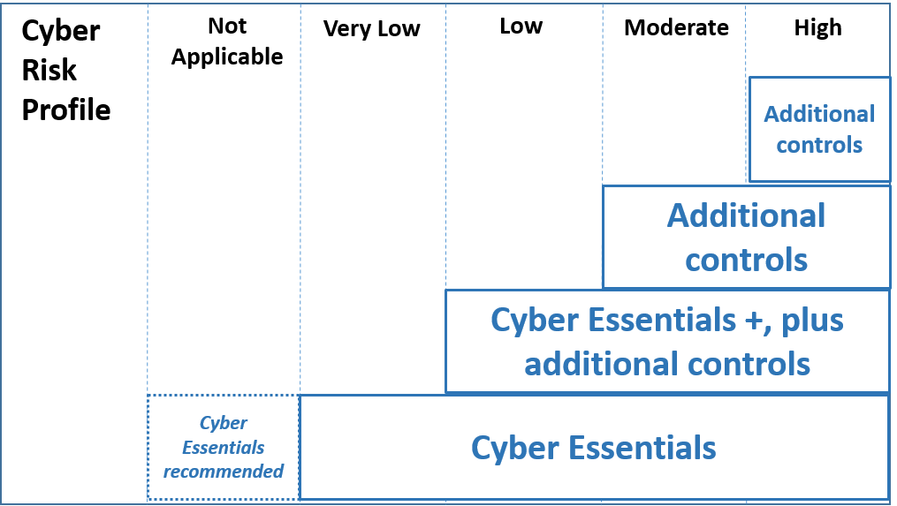
DEFSTAN 05-138
There are 5 possible cyber risk profiles from the first stage of the CSM, a Risk Assessment, these are: Not Applicable, Very Low, Low, Moderate and High.
The DEFSTAN (Defence Standard) sets out the control measures for the 5 Cyber Risk Profiles, focusing on the implementation of relevant security policies.
• N/A- No action required. Although the DCPP advises all suppliers to achieve Cyber Essentials certification as a minimum.
• Very Low - Cyber Essentials certification.
• Low - Cyber Essentials Plus certification, and additional controls.
• Moderate - All the requirements of ‘Low’ and additional controls.
• High – All the requirements of ‘Moderate’ and additional controls.
Key documents

Slide 10
Additional information
DCPP landing page: https://www.gov.uk/government/collections/defence-cyber-protection-partnership
Octavian, the online tool:
https://suppliercyberprotection.service.gov.uk/
A 30 minute podcast on the Cyber Security Model is available here:
http://www.techuk.org/insights/videos/item/11392-dcpp-webcast-recording
There is a DCPP group on the CiSP; register here: https://www.ncsc.gov.uk/cisp ;
a DCPP Group on LinkedIn : https://www.linkedin.com/groups/8351197 ;
Cyber Essentials : https://www.cyberessentials.ncsc.gov.uk/ ;
NCSC : https://www.ncsc.gov.uk/
Additional information
Notes:
All links correct at time of going to press.

