Slide 1
The Columbus Programme HMRC’s journey
04/10/2017

Slide 2
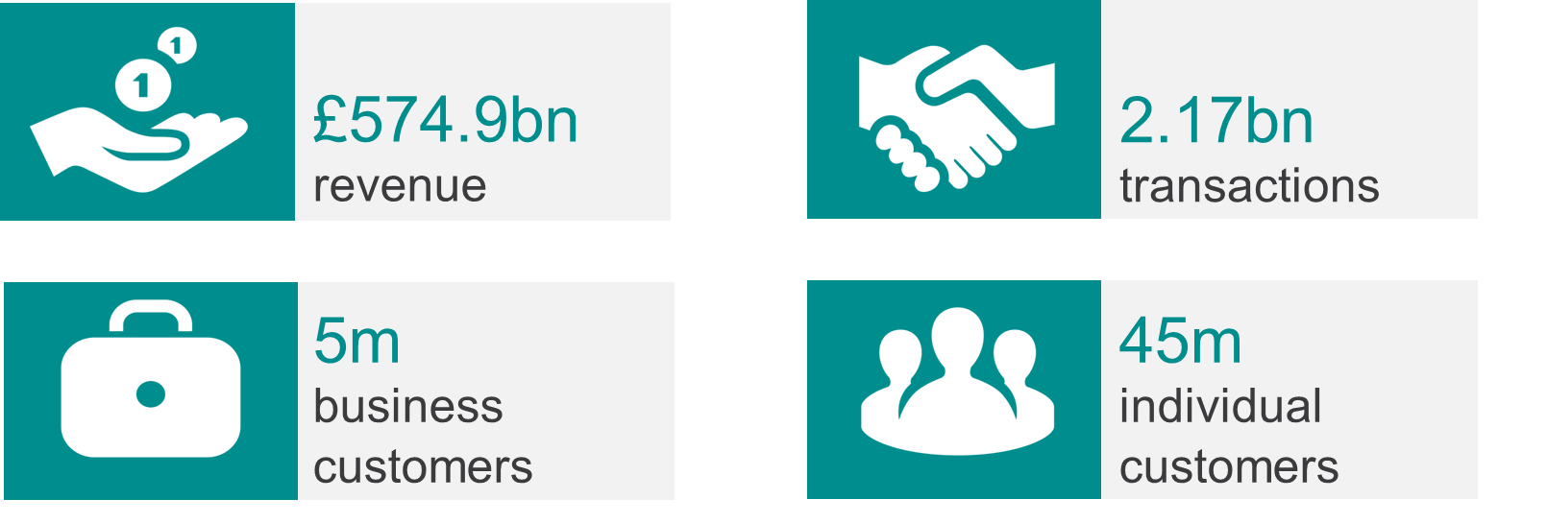
HMRC at a glance
We’re the UK’s tax, payments and customs authority

Slide 3
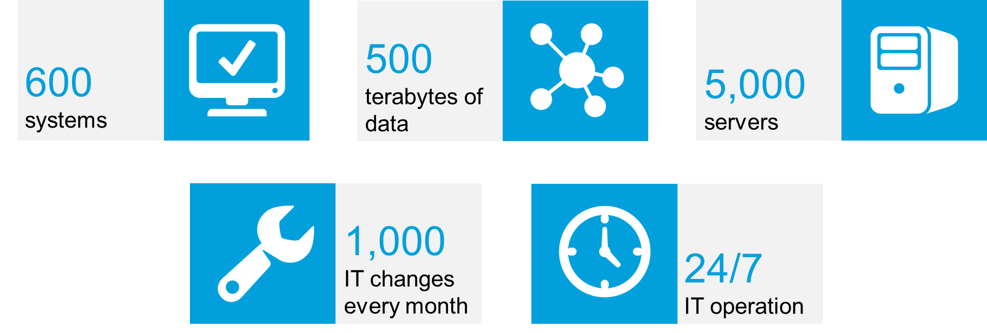
With one of the largest IT estates in Europe

Slide 4
… the Aspire contract delivered circa 84% of HMRC IT services but was inflexible and expensive…
Current spend ~£850m pa
(84% of HMRC ICT spend)
Key statistics:
£7.9bn cumulative spend July 2004 – March 2014
Enables >£500bn tax collection pa

Slide 5
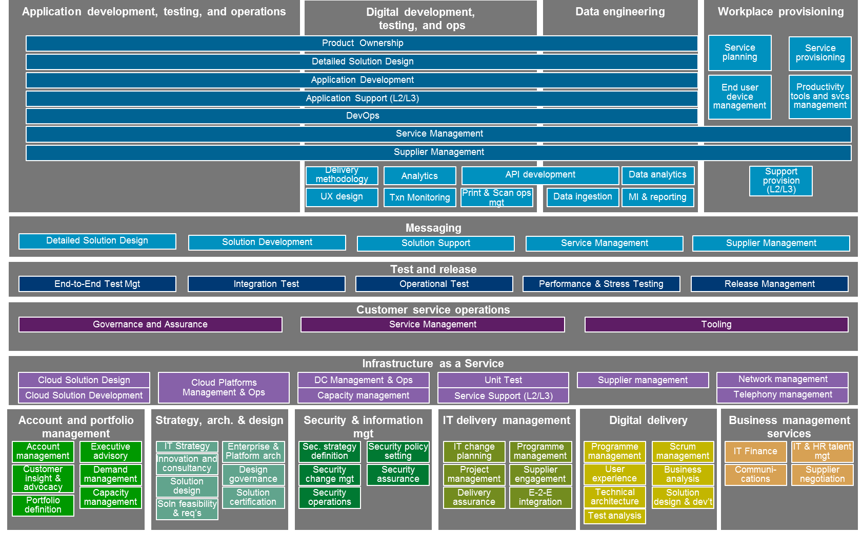
11_85 62_85
… where the replacement strategy required the creation of a Future Operating Model (FOM)…
TOM Summary / overall guidance
Capabilities taxonomy
High-level direction | Structure |  | Delivery Groups & Functional Areas CDIO-2 Target Organisation Chart
 | Accountabilities |  | Summary of Delivery Group & Functional Area accountabilities
 | Governance |  | Summary of CDIO governance RAPIDs for ‘top 20’ CDIO decisions CDIO KPIs
 | Culture & ways of working |  | Summary of CDIO target culture and ways of working [to be defined subsequently]
 | Capabilities | People | HMRC/RCDTS principles (one organisation) Per-DG / Functional Area DG FTE targets by quarter to June 2018 (per business case, as updated), including SR15
 |  | Technology | CDIO Tooling principles ITSM strategy OSS strategy
 |  | Suppliers | Capabilities to be retained (Hydra principles) Future supplier landscape (by quarter, to June 2018)
 |  | Processes | List of processes to be centrally defined
 | Location |  | BOF plans, by quarter (or year, as required)
Further guidance & templates
Summary terms of reference / guidance for CDIO-wide detailed design (DevOps model, Governance, CDIO interface with business, vendor management model, end-to-end integration, user-centric design)
Key
BOF: Building Our Future locations – a transformation programme focused on HMRC’s future office estate and creating modern working environments
CDIO Group: Chief Digital & Information Officer Group - HMRC’s IT, digital and security function
DG: Delivery group
RCDTS: Revenue and Customs Digital Technology Services Ltd- a company set up, and wholly owned, by HMRC.

Slide 6
… and HMRC retaining four core IT capabilities to enable effective management of a multi-sourced supply chain…
11_85 12_85 13_85 15_85 17_85 19_84
CDIO is adopting a multi-sourced model, selecting the most appropriate internal or external supplier for each service
To effectively manage the supply chain four core capabilities will be retained in-house:
Architecture and Design
Strategy & Architecture (CTO) is responsible for:
Setting IT strategy
Designing underlying architecture and governing the selection of tooling
Ensuring IT solutions fit with HMRC IT strategy
Operational Service Management
Service Ops will be responsible for:
Oversight of availability, performance and resolution of incidents across the entire IT estate
Ownership of service management processes
Delivery Groups will be accountable for performance of their service
HMRC will retain 4 core capabilities to manage multiple suppliers
Vendor Management
Delivery Groups will be responsible for managing their own supply chain
TOCM project will develop overarching vendor management principles for Delivery Groups to follow
Change Delivery
IT Delivery will:
Coordinate major change and introduction of new services across multiple Delivery Groups
Ensure common delivery methods are utilised
Delivery Groups will manage change delivered through their supply chain
6

Slide 7
… but to move forward required re-alignment of the Current Operating Model with the supplier…
As is
The target operating model for CDIO is to deliver certain key functions;
Account and portfolio management
Architecture
Service operations
Which will enable;
Cost reduction
Agility
Competitive supply chain
Supported by;
Technical transformation
Consolidation / rationalisation
CDIO Portfolio Management
IT Architecture & Requirements
Build
Unit Test
Service Ops
Application Operations
Systems Integrations & Test
Applications Maintenance
Network
Infrastructure
To be
CDIO Portfolio Management
IT Architecture & Requirements
Build
Unit Test
Service Operations
Workplace & Corporate Services
Operational Support
Services
Case Management
Data Engineering
Customs & Intl Trade
Digital Operations
Messaging
Test & Release
Core Business Platform
VOA
SAP Customer Competency Centre
Infrastructure as a Service
HMRC
Hybrid
Supplier

Slide 8
… this required continual and iterative ongoing commercial negotiations…
4_85 15_85 16_85 17_89 40_84
Terms & Conditions
Introduction of the ability for Partial termination of services
Full overhaul of Exit provisions and data matrix timing (including re-procurements)
Exploitation of available Term to support continuation of legacy and to Departmental transformation project timings
Services
Service requirements restructured in line with the TOM and market standards
Service levels re-negotiated to be industry comparable
Service Operations carved out as a Department delivered capability in the heart of a SIAM aligned multi-sourced model
All services scopes integrated across the supply chain and controlled via the departments Design Authority
Financials
Financial model realigned to represent a market service scope
Defined Step down process and values by service
Enforceable Benchmarking provisions with upper quartile targets
Commitments
Removal of Minimum Revenue Commitments
Introduction of new performance based targets

Slide 9
… with a strategy for each delivery area
25_81 32_81 33_81 34_81 35_81 12_81 37_81 38_81 39_81 40_81 41_81 42_81 43_81 44_81 45_81
Phase 2
1
Digital
Digital Delivery
Messaging & Digital Operations
Digital Operations - Print & Scan
Insource Messaging & Digital Ops
Re-procure Print & Scan
2
Core Business Platforms (ITMP)
Core Business Platforms (ETMP & Sunset)
SAP CCC
Case Management
Customs & International Trade
Test & Release
Data Engineering
Valuation Office Agency
Tax Platforms
Given SR15, negotiate an terms and conditions which will provide stability, deliver SR15 systems transformations and improve delivery efficiency
3
Service Operations
Service Operations (Capgemini)
Service Operations (Fujitsu)
Network Operations Centre
Service Operations - Call Centre
Bring in ~400 heads to take control of service to enable transformation and multi-sourcing
4
Architecture, IT & Commercial Management
Account and Portfolio Management
Strategy, Architecture & Design
IT Project Management
Security & Information
Other (inc. Shared Services)
Insource design and delivery management capabilities to gain control
De-duplicate resource and transform
Key
ITMP: Individuals Tax Management Platform – HMRC’s core platform for individuals taxes
ETMP: Enterprise Tax management Platform – HMRC’s core platform for business taxes
SAP CCC: SAP Customer Competency Centre
5
Datacentre & End User
Cloud Infrastructure
Workplace & Corporate Services (Capgemini)
Workplace & Corporate Services (Fujitsu)
Negotiate datacentre contract, including transformation to reduce cost & improve flexibility
Strengthen internal management
Re-procure workplace services
9

Slide 10
… mitigating risk and capacity constraints through a phased and sequenced schedule…
Outline Business Case approval*
Phased approvals
Sept. 2015 headcount
Apr 2022 headcount
2015
2016
2017
2018
2019
2020
2021
Int
Ext
Tot
Int
Ext
Tot
Q3
Q4
Q1
Q2
Q3
Q4
Q1
Q2
Q3
Q4
Q1
Q2
Q3
Q4
Q1
Q2
Q3
Q4
Q1
Q2
Q3
Q4
Q1
Q2
Q3
Q4
1
Digital
Messaging & Digital Ops
xxx
xxx
xxx
tbc
tbc
tbc
Re-procure Print & Scan
2
Tax Platforms
Negotiate to provide stability and deliver SR15 transformation
xxx
xxx
xxx
tbc
tbc
tbc
Deliver Phase 1 integration
3
Service Operations
Service Ops and NOC
xxx
xxx
xxx
tbc
tbc
tbc
Service Desk
4
Architecture, IT & Commercial Management
Design and delivery management
xxx
xxx
xxx
tbc
tbc
tbc
5
Datacentre & End User
Renegotiate Cloud Infrastructure
xxx
xxx
xxx
tbc
tbc
tbc
Re-procure workplace
Total
xxx
xxx
xxx
tbc
tbc
tbc
* Outline Business Case approval includes approval of design / change work needed to support 2017/2018 decision points
Insource
Re-procure
Renegotiate
10
Official

Slide 11
… where services transition from suppliers to HMRC / RCDTS on a phased basis through to Q2 2017/18
33_84 49_84
 |  | 2015/16 |  |  |  | 2016/17 |  |  |  | 2017/18
 |  | Q1 | Q2 | Q3 | Q4 | Q1 | Q2 | Q3 | Q4 | Q1 | Q2 | Q3 | Q4
Delivery Groups | Case Management
 | Customs & International Trade
 | Core Business Platform
 | SAP CCC
 | Test & Release
 | Data Engineering
 | Cloud & Infrastructure
 | Digital Operations
 | Messaging
 | Service Operations
 | Service Desk
 | Fujitsu Service Operations
 | Workplace & Corporate
Functional Areas | Account & Portfolio Mgmt.
 | Strat., Architecture & Design
 | Security & Information
 | Digital Delivery
 | Print & Scan
 | Valuation Office Agency
 | IT Delivery
 | Shared Services
 | HR
 | Finance
 | Comms
 | Commercial
HMRC/RCDTS
Capgemini
Fujitsu
Accenture
Accenture, Equal Experts, + Others
Re-procured
11

Slide 12
…resulting in the supplier map balance changing to a desired split between internal and external delivery…
VOA
IT Services
Digital Delivery
Centres
KEY
Move into HMRC
Finishes 2020
Transform & partner post 2017
Re-procure
Service Operations
Case Management
Customs and International Trade
SAP CCC
Test and Release
Messaging
Digital Operations
Data Engineering
Development, Test & Ops
Core Business Platform
Workplace and Corporate Services
Cloud
SAP AM&AD
Legacy AM and AD
Hosting
Data
To support transformation to ETMP and ERP
Benchmarking of services in 2017
New AM support pricing model to be agreed in work off plan
To mange the run down of the legacy estate in transformation to new platforms
Manage the shutdown of legacy systems once service migrated
Sunset negotiation of traditional hosting to facilitate virtualisation and Public Cloud
Annual Benchmarking of services commencing Q2 of 2017
Platform transformation commencing during 16/17
Project to shutdown legacy data warehouses

Slide 13
HMRC insights…
Phased the implementations / service transitions
Sequenced phasing with 1st ‘wave’ non-business impacting services
Design Authority established
Used a 3rd party transition specialist with detailed 9 month methodology under a managed service contract
Mixed economy teams – external specialists, internal service leads, contingent labour
All functions took responsibility for parts of the transition – IT, HR, Finance, Estates …
Revised supplier contract exit schedules to a common form across all parties
High degree of governance and reporting, including weekly supplier exec/SRO meets
Detailed planning and controls put in place, but used an agile critical path instead of integrating all plans
Skills developed and both IP and capabilities transferred to the Department
Continual incumbent supplier negotiations and management to manage step down

