Slide 1
Libraries Deliver: Ambition for Public Libraries in England 2016-2021

Slide 2
What I’m going to cover
Ambition document
Action plan
What is the Taskforce doing?
What can you do?
How can we help you?

Slide 3
Not talking about how we got here
If you want to know the background, including details of the consultation process, see our website and blog….

Slide 4
Ambition

Slide 5
Foreword
Statement of government support for libraries through a joint foreword by:
Rob Wilson, Minister for Civil Society
[then Libraries Minister]
Cllr Ian Stephens, Chair, Culture, Tourism and Sport Board, Local Government Association

Slide 6
Executive summary
Covers all the main messages in the document
Get people to read this and/or the Ambition flyer if they read nothing else!

Slide 7
Context
Reinforces existing usage and reach of libraries and what libraries have to offer

Slide 8
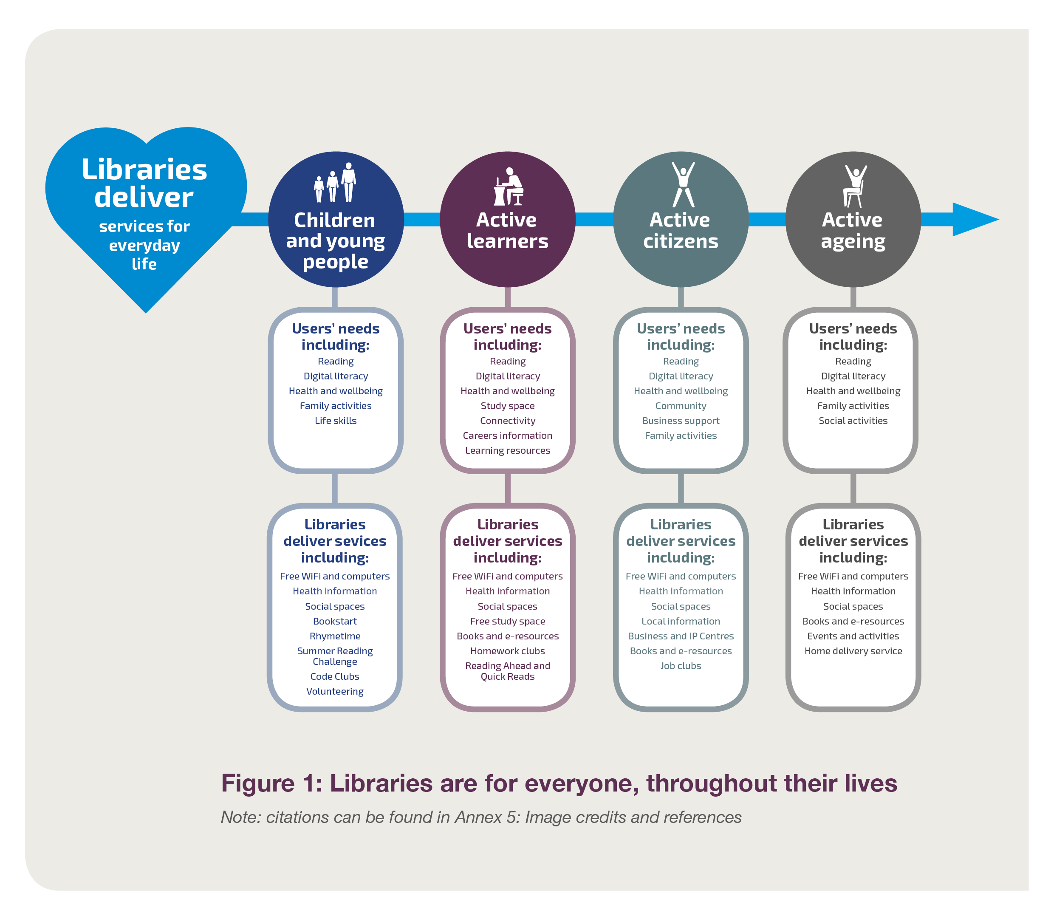
For everyone, throughout their lives

Slide 9
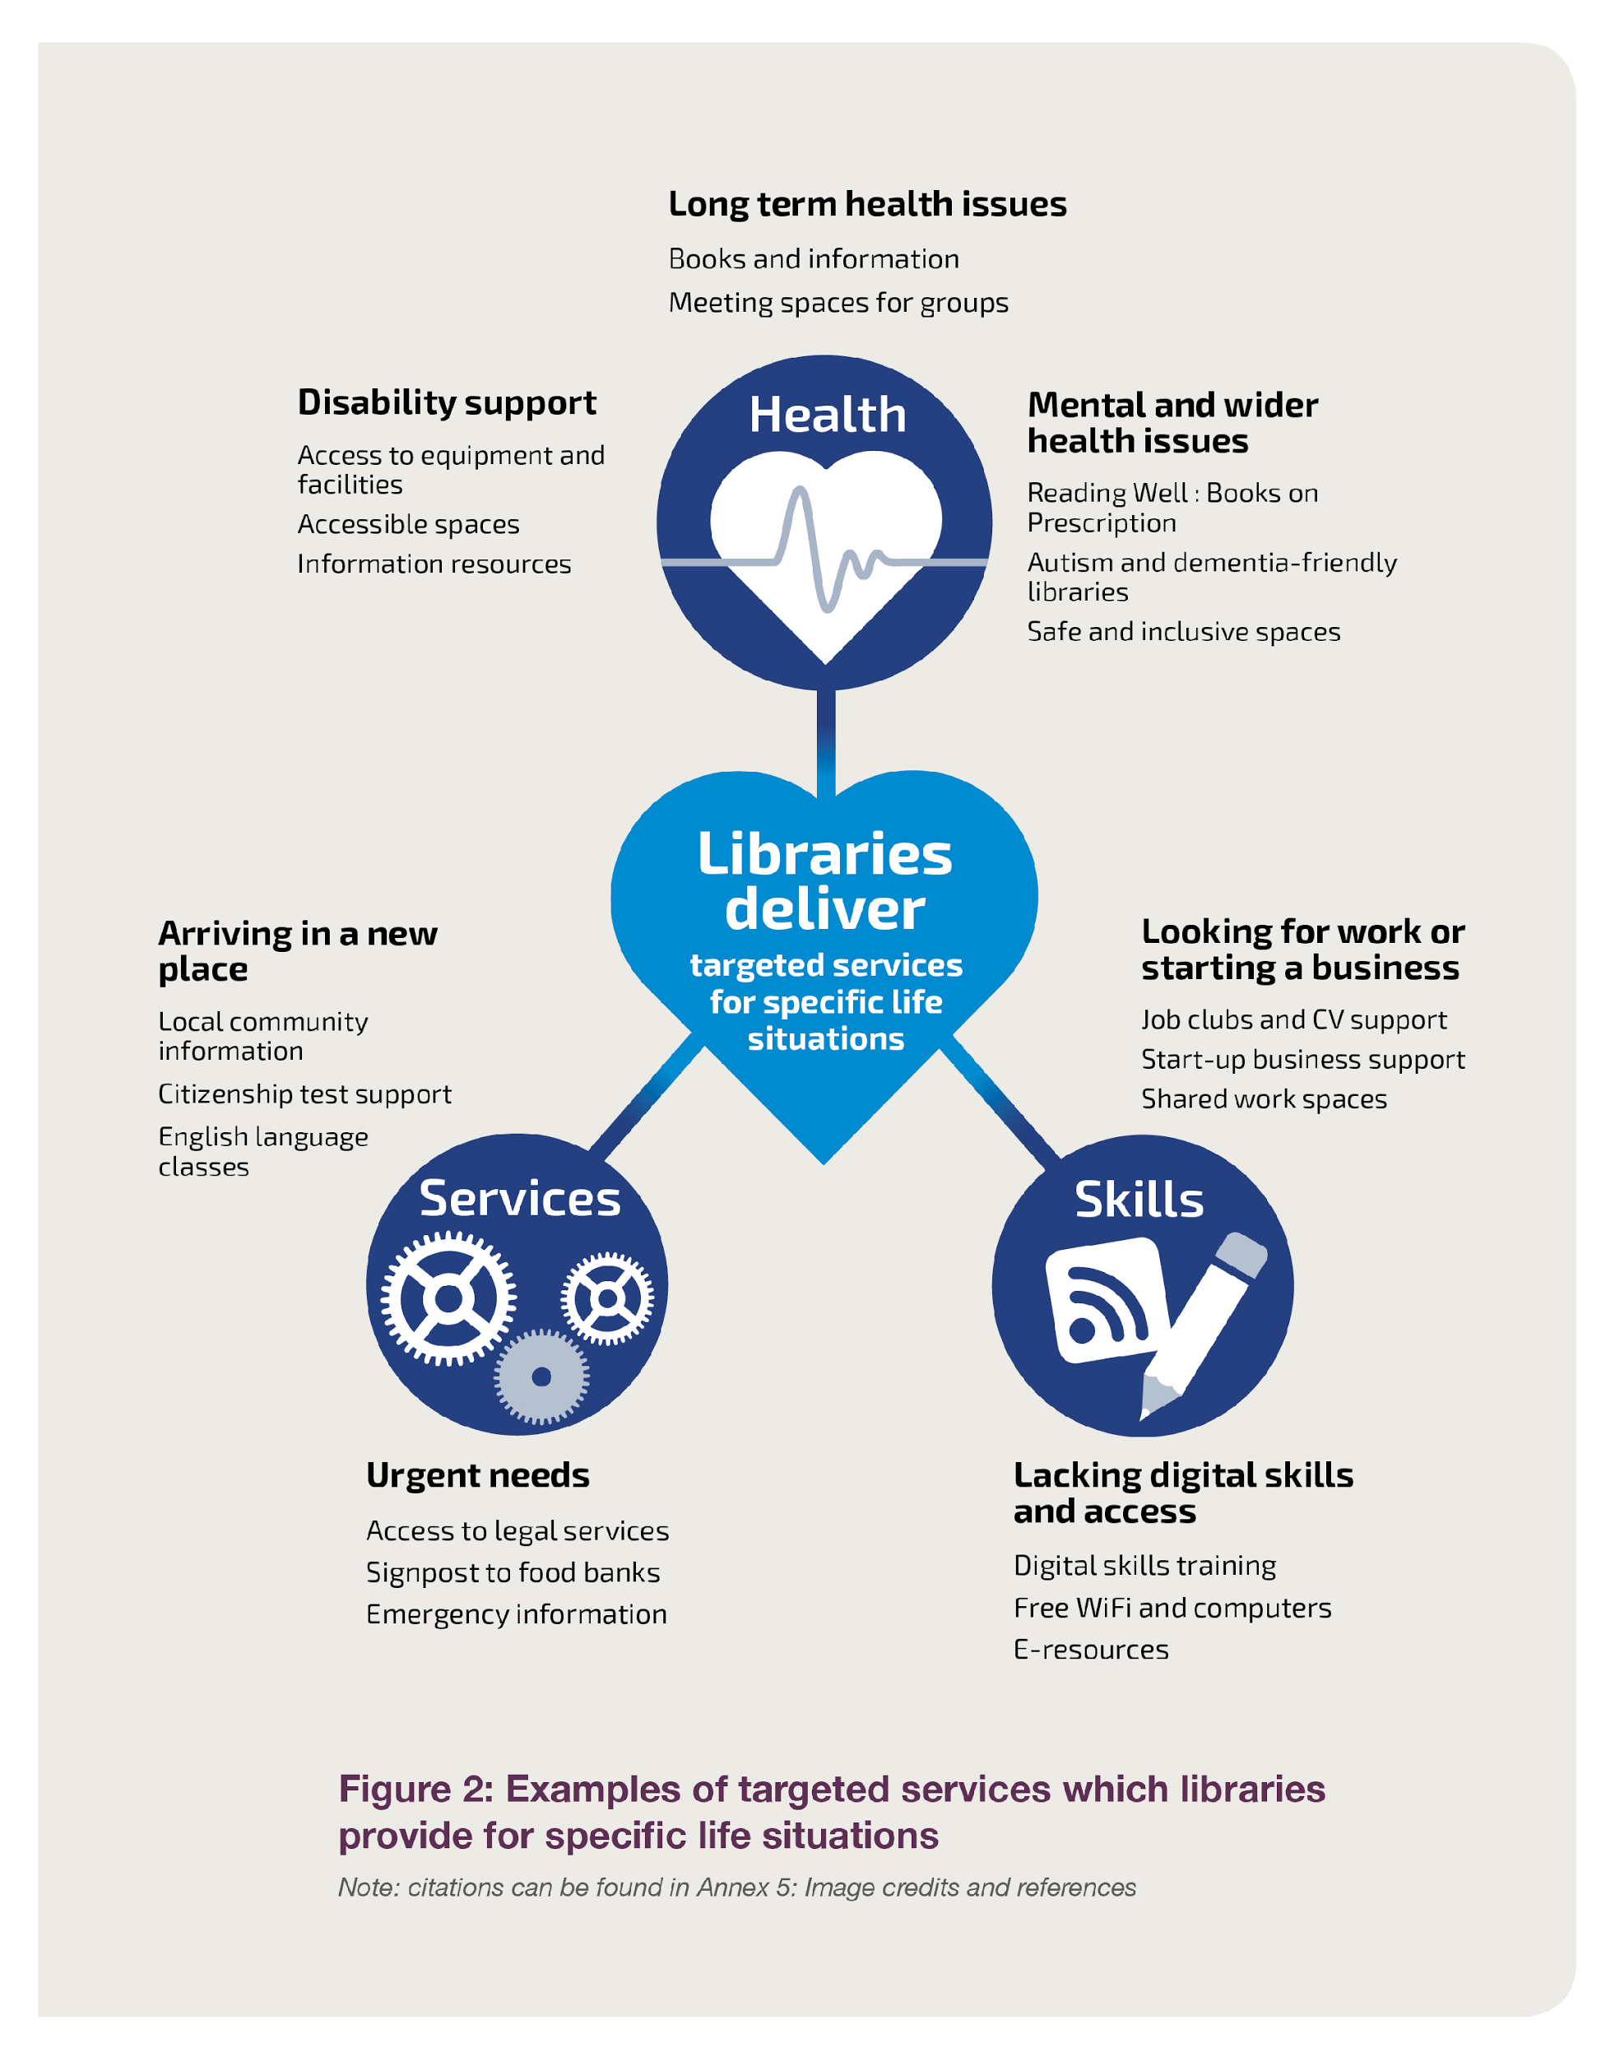
Figure 2: Examples of targeted services which libraries provide for specific life situations

Slide 10
Context
Reinforces existing usage and reach of libraries and what libraries have to offer
Describes the legal position (Foreword confirms DCMS intention to use their superintendence powers under 1964 Act)
Outlines the local government funding constraints

Slide 11
Vision
Libraries and the people working in them change lives:
Promoting enjoyment in reading and other cultural and creative activities
Raising aspirations and building skills so people can achieve their full potential
Actively sharing information, encouraging people to engage with, co-create and learn from each other
Providing trusted and practical support and advice to those who need it

Slide 12
Vision
If our ambitions are achieved, describes what:
Individuals
Communities
Public services and other partners
Library services
will see, feel and do in 2021
Reinforces the importance of following ethical principles of librarianship in delivery of library services

Slide 13
Outcomes libraries deliver
Cultural and creative enrichment
Increased reading and literacy
Improved digital access and literacy
Helping everyone achieve their full potential
Healthier and happier lives
Greater prosperity
Stronger, more resilient communities

Slide 14
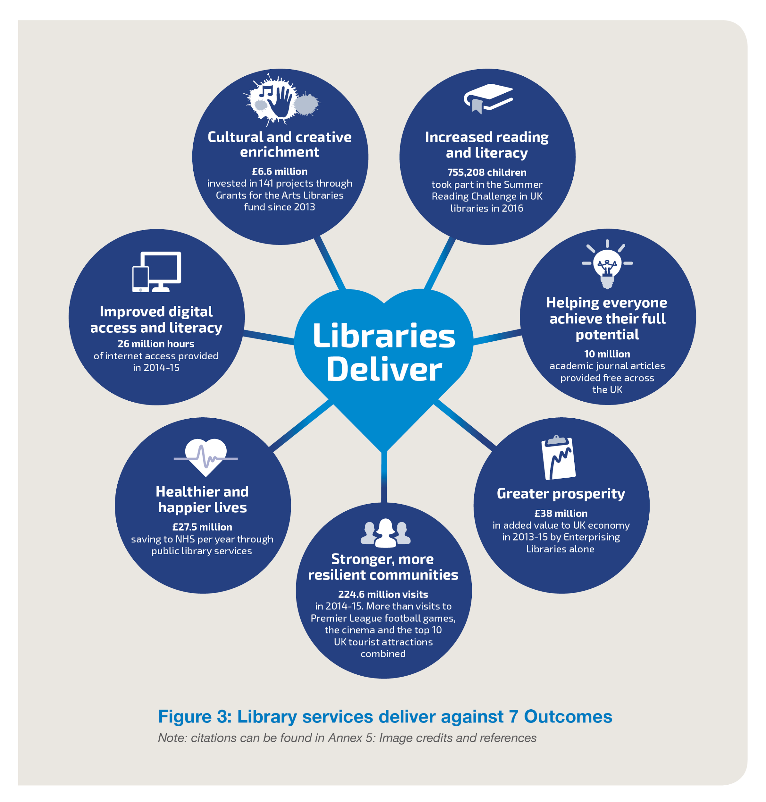
Figure 3: Library services deliver against 7 Outcomes

Slide 15
Outcomes libraries deliver
For each outcome, it describes:
The challenges we are responding to
Examples of existing good practice
What success would look like in 2021
Initial ideas on progress indicators

Slide 16
How we’ll achieve this
Emphasises the importance at local level of:
Strong local leadership
Strategic planning, using common principles
Cross-boundary working and partnerships
Co-creating services with the community
Exploring all options to achieve resilient services
Developing the library workforce

Slide 17
How we’ll achieve this
Describes the role of the Taskforce, including:
Supporting and enhancing local leadership
Providing guidance / frameworks / common principles to inform local action
Raising awareness / making the case for libraries
Producing shared assets (eg. for advocacy)
Sharing and promoting good practice
Addressing difficult issues once (eg. data)

Slide 18
Action Plan

Slide 19
Action Plan: Taskforce
Make the case for investment in libraries: advocacy
Raise public awareness of what libraries offer
Identify and showcase good practice and support innovation
Support workforce development
Support development of the digital offer
Monitor and report on progress

Slide 20
Action Plan: Challenges
Challenges to central and local government and library services include:
Acknowledge and promote the role libraries play
Think ‘Libraries First’
Use the guidance the Taskforce produces
Identify, share and adopt good practice
Explore and exploit all options before making service reductions

Slide 21
What is the Taskforce doing?

Slide 22
Promotion of Ambition
Letters (and hard copy documents) sent to local authority leaders, library portfolio holders, chief executives, heads of library services
Letters gone to all Ministers / MPs / Lords
Articles placed in local authority publications, conference presentations / workshops, etc
Working to get messages out to other sectors (eg. to health colleagues) and partners

Slide 23
Action Plan: Taskforce
Some things are already underway including:
£4m Libraries: Opportunities for Everyone Fund
Masterclasses (on a range of topics)
Support to explore and spin out to a mutual
Community-managed libraries research
Public libraries skills strategy
Sharing communication assets

Slide 24
What can you do?

Slide 25
What can you do?
Be an ambassador for library services
Promote Ambition through your networks. Use it as a prompt to start discussions / build stronger partnerships within your organisation and with partners
Contribute to delivery of the Taskforce actions
Deliver on the Challenges we’ve set you (if applicable)

Slide 26
How can we help you?

Slide 27
Tell us how can we help you…
…to be ambassadors for Ambition and library services with colleagues, partners, the public?
…and your organisation to share and adopt good practice and use the guidance we produce?
…overcome barriers and deliver on the Challenges we’ve set (if applicable)?

Slide 28
Any Questions?
Email: librariestaskforce@culture.gov.uk
GOV.UK: https://www.gov.uk/government/groups/libraries-taskforce
Blog: librariestaskforce.blog.gov.uk
Twitter: @LibTaskforce #LibraryAmbition Libraries Deliver: Ambition https://www.gov.uk/government/publications/libraries-deliver-ambition-for-public-libraries-in-england-2016-to-2021

