Slide 1
PACT (DVLA) Relevant section – Programme Structure

Slide 2
Background
The Partners Achieving Change Together (‘PACT’) ICT contract was awarded by DVLA in September 2002 on a 10 year term, which was then extended by 3 years, expiring in September 2015.
This was a large monolithic outsourced contract with a single supplier, typical of the other large government IT contracts of its time, and was viewed as being restrictive and expensive from the perspective of a modern day agile business.
The prime contract was entered into with IBM (now Concentrix), with Fujitsu as the key sub-contractor, delivering circa 99% of legacy support services, with over 180 third party contracts supporting overall delivery. The vast majority of these were coterminous with PACT.

Slide 3
Multi-Disciplinary Programme Structure
The project had a 15-month timescale, including obtaining necessary spend approvals.
A multi-disciplinary team comprising of IT, Project Management, Commercial and Finance was created to manage and deliver this transition.
Where it was identified, via analysis of the skill sets already possessed plus those which would be needed going forwards, that the skills were not available in-house, DVLA brought in external client-side resources via G Cloud and Crown Commercial Service’s Contingent Labour ONE framework, to enhance its own project team to support delivery.
A defined governance structure was implemented to enable transparent decision making

Slide 4
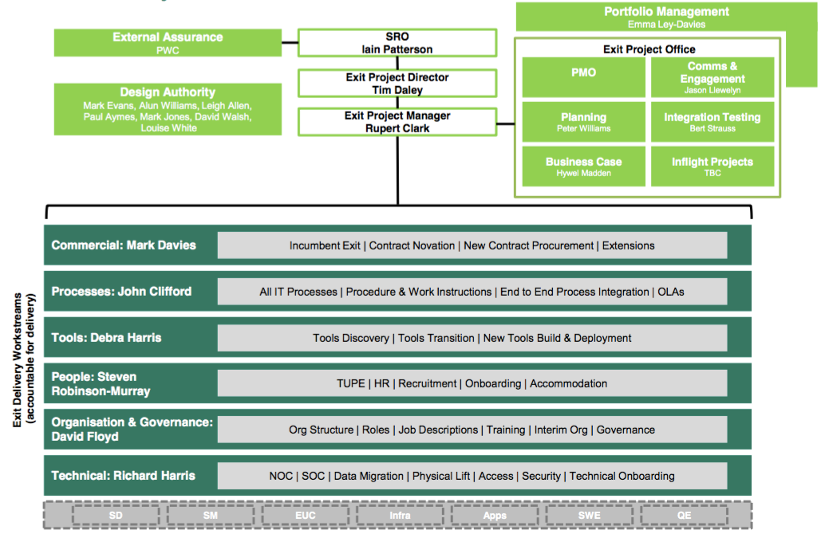
PACT Programme Structure

Slide 5
Governance Structure
Pre-existing supplier management forum chaired by IT Director which covered day to day service delivery and performance, with PACT exit a standard agenda item.
T2T Programme Board (monthly)
PACT Governance Forum (monthly)
Review Group (monthly)
Service Authority (Fortnightly)
Attended by senior managers with a high level view of progress against the plan, as a point of escalation where appropriate.
PACT Contract Exit Project Board (monthly)
PACT Contract Exit Checkpoint (fortnightly)
First formal tier of supplier/DVLA project meetings where exit plan was discussed and reviewed, along with risks and issues highlighted.
Weekly stand ups
Weekly team meetings (workstream reports)
PACT Contract Exit Project

