Slide 1


Slide 2


Slide 4
Vocational and technical qualifications: the regulator’s perspective
Phil Beach CBE
Ofqual

Slide 5
Scope of this presentation
Who we are
The qualifications landscape
How we regulate on behalf of qualification users
Reform

Slide 6
Who we are

Slide 7

Who we are

Slide 8






Many government players: much expertise
  The Quality Alliance

Slide 9

Qualifications – a £Billion business

Slide 10
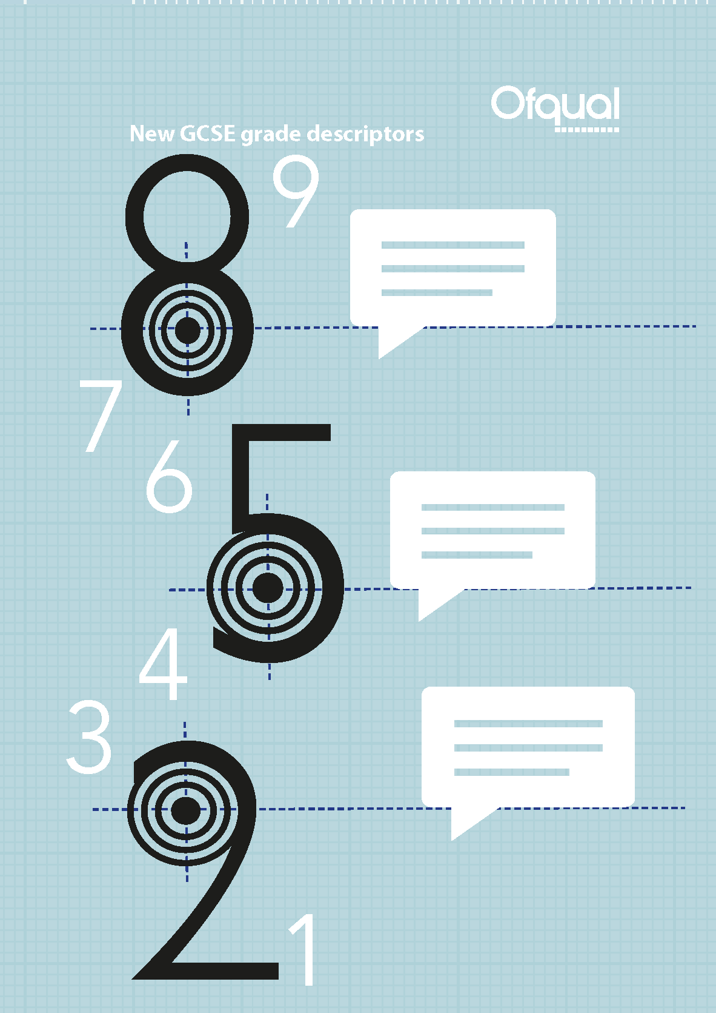
Significant changes

Slide 11

Reform reflecting requirements

Slide 12
The qualification landscape is complicated

Slide 15
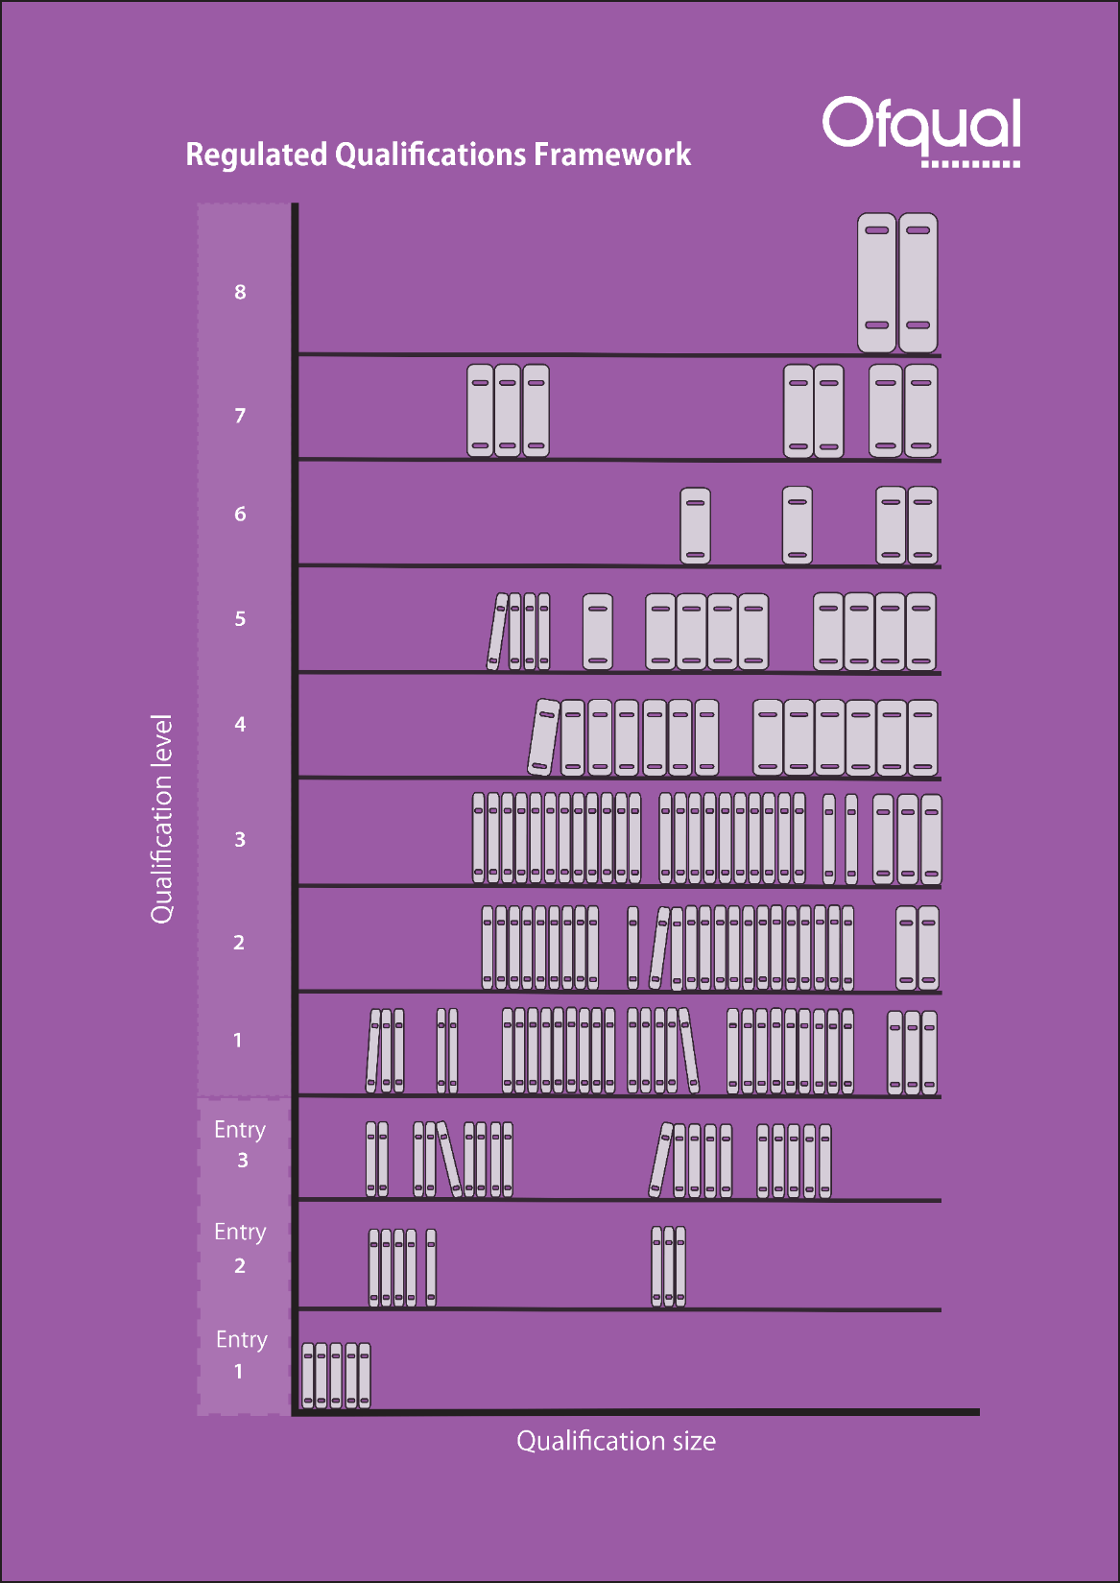
Getting a sense of order

Slide 16
Navigational tools
We are launching a prototype app:
  Interactive
  Allows you to explore the vocational and technical qualification landscape
  Hosted on Ofqual Analytics:
https://analytics.ofqual.gov.uk/apps/2017/VTQ/VTQLandscape/

Slide 17
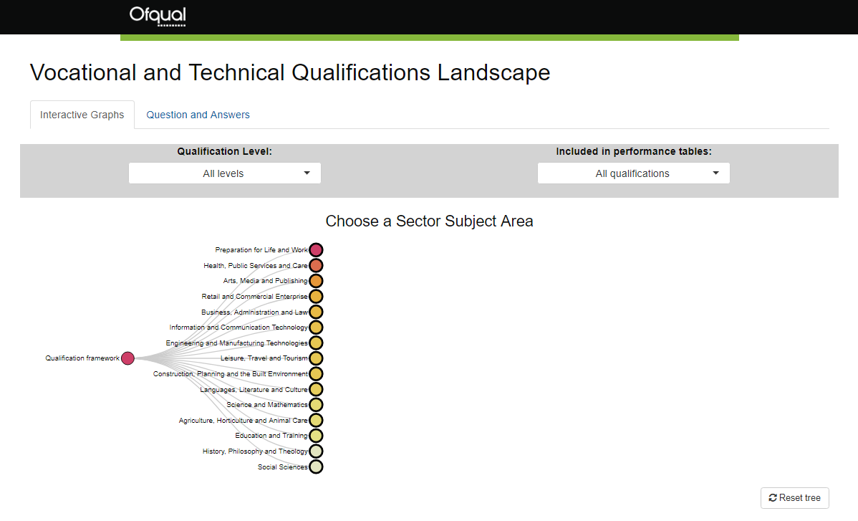
Vocational and Technical Qualifications Landscape app

Slide 18
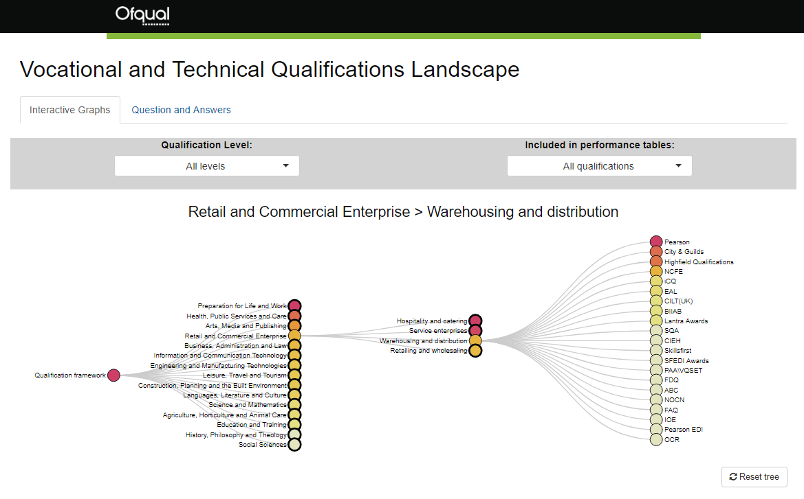
Vocational and Technical Qualifications Landscape app

Slide 19
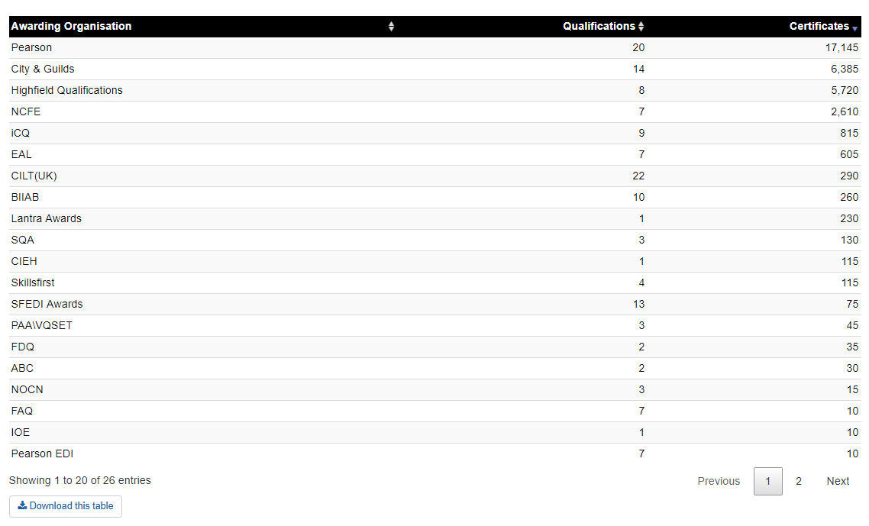
Vocational and Technical Qualifications Landscape app

Slide 20
How we regulate

Slide 21



How we regulate for you

Slide 22



Legitimate needs: Assessment compromise

Slide 23























Regulating to meet your needs

Slide 24
Using our powers
E
We control entry to the regulated market
We control the legal framework through the Conditions of Recognition
We take a variety of different forms of action to drive and enforce compliance
Employer needs

Slide 25

We don’t create extra red tape

Slide 26

Risk based regulation

Slide 27



Quality Assurance in practice
Proactive
Sophisticated analysis
Intelligence from many sources

Slide 28
Vocational and technical qualification reform

Slide 29
Sainsbury’s routes
Vocational qualifications
University
Work
A levels (& Applied Generals)
T levels
Apprenticeships
Academic route
Technical route

Slide 30
The reform programme
University
Work
A levels (& Applied Generals)
T levels
Apprenticeships
Academic route
Technical route

Slide 31
Guiding principles of reform
Reform
Market reform
Employer leadership
Policy & qualification purpose
System readiness
Content
Design
Development
Delivery

Slide 32
Milestones of reform
 |  | Functional Skills 1st teach | T Levels 3 routes Limited pathways | T Levels More pathways + further 3 routes | T Levels + further 5 routes
Standards Apprenticeships Continuous development and release
2017 | 2018 | 2019 | 2020 | 2021 | 2022
Reduction of some existing qualifications
Standards Apprenticeships
Continuous development and release
SASE
No new starts

Slide 33
Apprenticeship End Point Assessment
Apprenticeship standard
Assessment plan
Employer
Group
Approve standard
Approve assessment plan
Institute
External
Quality
Assurance
ESFA Funding
Design and deliver End -point Assessment
End-point Assessment Organisation

Slide 34
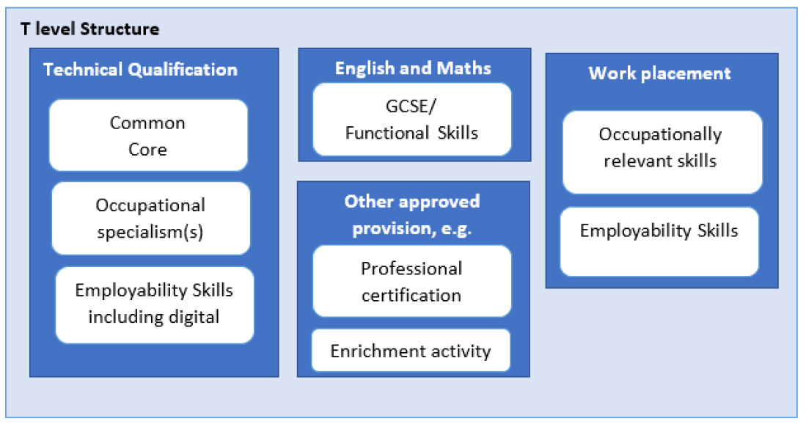
T Levels

Slide 35
Key messages
We want to help you understand and navigate the qualifications landscape
We regulate so that:
  You get what you want from qualifications and;
  Have confidence in them
Reform is underway – we want to work with you

Slide 36


Slide 37
Assessment functioning
Beth Black
Associate Director, Research and Analysis, Ofqual.

Slide 38
overview
What makes a good test… from an assessment functioning point of view
Results from our study
What this tells us and what it doesn’t tell us

Slide 39
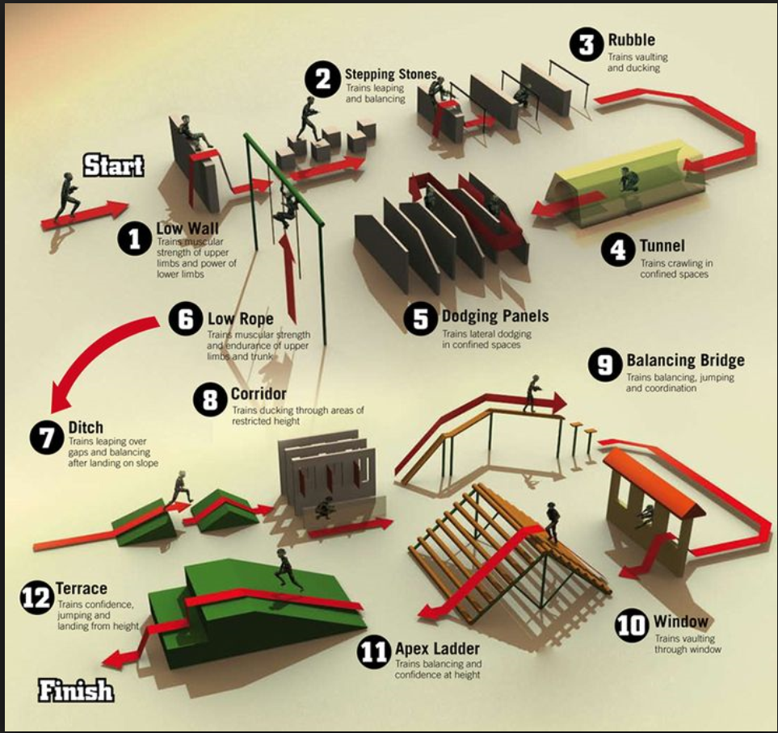
What makes a good test?
Appropriate ease/difficulty
Test and test items should separate people out according to their ability
Should be reliable.

Slide 40
The study
3 criteria:
  On/going on to performance tables
  External assessment in the form of an exam
  Likely >500 candidates entering in 2016
27 qualifications
49 units
Includes:
  Level 1, 2 and 3 tests
  Subject areas: applied science, maths, carpentry

Slide 41
What makes a good test?
Appropriate ease/difficulty
Test and test items should separate people out according to their ability
Should be reliable.

Slide 42
Appropriate ease/difficulty
For the standard according to the level of the qualification
Targetted to the ‘cohort’ of students taking the qualification
Ease/difficulty of the overall test is mainly a function of the test items (questions) within the test…
Imagine an item worth 1 mark; can calculate a facility index
Very easy item – all students get 1 mark – Facility = 1.0
Very difficult item – all students get 0 mark – Facility = 0.0
Ideally; facility values – between 0.3 and 0.8

Slide 43
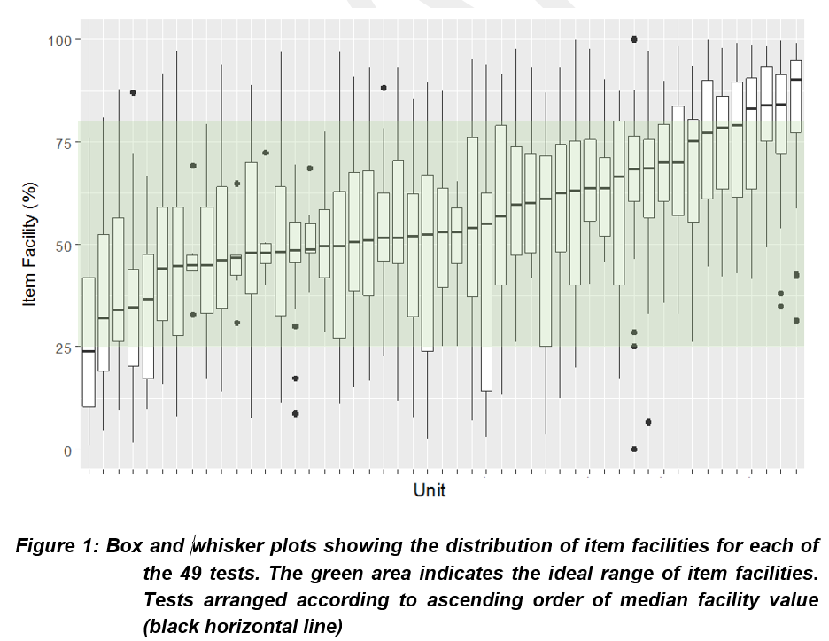
Item facilities for 49 tests

Slide 44
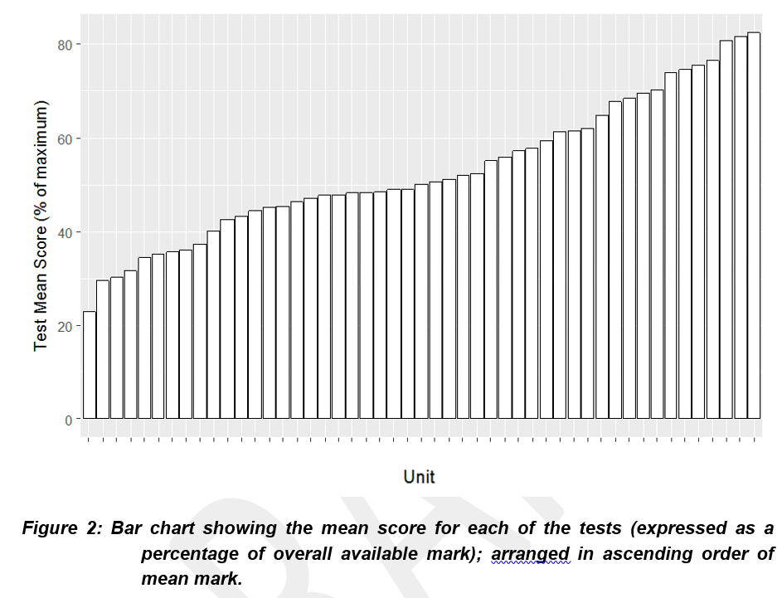
Average score of the 49 tests

Slide 45
What makes a good test?
Appropriate ease/difficulty
Test and test items should separate people out according to their ability
Should be reliable.

Slide 46
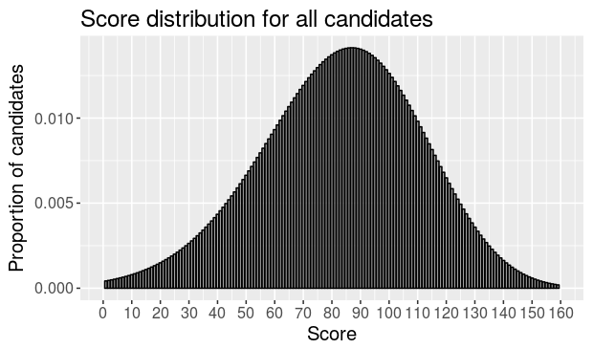
Discrimination – separating out people according to their ability
Worse at construct being measured
Better at construct being measured

Slide 47
Discrimination – separating out people according to their ability
Discrimination index
Look at the relationship (correlation) between item score and overall test score:
0 – no relationship
1.0 – perfect relationship
Worse at construct being measured
Better at construct being measured

Slide 48
Discrimination – separating out people according to their ability
Discrimination index
Look at the relationship (correlation) between item score and overall test score:
0 – no relationship
1.0 – perfect relationship
Ideally, values should be 0.3 or above

Slide 49
Discrimination – separating out people according to their ability
Worse at construct being measured
Better at construct being measured

Slide 50
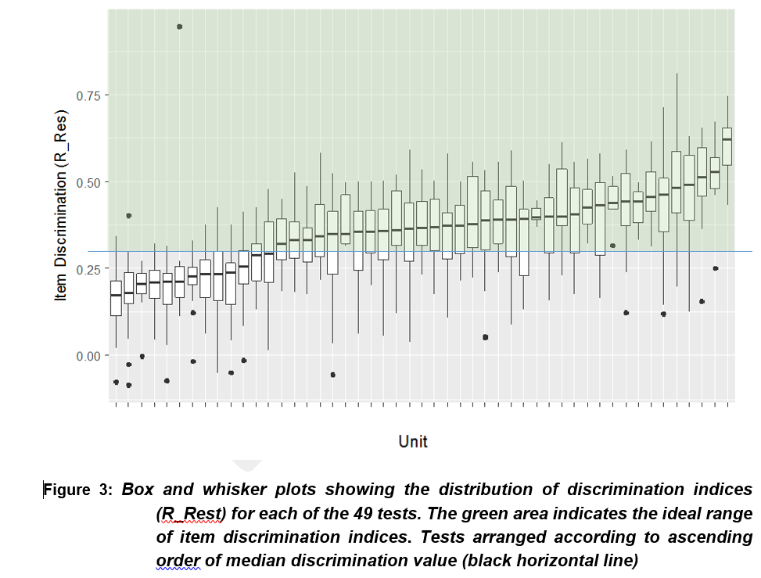
Discrimination values
For the 49 tests

Slide 51
What makes a good test?
Appropriate ease/difficulty
Test and test items should separate people out according to their ability
Should be reliable.

Slide 52
Reliability
Reliability = consistency
Cronbach’s Alpha – measure of internal consistency

Slide 53
Reliability
Reliability = consistency
Cronbach’s Alpha – measure of internal consistency
Ideal values – above 0.8

Slide 54
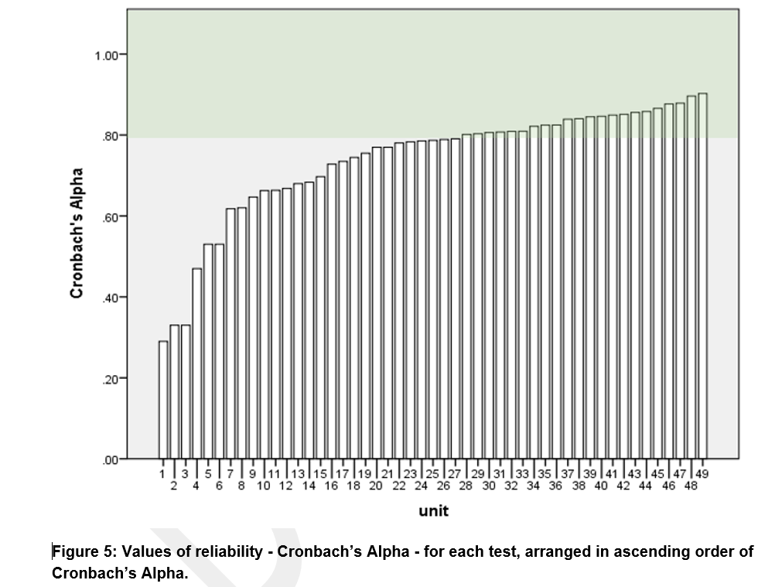
Reliability – Cronback’s Alpha

Slide 55
In context….
Test purpose: ‘ranking’ or ‘mastery’.
Grade boundaries
Test quality: need good assessment functioning; but other stuff is important too:
  Is it ‘assessing the right stuff’?

Slide 56
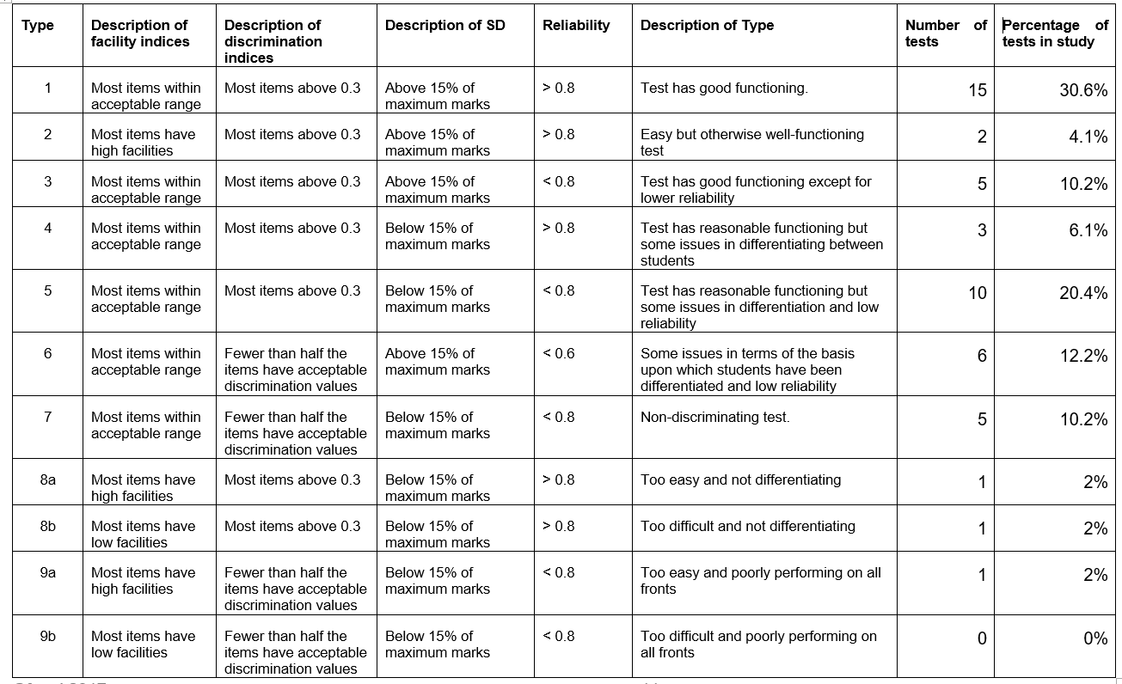
Overall….
≈71% good or reasonable functioning

Slide 57
What happened next
AO engagement & improvement
Next phase of this work is underway…
Thank you
Beth.Black@ofqual.gov.uk

Slide 58
Apprenticeship Standards and Ofqual EQA
November 2017

Slide 59

External Quality Assurance (EQA)

Slide 60
Apprenticeship Frameworks
Apprenticeship Standards
comprise 3 elements
standard and assessment plan developed by a ‘Trailblazer’
EPA developed by an end-point assessment organisation (EPAO)
there may or may not be qualifications as part of the standard
the Specification of Apprenticeship Standards for England (SASE)
a competence element and a knowledge element – regulated qualifications
SASE Framework
Apprenticeship Standard
Qualification
Qualification
Standard
Assessment plan
End-point assessment (EPA)
AO
AO
Trailblazer
EPAO

Slide 61
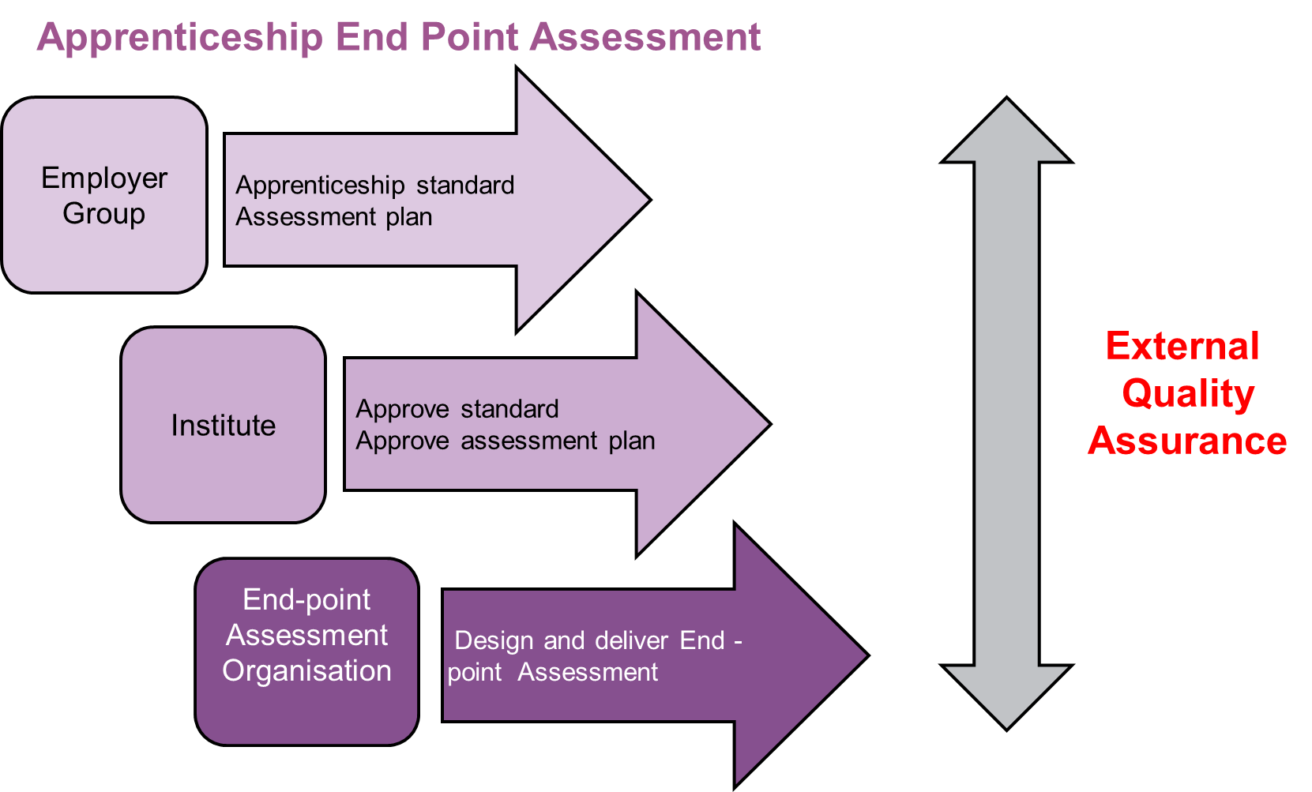
What is EQA?
Apprenticeship Standard
With the potential for multiple organisations to develop EPAs against one assessment plan there is a need to secure sufficient comparability between assessments
Standard
Assessment plan
End-point assessment (EPA)
Standard
EPAO
EPAO
EPAO
Assessment Plan
Trailblazer
EPAO
Standard
EPAO
Assessment Plan
Standard
Assessment Plan
EPAO
EPAO
EPAO
EPAO
EPAO
EPAO
EPAO
EPAO
EPAO
EPAO
EPAO
EPAO
EPAO

Slide 62

Four options for External Quality Assurance of apprenticeship standards
  Employer led route
  Professional Bodies
  Ofqual
  Institute for Apprenticeships

Slide 63

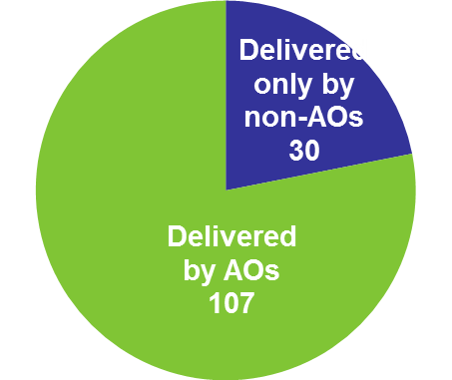
Current Landscape
392 is the projected total for standards at present
Standards in development 196
Standards Approved for Delivery 196
59 have no EPAO
392
Ofqual EQA
(86 Standards)
137
137 standards have an EPAO
94 EPAOs on ESFA’s Register:
  35 are Ofqual-recognised AOs
  59 are non-AOs
78% of standards have an AO delivering them

Slide 64
Ofqual’s approach to EQA

Slide 65
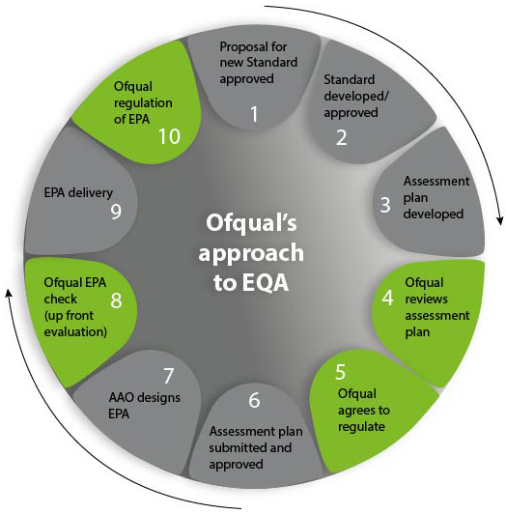
Our approach to EQA
EPAO

Slide 66
Assessment plan review: Technical Advisory Group (TAG)
Convened to consider the assessment detailed in the assessment plan
  We make no comment on the content
  The group has no sight of EPAs at this point
Central question: “Is there anything in the assessment plan that would cause an awarding organisation to develop an EPA that wasn’t sufficiently valid?”
  This is early intervention – to minimise the risk of problems further down the line
  A commitment from us to work with the Trailblazer
EPAO

Slide 67
Recognition
Part of our regulatory framework
Is a consequence of our acceptance of a request to EQA
We are looking at the recognition process that will apply to EPAOs that are seeking to become Ofqual-regulated
EPAO
Standard
Standard
EPAO
EPAO
EPAO
EPAO
EPAO
EPAO
EPAO
EPAO
EPAO
Assessment Plan
Assessment Plan

Slide 68
EPA check
We will seek to consider Ofqual-regulated EPAs before they are delivered/awarded
The process will focus on issues relating to assessment validity and standards
The pilot for our approach - consideration of the assessments themselves (EPA tools) will take place in November
  Customer service Level 2
  Hair Professional Level 2
EPAO

Slide 69
Ongoing monitoring
For EPAs, this will be consistent with our overall approach to VTQs:
  findings from EPA check
  thematic issues and risks
  intelligence and evidence
  AO risk profiles
  annual Statement of Compliance activity
  build on our AO communications and influence positive behaviours
EPAO

Slide 70
What have we seen?

Slide 71







What have we looked at so far?
Customer service (L2)
Arborist (L2)
Land based engineering technician (L3)
Mineral processing (L2)
Chartered manager (L6)
Operations Departmental Manager (L5)
Children Young People and Families Manager (L5)
Probate Technician (L4)
Creative Venue Technician (L3)
Highways Electrical service operative (L3)
Healthcare assistant practitioner (L5)
Fishmongering (L2)
Facilities Manager (L4)
Senior Leader (L7)
Recruitment Consultant (L3)
Nursing Associate (L5)

Slide 72

What have we’ve seen?
A huge commitment from employers to develop good assessment
Some thematic issues
  Mapping of KSBs in the assessment model:
    Considerable overlap and potential for ‘bespoking’ of assessment
  ‘Can-do’ v ‘degrees of achievement’, Compensation v Mastery
    Variable consideration given to these considerations, for KSBs, individual assessment methods, or the aggregation of assessment methods
  Levels of detail in the plan
    Criteria for differentiation are too subjective, unclear how they relate to the KSBs in the standard, do not describe the expectations of evidence for the grades on offer
  Application of marks or points thresholds open to interpretation
  Complicated weighting or scaling of marks

Slide 73
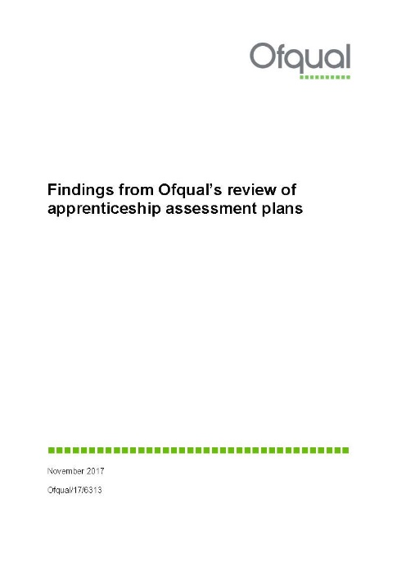

Findings document
- A ‘toolbox’
Based on considering over 90 Assessment Plans in the last 18 months, dialogue with over 70 Trailblazers
An overview of validity
Assessment methods
Individual assessment method grading
Aggregating overall results
Concepts such as mastery, compensation, grade thresholds, degrees of achievement, hurdles, grade descriptions, grade differentiation, weighting, scaling
Some examples of what we’ve seen that is good
A ‘methodology of thinking’ through the process of assessment design within an assessment plan.

Slide 74
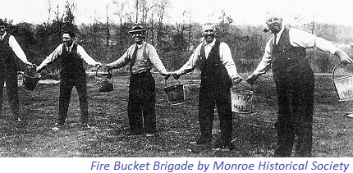
Assessment plan findings
Crucial that validity is designed into the assessment - at the beginning
In order that confidence in the measurement provided by the end-point assessment can be assured as far as is possible - at the end
There are many steps between
  confidence that the passing of an EPA represents competence in that occupation
  the design of an assessment plan for an occupation

Slide 75

Continuing our own improvements
Continue to cross pollinate with IfA on our experiences and to harmonise our messages on assessment
Doubled the size of our Technical Advisory Group
Refined our process to respond to Trailblazers more efficiently
Increased our engagement with employers

Slide 76
apprenticeships@ofqual.gov.uk

Slide 78


Slide 79
