Slide 1

Department for Business, Innovation and Skills
Analysis of Cash Retention Behaviour of PNFCs
March 2015

Slide 2
Do we observe that cash is being “hoarded” in the corporate sector?
How much cash? Per firm, in total?
Is the cash increasing? In absolute terms and as a % of turnover?
Is the cash concentrated?
We analyse the PNFC population through the lens of company demographics:
Company size (turnover, employees)
Complexity (group structure)
Industry sector (SICs re-grouped by BIS team)
…does this behaviour appear to have an impact on business investment, and thus on the pace of the recovery?
Given the nature of the granular data, a substantial amount of work was undertaken jointly with the BIS team to identify and remove outliers, and to re-classify certain types of records as non-PNFC etc.

Slide 3
The Data Resource
The analysis draws on the Experian pH database of all UK businesses, the most comprehensive such dataset available, we focused on the subset of 3 million live, trading UK-PNFC firms (there are 2 million more but these are either non-PNFC, or dormant, or foreign records, or very late filers etc; consolidated accounts are also left out to avoid double-counting, as each separate subsidiary is analysed)
For purposes of overall quantifications, key values (such as cash) for firms which do not file accounts are inferred based on the observed values for filers in the same size band and sector
In order to adjust the data to real terms, we have applied a deflator based on the year’s RPI inflation rate across all the analysis in the report.
By necessity, we focus the analysis, aimed at revealing any correlations and behavioural patterns, on the sub-universe of firms which do file accounts and declare cash levels, assets, etc.; they represent nearly half the total firms, but over 90% of total value, as non-filers are mostly sole traders and small partnerships
The types of data attributes used in the analysis include demographic parameters, financial (where filed), and historical

Slide 4
Selected examples of the top cash holders (and of anomalies):
- some are perennial (e.g. WPP, Vodafone)
- some build up for a specific purposes (e.g. BP at the time of the US oil spill)
- some appear topically (e.g. Easyjet, EDF)
CASH | NAME | LAST EMPT | CASH (£) | STRUCTURE
Top 5, 2012 | WPP Finance Company Ltd | N/A | 3,921,339,066 | very complex
(after outliers exclusions) | Vodafone Finance Ltd | N/A | 3,063,975,660 | very complex
 | Easyjet Airline Company Ltd | 5000&+ | 1,476,935,100 | very complex
 | EDF Energy plc | 5000&+ | 1,105,791,940 | very complex
 | Diageo Finance Plc | N/A | 1,051,709,900 | very complex
For ref: Top 5 in 2011 | IHS Group Holdings Ltd | 10-19 | 37,692,512,233 | ANOMALY
 | BP International Ltd | 5-9 | 11,254,317,000 | very complex
 | WPP Finance Company Ltd | N/A | 4,172,718,542 | very complex
 | Vodafone Finance Ltd | N/A | 4,031,330,009 | very complex
 | Network Rail Infrastructure Fin. | N/A | 2,428,934,600 | Independent
…and Top 3 2009 | Techtronic Industries (UK) Ltd | 100-199 | 4,974,349,723 | very complex
 | BP International Ltd | 5-9 | 3,834,880,600 | very complex
 | WPP Finance Company Ltd | N/A | 3,271,054,851 | very complex
EXAMPLES OF ANOMALIES | NAME |  | £
CASH: | Nuclear liabilities fund ltd |  | 8,178,000,000,000 | £8 trillion!
CAPEX: | Bow Bells House Ltd Partnership |  | 53,553,514,092

Slide 5
CHAPTER 1: CASH
ESTIMATING THE TOTAL UK PNFC CASH HOLDING
Having removed the outliers, we observe total holdings of £231bn; on average, this equates to £76k per firm, or one month of sales. Within this, the 1.5m reporting firms hold £210bn of cash, (£140k on average) compared to the 1.6m of much smaller, unregistered firms (for which cash is inferred) and who hold very little cash (estimate of £21bn).
2012 data
 |  |  |  |  |  |  | Number of firms |  | Total cash held |  | Average cash balance |  |  | Cash as % of turnover
 | Total live firms (excl outliers) |  |  |  |  |  | 3.6m |  | £418bn |  | £116k |  |  | 12%
 | Of which, PNFC * (excl fin, public, not-for-profit) |  |  |  |  |  | 3.1m |  | £231bn |  | £76k |  |  | 8%
 | Of which, data reported (mean empl size for all firms = 44*) |  |  |  |  |  | 1.5m |  | £210bn |  | £140k |  |  | 7%
 | Data inferred (mean empl size for all firms = 6*) |  |  |  |  |  | 1.6m |  | £21bn |  | £12k |  |  | 10%
 | *where reported

Slide 6
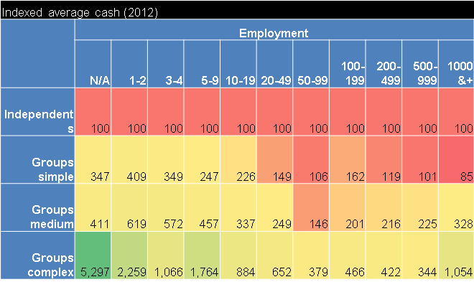
VARIABILITY OF CASH HOLDINGS
We observe strong variation by company size, and also by type (independent vs
group), and complexity of corporate structure (no. of subsidiaries). There is a considerable “group effect” over and above the size effect - complex group companies hold much larger balances than equally-sized independents. 2012 data
Average Cash

Slide 7
CASH RETENTION IS HIGHLY CONCENTRATED
As a result of the impact of firm size combined with structural complexity, complex groups, with only 3% of the firms, concentrate half of the total cash (51%); very small independents are 73% of firms, but hold only 16% of the total cash, with 13% for small-to-large independents and 20% for simple and medium groups.
No of firms at granular level for groups; outliers within “independents” of no reported size resembling cash boxes of larger groups were re-classified into groups
 |  |  |  |  |  | Independents |  |  |  |  |  |  |  | Group-structured | Group-structured |  |  |  |  | TOTAL
 |  |  |  | Very Small |  | Small |  |  |  | Medium |  | Large |  | Simple |  | Medium |  | Complex
 |  |  |  | (1-4 empl) |  | (5-49) |  |  |  | (50-249) |  | (250+) |  | See note 3 |  | See note 2 |  | See note 1
 | No of firms |  |  | 1.1m |  | 172k |  |  |  | 10k |  | 1k |  | 114k |  | 57k |  | 44k |  | 1.5m
 | Total cash volume |  |  | £33bn |  | £19bn |  |  |  | £7bn |  | £2bn |  | £23bn |  | £19bn |  | £108bn |  | £210bn
 | Average cash balance |  |  | £30k |  | £113k |  |  |  | £629k |  | £1.7m |  | £200k |  | £328k |  | £2.4m |  | £140k
 | Median cash balance |  |  | £7k |  | £21k |  |  |  | £94k |  | £194k |  | £21k |  | £19k |  | £334k |  | £9k
 | Cash as % of sales |  |  | 14% |  | 9% |  |  |  | 8% |  | 7% |  | 9% |  | 9% |  | 6% |  | 7%
 | Members of complex groups: >5 subsidiaries, and >£100m turnover; average empl size at subs level 265, but note 24% are under 10 empl. Medium = >5 subsidiaries but with <£100m turnover, and <5 subsidiaries but with >£100m turnove Members of simple groups: <5 subsidiaries, and <£100m turnover; average empl size at subs level 30, note 43% are under 10 empl.

Slide 8
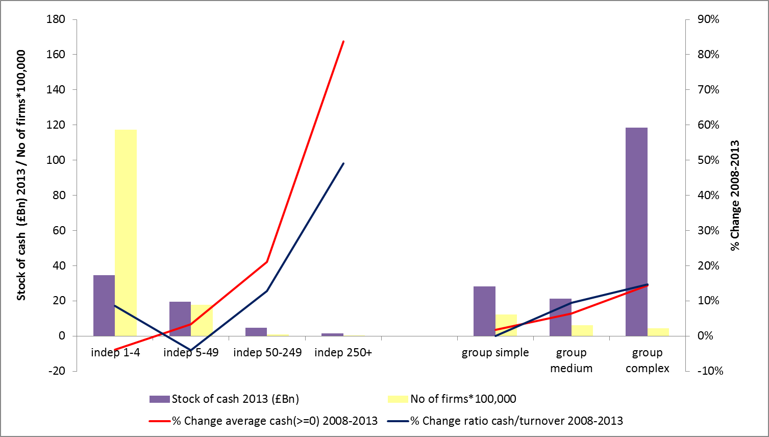
THOSE WITH THE LARGEST BALANCES, HAVE GROWN THEM MOST
Since 2008, the larger and/or the more complex the firm, the higher the increase,
in what are already the largest and most concentrated cash holdings to begin with.
- Increasing not just in absolute terms, but also faster than turnover.
- Smaller independents and simple groups hold the only stable (and small) cash balances.
Full period 2008-2013

Slide 9
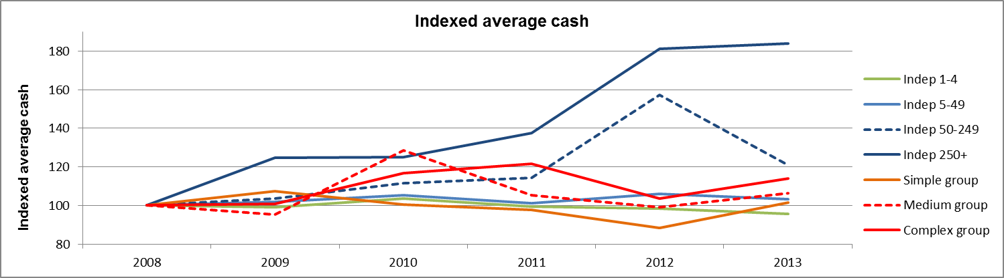
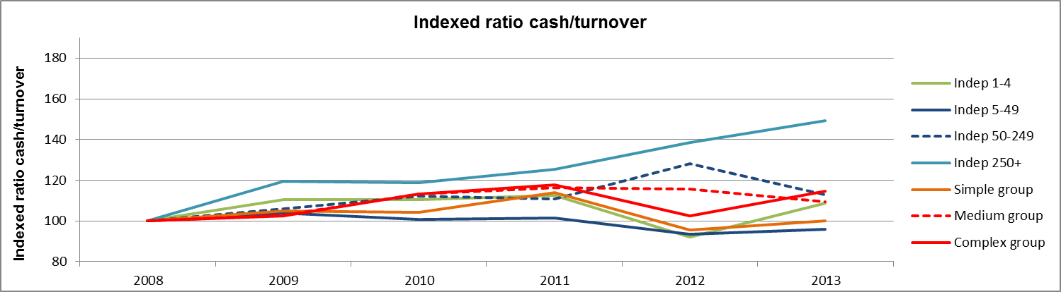
THE PATTERN HOLDS OVER TIME
Examining the pattern across all the years, there are some ups and
downs but the overall pattern holds: large/complex cash holdings on the increase, small/simple cash holdings reducing or steady.

Slide 10
INTRODUCING INDUSTRY SECTOR
Highly populated sectors such as agriculture have low average balances per firm. Sectors with the highest average balances, such as pharmaceuticals, have few but very large firms and very high average cash balances.
2012 data
 |  |  |  | Sorted by:
 | Sector | Number of firms | Total cash | Average cash | As % of sales
Top 3* | Pharmaceuticals | 1k | £1.4bn | £1365k | 4%
 | Electricity/Gas | 3k | £2.3bn | £687k | 3%
 | Aerospace | 1k | £0.4bn | £529k | 5%
Last 3 | Agriculture | 111k | £3.2bn | £28k | 11%
 | Repair services | 32k | £0.8bn | £25k | 10%
 | Misc recreational | 15k | £1.9bn | 16k | 15%
Largest 3 by | Management Consulting | 144k | £14.5bn | £101k | 26%
total cash | Computing/IT | 174k | £11.0bn | £63k | 15%
held | Construction (Buildings) | 116k | £11.3bn | £29k | 7%
*69-way BIS grouping
** not including “Holding Companies”

Slide 11
FULL INDUSTRY SECTOR LIST
Some sectors concentrate more cash, either in absolute or in relative terms or both – though some of this is driven by differential average company sizes across the sectors. 2012: Overview of cash behaviour by BIS 69-way classification

Slide 12
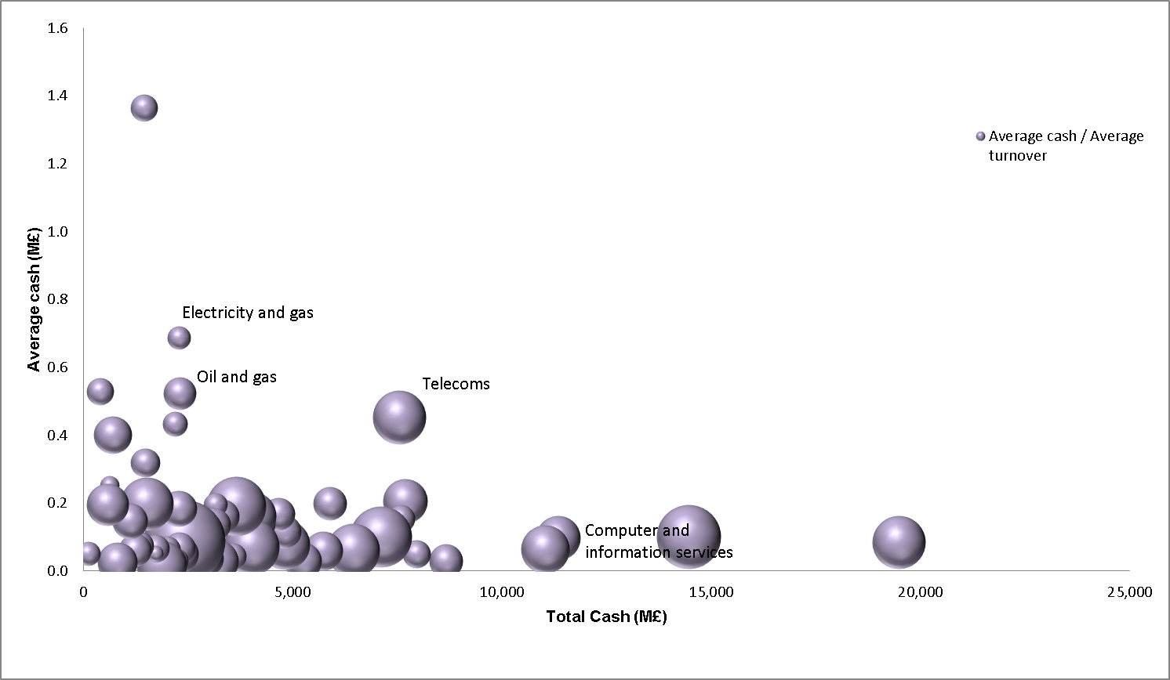
AVERAGE CASH PER FIRM (y axis) VS TOTAL CASH HELD, PLUS AVERAGE CASH NORMALISED BY TURNOVER:
No sector combines both a high average balance and total cash held; the bubbles are proportional to the % of turnover held in cash, which, for example, is much higher for management consultancy than pharmaceuticals. 2012 data
Pharmaceuticals
Management consultancy
services
Other administrative
services
Buildings

Slide 13
CHANGES IN VOLUME OF CASH AND AVERAGE CASH OVER TIME,
BY SECTOR:
Water & waste, admin & support services grew in cash the most; mining, real estate and construction are down the most. For average cash, water & waste, transport, admin & support services are up the most; mining, energy, real estate and construction are down the most.

Slide 14
CASH-HOARDING RATIO:
On the evidence, since 2008, the mining sector as a whole has been the largest cash hoarder, followed by the ICT sector, then by manufacturing and water/waste

Slide 15
AVERAGE CASH BY INDUSTRY SECTOR (ADDS INSIGHT BEYOND THE SIZE VIEW):
Holding company size constant, there is some variation from one sector to another in average cash for group firms (e.g. mining consistently above average,
accommodation below average)…although for small/medium independents, most sectors cluster. 2013 data

Slide 16
CHAPTER 2
Bringing debt into the picture to get a more complete view of cash
How does borrowing behaviour reflect available cash resources? To what extent do some firms borrow in order to sustain high cash balances?
We use total liabilities as the metric, to encompass reliance on trade debt etc, not just bank debt; this is banded, then cross-tabulated against cash held (also banded), to look for concentrations (see next page, p17).
To facilitate the visualisation of these granular cross-tabulations of numbers, the « bubble charts » (e.g. p19) represent each cell in the table, by a circle whose size is proportional to the number in that cell – in this way, concentrations become very easily apparent.
Bubble charts are especially useful when comparing the relative concentrations of two separate populations: by overlaying two transparent bubble charts, cohorts which weigh more in one population (e.g. small independents), and differentiate it from another (e.g. the overall population), are immediately apparent (see pp20 and 21).
1 cadre dans le template pptx Experian pH

Slide 17
- INTRODUCING THE GRANULAR DATA -
DEBT NOT GENERALLY FINANCING OVERALL CASH HOLDINGS, BUT SOME EVIDENCE OF THE CONTRARY AMONGST FIRMS WITH LARGE CASH HOLDINGS (>£10m) (2008 similar to 2013)
Overall, in 2013 only 29% of all firms have over £100k of total liabilities (down from 34% in 2008), and only 11% of firms have over £100k of cash. Even focusing on the 21,675 firms in 2013 with over £10m liabilities, a majority of these firms (52%) have under £200k of cash; but 9% of this group show evidence of contrary behaviour with over £10m cash...
1 cadre dans le template pptx Experian pH

Slide 18
The granular data enables us to search still closer for
“unusual” types of behaviour among the firms with the largest debt and/or cash figures
…Of the 21,675 firms in the previous chart, with over £10m total liabilities in 2013:
52% of these have <£200k cash; so clearly not a “hoard”, and at the other extreme “only” 1,938 (11%) also have >£10m cash
But this 1,938 with large debts are the vast majority of the cash “piggybanks” (87% out of the total 2,231 firms with >£10m cash – so the largest “piggybanks” are also simultaneously big borrowers, which suggests possible hoarding.
However, the evidence of hoarding is not conclusive: the case studies below illustrate how the debts of many of these 1,938 firms may still be much larger than their cash balance and therefore is likely to relate to real investment needs, i.e. “normal” behaviour:
 | Cash (£m) |  | Liabilities (£m)
Company Name | Stock (2013) | Change (2012-2013) | Stock (2013) | Change (2012-2013)
Network Rail Infrastructure Finance plc | 1,778 | 1,112 | 30,016 | 3,123
Tesco Stores Ltd | 679 | 34 | 22,084 | 11,060
Jaguar Land Rover Holdings Ltd | 1,851 | 1,172 | 5,741 | 1,206
Heathrow Airport Ltd | 34 | 31 | 12,511 | 826
The London Organising Committee of the Olympic | 287 | 263 | 11,493 | 1,467

Slide 19
Now for an overall view of the market - methodological note
The following analyses (p20-23) are “bubble charts”, which are simply large tables of numbers mapping out all the firms in the market, made more visual for ease of interpretation.
In each case, the number in every cell of the table (which here is the number of firms contained within that cell) has been graphed as a circle which is proportional to that number.
In this way, it is easy to immediately identify the concentrations within the populations, as well as to infer possible correlations between the dimensions portrayed by the table (in this case, the amount of cash and liabilities held by the individual firms, banded).
This data-visualisation technique is especially useful when comparing two different populations (for example, spotting concentrations which make large independents different from the overall population, then similarly for large groups against the overall, etc). As shown in p21-22, this is done by overlaying one population (e.g. large independents, in red, on top of the overall, in clear), revealing at a glance areas where they are over-represented (the red exceeds the clear bubbles), and those where they are under-represented (the red is smaller than the clear).

Slide 20
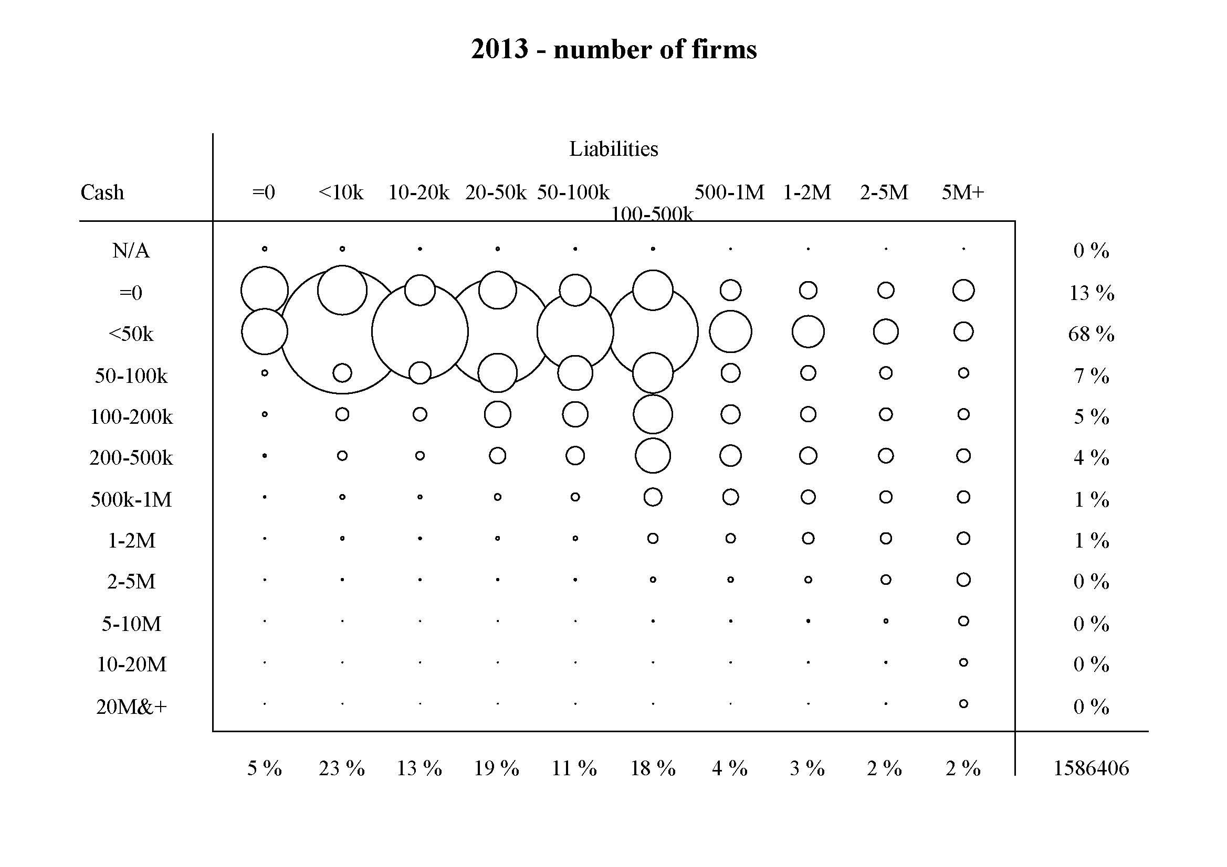
THERE IS NO OBVIOUS MASS BEHAVIOUR OF BORROWING PURELY TO SUSTAIN HIGHER CASH BALANCES… in fact the bubbles show that the bulk of firms hold under £50k or 0 cash (68% + 13%), most of which also hold <£50k liabilities.
The cohort of firms with >£500k cash and >£1m liabilities, i.e. where significant hoarding could perhaps be taking place (and which we will investigate in more detail later), is very small.
1 cadre dans le template pptx Experian pH

Slide 21
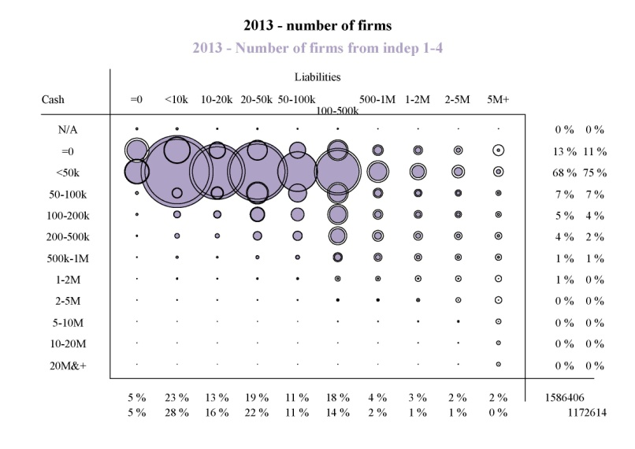
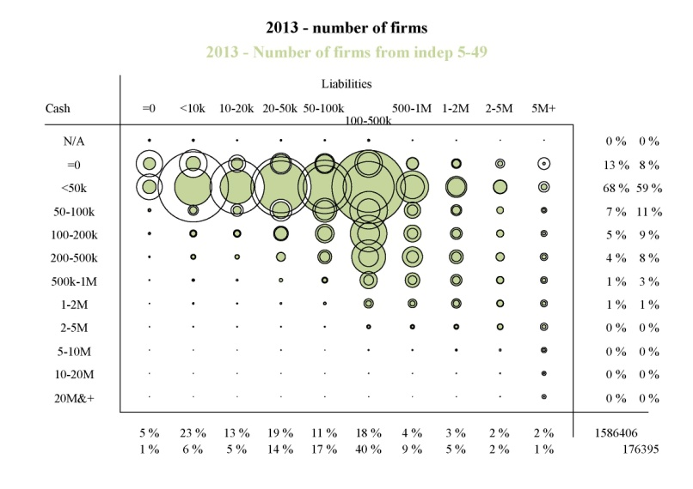
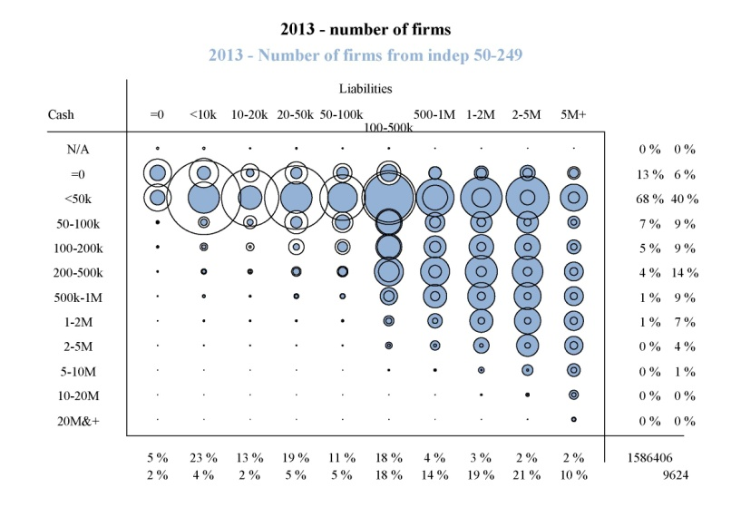
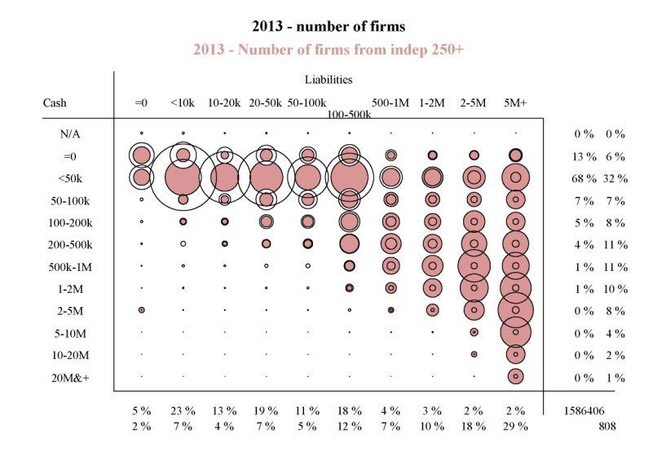
FOR EACH OF THE 4 CHARTS, THE CLEAR BUBBLES REPRESENT THE OVERALL MARKET FROM THE PREVIOUS PAGE:
Large independents (in red) are strongly represented among firms with over £2m liabilities, especially
when they also hold over £500k cash (i.e. in the bottom right corner); however they are under-represented among firms with £50k cash, especially if holding less than £500k in liabilities. Small independents are of course the mirror image. Mid-sizes display intermediary behaviour. Note nonetheless how non-trivial numbers of small firms have high cash and/or liabilities, and similarly for large firms with very low values – i.e. the behaviour is very dispersed.
1 cadre dans le template pptx Experian pH

Slide 22
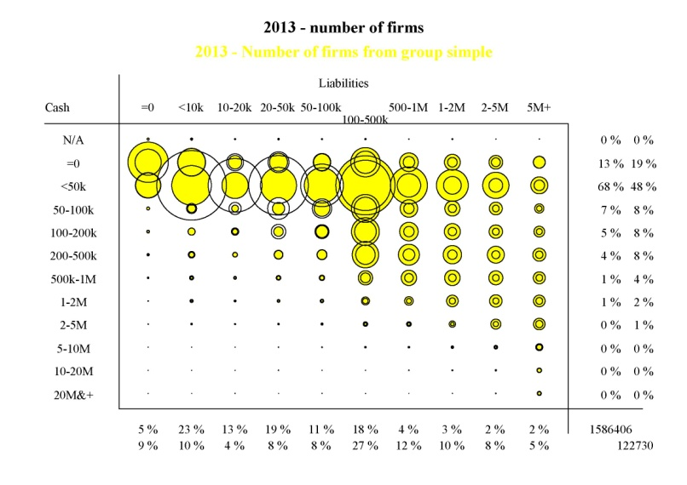
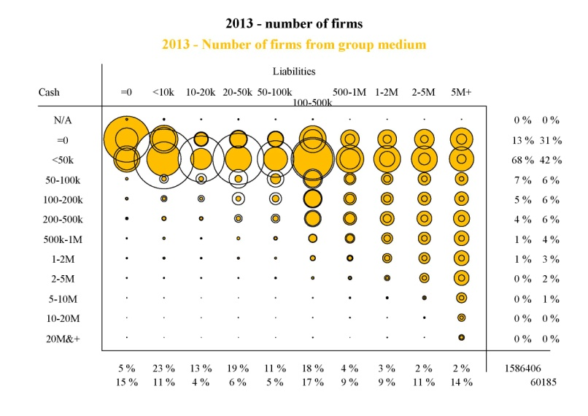
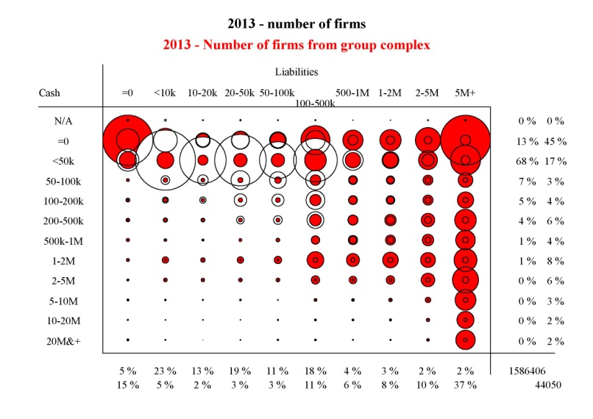
SIMILAR PROCEDURE FOR COMPARING THE 3 GROUP COHORTS TO THE
OVERALL MARKET:
Simple and medium groups (yellow and orange) look very similar to the mid-sized independents of the previous page. Large/complex groups look very different: 45% of the firms have no cash at all (top row), as
this is often concentrated by the parent, while the large liabilities are often concentrated in those 0-cash entities (right-most column, the biggest bubble of which is at the top).
1 cadre dans le template pptx Experian pH

Slide 23
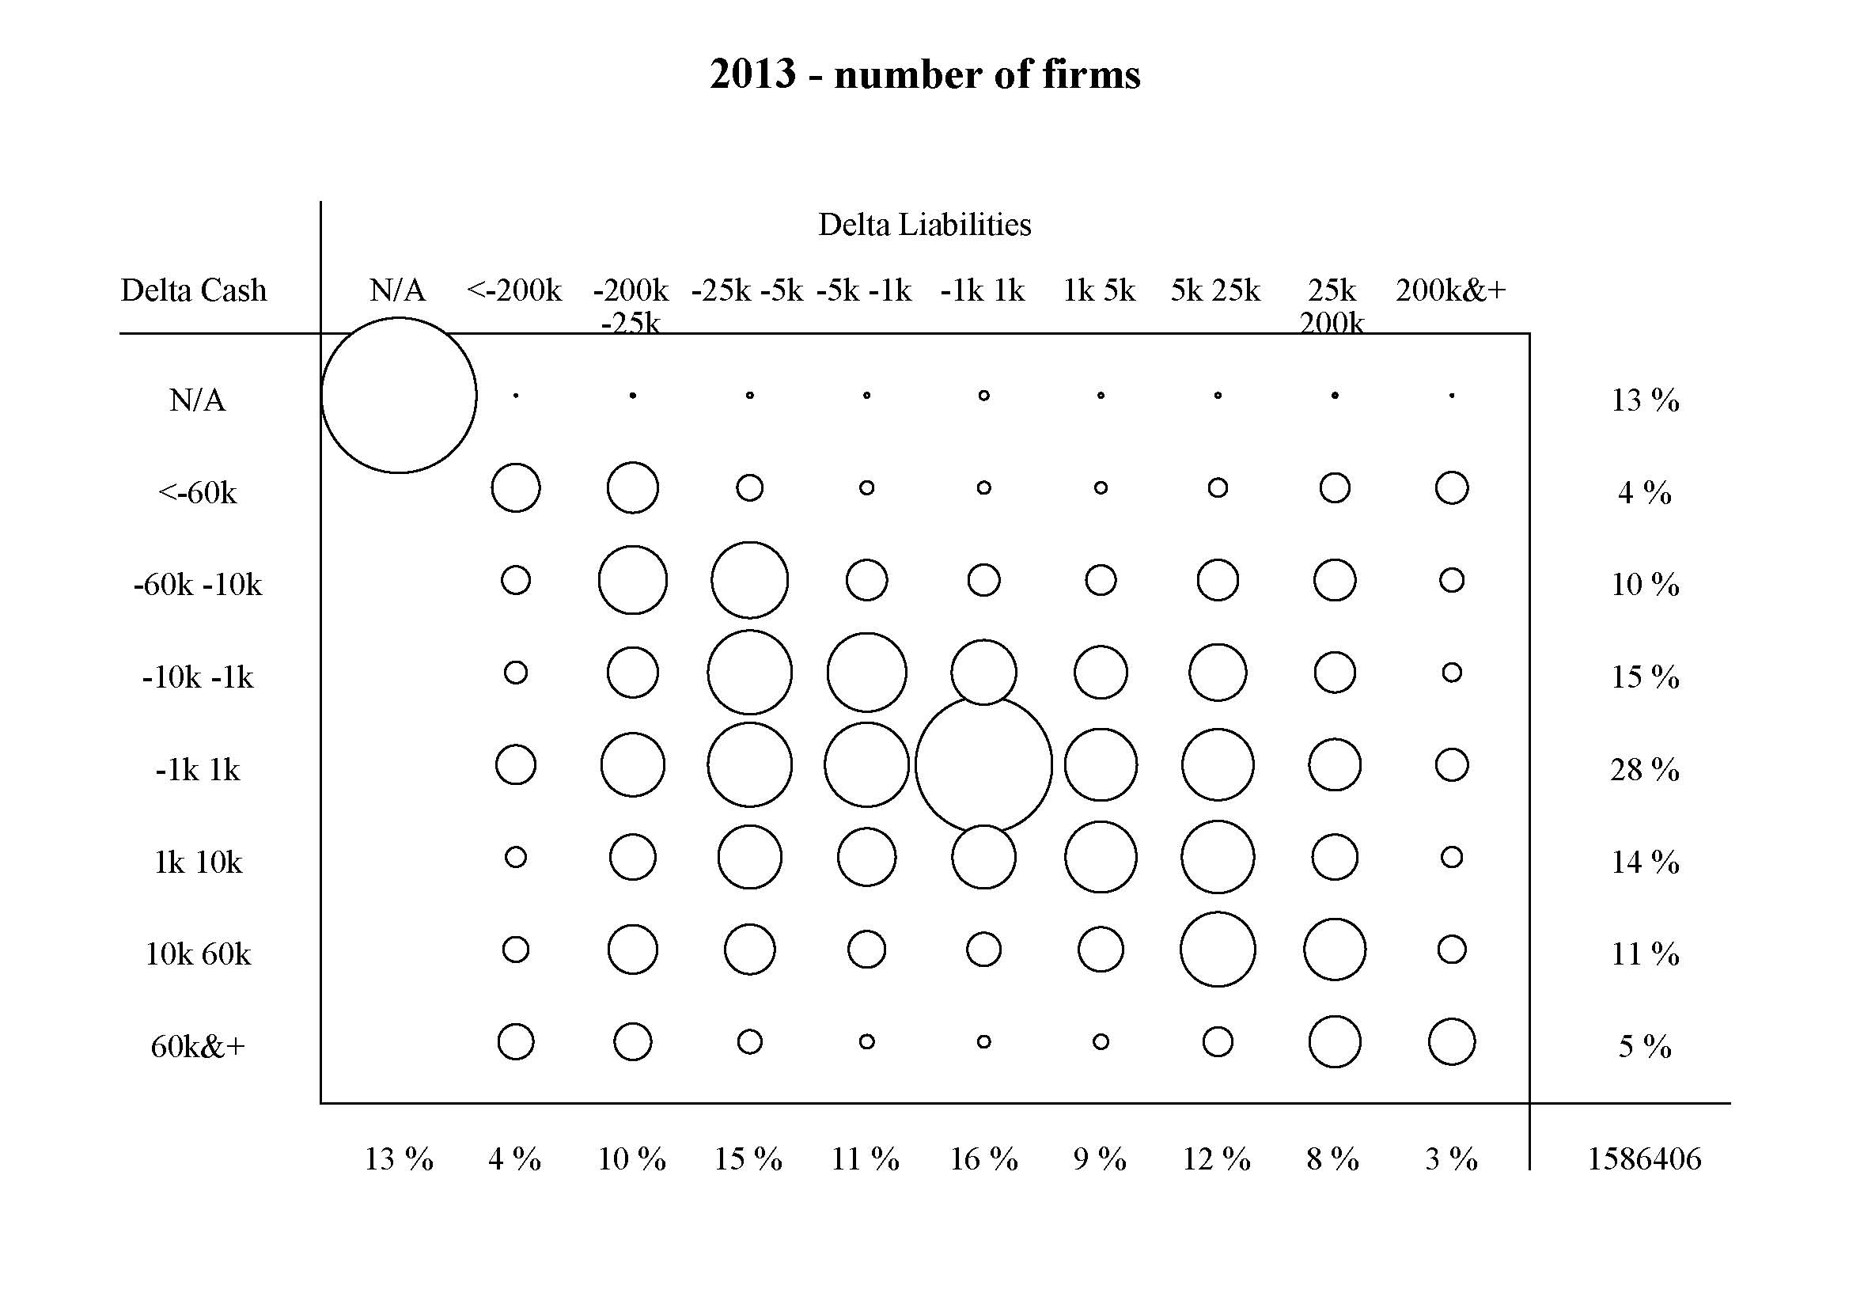
GOING FROM THE STATIC TO THE DYNAMIC VIEW:
Do changes in borrowing match changes in cash held? Again, there is no visible correlation overall. If anything firms concentrate along the diagonal, i.e. exhibiting similar trends in both liabilities and cash; increasing liabilities by no means imply an increase in cash (bottom of chart), or vice-versa...
This finding is confirmed for each of the individual market segments (e.g. small independents, large groups, etc)
1 cadre dans le template pptx Experian pH

Slide 24
Finally, we combine cash and debt in order to define a
“net cash” position (and take dividends paid into account)
Net cash = cash - liabilities
How many firms borrow even though they have plenty of cash (i.e. net cash >£0)?
As is detailed in the following slide, only 1 in 7 firms has positive net cash* (for only 1 in 25 does it exceed £70k); for over 60% of firms, it is negative**. Since many firms do not even borrow at all***, this suggests that only a very small minority borrow just to artificially support cash balances.
Looking for potentially “unusual behaviour”, we can for example isolate 1,105 firms each with >£5m cash and net cash >£70k; these weigh 12% (£26bn) of total PNFC cash, having already paid dividends of £29bn (i.e. “gross cash” of £55bn; their liabilities being £13bn****).
By contrast, 3,270 firms, also with cash of >£5m but with net cash <-£500k, concentrate £87bn of cash (net of £77bn dividends paid, so “gross cash” £164bn), and liabilities of £946bn**** – i.e. potentially “normal” behaviour, since the cash held is a small proportion of total borrowing?
We discuss under next steps the possibility of zooming in on these small but very cash-rich cohorts. See the detail in the next table.
*: in LHS panel, the top 3 cohorts as a proportion of the total; **: in the same panel, the last 3 cohorts; ***: the majority of firms which file accounts declare nil bank debt (not shown in chart); ****: total liabilities for this population is £4.5 trillion

Slide 25
DETAIL UNDERLYING THE “NET CASH” VIEW
Combined view: cash compared with debt, also quantifying dividends paid, and “investment” (= modified Capex, as defined on the next page)

Slide 26
CHAPTER 3
TURNING TO PROPENSITY TO INVEST BY PNFCs:
Has « investment » increased or decreased recently, and if so, is there a correlation with cash behaviour?
For purposes of this analysis, we define « investment » in year t, as:
Tangible assets(*) in year t, minus tangible assets in year (t-1), in constant prices by deflating(**) using the RPI inflation rate between t and t-1
I.e. CAPEX, but without adding back the depreciation term. (We found that adding back depreciation induced additional volatility in the data set.)
So, we compare the book values of capital stock for years t and t-1 and the information is aggregated for all firms who report it at Companies House.
This provides us with a “net” view of capital investment activity each year, since tangible assets reported in the accounts for a given year contain (but do not break down): the pre-existing stock of tangible assets, plus new investment during the year, minus retired assets during the year.
This is an alternative view to ONS figures, which are based on survey results and focus on the actual, new-in-year investment figures (without reference to retirements of capital where no sale is recorded).
(*) tangible assets = all assets which have physical form, such as machinery/plant & vehicles, buildings & land, fixtures & fittings (excluding dwellings)
(**) In line with the analysis in the rest of the report, a deflator was applied to put the investment data into real terms. Extra analysis of the investment data was carried out in nominal terms and this did not alter the findings throughout the chapter.

Slide 27
USING THE DEFINITION ON THE PREVIOUS PAGE, FIRMS’ INVESTMENT BEHAVIOUR IS NEGATIVE
The next 2 pages break out the quantum of investment (or disinvestment) by size and complexity cohort, then examine the change over the period 2008 to 2013:
Overall, we observe net disinvestment by PNFCs of -£49bn in 2013 (net of outliers).
The average amount per firm only exceeds £50k (whether positive or negative) for independent firms with >50 employees, or medium-to-complex groups (under 8% of the population).
As with cash, the volumes are highly concentrated in the large/complex groups (-£44bn of the -£49bn overall); other groups add -£5.5bn, whilst all independents together are just barely in positive territory (+£0.5bn; with some size bands positive, some negative).
In 2008, large/complex groups were more negative (-£120bn vs -£44bn; similarly but to a lesser extent for medium groups), while independents were positive in all size bands.
Although large/complex groups seem to be improving by 2013 (not as negative as in 2008), the continued disinvestment is occurring even as cash has continued to steadily increase. Mid-to-large independents perform best.

Slide 28
…THOUGH THERE ARE POCKETS OF POSITIVE
INVESTMENT BEHAVIOUR
The observed net disinvestment by PNFCs of -£49bn in 2013 is not generalised: 21% of all firms actually show positive investment (on average £270k), while 53% show negative investment (on average -£170k); and 26% firms show a neutral profile.
Zooming on the 1 in 5 firms with positive investment:
Only 5,000 of these are large/complex groups (13% incidence)
Vs. 191,000 very small Independents (20%)
…Or 4,000 medium-large Independents (32%)
However these large/complex groups weigh 61% of the total invested by this “positive” cohort: so the large/complex group segment is bipolar, as overall it is “negative” (next chart).

Slide 29
CAPEX SUMMARY BY COHORT:
Persistent and high disinvesting activity is observed among the groups cohort
(even if less virulent in 2013 than in 2008); in contrast, independents, especially larger ones, are exhibiting positive investment behaviour.
 |  |  |  |  | Independents |  |  |  |  |  |  | Group-structured
 |  |  | V. Small |  | Small |  | Medium |  | Large |  | Simple |  | Medium |  |  | Complex
 |  |  | ______ |  | _____ |  | ______ |  | ______ |  | _______ |  | ________ |  |  | _______
No of firms* |  |  | 933k |  | 160k |  | 10k |  | 1k |  | 109k |  | 54k |  |  | 43k
2013 Total invt (net) |  |  | -£0.2bn |  | £1.0bn |  | -£0.5bn |  | £0.2bn |  | -£2.0bn |  | -£3.5bn |  |  | -£44.0bn
2008 |  |  | £0.5bn |  | £1.1bn |  | £1.0bn |  | £0.4bn |  | -£1.5bn |  | -£9.8bn |  |  | -120.0bn
2013 Avg net invt |  |  | -£0k |  | £6k |  | -£55k |  | £212k |  | -£15k |  | -£145k |  |  | -£820k
2008 |  |  | £0k |  | £4k |  | £93k |  | £486k |  | -£20k |  | -£162k |  |  | -£1.6m
* No of firms with tangible assets available; at granular level for groups; outliers within unknown-size independents re-classified in groups. Note less firms report this data than earlier in the report.

Slide 30
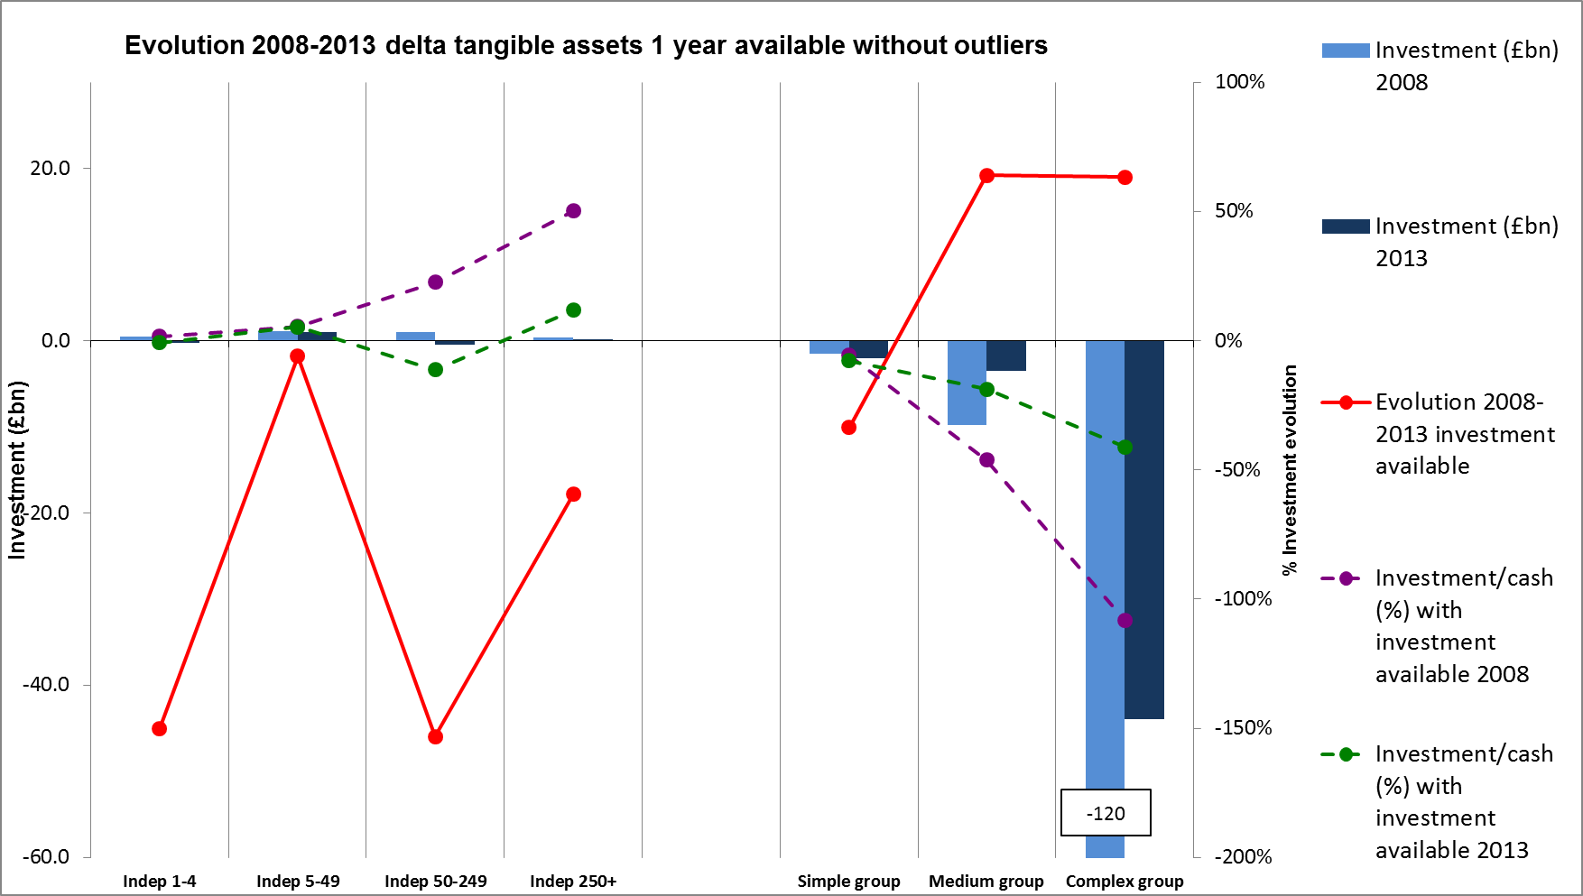
INVESTMENT PERFORMANCE SINCE 2008 BY COHORT:
Visualising the data confirms how much disinvestment is concentrated in the large
groups; and the continued disinvestment is occurring even as cash has continued to steadily increase (see dotted lines)
“Available” in the chart below refers to firms that have reported the data
1 cadre dans le template pptx Experian pH

Slide 31
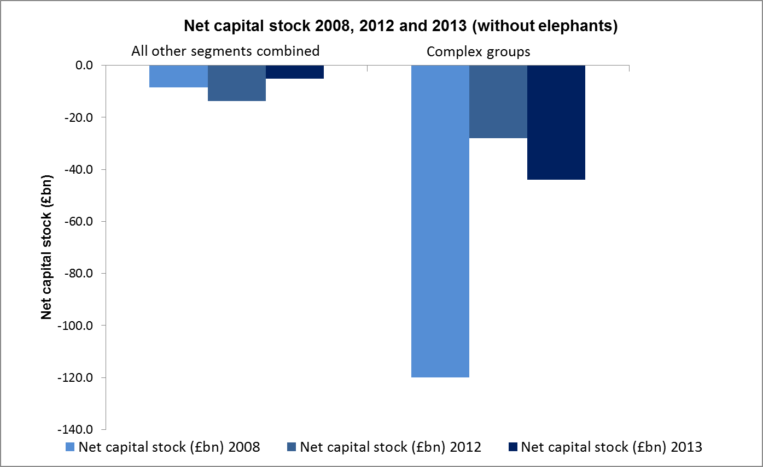
INVESTMENT SINCE 2008 BY COHORT CONT.:
In fact, whether in 2008, 2012 or 2013, large/complex groups concentrate the overwhelming
majority (even up to 93%) of the overall PNFC disinvestment, although they represent only 3% of all firms; note that this high disinvestment in the large complex group has “improved” since the levels of 2008, though it is down on 2012.
1 cadre dans le template pptx Experian pH

Slide 32
FOCUSING ON INVESTMENT PERFORMANCE BY FIRMS THAT INVEST:
Zooming in on the 273,000 firms with positive investment behaviour (1 in 5 of all firms), medium to large independents are much more likely (1 in 3) to be positive investors than groups (1 in 6), though this reflects in part the fact that within groups, investment may be done just by certain subsidiaries within the group. Note that groups concentrate 82% of the total value of investment, 61% for the complex groups alone.
Note: % incidence = proportion that positively investing firms account for all firms in each size cohort
1 cadre dans le template pptx Experian pH

Slide 33
Unfortunately these 270k positively-investing firms fail to outweigh the 703k dis-investing firms, not just in number but also in total invested (+£70bn vs.
-£112bn), and in total cash (£53bn vs. £105bn). The 39k firms with highest cash increase, yet simultaneously disinvesting, concentrate £53bn cash while “disinvesting” by -£23bn…
Cash evolution is an analysis of the stock of firms in 2012, and then examining their change 2013/2012
But there is a “goldilocks” cohort as well: the 23k firms that are in the highest cash-increase band, yet are investing (see top-right table) – concentrate +£30bn of investment (bottom right), and £29bn of cash (bottom left)!
In incidence terms, stepping away from these small-but-weighty cohorts, there is however very little overall correlation between the trend in cash holdings, and whether firms have invested (top-right).
1 cadre dans le template pptx Experian pH

Slide 34
Profitability
This did not prove to be a fertile ground for analysis:
Very low fill-in rate (only 10% of firms overall declare their profits)
…Even if we try to approximate profit by "change in net worth"
…Still relatively disappointing for large firms (e.g. 38% of the >250 empl independents do not declare their profits)
…Moreover, when the data is reported, it is given to many outliers
…Not to mention that profits is a highly manipulated number, for tax exposure management purposes!
However, large independents have good data fill-in rates and are without the complexities of balance sheets being linked to mother-daughter balance-sheets, and so we analyse large independents’ profitability in the next table.
1 cadre dans le template pptx Experian pH

Slide 35
PROFITABILITY AND INVESTMENT OF LARGE INDEPENDENTS (250+):
For the 624 firms with known data, profitability and investment are not correlated – a fairly even spread of investment levels is observed for unprofitable firms, similarly for profitable ones (top table). The great bulk of the net £585m investment made by this cohort does however come, in value, from the most profitable (bottom table), in line with the Pareto (80/20) rule.

Slide 36
CONCLUSIONS
Over the 2008-2013 period, we observe 3 distinct and even opposite behaviours within PNFCs
Very small independents as a segment (1.1m firms out of 1.5m analysable) have reduced their investment levels overall (from +£574 to -£229 in 2013 on average, accounting only for -£226m total).
However their cash position has also dropped (median of under £10k each), by 4% in the same period, as have liabilities…
…Net of small dividends paid (which have been dropping 75%...).
Thus, small independents seem on the whole to have experienced a slight overall contraction. Inversely, large independents (>250 empl) on the other hand are the only cohort to have positively invested:
Even as their cash has increased significantly
Along with (and net of) high and increasing dividends paid, and increasing debt.
These seem on the whole to have been able to achieve several goals at once (investing, but also saving for a rainy day and rewarding shareholders). Unfortunately there are only 1,052 of them (total invested just over £1bn).
Note that small/medium independents (5 to 250 empl) form an intermediary behaviour in terms of investment, with intermittent positive contribution (either investing in 2012 or 2013 but not both).

Slide 37
CONCLUSIONS
Depending on the year, 67% to 93% of the total PNFC disinvestment is down to a single segment of just a few thousand firms – the same one which also dominates the cash hoard
By contrast, the large/complex group cohort (only 3% of all firms) appears to show high dis-investing overall; this was true in 2008, remained true in 2012 (by which time the situation had “improved” to a -£28bn disinvestment level, 67% of total), and also in 2013 (when it fell back, to -£44bn, or 90% of total);
But this cannot be attributed to a precarious cash position: they concentrate a dominant £108bn of cash, half the PNFC total (£2.4m each on average)
Which they have increased by 14% from 2008 to 2013
NET of dividends paid, which themselves have more than doubled.
On the other hand, this cohort also concentrates a dominant proportion of all PNFC liabilities (£3.6tn out of total £4.3tn, £82m on average and stable), with a negative overall net cash position.
In fact, within the L/C group cohort, this behaviour is attributable to an even less numerous sub-cohort, as many L/C groups actually show positive investment and net cash profiles. In principle, we should therefore focus deeper on this small but key population (a few thousand CEOs at most, as the 44,000 firms in the entire L/C group segment, which are mostly subsidiaries, concentrate into a much smaller number of corporate groups).
1 cadre dans le template pptx Experian pH

Slide 38
Summary: behaviour in 2013, compared to 2008
Segment | Cash | Debt | Net Cash | Dividends | Investment | Conclusion
Very small independents (1.1m firms) | Slightly down (£30k on avg) | Down | Up | Way down (and very small: under £1k on avg) | Down | "Contracting, and de-leveraging"
Med/large independents (>50 empl; 12k firms) | Way up (£600k on avg) | Up | Down | Mostly up (and £50k on avg) | Down | "Positive momentum"
Large/complex groups (44k firms) | Up (£2.7m on avg) | Stable | Stable | Way up (and £12m avg) | Very negative in 2013, though up from 2008 | "WHY"?*
 |  |  |  | * Note that a sub-cohort concentrates this behaviour (many other firms in this segment are positively investing)
NB: 5-49 indepts and simple groups similar to each other, and in "mixed" profile. Medium-complex groups also mixed but close to L/G groups

Slide 39
Summary-2: underlying data for the overall analytical universe
- data used for stock views

Slide 40
Summary-2: underlying data for the overall analytical universe
- data used for time trends

Slide 41
Potential next steps: focussing on the “apparently ineffective” sub-cohort within the large, complex group segment
A combination of desk and field research should be undertaken to:
Confirm we are not missing legitimate aspects of the behaviour peculiar to that cohort
Delve deeper into the likely reasons for the behaviours.
We would thus take the preceding analysis to a more granular level: in particular, we should recognize that for this cohort, intangibles (as opposed to tangible assets only) could represent an important quantum of investment, which may well have increased in the period and could possibly make up for the dip in intangible assets:
Goodwill on acquisitions
Capitalised R&D
Patents, Brand value, etc.
Liabilities could also usefully be split into working capital debt and long-term debt, in case this reveals differentiated patterns.

Slide 42
Going to the fully granular level, for both field and desk research
Who are the top UK firms/groups, which simultaneously combine:
Very high (and increasing) cash balances (say >£10m), with
High (and increasing) debt,
…but the cash exceeds the debt significantly,
And the cash represents a higher-than-normal % of sales,
And we simultaneously observe a negative investment profile?
There will only be a relatively small number of them, and patterns may emerge from a close examination of their actual identities and of the industry sectors they populate, ideally combined with some field research:
Providing clues as to the likely reasons for the choices made
For example, M&A activity has been notoriously down since 2008; would a return to normal levels account for the investment gap, and for the cash build-up?
Is it not rational for groups to load up on cheap debt now, while it is available?

Slide 43
Appendices
The following slides (44-59) are appendices,
containing more background data to the main results.

Slide 44
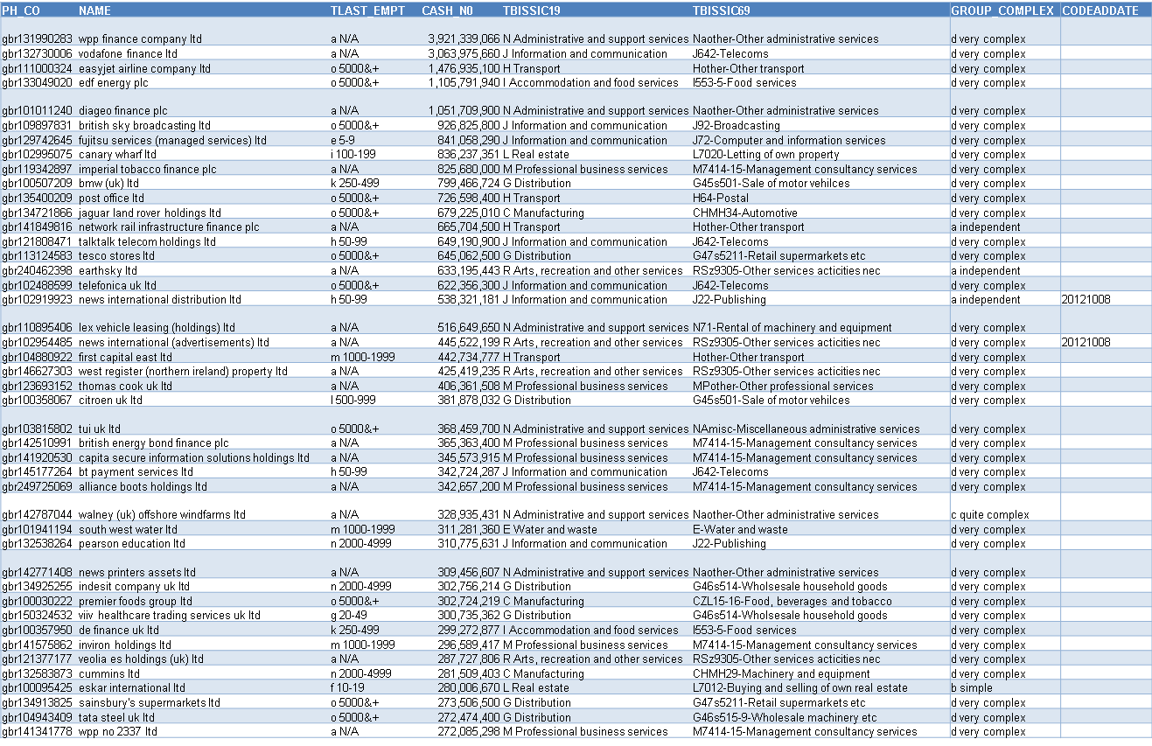
List of the largest cash-balances, across PNFC - 2013
Many unknown-size at the top – these are specialised “piggybank” subsidiaries of complex groups

Slide 45
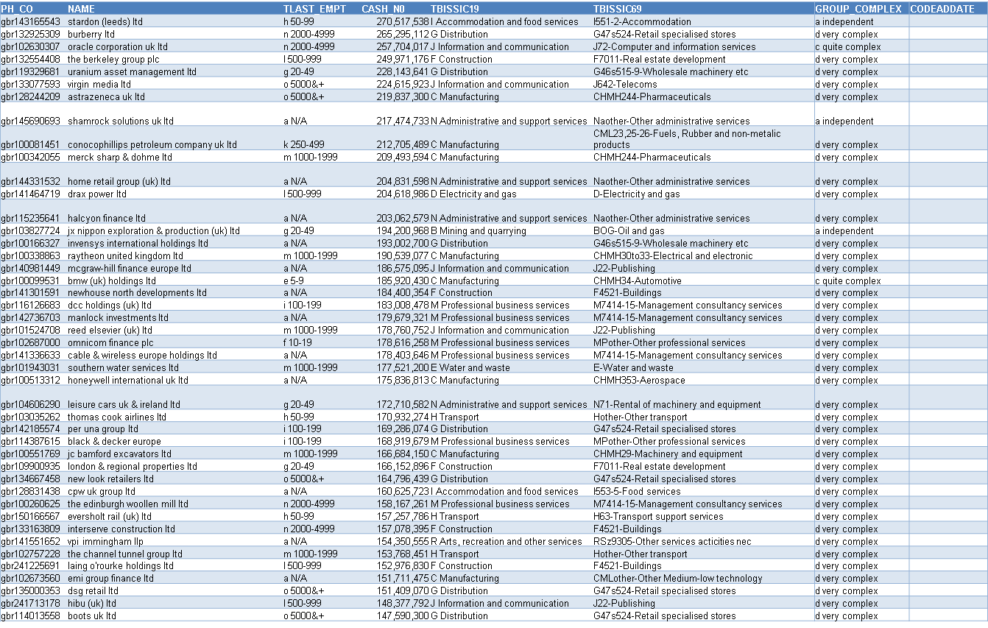
Continued…

Slide 46
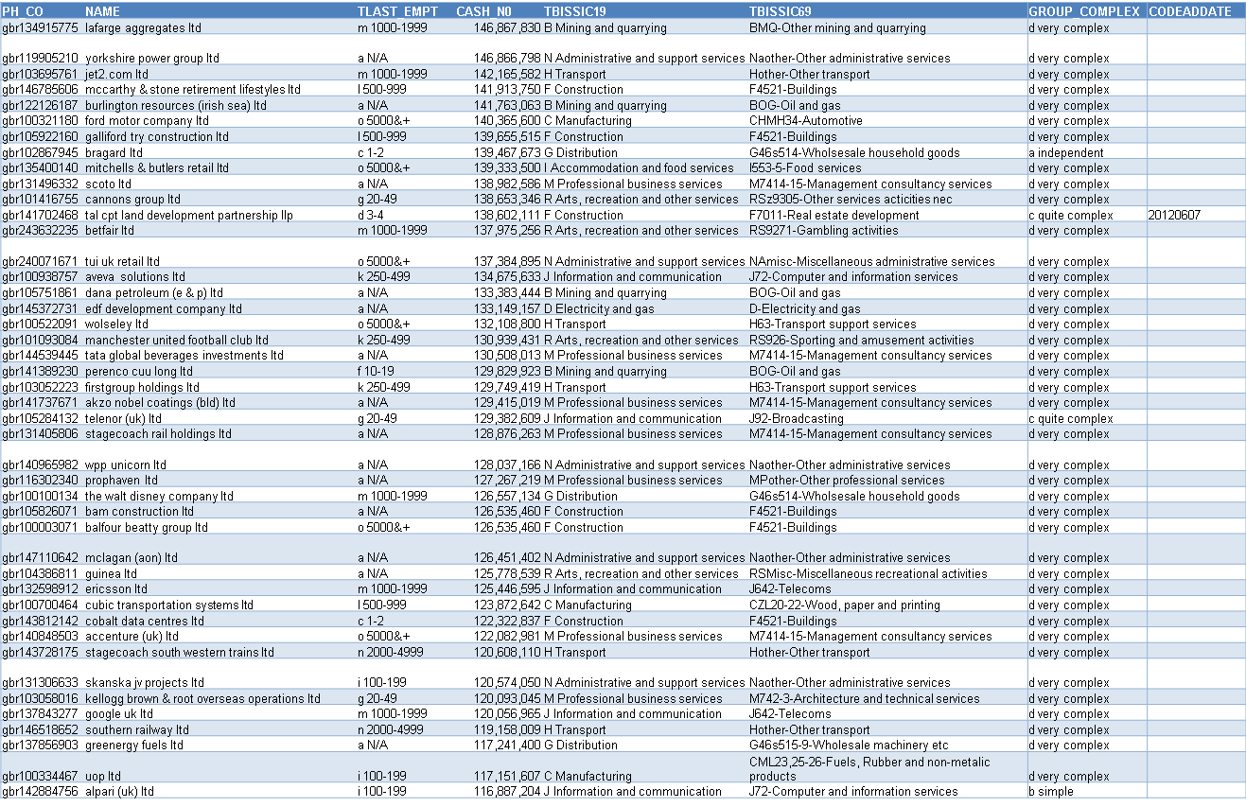
Continued…

Slide 47
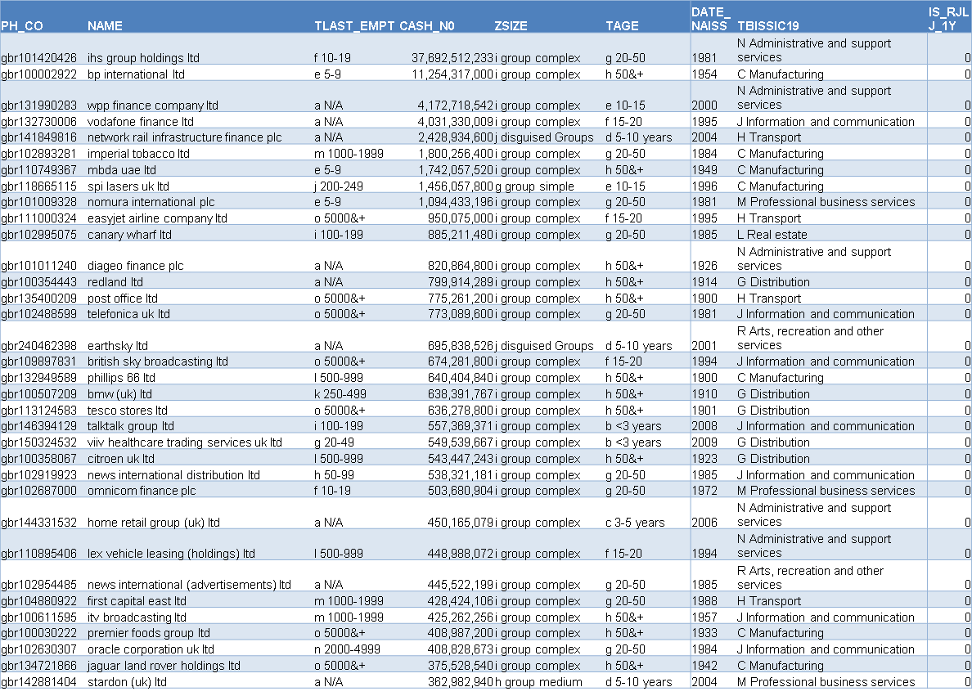
2011 1/3

Slide 48
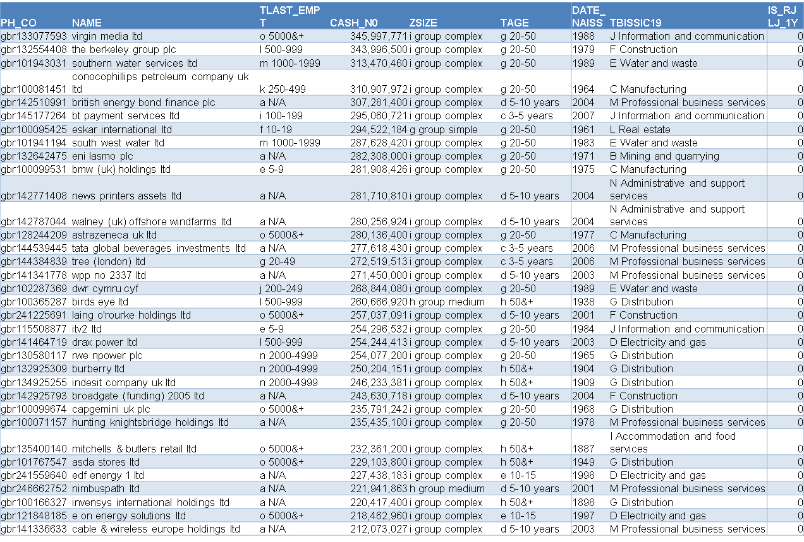
2011 2/3

Slide 49
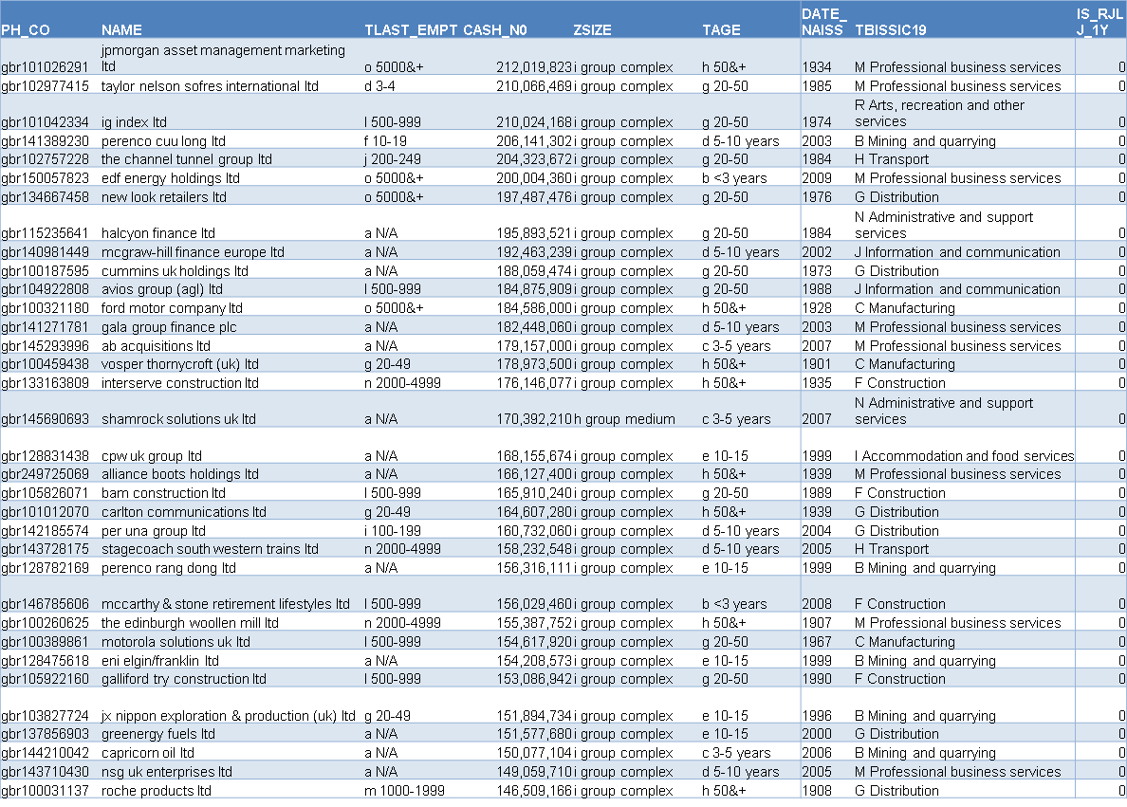
2011 3/3

Slide 50
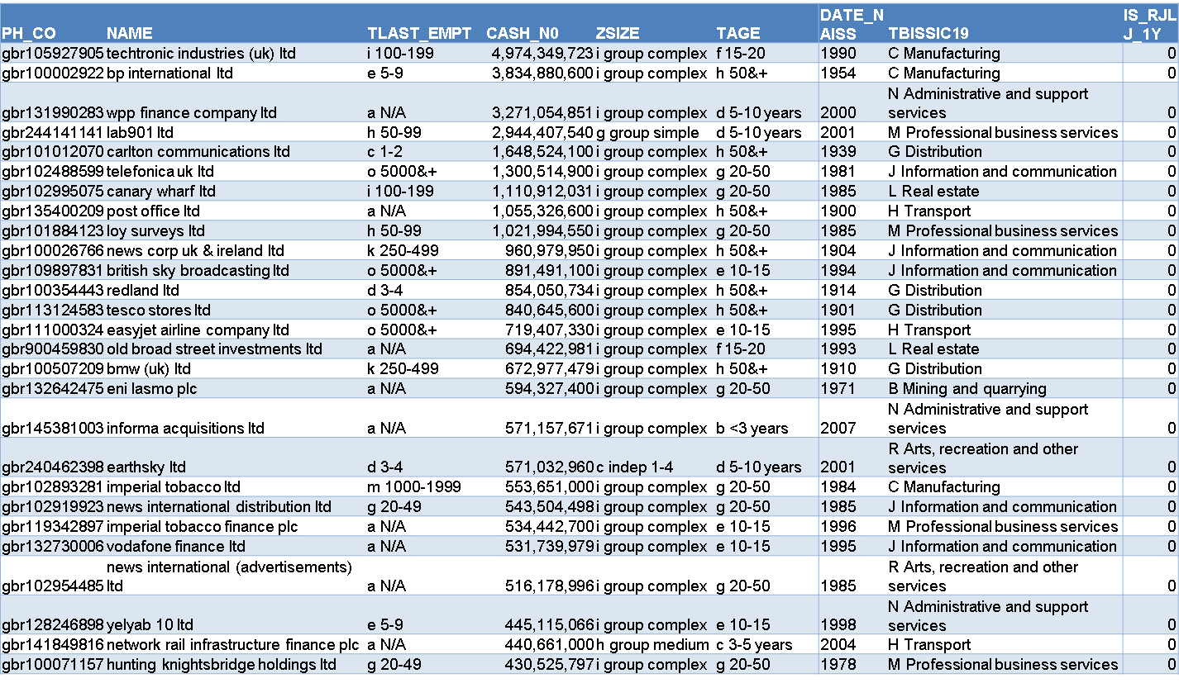
2009 1/3

Slide 51
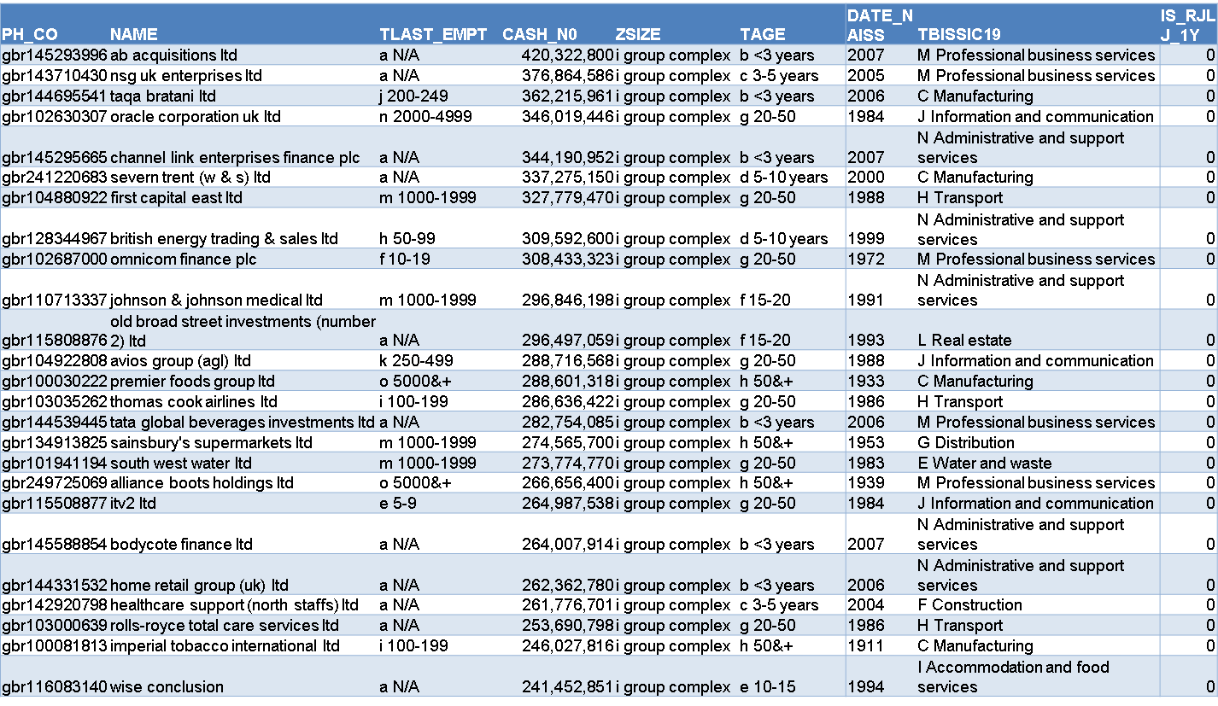
2009 2/3

Slide 52
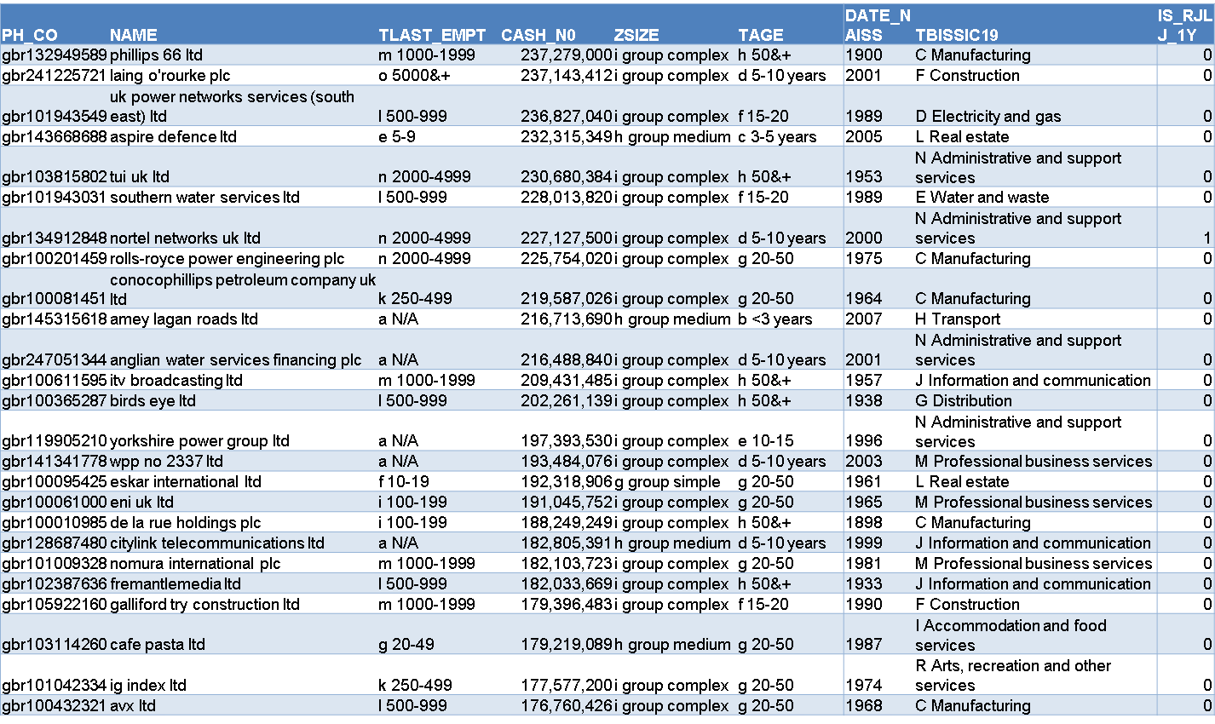
2009 3/3

Slide 53
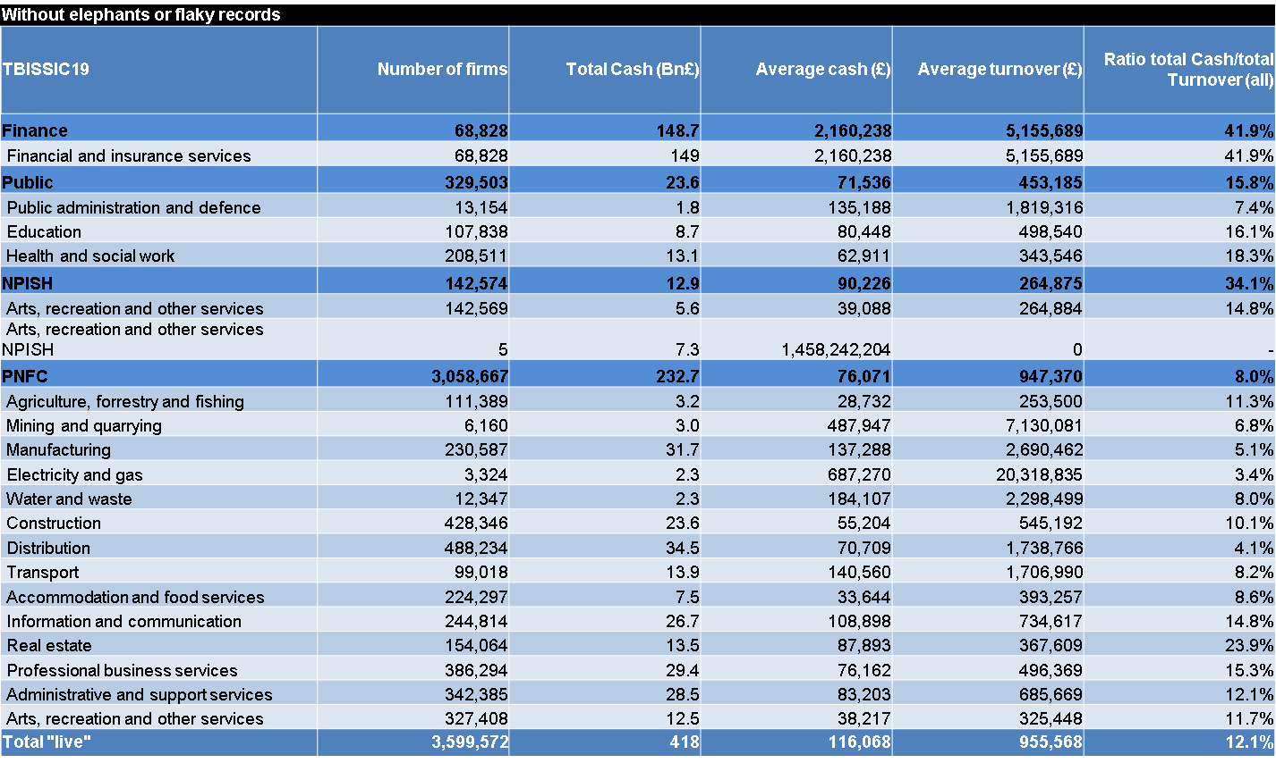
Breakdown by the BIS 19-way SIC cut: the core £233bn cash is fairly evenly distributed; average cash/firm is highest by far for the two sectors with the lowest populations: Mining, elec & gas (though they also have the highest average turnover per firm).

Slide 54
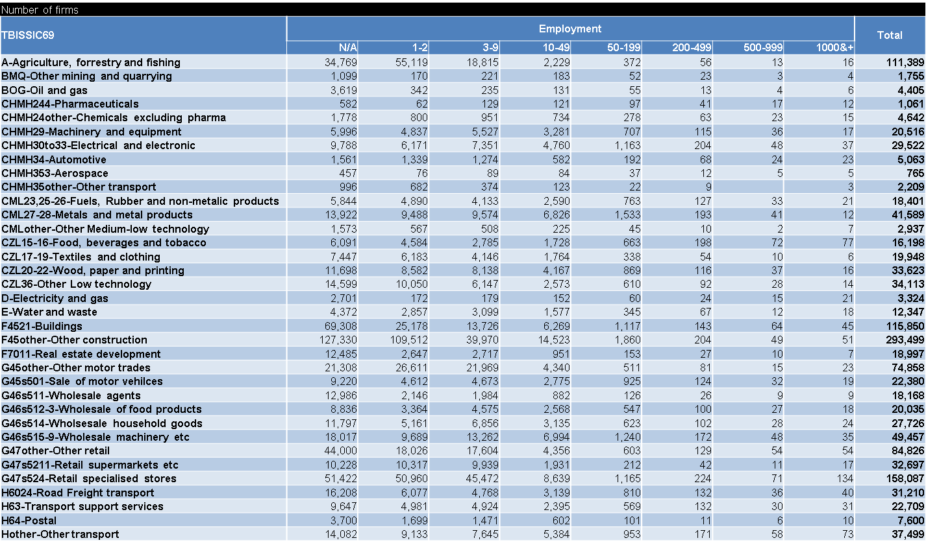
Detailed Industry Sector View (64-way BIS cut), by size band
First - number of firms

Slide 55
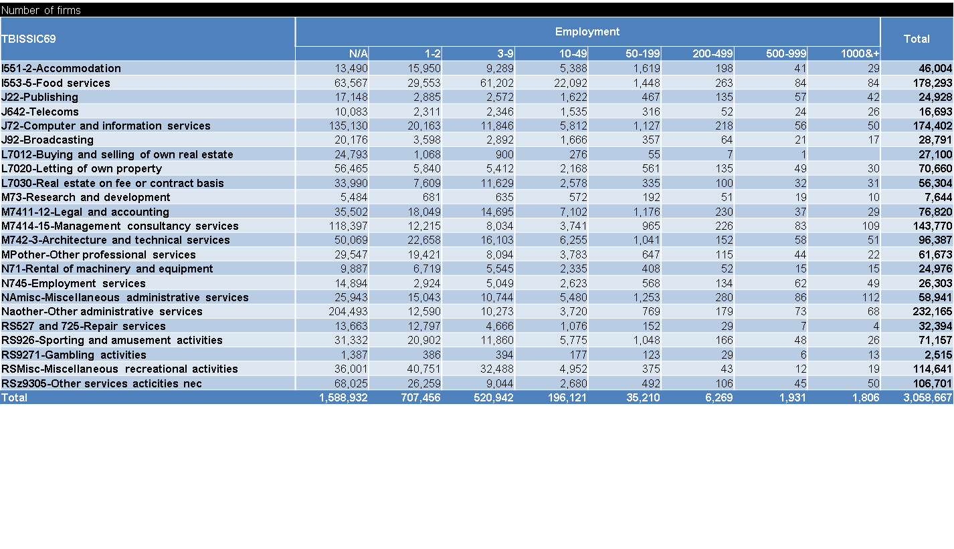
Continued…

Slide 56
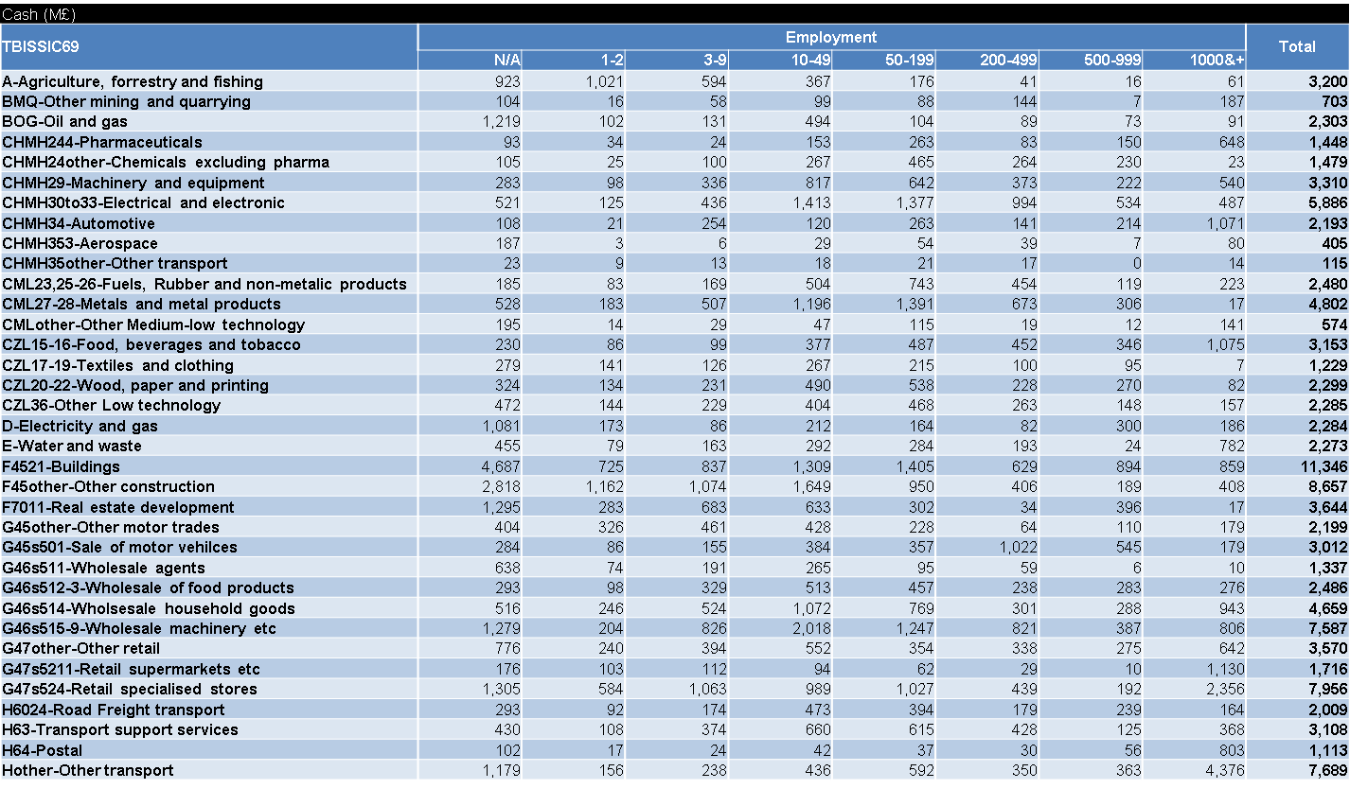
Now total cash…
Four sectors out of 57 concentrate £56.3bn of the total £233bn cash:
Buildings, computer/IT, management consultancy, admin services.

Slide 57
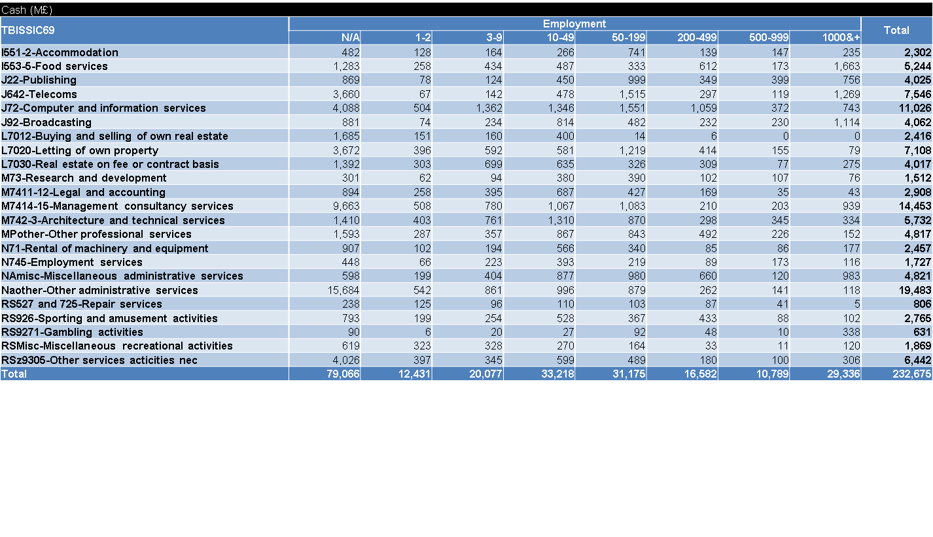
Continued…

Slide 58
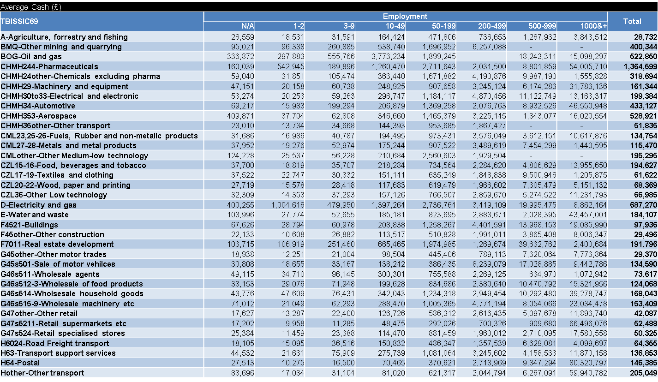
Now average cash/firm… within the >1000-empl, several sectors exceed £40m/firm; note anomalies within the small (similar to the N/A)

Slide 59
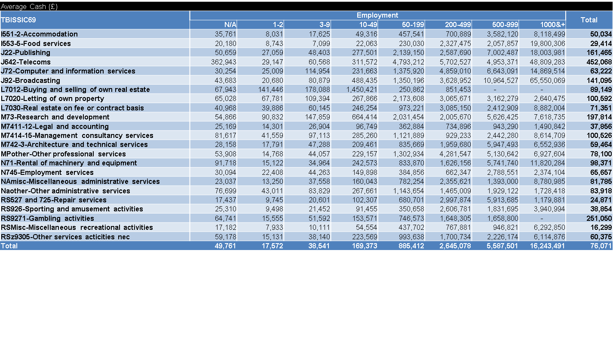
Continued…

