Slide 1
Marking consistency
Beth Black and Stephen Rhead
Ofqual Marking Consistency Symposium
14th November 2016

Slide 2
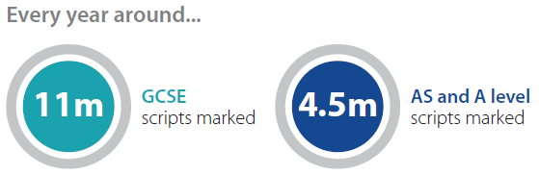
Background
Constructed-response questions
(mainly)
Responses hand-written in ‘scripts’
(almost all)
Responses scanned and distributed for online marking by item or by script
(mostly)
Responses marked only once
(mostly)
≈51k examiners
(mainly teachers)

Slide 3

Quality Assurance processes
examiner selection
standardisation
- online or face-to-face
“qualification”
- sessional or daily
monitoring
seeding items
sample double marking

Slide 4


An analysis of ‘seeding’/’validity’ items
pre-live marking
live marking..
6
6
6
6
6
6
4
Senior Examiners select response to be a seed
Senior Examiners give definitive mark to seed
Assistant Examiner marks seed ‘blind’ (approx. 1 per 20 live items)
Assistant examiner marks same/within tolerance – marker continues
Assistant Examiner mark out of tolerance = guidance / retraining / stopped
Or…

Slide 5
Why might examiners give different marks?

Slide 6
Why do examiners disagree over the quality of responses?
Procedural error
  sometimes examiners just make mistakes, e.g.
    failing to reveal evidence beyond the ‘clip’ area
There is a single ‘right mark’ for the response
It can be found by following the procedure correctly
Definitive = 2 Mode = 1

Slide 7
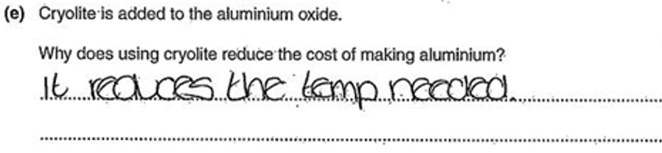
Why do examiners disagree over the quality of responses?
Attentional error
  sometimes examiners have concentration lapses, e.g.
    misreading what a candidate has written
There is a single ‘right mark’ for the response
It can be found by paying sufficient attention
Definitive = 1 Mode = 0

Slide 8
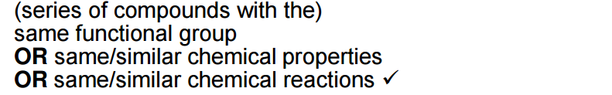
Why do examiners disagree over the quality of responses?
Inferential uncertainty
  sometimes examiners have insufficient evidence to reach a definitive judgement, e.g.
    over- or under-interpreting a candidate’s response
There may be a single ‘right mark’ for the response
It is not actually knowable from the available evidence
Definitive = 2 Mode = 1, 2

Slide 9
Why do examiners disagree over the quality of responses?
Definitional uncertainty
  sometimes the definition of the attainment construct and its scale is insufficiently precise to arbitrate between different views, e.g.
    different valuations of the same performance features
There is no single ‘right mark’ for the response
Definitive = 6 Mode = 8

Slide 10
Definitional uncertainty – no single ‘right mark’ for the response
There may be definitively ‘wrong marks’ without there being a definitively ‘right mark’

Slide 11
How consistent is marking?
Up until now, we have not had a good way of summarising marking consistency – we need some metrics.
Ofqual’s Quality of Marking report (2014) - we said we would develop a suite of metrics
Will help us develop benchmarks against which we can better evaluate marking consistency
Publishing technical report today

Slide 12
metrics
To produce metrics, we need two or more independent marks per item
Data from marker monitoring e.g. seeding items
N.B. we’ve appropriated data produced for another purpose
5
1
4
5
5
5
5
5
5
6
6
60% exact agreement

Slide 13
metrics
To produce metrics, we need two or more independent marks per item
Data from marker monitoring e.g. seeding items
i.e. we’ve appropriated data produced for another purpose
5
1
4
5
5
5
5
5
5
6
6
60% exact agreement
90% agreement within +/-1 mark

Slide 14
metrics
To produce metrics, we need two or more independent marks per item
Data from marker monitoring e.g. seeding items
i.e. we’ve appropriated data produced for another purpose
5
1
4
5
5
5
5
5
5
6
6
-4
-1
0
0
0
0
0
0
+1
+1
60% exact agreement
90% agreement within +/-1 mark
Mean mark difference = -0.3 marks

Slide 15
metrics
To produce metrics, we need two or more independent marks per item
Data from marker monitoring e.g. seeding items
i.e. we’ve appropriated data produced for another purpose
5
1
4
5
5
5
5
5
5
6
6
60% exact agreement
90% agreement within +/-1 mark
Mean mark difference = -0.3 marks
Standard Deviation = 1.418

Slide 16
metrics
To produce metrics, we need two or more independent marks per item
Data from marker monitoring e.g. seeding items
i.e. we’ve appropriated data produced for another purpose
5
1
4
5
5
5
5
5
5
6
6
60% exact agreement
90% agreement within +/-1 mark
Mean mark difference = 0.4 marks
Standard Deviation = 1.418

Slide 17
Possible reasons for the award of a ‘questionable’ mark
Procedural error
  examiner recorded their mark incorrectly (e.g. recorded ‘6’ not ‘7’)
  examiner failed to scrutinise all of the evidence (e.g. final paragraph over the page)
Attentional error
  examiner failed to spot significant evidence (e.g. incorrect spellings, like ‘boats’ not ‘boots’)
  examiner misread words or passages (e.g. ‘work in learn groups’ vs. ‘work in team groups’)
Inferential uncertainty
  examiner over-/under-interpreted ambiguous evidence (e.g. ‘we just [?] to the teachers’)
Definitional uncertainty
  examiners’ views differ on the definition of the construct and its quality scale, i.e. quality means subtly different things to different examiners (e.g. travel writing quality)
Consistency metrics do not differentiate between errors and uncertainties

Slide 18
Data
Summer 2013, 2014 and 2015 mark-remark data at item level for all items on all online marked units for the following subjects (GCSE, AS and A):
  Business
  Physics
  Geography
  Spanish
  Psychology
  English
  English Literature
  Religious Studies
  History
  Physical Education
  French
  Sociology
Year | Seed Items | Components/Units
2013 | 3.1m | 358
2014 | 4.1m | 378
2015 | 4.6m | 376
Total | 11.8m | 1,112

Slide 19
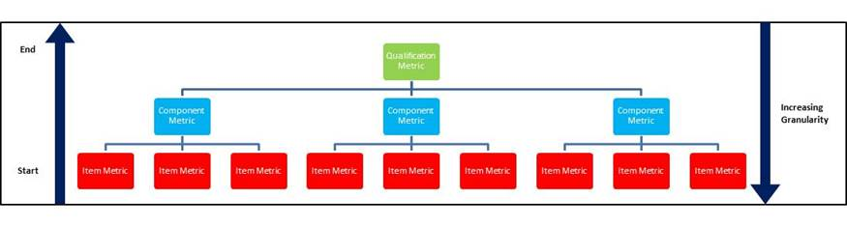
Metric requirements
Ideally marking reliability metrics should be presented at different levels of granularity, but that qualification level is particularly desirable.
  Use bottom up approach:
Qualification Metric
End
Component Metrics
Increasing
granularity
Item Metrics
Start

Slide 20
Item level analyses
Consistency metrics

Slide 21
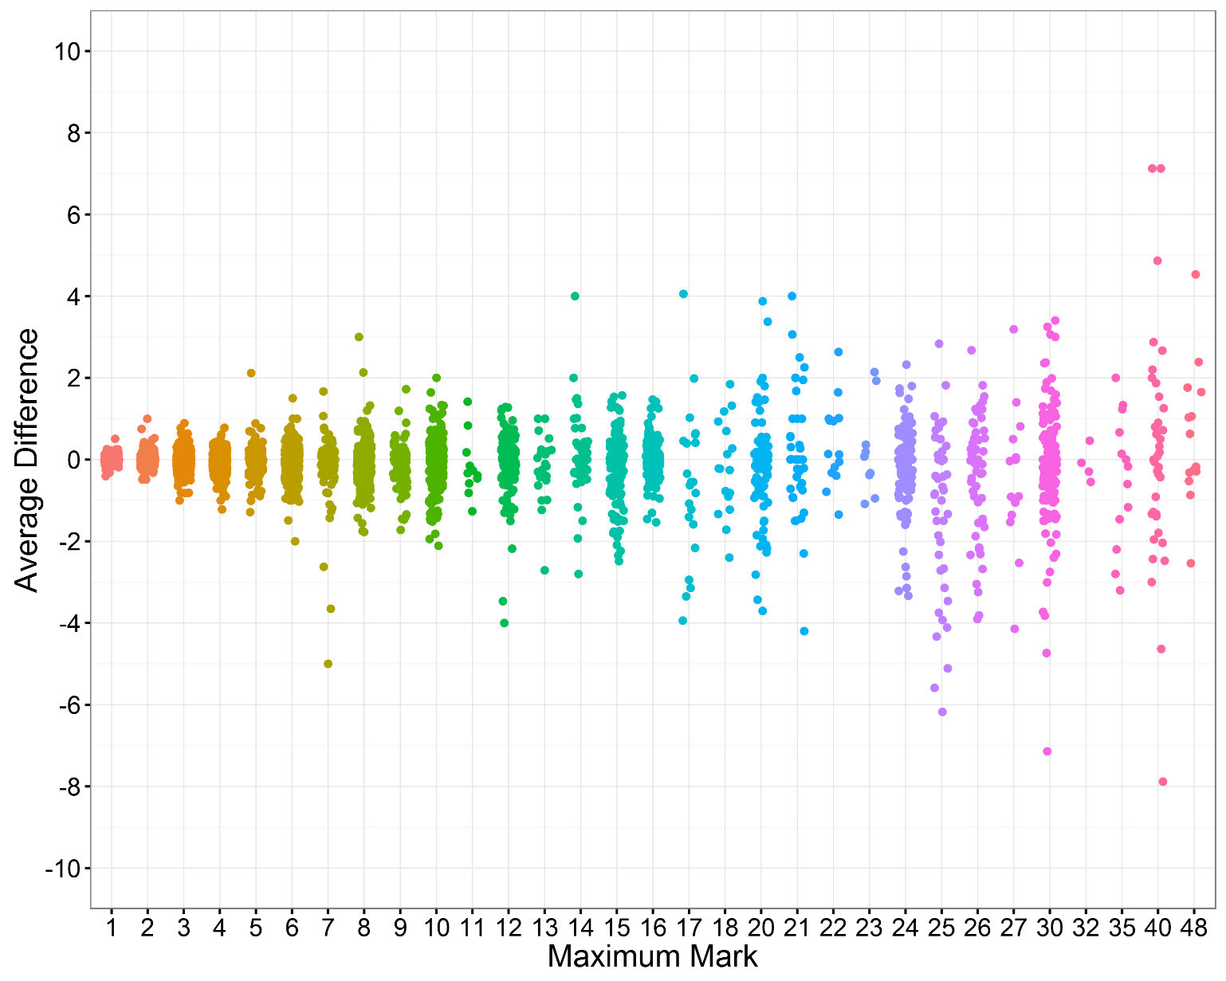
Item level: average difference between the definitive mark and examiners’ marks

Slide 22
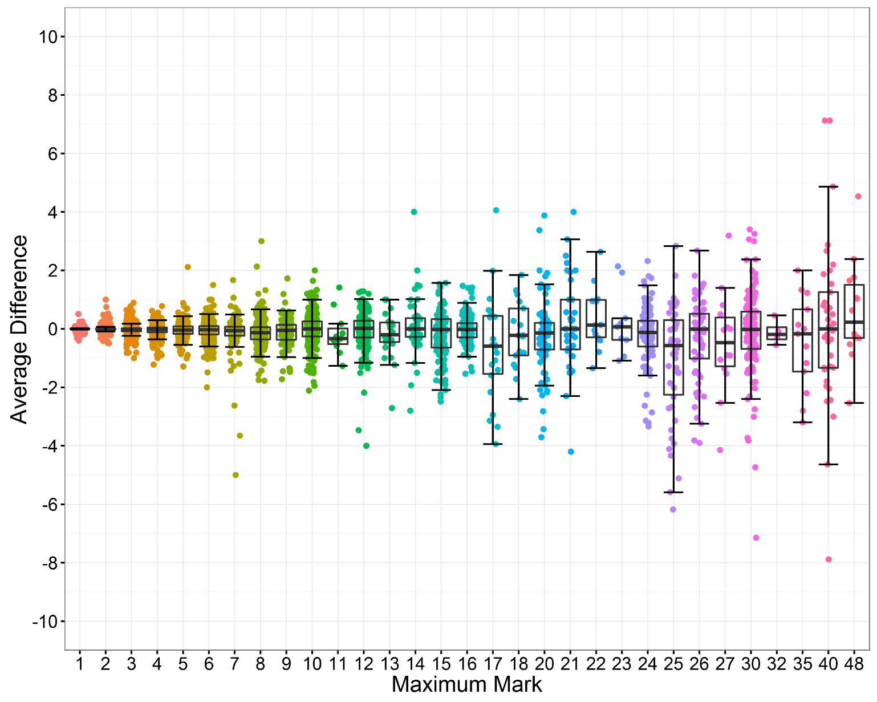
Item level: average difference between the definitive mark and examiners’ marks

Slide 23
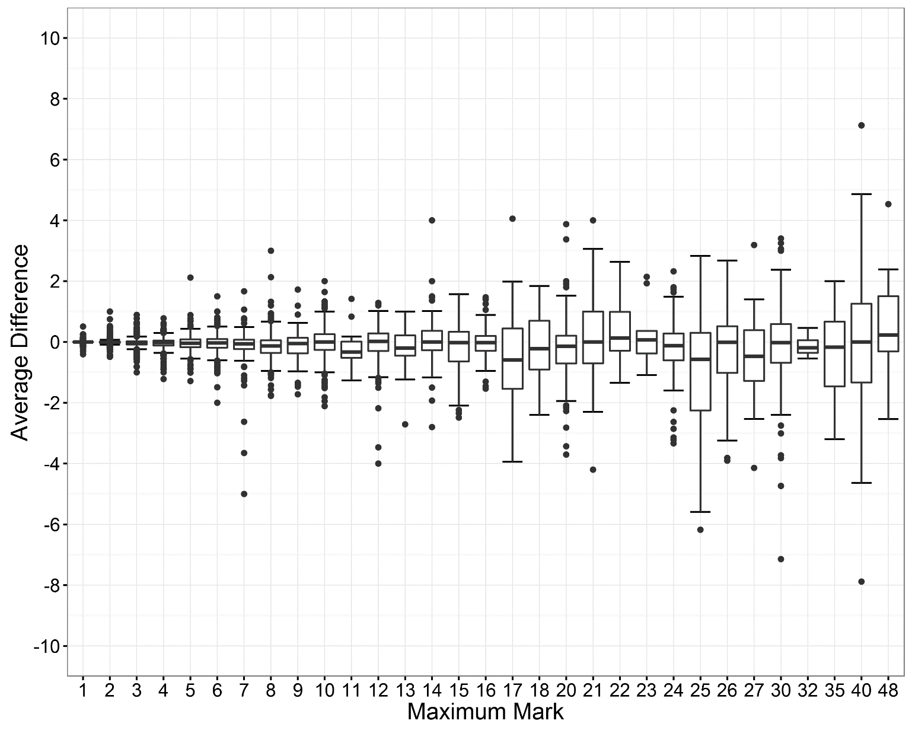
Item level: average difference between the definitive mark and examiners’ marks

Slide 24
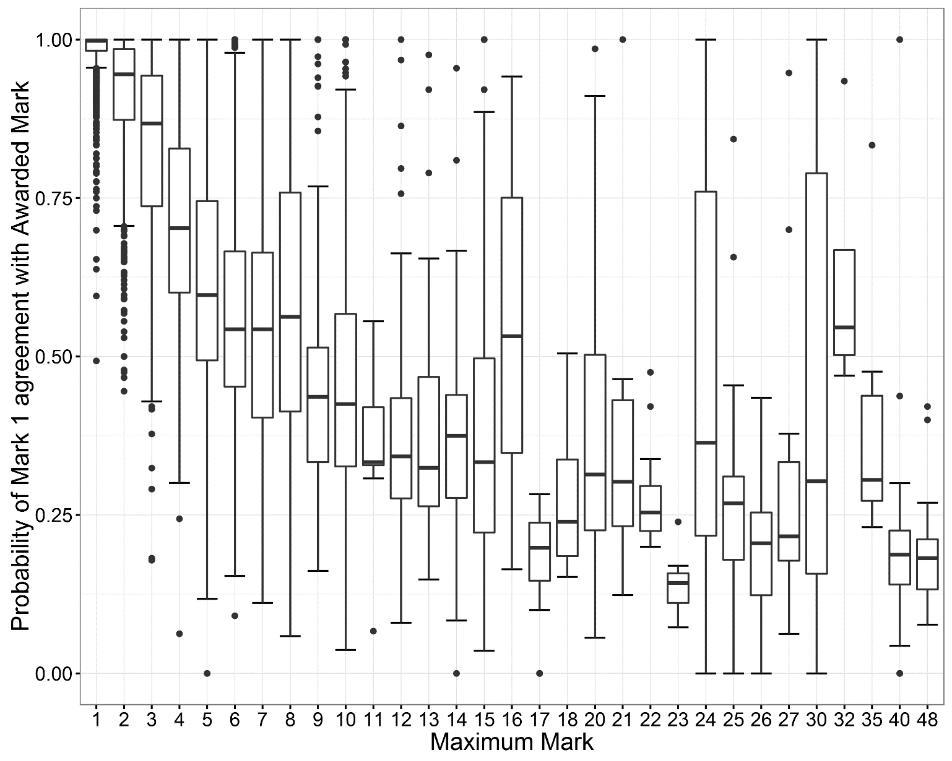
Probability of Exact Agreement with Awarded Mark - item level

Slide 25
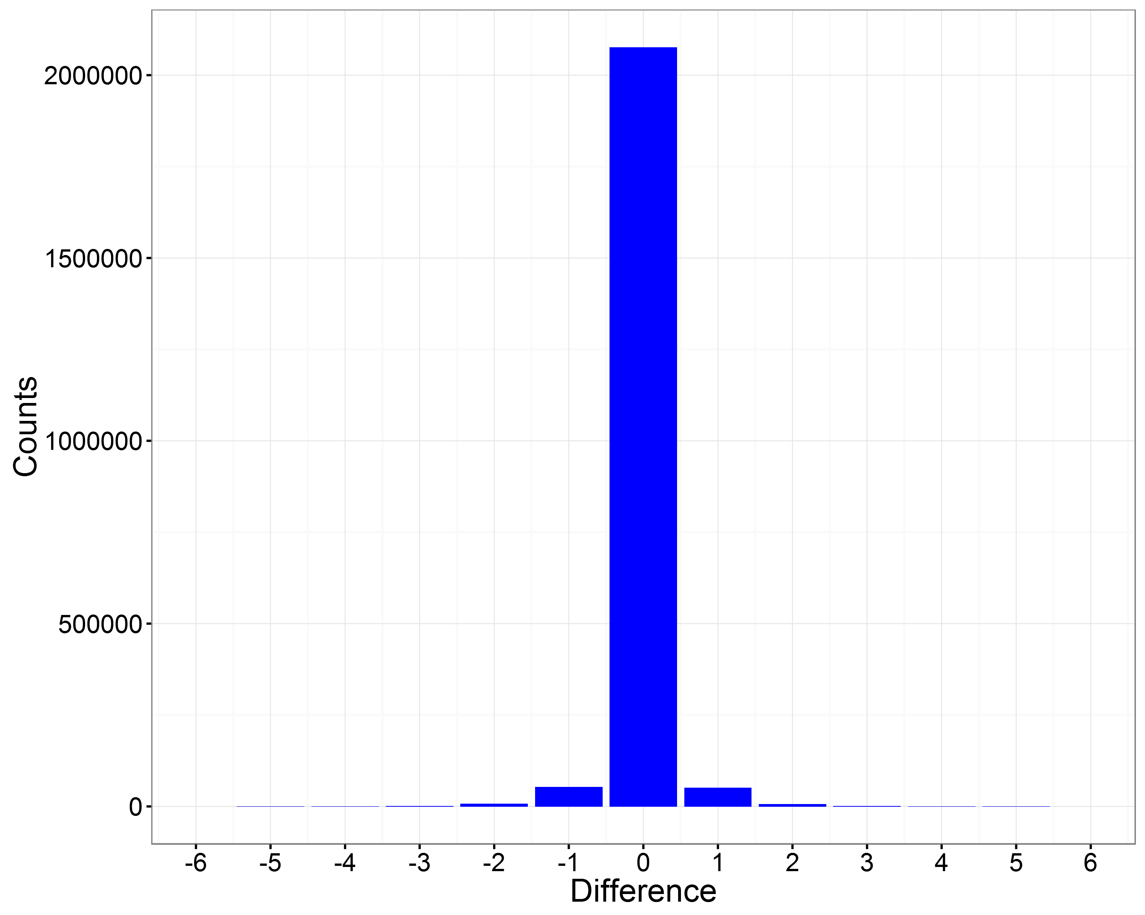
Mark Distributions – Physics – item differences
Mark Difference | 2013 | 2014 | 2015
-6 | 1 | 4 | 7
-5 | 5 | 19 | 9
-4 | 69 | 200 | 90
-3 | 417 | 744 | 504
-2 | 4,364 | 6,983 | 6,646
-1 | 33,993 | 52,696 | 52,427
0 | 1,261,165 | 1,754,047 | 2,075,847
1 | 28,530 | 48,109 | 50,338
2 | 2,942 | 5,037 | 5,756
3 | 298 | 591 | 533
4 | 38 | 95 | 126
5 | 3 | 21 | 5
6 | 0 | 1 | 0
Increasing Severity
Increasing Leniency

Slide 26
Mark Distributions – Physics – item differences
Mark Difference | 2013 % | 2014 % | 2015 %
-6 | 0.0001 | 0.0002 | 0.0003
-5 | 0.0004 | 0.001 | 0.0004
-4 | 0.005 | 0.01 | 0.004
-3 | 0.03 | 0.04 | 0.02
-2 | 0.3 | 0.4 | 0.3
-1 | 2.6 | 2.8 | 2.4
0 | 94.7 | 93.9 | 94.7
1 | 2.1 | 2.6 | 2.3
2 | 0.2 | 0.3 | 0.3
3 | 0.02 | 0.03 | 0.02
4 | 0.003 | 0.005 | 0.006
5 | 0.0002 | 0.001 | 0.0002
6 | 0 | 0.00001 | 0
Increasing Severity
Increasing Leniency

Slide 27
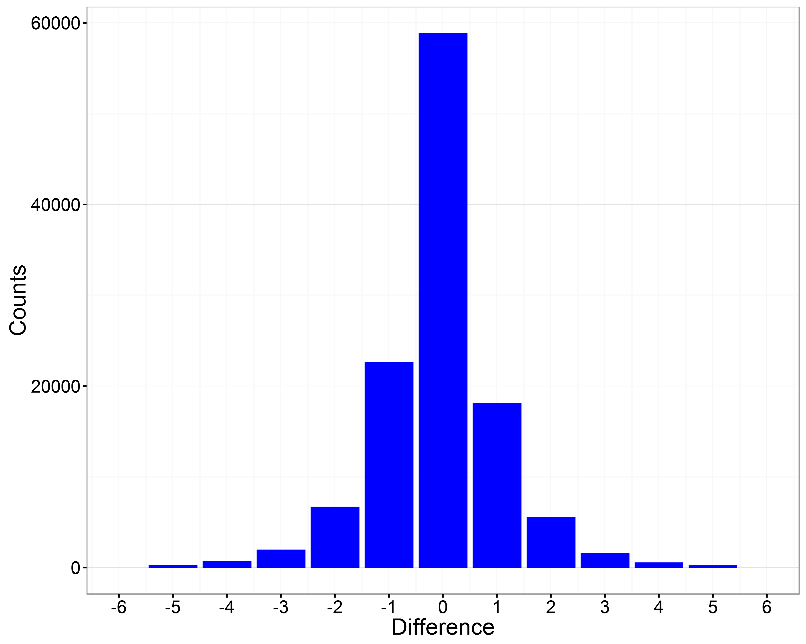
Mark Distributions - English
Mark Difference | 2013 % | 2014 % | 2015 %
-6 | 0.1 | 0.1 | 0.1
-5 | 0.2 | 0.2 | 0.2
-4 | 0.4 | 0.4 | 0.6
-3 | 1.2 | 1.3 | 1.7
-2 | 4.2 | 5.0 | 5.7
-1 | 15.5 | 17.3 | 19.3
0 | 52.0 | 53.8 | 50.0
1 | 17.6 | 16.1 | 15.4
2 | 5.7 | 4.3 | 4.7
3 | 1.8 | 1.0 | 1.4
4 | 0.6 | 0.3 | 0.5
5 | 0.2 | 0.1 | 0.2
6 | 0.1 | 0.1 | 0.1
Increasing Severity
Increasing Leniency

Slide 28
Component level analyses
Can build item level analyses up into…

Slide 29
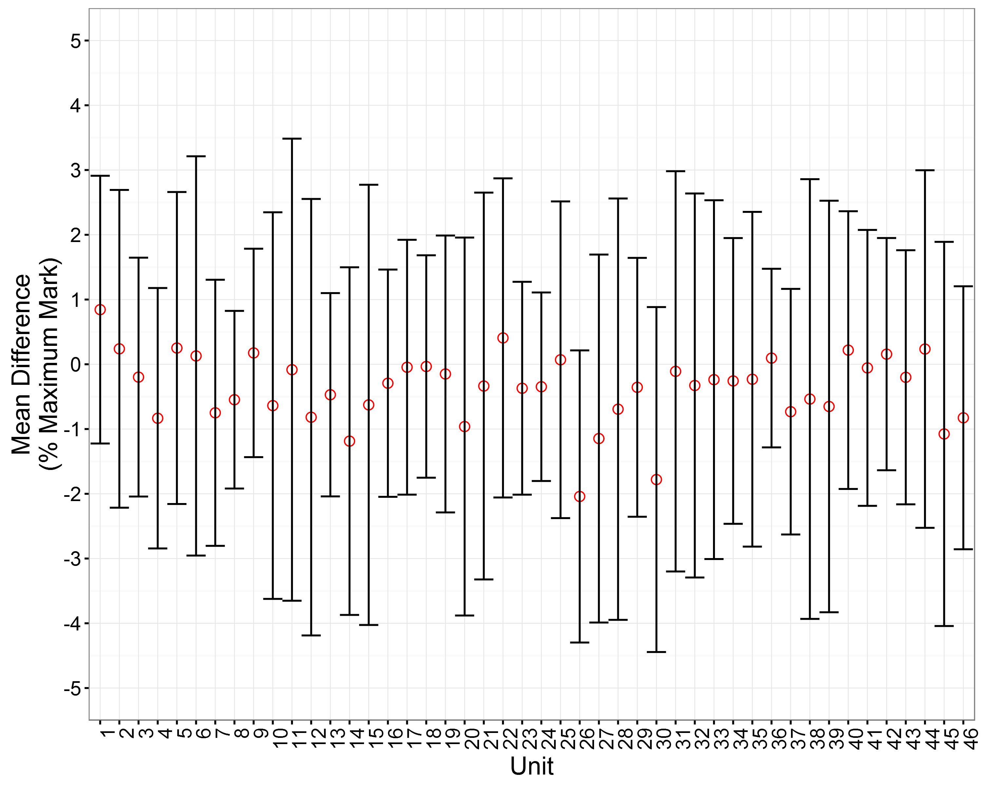
Mean Difference – all Physics components

Slide 30
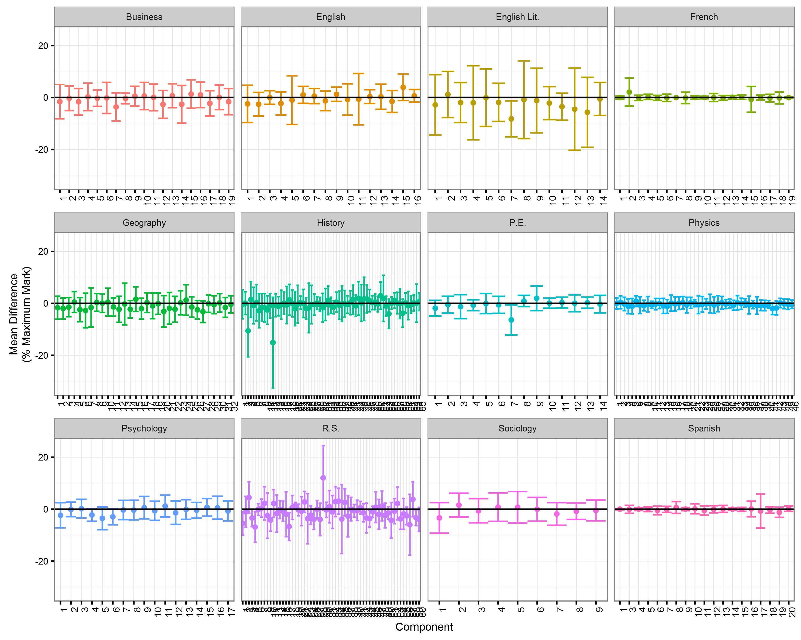
Units within subjects
variability between subjects
also, variability within subjects

Slide 31
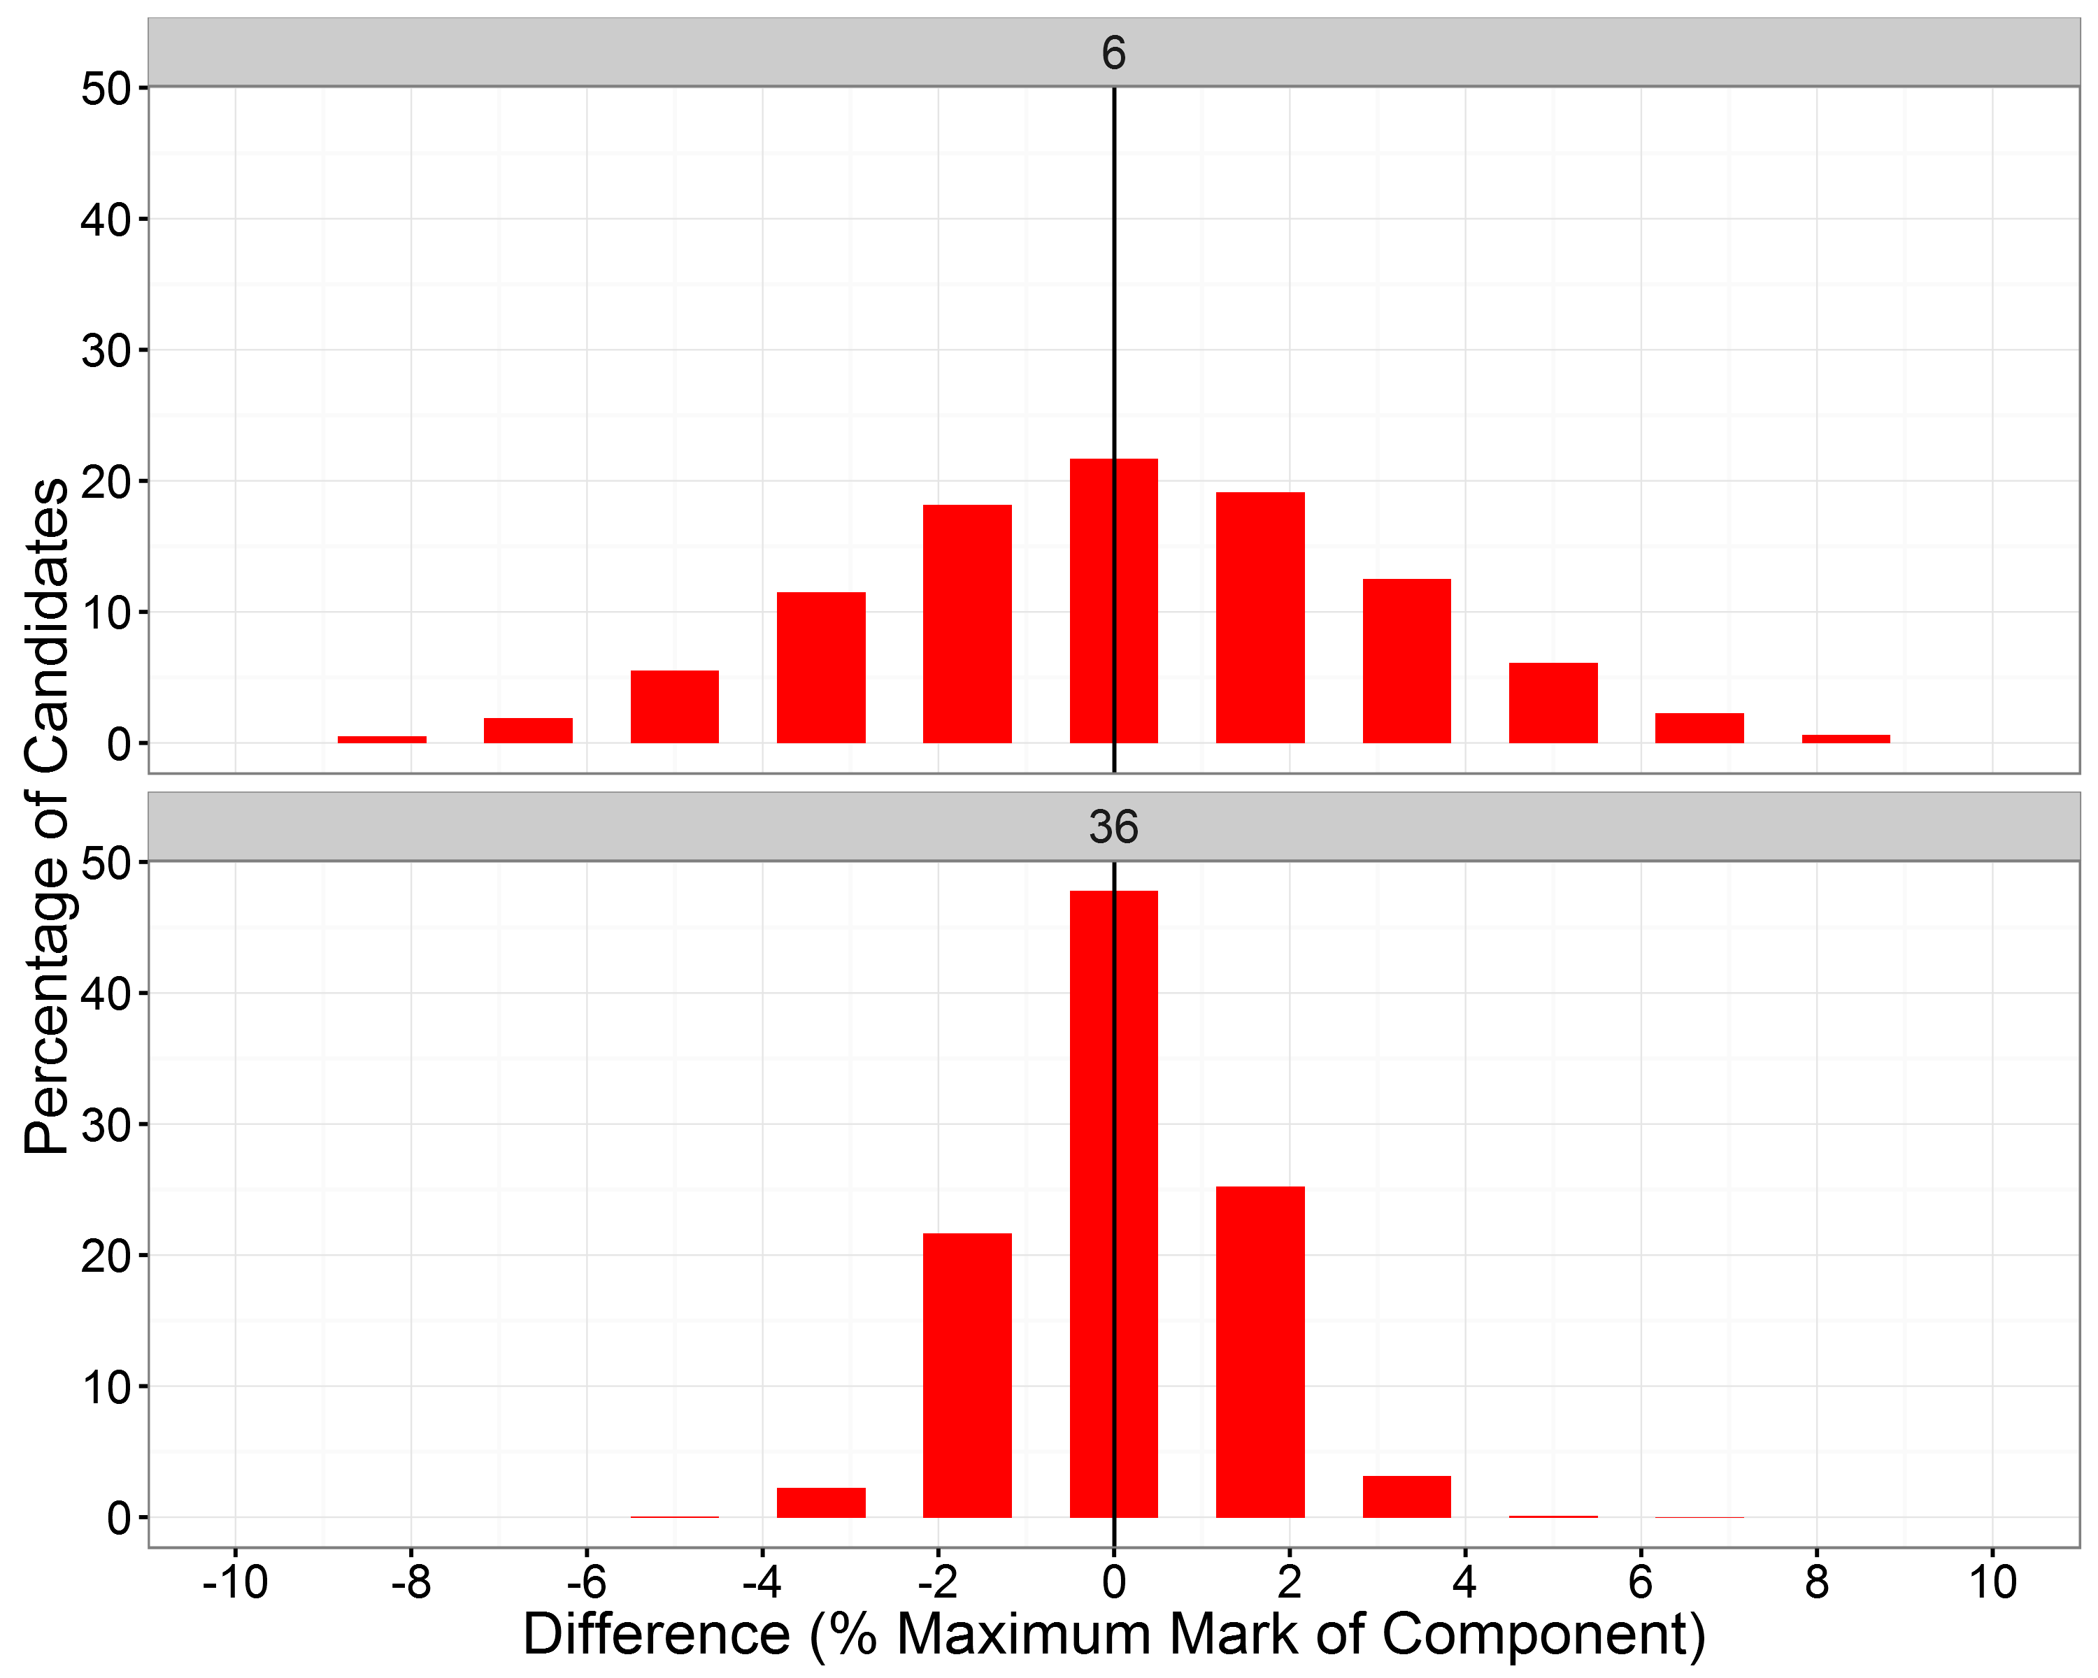
Impact on Candidates
Unit X
Mark Diff. (Raw) | Mark Diff. (% Max. Mark) | % of Cands. (Unit X) | % of Cands. (Unit Y)
0 | 0 | 21.5 | 48.0
± 1 | ± 1.7 | 58.7 | 94.6
± 2 | ± 3.3 | 82.8 | 99.9
± 3 | ± 5 | 94.4 | 100
± 4 | ± 6.7 | 98.6 | 100
± 5 | ± 8.3 | 99.7 | 100
Unit Y

Slide 32
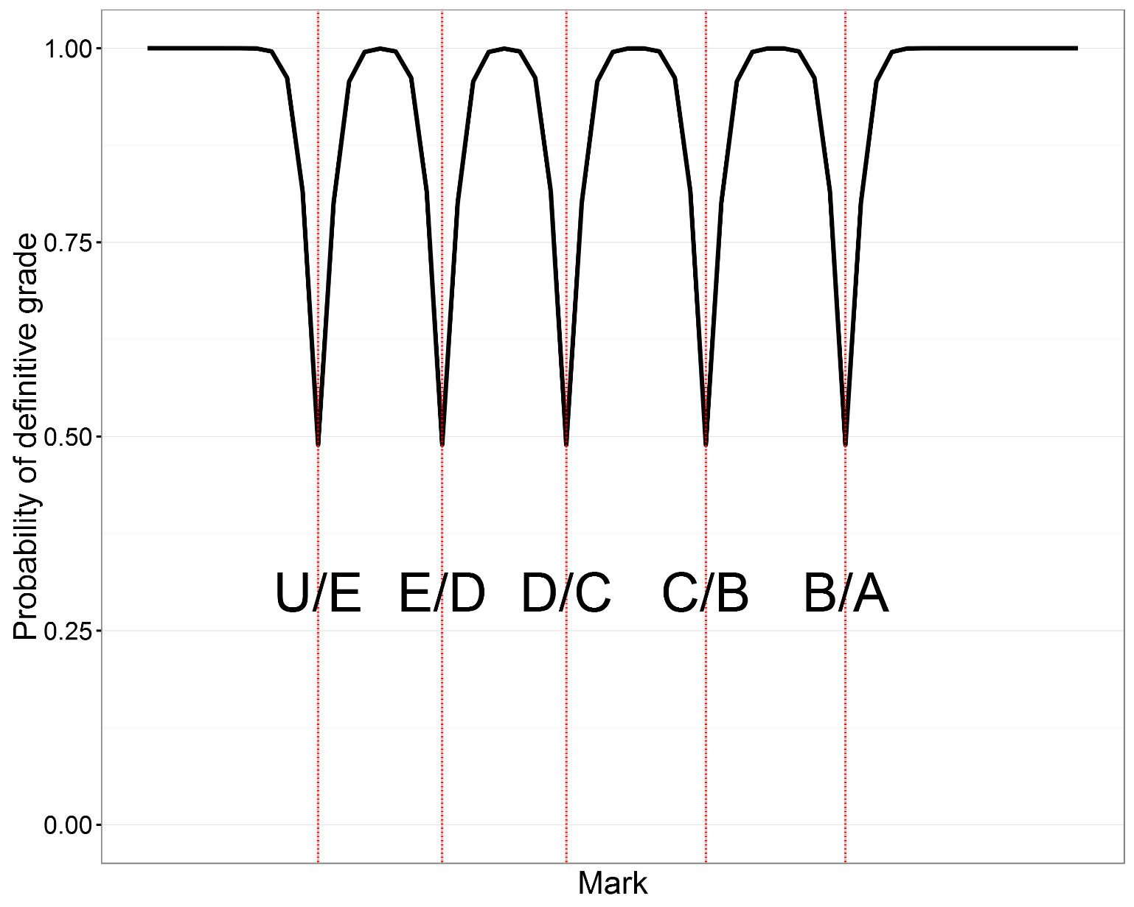
Probability of “definitive” grade – component level

Slide 33
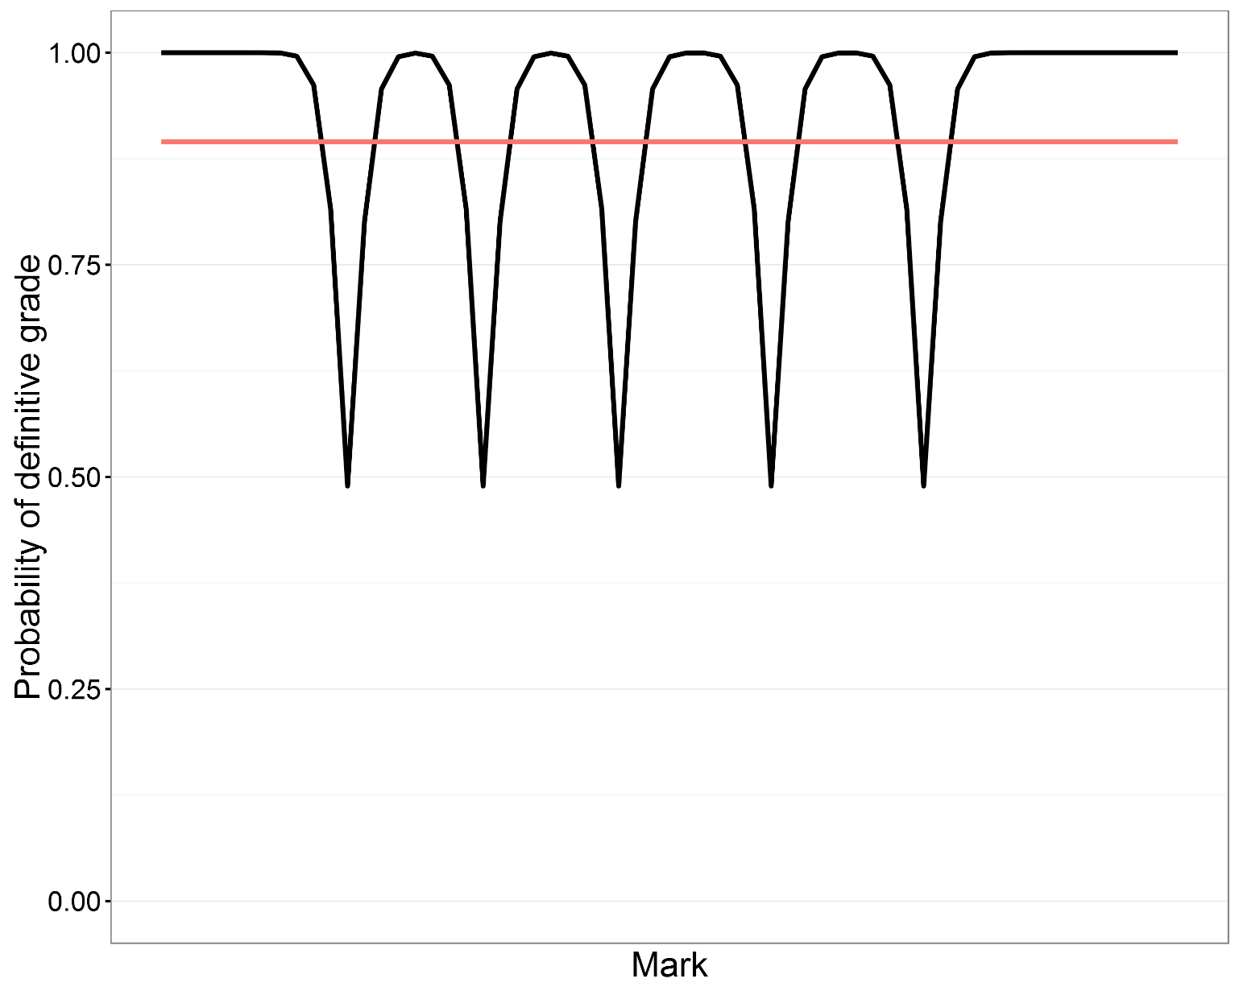
Probability of “definitive” grade – component level

Slide 34
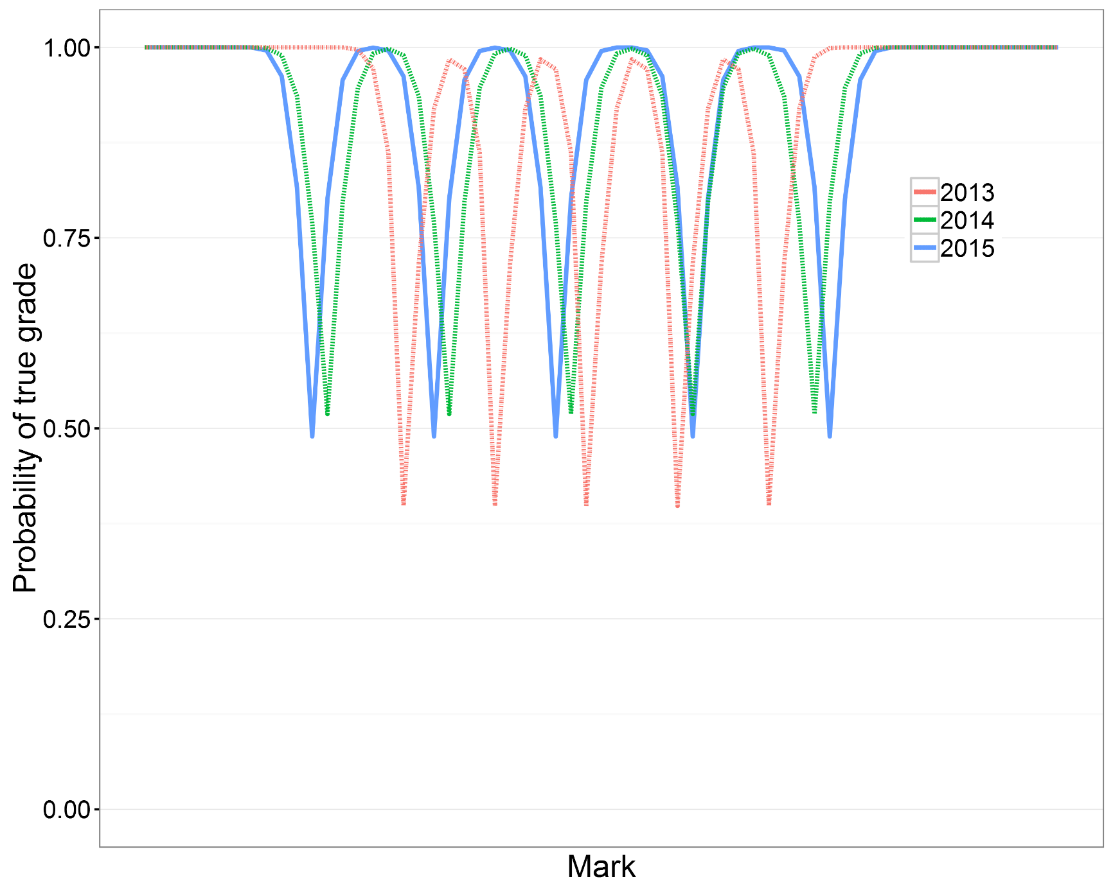
Probability of “definitive” grade - component level
Year | Mean Difference | Standard Deviation
2015 | -0.03 | 1.15
2014 | 0.05 | 1.27
2013 | -0.31 | 1.20

Slide 35
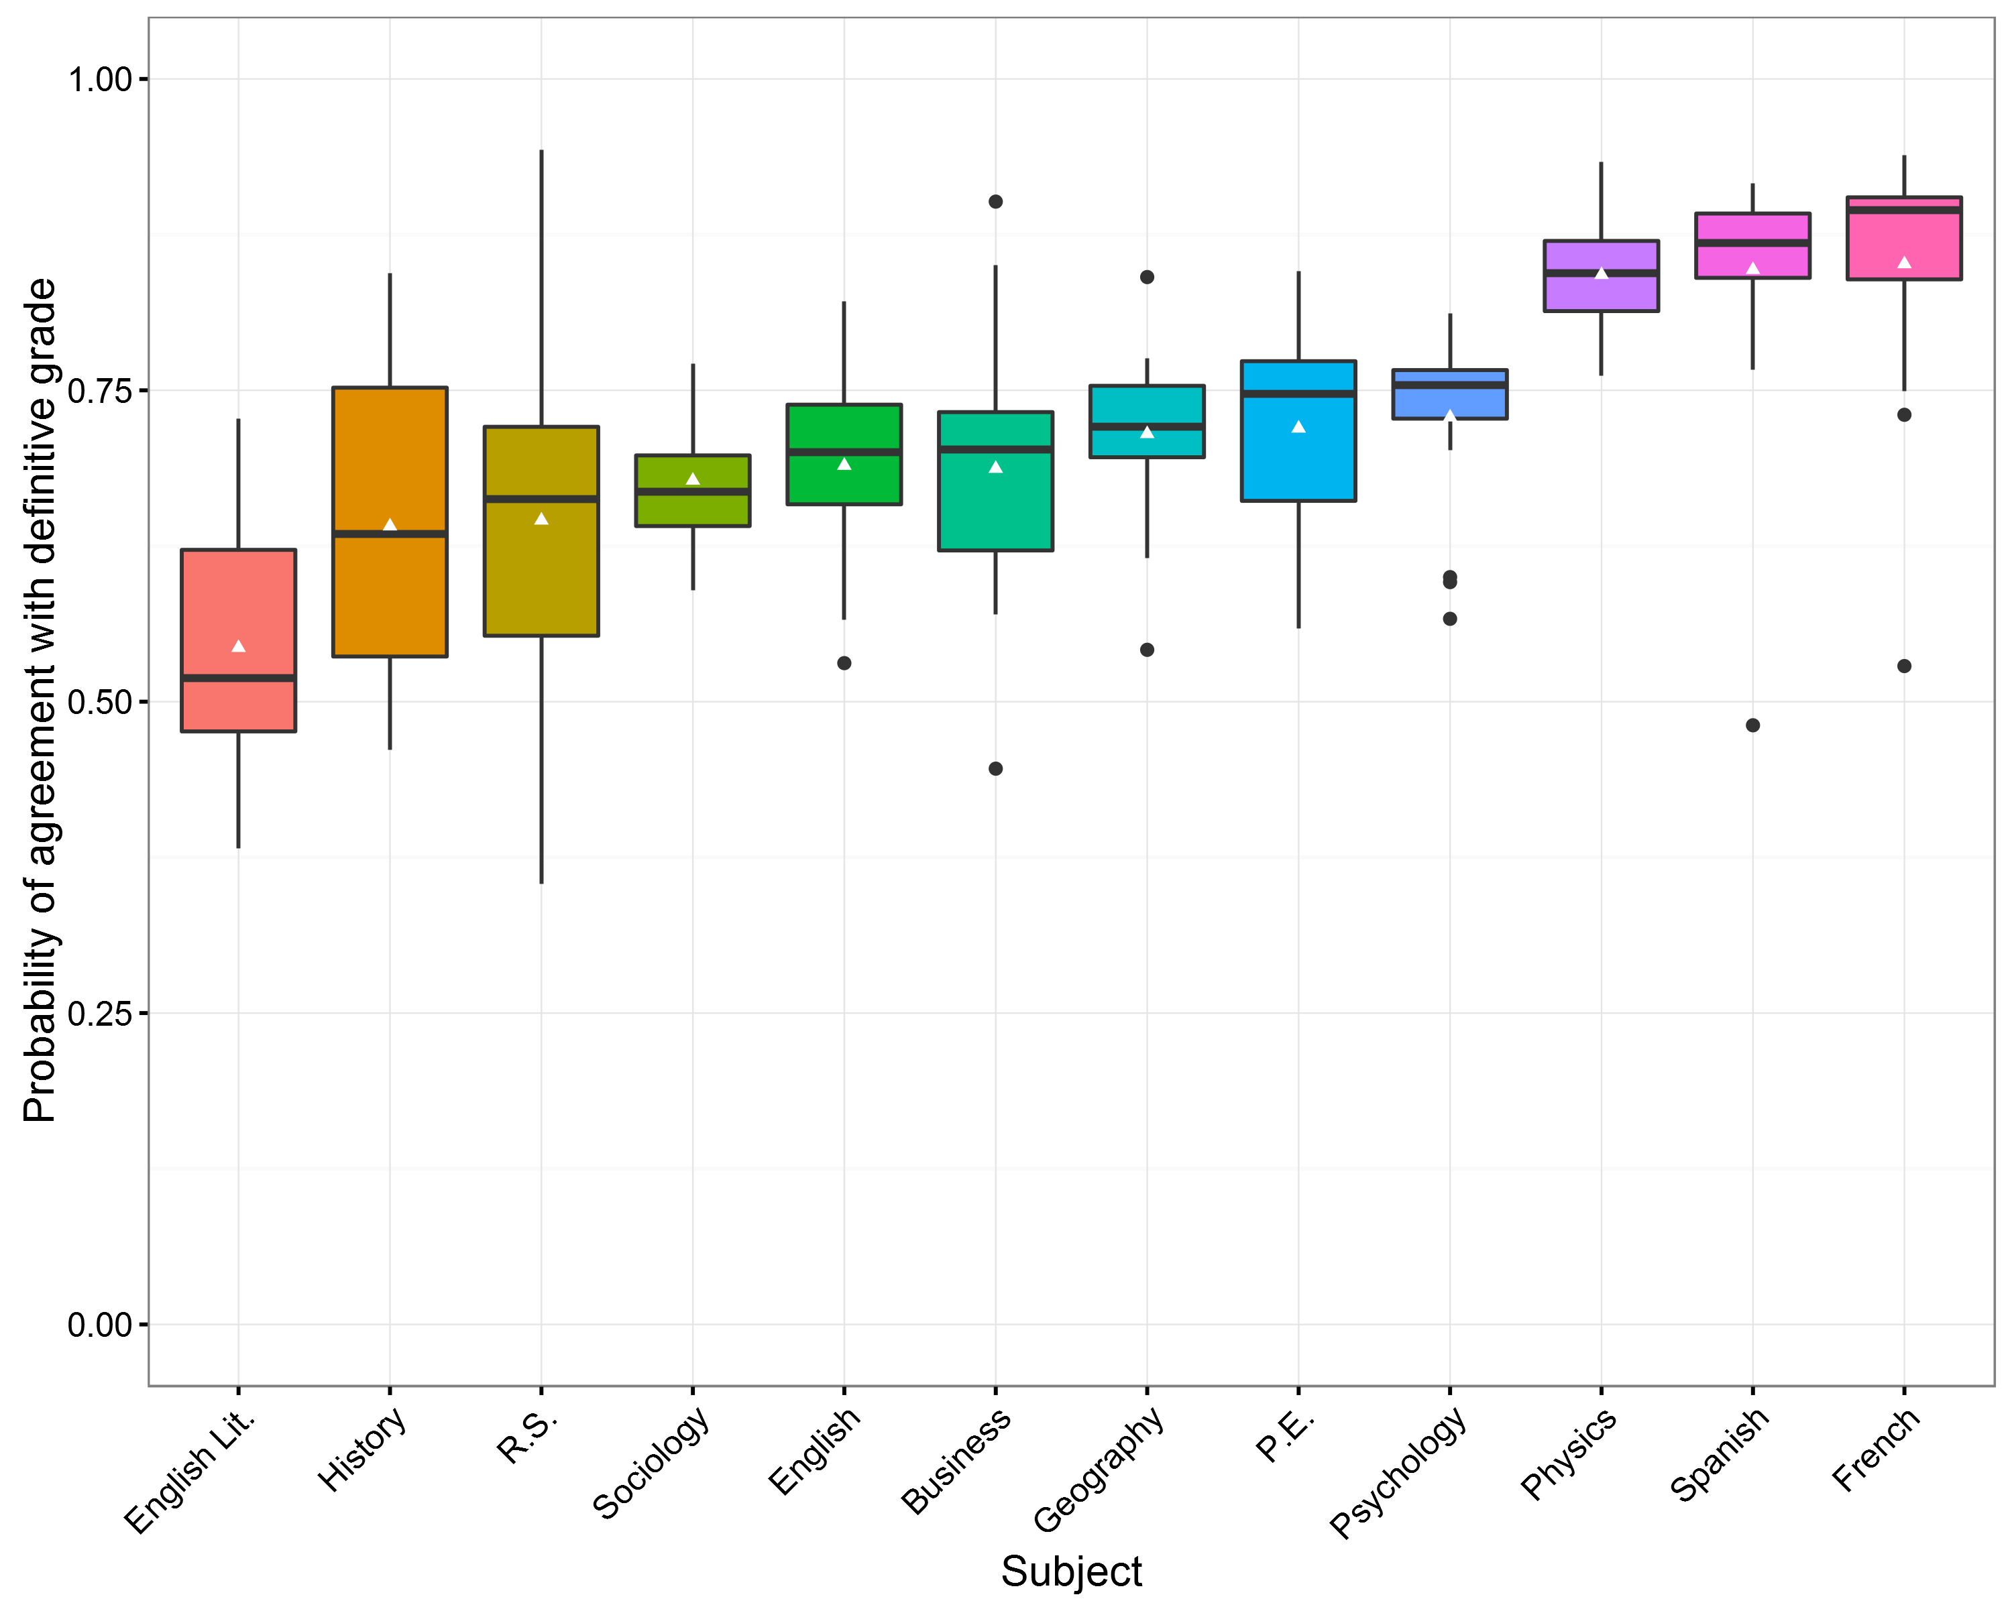
Units within subjects displayed in box plots

Slide 36
How does marking compare internationally?

Slide 37
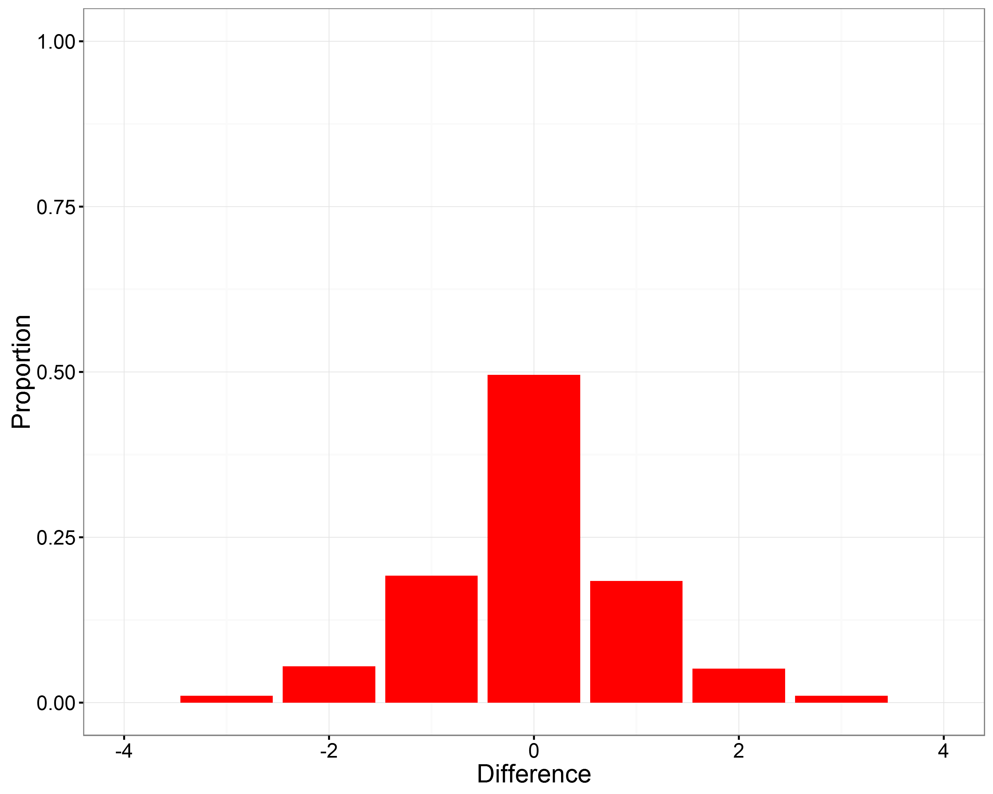
Geography
39,091 items
Difference | Percentage (%)
-3 | 1.04
-2 | 5.46
-1 | 19.15
0 | 49.52
1 | 18.35
2 | 5.09
3 | 1.04

Slide 38

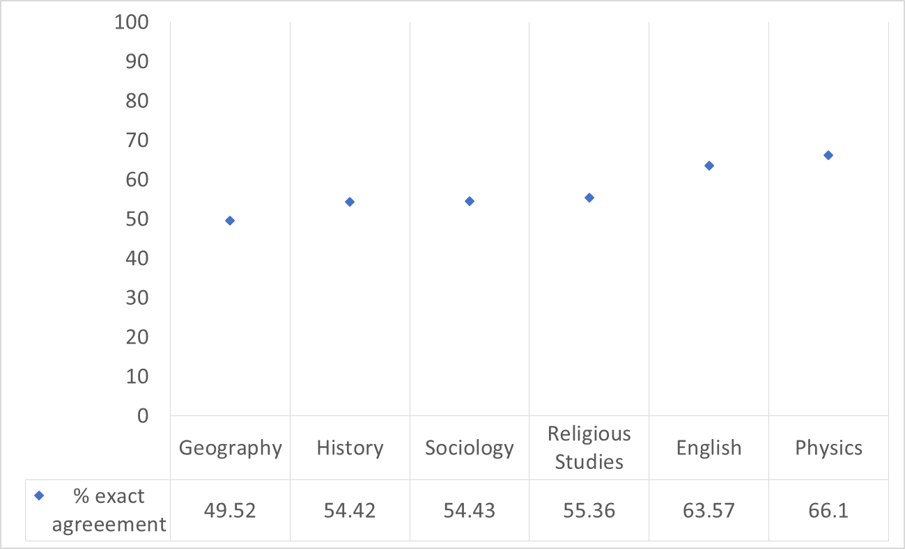
6 mark items in different subjects – exact agreement

Slide 39
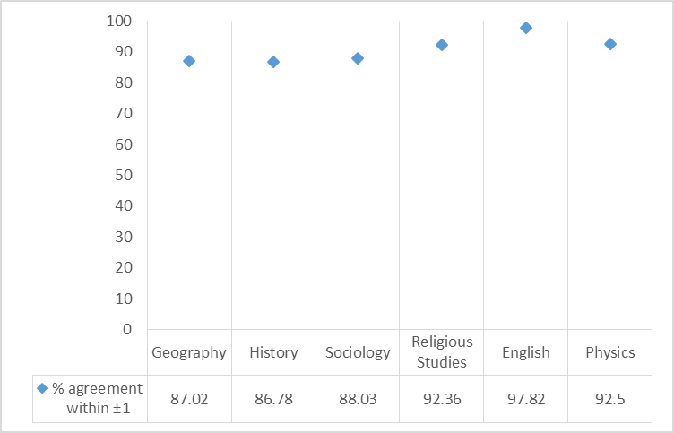
6 mark items in different subjects – within ± 1 mark

Slide 40
What next for the metrics
Will develop benchmarks against which we can better evaluate consistency
Benchmarks will need contextualising according to nature of assessment
Ensure that our use of metrics does not undermine the prime use of marker monitoring – i.e. to make decisions about marking and markers during the live session

Slide 41
Summary
Have provided you with a flavour of the report – on Ofqual website later today.
We have developed metrics at different levels
  Item
  Unit
  Specification level
Marking looks reasonable compared to international studies
Metrics do not distinguish between marking error and legitimate differences
Over time will provide benchmarks against which we can better evaluate marking consistency
Need to ensure use of metrics does not undermine live marker monitoring

