Slide 1
Comparability of Subjects: Lessons from Abroad
Iasonas Lamprianou
Department of Social and Political Sciences
University of Cyprus

Slide 2
In just 15 minutes….
"Statistical adjustment” in Cyprus high stakes exams
Other evidence around the world
Lessons for English policy

Slide 3
Statistical adjustment for Comparability purposes in Cyprus
How did it all start?
More than 35 years of history (around 1980)
More sciences students in the Pedagogical Academy
ETS report → statistical adjustment

Slide 4
Statistical adjustment for Comparability purposes in Cyprus
How did it all start?
An ecosystem of problems: Social, Political and Financial dimensions (see Lamprianou, 2009, 2012) Heated discussions in the Parliament & Horror stories in the Press Teacher Unions lobbied to maintain their “clients”

Slide 5
% of students examined (Latin and Biology)

Slide 6
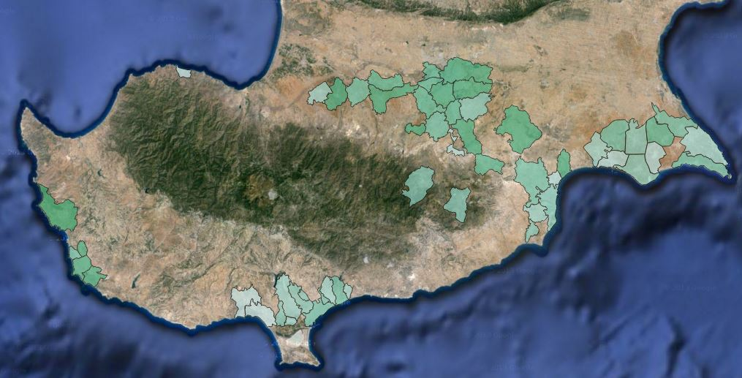
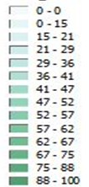
% of students (per school) taking advanced mathematics
60%-70%
~47%
50%-60%
38%-61%

Slide 7
Comparability of subjects in Cyprus
How did all start? 25 years of history
An ecosystem of problems
A 5-year Legal Battle
The law to be declared unconstitutional (2002 → 2007)
The Supreme Court rejected the claim

Slide 8
Comparability of subjects in Cyprus
How did all start? 25 years of history
Social and Political dimensions of the problem
The 5-year Battle at the Supreme Court
Public trust and the social contract
Students do not understand scaling but consider it necessary (Michaelides, 2014)
Web sites with misleading information: multiple levels of interpretation
35 years later, many people try to find a way to abolish it

Slide 9
In just 15 minutes….
“Statistical adjustment” in Cyprus high stakes exams
Other evidence around the world
People try to work the system (Australian Univ. Admissions Centre)
Violations of constitution (Fiji Islands)
Heated politics and resignations (New Zealand)
Improvements to existing methods are investigated (e.g. Tertiary Institutions Service Centre, Western Australia)

Slide 10
In just 15 minutes….
“Statistical adjustment” in Cyprus high stakes exams
Other evidence around the world
Lessons for English policy
Important side-effects
Is it really necessary, i.e. what is the practical impact?
A vicious circle of defending and improving
The legal dimension needs to be investigated

Slide 11
In just 15 minutes….
“Statistical adjustment” in Cyprus high stakes exams
Other evidence around the world
Lessons for English policy
If you think it should happen, educate all the stakeholders first and stop looking for the perfect solution.
It should be simple to explain and practical to implement.

Slide 12
… some references
Supreme Court, Cyprus, (March 2007), Kitromilis vs The Republic of Cyprus, No. 3913
Lamprianou, I. (2009). Comparability of Examination Standards Between Subjects: an International Perspective. Oxford Review of Education, 35 (2), 205-226.
Lamprianou, I. (2012). Effects of Forced Policy-Making in High Stakes Examinations: the Case of the Republic of Cyprus. Assessment in Education: Principles, Policy & Practice, 19 (1), 27-44.
Michaelides, M. P. (2014) Validity considerations ensuing from examinees’ perceptions about high-stakes national examinations in Cyprus. Assessment in Education: Principles, Policy & Practice, 21:4, 427-441.

