Slide 1
Local wellbeing, local growth
A resource to support local authorities in adopting a Health in All Policies (HiAP) approach

Slide 2
About this resource
This resource has been produced by Public Health England to support the introduction of a Health in All Policies approach at a local level
This slide set is part of a resource comprising an overview paper, practical examples of HiAP implementation, background information about Health and Health equity in All Policies and a glossary of terms
Audiences for this resource include local authority leaders, chief executives and other senior officers and councillors as well as directors of Public Health
2

Slide 3
“Many local authorities are taking a whole-council approach to public health, based on an understanding of the interconnectedness of the social determinants of health.”
Councillor Izzi Seccombe Chair, Community Wellbeing Board (LGA)
“Place-based leadership can orchestrate a process of social discovery and promote innovative approaches to regeneration.”
Professor Robin Hambleton University of the West of England
3

Slide 4
Contents
Introducing the Health in All Policies approach
Health in All Policies in action
Questions to consider

Slide 5
Introducing the Health in All Policies approach
The WHO definition
Social determinants of health
A ‘win-win’ approach
How Health in All Policies works

Slide 6
The WHO definition
A Health in All Policies (HiAP) approach is strongly advocated by WHO and is being adopted worldwide.
“An approach to public policies across sectors that systematically takes into account the health implications of decisions, seeks synergies, and avoids harmful health impacts in order to improve population health and health equity.”
WHO, 2013
Notes:
Health in All Policies (HiAP) has been strongly advocated by WHO, the European Union and public health associations worldwide. Alongside this, there has been growing interest and engagement from key UK organisations such as FPH, ADPH, LGA and PHE – and an All party Parliamentary Group has been established.
HiAP has been defined as:
“An approach to public policies across sectors that systematically takes into account the health implications of decisions, seeks synergies, and avoids harmful health impacts in order to improve population health and health equity.”
APPG on HiAP: www.fph.org.uk/all-party_parliamentary_group_on_health_in_all_policies

Slide 7
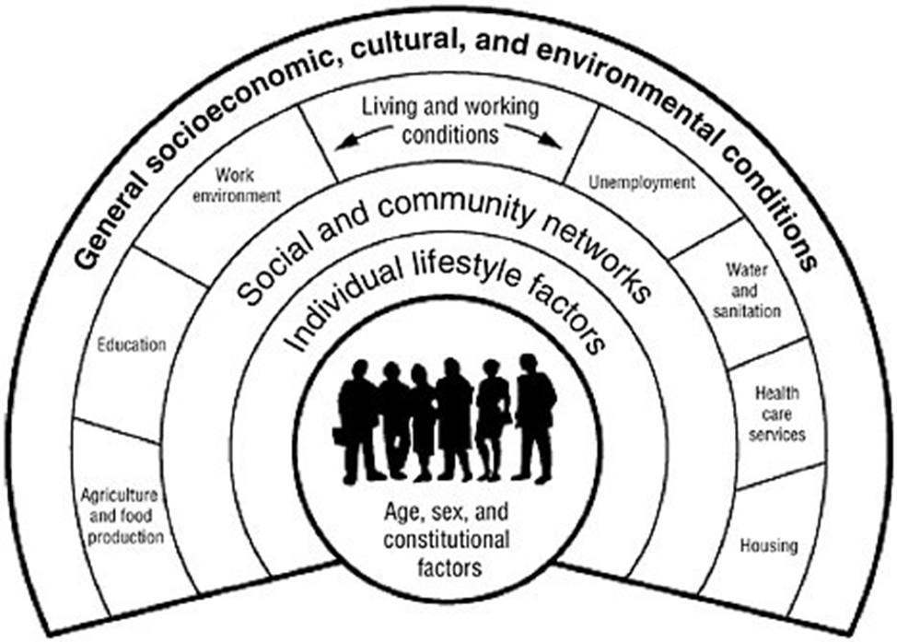
Social determinants of health
Health and health inequalities are largely determined by living conditions and wider social, economic, environmental, cultural and political factors
Many of our 21st century challenges such as obesity, mental wellbeing and climate change involve multiple interacting causal factors and lack a clear linear solution
Dahlgreen and Whitehead (1991)

Slide 8
A ‘win-win’ approach
With statutory responsibility for local health passing to local authorities in 2013, local government offers the opportunity to:
support economic, social and environmental wellbeing
across multiple services, programmes and policy areas
in collaboration with partner agencies and sectors.
A Health in All Policies approach:
supports populations in living better, for longer
contributes to the achievement of local priorities
helps overcome local challenges
allows more efficient outcome-driven commissioning
helps manage reduced budgets as pressures on local government increase
supports the integration of local services
adds value to cross-departmental and cross-sectoral working
8

Slide 9
How Health in All Policies works
A cross-sector approach to improving health, wellbeing and health equity by focusing on joined-up decision-making across multiple services, programmes and policy areas.
Highlights health, wellbeing, equity, and sustainability consequences of different policy and decision-making options.
Identifies how decisions in other services, departments and sectors affect health – and how better health can support achievement of other sectors’ goals.
Engages multiple stakeholders to work together to improve health and advance other goals, which in turn reduce demand for scarce resources.
Emphasises co-benefits, encourages a multi-lens perspective and points to the need for inclusive boundary-spanning language and joined-up narratives.
Notes:
Breaking this down, HiAP is a cross-sector approach that:
focuses on joined-up decision-making across multiple services, programmes and policy areas
ensures that key stakeholders are informed about the health, equity, and sustainability consequences of different options during policy development and decision-making processes
identifies how decisions in other sectors affect health, and how better health can support the achievement of goals by other services, departments and sectors
encourages multiple stakeholders to work together to improve health and advance other goals such as educational attainment, economic development and accessible transport – which in turn reduce demand for scarce health and social care resources
Emphasises co-benefits, encourages a multi-lens perspective and points to the need for inclusive boundary-spanning language and joined-up narratives.

Slide 10
Health in All Policies in action
Infographics on six topics are presented to illustrate how Health in All Policies approach can be implemented in practice, articulating the scale of the issue, why it matters and what local government can do to contribute to local wellbeing and growth.
insecure employment
mental health
obesity
appropriate housing
giving every child the best start in life
public spaces and green areas

Slide 11
11
Notes:
References
ONS. 2015. Contracts with no guaranteed hours.
Benach J, Muntaner C. Precarious employment and health: developing a research agenda. Journal of Epidemiology and Community Health 2007;61(4):276-77.
Kim, I. H., Muntaner, C., Vahid Shahidi, F., Vives, A., VanRoelen, C. & Benach, J. 2012. Welfare states, flexible employment, and health: a critical review. Health Policy, 104, 99-127.

Slide 12
12
Notes:
References
The Five Year Forward View for Mental Health: https://www.england.nhs.uk/wp-content/uploads/2016/02/Mental-Health-Taskforce-FYFV-final.pdf

Slide 13
13
Notes:
References
Health and Social Care Information Centre. National Child Measurement Programme: England, 2014/15 School Year. 2015. http://www.hscic.gov.uk/catalogue/PUB19109/nati-chil-meas-prog-eng-2014-2015-rep.pdf
Griffiths LJ, Dezateux C, Hill A. Is obesity associated with emotional and behavioural problems in children? Findings from the Millennium Cohort Study. International Journal of Pediatric Obesity 2011; 6(2-2):e423-32.
Gatineau M, Dent M. Obesity and Mental Health. Oxford: National Obesity Observatory, 2011
World Health Organization. Obesity and overweight. Factsheet No 311. Updated August 2014.
Healthy Weight, Healthy Lives: A toolkit for developing local strategies’, Dr Kerry Swanton for the National Heart Forum/Cross Government Obesity Unit/Faculty of Public Health, 2008.
Scarborough P, Bhatnagar P, Wickramasinghe KK, Allender S, Foster C, Rayner M. (2011) The economic burden of ill health due to diet, physical inactivity, smoking, alcohol and obesity in the UK: an update to 2006–07 NHS costs
Butland B, Jebb S, Kopelman P, et al. Tackling obesities: future choices – project report (2nd Ed). London: Foresight Programme of the Government Office for Science, 2007. www.bis.gov.uk/assets/bispartners/foresight/docs/obesity/17.pdf (Accessed 4 November 2010)

Slide 14
14
Notes:
References
English Housing Survey (DCLG, 2012-13)
The English Housing Survey, Profile of English Housing (DCLG, 2012)

Slide 15
15
Notes:
References
Public Health Outcomes Framework. School Readiness: the percentage of children achieving a good level of development at the end of reception 2014/15. Available from: http://www.phoutcomes.info/public-health-outcomes-framework#page/3/gid/1000041/pat/6/par/E12000004/ati/102/are/E06000015/iid/90631/age/34/sex/4
Public Health Outcomes Framework. School Readiness: the percentage of children with free school meal status achieving a good level of development at the end of reception 2014/15. Available from: http://www.phoutcomes.info/public-health-outcomes-framework#page/3/gid/1000041/pat/6/par/E12000004/ati/102/are/E06000015/iid/90632/age/34/sex/4
Baby Bonds: Parenting, attachment and a secure base for children, The Sutton Trust, 2014
Department for Education. Find a parenting programme: Department for Education; 2014 [07/04/2014]. Available from: http://www.education.gov.uk/commissioning-toolkit/Programme/Index
Davies, S.C. Annual Report of the Chief Medical Officer, Surveillance Volume, 2012: On the State of the Public’s Health London: Department of Health (2014) Available from: https://www.gov.uk/government/uploads/system/uploads/attachment_data/file/298297/cmo-report-2012.pdf

Slide 16
16
Notes:
References
Natural England Technical Information Note TIN 055. An estimate of the economic and health value and cost effectiveness of the expanded WHI scheme 2009 http://publications.naturalengland.org.uk/publication/35009?category=127020.
Walking for Health How walking can help everyone lead longer, healthier and happier lives https://www.walkingforhealth.org.uk/sites/default/files/Walking%20works_summary_AW_Web.pdf
Re-imagining urban spaces to help revitalise our high streets (DCLG, 2012) https://www.gov.uk/government/uploads/system/uploads/attachment_data/file/5987/2185491.pdf
Getting Active Outdoors: a study of Demography, Motivation, Participation and Provision in Outdoor Sport and Recreation in England (Sport England, 2015) http://www.sportengland.org/media/871842/outdoors- participation-report-v2-lr-spreads.pdf (Accessed 29.07.2015)

Slide 17
Questions to consider
How can a Health in All Policies approach help deliver your strategic priorities?
How can you incorporate health, health equity and sustainability into services, programmes, policies and processes?
What evidence do you need to determine where to focus your resources for the most effective impact?
Which stakeholders can you collaborate with to tackle them?
How can you maximise common themes and balance conflicting interests to achieve both your and others’ goals?
How can you embed health, health equity and sustainability considerations into decision making processes for the long term?

Slide 18
Summary
‘Local wellbeing, local growth’ resource introduces why Health in All Policies (HiAP) approach matters and how it can be translated into different areas of work, supplemented with a suite of practical examples from local areas. The approach can be applied to existing processes, decision making structures and managed through relationship building and collaborative ‘win-win’ working.
The HiAP framework is a helpful way to contribute to wellbeing locally because it systematically addresses health and wellbeing in strategies, programmes by targeting broad health determinants. In return, better wellbeing helps contribute to local priorities, such as economic growth and community cohesion.
For more information, please contact Public Health England, Health Equity Unit, Lina.Toleikyte@phe.gov.uk
18

Slide 19
About Public Health England
Public Health England exists to protect and improve the nation’s health and wellbeing, and reduce health inequalities. We do this through world-class science, knowledge and intelligence, advocacy, partnerships and the delivery of specialist public health services. We are an executive agency of the Department of Health, and are a distinct delivery organisation with operational autonomy to advise and support government, local authorities and the NHS in a professionally independent manner.
Public Health England Wellington House
133-155 Waterloo Road London SE1 8UG Tel: 020 7654 8000 www.gov.uk/phe Twitter: @PHE_uk
Facebook: www.facebook.com/PublicHealthEngland
© Crown copyright 2016 You may re-use this information (excluding logos) free of charge in any format or medium, under the terms of the Open Government Licence v3.0. To view this licence, visit OGL or email psi@nationalarchives.gsi.gov.uk. Where we have identified any third party copyright information you will need to obtain permission from the copyright holders concerned.
Published October 2016 PHE publications gateway number: 2016372
19

