Slide 1
The Future of Functional Skills: The Regulatory Picture Now and Beyond
Ian Pursglove, Associate Director, Literacy and Numeracy Qualifications
8 March 2016

Slide 2
Areas to cover
About Ofqual
The role of vocational qualifications
Validity in vocational qualifications
Introducing the RQF
Accessing information about qualifications
Promoting confidence in vocational qualifications
Changes to Functional Skills in English and maths

Slide 3
About Ofqual
We are the regulator of qualifications in England (except for degrees) and vocational qualifications in Northern Ireland*
c160 recognised awarding organisations to offer regulated qualifications
c22,500 regulated vocational qualifications on our register
We are a non-ministerial Government department, and we regulate assessment and qualifications
Not quality of teaching, not curriculum, performance table, or funding decisions
“We regulate so that qualifications are sufficiently valid and trusted” (Corporate Plan, 2015-18)

Slide 4
Where do qualifications fit into the vocational system?
Qualifications should not be an end in themselves (but often seen that way)
Many factors other than qualifications drive a healthy vocational education and training system
But qualifications are important in signalling achievement, and so supporting progression

Slide 5
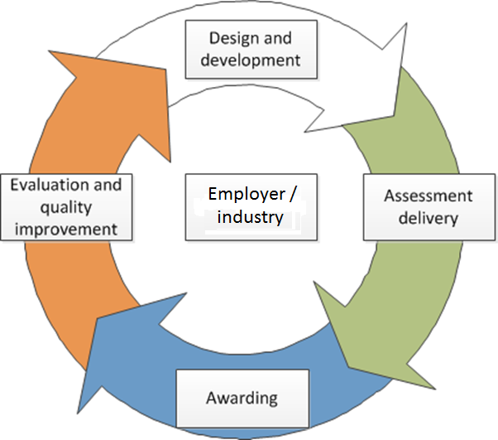
What makes a qualification sufficiently valid?
Should assess effectively the skills and knowledge taught in the qualification
Should enable results to be trusted as a measure of what a person can do
Purpose and content should meet the needs of end users, e.g. employers
Should be kept under regular review
Whole lifecycle is important: from design of qualification to evaluation of assessment

Slide 6
Withdrawal of the QCF
Intention of the QCF was to give learners maximum flexibility by requiring:
unit-based qualifications described by level and size and awarded using credits
mechanisms to allow accumulation and transfer of credit to build up qualifications
The reality was:
Not enough focus on quality, too much on meeting design rules that were inflexible
Unitisation did not work for all types of qualifications
No real evidence of supporting social or labour mobility

Slide 7
Withdrawal of the QCF
September 30 2015 – formally withdrew the rules governing the QCF
No new design rules and no forced changes to qualifications
Not asking awarding organisations to change all of their existing qualifications
QCF in qualification titles being phased out between now and end of 2017
Awarding organisations still have to comply with all our Conditions

Slide 8
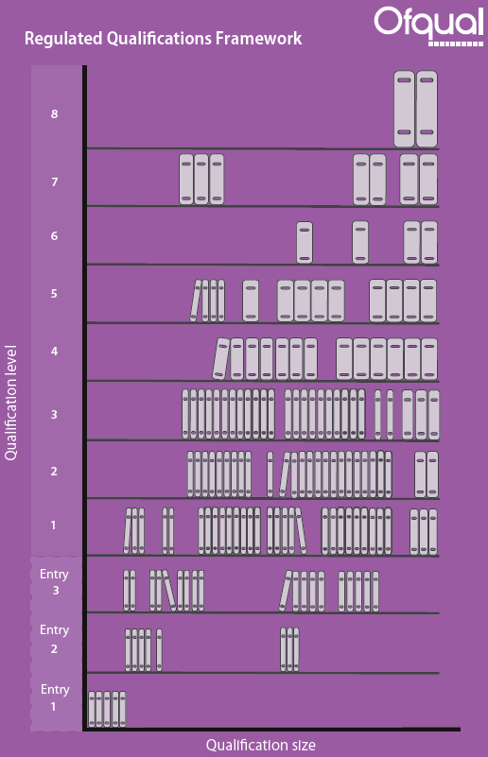
Introducing the RQF
October 1 2015 – launched the Regulated Qualifications Framework
Framework to help understand qualifications in a consistent way
Downloadable ‘postcard’ available at:
www.gov.uk/government/publications/regulated-qualifications-framework-a-postcard

Slide 9
Introducing the RQF
Levels - Entry level 1 to Level 8
Same levels of demand, same numbers, but using updated level descriptors
Still align with European Qualifications Framework and the Framework for Higher Education Qualifications
Size – Total Qualification Time
More accurate approach to describing size, still includes Guided Learning Hours
An indication of how long a typical learner might take to study a qualification, including the time spent on individual study
Qualifications can still be broken down into units and assigned credits
If the awarding organisation judges that it is the most valid way of meeting a qualification’s purpose

Slide 10
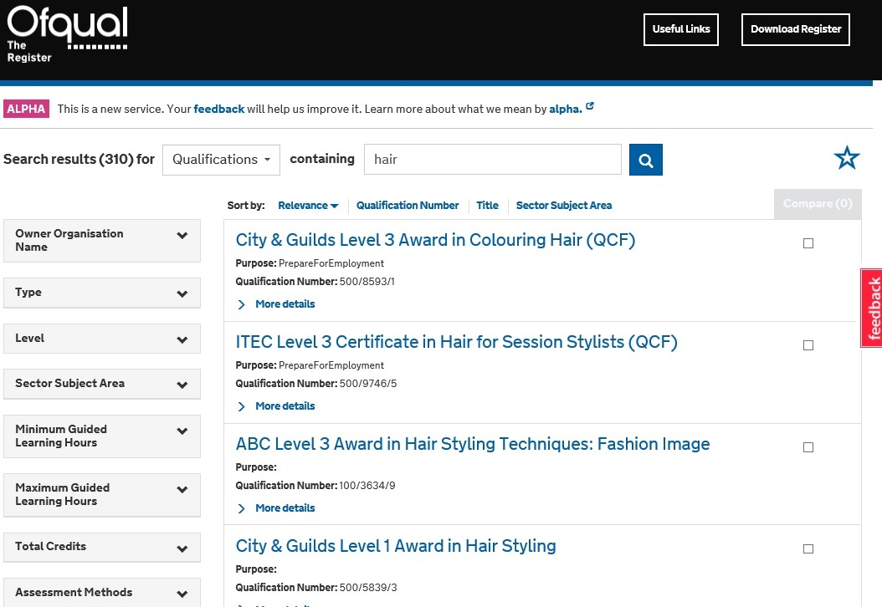
The Register
http://alpharegister.ofqual.gov.uk
alpharegister.ofqual.gov.uk
CURRENT VERSION

Slide 11
Confidence in vocational qualifications
What might promote confidence in VQs?
Qualifications are grounded in and built round the needs of end users, e.g. employers
Employers and others understand qualifications and can see they do what they are meant to
Students and their teachers have ready access to information about qualifications and the progression opportunities they offer
Where there are problems with qualifications, action is taken

Slide 12
Confidence in vocational qualifications
Ofqual is doing its bit:
Engaging in public debate about VQs to build understanding
Discussing with employers and Government the need for credible skills standards
Developing the Register to improve access to information about qualifications
Requiring awarding organisations to keep their qualifications under review
Following up intelligence about problems and preparing to take regulatory action where it is justified
Are there other things we should be doing?

Slide 13
Functional Skills Reform
There are some skills that are fundamental: to be successful in life and at work, people must be able to read and write and to use numbers with confidence.

Slide 14
Ofqual looked at these qualifications in 2014 and found that, whilst they were not broken, there was room to improve the offer
ETF published ‘Making maths and English work for all’ which came to a similar conclusion
The government wants to ensure everyone has an appropriate opportunity to improve their maths and English skills and achieve a credible qualification that employers recognise
The purpose of the programme is to make sure that the regulation of maths and English Functions Skills qualifications allows the development and award of valid qualifications, and reflects any policy changes to the qualifications

Slide 15
We are looking at reform of Functional Skills Qualifications as a whole; including qualifications and the regulation framework.
In particular, we are looking at standard setting and assessment issues.
We will consult on any changes that we propose to make.

Slide 16
Next steps
Awarding organisations should focus on the validity of their qualifications – design and ongoing delivery
We will aim to provide stable, transparent, evidence-based regulation
We will develop the information we provide to users about the qualifications we regulate
We will continue to advise Government on where qualifications fit into VQ and apprenticeship reform, and take forward functional skills reform

