Slide 1
Inter-Subject Comparability: What should we do about it?
Robert Coe
Ofqual Inter-Subject Comparability Conference
4 Feb 2016

Slide 2
What do we know about ISC?
Is it a problem?
Can we solve it?

Slide 3
What do we know?
We have been arguing about this (in an informed, academic way) for at least 50 years; disagreement remains
Too hard to solve?
Grades in different subjects are treated interchangeably
Not acceptable to say ISC is meaningless
On common-sense meanings of ‘easy’/ ‘hard’, subjects are not comparable
Not likely to go away

Slide 4
Comparability (Coe, Newton & Elliott, 2012)
Any rational claim about the comparability of grades in different qualifications amounts to a claim that those grades can be treated as interchangeable for some purpose or interpretation.
We should talk about the comparability of grades or scores (rather than of qualifications), since these are the outcomes of an assessment that are interpreted and used.

Slide 5
Subject interchangeability requirements are not mutually compatible
Selection
Subjects are interchangeable in terms of what their grades indicate about a candidate’s suitability for X, Y, Z …
School evaluation
Subjects are interchangeable in terms of what their grades indicate about the impact of the school/teacher

Slide 6
Is it a problem?
Students avoid sciences and languages because they will get lower grades
Or choose them for higher status
Or choice interacts with social advantage
Schools withdraw or discourage hard subjects to optimise league table position
Universities offer places to the wrong students

Slide 7
Can we solve it?
Aegrescit medendo
(Virgil)
(The cure is worse than the disease)

Slide 8
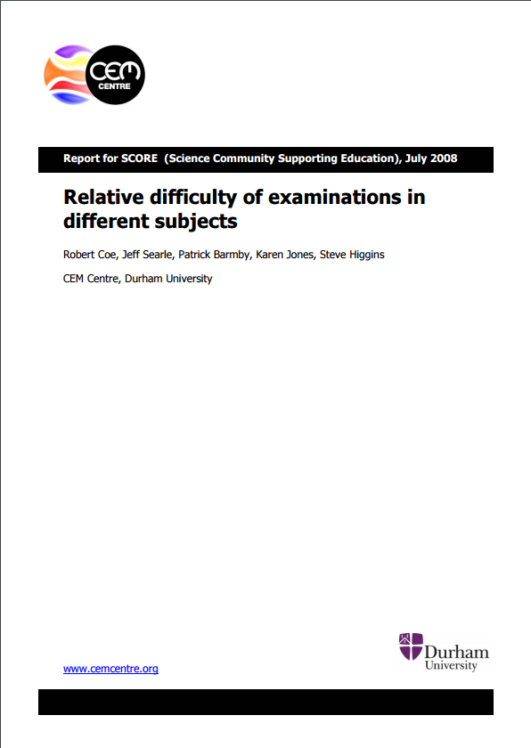
Policy options (Coe et al, 2008)
Do nothing
Align at grading
Adjust tariffs
Notes:
Coe, R., Searle, J., Barmby, P., Jones, K. and Higgins, S. (2008) Relative difficulty of examinations in different subjects. Report for SCORE (Science Community Supporting Education), July, 2008. Curriculum, Evaluation and Management Centre, Durham University. Available at http://www.cem.org/attachments/SCORE2008report.pdf Summary at http://www.cem.org/attachments/SCORE2008summary.pdf

Slide 9
1. Do nothing
pro
con
Comparability across different subjects is meaningless
Statistical methods have too many problems
Comparability over time is more important
Unfair if grades used for selection to HE or employment
Unfair if grades used in league tables

Slide 10
2. Align at grading
pro
con
Simple and apparently fair
Grade profiles for some subjects would be skewed (half GCSE Latin candidates would get A)
Which definition of ‘comparability’ would we use?
Purely statistical methods lead to some anomalies
Would destroy comparability over time
Gradual ‘dumbing down’ if hardest made easier
Would delay awarding process

Slide 11
3. Adjust tariffs
pro
con
Can have different conversions for different purposes
Allows for judgement in grading process
‘Scaling’ used in Australia and elsewhere
Methods are complex, may not be understood or accepted

Slide 12
What would I do? (if evidence supports action)
Prioritise UMS
Promote a more finely differentiated outcome to mitigate mismatch and attenuation
Bring outliers in
Gradually, incrementally & unobtrusively cap the scale of differences in subject difficulty
Encourage tariffs
Get users (UCAS, universities) to develop and apply fair tariffs
Fair value-added
Emphasis progress in league tables and calculate value-added within qualifications before aggregation

