Slide 1
External Quality Assurance (EQA) and apprenticeships:
what you need to know
Steve Walker – Senior Manager,
Standards for Design and Development of Vocational & Technical Qualifications
February 2017
Notes:
Will not just be me talking.
There will be an opportunity for some discussion
We would like to know what you think,
- what you think we need to know - about what I’m saying here, and about apprenticeships more generally.

Slide 2
EQA landscape
Ofqual’s approach to EQA
Regulation and end-point assessment (EPAs)
Working with other EQA providers

Slide 3
1. The External Quality Assurance (EQA) landscape

Slide 4
Some current figures
3 million starts by 2020
NAO estimates potential 1,600 standards (Sept 2016 report)
162 Apprenticeship standards ‘ready for delivery’ (end Feb)
funding cap established
approved assessment plan
The Register of Apprenticeship Assessment Organisations (RoAAO) (end Feb)
47 Apprenticeship Assessment Organisations (AAOs) listed on it
88 standards have at least one AAO listed against them on the Register
Notes:
Ready for Delivery – and what that means
As far as standards moving from development to delivery – The RoAAO has
That’s 88 standards from 162 ‘ready for delivery’

Slide 5
Apprenticeship Standards and External Quality Assurance (EQA)
New Trailblazer group approved
Apprenticeship standard set by trailblazer
Trailblazer assessment plan developed
Assessment plan approved by Government
Apprentice Assessment Organisation designs End Point Assessment
Apprenticeship standard approved by Government
Apprenticeship ready for delivery
EQA
Notes:
This is a brief reminder of the Apprenticeship standard development process
CLICK
External Quality Assurance wraps around the EPA element of the process and those organisations involved in the delivery of EPAs.

Slide 6
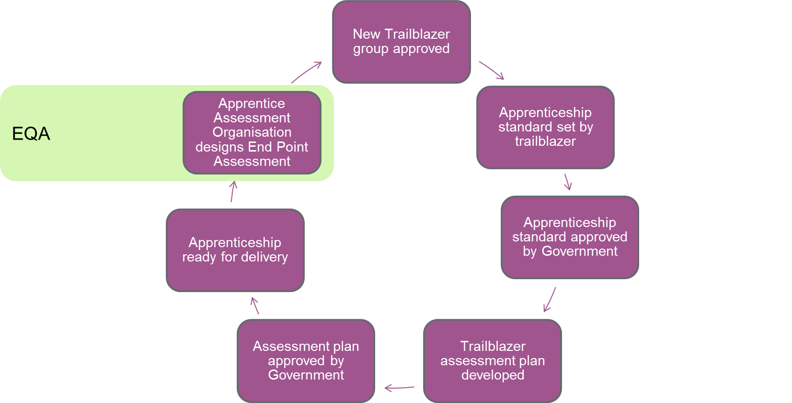
What is EQA?
With the potential for multiple organisations to develop EPAs against one assessment plan there is a need to secure sufficient comparability between assessments
between different assessment organisations
for the same EPA over time.
Where Ofqual is asked to externally quality assure an EPA by a Trailblazer and we agree to do so, we will do this by applying our regulatory framework.
we will regulate the EPA as a qualification.

Slide 7
Four options for External Quality Assurance
Employer: ‘You could propose your own approach but, in line with our quality assurance principles’
You could ask Professional Bodies to carry out this role’
You could ask Ofqual to oversee your external quality assurance by regulating your End Point Assessment (EPA)’
Institute for Apprenticeships
Notes:
QAA – are the regulator of degrees and therefore integrated degree apprenticeships
Ofqual can where we are asked to do so regulate higher and degree level apprenticeships – where the degree is not part of the EPA or the EPA is not part of the degree….

Slide 8
The EQA Landscape
Of the 162 standards published and ready for delivery…
97 have an External Quality Assurance route defined
32 employer-defined
28 Institute for Apprenticeships
20 professional body
11 Ofqual
6 other
65 have no EQA route defined
Notes:
Given all the EQA choices and developing policy therefore, this is the current situation according to our analysis
We know this is partly the result of developing policy over the last year or so, and SFA are working hard to close the gaps where earlier assessment plans were published under different rules. We are also working with Trailblazers to that end.
Nevertheless this is the position derived from published assessment plans.

Slide 9
The Developing Landscape - EQA providers
Dairy Industry Skills Partnership Board
Food and Drink Industry Skills Partnership Apprenticeship Board
People 1st (non-profit)
Skills for Care
Tech partnership (non-profit)
National Education Network for Ambulance Service (NENAS)
Trailblazer
an 'Employer panel'
Chartered Institute of Logistics and Transport (CILT)
Royal Institution of Chartered Surveyors (RICS)
Solicitors Regulation Authority (SRA)
The Academy for Healthcare Science (AHCS)
The Institute and Faculty of Actuaries (IFoA)
The Institute of Meat (IoM)
The Institution of Mechanical Engineers (I.Mech.Eng)
Institute of Groundsmanship (IOG)
The Association for Project Management (APM)
Chartered Institute of Legal Executives (CILEx)
Engineering Council
The General Dental Council (GDC)
Energy Managers Association
The International Council on Systems Engineering (INCOSE)
Notes:
Produced a considerable variety of organisations and approaches to EQA stated on assessment plans.
From the more vague – to the more recognised sector skills bodies, professional bodies and regulators.

Slide 10
Where do awarding organisations fit in
23 of the 47 AAOs are Ofqual recognised Awarding Organisations
These 23 are delivering EPAs for 81% of the standards on the register
Only 17 standards on the RoAAO do not have an AO against them
The awarding organisation community is significant
Notes:
Remember ‘ready for Delivery means they have a funding cap and a published assessment plan
Green and purple slices account for the 88 standards which currently have any organisation against them (on the register)
The AO community is significant,
- has a significant presence in reformed apprenticeship assessment
- has a significant voice in reformed apprenticeship landscape.

Slide 11
2. Ofqual’s approach to EQA

Slide 12
Ofqual’s approach to regulation
Our Conditions take the whole lifecycle of a qualification into account with the aim of ensuring that EPAs are, and remain, sufficiently valid.
Validity is the degree to which it is possible to measure what needs to be measured by implementing an assessment procedure.
should assess effectively the skills and knowledge taught in the qualification
should enable results to be trusted as a measure of what a person can do
purpose and content should meet the needs of end users e.g. employers
be graded in line with clear and defensible prescriptions
should be kept under regular review
Design and development
Awarding
Evaluation
Quality improvement
EPA delivery
The
Qualification
Lifecycle
Notes:
Brief reminder about our regulation
Where Ofqual is asked to externally quality assure an EPA by a Trailblazer and we agree to do so, we will do this by applying the regulatory framework we use for qualifications.
- we will regulate the EPA as a qualification.
I often use this slide when talking to Trailblazers – to show the intention of our regulatory approach
- it’s very obvious to them how our goals in relation to qualification validity and the qualification lifecycle are applicable to EPAs
We want the same thing
- to assess effectively
- for results to be trusted
- to meet the needs of end users
- have grading that is clear and defensible
- be kept under regular review

Slide 13
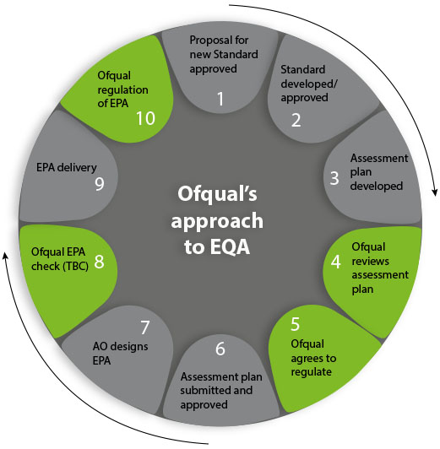
Regulation and EQA
Notes:
How does our regulation dovetail with the apprenticeship standard development process?
- This is a ten step process to represent our approach to EQA within the apprenticeship development process
The green elements indicate where our regulatory framework is brought to bear.
CLICK
One of the most significant parts in our process is the review of an assessment plan by our Technical Advisory Group

Slide 14
Our assessment plan Technical Advisory Group (TAG)
Convened to consider the assessment detailed in the assessment plan
We make no comment on the content
The group has no sight of EPAs at this point
Central question: “Is there anything in the assessment plan that would cause an awarding organisation to develop an EPA that wasn’t sufficiently valid”
This is early intervention – to minimise the risk of problems further down the line
Notes:
We are assuring ourselves as far upstream as possible that we’ve done everything we can to minimise potential issues downstream
We don’t want awarding organisations to be caught in a difficult position when developing an EPA that might require something of them which was contrary to our conditions.

Slide 15
What have we looked at so far?
Customer service (L2)
Arborist (L2)
Land based engineering technician (L3)
Mineral processing (L2)
Chartered manager (L6)
Operations Departmental Manager (L5)
Children Young People and Families Manager (L5)
Probate Technician (L4)
Creative Venue Technician (L3)
Highways Electrical service operative (L3)
Healthcare assistant practitioner (L5)
Notes:
We considered in our technical advisory group over 50 assessment plans so far - for different reasons,
- most because we have been asked to provide the EQA for the standard
- others we’ve scrutinised to get a feel for the assessment within standards where we were not being asked to EQA
This is a sample of the areas and levels we’ve looked at so far – and just a fraction of some of the employers who are involved in developing the standards and assessment plans
- good to bear in mind both the end users of these assessments, and people involved in designing and contributing to the standards and assessment plans.

Slide 16
Breadth of assessment
Online knowledge test
Scenario based practical tasks
Presentation and professional interview
Knowledge test (multiple choice)
Practical test
Professional interview
Showcase
Practical observation
Professional discussion
Portfolio
Competence Interview
Scenario based written test
Portfolio
Showcase and professional discussion
Multiple choice and Short answer test
Reflective journal
Observed practical
Portfolio
Project
Presentation and Interview
Showcase
Practical observation
Professional discussion
Portfolio
Project
Presentation and Interview
Multiple choice test
Practical test
Structured interview
Holistic project
Online test
Practical assessment
Portfolio and professional discussion
Scenario based Multiple choice test
Portfolio
Presentation of project
Structured competency based interview
Online knowledge test
Scenario based practical tasks
Presentation and professional interview
Knowledge test (multiple choice)
Practical test
Professional interview
Presentation and portfolio
Scenario-based Professional discussion
Timed practical assessment
Notes:
In considering those assessment plans we’ve come across a plethora of different assessment combinations used within plans
- it’s been very interesting to see how different trailblazers have used the different forms of assessment available to them.
You might spot some obvious one appearing in different combinations – and it’s very appropriate that they are
Word cloud makes this even more obvious

Slide 17
Breadth of assessment
Notes:
This is just from the 15 or so combinations from the previous slide – it’s probably representative of what we’ve seen across all the plans we’ve looked at.

Slide 18
Issues we’ve identified
Lack of criteria for differentiation
Nothing to differentiate between pass and higher grades
Either in terms of level descriptors, or
where marks are implied or a percentage boundary applied, no division of marks is stipulated
Criteria supplied for one form of assessment and not for others
Practical exercise for example may have a description of expectations for a ‘pass’, but none are supplied for the professional discussion element
Efficacy of criteria
Weak lexicon in differentiation criteria
Criteria which are very subjective
‘personal accountability’, ‘professionalism’, ‘team working’, ‘customer interactions’ – sometimes stipulated without provision for the evidence of those things in the assessment
Notes:
It is very clear that Trailblazers are putting a lot of time into deciding what they want to assess,
- and are very clear on the knowledge skills and behaviours they want to see demonstrated from their apprentices.
We have seen some re-occurring themes however in the way some of those things are being assessed, as we’ve looked at the way different forms of assessment have been used and in the way some of the assessment are combined to produce an overall result for an apprentice.

Slide 19
Grading calculations and aggregation
Grades differentiated on very small parts of assessment
Confusing grade calculations, between different methods of assessment
Weighting and compensation confusing the grade intent
Security, predictability and manageability
On-line assessments, and knowledge tests required, with little information on mitigating predictability
Manageability issues - Large amounts of multiple choice assessment requiring significant development from assessment organisations
Notes:
Grades differentiated on very small parts of assessment
Very narrow grade boundaries – amounting to a handful of marks, and a couple of extended answer questions being difference between a pass and a higher grade
Confusing grade calculations, between different methods of assessment
Grading competencies across assessment, and grading the different assessments marked – matrix of results
Weighting and compensation confusing the grade intent
The extent of possible compensation either in one assessment element of the EPA or within the whole apprenticeship leading to the possibility of the achievement or otherwise of essential competencies not being reflected in the final grade.
On-line assessments, and knowledge tests required, with little information on mitigating predictability
requirements for item banks, numbers of questions, guidance on the regularity of change, or options to re-sit
Issue of capping grade on resits – there is a concern around the fairness to candidates of this approach, the AP needs to ensure that the requirement within the AP is completely transparent both for Assessment organisations developing the assessment and apprentices taking the assessments

Slide 20
Assessment issues
Marking reliability
Classification reliability
Aggregation
Assurance of competence vs compensatory models
Ensuring comparability vs mitigating predictability
Sufficient levels of detail to facilitate intended and consistent interpretation.
Manageability
Types of assessment
Showcase
Professional discussion/ Interview
knowledge test (often multiple choice)
Practical test
Project
Portfolio
Notes:
Classification reliability = differentiation criteria
Aggregation = component weightings complicated or unworkable
Ensuring comparability vs mitigating predictability = sufficient numbers of questions/scenarios to mitigate predictability, but the greater the size of the ‘bank’ the potentially less comparable are the items within that bank…
Subjectivity in assessment
Applying grade boundaries
Manageability – both extremes, (30% sampling of all assessments), or (no indication of size of assessments and an AO has no idea what resource implications will be for development)

Slide 21
In the opinion of Ofqual’s Technical Advisory Group…
The assessment issues do not generally appear to be unique to apprenticeships, however the number of standards, and the role and expertise of parties involved may exacerbate their likelihood and impact.
The assessment methods employed are familiar and guidance for trailblazers could mitigate some of the risks and issues associated with them: e.g.
what different assessment methods are particularly suited to assessing and the limitations, and challenges of each
a common lexicon in relation to assessment methods
principles (and perhaps examples) to address specific assessment issues.
the minimum amount/type of information necessary to support the effective review of assessment plans and the effective development of EPAs.

Slide 22
Table discussion: 10 minutes
Do you agree?
In your opinion how do you think we should/could go about mitigating the risks and issues highlighted?

Slide 23
3. End-point assessments and our regulatory framework

Slide 24
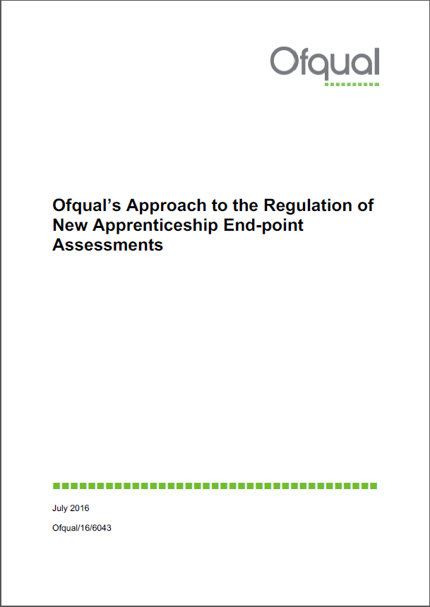
Conditions and Guidance
The General Conditions of Recognition
July 2016 guidance is being revised
Notes:
Our conditions of recognition – are the backbone of our framework
We outlined our approach in July to end-point assessments
- that guidance is being revised in-line with our published response to the IFA operational plan and will be published again very shortly
It outlines the approach I’ve already described how our regulatory purview applies to EPAs within an awarding organisation’s scope of recognition.
The following few slides outline some practical guidance and information about the portal, and some early thinking on approaches we would like to share with you.

Slide 25
Recognition
Notes:
Recognition is an important part of our regulatory framework
- if we agree to be the EQA provider for a standard – then the SFA will only allow Ofqual recognised awarding organisations on to the RoAAO against that standard
We are actively looking together with the SFA into how we might better align the RoAAO with our recognition process - in our view we are looking for many of the same things, and there may be opportunities for synergy in that process which ‘eases’ the pain for AOs looking to get onto the RoAAO, and for new organisations who might conceivable be looking to put themselves through both processes.

Slide 26
EPAs and the portal
Will EPAs be put through the Portal? If yes, how will EPA/EPA components have to appear on the register? Would the entire EPA appear as single unit qualifications or would each assessment component appear separately as units within a qualification? Will there be the facility to set-up pathways in the portal for an EPA?
EPAs must be entered on the register through the portal. EPAs placed on the portal should be a single entry with the constituent methods of assessment indicated. Where optional pathways to complete the EPA exist these can be indicated under 'optional routes to complete qualification'
Notes:
The following few slides outline some practical guidance and information about the portal, and some early thinking on approaches we would like to share with you.
Questions from our symposium in November 2016 from AOs querying how EPAs would work in relation to the portal and register.
- Apologies that it’s taken a little while to bottom out answers to some of those questions, but now having consulted with our colleagues at SFA we can answer some of these.
Some of the more practical ones I will go through now, the full list will be available on the portal.
Will EPAs be put on the register through the portal?
- Yes we have to maintain a register for the things we regulate – therefore if you are delivering an EPA which is within your scope of recognition then you will need to enter it on the register.
- the Register and portal are currently undergoing some architectural changes which we expect to be complete in April.
- one of those changes (following users feedback) will be the amalgamation of two lists ‘legacy description’ and ‘qualification type’ into one list from which you can select when entering something onto the register. End-point assessment will be entered as a new option to that amalgamated list.
we understand that some of you may want to put EPAs on immediately - but we would ask you to hold off until the work is complete and the register allows you to enter EPA as a distinct entry…
- we’ll be communicating that out as soon as the work is complete via the portal

Slide 27
Will operational start date relate to the first offer of the EPA or start date of apprenticeship?
Given the differing states of readiness of apprenticeships, EPAs we would suggest the operational start should mirror the regulation start date and reflect the date the EPA was placed on the register.
What are the requirements for titling an EPA? Will titling include any indications of size and level?
The title of an EPA needs to be in line with our Conditions and could follow a similar format to the example below.
(AO) Level (x) end-point assessment for (name of apprenticeship standard)
Notes:
Titling
- condition E2 details our requirements for qualification titling, and the title of the EPA should be inline with those conditions
- as an example of what we consider to be reasonable…
City and Guilds L2 end-point assessment for Arborist
IMI level 3 end-point assessment for land-based engineering technician

Slide 28
Will the TQT criteria (Condition E7) be applied to EPAs? If yes, how should this be applied?
Awarding organisations should apply TQT criteria (Condition E7) to EPAs being mindful both of our guidance for the general conditions of recognition and, any stipulations in the relevant assessment plan. We are considering expanding our current guidance on the application of TQT.
What are the requirements for certification of EPAs? What information/data do awarding organisations need to capture around certification.
Condition H6 requires awarding organisations to issue results. There are no additional requirements on awarding organisations to capture information beyond what is currently required in the General Conditions.
Notes:
TQT
- suggest that assessment plan is the guidance required – make a reasonable judgement on the TQT based on the AP requirements
- It may be most appropriate to think of the length of the Apprenticeship itself - it is a job with training, but
- there might be requirements in the AP which limit the application of the EPA to a certain portion of the Apprenticeship programme
- eg – where an element of the EPA is a project compiled in the last 6 months - combined with other forms of assessment – it might be more appropriate to think of the TQT as starting from that date
- as opposed to where a portfolio compiled of the duration of the apprenticeship is part of the EPA
- there will be different requirements in the AP which can inform your decision on how to apply
- we are looking at some exemplification of those for our future guidance.
Certification
- Overall certification is the responsibility of the SFA, although we understand the SFA/ are developing an EPA handbook which may make clear some further requirements around the retaining of information .

Slide 29
Table discussion: 10 minutes
How can we further clarify for you as awarding organisations our requirements for EPAs?
Guidance?
Conditions?
Exemplification?
Notes:
Would any of the following be helpful in general terms??
Are there any specifics you would like us to address??

Slide 30
4. External Quality assurance partnerships
Notes:
Want to introduce to you our early thinking about partnering with other UQA providers.
- we are currently testing the appetite for these approaches with organisations at the moment
I’d be more than happy to take any comments or suggestions you might around this into our mailbox apprenticeships@Ofqual.gov.uk

Slide 31
The Developing Landscape - EQA providers
Dairy Industry Skills Partnership Board
Food and Drink Industry Skills Partnership Apprenticeship Board
People 1st (non-profit)
Skills for Care
Tech partnership (non-profit)
National Education Network for Ambulance Service (NENAS)
Trailblazer
an 'Employer panel'
Chartered Institute of Logistics and Transport (CILT)
Royal Institution of Chartered Surveyors (RICS)
Solicitors Regulation Authority (SRA)
The Academy for Healthcare Science (AHCS)
The Institute and Faculty of Actuaries (IFoA)
The Institute of Meat (IoM)
The Institution of Mechanical Engineers (I.Mech.Eng)
Institute of Groundsmanship (IOG)
The Association for Project Management (APM)
Chartered Institute of Legal Executives (CILEx)
Engineering Council
The General Dental Council (GDC)
Energy Managers Association
The International Council on Systems Engineering (INCOSE)
Notes:
Produced a considerable variety of organisations and approaches to EQA stated on assessment plans.
From the more vague – to the more recognised sector skills bodies, professional bodies and regulators.

Slide 32
EQA ‘levers’ available
Ofqual
Powers to…
Impose rules
Set gateway criteria
Audit
Investigate
Impose punitive
sanctions
Compel action
etc.
IfA/SFA
Removal from
register
Report to SofS
Other
Raise concerns
Refer to IfA
Notes:
There are some differences between the EQA options currently available – one of those is the ‘levers’ available
Depending on the EQA options chosen by a Trailblazer - there are different levers available to ensure quality.

Slide 33
A partnering approach to EQA
Ofqual
Assessment expertise
Regulatory tools
Reputation
Tried & tested framework
EQA provider
Sector/ content expertise
Relationships
Intelligence
Significant benefits:
reputational
operational
system coherence
Not a new concept
Use of ‘subject specialists’
Aligned with statutory objectives
Standards
public confidence
Rigorous
Informed
Enforceable
Notes:
We are thinking through our approach to partnerships with other EQA providers.
Benefits to the reputation of the organisations concerned and Apprenticeships in general
How would this work in practice???

Slide 34
EQA partnering in practice
Assessment scrutiny
Intelligence
Assessment plan review
.
EPA check
Notes:
Looking for synergy in part of the process which we believe will benefit from partnerships available
Talk through the wheel – there are elements of a cycle approach here – review and change may mean that this have to be reviewed again….
There are a couple of different approach we’re thinking through.

Slide 35
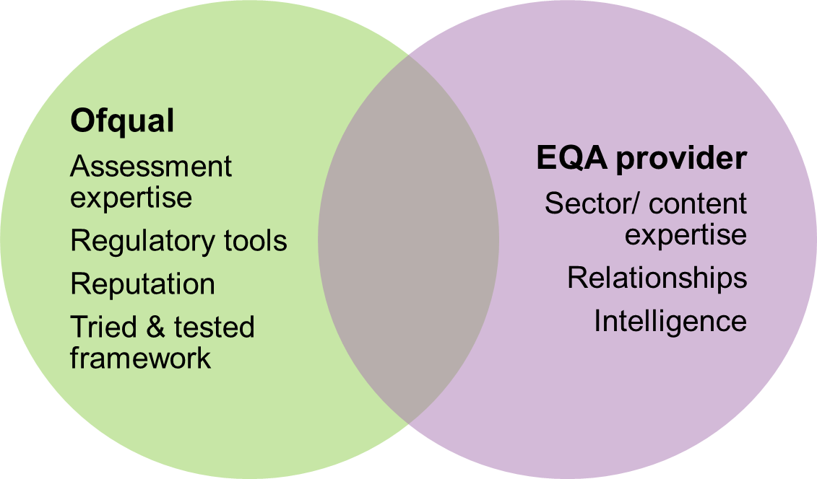
Approach 1
An EQA organisation could remain the EQA lead
Ofqual would then partner with that organisation in aspects of an external quality assurance process. Specifically, Ofqual would;
require sight of the assessment plan prior to its final submission to the IFA
partner with the EQA provider in the sampling of EPAs
once EPAs are in delivery, partner with the EQA provider in assessment scrutiny
expect any relevant intelligence from the sector to be passed through to our standards team
Implications
the partner organisation would be named as the EQA provider on the assessment plan,
we would require that the EQA provider stipulate that any AAO who delivered EPAs against these standards would need to be Ofqual recognised.
Notes:
- require sight of the assessment plan prior to its final submission to the IFA
seeking to combine the opinions of the EQA organisation, with our assessment scrutiny of the plan: with the goal of indicating that the assessment in the plan is capable of producing sufficiently valid assessment
- partner with the EQA provider in the sampling of EPAs
before they were to be made available to apprentices, to scrutinise the appropriateness of the assessment.
- once EPAs are???ng maintenance of standards
- expect any relevant intelligence from the sector to be passed through to our standards team
?to inform our risk model and future regulatory activities.

Slide 36
Approach 2
An EQA organisation could request that Ofqual take the lead
Our regulatory approach to EPAs would then apply in its entirety
Where an apprenticeship standard and assessment plan have been approved and Ofqual has no identified EQA role, yet Ofqual recognised awarding organisations have been approved to deliver EPAs against that standard
we will consider these assessments as high risk in our regulatory approach and will be looking to collaborate with the relevant Trailblazer and awarding organisation(s)
Notes:
Approach 2
- our regulatory approach stands as I’ve laid out before
Where everything has been approved and AOs are delivering EPAs we will consider this as high risk in our regulatory approach
- we will have had no involvement in the process to that point
- Indeed as a risk based regulator – we must consider them high risk in our regulatory approach – and we would be looking to collaborate with the TB and the AOs in such cases
- in order to maintain sufficient validity in assessment and to safeguard assessment standards.

Slide 37
Thank you
Please send comments or feedback to
apprenticeships@ofqual.gov.uk

