Slide 1
An Alternative to University

Slide 2
What is an apprenticeship?
An apprenticeship is a real job with training so you can earn while you learn
Apprenticeships are specifically tailored to ensure you develop the skills employers want, giving you a real advantage in the workplace.
Notes:
Click the mouse to reveal the definitions

Slide 3
What is the Civil Service?
Non-political body that helps the Government of the day to develop and deliver its policies as effectively as possible
There are roughly 400,000 UK civil servants across the country and the globe
24 Ministerial Departments that deal with everything from the NHS to national security
Notes:
1. The Civil Service helps the Government of the day to develop and deliver its policies as effectively as possible.
2. It incorporates three types of organisations – departments, agencies, and non-departmental government bodies (NDPBs) that work in a wide range of areas, touching on everyone’s day-to-day lives, such as education, health and policing.
3. Because our organisations deal with so many different aspects of government, civil servants work in an enormous variety of roles)
There are a range of more unusual jobs…. Did you know the Civil Service employs:
Child protection officers
Software developers
Space sensor engineers
Crime Scene Investigation Trainer
Vets
Immigration Officers

Slide 4
Who are Civil Servants?
The Civil Service is evolving to become more diverse and more
representative of the society that we serve.
Notes:
You may wish to talk about the traditional homogeneous image of the Civil Service and the way in which it is increasing in diversity.
You could go into detail about the underrepresented communities from whom we are trying to recruit: BAME, LGBTQ+, Lower SES and disabled candidates

Slide 5
Professions in Civil Service
There are currently 25 recognised professions in the Civil Service, including:
Policy
Economics
Finance
Operational Delivery
Law
Communications
IT
Project Delivery
Commercial
HR
Science and Engineering
Medical
Occupational Psychology
Intelligence
Social Research
Notes:
Civil service provides a breath and depth of career opportunity.
There are 25 professions in the Civil Service.
There are a huge range of learning & development opportunities within departments.
You could build a career within same profession in different departments
Or different roles in same department.

Slide 6
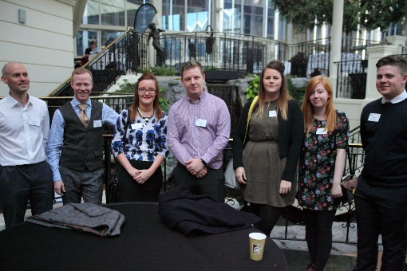
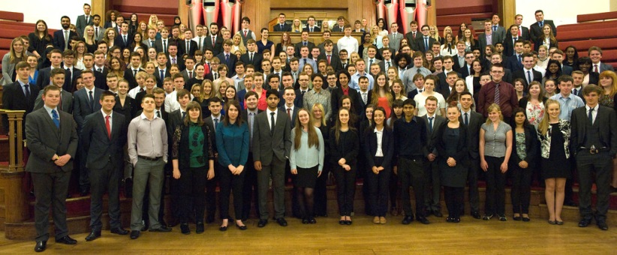
Introducing the Civil Service Fast Track Apprenticeship Scheme?
Alternative to university and a great way into the Civil Service
Civil Service Fast Track offers you six choices of apprenticeship
Business
Finance
Project Delivery
Commercial
Digital and Technology

Slide 7
Benefits
You will be working towards a Level 4 Apprenticeship
Starting salary of around £19,500
Flexible working patterns
20 days minimum holiday plus public holidays
High-profile work
Working for the public
Structured career development
Can apply for the Fast Stream without a degree upon completion of the scheme
Notes:
Salary – above apprenticeship minimum, same as a non-apprentice would receive in your role

Slide 8
My experience on the Civil Service Fast Track Apprenticeship Scheme
Notes:
Talk about your role in your department, what you do and any achievements to date, your broader experience of the Scheme so far, etc

Slide 9
Application Process
Fill in an online application form
Complete online assessments
If successful at the online stage you will be invited to an assessment centre. Here you may be asked to:
Complete a written exercise
Participate in a group exercise
Attend a 1-to-1 interview
Notes:
The scheme should open for new applications in March 2016.
Talk about the application process and how they will be assessed both online and at the assessment centre.

Slide 10
Next steps
We expect to be open for applications from March.
But why wait?
You can register your interest now by emailing:
Fasttrack.events@hmrc.gsi.gov.uk
Or search for “Civil Service Fast Track Apprenticeship Scheme” You can also find us on Facebook and Twitter
Notes:
Any questions?
Signpost attendees to CSFTA representatives and marketing collateral.
We expect people to be able to formally apply from the first of February 2016 but you can register your interest beforehand by following this link or searching for “Civil Service Fast Track Apprenticeship Scheme”.
You can find us on Facebook and Twitter using the details below.
Many thanks!

