Slide 1


Slide 2
Ofqual: Who we are, what we do
Office of Qualifications and Examinations Regulation (Ofqual)
we regulate a broad range of qualifications in England, including GCSEs, AS and A levels
our mission is to make sure that qualifications are valid and trusted
we have five statutory objectives. In brief, they are:
  1. to secure qualification standards;
  2. to promote National Assessment standards;
  3. to promote public confidence in regulated qualifications and National Assessment arrangements;
  4. to promote awareness of the range and benefits of regulated qualifications;
  5. to secure that regulated qualifications are provided efficiently.

Slide 3
Today’s Presentation
Qualifications Reform
Quality and Consistency of Marking
Awarding
National Reference Test
Our Priorities

Slide 4
Qualifications Reform
GCSEs and A levels in England are being reformed to match the best systems in the world and keep pace with universities’ and employers’ demands
Reformed GCSEs
will have more demanding content
have been designed for a two-year period of study
will be linear
degree of non-exam assessment will reflect balance and nature of new subject content
will have a new grading scale from 9 to 1
Reformed AS/A levels
content refreshed with input from universities
AS results no longer count to an A level
will be linear
degree of non-exam assessment will reflect balance and nature of new subject content
will keep the A* to E grading scale (A to E for AS level)

Slide 5
Qualifications Reform – Communicating the Reforms
affects schools and pupils, but also further education, higher education and employers
we are launching a national communications campaign
we need your help to reach all teachers, parents and students
resources available – any feedback would be welcomed
  Postcards
  Presentation
signing up to our newsletter ‘Exam matters’ is a good way of keeping up-to-date with our work

Slide 6
Quality and Consistency of Marking
teachers want good quality marking…so do we
exam boards have safeguards in place to make sure papers are marked well; they employ sophisticated checking systems
we are conducting research that will help us better evaluate reliability and take action if necessary
degree of marking consistency in England is in line with other countries (eg US & NZ)
sometimes there is no single correct mark for a response
the system relies on tens of thousands of teachers; it can never be perfect
it needs you to be prepared and able to mark; the system needs to find ways to encourage and help you to do that

Slide 7
Quality and Consistency of Marking
most enquiries are made for scripts that are just one or two marks below a boundary
if concerns were just about quality of marking, you would not expect a peak at the D/C boundary…
…accountability pressures are another reason
Data are for GCSE English and maths
Notes:
BB
Teachers often use levels of enquiries about results and the associated grade changes as an indictor of quality of marking. We believe this is problematic, although large grade changes are telling.
Why do we think EAR figures tell us little about quality of marking? One reason is that concern about quality of marking is only one reason that schools and colleges submit enquiries. School accountability measures are another reason. Schools tell us that they routinely submit enquiries for all students who are within a few marks of the D/C boundary at GCSE, regardless of the marking quality. We can see this for the 2015 EAR data in English and Maths. Other subjects show the same pattern.
Most enquiries are made for scripts that are just one or two marks beneath a boundary. Up until this year, markers involved in reviewing scripts changed marks even though the mark given was a reasonable interpretation of the mark scheme, and not given in error. So changes of one grade often resulted from small differences in the professional judgement of markers rather than errors. From now on, this will not happen although ALL errors, no matter how small must be corrected.
Changes of one grade following EAR are therefore difficult to interpret – a proportion will be caused by one legitimate mark being replaced by another. But changes of two grades seem unlikely to be caused by small differences of opinion they are likely to be caused by errors of some kind. So we have been particularly interested in the number and cause of large grade changes.

Slide 8
Marking Reviews and Appeals
review and appeals systems provide an important safeguard beyond exam boards’ marking processes
  8 million qualifications awarded in 2015
  572,000 reviews - 52% saw no mark change, 23% saw a mark change of ±1 mark
  ≈1.1% of grades changed overall; ≈0.0075% changed by 2 grades or more
evidence suggests that some reviewers were substituting one legitimate mark for another…that advantaged some students over others
from this summer, differences in professional opinion will stand; marking errors will be corrected – important they are found and corrected quickly
data for this summer will be published in December
some decisions still to take, need to evaluate changes

Slide 9
Awarding – Comparable Outcomes
the idea that if cohorts ‘look’ the same, then outcomes should ‘look’ the same has existed for decades
comparable outcomes is the principle we use to turn this notion into a source of evidence to inform awarding
it has proved effective at maintaining standards in GCSEs, AS and A levels over the period it has been in use
using predictions is more reliable than examiner judgement and also means we can align standards between exam boards…
…but exam boards also have the opportunity to put the case for an award being higher, or lower, than predicted
  33 out of tolerance awards in 2016 (21 up, 12 down)
comparable outcomes it is not a straitjacket on success

Slide 10
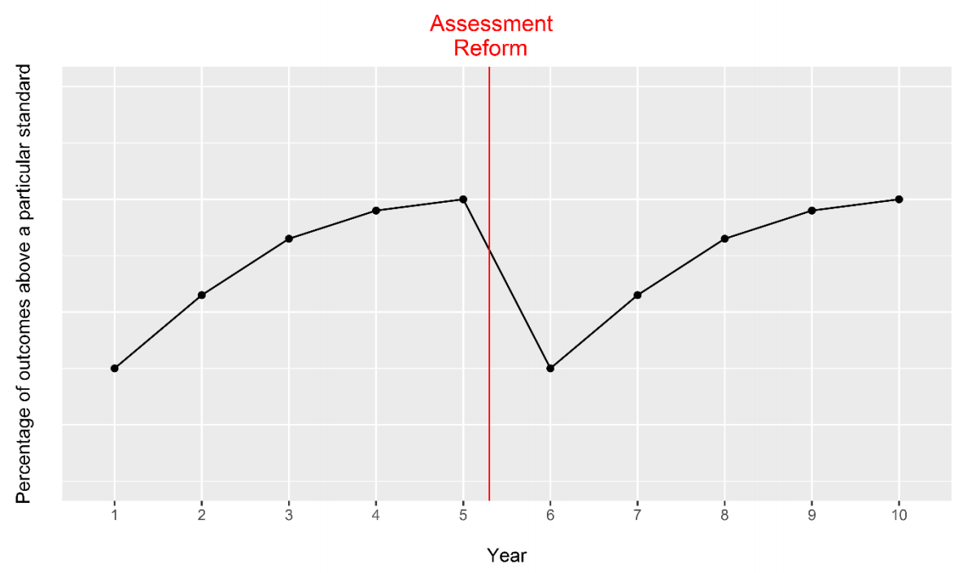
Awarding – Comparable Outcomes
sawtooth effects
performance would be expected to fall as new qualifications are introduced, but…
…using comparable outcomes means students will be insulated from sawtooth effects as qualifications change

Slide 11
Awarding – Variability in Results
year-on-year variability in results can stem from individual school factors
  differences in the ability mix of students
  different teaching approaches
  changes in teaching staff or teaching time
  choice of qualifications
every year a minority of schools see unexpected increases or decreases in results

Slide 12
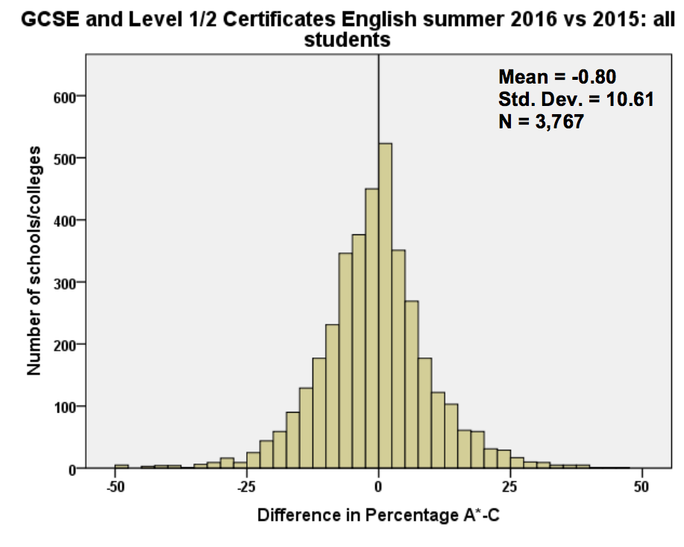
Awarding – Variability in Results
school level
bell curve common to all subjects, in all years
a small number of schools see a ±25% (or more) change in results year-on-year
consistent pattern across the country, over time
this is ‘normal’

Slide 13
National Reference Test
designed to help inform GCSE awarding
first Test to be held in spring 2017, following successful trial
two subjects, 300 schools, 18,000 students; each student only does one test
tests reflect the content and style of the new English language and maths GCSEs
there is no need for students or teachers to specifically prepare
results will be used to measure performance changes nationally and these will be published; no results for individual students or schools
extra information at awarding, not the only information
test results will not be used in awarding until at least 2019

Slide 14
Our Priorities
completing accreditation of new GCSEs, AS and A levels for first teaching in September 2017
building awareness and understanding of new GCSE 9 to 1 grading and all other aspects of reform
ensuring the safe delivery and awarding of new GCSEs, AS and A levels in summer 2017
delivering a clearer, fairer and more consistent system for marking reviews and appeals
taking forward work on the quality and consistency of marking
playing a full part in reform and regulation of vocational and other qualifications and learning, including functional skills, apprenticeships and
technical qualifications

