Slide 1
Visual Management in Procurement Dialogue Boot Camp Guidance Execution of Sourcing Strategy through Competitive Dialogue Phase

Slide 2
Content
Boot Camp Room Set Up
1.1 Background / Overview
1.2 Purpose, Objectives and Deliverables
1.3 Stakeholders/Users
1.4 Briefing Room:
a. Standard Template Layout
b. Standard Room Layout
1.5 Project Room:
a. Standard Template Layout
b. Standard Room Layout
1.6 Dialogue Room:
a. Standard Template Layout
b. Standard Room Layout
1.7 Supplier Room:
a. Standard Template Layout
b. Standard Room Layout
Standard Templates
2.1 Dialogue Schedule
2.2 Dialogue Status Map
2.3 Key Messages Notice Board
2.4 Supplier Relationship Barometer
2.5 Question Log
2.6 3C
2.7 Supplier De-selection Register
2.8 Supplier Interest Tracker
2.9 Customer Needs Statement
2.10 Topic of the Day

Slide 3
1. Competitive Dialogue Boot Camp Room Set up

Slide 4
1.1 Background/Overview
Visual Management
Visual Management is used in a Lean environment to make the status and performance of a work area immediately obvious, both to those working in the process, and to those managing the process. The test of good Visual Management is that a visitor to the work area should be able to pick up the progress and issues in the work area, without having to ask.
This is the Visual Management pack for the Competitive Dialogue Boot Camp to aid the team in successfully managing the whole period of dialogue. It is intended to give you specific guidance on how to set up the rooms and the Visual Management templates to be used.
Competitive Dialogue Boot Camp
A dialogue boot camp will be held during the execution of the sourcing strategy stage as outlined in the
Future State Value Stream Map (FSVSM). The dialogue boot camp sessions will be based around the draft
contract and schedules and any related technical work streams you have identified. The dialogue boot
camp is likely to be run over a number of weeks. Accommodation required will depend on the number of
suppliers and work streams but is likely to include a room for dialogue sessions, a back office room to
establish the project performance hub and a working room for each of the suppliers.
Related Documents
FSVSM
SOP 2.7 Establish boot camp logistics
SOP 6.5 Finalise boot camp logistics
SOP 6.6 Plan dialogue sessions
SOP 7.1 Run dialogue sessions

Slide 5
1.2 Purpose, Objectives and Deliverables
Purpose
The best outcome based solution established through fact based negotiations. Ensuring suppliers only have to engage once.
Objectives
Mutual understanding of final solution requirements, validation and affordability
Immediate evaluation and feedback to suppliers with the opportunity for self deselection
Deliverables
Draft Full Business Case
Draft Solution from Suppliers with Indicative Pricing (to enable closure of dialogue)
Draft Contract

Slide 6
1.3 Users
Procurement
Team (Evaluation)
Core Supplier Bid Team
(Decision Makers)
Legal (HR & Commercial) /
Finance
Team
Scenario 3:
Dialogue Boot Camp
Owner: Project Lead
Business End User
(Subject Matter
Experts)
Contract
Manager
Project
SRO (or delegate)

Slide 7
1.4a Briefing Room - Standard Template Layout
Inputs
Processes
Outputs
Building Map & Domestics
A3
Dialogue Status Map
A3
Standard Template #10
Key Messages Notice Board
Flip Chart
Standard Template #13
Dialogue Schedule
A3
Standard Template #9

Slide 8
1.4b Briefing Room - Standard Room Layout
Wall Space
Projector (if required)
Wall Space
Wall Space
Supplier Tables
Note: You may also require WIFI, Teleconferencing and IT Functionality
TOP TIP – check opening times of the building you are using

Slide 9
1.5a Project Room – Standard Template Layout
Supplier 1
Supplier 2
Supplier 3
Evaluation Team
Supplier Organogram for Bid Team
A3
Supplier Organogram for Bid Team
A3
Supplier Organogram for Bid Team
A3
Supplier De-selection Register
A3
Standard Template #25
Supplier Relationship Barometer
A3
Standard Template #27
Supplier Relationship Barometer
A3
Standard Template #27
Supplier Relationship Barometer
A3
Standard Template #27
Supplier Interest Tracker
A3
Standard Template #26
Question Log for Supplier
A3
Standard Template #17
Question Log for Supplier
A3
Standard Template #17
Question Log for Supplier
A3
Standard Template #17
Evaluation Criteria
A3
3 Cs
A3
Standard Template #1
3 Cs
A3
Standard Template #1
3 Cs
A3
Standard Template #1
Supplier Outline Solution
A3
Standard Template OST
Supplier Outline Solution
A3
Standard Template OST
Supplier Outline Solution
A3
Standard Template OST

Slide 10
1.5b Project Room – Standard Room Layout
Wall Space
Tables
Wall Space
Wall Space
Chairs
Note: You may also require WIFI, Teleconferencing, Videoconferencing and IT Functionality

Slide 11
1.6a Dialogue Room – Standard Template Layout
Inputs
Processes
Outputs
Customer Needs Statement
A3
Standard Template #6
Evaluation Criteria
A3
Question Log for Supplier
A3
Standard template #17
Dialogue Topic of the Day
A3
Standard Template #11

Slide 12
1.6b Dialogue Room – Standard Room Layout
Wall Space
Table
Wall Space
Wall Space

Slide 13
1.7a Supplier Room – Standard Template Layout
Inputs
Processes
Outputs
Customer Needs Statement
A3
Standard Template #6
Evaluation Criteria
A3
Question Log for Supplier
A3
Standard template #17
Objective of the Day
A3
Standard Template #
3 Cs
A3
Standard Template #1

Slide 14
1.7b Supplier Room – Standard Room Layout
Wall Space
Tables (with IT)
Workspace
Wall Space
Wall Space
Note: The supplier may also require WIFI, Teleconferencing and IT Functionality
TOP TIP: Ensure that the rooms have adequate mobile signal

Slide 15
2. Standard Template Guidance The standard template guidance has been designed to enable the user to attain a good understanding of how to use, populate and display the visual management templates set out in this pack, as well as how frequently they should be reviewed and updated and who is responsible for the data.

Slide 16
2.1 Dialogue Schedule
How to use
The document provided in the Standard Document Library is an example only.
You should use Excel to schedule activities for the week – in whichever format works best for the Project Team.
Owner
Hub data manager
Users
Project Lead
Project team
Frequency of review
Review daily during dialogue
Audience
Project SRO
Key stakeholders
Suppliers

Slide 17
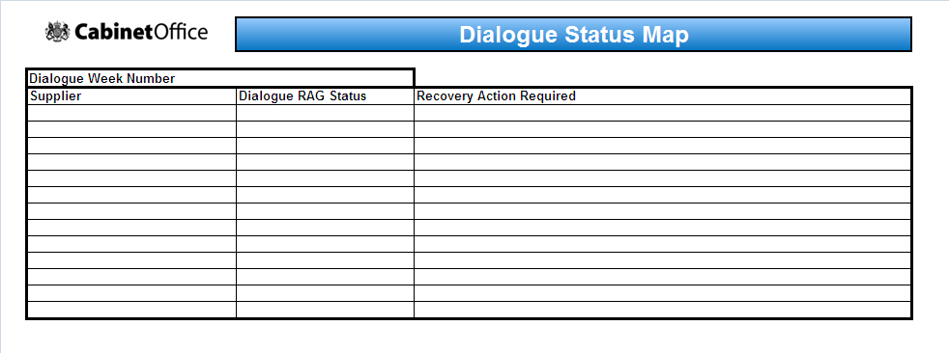
2.2 Dialogue Status Map
1
2
3
How to use
Print copy and display.
Populate the template with the following information:
Supplier Name
A Red, Amber or Green Status for dialogue progress
A note of any recovery or follow up action required by Supplier or Client (Procurement) Team
Owner
Hub data manager
Users
Project Lead
Project team
Frequency of review
Every day during dialogue
Audience
Project SRO
Key stakeholders
Suppliers

Slide 18
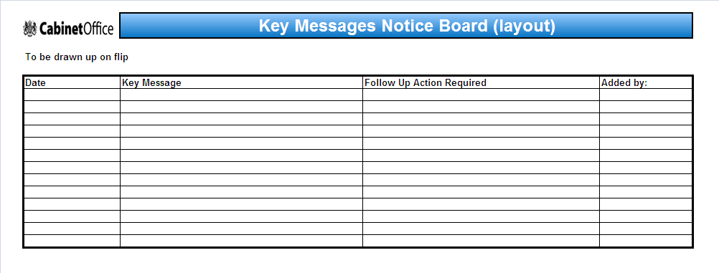
2.3 Key Messages Notice Board
1
2
3
4
How to use
Draw up a copy of the template onto a flip chart or whiteboard and display in the briefing room or project room reception
The template should be populated as follows:
Date Key Message raised
The Key Message that suppliers need to be aware of
Any follow up action that is required by the Client Team
The name of the person that added the Key Message so that suppliers know the point of contact for queries
Owner
To be agreed on a weekly basis
Users
Project lead
Project Team
Frequency of review
Daily during dialogue
Audience
Project SRO
Key stakeholders
Suppliers
UNCLASSIFIED

Slide 19
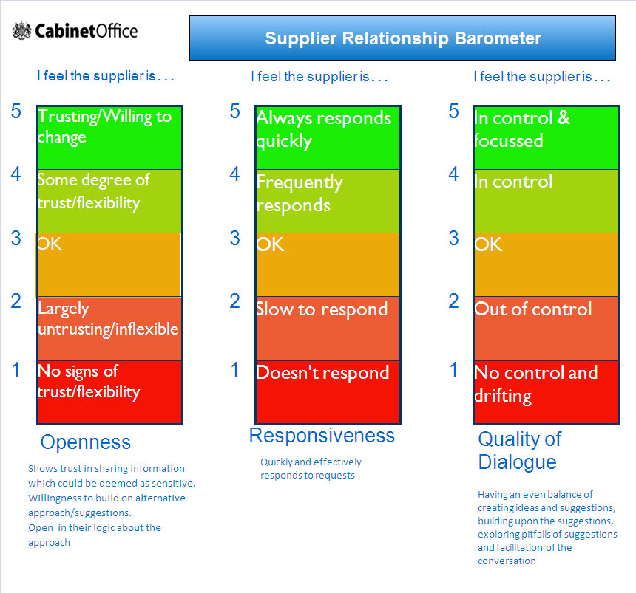
2.4 Supplier Relationship Barometer
How to use
Print for each supplier attending the Competitive Dialogue Boot Camp and display in the project room
Display each one in the Project Performance Hub after Dialogue boot camp
Print 3 sets of starbursts with the suppliers name for each of the suppliers participating in dialogue
After each dialogue session has been completed a member of the project team (involved in the dialogue) selects the ranking that best reflects the supplier throughout the session (by placing the starburst)for each of the 3 categories:
Openness: Shows trust in sharing information which could be deemed as sensitive. Willing to build on alternative approach/suggestions. Open in their logic about the approach
Responsiveness: Quick and effectively responds to requests
Quality of Dialogue: Having an even balance of creating ideas and suggestions, building upon the suggestions, exploring pitfalls of suggestions and facilitation of the conversation
1
2
3
Users
Project Lead
Project Team
Owner
Hub data manager
Frequency of review
After each dialogue session
Audience
Project SRO
Key stakeholders

Slide 20
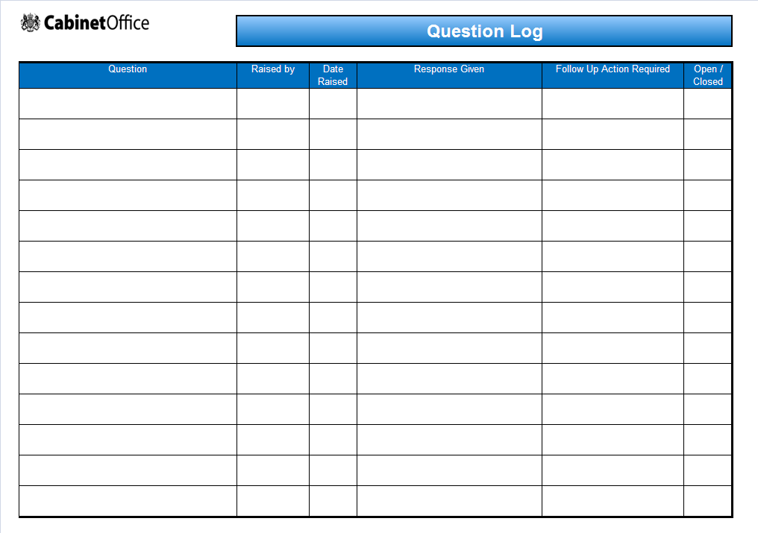
2.5 Question Log
1
2
3
4
How to use
Template to be drawn on flip chart paper and displayed in the briefing room
Write up each questions as its raised
Add the answer if known
List who the question came from (supplier name)
List who is responsible for attaining the answer if not know (using initials or business area
Question
Answer
Who
Owner
Owner
Supplier Bid Team Lead
Users
Supplier Team
Frequency of use
As questions are raised
Audience
Project Team
UNCLASSIFIED

Slide 21
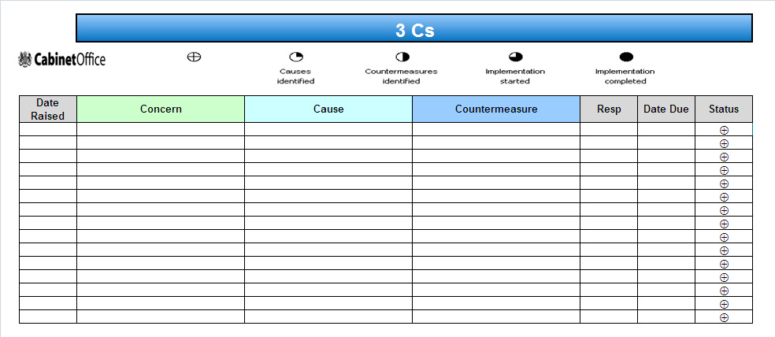
2.6 3Cs
7
1
2
3
4
5
6
7
How to use
Print and display in the project room and each of the suppliers rooms (if required)
Insert the date that the concern was raised
Highlight the concern
Include the cause for the concern
Highlight the countermeasure for the concern
Who is responsible
Date for review
Status of the concern:
Date raised
Concern
Cause
Countermeasure
Responsible
Date due
Status
Owner
Supplier Bid Team Lead
Users
Supplier Team
Frequency of review
Daily during Dialogue
Audience
Procurement Team

Slide 22
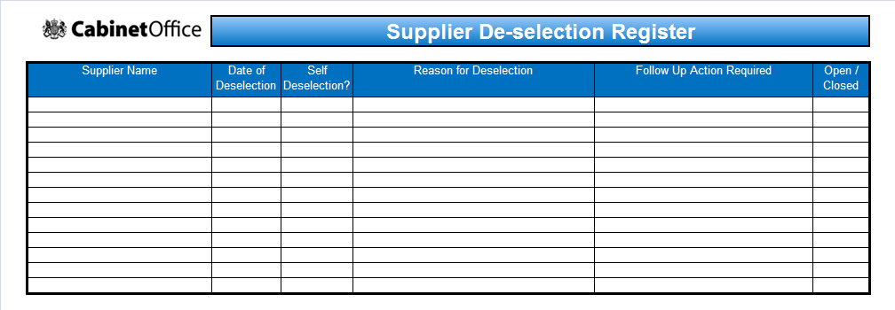
2.7 Supplier De-Selection Register
1
2
3
4
5
6
3
How to use
Print and display this template in the project room.
Areas should be populated as follows
Supplier Name
Date Supplier deselected
Note whether the supplier self deselected or were deselected by the evaluation team
Note the reason the supplier was deselected
Note any follow up action required by the Procurement Team
Note whether this follow up action is ongoing (open) or completed (closed).
Owner
Performance Lead
Users
Project team
Audience
Project SRO
Key stakeholders
4
UNCLASSIFIED

Slide 23
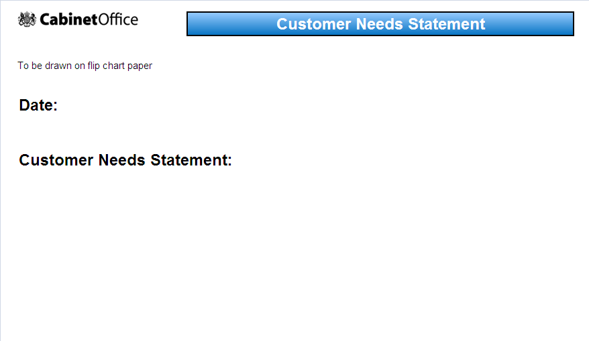
2.5 Customer Needs Statement
How to use
Draw template on flip chart paper and display in the briefing and dialogue rooms
Today's date
Detail the customer needs statement from the business
1
2
Owner
Hub data manager
Users
Project Lead
Project team
Audience
Project SRO
Key stakeholders
Frequency of review
As part of the daily meeting

Slide 24
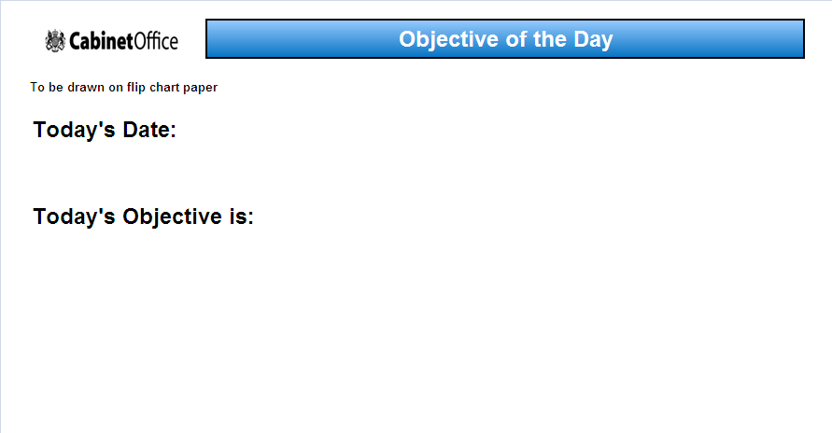
2.10 Dialogue Topic of the Day
How to use
Print and display this template in the briefing and dialogue rooms.
Areas should be populated as follows
Today’s Date
The objective to be achieved during dialogue for that day
1
3
2
Owner
Project Lead
Users
Project team
Audience
Suppliers
3
4
UNCLASSIFIED

