Slide 1
Price Duration Equivalence in the GB Capacity Market
Analysis for DECC
August 2015

Slide 3
Background
Project objectives
Option development
Fundamental challenges
Evaluation
Conclusion
Appendices

Slide 4
Price Duration Curves should help the auctioneer discriminate between contracts of differing durations
Problem
The GB capacity market currently offers contracts of different durations between 1-15 years. These are allocated in the same auction and no distinction is made between these different contracts in the clearing process.
As a result, it’s possible for DECC to procure a 15-year contract at a high clearing price, and therefore be liable to pay this high price for 15 years, even when:
  It expects the capacity price to fall and be significantly lower in all future capacity auctions; and
  It could alternatively have met this year’s immediate capacity requirements with a shorter duration contract (albeit with a higher bid).
Price Duration Curves
The current capacity market legislation therefore permits the Secretary of State to establish a Price Duration Curve (PDC) that, for the purposes of clearing the auction, would adjust bids for multi-year contracts to make them ‘equivalent’ to the bid of one-year contract.
So in the example where prices are expected to be lower than the current clearing price in future, the bids of 15-year contracts would be inflated so that shorter duration bids were selected instead.
PDCs are an attempt to ensure that contract prices are fully reflective of differences in duration. They are one form of a wider set of Price Duration Equivalence (PDE) methodologies (such as splitting the capacity market into separate auctions) designed to ensure that differences in duration are appropriately reflected in price.

Slide 5
A PDC has the effect of presenting a menu of prices to participants during the auction
At the start of each round the auctioneer presents a menu of prices at which they are indifferent between short- and long-duration contracts. Parties then self-select within the bounds of their bidder type:
  existing plant can only take a 1 year contract;
  refurbishment plant could take a contract anywhere between 1-3 years; and
  new plant could take a contract anywhere between 1-15 years.
Supply and Demand in the Auction
The ‘menu’ of prices maps out the ‘indifference curve’ and is updated each round.
Each auction round is defined by the price offered to a one-year capacity contract.
Illustrative Round Menu
Price Cap
£75
Duration Price
1 year £65/kW
3 year £72/kW
15 year £75/kW
Net CONE
£49
Price taking threshold
£25

Slide 6
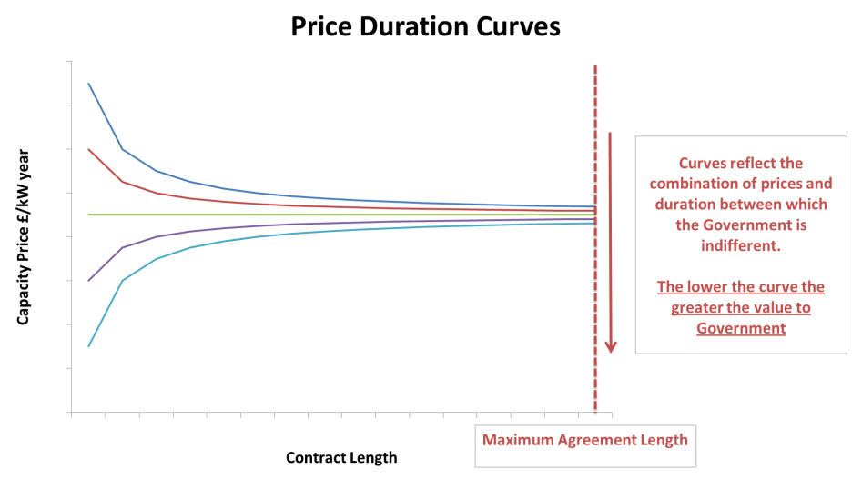
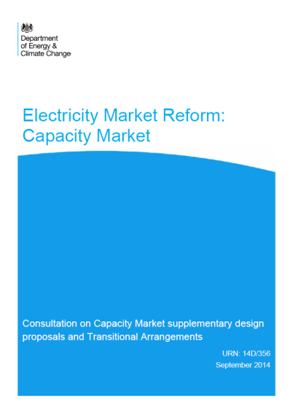
DECC proposed a specific Price Duration Equivalence (PDE) methodology as part of its 2014 Consultation
DECC’s proposal was based on establishing cost equivalence (in NPV terms) between bids of different durations based on modelled estimates of future prices. So, for example, the payments due under a 15-year contract would be compared with the expected payments due under a string of 1-year contracts. DECC defined a Price Duration Equivalence (PDE) formula to define a PDC around any given price and duration.
Long-duration contracts that were expensive relative to expected future prices had their 1-year equivalent price increased, to reflect their expense, relative to a series of shorter-term contracts. Conversely, long-duration contracts that were cheap relative to expected future prices had their 1-year equivalent price decreased, to reflect their value, relative to a series of more expensive shorter-term contracts.
This gave rise to ‘fan shaped’ PDCs, centred around DECC’s forecast of average future prices.

Slide 7
Background
Project objectives
Option development
Fundamental challenges
Evaluation
Conclusion
Appendices

Slide 8
This work aims to support DECC’s consideration of whether and how to implement a PDE methodology
Context
DECC issued a consultation on a price duration equivalence methodology in 2014 but, based on stakeholder responses, decided that further thinking was needed.
It plans to consult further on the issue in 2015 and for this consultation to inform any decisions on whether to implement a PDC in the future, for example in the 2016 capacity auction.
Project objectives
Research pack
Build on the analysis DECC has already undertaken.
Review stakeholder responses to DECC’s 2014 consultation.
Examine experience in other countries and in other sectors to identify potential alternative approaches and any suitable lessons learned.
This work is available in a separate research pack (the “PDE Research Pack”).
This pack
Set out potential PDE options for DECC to consider, and identify wider options that may be relevant.
Test these options with a limited set of stakeholders.
Develop those options which are consistent with the current design of the capacity market, and could therefore be implemented in time for the 2016 auction.
Carefully discuss and agree on a set of evaluation criteria with DECC and evaluate the options against these criteria.

Slide 9
Our research methodology has involved a review of four main areas…
Stakeholder responses
We have examined these in detail to understand stakeholder concerns
International capacity & energy markets
US, South American and European examples
Lessons learned for option development
VPP auctions
We examined in detail the French virtual power plant auctions
Other relevant sectors
We have looked at, for example, waste, transport and financial markets
… in each we have looked to identify any relevant learning for the design of a PDE methodology

Slide 10
Summary of key findings
Stakeholder responses
International capacity & energy markets
Proposed method risks inadvertently capping prices below the CONE, inflating CM costs, and embedding the modelled prices in market outcomes.
Although some international capacity markets do effectively issue different contract lengths, we did not find any examples where an indifference methodology has been implemented.
VPP auctions
Other sectors
  French VPP auctions seem to be most relevant because an indifference price methodology was applied (although estimating future prices was comparatively easy). Unlike DECC’s proposal, fixed price differentials were used.
We have investigated a range of auctions in other sectors such as financial markets, gas pipeline capacity and toll roads. In some, contract duration is an auction clearing criteria, but nowhere is a PDE methodology being used.
For more information on these finding please see the companion slide pack ‘PDE Research Pack’

Slide 11
Of the markets examined, Virtual Power Plant auctions are the only example where a PDE methodology is used
The approach used in VPP (Virtual Power Plant) auctions is distinct to DECC’s proposed methodology in that fixed price differentials are used. We summarise below the methodology used in VPP auctions and provide more detail in the PDE Research Pack.
We consider fixed price differentials as one of the PDC options available to DECC and discuss the implications this might have in more detail in this pack.
VPP auctions
Overview
VPP auctions were developed in response to market power concerns raised by the European Commission when EDF intended to purchase a controlling stake in its competitor EnBW. The European Commission wanted EDF to make available generating capacity to potential competitors in the French market. The favoured approach was to conduct VPP auctions, which sell contracts that give the buyer the option to purchase a share of the generation of a plant.
PDE approach in VPP auctions
In VPP auctions there were contracts of different lengths on offer and there was therefore a trade-off between price and contract duration. Unlike in DECC’s proposed methodology, this trade-off was made using a PDC with fixed price differentials. This is a simplification, because theoretically the price difference between short- and long-term contracts should vary with the short-term price.
Implications for UK CM auctions
Relative to the CM, it was comparatively easy to estimate the value of different VPP contract durations. The key complexity was the need to value the optionality of the VPP contract. However, even here, there was ample historic data to inform the modelled valuation. Estimating differences in value in the CM would be made difficult by:
the lack of a liquid forward market; and,
the lack of an extensive historic price series.

Slide 12
In the rest of this pack, we explore the implications of different responses to a set of key design choices
The remainder of the pack is structured as set out below.
After setting out four key design questions, we explore the implications of different responses and identify a series of fundamental challenges to effective PDC design along the way.
Option development
Sets PDCs in the context of a wider variety of potential policy options.
Presents four key design questions that allow us to systematically explore different design options.
Outlines a set of different design options that respond to these questions.
Fundamental challenges
Explains some of the fundamental challenges to the design of an effective PDC.
Illustrates the implications of these challenges using modelling outputs for a variety of assumptions and design options.
Evaluation
Establishes evaluation criteria to assess the design options.
Evaluates the design options considered for each of the four key design questions.
Conclusion
Summarises the key insights from the work and their implications for the preferred policy.
Appendices
Provides further detail on the modelling assumptions and results.
Summarises points raised in the discussions with stakeholders.

Slide 13
Background
Project objectives
Option development
Fundamental challenges
Evaluation
Conclusion
Appendices

Slide 14
We have focussed on those options, i.e. PDCs, that can be delivered without new legislation
Current capacity market product
Different capacity market product
Current market clearing process
Price Duration Curves
Sharing price risk with the holders of long-duration contracts would limit Government's procurement risks, but would also change the nature of the product and expose developers to greater risk.
Price Duration Curves can be implemented without changing the formal market clearing process or the capacity products being offered.
Price risk sharing
Different market clearing process
Fixed quantities
Fixing the quantity of different durations to procure in advance would require different durations to clear independently.
All these options are described in more detail in the following slides.

Slide 15
In addition to PDCs, we have also considered some options that would require legislative changes
Fixed quantities
The price duration equivalence methodology regulations have been drafted to allow DECC to specify the prices at which it is indifferent between durations. An alternative way of defining DECC’s procurement strategy would be to specify the quantities of each duration that DECC wanted to secure.
Under this approach, the different durations would be cleared separately based on the duration-specific quantities specified. As a result, different durations would face different clearing prices. Existing plant would never be paid new build clearing prices, but dividing the auction may well reduce competitive pressure.
Price risk sharing
The current capacity market arrangements involve giving investors with multi-year contracts absolute price certainty. This protects them from price uncertainty, but exposes the Counterparty to the risk that it forecasts future capacity prices inaccurately.
Alternative price risk sharing arrangements are possible. For example, multi-year contracts may receive a blended price in future years combining the original auction clearing price, and the actual price obtaining in the relevant year. In this example, the capacity payment received under a multi-year contract in any year would be:
a(Original clearing price) + (1-a)(Current clearing price) where 0<a<1
A wide variety of possible blended prices are possible. Critically, they all shift at least some price risk back onto investors.
In doing so, they reduce investor price certainty, arguably undermining the original intent of long-duration contracts.

Slide 16
PDCs set the price differential between long and short contracts, effectively defining a demand curve
PDCs create an effective demand curve with which the Government trades-off procurement of capacity using long- or short-duration contracts. For example, if the current auction price is high, this implies that long-duration contracts at this price are expensive and DECC may wish to procure few long-duration contracts as a result.
High
Fixed quantities
Premium applied to long duration contracts
Fixed differentials
Low
Fixed differentials and fixed quantities are the extreme ends of spectrum of varying price sensitivity, discussed in more detail later.
Quantity of long term contracts
Fixed quantities
Fixed differentials
Risks inefficient allocation among durations as quantities must be set before bids are known.
Separate clearing may exacerbate issues of market power, manipulation and informational asymmetries, potentially reducing value for money.
This effect may be offset by reduced payments to existing plant, which no longer benefit from new build clearing prices.
Generally, bidders can exploit poor estimates of the relative value of different durations by spilling into overvalued durations.
However, in the CM context this problem is limited by the fact existing plant can’t bid for long duration contracts.

Slide 17
Within the PDC options, we consider the following…
What are we trying to achieve by trading off price and duration?
1
As discussed on the next slide, there is a fundamental trade-off between realising societally efficient investment choices (i.e. reducing the resources used to maintain security of supply) and reducing the financial cost to consumers of the capacity market. It’s therefore worth being explicit as to our ultimate objective for a PDC.
How do we proxy future capacity prices?
2
The equivalence methodology must take a view on future capacity costs if it is to estimate the implied costs or benefits of entering into a multi-year fixed-price capacity contract.
How sensitive should ‘equivalised’ prices be to expected over/underpayments?
3
Under DECC’s proposed methodology, the equivalised value of long-duration contracts was very sensitive to expectations of over/underpayments in future years, as assessed against the forecast future capacity price.
This sensitivity is removed entirely under a fixed differential option, like that used in VPP auctions.
How do we account for the hedging value/cost of procuring capacity in advance?
4
Issuing a long-duration contract gives us certainty as to the future price of that capacity and locks us into paying that price. How do we value this certainty and obligation given an uncertain future?

Slide 18
Customer bills may actually be higher using a methodology designed to stimulate efficient investment
Objective
Focus on investment efficiency
Focus on minimising CM payments
DECC’s proposal focused on establishing cost equivalence for a given amount of capacity.
Effectively asked at what price the stream of capacity payments would be equal.
This approach will be efficient, in the sense that the capacity with lowest resource costs will get picked…
…but could push up CM costs overall.
Costs can be driven up where long-duration contracts set the clearing price and have their bids inflated through the equivalence methodology because future prices are expected to be lower.*
If, in this example, the one-year equivalent price of long contracts had been reduced (even though future prices were expected to be lower), the clearing price and CM costs would have been lowered. However, we may, as a result, inefficiently clear long contracts in the place of short ones.
Uplifts on long duration contracts
Increase in CM costs (a transfer from consumers to generators)
Fixed payments
CM bids
Long-duration contracts
Capacity price
Short-duration contracts
Estimated variable payments
Capacity
Time
* In theory, costs can be pushed down where long-duration contracts have their bids reduced because future prices are expected to be higher. However, as discussed later in the pack, this situation is unlikely to arise in practice.

Slide 19
One approach to getting future prices would be to actually create a forward market
Future prices
Centralised capacity auctions
Decentralised long-term trading
Under this option, National Grid would effectively hold capacity auctions for more distant delivery years. Winners would get a capacity contract for the relevant year, or a swap that would in-effect become a capacity contract following the T-4 auction.
Only a fraction of capacity would auctioned, but this would be sufficient to establish market expectations as to future prices.
However:
  Complicated to implement; and
  Liquidity may be insufficient to create robust price estimates.
Under this option, market participants would be encouraged to contract for capacity bilaterally, with any such contracts ‘netted off’ the amounts acquired centrally and the associated settlement arrangements.
The prices and durations of these trades would have to be reported centrally. From this information, it should in theory be possible to build up a picture of prices over the periods traded.
However:
  Netting off values adds to complexity of implementation; and,
  Liquidity concerns remain.

Slide 20
Without actual prices, we must make estimates, varying from rules of thumb to involved modelling
Future prices
Complex
Fully modelled forward curve
Fully modelled price forecasts using the DDM and capacity market models.
Modelled price adjustment
Rule of thumb price level is adjusted up or down, using published methodology, based on modelled expectation of whether new capacity will be needed.
Rule of thumb
Future prices are set based on a simple rule. For example, the future price in all years could be assumed to equal the current estimate of net CONE.
The 2014 and 2015 auctions have effectively assumed that future prices will equal the auction clearing price.
Simple
Additional details on these potential approaches to estimating future prices are included in the Appendix ‘PDE option detail’.

Slide 21
Significant price sensitivity to expected over/under-payments requires confidence in our price forecasts
Sensitivity
Sensitive
Insensitive
DECC’s proposal
VPP-like fixed differentials
DECC’s proposal set the one-year equivalent price so that it made up for any expected over/underpayments in future years.
Small deviations from the expected future price led to big changes in the equivalised price. New generation might therefore find itself hemmed in by the modelled prices (which could be significantly different from actual outcomes).
The chart below illustrates how this approach led to widely divergent one-year equivalent prices for long-term contracts prices around the forecast average capacity price.
An alternative approach would be to set fixed £/kW adjustments to the bids of long-duration contracts for the purposes of clearing, e.g. 15-yr contracts always have £1/kW added to their bids when determining clearing.
This approach eliminates the sensitivity of the DECC proposal, allowing new build to potentially clear at a wider range of prices.
However, it ignores completely the changing size of expected over/underpayments and there is no clear basis to inform the setting of an appropriate increment.
The current auction design is effectively this approach without the mark-up (mark-down).
A fixed mark-up (-down) is applied to multi-year bids
One-year equivalent prices
Price
Price
Duration
Price paid to 15-year contract
Duration

Slide 22
There are options that represent a middle ground
Sensitivity
Sensitive
Insensitive
Options to reduce the sensitivity of DECC’s proposal include a proportional reduction of the implied discount/premium, or use of an increased (or increasing) discount rate.
In either case, the resultant equivalised price would not fully account for expected over/underpayments, but might nevertheless be justified on the grounds that future capacity prices are uncertain.
A proportional reduction option would involve only applying a fraction of the discount/premium implied by DECC’s proposal when converting long-term contract prices to an equivalent one-year price.
Under a discount rate option, a similar effect would be achieved by more heavily discounting forecast over/underpayments in distant years.
Price
Price
Duration
Duration

Slide 23
Long-duration contracts provide price certainty while limiting our ability to take up cheaper capacity in future
Hedging
DECC’s proposed equivalence methodology ensured that payments for long- and short-duration contracts were equal given a specific profile of future capacity prices.
However, there is significant uncertainty regarding future prices and, as a result, the Government may be naturally inclined towards or away from long-duration contracts.
The key determinants of the Government's preference would depend on:
  The probabilistic distribution of future prices; and
  Its preferences regarding risk.
Distribution
Even if risk-neutral, the Government might prefer long or short contracts depending on the skew of the price distribution.
For example, if the distribution were skewed towards significant future price increases, the Government might be better off, in expectation, if it entered into long-term contracts now.
Risk preferences
Risk aversion might also encourage the use of long-duration contracts, since these contracts provide certainty over future payments.
The Government might consider risk-averse procurement to be an accurate reflection of end consumers preferences.

Slide 24
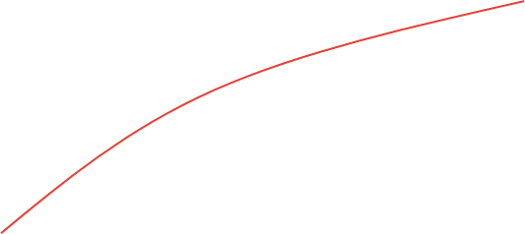
Analysis to quantify this value/cost would involve probabilistic modelling of future capacity prices
Hedging
A range of future capacity price scenarios would be generated and assigned probabilities.
In each scenario, costs would be assessed for both long- and short-duration contracts. Using the probabilities of these scenarios, the expected change in costs from long- or short-contracting can then be calculated.
If risk aversion were also to be included, one would also need to define the Government's (or consumers’) willingness to pay for cost certainty.
This would be a complicated (and potentially controversial) piece of analysis, with wider applicability to decisions in which the Government choses to take on, or avoid, risk on behalf of consumers.
As a result, although it needn’t necessarily be updated for every auction, it shouldn’t be entered into lightly.
Illustrative capacity price scenarios
Capacity price
Time

Slide 25
The different combinations of responses to these key questions define a wide variety of policy options
Objective
Focus on investment efficiency
Focus on minimising CM payments
1
Future prices
Facilitate forward trading and therefore create market prices
Model the forward curve
e.g. as in DECC’s proposal
Use a ‘rule of thumb’
e.g. use net CONE
2
Price sensitivity to forecast
Sensitive to forecast
Insensitive to forecast
3
e.g. DECC’s proposal
e.g. Fixed differentials (VPP)
Hedging
Ignore hedging value/cost
Add estimate of hedging value/cost to multi-year bids
4
After explaining some of the fundamental challenges to the design of an effective PDC, we return to these design choices as part of our evaluation.

Slide 26
Background
Project objectives
Option development
Fundamental challenges
Evaluation
Conclusion
Appendices

Slide 27
This section highlights some fundamental challenges to the PDC approach
In the section we examine a number of potential PDC approaches using a quantitative model of the capacity market*
This analysis has highlighted some key challenges that potentially affect any type of PDC and which form the focus of this section
The model simulates the clearing of the Capacity Market by building a supply curve of bids from different market participants based on a defined cost base. These exit bids are adjusted for each PDC approach modelled (see Appendix for more details).
The analysis is conducted across a number of scenarios and PDCs. We compare results to a business as usual (BAU) case in which the capacity market is operated without the application of a PDC (as in the 2018/19 auction).
Full modelling results for the building blocks and scenarios modelled are included in the Appendix and drawn on in the evaluation of options.
We begin with an introduction to the quantitative modelling and an explanation of the scenarios and result metrics that are discussed throughout.
We then outline the three main challenges that are common to all modelling scenarios and PDCs. Each challenge is demonstrated using illustrative scenarios and where appropriate we compare modelling results for different PDCs.
After explaining some of the fundamental challenges to the design of an effective PDC in this section we return to these design choices as part of our evaluation.
* The quantitative modelling is limited to the PDE based approaches that do not require different capacity market products or clearing processes (such as fixed quantity or price risk sharing approaches).

Slide 28
We have examined a range of metrics
Metrics
Measuring efficiency?
Across the analysis we look at several key metrics:
CM cost (£m) (over varying time horizons) – the net present value of CM contract payments over the time horizon specified.
CM clearing prices (£/kW-yr) – the clearing price of a 1-year capacity contract awarded in the auctions.
Capacity procured (MW) – this varies depending on the auction clearing price due to the auction demand curve.
Capacity shortage (MW) – capacity procured below the minimum capacity threshold (1500MW below capacity target that equates to a LOLE of 3).
Contract mix (MW) – capacity procured split by contract duration.
Economic surplus (£m) (the measure of auction efficiency) is defined as the sum of consumer and producer surplus and inherently values capacity to consumers based upon the demand curve defined by DECC. No penalty is applied for procuring capacity less than the minimum requirement. When aggregating over time the NPV of this series is reported.
Cost of capacity *
Price (£ / kW-yr)
Consumer surplus
Producer surplus
Quantity MW
* The cost of capacity can differ from the bid supply curve in a PDC approach. Additionally, the cost of plant with previous long term contracts is included; this again can differ from the capacity payments to these plants as they may receive producer surplus having locked in a clearing price above their cost.

Slide 29
We have examined a range of scenarios
Basecase
Scenarios
As we will see in the modelling results, the effectiveness or otherwise of a PDC is highly sensitive to the scenario being considered.
To provide a range of potential outcomes we analyse the effect of PDCs across a number of scenarios.
These scenarios have been developed to show a range of potential results. However, the full range of potential results could include more extreme outcomes.
The basecase is derived from modelling assumptions from the DDM with a slightly wider contract duration and exit price mix, which adds granularity to the range of bids. This is required for the PDE approaches to be able to improve efficiency in the modelling. While based on realistic assumptions, this should not necessarily be considered a central view, particularly due to the sensitivity of the modelling results to changes in these assumptions and the uncertainty underlying them.
The parameters are discussed in more detail in the Appendix.
A) Reduced competition from short-term contracts
A.) Reduced competition from short term contracts
Many of the results rely on substitution towards short-term capacity contracts, we explore a scenario where less capacity comes forward for these contracts.
B.) Extensive competition of short term contracts
Additionally we explore a scenario where these short term capacity contracts are highly competitive.
C.) Additional refurbishment eligibility
The basecase examines lifetime extensions from all CCGT plant. We explore a scenario where other technologies compete for refurbishment contracts in addition.
Capacity requirement is a key driver of results and is driven both by demand growth and renewable uptake. A scenario where events result in a higher capacity requirement is examined.
E
A scenario where events result in a lower capacity requirement is also examined.
B) Extensive competition of short-term contracts
BASE – Illustrative basecase
C) Additional refurbishment eligibility
D) Higher capacity requirement
E) Lower capacity requirement

Slide 30
Modelling of PDC characteristics highlights a common set of issues
Using the modelling approach discussed and scenarios defined above our evaluation of the different PDC options has highlighted three key areas that affect any PDC approach.
In the following slides we look to quantify the relevant effects where possible and set out how different PDC designs can mitigate these issues.
Efficiency gains may be rare and these generally require a significant increase in CM costs to consumers.
Efficiency gains generally require a significant increase in CM costs to consumers. The increase in total CM payments is typically significantly greater than any efficiency gains.
Efficiency gains require a trade-off in contract lengths. In the context of the capacity market, this requirement has implications for the type of capacity that is willing to come forward into the auction.
Results can be extremely sensitive to the forecast of future prices.
An error in the forecast of future clearing prices can prevent any efficiency gains while still materially increasing CM costs.
If the PDC methodology affects future CM prices while also depending on forecast prices, it results in a circular and potentially unstable system.
The circularity poses a modelling challenge but more importantly creates real-world instability in clearing prices.
Even with perfect foresight over all participants’ bids it not necessarily possible to design a PDC that is able to realise efficiency gains, due to lumpy nature of capacity investments.

Slide 31
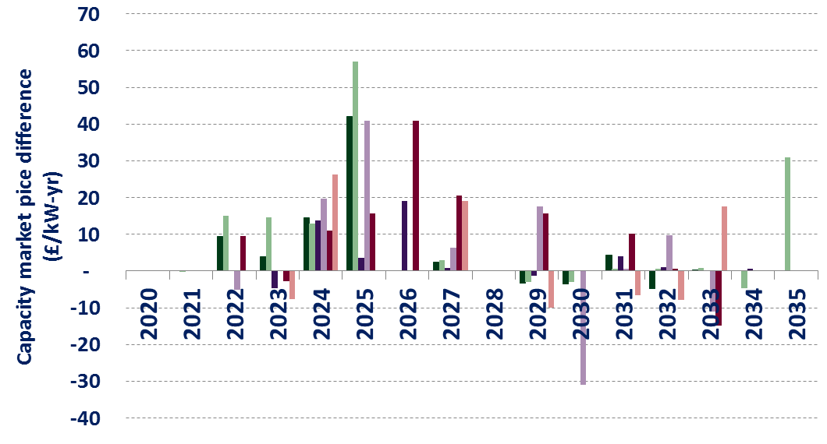
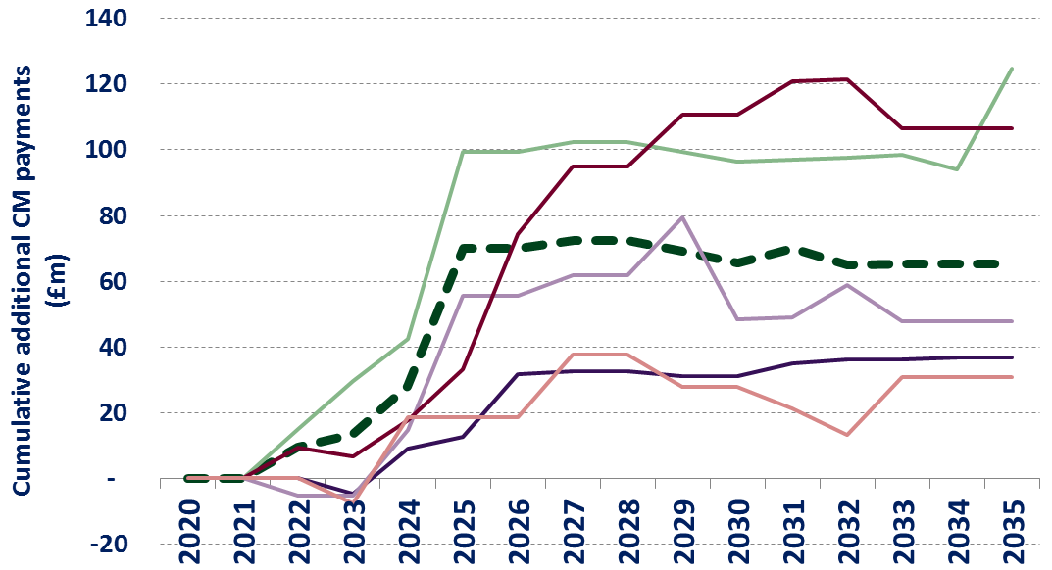
There is a trade-off between improving economic efficiency and reducing CM costs
Efficiency and cost
Issue
Example – all scenarios
The model demonstrates there exists a clear trade-off between improving economic efficiency and reducing CM costs.
In most cases we would expect an increase in CM payment costs in scenarios where long-term capacity is not needed in all years.
The charts on the right show the effect of the PDC approach proposed in last year’s consultation across a range of scenarios (i.e. Focus on investment efficiency approach).
All scenarios result in an increase in capacity prices relative to the BAU. This in turn results in a cumulative increase in capacity payments through the modelled horizon.
Change in capacity market clearing price
Change in CM payments over BAU
The consistent increase in CM payments derives from the fact that the average future clearing price is likely to lie below the entry price for long-term capacity. This is explored in detail in slides 34 to 36.

Slide 32
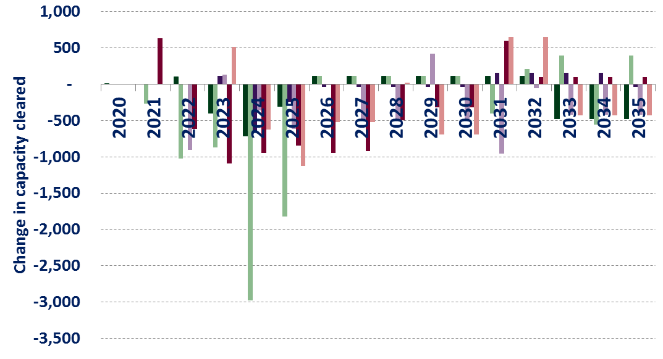
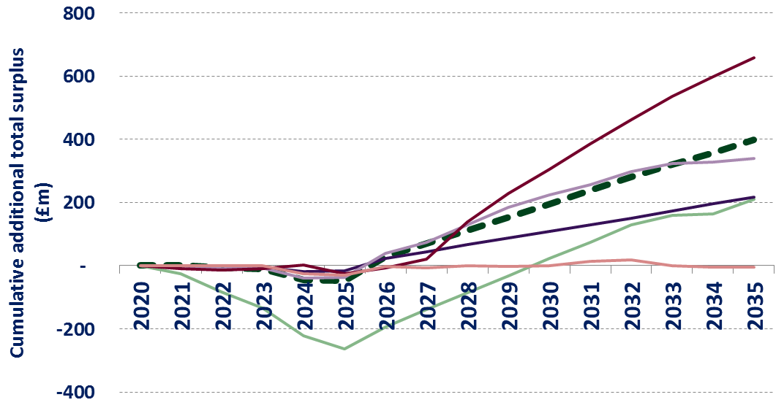
The modelling suggests that the increase in CM costs is several times the resultant efficiency gain
Efficiency and cost
Issue
Example – all scenarios
All scenarios do result in an increase in total surplus over the longer term as a result of applying the PDC approach that focuses on auction efficiency.
However, the increases in CM costs to consumers are typically 5 to 10 times greater than the gains in economic efficiency. These costs persist even in scenarios where no efficiency gains are realised.
It is also important to note that the increase in prices is generally associated with a reduction in clearing capacity, due to the shape of the auction demand curve. This will act to lower security of supply. The cost of this is reflected to a degree in the economic surplus measure through the shape of the demand curve.
The scenarios with the most significant efficiency gains are those in which there are large volumes of short-term contracts entering the market at a similar price point to new build. Notably this is the case in scenario C, with additional refurbishments being modelled. In this case, there is a greater potential for long-term contracts to be replaced with shorter-term refurbishment contracts.
Annual change in capacity cleared
Economic surplus over BAU

Slide 33
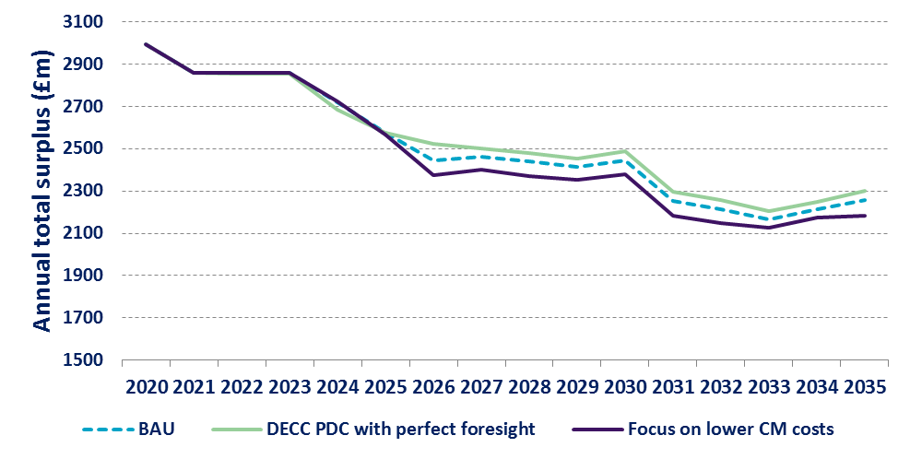
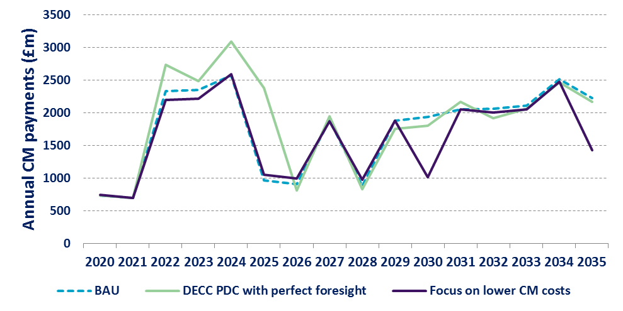
Attempting to reduce CM costs in the PDC design continues to demonstrate the trade-off with efficiency
Efficiency and cost
Illustrative basecase
Results
Alternatively, a PDC could be used to try and lower CM costs. Using the base case scenario we can compare the effect of DECC’s original proposal (the ‘Focus on investment efficiency’ approach assuming perfect foresight) with a PDC designed to reduce CM costs.
The latter approach is able to reduce capacity market prices, and therefore CM payments, by lowering the bids of long-term contracts when they are marginal.
However, this is achieved at the cost of procuring additional long-term contracts, even when not necessarily required, reducing total economic surplus.
This effect is consistent across the scenarios modelled. See the Appendix for complete comparison of the results.
Economic surplus
CM Payments
It is worth noting that these results require perfect foresight of future capacity prices and are not necessarily representative of the gains that could be achieved, as discussed in the next section.

Slide 34
The increase in CM prices is a result of the relative cost of long term contracts to forecast future prices
Efficiency and cost
Issue – Future clearing prices are likely to be below the cost of long-term contracts
Assuming efficiency gains are possible, then an important consideration is the effect that a PDC will have on the overall cost of the Capacity Market to consumers. In theory, prices and costs could change in either direction depending on the bid of multiyear contracts relative to the forecast of future prices. However, in practice one direction is likely to dominate. Consider 2 assumptions:
Under most scenarios, we would expect the average long-term contract to require a higher CM revenue than shorter-term contracts. This is reflected in the auction design, with the price taker threshold for existing plant being lower than the net CONE estimate for new build.
In most future scenarios we expect some years where no new capacity is required, with lower clearing prices, and some years where new build is required, with higher clearing prices.
Given these assumptions, we would expect the average long-term clearing price to be lower than the cost required by new plant that desire the certainty of long-term contracts. This is because the price is either set by long-term contracts, or by cheaper shorter-term contracts, resulting in an average price lower than the long-term contract entry price.
For this situation not to hold, the forecast price in a significant number of future years must be above the price required by a long-term contract. This would mean a combination of:
Significant and forecastable increases in the future cost of capacity, or significant constraints on the ability of low-cost, long-term capacity to come forward in a given year, which do not apply to other years.
A significantly increasing capacity requirement (due either to demand, or retirements).

Slide 35
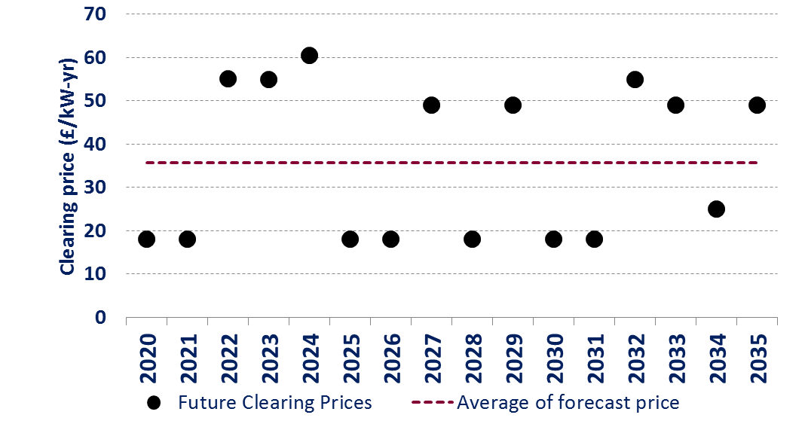
The average clearing price is likely to lie below the entry price for long-term capacity
Efficiency and cost
Issue – Future clearing prices are likely to be below the cost of long-term contracts
Bid range where long-term contracts compete
Average is below long-term capacity cost
Bid range where existing plant compete
The above diagram demonstrates how the average clearing price is likely to lie below the entry price for plant requiring long-term contract.
For this not to be the case, we would need to expect the price to go significantly higher than the cheapest long-term contract on a regular basis.
The next slide discusses how this observation will affect the price at which long term contracts exit the auction with a PDC methodology that focuses on market efficiency and the resultant capacity market outcomes.

Slide 36
Cost reductions from more efficient contract mixes are likely to require higher clearing prices
Efficiency and cost
Issue – In this situation a PDC will increase the capacity market price and payments
In most of the scenarios considered, as with the assumptions discussed in slide 34, long-term contracts require a capacity payment higher than the average forecast of future clearing prices (even without considering the forecasting issues discussed later).
Under any PDC design that focuses on efficiency, the result of this situation is to favour short-term contracts rather than locking into long-term contracts at prices above the long-term expectation.
In this situation any PDC methodology that focuses on auction efficiency will act to increase the price at which long-term contracts exit the auction above their required payment level. Under the assumption that new build enter a given auction at a higher price with the PDC approach we can observe two possible outcomes within a given auction:
1.) The same volume of long-term contracts clear but at the same or higher auction price, or
2.) A lower volume of long term contracts clear with a higher auction clearing price.
The result of these two situations is illustrated in detail in the Appendix on slides 76-77. It is also important to consider how the dynamic in each of these cases will continue into future auctions.
1.) In this case, the quantity of capacity continuing to the next auction is unchanged and we should not expect a change in future clearing prices.
2.) In this situation, we have a higher clearing price and different capacity. Given the CM demand curve, this means we either have the same, or less, capacity continuing to future auctions. As a result, we can expect capacity prices to be unchanged or, if there is a lower supply, to increase.
Under these assumption the application of a PDC methodology focused on auction efficiency acts to either increase clearing prices (both in a given auction and in the subsequent auctions) or leaves prices unchanged.

Slide 37
Alternatively, a PDC could be used to try and lower CM costs; however there is a trade-off
Efficiency and cost
An approach for minimising CM cost
Implication of this approach
The results above show that a PDC designed to improve efficiency by establishing cost equivalence for the marginal unit can be expected to increase overall CM costs.
An alternative approach would be a methodology that looks to minimise CM costs.
To do this we account for the change in the total cost of contracts awarded in the current year’s auction as a result of the PDC. The details of the calculation can be found in the appendix.
This approach cannot be implemented with a simple menu of prices as the capacity of a given long-term contract is an important component of the calculation.
This change in objective fundamentally changes the effect of the PDC – rather than increasing the price at which long-term contracts enter the auction, the price is reduced to avoid higher prices in the given auction year.
This is the case even in the situation described previously, where the forecast of capacity prices is above the cost of new build.
It is worth noting that new build will nevertheless receive a payment higher than the clearing price to ensure they receive their required payment.
The importance of this will depend on the size of the new build contract relative to the market overall.
This approach generally leads to an increase in long-term contracts clearing and a reduction in overall CM costs.
Increase in CM costs (a transfer from consumers to generators)
CM bids
Capacity

Slide 38
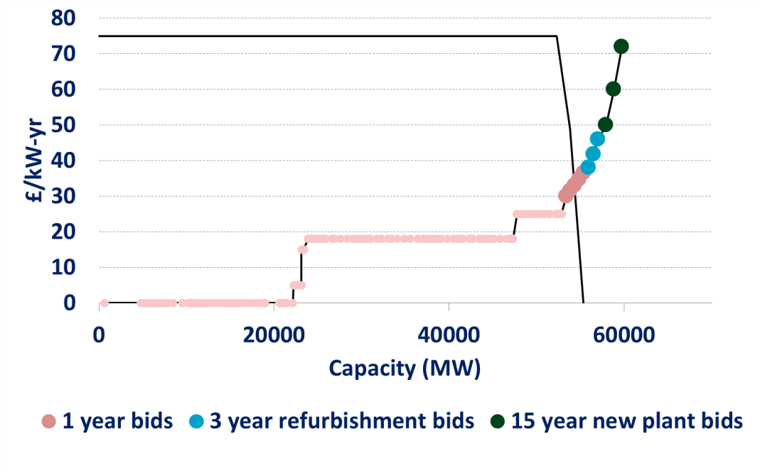
Additionally, the circumstances in which a PDC can improve efficiency may be rare (1)
Efficiency and cost
In order to provide efficiency gains, any PDC needs to trade off short- and long-term capacity contracts.
In the majority of plausible scenarios, new entry cost is expected to be higher than existing plant bids. If the auction bid curve is similar to that shown in the example below, then no efficiency gain is typically possible.*
In order for a PDC to improve efficiency, it requires plant with different contract lengths competing within similar price bands. This could be caused by:
a) Existing plant entering the market at higher prices, potentially as they reach the end of their economic life;
b) Plant refurbishments entering at prices comparable to new build; or,
c) New plant entering the market at lower prices similar to existing plant bids.
c) Lower new 15-year contract exit prices below those of other capacity
b) Increase volume refurbished capacity.
a) Higher 1-year contract exit prices above those of new capacity
*This point was explored in detail in slides 34-36, in this situation increasing long term contract exit bids will not promote substitution to shorter contract lengths.

Slide 39
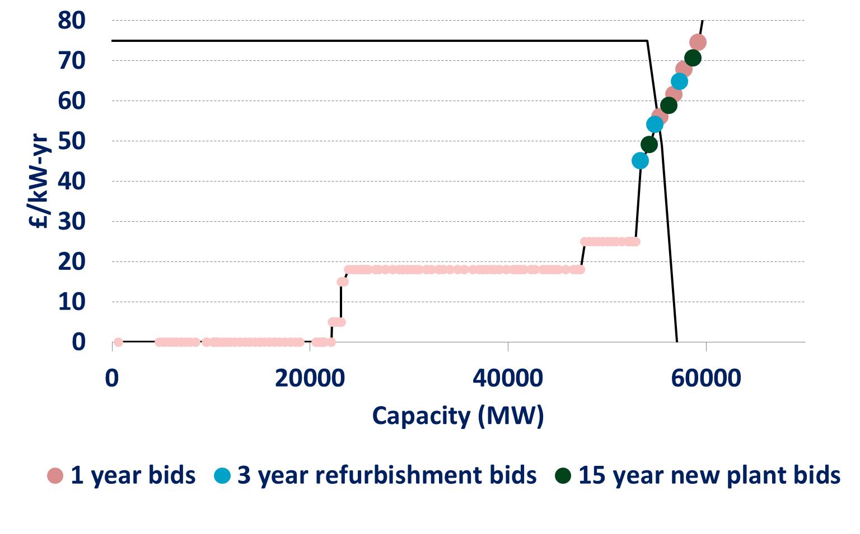
The circumstances in which a PDC can improve efficiency may be rare (2)
Efficiency and cost
A typical supply curve where a PDC may be beneficial is demonstrated below.
There is significant price overlap of different contract lengths meaning substitutions will result from relatively small changes in relative prices.
In particular, there is a significant quantity of capacity entering the auction on a 1-year contract basis with exit prices similar to those of new build. In this example that means capacity willing to accept 1-year contracts only at prices from 60 – 75 £/kW-yr (above the price taker threshold).
Potential changes to outcomes from applying PDC:
If long-term clearing prices are expected to be high, then 15-year capacity contracts will enter at a lower price and substitute for shorter contracts.
Capacity Market where PDC is beneficial
If long-term clearing prices are expected to be low then 15-year contracts will enter at a higher price and be replaced by shorter contracts.
As with long-term capacity contracts, the 3-year refurbishment contract could move up or down depending on the medium-term view of capacity prices.
1-year contracts remain unchanged. It is the relative move of multiyear contracts that is important.

Slide 40
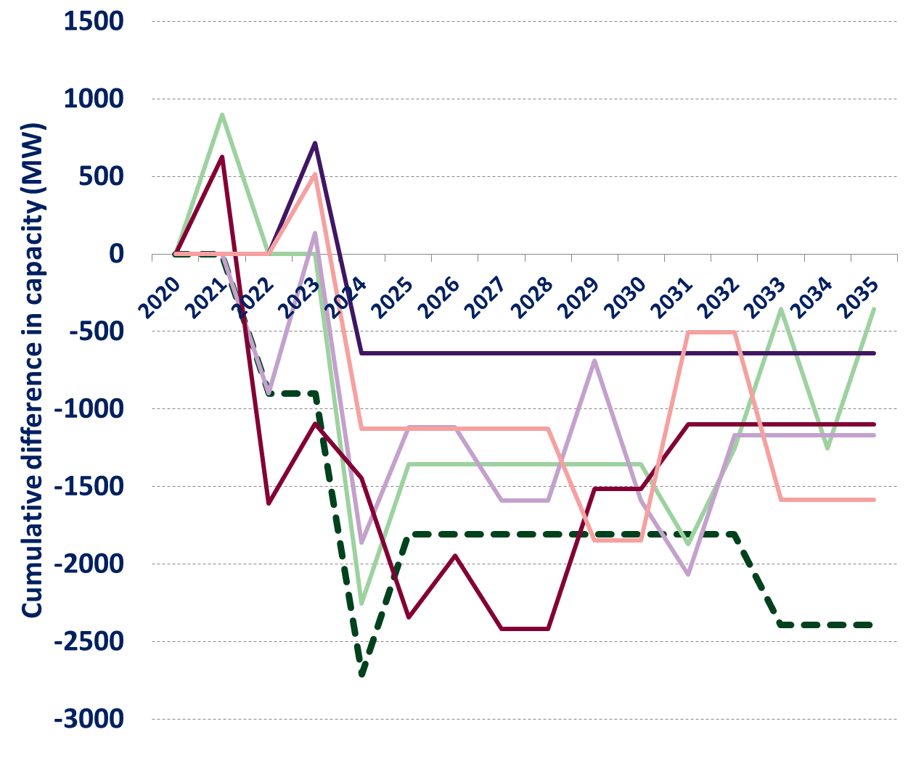
Efficiency gains are dependent on large quantities of new capacity willing to come forward on a one-year contract basis. This capacity may not emerge.
Efficiency and cost
Issue
Cumulative new capacity required
DECC proposed approach
The PDC approach requires there to be significant capacity willing to come forward on short-term contracts that can offset the requirement for new build.
With existing plant limited to bidding below the price taker threshold, there can only be trade-offs between existing capacity and long-term contracts if new build is also willing to accept prices at around this level. Alternatively, existing units may be able to demonstrate the conditions required to enter an exit price at a higher level, in particular if looking to extend a plant’s lifetime.
We have included the ability for CCGTs to undertake lifetime extensions and compete for a 3-year refurbishment contract. In reality, the capital expenditure requirements for this form of contract may be prohibitively high for some units.
Other sources such as DSR may be willing to come forward at higher prices and without a guaranteed contract length, but such capacity may be limited.
It is worth noting that efficiency gains often stem from the ability to not award contracts to these short term units in the future when they are not required. This means that capacity willing to come forward on a 1-year contract basis faces significant uncertainty.
Change in multiyear contract capacity
Efficiency gains often require multi-year (i.e. new or refurbished) capacity to be replaced by new one-year contracts, which can then be dropped in future rounds. As a result, fewer multi-year contracts are taken up.

Slide 41
We have tested PDC specifications that differ with respect to their sensitivity
Forecast accuracy
Issue
Levels of PDC sensitivity modelled
One of the key areas of concern is the sensitivity of auction results to the choice of PDC methodology.
There are 2 key problems:
1.) Restricted participation – The PDC formula can restrict the level of income that a long-term contract can receive. In some cases, new build may be unable to participate in the auction below the price cap.
2.) Risk of inefficient decisions – The sensitivity of the PDC can make any efficiency gains highly dependent on the accuracy of the forecast.
As outlined in the option development, the range of sensitivity can be been seen as a continuum. In the examples that follow we consider three levels of sensitivity.
BAU: No sensitivity
The current market rules without a PDC are the least sensitive option.
Partially sensitive:
There are a number of ways to construct a partially sensitive PDC. All of these approaches lead to a similar dependence on the accuracy of the forecast.
In the results below we enter multi-year contracts using a weighted average price between the fully sensitive and non-sensitive approaches. We take a weighted average of a multi-year contacts cost (the price at which it would enter a no PDC auction as above) and the price at which it would enter under DECC’s original proposal, the PDC price (as below). Two different weightings are used: 50% PDC price, and 10% PDC price.
DECC’s original proposal, i.e. cost equivalence of a single bid (with perfect foresight)
The consultation suggested an approach where the results are very sensitive to the forecast.
Three potential levels of PDC sensitivity to forecast prices are modelled across each of the scenarios. In addition we model each of these three options with biased forecasts of future capacity prices to explore the effect of forecast errors on their ability to achieve efficiency gains.

Slide 42
Highly sensitive variants risk effectively closing the auction to new capacity
Forecast accuracy
Restricted participation
The table below shows the range of potential contract prices that can be received when using the price forecast from the DECC impact assessment (and the PDC consultation).
 | BAU | Mixed PDC(10%) | Mixed PDC(50%) | DECC’s original proposal
Payment received at £75 clearing price | £75 | £52.27 | £38.20 | £35.11
Payment received at £0 clearing price | £0 | £16.42 | £26.60 | £28.83
If the cost of new entry had not been correctly estimated, and required a bid of over £75 these units would not be able to participate in the auction, leading to a shortage in capacity. In a severe situation this could lead to an auction that does not clear.
Under DECC’s original proposal, the forecast cost of new entry would need to be within 11% of the average long-term forecast in order for the equivalent bid to be within auction limits. With the 50% mixed PDC methodology this is increased to 21%.

Slide 43
The results are sensitive to the accuracy of the forecast of future clearing prices
Forecast accuracy
Sensitivity to forecast errors
Impact of forecast error (NPV 2020-2035) relative to base case
The tables to the right show the efficiency gains and CM cost impacts for forecast errors relative to BAU (no PDC) using the base case scenario.
Under DECC’s original consultation approach, an efficiency gain is only achieved when the forecast has no error. Also there is not a clear trend between size of forecasting error and reduction in efficiency. This is caused by cliff edges, beyond which the PDC has little effect.
With 10% forecast error, the 50% and 10% PDC’s are less sensitive and incur lower efficiency costs.
Cost equivalence of a single contract PDC
£m | 10% | 5% | No error | -5% | -10%
CM Payments | -1,613 | 830 | 1,327 | 1,998 | 4,688
Economic efficiency | -1,558 | -108 | 209 | -922 | -72
Significant effects on CM costs without efficiency gains
50% PDC Methodology
£m | 10% | 5% | No error | -5% | -10%
CM Payments | -930 | 1,142 | 1,271 | -225 | 2,205
Economic efficiency | -1,327 | 73 | 54 | -806 | 208
For the 10% and 50% PDCs, errors in the forecast of -10% actually improve efficiency, as this results in similar adjustments to bids as would have occurred under a fully sensitive PDC with perfect forecasting.
10% PDC Methodology
£m | 10% | 5% | No error | -5% | -10%
CM Payments | -654 | 434 | 1,028 | 37 | 1,085
Economic efficiency | -1,098 | -82 | 20 | -1,011 | 14
The efficiency gains when the forecast is correct reduce significantly with reduced sensitivity. However, the economic efficiency cost of an incorrect forecast is also reduced.

Slide 44
A PDC will itself affect future prices, often leading to internal inconsistency or undesirable outcomes
Endogeneity
Issue
In other markets and areas where PDCs have been applied the forward price projection has been largely independent of the price forecast. With the capacity auction the future value of capacity can be materially affected by the design of the PDC; both due to changes in:
1.) Price, and
2.) Capacity
1.) Factors that affect the future prices:
In the future the prices of the auction will be set by the given PDC methodology and this must be taken into account in the future forecast. This effect makes a future forecast difficult to create as the forecast itself becomes an input into the price forecasting methodology.
This can normally be addressed from a modelling perspective by finding a steady state solution. A simplified example of this can be found in the appendix. However, due to the integer nature of the power system there are situations in which a solution may not exist. This is seen in a number of modelling results where a set of outcomes cannot be derived that is consistent with the forecasts used in the PDC.
This effect can also add volatility to CM clearing prices, as forecasts that are too low lead to potentially disproportionately high clearing prices and visa versa.

Slide 45
A PDC will itself affect future prices, often leading to internal inconsistency or undesirable outcomes (2)
Endogeneity
2.) Factors that affect the expected future capacity mix:
Different amount of capacities that carry forward to future auctions
For example if prices rise due to the application of a PDC, this shifts the clearing quantity along the demand curve to the left, resulting in a lower quantity of capacity clearing and entering future auctions.
How much capacity is “locked into” in given years and the plants that are marginal (and extra-marginal and therefore closed) in future years
When a given PDC methodology results in less existing plant clearing, this will result in changes to the future availability of capacity. Those existing plant may, or may not, have been close to the end of their lives and this is not considered in the PDE trade-off.
Changes to the plant technology mix
Changes to the technology mix will affect wholesale prices and the bids of units into the capacity market. Where we cannot tell from an contract’s length the type of the plant, this cannot be taken into account.
All of the PDC methodologies fundamentally consider the future forecast of prices to be fixed, and do not consider changes to prices that result from changes to future capacities. In the modelling this is addressed by an iterative approach that ensures the forecast used reflects the actual outcomes, however, this is significantly more difficult to achieve in the real world.

Slide 46
Background
Project objectives
Option development
Fundamental challenges
Evaluation
Conclusion
Appendices

Slide 47
In this section we evaluate the design choices available against a common set of criteria
Options
This section predominantly covers PDC options and is subdivided by the key design questions set out in the option development section:
  Objective – What are we trying to achieve by trading off price and duration?
  Future prices – How do we proxy future capacity prices?
  Sensitivity – How sensitive should ‘equivalised’ prices be to expected over/underpayments?
  Hedging – How do we account for the hedging value/cost of procuring capacity in advance?
The individual options under each of these questions are set out in more detail on the following slide.
In addition, we also conduct a high-level evaluation of the two non-PDC options discussed previously: price risk sharing and fixed quantities.
Criteria
We have, in discussion with DECC, identified five criteria on which to assess the available options.
These are:
Each of these is discussed in more detail in the following slides.
CM costs
Auction efficiency
Investor certainty
Policy / legal
Fairness

Slide 48
PDC options are assessed with reference to our four key design questions
Questions
Options
Objective
Focus on investment efficiency
Focus on minimising CM payments
1
Future prices
Facilitate forward trading and therefore create market prices
Model the forward curve
e.g. as in DECC’s proposal
Use a ‘rule of thumb’
e.g. use net CONE
2
Price sensitivity to forecast
Sensitive to forecast
Insensitive to forecast
3
e.g. DECC’s proposal
e.g. Fixed differentials (VPP)
Hedging
Ignore hedging value/cost
Add estimate of hedging value/cost to multi-year bids
4

Slide 49
The choices available are evaluated against the five criteria below
CM costs
What is the expected change in CM costs?
How sensitive are CM costs to errors in our forecasting?
Auction efficiency
How efficient are auction outcomes in expectation? Is the lowest-cost capacity (economically) being supported?
How robust is this economic efficiency to errors in our forecasts?
What is the expected impact on the degree of competition? Will new entry be dissuaded? Will gaming be possible?
Investor certainty
What is the impact on investor certainty and what does this imply for investor risk premia?
Policy/legal
How significant is the change from the current design? Might state-aid clearance be re-opened? Would it materially change the balance between new and existing capacity?
Is the option in line with the principles underlying previous market design decisions?
Does the option materially increase the risk of a legal challenge?
Fairness
Can the discrimination implied by the methodology be justified?
Is the option likely to result in inadvertent discrimination (e.g. of independent generators, certain technologies, DSR etc.)?

Slide 50
What are we trying to achieve?
Objective
Summary: There is a trade-off between improving auction efficiency and minimising the cost of the CM to consumers. The PDC can be designed to deliver either objective, at the cost of the other one.
Efficiency focus: It should be noted that a more efficient PDC design will only improve the efficiency of decisions in rare circumstances and, even then, only when price forecasts are accurate. These limited gains are generally only possible by accepting significant increases in CM costs.
Cost focus: A design that seeks to lower consumer costs is possible, but would tend to over procure long-duration contracts. It would also represent a significant departure from the current framework’s stated policy objective.
Criterion
Focus on investment efficiency vs. Focus on minimising CM payments
CM costs & Auction efficiency
Provided price forecasts are accurate, cost equivalence for a single bid will tend to improve economic efficiency in the sense that cumulative economic surplus will be higher.
These efficiency improvements are realised in relatively rare circumstances and rely on the existence of shorter-term capacity that can realistically substitute for long-duration new build in the capacity supply curve.
Notably, the efficiency gains are outweighed (by roughly 5 to 10 times) by increases in total CM payments, the result of higher clearing prices and larger transfers from consumers to generators.
Alternatively, one can make CM cost minimisation the objective of the price-duration mechanism, at the cost of harming efficiency. Specifically, one will tend to over-procure long-duration contracts in some situations.
The effectiveness of the cost equivalence PDC in improving efficiency depends on the accuracy of the forecast (see slide 43). Errors in the estimates of future prices of just 5% can result in the PDC being even less efficient than the status quo.

Slide 51
What are we trying to achieve? (2)
Objective
Criterion
Focus on investment efficiency vs. Focus on minimising CM payments
Investor certainty
If the objective is to achieve cost equivalence between long and short-term bids (DECC’s current proposal), low future price forecasts combined with a sensitive methodology can make it effectively impossible for new build to clear, or much harder to predict. The risk of this outcome could dissuade pre-development of projects in advance of the capacity mechanism.
Cost minimisation may contribute to price stability across years by narrowing the gap between the clearing price when set by new and existing plant. However, existing plant and refurbs would face greater uncertainty about their ability to secure capacity contracts relative to new build.
Policy/ legal
Achieving cost equivalence for a single bid is in line with the current proposal.
CM cost minimisation would mean a departure from the current proposal and has therefore an additional risk of being challenged by stakeholders. As this involves sacrificing efficiency to lower total CM costs, it may be out of line with previous decisions on the clearing process (pay-as-clear vs. pay-as-bid).
However both approaches fall within the PDC framework and therefore no legislative change is required.
Fairness
Cost minimisation will support long-duration contracts (and therefore new build), not because these projects have lower resource costs, but as a means to reduce consumers transfer payments to generators. This can result in arguably unfair outcomes in which existing plant are rejected despite wanting lower payments than successful new build.
Designs that focus instead on efficiency can, arguably unfairly, increase transfers from consumers to generators, sometimes without actually altering the auction outcome.

Slide 52
  How do we proxy future capacity prices?
Future prices
Summary: We consider three approaches: forward trading, modelling and rules of thumb. Their success rests ultimately on their accuracy. A market-based approach to create a set of traded prices is theoretically appealing, though it would be complex and time-intensive to implement, and the market is likely to be illiquid, raising concerns about the validity of the prices and potential opportunities to abuse market power. A modelling approach or ‘rules of thumb’ are therefore likely to be preferable. Modelling using the DDM is readily available, but some stakeholders have expressed concerns about transparency and external validation of the forecasts. There may be ways to mitigate such concerns, for example by introducing a simpler rule of thumb. Whatever approach is taken, the prices need to have predictive power, highlighting cases where the need for capacity is short-lived, and should ideally be free from persistent, systematic errors, for example because the approach includes the ability to learn from past mistakes.
Criterion
Forward trading; Modelling; or a rule of thumb
CM costs
Regardless of which approach is taken to estimating future capacity prices, there is a risk that actual prices will deviate from the forecast. If, for example, actual future prices turn out to be lower than expected this could mean higher CM cost ex post.
It is unclear which approach is most accurate. Arguably complex forecasting could be more accurate and has the ability to incorporate all relevant information (at the loss of transparency from the perspective of stakeholders and investors).
Auction efficiency
A newly created forward market may be illiquid, such that a small number of trades influence the clearing price on which any PDC is based.
Efficiency benefits are realised in those (rare) instances where new capacity is needed only for a short period and the PDC results in short-term contracts winning out over long-duration new capacity. Simplistic approaches that cannot look forward to ‘spot’ potential opportunities for efficiency are unlikely to lead to efficiency gains.

Slide 53
  How do we proxy future capacity prices? (2)
Future prices
Criterion
Forward trading; Modelling; or a rule of thumb
Investor certainty
Compared to the status quo (no PDC methodology) any of the options considered is likely to increase investor uncertainty.
A forward curve based on a model that is not publicly disclosed might raise concerns about political interference among investors and therefore create additional uncertainty. The same risk exists with a ‘rule of thumb’ where the rule can be changed in any given year.
Stakeholder discussion suggest external, independent validation will be key to investor certainty, regardless of the approach.
Policy/ legal
Creating a forward market would mean a departure from the current framework and would be time-intensive to implement. It is therefore unlikely it will be a workable solution for the 2016 capacity auction.
Modelling and rule of thumb approaches are considerably easier to implement. Though it may be difficult to implement a validation process to give industry confidence in any modelling approach.
A rule of thumb approach, while simple to implement, if it seems out of line with current expectations of future prices by market participants it could face challenges.
Fairness
There is the risk that if the chosen methodology systematically over-/ under-estimates future prices, this could lead to favouring/penalising bidders for long-term contracts and therefore influence the plant mix in an unintended way. This is more likely to be a problem with approaches that do not allow for learning.

Slide 54
How sensitive should the PDC be to forecast prices?
Sensitivity
Summary: We considered a spectrum ranging from high price sensitivity (like DECC’s proposal) to low price sensitivity (like in VPP auctions), as well as options in between those two extremes. In light of the unknown predictive accuracy of the various proposed price forecasts, and the risk of inadvertently restricting participation in the auction under highly sensitive options, there might be merit in choosing a mechanism that is less sensitive to the forecast than DECC’s current proposal. However, by desensitising the PDC the chances of efficiency gains will also be diminished. By completely desensitising the PDC, fixed differentials would be completely incapable of comparing current and future prices and so potentially hard to set and justify.
Criterion
Insensitive vs. Sensitive
CM costs & Auction efficiency
Slide 43 shows how a sensitive, cost-equivalent PDC can improve auction efficiency, but drive up CM costs. In such cases, a less sensitive option will tend to diminish the scale of both the efficiency and CM cost and effects relative to the status quo (which is an example of a perfectly insensitive approach).
Price sensitivity is necessary to affect auction outcomes and, assuming the price forecasts are accurate, promote efficient procurement decisions.
However, this sensitivity is counterproductive when tied to inaccurate price forecasts, actually reducing the efficiency of decision making.
The appropriate level of sensitivity to maximise the potential efficiency benefits therefore depends on the (unknown) accuracy of the price forecast, with greater accuracy warranting greater sensitivity and vice versa.
Fixed differentials could lead to more efficient outcomes than under the status quo if they capture fixed Government hedging preferences for or against long-duration contracts.

Slide 55
How sensitive should the PDC be to forecast prices? (2)
Sensitivity
Criterion
Insensitive vs. Sensitive
Investor certainty
A price sensitive mechanism, like DECC’s proposal, can effectively prevent long-duration bids from clearing above the forecast average price. The risk that new build is unable to clear might dissuade the pre-development of new projects.
A price insensitive mechanism on the other hand gives investors certainty about the relative price differentials of different contract lengths.
An intermediate solution leads to a price that would not fully account for expected over/underpayments, but might nevertheless be justified on the grounds that future capacity prices are uncertain.
Policy/ legal
DECC’s original, highly-sensitive proposal could effectively prevent new build from clearing at net CONE if the forecast price is too low. This apparent inconsistency would leave it open to potential legal challenge.
Defending specific numbers for fixed differentials is likely to be challenging since these differentials can’t account for the current clearing price.
Fairness
A highly sensitive mechanism based on very uncertain prices will discriminate for/against plant on the basis of price forecasts that may be different from market participants’. Greater transparency about the forecast may mitigate this, but it may still be thought of as unfair.
Similarly, any errors in the price forecasts will tip the scales in the favour of new or existing plant and be unfair.

Slide 56
How do we account for the hedging value/cost?
Summary: When developing PDC options, we considered whether the Government might have a natural preference for or against long-duration contracts given uncertainty about the future. In particular, we noted that (i) the distribution of price forecasts and/or (ii) the Government’s risk preferences might influence its valuation of the effects of locking into long-term contracts. If the probabilistic distribution of prices can be reasonably estimated and the true risk preferences of Government/consumers are known, accounting for these inherent preferences would be beneficial to end consumers. However, doing so comes at the risk of adding another layer of complexity and could well rest on assumptions that make the adjustments controversial. Hedging value/costs could be accounted for independently of attempts to make short- and long-duration contracts cost-equivalent on the basis of future prices (as in DECC’s approach). In this case, it would fit well with a fixed differential PDC approach.
Hedging
Criterion
Ignore vs. Attempt to include
CM costs
The degree to which the Government (or consumers) care about having price certainty might have an impact on total CM cost. If for example the Government was risk averse it might be willing to pay for price stability through a higher risk premium. In this case it might prefer to lock into (more expensive) long-term contracts and thereby increase total CM costs.
Auction efficiency
Factoring the value/cost of hedging into capacity market decisions should in theory make these decisions a better reflection of the Government (or consumers’) preferences. However, these preferences may not be well enough understood to reliably improve efficiency.

Slide 57
How do we account for the hedging value/cost? (2)
Criterion
Ignore vs. Attempt to include
Hedging
Investor certainty
The impact on investor certainty will depend on the expected stability of the estimate of hedging value or cost. Given the difficulty and complexity of accurately quantifying these effects, their inclusion is likely to result in additional policy uncertainty for investors and may dissuade some pre-development of projects for fear of adverse policy changes before a long-duration capacity contract can be procured.
Policy/ legal
There is an additional complexity of implementing this approach and potentially controversial assumptions about the Government’s willingness to pay for cost certainty need to be made.
The lack of a clear precedent and the need to make a range of sweeping assumptions provide significant scope for challenge.
Fairness
If the PDC methodology is adjusted to account for estimates of hedging value/cost that are robustly generated, then it should help make decisions that are more reflective of Government and consumers’ preferences, and therefore arguably fairer.
In practise however, it will be very difficult to reliably and uncontroversially develop estimates of hedging value/cost.

Slide 58
What about sharing price risk?
Summary: A methodology which shares the price risk between Government and the generator will mitigate the risk of locking into expensive capacity over the long term. However, in doing so, it may also increase investor risk and introduce new gaming opportunities, potentially pushing up CM costs. Critically, this approach would require significant changes to the existing capacity market product. Given the problems of implementing a PDC, this approach may be worthy of further investigation. However, it is not a PDC and couldn't be implemented within the scope of the existing regulations.
Criterion
Sharing price risk
CM costs & Auction efficiency
To the extent that investor uncertainty is increased (see next page) bidders may require a premium when participating in the auction, or may not be able to obtain project finance at all. This potentially raises barriers to entry and reduces competition in the auction. As a result this may increase total CM costs.
By reducing new build’s exposure to the current auction clearing price, price risk sharing may also encourage new forms of gaming. For example, new build may bid artificially low into the auction simply to secure a contract, knowing that its actual stream of future payments will be largely unaffected by the current clearing price.

Slide 59
What about sharing price risk? (2)
Criterion
Sharing price risk
Investor certainty
This measure would effectively shift some of the risk that the Government currently assumes onto investors and therefore increase investor uncertainty. However, their ability to clear in the auction is within their control, and not subject to a PDE methodology which adjusts their bids.
Policy / legal
The current capacity market design intends to provide investors in new capacity with a degree of revenue certainty through long-term contracts. Sharing price risk with investors in new build would rollback some of this certainty. This approach is potentially inconsistent therefore with the original policy intent of the capacity market design.
This change will definitely require significant changes to the contract design currently in place.
Fairness
Incorporating a mechanism for sharing price risk in the auction design would mean that long-term contracts become relatively more risky than currently. To the extent that this makes it less likely for new plant to enter the auction, it could potentially and unintentionally affect the plant mix.

Slide 60
What about fixed quantities?
Summary: Fixing the quantity of contracts prior to the auction and enabling separate clearing prices would be a complex change to the existing auction that is unlikely to result in more efficient decision making. The basis on which the quantities are fixed prior to the auction would need to be based on a forward view of capacity value, and so will suffer from similar problems to a PDE methodology. The key benefit of this approach would be to reduce CM costs by clearing existing capacity at a lower price, however this position reverses previous arguments made by Government for the ‘pay as clear’ methodology in the CM.
Criterion
Fixed quantities
CM costs & Auction efficiency
This auction mechanism would require holding two separate auctions for capacity from new and existing plant (or holding them simultaneously but allowing for different clearing prices)
Separating the clearing prices for new and existing capacity may help reduce total CM costs by denying existing capacity windfall capacity market revenues during years when new capacity is procured.
It is not clear how the quantities in each pot would be set. Efficient decision making would need to be based on expectations of future capacity prices and so suffers from the same problem as the general PDE methodologies that the future value of capacity is unknown. In fact, fixed quantities would reflect even less information than a PDC approach, since the selected quantities cannot adjust in response to current auction prices.
At the same time, holding separate auctions may exacerbate problems of market power and coordination if, for example, only few bidders participate in the auction for long-term contracts. This may lead to increased total CM cost.

Slide 61
What about fixed quantities? (2)
Criterion
Fixed quantities
Investor certainty
It is unclear how the Government would decide before the auction how much capacity of each contract length to demand. If this is not determined by a transparent approach (which in any case is unlikely to lead to the efficient capacity mix) this could add to investor uncertainty and reduce the number of new projects developed for the capacity market.
Policy / legal
As explained above, this auction would require separate auctions or separate clearing prices for different contracts lengths. In this sense it is a deviation from the current design and would therefore likely require significant legislative changes.
Fairness
The capacity demanded for each contract length would have to be determined before the auction. There is therefore a risk that some technologies might be disadvantaged. For example existing plant might be disadvantaged if the amount of 1-year contracts in a given year is set at a relatively low level.
Gaming may be an issue if the quantities procured are not determined independently and can therefore be influenced by market participants.

Slide 62
Background
Project objectives
Option development
Fundamental challenges
Evaluation
Conclusion
Appendices

Slide 63
There does not appear to be a workable PDC methodology at present
A PDC is theoretically capable of improving the choices made between long- and short-term capacity and, through the course of this work, we have set out a variety of ways in which a PDC could be designed.
However, in assessing these designs, we have identified a number of fundamental challenges with the PDC approach. Given these challenges, we do not believe a workable PDC implementation is possible at present.
Fundamental challenges
The fundamental challenges associated with the use of a PDC include:
The potential efficiency gains that the PDC is intended to realise may be rare and can generally only be realised with a significant increase to the costs of the CM;
Errors in the forecasting of future prices can prevent efficiency gains from being realised, while nevertheless increasing CM costs; and,
The circularity of effects from PDC to future prices and back again can destabilise the system and increase capacity price volatility.
Other options
This pack has considered some non-PDC options, albeit in limited detail given the project’s focus. These would require significant changes to the design of the capacity market, which are not considered at this stage.
Of these, sharing price risk with the winners of long-duration contracts would help address the issue PDCs were intended to solve, but could also introduce other problems, such as higher investor risk premia, reduced competition or opportunities for gaming.

Slide 65
Use of our work
Our work has been provided to assist you and is only appropriate for the purposes described. Unless otherwise indicated, it is not intended to assist any other party nor should it be used to assist with any other action or decision.
We accept no liability to any third party to whom our work has been provided (with or without our consent), unless the third party has asked us to confirm our liability to them, and we have done so in writing.
Our work may, by necessity, be based on assumptions with respect to future market events and conditions. Actual future outcomes may differ, perhaps materially, from those predicted or forecasted. We do not accept liability for losses suffered, whether direct or consequential, arising out of any reliance on its analysis.
Interpretation and Limitations
The results presented in this slide pack are dependent on the assumptions used and the modelling methodology applied. In particular, long term forecasts are subject to significant uncertainty and actual market outcomes may differ materially from the forecasts presented. We can therefore accept no liability for losses suffered, direct or consequential, arising out of any reliance on the results presented. In particular:
• The scenarios presented do not take into account all changes that could potentially occur in the power market. More extreme market outcomes than those presented are therefore possible.
• The modelling makes simplifying assumptions about the operation of the capacity market and does not consider the wider interaction with the GB wholesale electricity market or any other markets.
• The modelling results are based on all market participants having a common view on future market outcomes. To the extent that views vary between market participants the results could be considerably different to those presented in this report.
• The modelling makes use of a power plant fleet database maintained by DECC and a number of simplifying assumptions. In particular the relationship between the cost of capacity and prevailing market prices has been based on simplifying assumptions. To the extent that this relationship differs to assumptions or changes over time results could vary.
• We do not take into account the effect that future changes to the market structure may have on the behaviour of market participants. For example we do not assume any change in wholesale market behaviour as a result of cash out reform.

Slide 66
Appendices
  PDE option detail
  Quantitative modelling
  Stakeholder interviews

Slide 67
DECC’s original consultation proposal involved full modelling of future prices
Future prices
Forecast of capacity prices using the DDM
Arguably, full modelling will provide the most accurate future price estimates.
However, investors may be concerned about political influence over the modelled outputs and lack of transparency, potentially undermining investor confidence in any PDC and the wider auction process.
Could have independent technical panel or use a range of independent forecasts.
£/kW
Delivery year
Endogeneity or Circularity
A further challenge associated with a modelled approach, and discussed in more detail later, is that the PDC itself affects the future prices on which it is based.
This endogeneity both complicates the task of generating reasonable estimates of future capacity prices and can contribute to real-world price instability.
Future prices
PDC

Slide 68
It may be possible to maintain the key insights of the modelling while enhancing transparency
Future prices
Future prices
The examples below show how modelling of the volumes required in the capacity market can be combined with a relatively simple price rule to generate an approximate forward curve. Note however that forecasting the need for new entry may itself be a complex modelling exercise, with limited transparency.
Weighted average long-term price
£/kW
Are net CONE and the price taker threshold the right assumptions?
The forward price is the weighted average of two prices: a typical “new entry” price (e.g. net CONE), and a typical “no new entry” price (e.g. price-taker threshold). The more years where new capacity is expected, the greater the weighting for the “new entry” price and vice versa.
Delivery year
£/kW
Any number of levels could be set.
How would the levels be set?
Increment/decrement to net CONE
Levels could converge over time to reflect greater uncertainty over marginal plant.
The forward price is based on a fixed increment/decrement to net CONE based on whether new entry is expected or not.
Delivery year

Slide 69
Alternatively, we could dispense with modelled inputs entirely and simply use a rule to generate prices
Future prices
This is the simplest approach and consequently the most transparent.
However, our ‘estimates’ of future prices may cease to provide a meaningful basis on which to trade-off fixed prices today against future auction outcomes.
Potential prices on which to base a ‘rule of thumb’ include:
The current estimate of net CONE,
The price taker threshold,
Previous auction clearing prices (in which new build clears),
Average historic clearing prices, and
Previous bids from existing plants and new build bidders.
£/kW
Delivery year

Slide 70
Appendices
  PDE option detail
  Quantitative modelling
  Stakeholder interviews

Slide 71
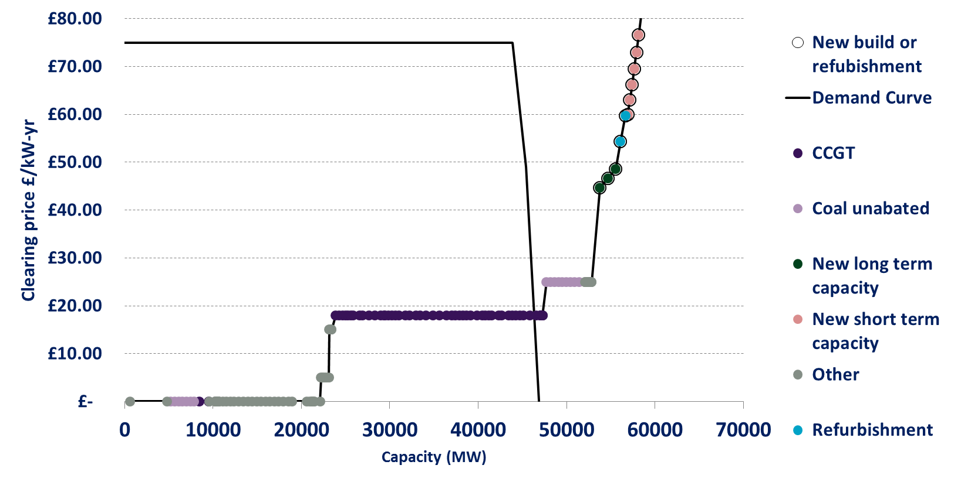
Modelling background
Illustrative basecase assumptions
BAU approach
The basecase used for modelling is based on the following key assumptions:
Existing units: Existing units eligible for CM and their expected retirement dates from DECC view. Existing units bids are based upon simplified technology level assumptions. The model results are not particularly sensitive to this last assumption.
Capacity target: Announced 2020 CM target and future target growth from DECC central case
New long term capacity: Up to 2.7GW of new capacity competes each year for 15 year contracts. Note the model is agnostic as to whether this is CCGT or OCGT capacity. The cost for this capacity starts at DECC’s estimate of CONE £49/kW-yr.
Refurbishment contracts: CCGT units at end of life can enter as 3 year refurbishment. Due to the high expenditure requirement they bid at a level above DECC’s estimate of CONE.
New short term capacity: New capacity is willing to come forward on a rolling 1 year contract price starting at a cost of £60kW-yr. This could represent DSR or other low capacity cost technologies.
The basecase represents a somewhat stylised example that demonstrates the advantage of a PDC approach. As shown above the BAU approach will always favour long term contracts even when they are not required for the full lifetime.
The model is simulated as a representation of the Capacity Market only. The effect of changes in plant mix on energy prices, and therefore CM bids, are not considered. Additionally the benefits resulting from improvements to security of supply of additional capacity is not considered explicitly.
Plant exist bids are adjusted for each PDC and, where a PDC depends on future prices, the model looks to find an equilibrium solution where forward expectations match outturn prices (i.e. the forecast of prices used to determine bids is correct). We deliberately do not consider wider effects outside of the CM, such as changes to wholesale market prices, resulting from changes to the clearing contracts.
Without the application of PDE the typical capacity / bid curve is as shown below. This auction in 2020 demonstrates an oversupply of capacity, however, this does not persist into the longer term
Results are typically sensitive to the ordering of short term and long term contracts in the modelling (driven by the availability of these contracts at different prices). This is explored in the scenarios.

Slide 72
Modelling background – scenario details
Scenario | Description
Reduced competition from short term contracts | Reflecting limited potential availability of capacity willing to come forward only 200MW of additional short term contracts are available in each year (in 50MW incremental CMU unit sizes). Basecase: 2000MW in 500MW incremental units.
Extensive competition from short term contracts | The 2GW (200MW unit sizes) of short term capacity contracts start with a cost of 38 £/kW-yr with a total of 1GW available at a price lower than the cheapest long term contract. Basecase: 2000MW in 50MW increments.
Additional refurbishment eligibility | Reflecting the levels of refurbishment seen in the first auction all CCGT, OCGT and Coal units at end of life enter as 3 year refurbishment contracts. The cost for these units start at £38/kW-yr which allows for up to 1.5-2GW entering at costs lower than long term contracts. Basecase: CCGTs only bid for life extension with costs starting at £55/kW-yr reflecting the high expenditure threshold.
Higher capacity requirement | 3 year delay to increases in the expected contribution of interconnection to the target post 2020. All reductions to target (due to lower demand or higher renewables) delayed two years and half magnitude. Total 30% increase in additional capacity required over period to 2035. Refurbishment availability as in scenario above.
Lower capacity requirement | No increase in target year on year (due to renewable growth lower than demand) and end of life units (which drive much of the new capacity requirement) enter the auction as in the ‘additional refurbishment availability’ scenario.
A
B
C
D
E

Slide 73
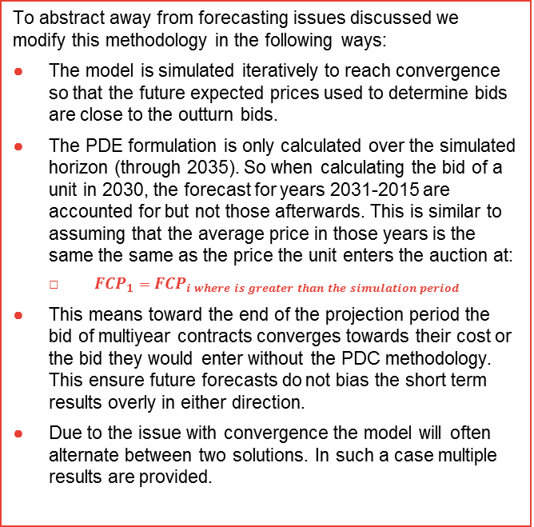
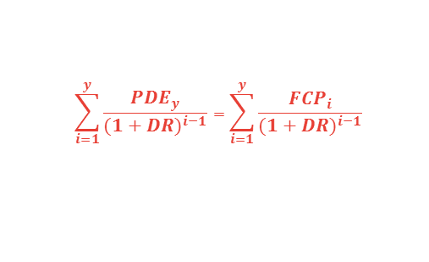
Implementation of perfect foresight efficiency focused PDC methodology
Cost equivalence for a single bid
Details of implementation
DECC’s proposal focused on establishing cost equivalence for a given amount of capacity.
Effectively asked at what price the stream of capacity payments would be equal.
The methodology is implemented as outlined by DECC. In this methodology the year 1 capacity price is found so the lifetime capacity payments for a given new build are set equal to expected future capacity payments without the build. If we know the return a new build needs to make this allows us to solve for the PDC equivalent price:
To abstract away from forecasting issues discussed we modify this methodology in the following ways:
The model is simulated iteratively to reach convergence so that the future expected prices used to determine bids are close to the outturn bids.
The PDE formulation is only calculated over the simulated horizon (through 2035). So when calculating the bid of a unit in 2030, the forecast for years 2031-2015 are accounted for but not those afterwards. This is similar to assuming that the average price in those years is the same the same as the price the unit enters the auction at:
  ${FCP}_{1}$ $={FCP}_{i where is greater than the simulation period}$
This means toward the end of the projection period the bid of multiyear contracts converges towards their cost or the bid they would enter without the PDC methodology. This ensure future forecasts do not bias the short term results overly in either direction.
Due to the issue with convergence the model will often alternate between two solutions. In such a case multiple results are provided.
Price multi-year contract enters auction at
Multi-year contract fixed payments
Capacity price
Estimated future variable payments
Time
$$\sum_{i=1}^{y}{\frac{{PDE}_{y}}{{(1+DR)}^{i−1}}}=\sum_{i=1}^{y}{\frac{{FCP}_{i}}{{(1+DR)}^{i−1}}}$$
For more background on this approach please see the companion slide pack ‘PDE Research Pack’.

Slide 74
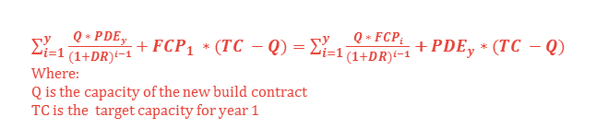
Implementation of CM cost minimisation methodology
Cost equivalence for total CM auction cost
Details of implementation
With the DECC methodology CM costs can be driven up where long-duration capacity contracts set the clearing price and have their bids inflated through the equivalence methodology.
In this approach we look to take this effect into account when setting the price duration equivalence.
One potential implementation is to include the change in year 1 cost, resulting from a change in bid price, in the equivalence
There are a number of complications with implementing this approach in practice:
The size of the new build capacity contract relative to the market is important. This is needed to trade off the year 1 clearing price effect against future CM cost / savings. This prevents a simple ‘menu of prices’ approach to the PDC implementation in reality.
If a plant is entering with a cost above DECC’s future forecast of future clearing prices, the only way to get cost equivalence is for the year 1 clearing price to be lower. This means the effect on expensive new build bids is the opposite to the previous methodology (depending on relative contract to market size) and the contract enters the auction at a price lower than their cost. In effect the formulation is looking to reduce year 1 clearing prices to equate additional future costs.
This formulation assumes that the multi-year contract is setting the CM price. If an alternative single year unit is doing so it will overpay the multiyear contract compared to alternative methodologies.
$\sum_{i=1}^{y}{\frac{Q ∗ {PDE}_{y}}{{(1+DR)}^{i−1}}}+{FCP}_{1} ∗(TC −Q)=\sum_{i=1}^{y}{\frac{{Q ∗ FCP}_{i}}{{(1+DR)}^{i−1}}}$ + ${PDE}_{y}$ $∗(TC −Q)$
Where:
Q is the capacity of the new build contract
TC is the target capacity for year 1
Uplifts on long duration contracts
Increase in CM costs (a transfer from consumers to generators)
CM bids
Long-duration contracts
Short-duration contracts
Capacity

Slide 75
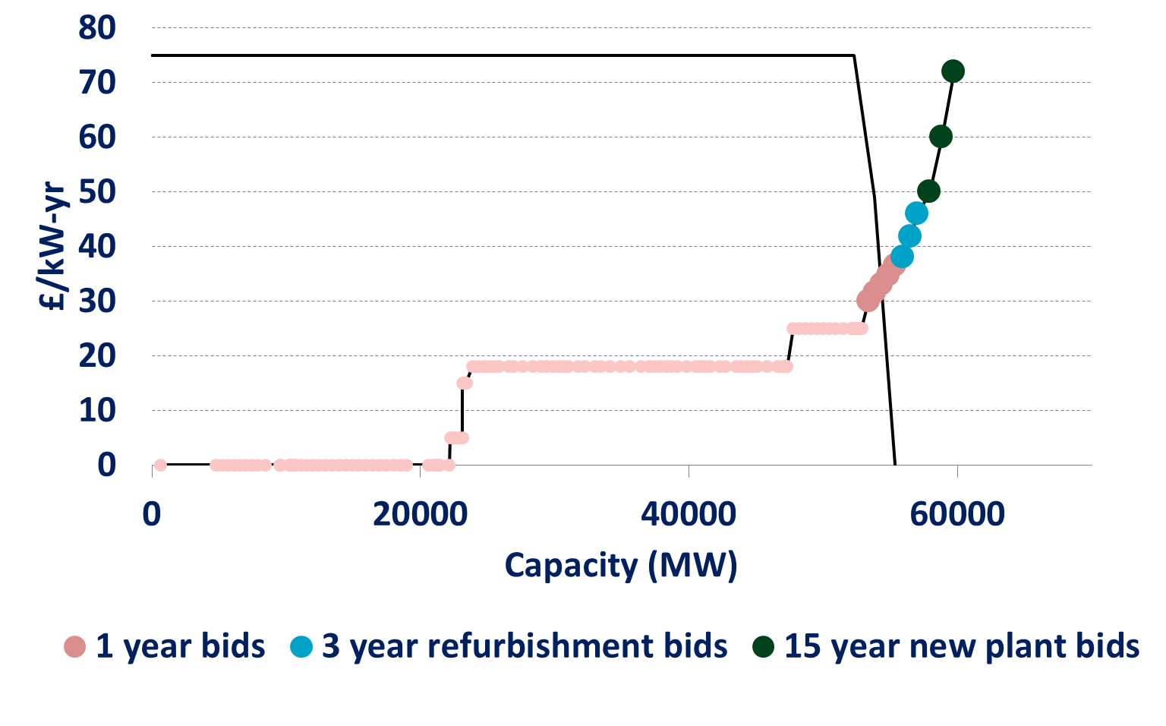
Cost reductions from more efficient contract mixes are likely to require higher clearing prices (1)
Efficiency and cost
1.) The same volume of long-term contracts clear but the same or higher auction price
Below we have looked at one possible construction of the supply curve. No positive adjustment to long-term bids can change the contract mix. However, if the demand was higher or their was less existing supply, the PDC could increase auction clearing prices without any associated increase in efficiency.
The application of a PDC would only act to increase the price at which long-term contracts enter the auction.
No increase in long-term bids can lead to changes in which plant clear since the order of bids cannot change.
However, if a long-term contract was marginal, the clearing price for all units would be increased.

Slide 76
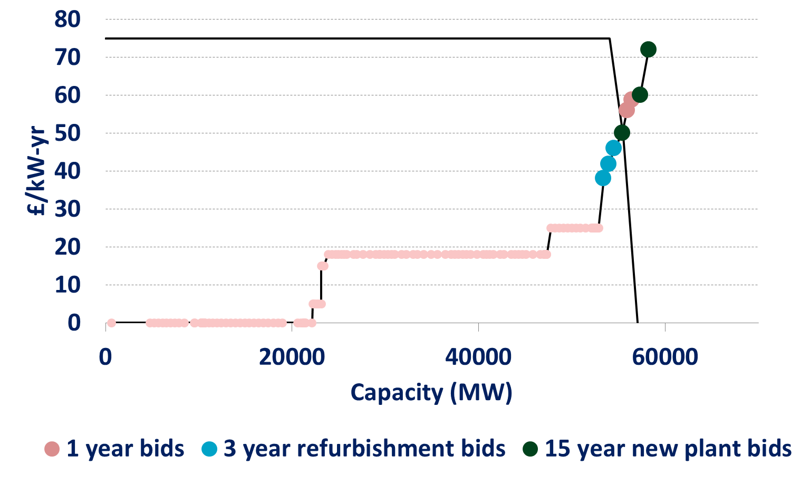
Cost reductions from more efficient contract mixes are likely to require higher clearing prices (2)
Efficiency and cost
2.) A lower volume of long-term contracts clears with a higher auction clearing price.
In this example we have increased the highest 1-year bids to illustrate a situation in which efficiency gains are possible, since a substitution can be made. There are now 2 potential effects of the PDC.
If the long-term contract bid is increased by < £6/kW, then the auction clearing price will increase, but there will be no change in build. This is because the long-term contract remains marginal.
If the long-term contract bid is increased by > £6/kW, then the new plant will no longer clear and the clearing price will also increase. As the new plant is no longer built, we will also have less capacity in future auctions and so will expect higher prices in the long term as well.
An increase of > £6 on existing plant bids will lead to less new build and higher prices.
An increase of < £6 will only lead to higher prices.

Slide 77
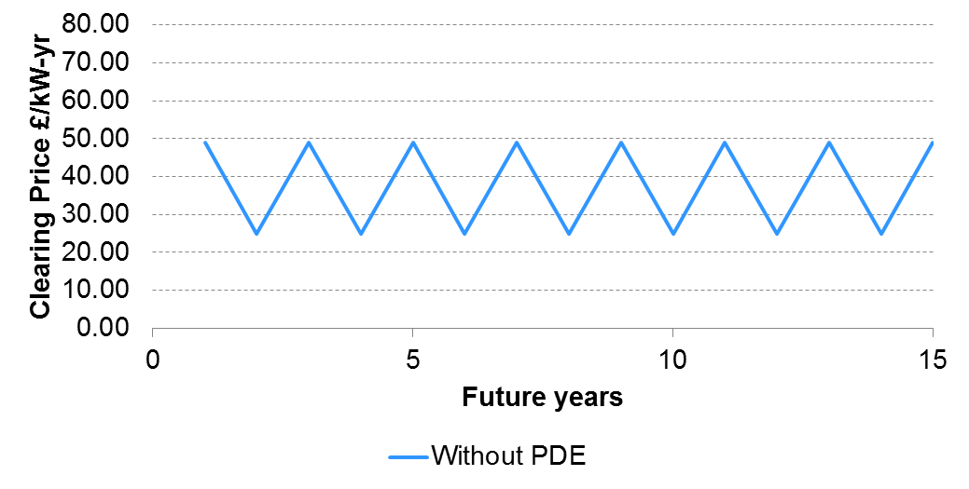
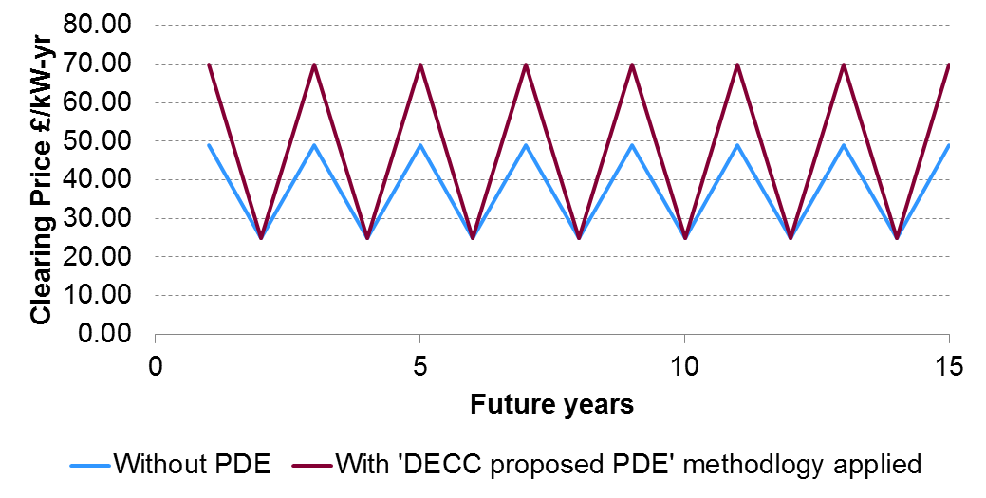
CM costs might actually be increased by adopting an inefficient equivalence methodology
CM Clearing prices without PDC
Applying PDC
If we examine a simple case where new capacity is required at regular intervals, for example, every second year.
If we assume new investors require a payment of CONE and existing plant require the price taker threshold to stay online. The future series of capacity prices alternates between these two prices depending on which type of capacity is marginal in a given year.
If we apply DECC’s PDC methodology to this forecast of CM Prices for a new build to achieve a payment of CONE (£49/kW-yr) in a 15 year contract it would require a clearing price of £182.30 (and this would then be its minimum bid).
However, this would mean the future forecast is inconsistent as the price in years requiring new capacity would be much higher than CONE (ignoring the price cap).
There is a steady state solution where DECC has a perfect foresight view of future prices given the PDE methodology and new build requires CONE to recover costs.
Capacity market clearing prices
Capacity market clearing prices
The PDC case increases average capacity market cost to consumers by 28% without changing the amount or type of capacity on the system.

Slide 78
Modelling results summary
Below we look at more detail behind the modelling scenarios. In order to identify the overall effectiveness of PDC approaches and the situations in which they provide the greatest benefit.
Results (1) shows the change in build decisions in the base case scenarios
Results (2) shows how the NPV for both efficiency gains and CM costs as a result of applying the cost equivalence PDC.
This shows the efficiency gains are achieved in almost all scenarios but at the cost of increased CM payments.
Results (3) repeats the results for the CM cost minimisation approach
This shows the reduction in CM cost but at the cost of lower efficiency in all scenarios.
Results (4) repeats the results for the 50% mixed PDC approach
This shows a reduction in efficiency gains (compare to Results (2)) but with a similar effect on CM cost in most scenarios.
Objective
1
Cost equivalence for a single bid
Objective
2
Minimisation of Capacity Market payments
Price sensitivity to forecast
3
50% Sensitive

Slide 79
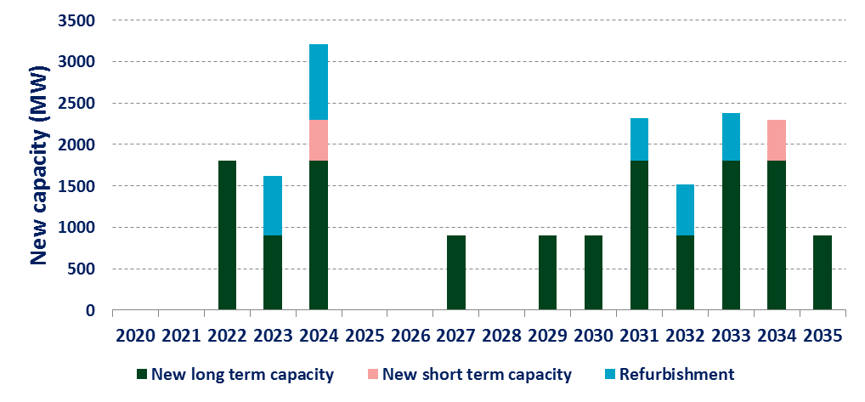
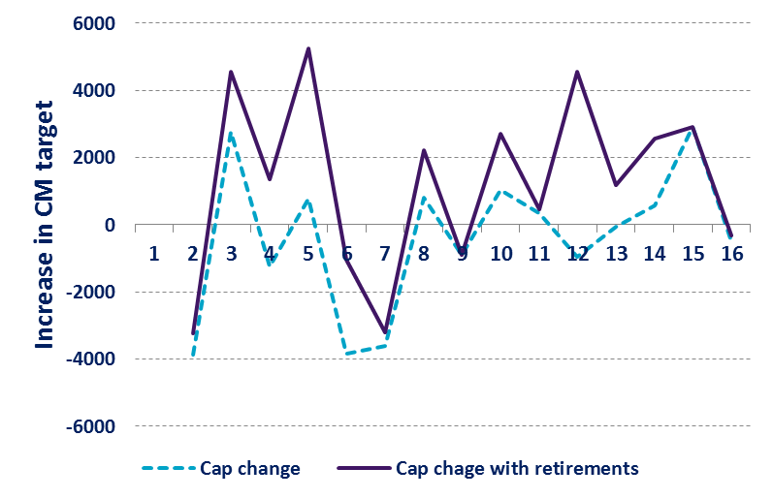
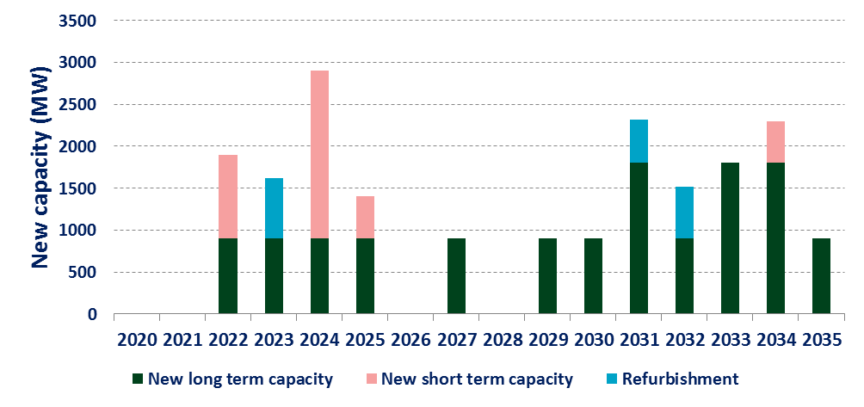
Results (1) The results are driven by the need for new capacity and how this is met
Illustrative basecase
Plant Mix
In the basecase there is a relatively consistent requirement for new capacity. As refurbishment bids are assumed to be higher than existing bids this results in a number of years where long-term contracts will be required.
.
The application of a PDC methodology is able to affect the mix of contract lengths that fills this requirement.
BAU (no PDC)
PDC – minimisation of contract cost
The PDC methodology has resulted in a substitution towards short-term contracts prior to the years 2025-2028 where less extra capacity required. Long-term contracts are either delayed or not required.

Slide 80
Results (2) These results are sensitive to a number of uncertain assumptions
Change against auction without PDC methodology – Cost equivalence PDC
NPV (from 2020) 2012£ millions | Total Capacity Shortages (MW-yr) | Cumulative CM Payments 2030 (£m) | Cumulative CM Payments 2035 (£m) | Cumulative Total Surplus 2030 (£m) | Cumulative Total Surplus 2035 (£m)
Illustrative basecase | -470 | 1490 | 1327 | 88 | 209
Reduced availability of short-term contracts | -2974 | 1945 | 2140 | -43 | 79
Extensive availability of short-term contracts | 0 | 601 | 673 | 50 | 115
Additional refurbishment availability | 0 | 1617 | 935 | 106 | 184
Higher capacity requirement | -170 | 2492 | 2426 | 129 | 343
Lower capacity requirement* | 0 | -6 to 551 | 5 to 563 | -2 to -6 | -3 to 8
Efficiency gains are achieved over an auction without PDC in almost all scenarios but at the cost of increased CM payments. As demonstrated on the previous slide the model is substituting away from long-term contracts in most cases by increasing the price at which they enter the auction. This dynamic also results in capacity shortages in some cases.
These results demonstrate the dynamics explained in the ‘fundamental challenges’ section.
Objective
1
Cost equivalence for a single bid
* Scenarios do not have a steady state solution that provides a consistent forecast / outturn position and a range of potential values resulted.

Slide 81
Results (3) These results are sensitive to a number of uncertain assumptions
Change against auction without PDC methodology – Minimisation of Capacity Market payments
NPV (from 2020) 2012£ millions | Total Capacity Shortages (MW-yr) | Cumulative CM Payments 2030 (£m) | Cumulative CM Payments 2035 (£m) | Cumulative Total Surplus 2030 (£m) | Cumulative Total Surplus 2035 (£m)
Illustrative basecase | 0 | -27 | -967 | -157 | -336
Reduced competition from short-term contracts | 0 | -397 | -942 | -71 | -169
Extensive competition from short-term contracts | 0 | -172 | -46 | -5 | -12
Additional refurbishment eligibility | 0 | 196 | -511 | -78 | -143
Higher capacity requirement | 0 | -288 | -980 | 0 | -13
Lower capacity requirement | 0 | -32 | -36 | 0 | 0
This approach achieves the aimed reduction in CM cost to consumers but at the expense of lower efficiency in all scenarios. The approach typically reduces the price at which long-term contracts enter the market below the level they would enter under BAU. While this reduces total CM payments it results in an over procurement of this type of capacity which can lead to efficiency loses.
Objective
2
Minimisation of Capacity Market payments

Slide 82
Results (4) These results are sensitive to a number of uncertain assumptions
Change against auction without PDC methodology – 50% mixed methodology PDC
NPV (from 2020) 2012£ millions | Total Capacity Shortages (MW-yr) | Cumulative CM Payments 2030 (£m) | Cumulative CM Payments 2035 (£m) | Cumulative Total Surplus 2030 (£m) | Cumulative Total Surplus 2035 (£m)
Illustrative basecase | -70 | 1429 | 1271 | 31 | 54
Reduced availability of short-term contracts | -1336 | 1921 | 2005 | 99 | 190
Extensive availability of short-term contracts | 0 | 660 | 821 | 36 | 82
Additional refurbishment availability | 0 | -277 | -622 | 16 | 34
Higher capacity requirement* | 0 | -209 to 1760 | -209 to 2256 | -154 to 120 | 288 to 295
Lower capacity requirement * | 0 | 38 to 931 | 306 to 1171 | -1 to 14 | 25 to 51
A less sensitive PDC results in a reduction in efficiency gains (compare to slide 80) but with a similar effect on CM cost in most scenarios. In the scenarios examined the this approach often increases the price at which longer-term contracts enter the market, increasing the clearing price and CM payments, without always making a substitution to increase efficiency.
Price sensitivity to forecast
3
50% Sensitive
* Scenarios do not have a steady state solution that provides a consistent forecast / outturn position and a range of potential values resulted.

Slide 83
Appendices
  PDE option detail
  Quantitative modelling
  Stakeholder interviews

Slide 84
Stakeholders generally recognise the value of a PDC but all have concerns around its implementation
As part of this work, Frontier discussed the four design questions, set out under the ‘Option development’ section, with five stakeholders that responded to the original DECC consultation.
These stakeholders were selected on the basis that their consultation responses demonstrated the most developed thinking regarding potential PDE approaches.
They included Energy UK and variety of existing UK generators.
Their collective comments are summarised in this section.
Overall
Most, but not all, of these stakeholders think that where there are differences in contract duration, these differences should, in principle, be accounted for in the auction.
However, none was aware of a PDC implementation with which they felt comfortable.
Objective
They would appreciate a clear articulation of the policy’s objectives from DECC.

Slide 85
In particular, Stakeholders were sceptical about efforts to forecast future capacity prices
Future prices
There were serious reservations around the determination of future prices.
  Stakeholders were sceptical that anyone could reliably forecast capacity prices (at least at present), making it difficult to justify a PDC intervention designed to optimise procurement across different auction years.
  They also felt that DECC’s in-house modelling was not sufficiently independent for this purpose. Use of a range of independent forecasts might be more acceptable.
They also thought it unlikely that trading in forward capacity markets would be sufficiently developed to generate useful price data.
This situation may change in future as the capacity market becomes more established and price forecasting becomes more reliable.

Slide 86

Frontier Economics Limited in Europe is a member of the Frontier Economics network, which consists of separate companies based in Europe (Brussels, Cologne, London and Madrid) and Australia (Melbourne & Sydney). The companies are independently owned, and legal commitments entered into by any one company do not impose any obligations on other companies in the network. All views expressed in this document are the views of Frontier Economics Limited.

Slide 87
FRONTIER ECONOMICS EUROPE LTD.
BRUSSELS | COLOGNE | LONDON | MADRID
Frontier Economics Ltd, 71 High Holborn, London, WC1V 6DA
Tel. +44 (0)20 7031 7000 Fax. +44 (0)20 7031 7001 www.frontier-economics.com

