Slide 1
What makes for good standards in Apprenticeships?
Jeremy Benson – Executive Director for Vocational Qualifications
Bryan Horne - Associate Director, Standards for Vocational Qualifications and Apprenticeships
17 March 2016

Slide 2
Contents
Regulating End Point Assessments
Ofqual’s approach to regulation
Validity, reliability and comparability
Discussion and questions

Slide 3
Some points to provide context
Assessments:
whether for a qualification or an end-point assessment, are small but important parts of apprenticeships
need to be ‘trustworthy’ - employers need to be confident they accurately test achievement of the standard
needs to be well designed and the ongoing delivery systems need to be right, which require assessment expertise
With a market in assessment providers, there is a risk that standards will be compromised - so there needs to be oversight of assessment providers
Ofqual has agreed to play a role in the reforms of apprenticeships to help make sure they are of high quality

Slide 4
Audience … getting to know you
Stakeholders – an interest in Apprenticeship developments, but no direct delivery?
Employers – involved or considering involvement in Apprenticeships?
Providers – colleges, training providers; involved in or considering involvement in delivery of Apprenticeships?

Slide 5
REGULATING END POINT ASSESSMENTS

Slide 6
Quality assurance options
‘You could propose your own approach, in line with our quality assurance principles’
‘You could ask Professional Bodies to carry out this role’
‘You could ask Ofqual to oversee your external quality assurance by regulating your End Point Assessment (EPA)’

Slide 7
Regulating End Point Assessments
Trailblazer group needs to confirm that it has asked us to do this
An organisation wishing to offer an Ofqual-regulated EPA will need to become a recognised awarding organisation (assuming it is not already recognised), by demonstrating to Ofqual that it meets our recognition criteria
Assessment organisations would have to ensure that they and their EPAs could comply with Ofqual’s rules, the General Conditions of Recognition
If there was a conflict between a Trailblazer’s requirements and Ofqual’s, we would require compliance with our Conditions

Slide 8
Regulating End Point Assessments
Training
Apprenticeship Standard
RoAAO
RoTO (or an approved subcontractor)
Assessment plan
Organisation A
Formative assessment
(Becomes recognised)
(Qualifications)
Awarding organisation A
End Point Assessment
Awarding organisation B
IfA
Awarding organisation C
Ofqual regulation
(Extends recognition)
Awarding organisation C

Slide 9
Ofqual’s approach to regulation
Recognition
‘If you want us to regulate your qualifications, you have to apply to become a recognised awarding organisation - an Ofqual-approved provider - of those qualifications’
‘We will regulate all your qualifications that are within the scope of your recognition. That means we expect all those qualifications to meet our rules, be valid and fit for purpose’

Slide 10
Ofqual’s approach to regulation
General Conditions of Recognition (our Rules)
‘Rules and regulations that all awarding organisations and their qualifications must meet’

Slide 11
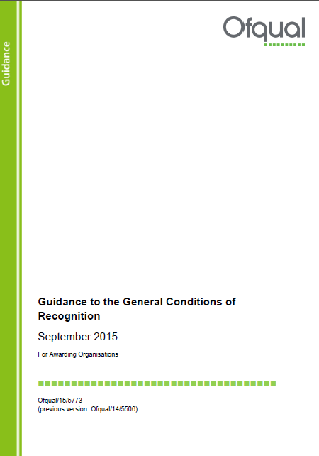
Ofqual’s approach to regulation
Guidance to the 'General Conditions of Recognition‘
‘This guidance is intended to help you understand how to comply with the ‘General Conditions of Recognition’ and the associated requirements. These apply to all awarding organisations and all regulated qualifications’

Slide 12
Ofqual’s approach to regulation
A qualification:
gives a reliable indication of someone’s knowledge, skills or understanding
is only awarded to someone who has demonstrated a specified level of attainment
awards a certificate naming the qualification to anyone who completes it successfully
We will regulate EPAs as qualifications

Slide 13
Validity, Reliability and comparability

Slide 14
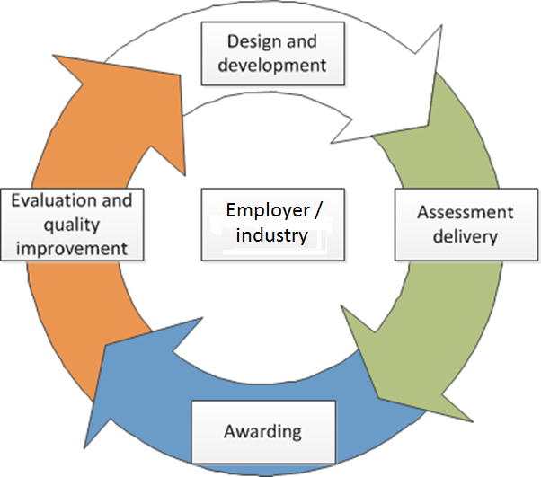
What makes a qualification sufficiently valid?
Should effectively assess the skills and knowledge taught in the qualification
Should enable results to be trusted as a measure of what a person can do
Purpose and content should meet the needs of end users, e.g. employers
Should be kept under regular review
Whole lifecycle is important: from design of qualification to evaluation of assessment

Slide 15
Validity
Validity:
is about whether we’re assessing the right thing, in the right way, to produce accurate assessment results
or in other words … it is the degree to which it is possible to measure what needs to be measured by implementing an assessment procedure
Validity comes in degrees – so measuring proficiency is an imprecise science
We need to be able to measure well enough – to render assessment results both useful and credible – but we cannot expect to measure perfectly
Ofqual regulates so that qualifications are sufficiently valid and trusted

Slide 16
The ideal …

Slide 17
A question …
Acceptable ‘trade offs and compromises’?

Slide 18
Acceptable ‘trade offs and compromises’ – discussion?
Enhancements
Trade-offs/compromises
Increase time of assessment
Practicality of what we can realistically do
Make assessment tasks as authentic as possible
Cover all scenarios where skills are required
Repeat assessments
100% quality assurance sampling (external verification)
Real-world tasks often complex – harder to assess
Time and resource constraints
Costs increase – takes time
Costs increase – takes time

Slide 19
Reliability and Comparability
Reliability:
the extent to which the various stages in the assessment process generate outcomes which would be replicated were the assessment repeated.
but whilst it is a necessary condition of Validity, a test could be reliable but not-valid
Comparability:
when we wish to be able to claim that results from different qualifications can be used interchangeably,
when we wish to be able to claim that results from the same qualification can be used interchangeably over time,
because they measure (more-or-less) the same thing in (more-or-less) the same way

Slide 20
A question …
Better comparability?

Slide 21
Assessment methods that make for better comparability – discussion?
Support better comparability
Oppose
Multiple choice test
Learner interview - unstructured
Structured interviews
Closed response questions
Non-compensatory – skills’ competency tests
Fewer assessment opportunities
Fixed balance between knowledge recall & understanding – structure
Criterion-referenced assessment
Learner selected projects
On-demand assessment
Open response
Compensatory marking
Variable balance between knowledge recall & testing understanding – variety
Norm-referenced assessment

Slide 22
The right balance
Skills tested
Comparability

Slide 23
Regulating EPAs …
EPA design
links to Assessment Plan
validity of assessment
reliability of assessment
ability to compare ~ over time, between EPAs, with other qualifications
Up-front criteria - EPA specific rules?
EPA Guidance?
Expectations of Apprenticeship Assessment Organisations:
working together – comparability
working to keep EPAs current
responding to employer, apprentice feedback
comparability role for Ofqual – supervisory regime?

Slide 24
Discussion and questions

