Slide 1
Sector insights: skills and performance challenges in the digital and creative sector June 2015

Slide 2
Sector insights: digital and creative sector
This study:
synthesises labour market evidence to identify the outlook for jobs and skills
identifies major trends affecting the sector and how the mix of skills needs is likely to change over the next decade
investigates employers’ perceptions of the skills needs of specific occupations, and the challenges employers have in meeting those needs
discusses current awareness of, engagement with and interest in National Occupational Standards in developing the sector’s workforce
draws out the implications for skills supply and workforce development

Slide 3
The study synthesises evidence from a range of sources
A review of recent literature on the digital and creative sector
An online and telephone survey of digital and creative employers
Consultations with industry stakeholders
Telephone interviews with 20 employers and 14 employees
Analysis of published datasets
Stakeholder workshop to review and refine findings

Slide 4
About the sector
The digital and creative sector ^{1,2}
2012 employment: 2.1 million in total
Digital sub-sector
Employers reported that the boundaries between ‘digital’ and ‘creative’ are becoming blurred as creative activities increasingly rely on digital technologies, and as creativity and design become increasingly important to digital outputs
Creative sub-sector
⁽¹⁾ This definition of the digital and creative sector was also chosen to allow the study to draw on the widest possible range of datasets.
⁽²⁾ While this report includes analysis of the digital and creative sub-sectors, a number of employers highlighted that the boundaries are becoming increasingly blurred.

Slide 5
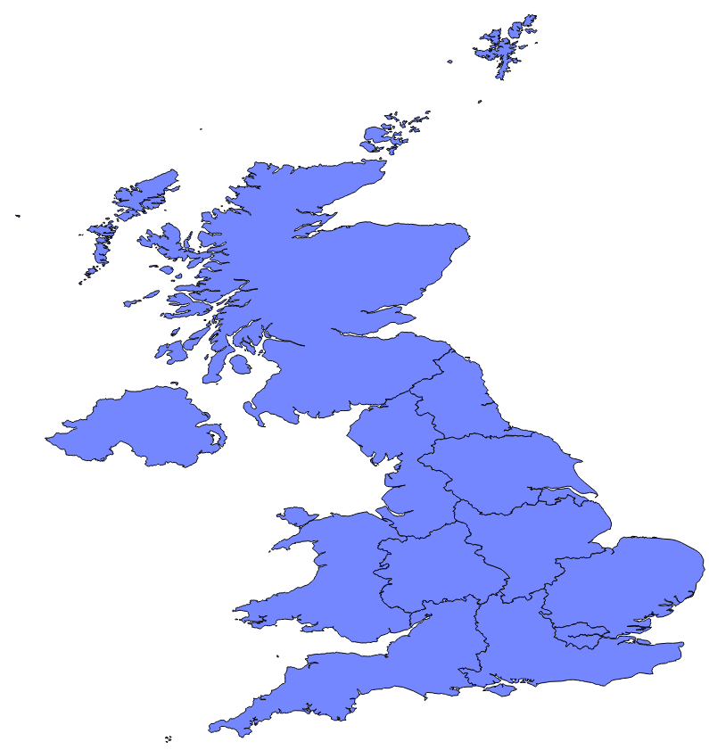
Rapidly growing sector contributed £134 billion to UK economy in 2014
In real (inflation-adjusted) terms, the GVA contribution of the sector has grown by 45 per cent since 2002
Almost half of digital and creative sector workers are in London and the South East of England
Numbers and size of bubbles indicate digital and creative employment in each region or nation
The sector received a strong boost from the introduction of tax relief to animation, high-end television, video games and theatre during 2013 and 2014
Scotland 121,000
Northern Ireland, 33,000
North East, 69,000
North West 183,000
Yorkshire & Humber, 123,000
West Midlands, 124,000
East Midlands
95,000
Rapid advances in technology and internet usage have driven strong demand for digital services and creative content over the last decade
East, 187,000
Wales, 47,000
London 605,000
South West, 152,000
South East, 382,000
Source: UKCES Working Futures

Slide 6
Sector characterised by a high proportion of self-employment and micro enterprises
There is an extremely high rate of self-employment in the digital and creative sector
Proportion of workers that are self-employed, 2012
The sector has a relatively low share of large firms % of firms with 10+ employees, 2014
13%
24%
Digital and creative
All sectors
Source: UKCES Working Futures
The number of creative employees fell between 2008 and 2012, but this offset by an increase in self-employment
These characteristics create skills challenges
Small firms and the self-employed are less likely to invest in training and development
Many employers do not provide training to freelancers on short-term contracts
However, freelancers may benefit from ‘sideways learning’ as they gain experience from working with different clients on different types of project
Self-employed
Employees
70,000
70,000
Source: UKCES Working Futures

Slide 7
The digital and creative sub-sectors each face challenges in the diversity of their workforce
A failure to attract more females to digital roles means the sub-sector misses out on a substantial share of the potential labour pool
The proportion of non-white workers in the creative sub-sector remains below average
Proportion of workers that are non-white
Females per 100 jobs

Slide 8
Rapid advances in technology are major cause of skills gaps
Skills gaps within the current workforce are more prevalent in the digital sub-sector
Employers highlight the importance of workers keeping up to date with the latest technological developments
Staff with skills gaps as % of employment
Advanced IT or software skills are much more likely to be identified as lacking amongst digital and creative employees than across the economy as a whole
Technical
Soft skills
Creative
The convergence of digital and creative roles, rising client expectations and increasing competitive pressure mean that employers increasingly seek a ‘fusion’ of technical, creative and soft skills
Source: UKCES ESS 2013
Team working is becoming more important as projects increase in complexity and involve more people

Slide 9
Employers face challenges filling vacancies
Vacancies per 1,000 workers¹
Skills shortage vacancies per 100 vacancies¹
Firms reporting that advanced IT or software skills are difficult to obtain from applicants^{1, 2}
Digital sub-sector
Creative sub-sector
Employers find it most difficult to recruit to technical roles such as data scientists, coders, programmers and web developers
Two-thirds of firms with skills shortage vacancies report that advanced IT or software skills are difficult to obtain
Severe challenges identifying candidates for certain high-value roles, such as cyber security experts and high-end business analysts. Those with expertise in such areas can command extremely high salaries
Vacancy rate is above the national average
Recent introduction of tax relief in areas such as TV, video games and regional theatres has stimulated extremely strong demand for workers
Small average firm sizes mean that it may take employers time to identify individuals with the specific and broad mix of skills they need
Particularly difficult for some creative firms to recruit to digital roles since those with requisite skills might not typically think of seeking a career in a creative environment
Wide choice of applicants for some of the most attractive roles (graphic designers, producers and photographers)
⁽¹⁾ Source: UKCES ESS 2013
⁽²⁾ Proportion of firms reported they have skills shortage vacancies

Slide 10
Graduate employment plays an important role
Almost half of the digital and creative workforce is educated to at least degree level
Employers reveal a strong preference for recruiting graduates
However, employers reported concerns that graduates do not leave university with the skills they need to be effective in the workplace
Courses do not keep pace with technological change
Too much reliance on textbooks rather than doing
Creative graduates have breadth rather than depth of knowledge
Technological change can have an impact in less obviously technical areas, e.g. the ability to write in less formal styles for digital media
Employers also highlight lack of soft skills and experience
Unemployment rates amongst computer science graduates six months after graduation are the highest amongst all graduates.
This suggests a significant mismatch between employers’ needs and the skills taught at university
% of those in employment educated to degree level or above, 2012
48%
29%
Digital and creative
All sectors
Source: UKCES Working Futures
Digital and creative firms are much more likely to hire university graduates, and less likely to hire school or college leavers
% of firms that have recruited someone to their first job on leaving education in the last 2-3 years
Source: UKCES ESS 2013

Slide 11
1.2 million new workers needed between 2012 and 2022 – equivalent to half the current workforce
Projected demand for workers, 2012 to 2022 (000s)
Three quarters of the workers needed will be in the three highest skill occupational groups. There are particular concerns about the ability of the education system to supply the quantity and quality of workers needed for digital roles
The following slides discuss factors that are expected to influence the number of workers and types of skills needed over the next 10 years
These forecasts include workers needed to support the sector’s growth and to replace those expected to leave
Source: UKCES Working Futures

Slide 12
Technology will be the most important influence on future skills demand
Technological drivers of change
Skills implications
Further growth in demand for digital content and services, and rapid technological progress
Automation of routine tasks
Growing importance of cyber security
Convergence across platforms
Further growth in mobile and cloud computing
Big data and analytics
New business models and collaborative platforms
Fusion of technical expertise, creativity, entrepreneurialism and softer skills
Employers will increasingly seek those workers best able to adapt and respond to technological change
Strategic thinking to identify the best ways to exploit and adapt to new technologies and business models
Specialists with a detailed technical knowledge in cyber security, different platforms, mobile and cloud computing, big data. Most workers will need at least a basic level of knowledge in these areas
Analytical skills to develop and anticipate how markets and individuals may respond to new business models

Slide 13
Regulatory, economic and demographic factors will also influence skills demand
Regulatory, economic, demographic drivers
Skills implications
Changes to rules on intellectual property
Changes to rules on the ownership and use of data
Pressure to increase workforce diversity
Potential changes to employment laws to make it more difficult to employ unpaid interns and increase regulation of self-employed workers
Older workers that retire later find themselves working alongside ‘digital natives’
Further deepening of globalisation
Increased demand for healthcare technology as population ages
Risk of further government spending reductions, and changes to tax incentives in the UK or overseas that make the UK a relatively less attractive location for digital and creative activity
Legal and regulatory expertise
New and more proactive approach to human resources management
People management skills
UK increasingly specialises in highest-skill, highest- value roles
Business skills to develop international networks, and develop and implement strategies to maximise UK’s share of the global market for digital and creative outputs
Expertise in areas that will see increased demand as population ages (e.g. healthcare technologies)

Slide 14
Skills needs and challenges in five occupations (1)
 | Skills needs | Challenges
IT business analysts, architects & systems designers | Technical skills Understand client needs and identify solutions People skills Cyber security and big data | Competing with financial and consultancy firms that can pay extremely high salaries
Programmers & software development professionals | Technical, programming and design ability Ability to understand user needs Work across platforms and formats Cyber security and big data | Very difficult to recruit to this role Start-ups attract best candidates Degree courses not equipping graduates with the right skills Retention a concern for smaller firms
Graphic designers | Blend of technical and creative skills Ability to design something attractive which also communicates a message People skills Adapt to different platforms and new technologies | Large pool, but finding a designer with right level of skill and experience can be challenging Many wish to work freelance

Slide 15
Skills needs and challenges in five occupations (2)
 | Skills needs | Challenges
Arts officers, producers & directors | Leadership, people skills, time and resource management creative and technical skills Keep up to date with technology Develop associated content across platforms | Large and competitive pool of workers Can be difficult to find expertise away from London
Photographers, audio-visual & broadcasting equipment operators | Operate and repair equipment, and work with computer hardware and software. Teamwork Increasing demand for video rather than photos Keep up to date with technology | Large pool of workers available Can be difficult to find experienced operators

Slide 16
Awareness and use of NOS
Both awareness and use of NOS is lower amongst digital and creative firms than across the economy as a whole
Employers suggested a number of ways to make NOS more useful and relevant to digital and creative firms
Awareness and use of NOS
Use NOS to ensure those leaving college and university are equipped with the skills employers need
Focus on core skills, rather than more specific technical skills that may quickly become outdated
Reduce the detail level
Improve the NOS database
Develop a clearer narrative to explain the rationale for and benefits of using NOS
Source: UKCES EPS 2014
There may be a greater role for NOS in the digital sub-sector, where standards can provide a valuable benchmark to enable employers to understand an individual’s capabilities

Slide 17
Attracting young people to the sector
Next Gen Skills has successfully campaigned for the introduction of a computer science course within the National Curriculum. It also campaigning for the embedding of essential ICT skills across the wider curriculum and promotes a mix of subjects crucial to the future success of the UK’s digital and creative sector. The campaign is backed by a coalition of employers and professional bodies.
The Tech Partnership TechFuture Girls initiative consists of after school clubs designed to encourage girls aged 10 to 14 to stay engaged in IT. The programme aids the development IT skills through a number of challenges on themes such as fashion, music, sport and celebrity.
{CODEZONERS} is a nine month foundation level computer programming and work placement scheme for 17 to 19 year olds that are not in education, employment or training. The course is aimed at individuals who already have some coding skills, or an interest in coding or design.
Creative Access aims to widen access to the creative industries for young people from a broader range of backgrounds. The scheme provides opportunities for young people from black, Asian and minority ethnic (BAME) backgrounds to undertake paid internships with major creative sector organisations.
The Creative and Cultural Skills (CCS) Building a Creative Nation campaign is calling upon creative employers to create jobs and promote responsible and sustainable recruitment practices. The campaign is particularly focused on addressing the issue of unpaid internships, which restrict recruitment to those who can afford to undertake an unpaid placement.

Slide 18
Equipping students with the skills the sector needs
The Creative Skillset Tick scheme accredits courses and apprenticeships that best meet employer needs. This acts as a signalling mechanism for students concerned about their future employability, and can help firms identify graduates with the skills they need.
The National Skills Academy for IT provides access to online courses and resources, and acts as a broker for apprenticeships. Employers have created the Academy to attract more people into the sector; provide a means for making strategic interventions in the areas of greatest skills need; and encourage individuals and employers to take up high quality training.
The National Skills Academy for Creative & Cultural runs careers events and information sessions across the UK. Comprising more than 500 employers and 40 Further Education colleges, the Academy aims to ensure that students on creative courses gain realistic experience of working in the arts and can develop the skills they need.
The Skillset Film Academy Network includes educational institutions that have been identified by the UK film industry as centres of excellence in film education and training.
The Tech Partnership runs the Professional Placement Scheme to enhance the employability of students. The student, employer and university commit to following a set of best practices, which have been defined by employers, and which are designed to enhance employability.
The Tech Partnership has led development of the IT Management for Business degree (ITMB) to combine technological expertise with business skills. Employers have contributed to the design of the course and deliver some of the content. The course is offered at 19 UK universities.

Slide 19
Meeting future skills demand
Trailblazers
The ‘Trailblazers’ initiative in England aims to make apprenticeships more attractive to employers by simplifying the system; and giving employers responsibility for developing standards that are closely aligned with industry needs. The digital sub-sector is one of the first sectors to develop apprenticeships under this new approach
The Tech Partnership coordinates the Tech Industry Gold apprenticeships scheme, under which a panel of employers designs course standards and accredits training providers to signal quality apprenticeships to other employers.
Creative Skillset coordinates training initiatives through Skills Investment Funds (SIFs), which are funded through voluntary levies on firms and co-investment from the Government. The SIFs support skills in film, high-end TV, animation, games and visual effects.
The Tech Partnership coordinates the Tech Partnership Training Fund to support greater training in the digital sub-sector. This allows employers to access up to half of the cost of providing additional training for IT apprentices and running short courses to develop skills that are important to the future of the industry.
Industrial partnerships comprise groups of employers working together to promote growth and competitiveness in a particular sector through skills. All aim to address skills shortages and test innovative approaches to training. The industrial partnership for the digital economy is the Tech Partnership. The Creative Industries Partnership covers a range of areas including media, games, fashion, publishing, advertising, and marketing and communications. They work on issues facing the sector across the UK.
Industrial Partnerships

Slide 20
Raise the supply of skills
Encouraging more people to work in the digital and creative sector
Consider how the allure of a career in the creative industries can be harnessed to encourage more people to acquire the digital skills needed across the digital and creative sector
Market the digital and creative sector to a wider field of potential recruits with different backgrounds, and ensure conversion courses are available to help people move into roles where shortages are most severe
Help young people at school and university to identify the skills they will need for a career in the digital and creative sector
Consider whether additional skills initiatives are needed in the immediate term to alleviate shortages in areas that are growing extremely rapidly following the introduction of new tax incentives
Accessing and fostering expertise in other parts of the economy
Consider whether sufficient expertise is available in areas such as legal services, human resources, market and pricing analysis, and business strategy, which will increasingly be needed to support the growth of the sector
Consider whether there is a need for skills initiatives to tailor such expertise to the specific and rapidly evolving needs of digital and creative employers.

Slide 21
Ensure education delivers the skills employers need
Ensuring university graduates have the right skills
Identify how university courses can better equip young people with the skills digital and creative employers need, and ensure they keep up with technological change
Research why unemployment rates are so high for computer science graduates
Ensure there is a wide choice of courses that combine technical and creative skills, so the study of digital and creative is not seen as an either/or choice
Ensure students in digital subjects pick up at least a basic knowledge of issues such as cyber security, intellectual property and data protection.
Increasing the use of apprenticeships and FE
Consider whether there is scope to tailor apprenticeships to better suit the profile of digital and creative employers
Assess whether lessons may be learned from the Irish institutes of technology model to bring more non-university graduates into digital and creative roles.
Training the current workforce
Explore new models for ensuring employees in small and larger firms have access to ongoing training to keep up with technological developments
Build stronger relationships with local educational institutions and training providers to enable employees to undertake modular training with minimal disruption to work.

Slide 22
https://www.gov.uk/government/organisations/uk-commission-for-employment-and-skills
info@ukces.org.uk
@UKCES

