Slide 1
Double marking? – is there a case for GCSE and A level marking?
Beth Black and Stephen Rhead

Slide 2
Outline of presentation
Double marking intro – what is double marking?
Why double mark?
Research design
Hypothetical worked example
Data from study
  Double marking
  Double marking with adjudication
  Component level double marking
Caveats
Operational considerations
Conclusions

Slide 3


double marking – version 1
9
9
8
Script/item
Marked independently by two examiners – they are not aware of the other’s mark
Take the average (and round up)

Slide 4

double marking – version 2 – (helps when marks are far apart – “adjudication”)
9
8
9
6
Script/item
Marked independently by two examiners – i.e. not aware of the other’s mark
Item is distributed to a third marker who marks independently
Take the average of the two closest marks and round up.

Slide 5
Study
Simulate double marking
Use seeding data from live marking
meets assumptions of independent marks
Compare the proximity to the definitive mark for:
  single marking versus
  double marking versus
  double marking with adjudication

Slide 6
A hypothetical worked example
Seed item A
Definitive mark = 9
Seed item A
Single mark = 7
Seed item A
Double mark = 7.5
Seed item A
Double mark = 8.5
Seed item A
Single mark = 8
Seed item A
Double mark = 8
Seed item A
Double mark = 9
Seed item A
Single mark = 9
Seed item A
Double mark = 8
Seed item A
Double mark = 9
Seed item A
Single mark = 9
Seed item A
Double mark = 8.5
Seed item A
Double mark = 9.5
Seed item A
Single mark = 10
Seed item A
Double mark = 8.5
Seed item A
Double mark = 9.5

Slide 7
A hypothetical worked example
rounded
Seed item A
Definitive mark = 9
Seed item A
Single mark = 7
Seed item A
Double mark = 8
Seed item A
Double mark = 9
Seed item A
Single mark = 8
Seed item A
Double mark = 8
Seed item A
Double mark = 9
Seed item A
Single mark = 9
Seed item A
Double mark = 8
Seed item A
Double mark = 9
Seed item A
Single mark = 9
Seed item A
Double mark = 9
Seed item A
Double mark = 10
Seed item A
Single mark = 10
Seed item A
Double mark = 9
Seed item A
Double mark = 10

Slide 8
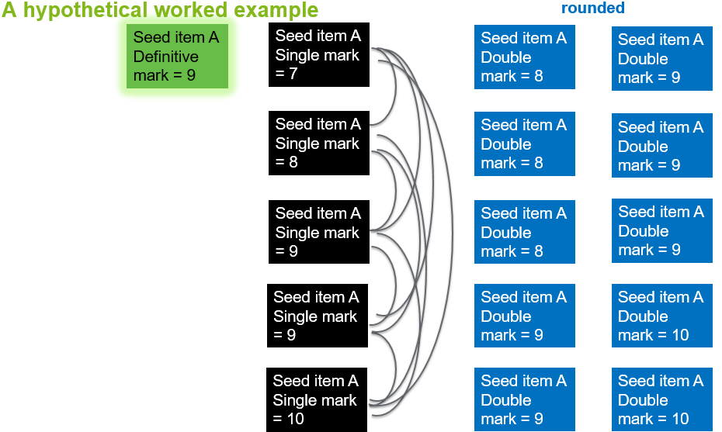
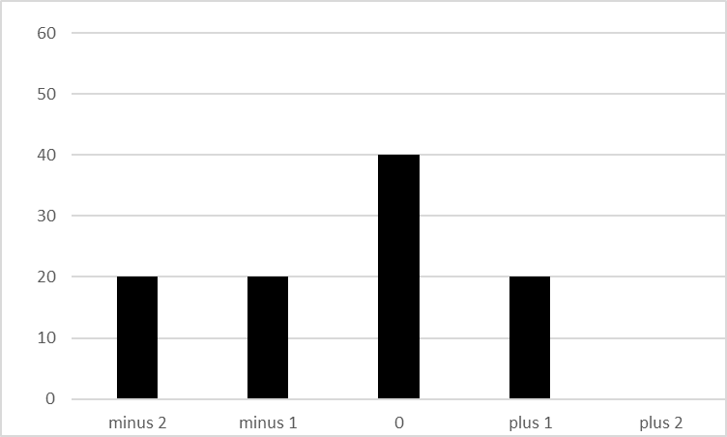
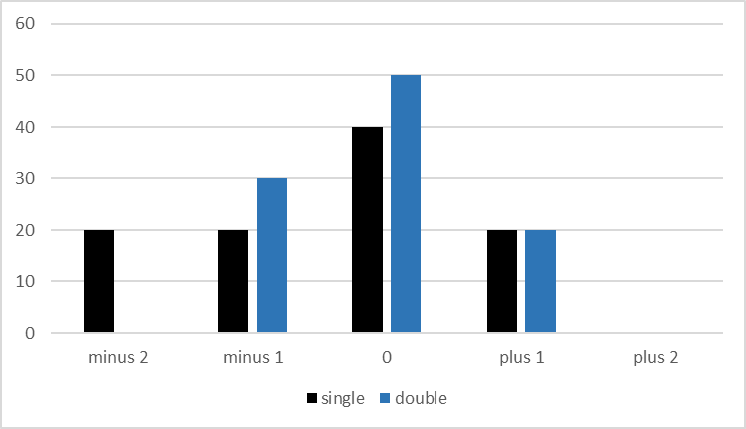
A hypothetical worked example
Single marking
Single v double marking

Slide 9
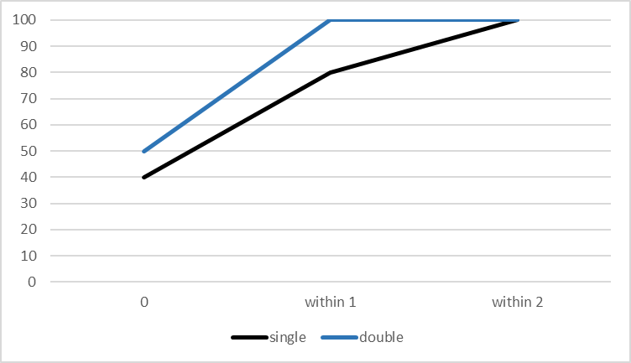
Proximity to the definitive mark
A hypothetical worked example
0%
+20%
+10%
Cumulative percentage

Slide 10
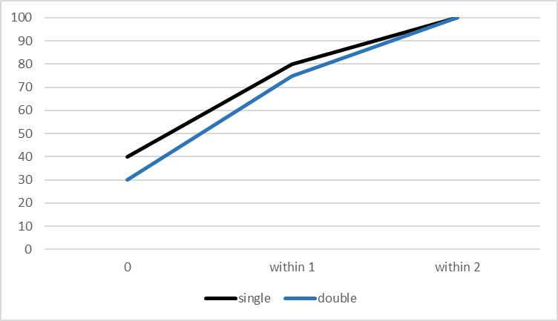
Proximity to the definitive mark
A hypothetical worked example
May sometimes be the case that single is better than double….
0%
+20%
-5%
+10%
-10%

Slide 11
Why might double marking not always be better?
 | First marker
Second marker |  | Good | Lenient | Harsh | Inconsistent
 | Good | Good | ½ lenient | ½ harsh | ?
 | Lenient | ½ lenient | lenient | good | ?
 | Harsh | ½ harsh | good | harsh | ?
 | Inconsistent | ? | ? | ? | ?
Ref: Elizabeth Gray

Slide 12
Advantages of research design
Very large data set
Live scripts marked under live marking conditions
  Examiners standardised
  In-session high stakes marking
  Normal use of marking software
Can look at different subjects, items with different tariffs etc.

Slide 13
Data
958 k marking events (2015)
  ≈ 1 million items
For each event match all possible combinations of examiners
  ≈ 30 million pairs of marks
Notes:
From the live monitoring data we have approximately one million marking events from 2015 alone.
Once we have matched all possible combinations of examiners for all items we have approximately 30 million paired marks.
As a result we have a very large amount of data with a range of boards, subjects and item and mark scheme features.

Slide 14
Double marking simulations

Slide 15
double marking
9
9
8
Script/item
Marked independently by two examiners – they are not aware of the other’s mark
Take the average (and round up)
Notes:
Each seed item is marked independently by two or more examiners.
Once examiners have been paired for a particular seed item we take the average of the two marks for that pairing. We then calculate the proximity of the averaged mark from the definitive mark for the seed item.
By taking such an approach we can compare the 30 million pairings with the 1 million marking events and can look at the probability of double marking giving a “more accurate” mark than single marking.

Slide 16
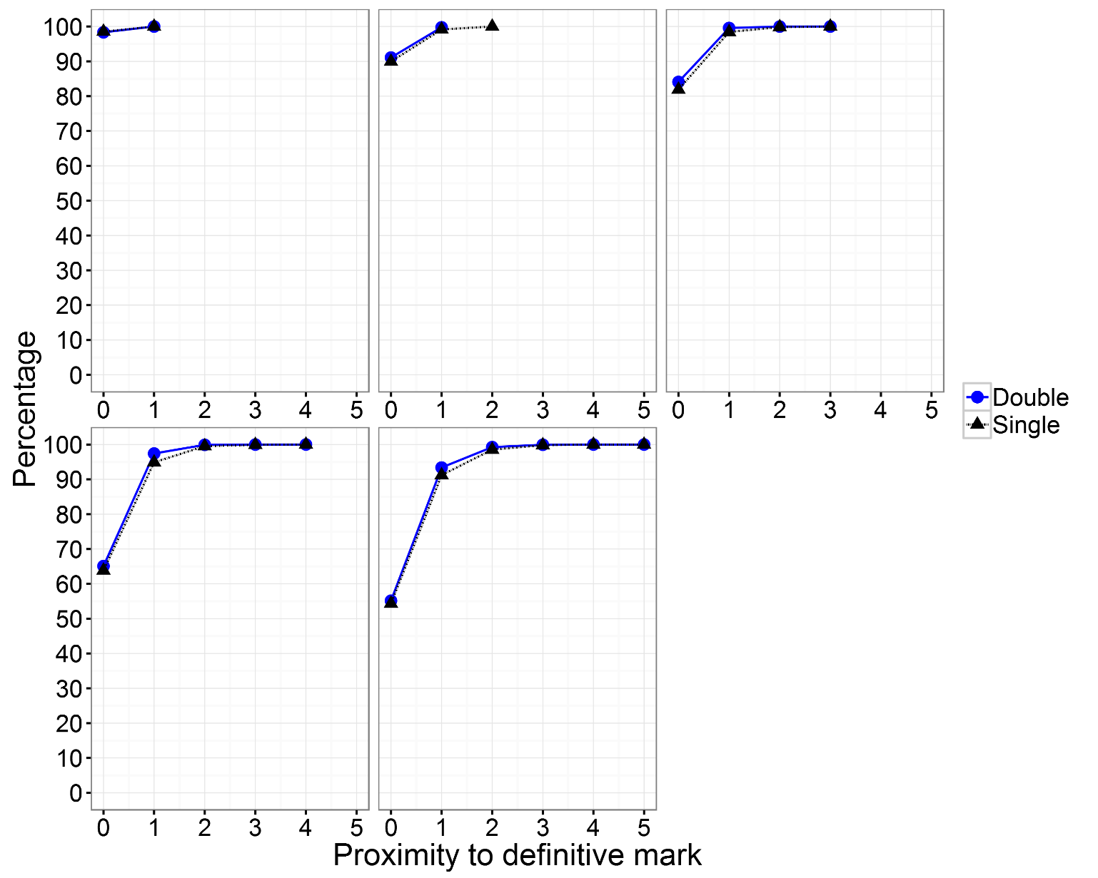
Proximity to definitive mark – short answer questions (1 to 5 mark items) in a range of subjects
Virtually no benefit
Probably because the marking on short answer questions tends to be fairly consistent
1 mark
2 marks
3 marks
4 marks
5 marks
Notes:
Here we can see the proximity to the definitive mark for short answer questions for a range of subjects including English, English Literature, Business Studies, modern foreign languages and history, but excluding physics.
It is observed that there is virtually no benefit for using double marking for these short answer questions as there is almost no difference between the two approaches. This is probably because it is likely that the mark schemes are constrained and points based and also that marking tends to be consistent and good for these short questions as at least 90% of all single marks and paired marks are within 1 mark of the definitive mark.

Slide 17
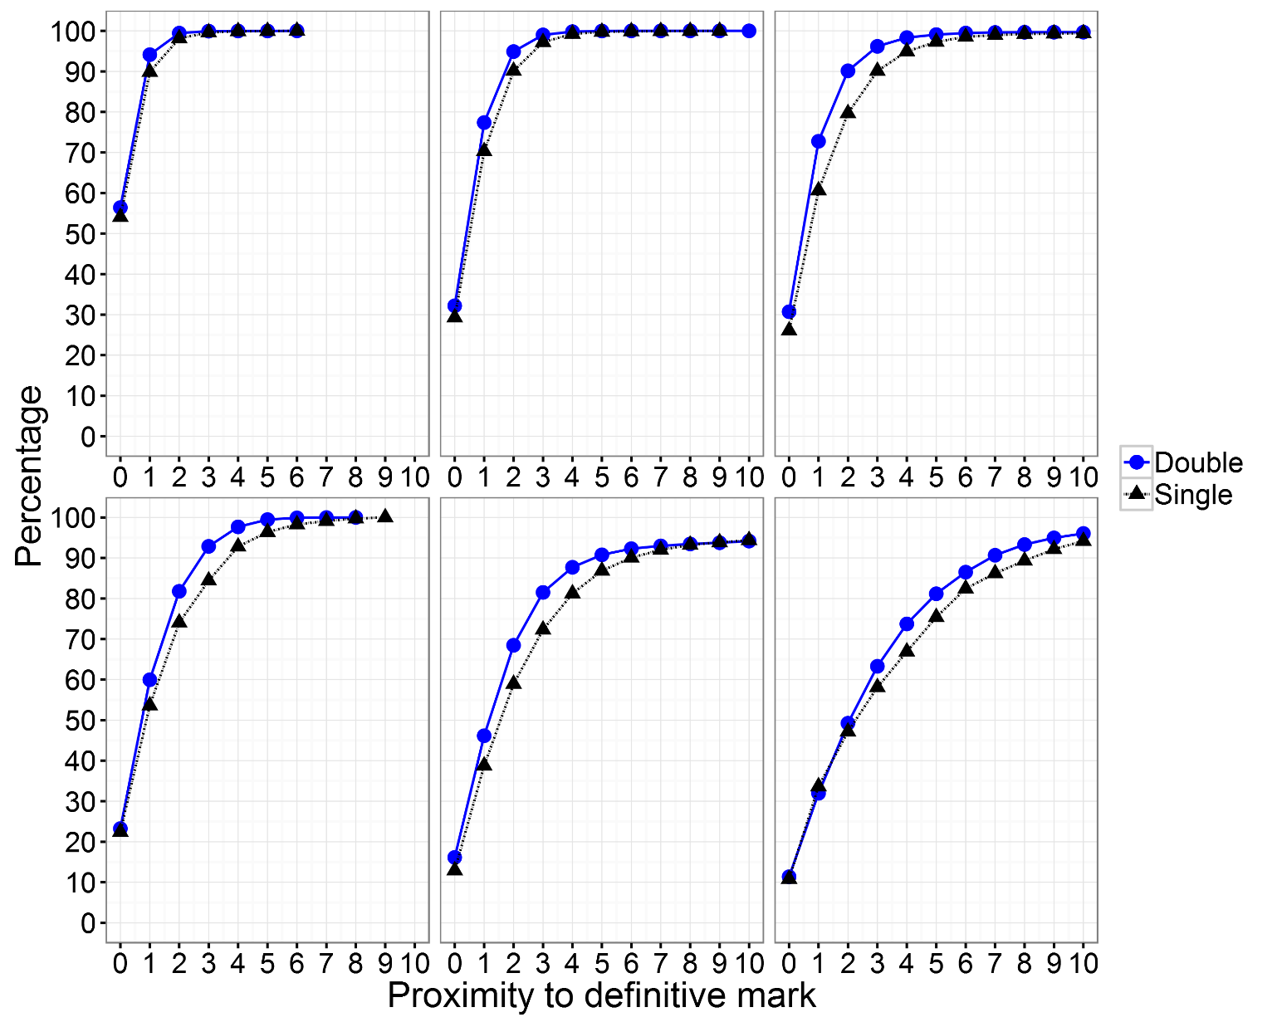
Proximity to definitive mark – longer response items (6 to 40 mark items)
6 mark items
12 mark items
16 mark items
20 mark items
30 mark items
40 mark items
Notes:
Here we see the proximity to the definitive mark for 6, 12, 16, 20, 30 and 40 mark items. Again these are for a range of subjects including English, business studies, history and geography but not including some of the more ‘objective’ ones such as physics.
We can see that as the maximum mark increases the probability of candidates receiving the definitive mark decreases ranging from approximately 55 % for 6 mark items to approximately 12% for 40 mark items. For these items there appears to be no apparent benefit to using double marking in terms of receiving the definitive mark as in most instances the percentage change is around 2 %.
Where the largest increases are observed depends on the item tariff. For example for 16 mark items the largest benefit is observed within 1 mark from the definitive mark (~ 15% increase) whereas for 40 mark items the largest benefit is seen at 4 marks away from the definitive mark.

Slide 18
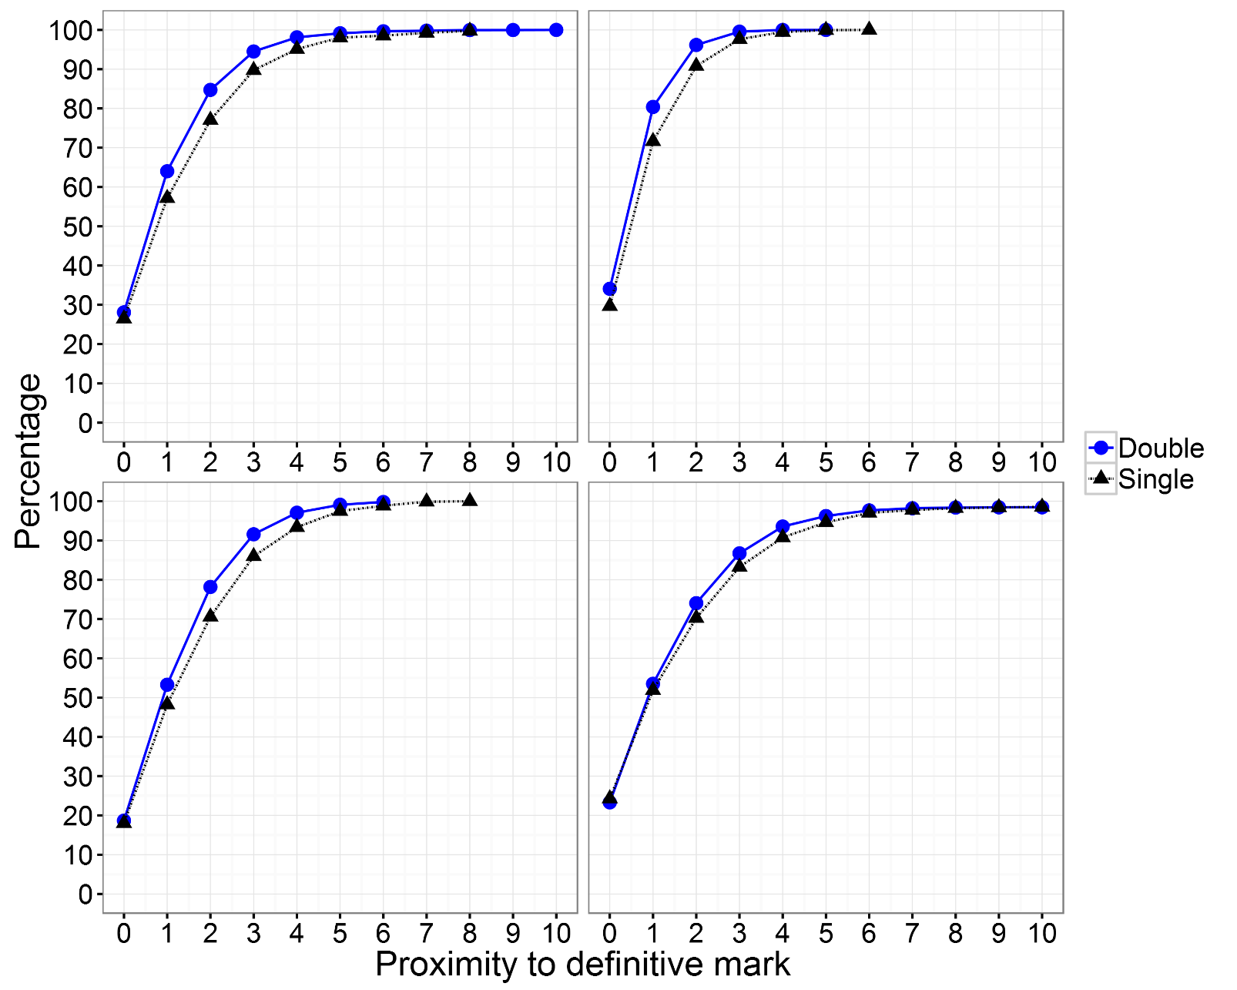
Subject differences? A look at 16 mark items
Single versus double – probability differences
Proximity to the definitive mark | Business | English | Geography | History
0 | 1.5 | 4.4 | 0.7 | -1.0
1 | 6.9 | 8.8 | 5.0 | 1.6
2 | 7.6 | 5.4 | 7.6 | 3.8
3 | 4.8 | 1.9 | 5.6 | 3.5
4 | 3.0 | 0.5 | 3.7 | 2.8
5 | 1.1 | 0 | 1.6 | 1.6
6 | 0.5 | 0 | 1.0 | 0.6
7 | 0.2 | 0 | 0.9 | 0.5
8 | 0 | 0 | 0.1 | 0.1
9 | 0 | 0 | 0 | 0
10 | 0 | 0 | 0 | 0
Events = 819
Pairs = 6482
Events = 6,080
Pairs = 484,118
Business
English
Events = 877
Pairs = 25,368
Events = 5,514
Pairs = 143,079
Geography
History
Notes:
There may be subject differences within questions with a particular maximum mark. Here we see a comparison of all 16 mark items for business, English, geography and history. 16 mark items were selected as they were longest response question where there were a large number of events for each subject.
For these four subjects the probability of achieving the definitive mark varies between 20 to 30 %. There is little benefit to using double marking in terms of achieving the definitive mark

Slide 19
Double marking with adjudication simulations
Notes:
During double marking if the marks from the two examiners are too far apart then they would go to adjudication and a third examiner’s mark is introduced. Here we show the process for simulating the adjudication process.

Slide 20
double marking – version 2 – (helps when marks are far apart – “adjudication”)
9
8
9
6
Script/item
Marked independently by two examiners – i.e. not aware of the other’s mark
Item is distributed to a third marker who marks independently
Take the average of the two closest marks and round up.

Slide 21
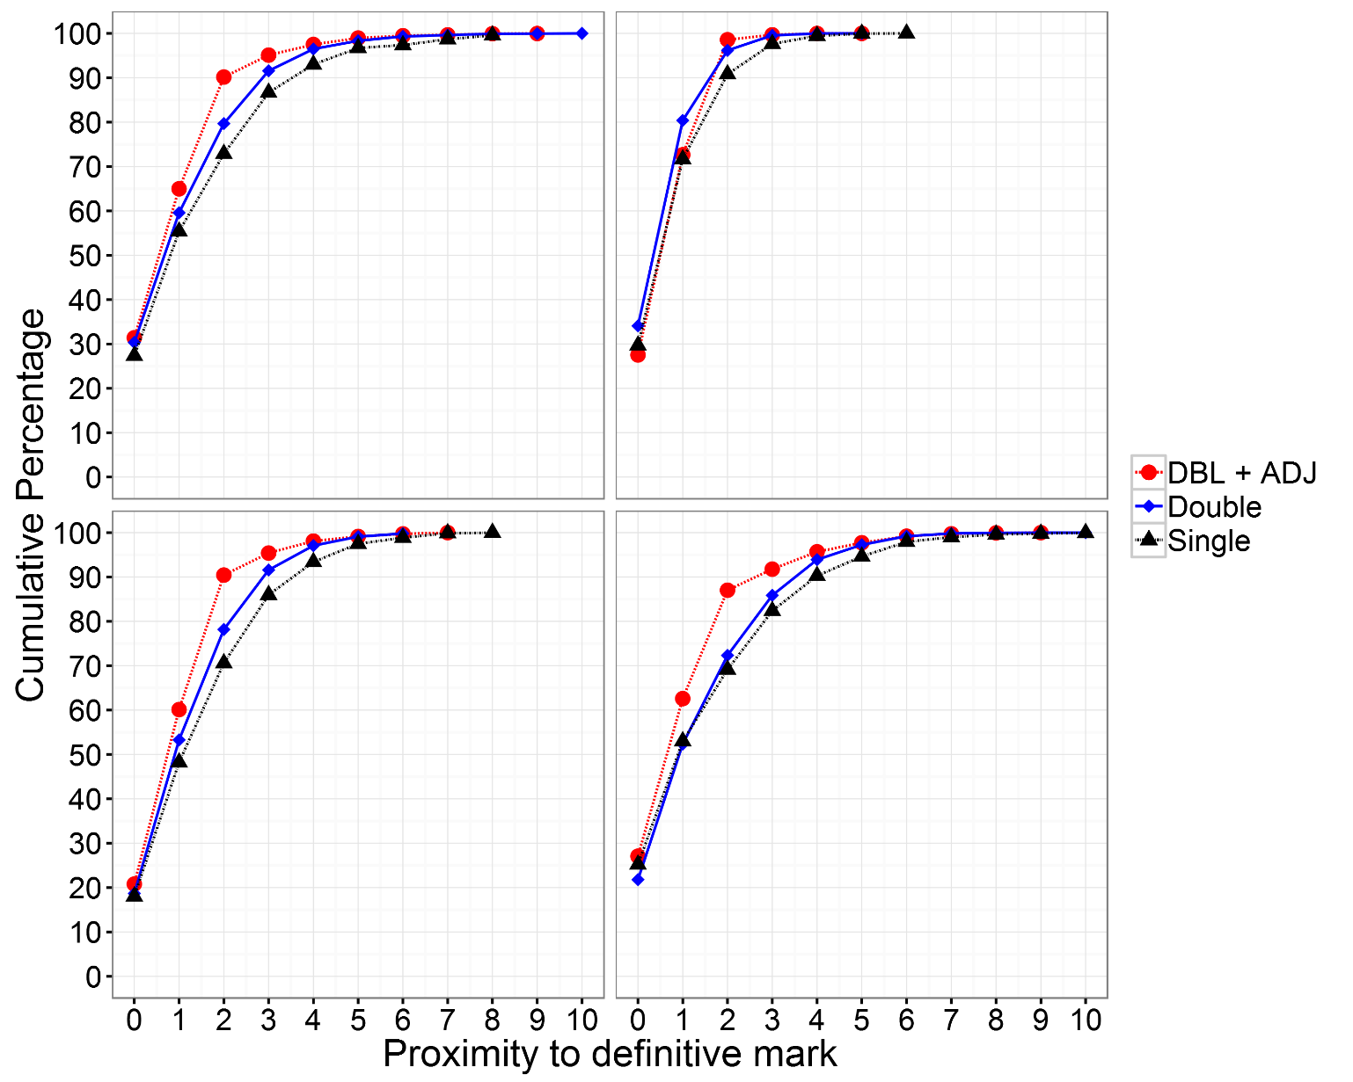
Double marking with adjudication - proximity to definitive mark - 16 mark items
Single versus double+adjudication
– probability differences
Absolute mark difference | Business | English | Geography | History
0 | 4.1 | -2.04 | 2.9 | 1.9
1 | 9.4 | 1.0 | 12.3 | 9.6
2 | 16.5 | 7.7 | 20.2 | 17.9
3 | 8.1 | 2.0 | 9.6 | 9.6
4 | 4.1 | 0.5 | 4.6 | 5.5
5 | 2.2 | 0 | 1.4 | 3.1
6 | 2.2 | 0 | 0.8 | 1.3
7 | 1.0 | 0 | 0.1 | 0.8
8 | 0.4 | 0 | 0 | 0.4
9 | 0 | 0 | 0 | 0.2
10 | 0 | 0 | 0 | 0.1
Business
English
Geography
History

Slide 22
Impact of double marking at Component level

Slide 23
Impact on receiving ‘definitive grade’ at component level – Geography – double marking
Unit | difference (%) in probability of candidates receiving the definitive grade
 | Double marking | Double marking with adjudication
#1 | 5.6 | 2.2
#2 | 4.5 | 3.9
#3 | 8.1 | 9.7
#4 | 2.2 | 3.2
#5 | 4.2 | 4.4
#6 | 5.1 | 3.9
Average | 4.95 | 4.55

Slide 24
Impact on receiving ‘definitive grade’ at component level – English Literature – double marking
Unit | difference (%) in probability of candidates receiving the definitive grade
 | Double marking | Double marking with adjudication
#1 | 4.3 | 7.0
#2 | 1.7 | 4.7
#3 | -2.3 | -2.9
#4 | 0 | 5.7
#5 | 0.3 | 5.3
#6 | -2.5 | 4.3
#7 | 4.9 | 6.4
#8 | 3.9 | 7.0
Average | 1.3 | 4.7

Slide 25
Why might double marking not always be better?
 | First marker
Second marker |  | Good | Lenient | Harsh | Inconsistent
 | Good | Good | ½ lenient | ½ harsh | ?
 | Lenient | ½ lenient | lenient | good | ?
 | Harsh | ½ harsh | good | harsh | ?
 | Inconsistent | ? | ? | ? | ?
Ref: Elizabeth Gray

Slide 26
Caveats
We haven’t yet been able to model at qualification level
There are other models of adjudication which we have not modelled e.g.
  Average of three marks
  Adjudication through discussion
  Adjudicating marker is a senior marker
Cannot simulate washback/psychological effects of being a double marker

Slide 27
Other things to consider
By the way, some of the improvements to accuracy will involve marks going up and some will involve marks going down.
Operational implications
  Double marking would require ≈ 2.5 x current number of markers
  Extending pool of markers might ‘dilute’ the quality of markers
    Any positive effects of double marking in the simulation may be reduced/destroyed?
Washback effects from being a double marker???
  e.g. less high stakes?
  avoidance of mark extremes?
  May be motivated to try hard to ensure mark is as accurate as possible so that likely to be close to second marker

Slide 28


A balancing act
Potential benefits in marking
Positive washback on marking
behaviours?
Costs
Dilution of marker
quality?
Negative washback on
marking behaviours?
28

Slide 29
Conclusions
Not a uniformly compelling case for using double marking – though there may be a case in some particular areas…(and what does other research show?)
In each case, the question will be: is this the optimum use of resource to improve quality of marking? Are there other, more cost effective ways? [of course, we want improvement in marking – is this the best way?]
Ofqual rules do not prevent boards from double marking.

