Slide 1
Inequalities in Sexual Health. Update on HIV and STIs in men who have sex with men in London
Field Epidemiology Services
PHE Publications gateway number: 2015709

Slide 2
Summary
  men who have sex with men (MSM) experience substantial inequalities in sexual health
  MSM constitute 2% of adult population in London, but
      90% of all syphilis diagnoses
      69% of all gonorrhoea diagnoses
      63% of new HIV diagnoses
  diagnoses of gonorrhoea and syphilis in MSM in London have increased dramatically in recent years
  1 in 11 MSM aged 15 to 44 years in London are living with HIV (diagnosed or undiagnosed)
  numbers of new HIV diagnoses in MSM are increasing (1,586 in 2014)
  an estimated 2,400 MSM in London with HIV are undiagnosed
  Shigella infections are now endemic in MSM in London

Slide 3
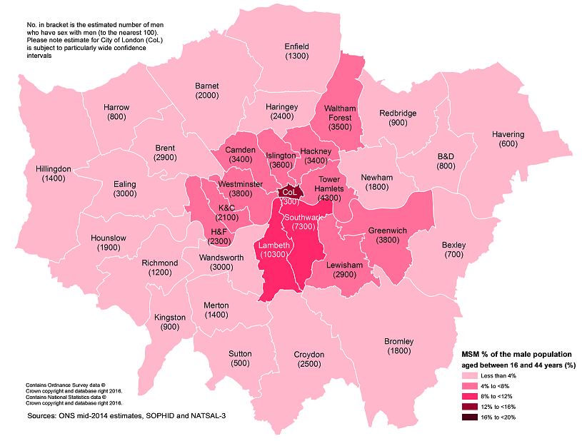
Figure 1: SOPHID weighted estimates of the number of 16 to 44 year old MSM resident in each LA in London and the estimated proportion of males aged 16 to 44 years that are MSM
Source: PHE Survey of Prevalent HIV Infections Diagnosed (SOPHID). Data from the third National Survey of Sexual Attitudes and Lifestyles (Natsal-3). Personal communication with Dr Catherine Mercer at University College London. Ruf M DV, Osuagwu U, Brown AE, Robinson E & Chadborn T. Men who have sex with men: estimating the size of at-risk populations in London primary care trusts. Int J STD AIDS. 2011;22:25-9.

Slide 4
Table 1: percentage change in new STI, HIV and Shigella diagnoses in MSM from 2010 and 2013 to 2014. London
Diagnoses | 2014 | % change 2010-2014 | % change 2013-2014
New STIs | 26,714 | 131% | 26%
Syphilis | 2,049 | 180% | 54%
Gonorrhoea | 10,871 | 320% | 31%
Chlamydia | 6,460 | 154% | 34%
Genital Herpes | 732 | 42% | 3%
Genital Warts | 1,395 | 37% | 14%
HIV** | 1,586 | 23% | 1%
Shigella* | 329 | 227% | 60%
LGV*** | 487 | 47% | 38%
GUMCAD started in 2009. Reporting of sexual orientation is less likely to be complete for earlier years, so rises seen may be partly artefactual.
Any increase in gonorrhoea diagnoses may be due to the increased use of highly sensitive nucleic acid amplification tests (NAATs) and additional screening of extra-genital sites in MSM.
Any decrease in genital wart diagnoses may be due to a moderately protective effect of HPV-16/18 vaccination.
Any increase in genital herpes diagnoses may be due to the use of more sensitive NAATs.
Any increase or decrease may reflect changes in testing.
*The number of Shigella diagnoses in MSM is estimated by calculating the excess male cases aged 16 to 60 years diagnosed with Shigella with no known history of travel outside the UK
** Numbers adjusted for missing information on route of transmission
*** Lymphogranuloma venereum, numbers reflect all LGV, however previous analysis has indicated that 99% are in MSM
Source: Public Health England, for new STIs, Gonorrhoea, Chlamydia, Genital Herpes and Warts - GUMCAD, for HIV - HIV and Aids New Diagnosis Database (HANDD), for Shigella Gastro Data Warehouse, for LGV STBRU laboratory returns
.

Slide 5
Figure 2: MSM as the proportion of different populations, including populations of people with STIs and HIV
Source: Public Health England, Natsal, GUMCAD, HIV and Aids New Diagnosis Database (HANDD),

Slide 6
Figure 3: MSM as a proportion of male local authority residents with a known sexual orientation diagnosed with a new STI in sexual health clinics: London, 2014
Sexual health clinic diagnoses only. Males with no information on sexual orientation are excluded from the calculation, Please note City of London has small numbers and has been excluded from this figure.
Source: Public Health England, GUMCAD

Slide 7
Figure 4: MSM and heterosexual males diagnosed with a new STI in sexual health clinics, age distributions compared: London residents, 2014
Source: Public Health England, GUMCAD

Slide 8
Figure 5: MSM diagnosed with a new STI in London by ethnicity, 2014
Source: Public Health England, GUMCAD

Slide 9
Figure 6: number of diagnoses of acute STIs in MSM in sexual health clinics in London residents, 2008 to 2014.
GUMCAD started in 2009. Reporting of sexual orientation is less likely to be complete for earlier years, so rises seen may be partly artefactual.
Any increase in gonorrhoea diagnoses may be due to the increased use of highly sensitive nucleic acid amplification tests (NAATs) and additional screening of extra-genital sites in MSM.
Any decrease in genital wart diagnoses may be due to a moderately protective effect of HPV-16/18 vaccination.
Any increase in genital herpes diagnoses may be due to the use of more sensitive NAATs.
Any increase or decrease may reflect changes in testing.
Source: Public Health England, GUMCAD

Slide 10
Figure 7: region of birth of MSM and heterosexual males diagnosed with a new STI in London 2014
Source: Public Health England, GUMCAD

Slide 11
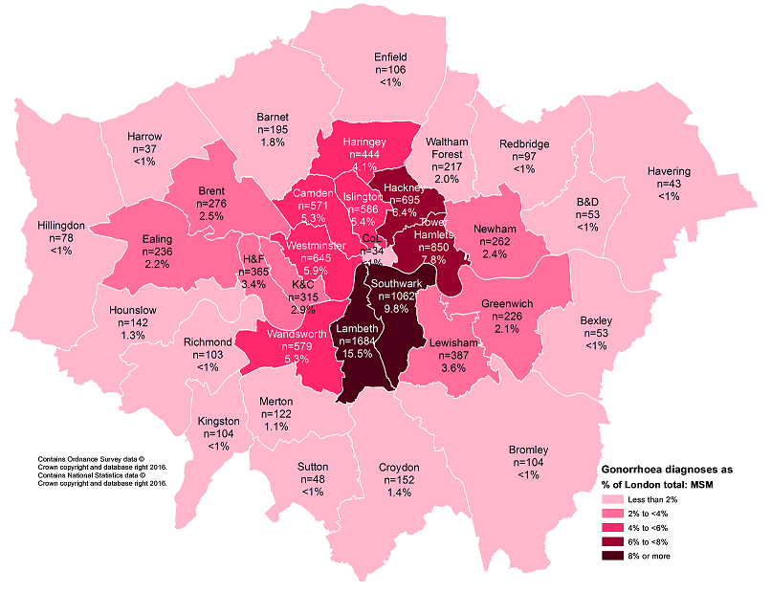
Figure 8: number of gonorrhoea diagnoses in MSM by London local authority of residence, 2014
Source: Public Health England, GUMCAD

Slide 12
Figure 9: LGV diagnoses by sexual health clinics in London,
2004 to 2015
Source: Public Health England, STBRU Laboratory Returns

Slide 13
Figure 10: excess male cases aged 16 to 60 years diagnosed with Shigella with no known history of travel outside the UK, by sex, London, 2011 to 2015
Source: Public Health England, Gastro Data Warehouse.

Slide 14
Figure 11: proportions of MSM living with diagnosed HIV in London by age group, 2004, 2009 and 2014
Source: Public Health England, Survey of Prevalent HIV Infections Diagnosed (SOPHID).

Slide 15
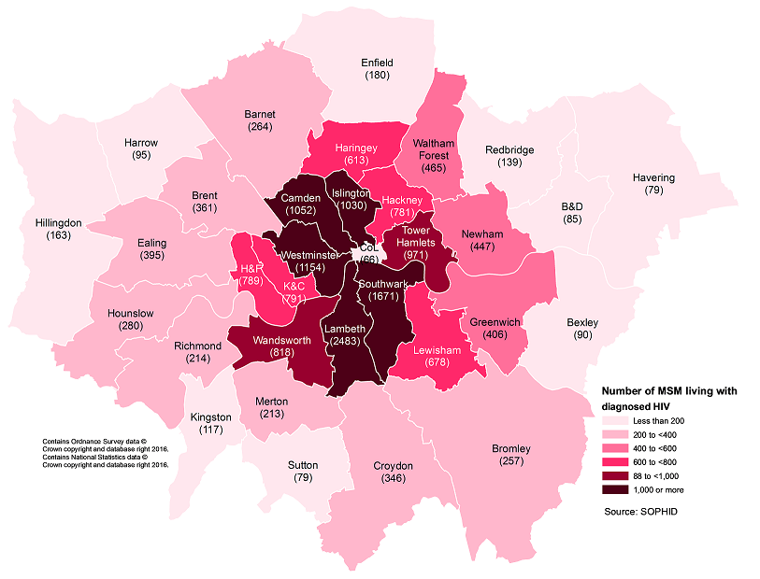
Figure 12: numbers of MSM accessing care for diagnosed HIV by London local authority, 2014
Source: Public Health England, Survey of Prevalent HIV Infections Diagnosed (SOPHID).

Slide 16
Figure 13: new HIV diagnoses by probable route of infection (adjusted for missing route of infection information), London residents, 2005 to 2014 (please see footnote on interpreting trends)*
The number of new diagnoses will depend on accessibility of testing as well as infection transmission. *Numbers may rise as further reports are received and more information is obtained on area of residence of those diagnosed. This is more likely to affect more recent year, particularly 2014. Please see important note on data earlier in this report. This will impact on interpretation of trends in more recent years.
Source: Public Health England, HIV and Aids New Diagnosis Database (HANDD).

Slide 17
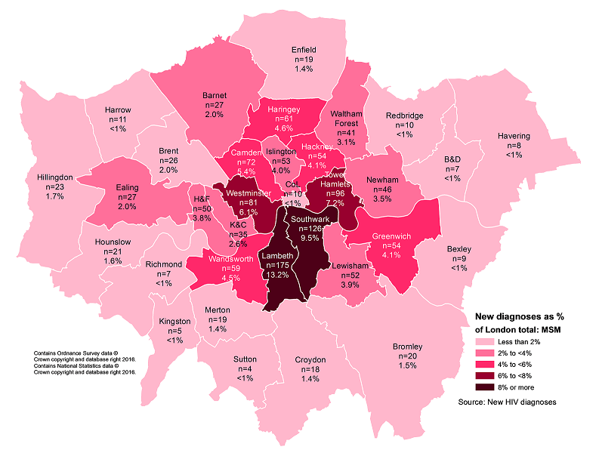
Figure 14: number of new HIV diagnoses in MSM by
London local authority of residence, 2014
Source: Public Health England, HIV and Aids New Diagnosis Database (HANDD).

Slide 18
Acknowledgements
Produced by Josh Forde, Paul Crook and Jenifer Smith from Public Health England
Local sexual health and HIV clinics for supplying the STI and HIV data
Institute of Child Health
PHE Centre for Infectious Disease Surveillance and Control (CIDSC) HIV and STI surveillance teams for collection, analysis and distribution of data
PHE CIDSC Gastrointestinal bacterial reference unit (GBRU) for Shigella
Stefano Conti of the PHE CIDSC modelling team for providing estimates of the total number of people living with HIV and the proportion that remain undiagnosed

Slide 19
More information
Please access the online ‘Sexual and Reproductive Health Profiles’ for further information on a whole range of sexual health indicators: http://fingertips.phe.org.uk/profile/sexualhealth
For more information on local sexual health data sources please access the PHE guide: https://www.gov.uk/government/uploads/system/uploads/attachment_data/file/395207/PHE_Guide_to_National_Local_Sexual_Reproductive_Health_Data.pdf
For an epidemiology summary of STIs in London https://www.gov.uk/government/publications/sexually-transmitted-infections-london-2014-data
For an epidemiology summary of HIV in London https://www.gov.uk/government/uploads/system/uploads/attachment_data/file/483335/2015_12_03LondonHIVSpotlight.pdf
For more information please contact Field Epidemiology Services at fes.seal@phe.gov.uk

