Slide 1

What should every trustee know?
8 November 2016 webinar
Sarah Atkinson, Director of Policy & Communications
@chtycommission
@sarahhatstand
1

Slide 2

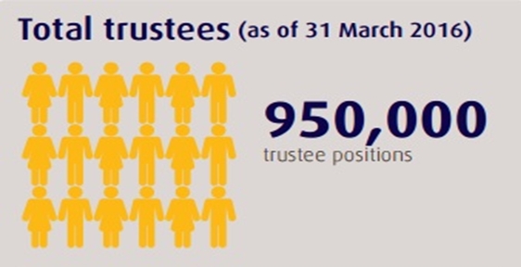
Trustees - an extraordinary force
5

Slide 3
Governance
CC3 flagship guidance
New trustees on registration tick to say they have read it
We recommend charity template eligibility forms include it
Reviewed, consulted on, updated in 2015
Informs trustees of the 6 essential legal duties on how to run a charity effectively and protect from harm
Charity law generally protects trustees who have acted honestly and reasonably
5

Slide 4
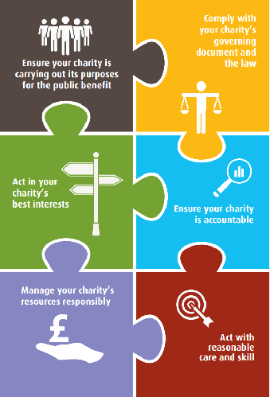
Do you know your duties?
5

Slide 5
Spofforths
21 July 2016
The Essential Trustee: ‘Must’ and ‘Should’
New tighter definitions of ‘must and should’:
‘Must’ a legal or regulatory requirement or duty that trustees must comply with
‘Should’ – something that is good practice that the Commisson expects trustees to follow and apply to their charity
Following good practice will help you to run your charity effectively, avoid difficulties and comply with your legal duties
5

Slide 6

Spofforths
21 July 2016
Ensure your charity is carrying out its purposes
It’s about knowing:
what your charity can and can’t do within its purposes
how your charity is fulfilling its purposes and benefiting the public
what difference your charity is really making
5

Slide 7

Spofforths
21 July 2016
Comply with your charity’s governing document and the law
It’s about being:
familiar with your governing document
up to date with filing accounts, returns and any changes to your charity’s registration details
aware of other laws that apply to your charity
It’s not about being:
an expert - but you do need to take reasonable
steps to find out
5

Slide 8

Spofforths
21 July 2016
Act only in your charity’s best interests
It’s about:
making balanced, informed decisions
recognising & dealing with conflicts of interest
ensuring trustee benefits are allowed
being prepared to question and challenge
accepting majority decisions
It’s not about:
preserving the charity for its own sake
serving personal interests
5

Slide 9

Spofforths
21 July 2016
Manage your charity’s resources responsibly
It’s about
managing risks, protecting assets (reputation) and people
getting the resources your charity needs
having and following appropriate controls and procedures
dealing with land and buildings
responsibility for, and to, staff and volunteers
5

Slide 10

Spofforths
21 July 2016
Act with reasonable care and skill
It’s about:
using your skills and experience
deciding when you need advice
preparing for meetings
getting the information you need (financial, management)
being prepared in case something does go wrong
5

Slide 11

Spofforths
21 July 2016
Ensure your charity is accountable
It’s about:
meeting legal accounting and reporting requirements
being able to show that your charity complies with the law and is effective
being accountable to members and others with an interest in the charity
ensuring that staff and volunteers are accountable to the board
welcoming accountability as an opportunity
not a burden
5

Slide 12
Themes from our compliance work
Conflicts of interest
Financial distress
Private benefit
Governance
Registration compliance
Decision-making
Fundraising
Source: Tackling Abuse and Mismanagement Report 2015-16, yet to be published, Charity Commission
5

Slide 13
Conflicts of interest – the bad
  People are in it for themselves
  Charities are closed shops
    Conflicts not declared
    No systems to identify them in the first place
Damage to public confidence
Not identified
Not recorded
Not prevented
    Actions pursued regardless
    Appointing trustees inappropriately
    Ignoring different, better courses of action
  Poor record keeping
  No evidence even if trustees suggest they have been managed
5

Slide 14
Decision making – the good
Resulting in…
Diverse boards
  Well informed decisions
  Good records
  Accountability
    Relevant experience
    Diversity
    Not just recruited from closed circles
Evidence
Behaviour
    Within powers
    In good faith
    Conflicts managed
    Reasonable decisions
  Sufficiently informed
  Take account of relevant factors
  Ignore irrelevant factors
5

Slide 15
How the regulatory landscape has changed from 2015
Fundraising regulation
New fundraising regulator
Review of the Code of Fundraising Practice
Plans for fundraising preference service
Updated CC20 - more focus on trustee oversight of fundraising
Charities (Protection and Social Investment) Act 2016
Closing gaps and loopholes in the Commission’s protective powers
New reporting requirements for fundraising (1 Nov)
Tighter controls on professional fundraisers and commercial participators (1 Nov)
Backstop powers for fundraising regulation
Enabling – social investment
5

Slide 16
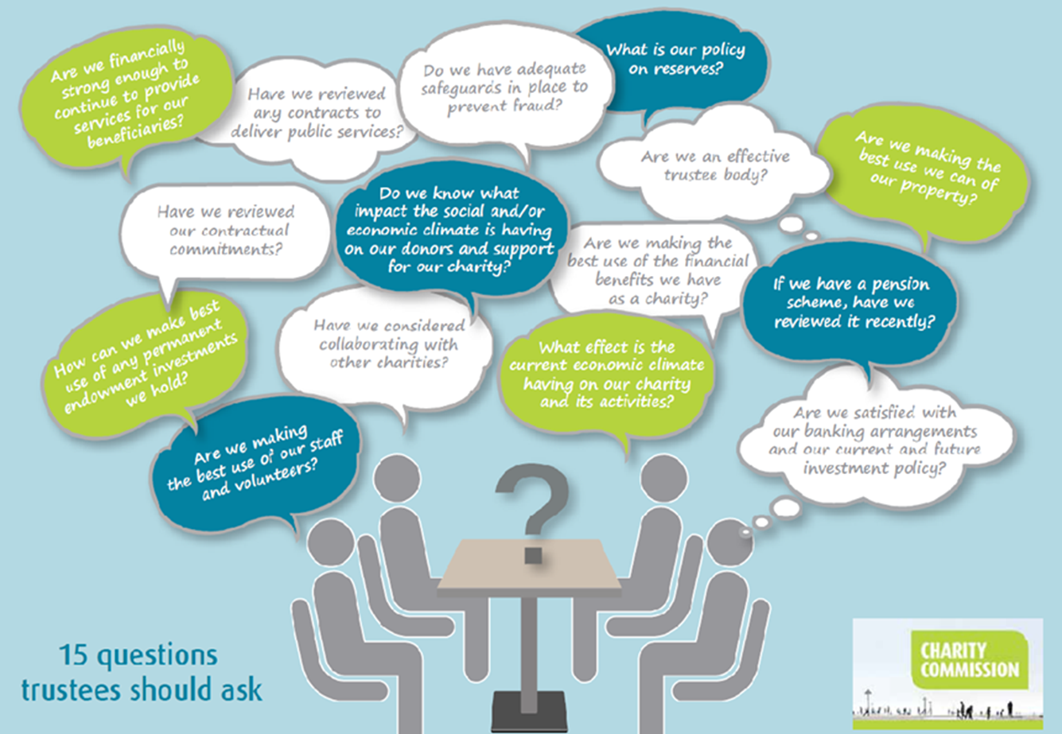
Have you read 15 Questions?
5

Slide 17
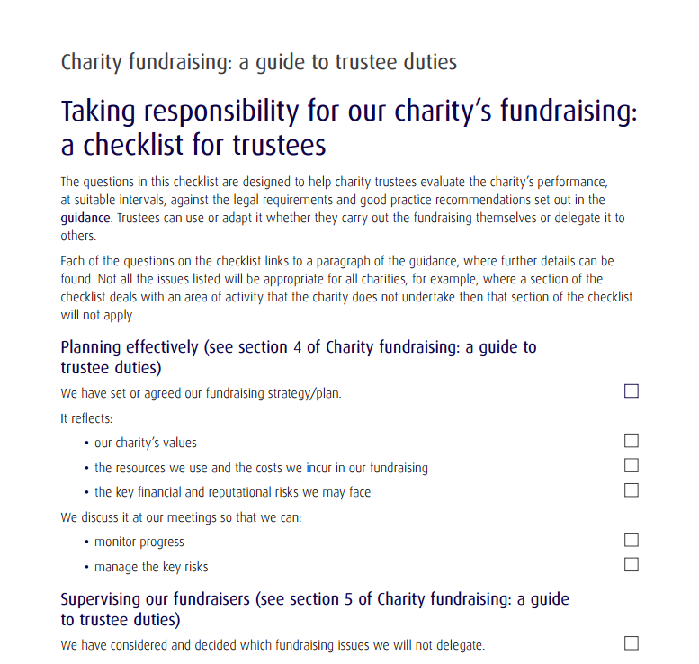
Fundraising CC20 checklist
3

Slide 18
Trustee duties – before and after
2007 | 2015
Trustees have … ultimate responsibility for directing the affairs of a charity and ensuring it is.. well-run and delivering the charitable outcomes for the public benefit for which it is set up. | Ensure your charity is carrying out its purposes for the public benefit
Compliance – trustees must: comply with charity law, reporting requirements, governing document, other relevant legislation Avoid conflicts of interest, act with integrity | Comply with your charity’s governing document and the law Act in your charity’s best interests
Duty of prudence – trustees must: Use funds reasonably Avoid undue risk | Manage your charity’s resources responsibly
Duty of care – trustees must: Use reasonable care and skill Consider relevant professional advice | Act with reasonable care and skill Ensure your charity is accountable
5

Slide 19
Other key resources
‘It’s your decision’, guidance on decision making (CC27)
Internal financial controls (CC8) – includes a self assessment checklist
Charities and risk management (CC26)
Your charity’s governing document!
Other sources of advice and support – check out the Trustees Week website and our partners including NCVO, Association of Chairs, Small Charities Coalition, ICSA, Charity Finance Group…
5

Slide 20
Any questions?
@chtycommission

