Slide 1
Inter-subject comparability matters
Dennis Opposs
4 February 2016
Notes:
. . . Link to what Paul has been saying . . .

Slide 2
The ISC Working Papers
    Comparability of Different GCSE and A level Subjects in England: An introduction
    Inter-Subject Comparability: A Review of the Technical Literature
    Inter-Subject Comparability of Examination Standards in GCSE and GCE
    Inter-Subject Comparability: An International Review
    A Recent History of Regulatory Perspectives on Inter-Subject Comparability in England
    Exploring Implications of Policy Options Concerning Inter-Subject Comparability

Slide 3
WP1 An Introduction
Why does inter-subject comparability matter?
Subject difficulty – real or perceived – might dissuade students from choosing some subjects or might affect decisions that schools make on behalf of their students.
HEIs might select the wrong students for their courses because they assume that A level grades for different subjects can all be counted as equal.

Slide 4
WP2 Literature Review
Conceptions of inter-subject comparability
Performance comparability
Statistical comparability
Conventional comparability
Construct comparability
Alternative frameworks

Slide 5
WP2 Literature Review
Comparability methods
Statistical methods
Criticisms of statistical methods
    Unidimensionality
    Factors other than ‘general academic ability’
    Unrepresentativeness
    Sub-group differences
Judgemental methods
Criticisms of judgemental methods

Slide 6
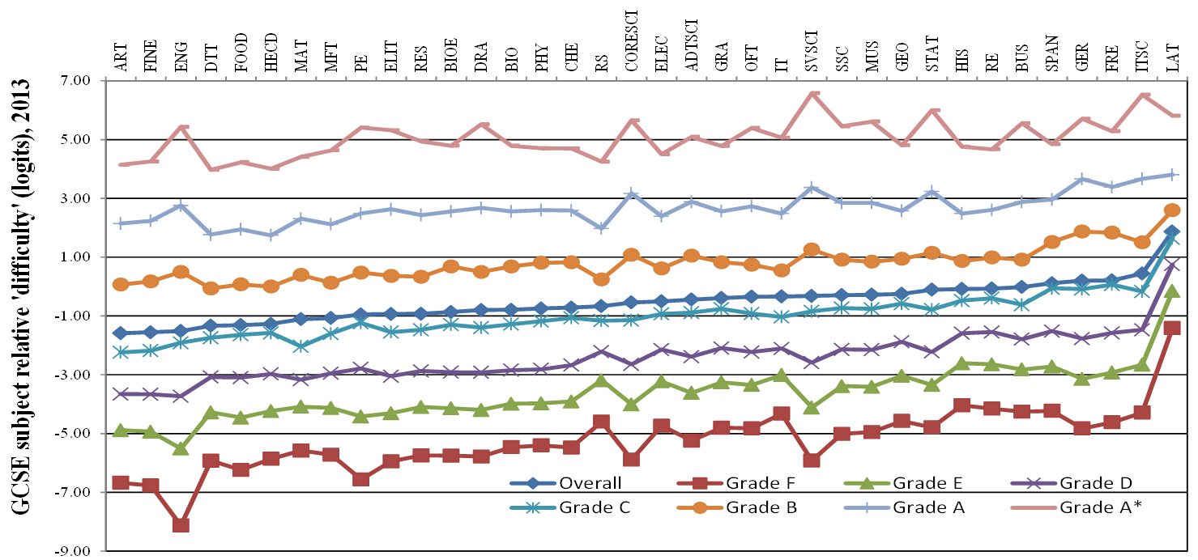
WP3 Comparison of the ‘difficulty’ of GCSE subjects

Slide 7
WP3 Comparison of the ‘difficulty’ of GCSE subjects

Slide 8
WP3 Comparison of the ‘difficulty’ of GCSE subjects

Slide 9
WP3 Comparison of the ‘difficulty’ of GCSE subjects

Slide 10
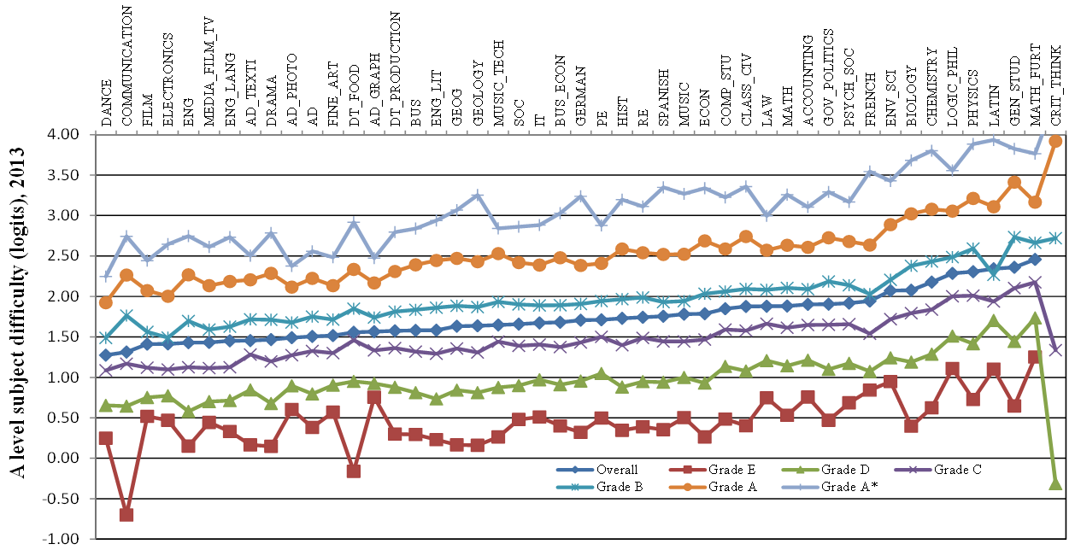
WP3 Comparison of the ‘difficulty’ of A level subjects

Slide 11
WP3 Comparison of the ‘difficulty’ of GCSE subjects

Slide 12
WP3 Impact of aligning a subject with the statistical average of all subjects on cumulative percentage of candidates at grade C and above
GCSE English and English language (‘lenient’) | fall of 18% | from 64% to 46%
GCSE German (‘severe’) | rise of 11% | from 75% to 86%
A level English language (‘lenient’) | fall of 14% | from 78% to 65%
A level physics (‘severe’) | rise of 15% | from 74% to 88%
A level further mathematics (‘severe’) | rise of 6% | from 90% to 96%

Slide 13
WP4 International Review
Assessments where there is evidence that inter-subject comparability is addressed
  Public perceptions of addressing inter-subject comparability through statistical methods
Assessments with limited or no evidence that inter-subject comparability is addressed
  Public perceptions of not addressing inter-subject comparability

Slide 14
WP5 Regulatory Perspectives
Formal position:
  no explicit regulatory requirement to align grade standards across (the full range of) subject areas
Informal inclinations:
  to support the idea that standards may be pitched at different levels in different subjects (as voiced by Ron Dearing)
  to deny the idea that standards may be pitched at different levels in different subjects (as voiced by Ken Boston)
  to reject the possibility of being able to judge whether or not standards are pitched at different levels in different subjects (as voiced by the independent expert groups)

Slide 15
WP6 Principal Policy Options
No action to achieve inter-subject comparability through the grade awarding process
Action to achieve inter-subject comparability through the grade awarding process
No action to achieve inter-subject comparability through the grade awarding process, but grades should be scaled subsequently to achieve inter-subject comparability
Action should be taken to achieve a plausible alternative to inter-subject comparability through the grade awarding process
Continue with no policy

Slide 17
Further reading
QCA. (2008) Inter-subject Comparability Studies. London: Qualifications and Curriculum Authority.
Baker, Sutherland and McGaw. (2002) Maintaining GCE A level standards: Baker, Sutherland & McGaw. London: Qualifications and Curriculum Authority.
Nuttall, Backhouse and Wilmott. (1974) Comparability of standards between subjects. London: Schools Council.
Coles, M and Matthews, A. (1995) Fitness for purpose: a means of comparing qualifications. London: University of London Institute of Education.
Coles, M and Matthews, A. (1998) Comparing qualifications - fitness for purpose. London: University of London Institute of Education.
‘Is A-level physics too hard (and media studies too easy)?’ on the Datalab blog.

Slide 18
More further reading
‘Is A-level physics too hard (and media studies too easy)?’ on the Datalab blog
Techniques for Monitoring the Comparability of Examination Standards. London: Qualifications and Curriculum Authority; especially chapter 9.
McGaw, B., Gipps, C. and Godber, R. (2004) Examination Standards. Report of the independent committee to QCA. London: Qualifications and Curriculum Authority.
‘The hard truth about ‘soft’ subjects’ by Policy Exchange.
‘Severe Grading in MFL’ by the London branch of the Association for Language Learning.
‘2 (b) or not 2 (b) … that is the question’ by the National Association for the Teaching of English.

Slide 19
Next Steps
Conference, 4 February 2016
Further stakeholder engagement
Additional research: extent to which subject choice is driven by perceptions of difficulty
Survey closes 4 March 2016
Ofqual Board meeting, 18 May 2016
Decision on policy options announced September 2016. Formal consultation may follow.

