Slide 1
March 2015
Juliette Burroughs, Policy, Research and Parliamentary Officer, National Energy Action
DECC and NEA survey to catalogue health-related fuel poverty schemes

Slide 2
Background and methodology
DECC commissioned NEA to carry out an online survey to catalogue local schemes that are targeting individuals with health problems for energy efficiency measures and other fuel poverty interventions.
The aim of the survey was to collate information on health-related fuel poverty schemes to better understand levels of activity in this area and highlight challenges to implementation, as well as successful approaches.
The survey was launched online at the beginning of January 2015 and closed in early February.
It was followed up with semi-structured telephone interviews with a sample of 19 survey respondents
2

Slide 3
Responses
110 responses were recorded to the online survey (including 4 late responses).
This number was reduced to 75 unique schemes following the exclusion of duplicate responses for a single scheme, spoiled and incomplete responses and responses on schemes with no discernible health-related component (for example, no methods identified for targeting either health professionals or households with health problems).
3

Slide 4
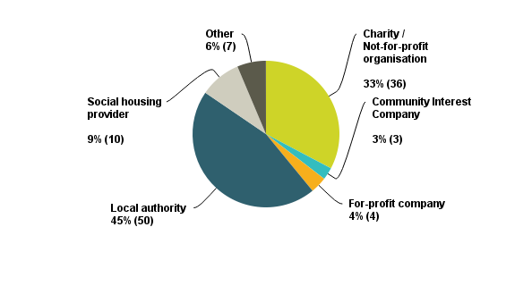
Delivery organisation
Key findings
Nearly half of respondents (45%) stated they worked for a local authority.
No one identified as working for a health and/or social care body (0%).
Figure 1. Organisation respondent identified as working for (respondent number = 110)
4

Slide 5
Geographic scope
Key findings
Most schemes reported covering a local authority area, with 64/89 respondents (72%) selecting this option when identifying the geographic scope of their scheme.
Figure 2. Respondent description of geographic area covered by scheme (respondent number = 89)
5

Slide 6
Locality
Key findings
Most schemes appear to be operating in urban or part urban areas. Only 5/89 respondents (6%) identified their scheme location as exclusively or mostly rural.
Figure 3. Respondent description of locality in which a scheme operates (respondent number = 89)
6

Slide 7
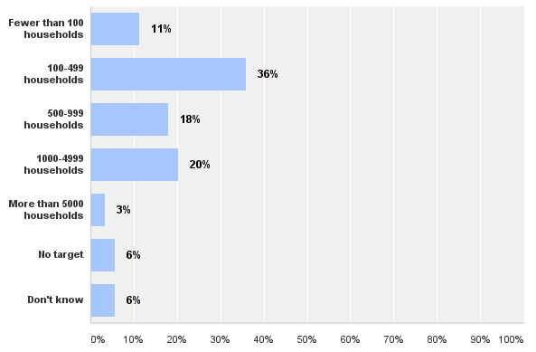
Scheme size
Key findings
Schemes varied in size however the largest proportion of respondents (32/89, 36%) identified a target reach of 100-499 households per year.
Figure 4. Households per year scheme aims to provide services to (respondent number = 89)
Percentage respondents
7

Slide 8
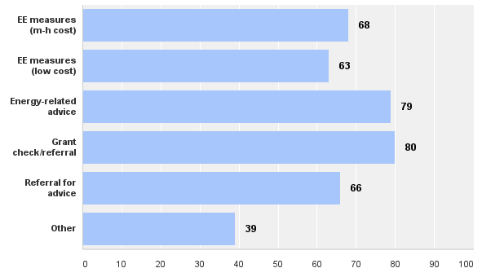
Scheme measures
Figure 5. Measures, advice and/or services scheme provides households (respondent number = 100)
Total respondents
8

Slide 9
Scheme measures cont.
Key findings
Most schemes appear to be holistic – providing access to a range of energy-related advice, measures and services.
68/100 respondents (68%) stated the scheme did provide households with medium-to-high cost energy efficiency measures (e.g. insulation). Follow-up research indicates delivery of such measures appears to range from funding them within the scheme itself to facilitating and supporting access to them through other schemes and providers (e.g. a local ECO-provider).
From the options on the previous slide 39/100 respondents (39%) selected ‘other’. When asked to specify the ‘other’ service or measure provided common responses included: referral into non energy-related services, including fire safety checks, falls prevention advice and measures, care and repair services and health and wellbeing services (e.g. befriending, healthy eating etc.); emergency heating provision; fuel advocacy services; and keep warm packs.
9

Slide 10
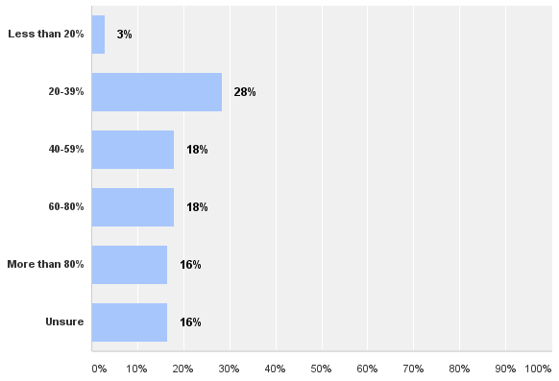
Health targeting
Key findings
A quarter of respondents (22/89, 25%) identified their scheme as only targeting households with health conditions.
Overall, nearly half of catalogued schemes (33/75, 44%) were targeted to a great extent on households with health problems (where 80% or more of the scheme’s annual target reach is estimated to be households with health problems).
Figure 6. Whether respondents identified their scheme as only targeting households with health conditions (respondent number = 89)
Figure 7. For respondents who answered ‘no’ at Figure 6 proportion of scheme’s annual target reach estimated to be households with health problems (respondent number = 67)
Percentage respondents
10

Slide 11
Health eligibility criteria
Key findings
Around half of schemes reported having a flexible approach to health eligibility criteria, with 50/100 respondents (50%) stating their scheme doesn’t target specific health conditions.
Of schemes that are targeting specific conditions the most commonly targeted condition (selected by 37/100 respondents, 37%) was chronic obstructive pulmonary disease (COPD).
When diseases were grouped together and the average taken of response rates for conditions in that group, respiratory diseases (asthma, bronchitis, COPD, pneumonia and other), circulatory diseases (cardiovascular disease, heart disease, stroke and other) and long-term illnesses were the most commonly selected health conditions.
Formal verification of health conditions does not appear to be common: 70/100 respondents (70%) stated their scheme did not require verification of health conditions. Only 14/100 respondents (14%) identified GPs as certifying qualifying/target health conditions.
11

Slide 12
Health eligibility criteria cont.
Figure 8. Average response rate by category of health condition for survey question: what health conditions does your scheme target? (respondent number = 100)
12

Slide 13
Health sector involvement
Key findings
Around two thirds of schemes reported working directly with the health sector: 62/99 respondents (63%) answered yes to a question if any health bodies or healthcare professionals were involved in helping to implement and/or fund their scheme.
The most common form of involvement was with health professionals, rather than with hospitals or health bodies. 44/99 respondents (44%) identified GPs as being involved to help implement a scheme. This was followed by district nurses (40/99 respondents, 40%), other healthcare professionals (36/99 respondents, 36%) and practice nurses (33/99 respondents, 33%). 19/99 respondents (19%) identified pharmacists as being involved in their scheme.
In terms of the nature of healthcare professionals’ involvement the vast majority appear to be supporting schemes through identifying/referring/contacting households.
Other than healthcare professionals, the most commonly identified health bodies involved in schemes were CCGs (33/99 respondents, 33%). 18/99 respondents (18%) identified CCGs as either commissioning services or contributing funding to schemes.
It should be noted Public Health within local authorities was not included as a choice on a list of healthcare professionals/bodies respondents were provided with in regard to health sector involvement.
13

Slide 14
Health referrals
Key findings
Around half of schemes reported having tailored methods for targeting households with health problems: 47/96 respondents (49%) answered ‘yes’ to the question: do you have a specific system to identify and target households with health problems for your scheme?
A broad range of health professionals appear to be involved in making referrals. Of those who answered yes to the question above the most common health referral source was ‘Other healthcare professional’ (a healthcare professional who is not a GP) (34/96 respondents, 35%). This was followed by GPs (27/96 respondents, 28%).
The number of healthcare professionals involved per scheme appears to range from small (fewer than 10) to larger (more than 40). This may reflect the size of the fuel poverty scheme but also the type of involvement: from targeted engagement with a select number of health venues to broader messaging through a range of health teams.
Figure 9. Estimated number of healthcare professionals referring to a respondent’s scheme (respondent number = 45)
14

Slide 15
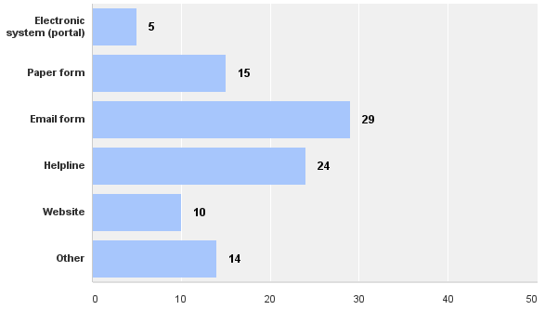
Health referrals cont.
Key findings
Healthcare referral mechanisms appear to be mixed with no method preferred and electronic systems not widely used. 7/45 respondents (16%) identified using a mail-out from the GP or other healthcare professional to contact households. Only 5/43 respondents (12%) stated the healthcare professional was using an electronic system or portal to make the referral.
The most commonly cited methods to make health referrals were email (29/43 respondents, 67%) and telephone (24/43 respondents, 56%). Patient self-referral upon the prompting of the health staff/venue and on-site presence of the scheme at health venues were some of the ‘other’ methods identified by respondents.
Figure 10. Method used by healthcare professional to make the referral (respondent number = 43)
Total respondents
15

Slide 16
Funding amounts
Key findings
Funding amounts for schemes (financial year 2014/15) were fairly evenly split between those operating on less than £100,000 (37/82 respondents, 45%) and those operating on £100,000 or more (33/82 respondents, 40%).
28/75 respondents (37%) identified the funding amount for the financial year 2014/15 as ‘about the same’ as the previous year (2013/14). 21/75 respondents (28%) identified this funding amount as somewhat or significantly less than the previous year. 15/75 respondents (20%) identified this funding amount as somewhat or significantly more than the previous year.
Figure 11. Percentage of respondents identifying total amount of funding secured/available for their scheme in the financial year 2014/15
16

Slide 17
Funding sources
Key findings
Nearly two thirds of respondents reported accessing ECO and/or Green Deal funding for energy efficiency works carried out under their scheme. Although follow-up research indicates some respondents may have selected this option where they are referring clients on for ECO-funded measures.
In terms of health funding, around half of respondents (37/88, 42%) reported accessing Public Health funding. 21/88 respondents (23%) identified Public Health as the principal funder for their scheme.
About one in five schemes appear to be accessing CCG funding: 17/88 respondents (19%) identified their CCG as a funding source for their scheme. Five of those identified the CCG as the principal funding source. This result correlates with an earlier survey question in which 18/99 respondents (18%) identified CCGs as either commissioning services or contributing funding to their scheme.
Many schemes are approaching organisations but failing to secure funding: 38/88 respondents (43%) reported unsuccessful funding requests.
Figure 12. Percentage of respondents identifying ECO and/or Green Deal funding secured for their scheme (respondent number = 89)
17

Slide 18
Data sharing
Key findings
Nearly half of respondents (46/93, 49%) stated their scheme uses data sharing between organisations to identify, target and/or refer households.
Data sharing appears to range from transferring contact details of a household with their consent to more complex data mapping exercises using local council and health data to identify a short-list of at-risk individuals.
Of schemes that do share data 29/45 respondents (64%) are using protocols or agreements to facilitate this sharing. An equal number (29/45 respondents, 64%) are using household consent.
Figure 13. Percentage of respondents using data sharing with partner organisations to identify, target and/or refer households (respondent number = 93)
18

Slide 19
Data sharing challenges
Key findings
Around a third of respondents (30/83, 36%) reported difficulties in sharing data. This should be understood in the context that 38/93 respondents (41%) reported in another question to not have even attempted to share data.
Respondents were asked to identify what difficulties they had faced in sharing data in an open-ended survey question. Common themes emerging across respondents’ answers were:
accessing health data (the most commonly-cited barrier)
general reluctance to share data
consistency of data capture across organisations and quality of data received
time and resources required to understand and then satisfy data sharing and data protection protocols, including where different data officers have different interpretations of what can/can’t be shared.
“Has been very time consuming and difficult to understand data protection issues which I personally think are subject to personal interpretation and unnecessarily overly complicated.” – Survey respondent
“Trying to set protocols with health to share data is the biggest obstacle. GPs are not very willing to share data or to trying to devise ways around the sharing of data.” – Survey respondent
19

Slide 20
Other challenges
Key findings
Apart from data sharing 66/92 respondents (72%) identified other barriers and challenges to implementing their scheme. Respondents were asked to identify those challenges in an open-ended survey question. The top three themes emerging across respondents’ answers were (in order of mentions):
Access to funding, including gap funding to support eligible households where ECO will not fund the full cost of works.
Engaging/working with the health sector.
Inconsistent, changing and short-term funding landscape, including changes to ECO.
Other challenges mentioned by a number of respondents included:
volume (too many or not enough) and quality of referrals
consumer scepticism about free in-house works and a scheme’s offer, sometimes associated with Green Deal
evaluation gap and evidence burden, including of health impacts
staffing and resources burden.
20

Slide 21
Other challenges cont.
“Health [professionals] are very task focused and we want to change working practices to widen out the view point of the health worker and make ‘every contact count’ concept not just focus on health interventions.” – Survey respondent
“Lack of gap funding (ECO) amongst vulnerable households. Continuing mistrust of Green Deal mechanism stemming from poor initial launch.” – Survey respondent
“Difficulties attributing positive [health] impacts directly to the support provided by our services.” – Survey respondent
“Short-term funding so that we cannot offer consistency.” – Survey respondent
“Constant restructuring in the health sector is a constant barrier to progress in trying to implement joined-up working.” – Survey respondent
“Getting health professionals on board - not sure word has got through. Training offered but not taken up.” – Survey respondent
21

Slide 22
Successes
Key findings
Respondents were asked to identify key successes of their scheme in an open-ended survey question. The top five themes emerging across respondents’ answers were (in order of mentions):
Support for households and impact on local housing and fuel poverty levels.
Partnership working (to implement a strong referral network and bespoke service offer for the householder).
Delivery model, including single-point-of-contact referral network, simple referral system and in-home and bespoke service offer.
Securing health sector engagement and funding.
Securing funding for scheme delivery.
“Clinicians engaged and patients receiving energy advice - happens when we can help clinicians understand the importance of patients being warm and well, and reducing hospital admissions.” – Survey respondent
“The network of partners with whom we work - both in terms of our referral network and for onwards signposting. The main reason for these successes has been the use of a paid full time team member to actively promote the service at meetings, events and to offer training to frontline staff giving them an insight in to how our service assists residents.” – Survey respondent
22

Slide 23
Evaluation
Key findings
Around half of schemes have been evaluated: 45/88 respondents (51%) answered ‘yes’ to the question: have you evaluated your scheme?
Of those who have evaluated their scheme the most commonly selected outcome (from a list of options) measured and reported against was ‘Household personal satisfaction (including with property, physical health and general wellbeing)’. This option was selected by 29/45 respondents (64%). This suggests household surveys are a relatively common form of evaluation.
Schemes do not appear to be having success in evaluating the wider health impacts of their interventions. Only 4/45 respondents (9%) and 6/45 respondents (13%) identified impact on GP visits and impact on hospital admissions respectively as outcomes they were measuring and reporting against.
23

