Slide 1
Tackling high blood pressure
Core slide deck – prepared 28 January 2015

Slide 2
Contents
what is high blood pressure?
why high blood pressure matters
current performance
the Blood Pressure System Leadership Board
the action plan
      prevention
      detection
      management
    resource hub
    healthier lives hypertension atlas
    future plans
    contact information

Slide 3
What is high blood pressure?
hypertension is the medical term for high blood pressure, it means that there is too much pressure in your blood vessels, which can damage your blood vessels and cause health problems
high blood pressure is a major risk factor for stroke, heart attack, heart failure, chronic kidney disease and dementia
certain factors can increase your risk of developing high blood pressure, these include:
      being overweight or obese
      eating too much salt
      not eating enough fruit and vegetables
      not doing enough exercise
      being of African or Caribbean descent
      drinking a lot of alcohol
      being older
      having a family history of high blood pressure

Slide 4
Why high blood pressure matters
high blood pressure affects more than 1 in 4 adults in England
it is the second biggest risk factor for premature death and disability
high blood pressure, which can often be prevented or controlled through lifestyle changes, accounts for 12% of all visits to GPs in England
people from the most deprived areas are 30% more likely than the least-deprived to have high blood pressure
figures from PHE show that:
diseases caused by high blood pressure cost the NHS over £2bn every year
by reducing the blood pressure of the nation as a whole, £850m of NHS and social care spend could be avoided over 10 years
Notes:
Re: the £2 bn figure
The cost to the NHS in England from diseases caused by high blood pressure is estimated as £2.1 billion per year. Analysts have looked at the annual costs of four key diseases which blood pressure can cause (coronary heart disease, stroke, vascular dementia and chronic kidney disease) and totalled the amount of these which are estimated to be caused by high blood pressure. For example, raised blood pressure has been shown to half of all strokes.
Note: there are further costs to the NHS from high blood pressure itself (not just the conditions it can lead to) including clinical time and cost of medication to manage the condition. Beyond the NHS, there is a burden on social care (for example people who need to be looked after following a stroke) and the wider economy (such as lost productivity from people in ill-health).
Re: the £850 m figure
The figures estimate potential impacts from specific levels of improvement in the prevention, detection and management of high blood pressure. This modelling estimates the “size of the prize” in terms of health outcomes and costs to health and social care. It is based upon assessing the coronary heart disease, stroke, chronic kidney disease and vascular dementia which would be prevented from the changes to high blood pressure.
Over ten years, an estimated 45,000 quality adjusted life years could be saved, and £850m not spent on related health and social care, if England achieved a 5mmHg reduction in the average population systolic blood pressure.
Note: the figures here assume the change is effective from year zero, and do not specify or allow costs for specific interventions which may be needed to achieve the change.

Slide 5
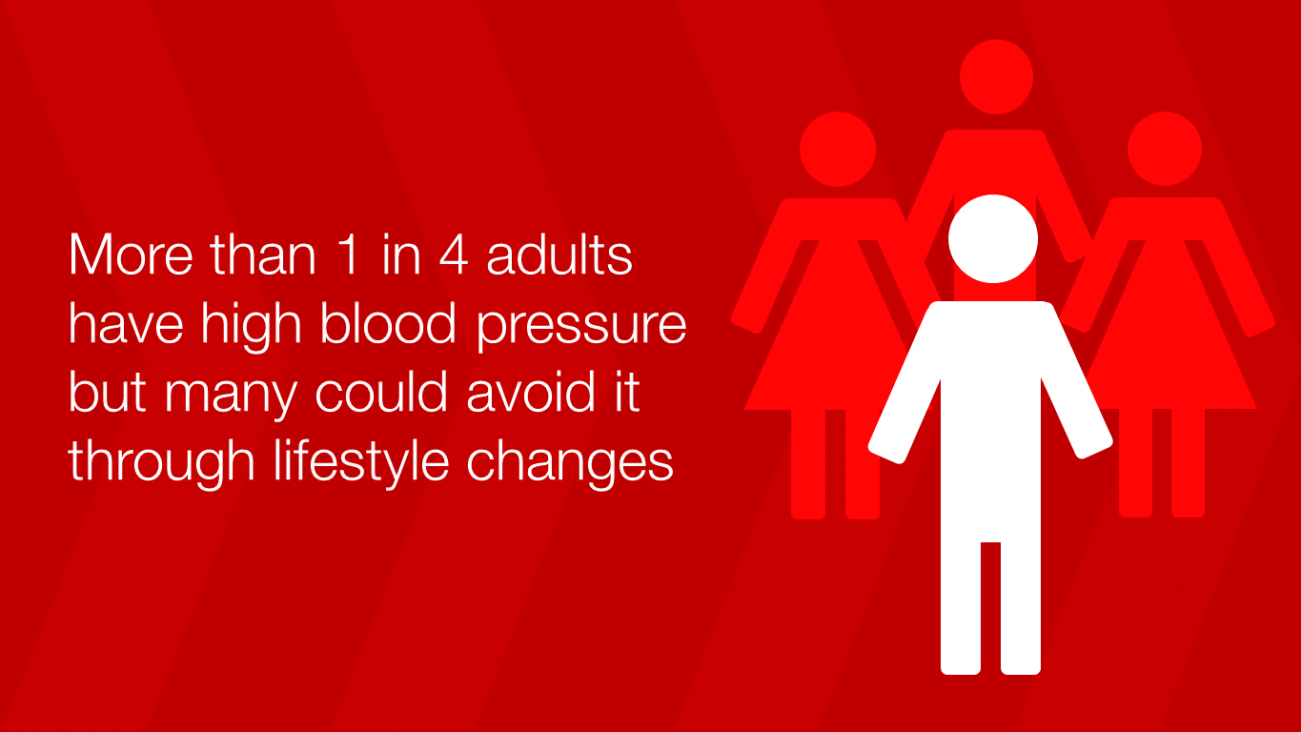
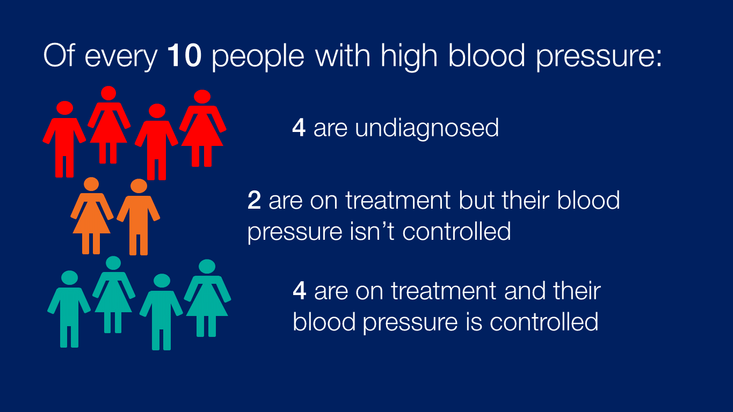
Current performance (1 of 3)
positive change in last decade - slightly lower population average blood pressure (↓3mmHg systolic), 2 million people newly identified, 10% more on treatment achieving control), however:
significant variation – for example between CCGs (average BP control 61% to 94%) and between income groups (30% more with hypertension in most-deprived areas versus least)
out-performed abroad - % adults with hypertension (diagnosed/undiagnosed) controlled:
England | 37% | USA | 57% | Canada | 66%
Notes:
Sources:
Positive change in the last decade: Health Survey for England
CCG variation: 2013/14 QOF variation at CCG level on HYP0003 (percentage of patients aged 79 and under with hypertension in whom the last blood pressure reading (measured in the preceding 9 months) is 140/90 mmHg or less)
Income group variation: Health Survey for England 2011
Outperformed abroad: Joffres M et al. Hypertension prevalence, awareness, treatment and control in national surveys from England, the USA and Canada, and correlation with stroke and ischaemic heart disease mortality: a cross-sectional study. BMJ Open 2013; 3(8).

Slide 6
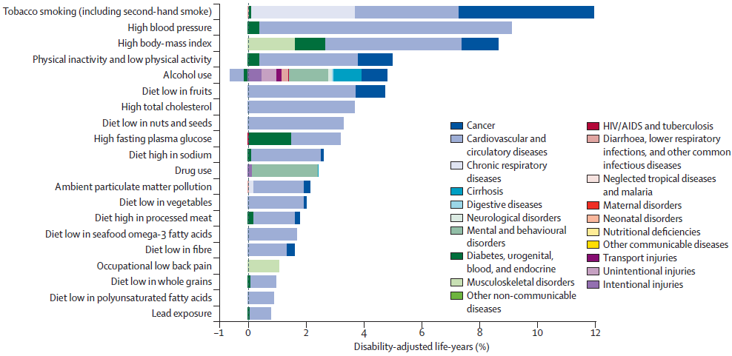
Current performance (2 of 3)
2013 Global Burden of Disease: UK results
Notes:
Burden of disease attributable to 20 leading risk factors for both sexes in 2010, expressed as a percentage of UK disability-adjusted life-years
The negative percentage for alcohol is the protective effect of mild alcohol use on ischaemic heart disease and diabetes.

Slide 7
Current performance (3 of 3)
Hypertension treatment cascade
Notes:
Source:
Health Survey for England 2011. Hypertension defined as BP >140/90mmHg, GP diagnosis is self-reported by study participants (does not guarantee respondent is on a GP hypertension register), control is where after treatment BP is <140/90mmHg.

Slide 8

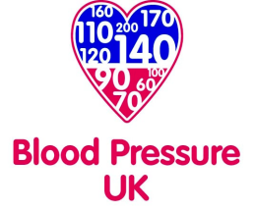






BP System Leadership Board
England’s Blood Pressure System Leadership Board is a cross-sector group which oversees the programme of work improve the prevention, detection and management of high blood pressure, and reduce health inequalities
NHS England
NHS Improving Quality

Slide 9
The action plan
Tackling high blood pressure: from evidence into action (18 Nov 2014)
intended to support partners at all levels to focus upon the work that will make the biggest impact in tackling high blood pressure
draws on the best evidence (including new economic analysis) and professional judgment of our group to:
      recommend most pressing issues on blood pressure pathway to address
      demonstrate roles for a wide range of organisations to achieve this
      set out what key partners have already pledged to do in support of our ambition
overarching themes:
      tackling inequalities: identifying approaches and targeting to achieve this
      partnership: need system leadership at all levels across government, health system, voluntary sector and beyond
      local leaders: change and implementation is influenced and driven by local professionals
    www.gov.uk/government/publications/high-blood-pressure-action-plan

Slide 10
Prevention (1 of 2)
high blood pressure is preventable, and risk of cardiovascular disease is reduced down to a threshold of 115/75mmHg
key risk factors include excess weight/salt/alcohol, physical inactivity
15% reduction in population salt intake achieved in last decade seen as main contributor to lower population blood pressure (↓3mmHg systolic)
over 10 years, an estimated 45,000 quality adjusted life years could be saved, and £850m not spent on related health and social care, if England achieved a 5mmHg reduction in the average population systolic blood pressure
Prevention
Detection
Management
Notes:
More detail on economics:
The interventions review commissioned to inform this plan identifies national dietary salt reduction as the most cost effective intervention reviewed (cost saving to health and social care within one year). General healthy lifestyle change (based primarily on studies looking at diet and exercise) were potentially cost-effective at ten years and cost-saving over a lifetime (40 years). These figures are based on these interventions applying at population-level, but where applied specifically to people diagnosed with high blood pressure their cost-effectiveness improves further.

Slide 11
Prevention (2 of 2)
Key approaches (plan sets out more fully how different groups contribute):
reducing salt consumption and improving overall nutrition at population-level
improving calorie balance to reduce excess body weight at population-level
personal behaviour change on diet, physical activity, alcohol and smoking, particularly prompted through individuals’ regular contacts with healthcare and other institutions
Prevention
Detection
examples of actions identified:
      PHE dedicated programmes on diet and obesity, physical activity, alcohol and healthy places
      Department of Health responsibility deal
      British Heart Foundation 2014-2020 strategic ambition on prevention
      deliver NHS England ‘Making Every Contact Count’ action plan
Management

Slide 12
Detection (1 of 2)
vast majority of testing occurs in primary care. In addition:
      >1.4m NHS Health Checks per year (age 40-74)
      voluntary sector (e.g. “Know Your Numbers” campaign >100,000 tests/year)
      pharmacy (e.g. Lloydspharmacy >65,000 tests/year)
      validated self-monitoring devices at low cost
    testing advisable at least every five years, more frequent re-testing for those with high-normal blood pressure.
    diagnosis never based on a single test, normally followed by ambulatory (24 hour monitor) or home testing
    over 10 years, an estimated 7,000 quality adjusted life years could be saved, and £120m not spent on related health and social care costs, if England achieved a 15% increase in the proportion of adults who have had their high blood pressure diagnosed
Prevention
Detection
Management
Notes:
More detail on economics:
The interventions review commissioned to inform this plan identified testing as most cost effective in pharmacy and then general practice, compared to the study identified for testing in community venues. However, published studies suitable for this rapid review were somewhat limited, and consideration needs to be given to alternative approaches, and the how best to access the target group.

Slide 13
Detection (2 of 2)
Key approaches (plan sets out more fully how different groups contribute):
more frequent opportunistic testing in primary care, achieved through using wider staff (nurses, pharmacy etc.), and integrating testing into the management of long term conditions
improving take-up of the NHS Health Check, a systematic testing and risk assessment offer for 40 to 74 year olds
targeting high-risk and deprived groups, particularly through general practice records audit and outreach testing
Prevention
Detection
Management
examples of actions identified:
      PHE developing campaign toolkit for local use, based on its Wakefield testing pilot
      Pharmacy Voice drive on increasing pharmacy testing role
      British Hypertension Society developing hypertension diploma

Slide 14
Management (1 of 2)
NICE recommend lifestyle treatment for all with hypertension – with good adherence can achieve dramatic blood pressure reduction
drug therapy for all over 160/90mmHg and many below with other risks; 4-step approach to incremental drug treatment set out by NICE; 80% of people require 2 or more agents to achieve blood pressure control
NICE treatment target (for adults under 80 years) 140/90mmHg
over ten years, an estimated 7,000 quality adjusted life years could be saved, and £120m not spent on health and social care, if England achieved a 15% increase in the proportion of adults on treatment controlling their blood pressure to 140/90mmHg or below.
Prevention
Detection
Management
Notes:
More detail on economics:
The interventions review commissioned to inform this plan looked at range of initiatives over and above standard care. Health lifestyle improvement interventions became cost effective within five years and potentially cost-saving to health and social care within ten years. Other categories of study showed wider variation, but typically intensive work on drug adherence became cost saving within a lifetime (by 40 years), and self-management support programmes were cost effective over the same period. Other intensive primary care interventions above standard care showed poorer results. However, in considering different approaches it is clear that dividing responsibility across the practice staff team (including nurses and healthcare assistants) and, if appropriate, to wider primary care partners such as pharmacy, can be a key to higher cost-effectiveness. We also suggest it is possible to improve outcomes with less intensive (and thus less costly) interventions than those which met the criteria for formal inclusion in the interventions review.

Slide 15
Management (2 of 2)
Key approaches (plan sets out more fully how different groups contribute):
local leadership and action planning for system change, to tackle particular areas of local variation, and achieve models of person-centric care
health professional support (communication, tools & incentives) to bring practice nearer to treatment guidelines where this falls short
support adherence to drug therapy and lifestyle change, particularly through self-monitoring of blood pressure and pharmacy medicine support
Prevention
Detection
Management
Examples of actions identified:
      RCGP/Primary Care CVD Leadership Forum working in partnership to raise standards and clinical leadership
      NHS Choices refreshing hypertension contents
      NICE collating info on uptake of recommendations & quality standards

Slide 16
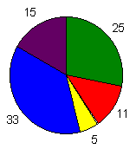
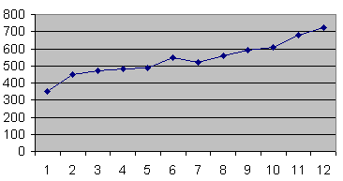
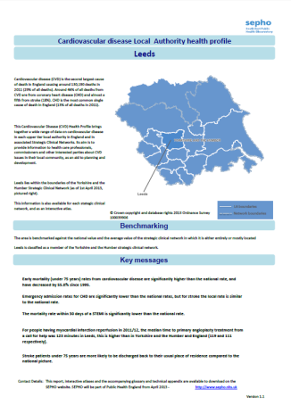
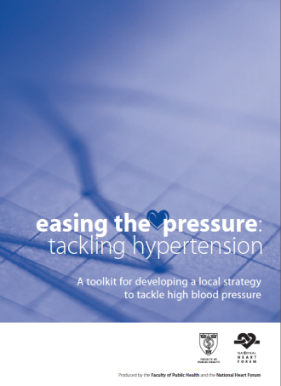
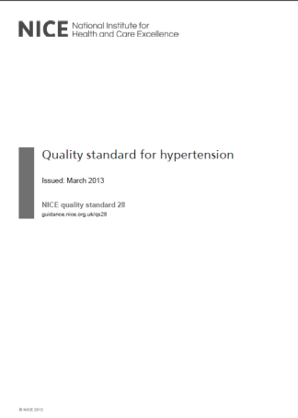
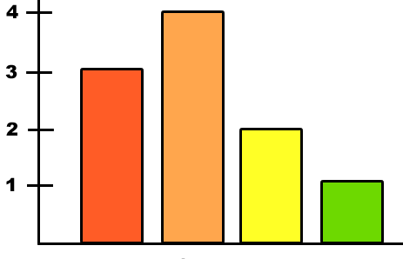
Resource hub
PHE wants to support local leadership in tackling high blood pressure, and has gathered resources in one hub to help those planning and delivering high blood pressure services and initiatives
resources include data, guidance, tools, case studies and examples of emerging practice
the PHE team welcomes feedback and ideas for new resources to include, particularly any local case studies – please email bloodpressure@phe.gov.uk
www.gov.uk/high-blood-pressure-plan-and-deliver-effective-services-and-treatment

Slide 17
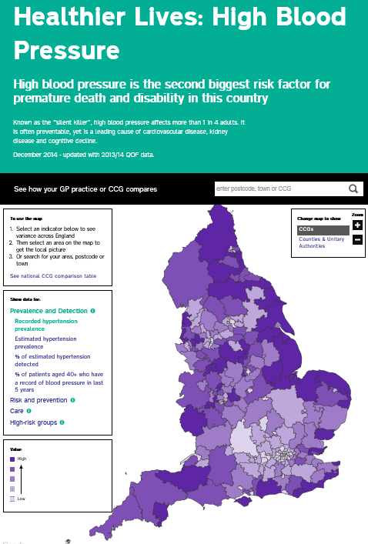
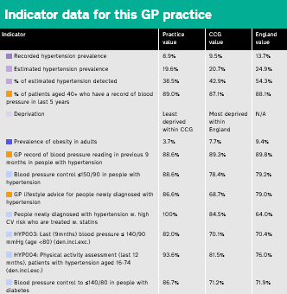
Healthier Lives variation atlas
Risk and prevention
Detection
Care
High risk groups
LA
CCG
GP
healthierlives.phe.org.uk/topic/hypertension
Notes:
This data can tell us about:
•What the local prevalence of key risk factors for high blood pressure is – to help us improve prevention
•How many of the missing millions of undiagnosed people with high blood pressure have been found in each area – to help us improve detection
•How well GPs look after people with high blood pressure, including people who also have another condition – to help us improve care
The data covers the whole of England and is broken down by:
•Clinical Commissioning Group
•Local Authority
•Individual General Practices
This data is not new, it has been available in the public domain but this is the first time it’s been published in this form making information easy to access, view and compare.
The majority of the data presented in Healthier Lives: High Blood Pressure has been drawn from the Quality Outcomes Framework (QOF), which is based upon general practice records. The QOF data is for the financial year 2013/14. They have not used the more usually published achievement scores, but the intervention rates which look at practices’ performance on all relevant patients without any exception.
This is supplemented with other data sources for individual indicators:
•Hypertension prevalence modelled estimates (2011, modelling by the former Eastern Region Public Health Observatory, now part of PHE, based on earlier data)
•Hospital Episode Statistics (2012/13)
•Health Survey for England modelled estimates (2011 modelling by National Centre for Social Research, based on earlier data)
•Active People Survey (2013)
•Index of Multiple Deprivation (2010)
The tool will be updated as new data becomes available, at least annually.

Slide 18
The future
  What is your role in tackling
  high blood pressure?
  future programme activity will include supporting:
  PHE, working with and reporting to the Blood Pressure System Leadership Board, will continue to pursue this agenda and provide support to local leaders
  clinical leadership, particularly in primary care
  local leadership, with local government as the hub for public health and wider local partner networks
  tools, evidence and economics
  public and community engagement

Slide 19
Contact
PHE publications gateway number: 2014683
Published: January 2015
© Crown copyright 2015
Re-use of Crown copyright material (excluding logos) is allowed under the terms of the Open Government Licence, visit www.nationalarchives.gov.uk/doc/open-government-licence/version/2/ for terms and conditions.
If you want to get in touch with the national blood pressure team in Public Health England, please email bloodpressure@phe.gov.uk

