Slide 1
Quality Control of Essay Marking
Yoav Cohen
NITE - National Institute for Testing and Evaluation, Jerusalem, ISRAEL
Paper presented at the Ofqual meeting
London, November 2016

Slide 2

Emma Rees: (senior Lecturer in English at the University of Chester)
The Mistery [sic] of Marking: What would James Caan do?
THE, June 5th ,2014

Slide 3
Marking a paper
Is an extremely complicated task:
Read the text
Decipher words, sentences, mistakes
Understand - reference
Interpret - meaning
Weigh various sources of information
Translate into numerical score
Decide upon a final mark
And all of the above in unfavorable conditions:
Repetitious task
Serial effects
Fatigue

Slide 4


Slide 5
Quality Assurance of Paper Marking
Proactive:
  Decide on the number of markers and the number of items per paper
  Decide whether horizontal or vertical marking?
  Train the markers
During:
  Give feedback to markers
  Remove under-performing markers
Retroactive:
  Arbitration/adjudication
  Equating/calibrating

Slide 6
Proactive means - 1
Number of markers & number of items:
  In generalizability studies (Brennan) it was found that adding items is ‘better’ than adding markers.
  But, requires more resources.

Slide 7
Proactive means - 2
Horizontal vs vertical marking:
  Horizontal marking improves overall reliability
  It also helps in reducing the effect of personal bias.
  (Allalouf, Klapfer & Fronton, 2008. Comparing Vertical and Horizontal Scoring of Open-Ended Questionnaires, Practical Assessment, Research & Evaluation. 13(8))

Slide 8
Quality assurance during the marking process
Underperforming markers:
  Productivity
  Bias
    Too severe or too lenient
    Too narrow
  Inter-rater reliability
  Intra-rater reliability

Slide 9
Estimating intra-rater reliability
Either by repeated marking of the same papers or by using the inter-rater correlations:
r₁₁ = r₁₂ r₁₃ / r₂₃
r₂₂ = r₁₂ r₂₃ / r₁₃
r₃₃ = r₁₃ r₂₃ / r₁₂ ,
(Cohen, 2016, Estimating the intra-rater reliability of essay raters , NITE RR-16-05)

Slide 10
Retroactive Quality Assurance: Replacement Procedures
Replace one of the original raters by a third rater.
Procedures adopted by ETS, GMAC, NITE:
  Whenever there is a marked gap
  Replace the odd man out – EVR

Slide 11

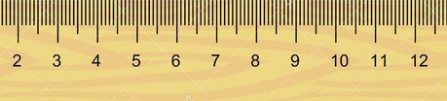
Extreme Value Replacement (EVR)
6.5
7.5

Slide 12
Close Value Replacement (CVR)
6
6.5

Slide 13
And the rationale is:
if there is disagreement between two raters, then probably one of the raters has erred. Hence, there is a need to replace that rater.
We do not know which rater it is, but we can assume that it is the rater who is farthest away from the third rater.
A similar logic applies when two counts of a set of objects differ from each other. A third count is then called for and, if it agrees with one of the former counts, then this number is taken as the correct one.

Slide 14
Error of measurement in Classical Test Theory
The Standard error of measurement is the sd of e. The error variance is the variance of e.
The error and the true score are independent, therefore the variance of the observed score is the sum of the error variance and the true score variance.
Since the errors of two ratings are independent of each other, the error variance of an average of 2 ratings is half of the error variance of each rating; the error variance of the average of three ratings is a third of the error variance of a single error, etc.

Slide 15
The measurement error of the average of two scores:
The difference between two scores is:

Slide 16
Simulation study:
Assume an error model:
  Normal distribution
  Binomial distribution
  Uniform distribution
Sample 3 ratings (rating errors) for 100,000 simulated essays. The mean of the ratings is 0.0, their variance equals the error variance of a single rater.
Apply EVR or CVR.

Slide 17
Analysis:
We now have 100,000 triads of ratings (1st, 2nd and 3rd)
For each triad calculate D - the difference between the 1st and 2nd rating.
Sort the triads by D, and apply the replacement procedure.
Now we can examine the error measurement for the average of the two final ratings in each triad, and calculate its mean for successive groups of 10,000 triads.

Slide 18
The MSE for the top 10% and the next 10% of the essays with the largest gap between them
(inter-rater correlation =0.60)
Next 10% | Top 10% | MSE of:
0.20 | 0.20 | Two raters
0.32 | 0.45 | Following EVR
0.20 | 0.25 | Following CVR

Slide 19


The effect of replacement on the MSE as a function of the inter-rater gap
Normal distribution, n=100,000, r=0.60
MSE
Decile of inter-rater gap

Slide 20
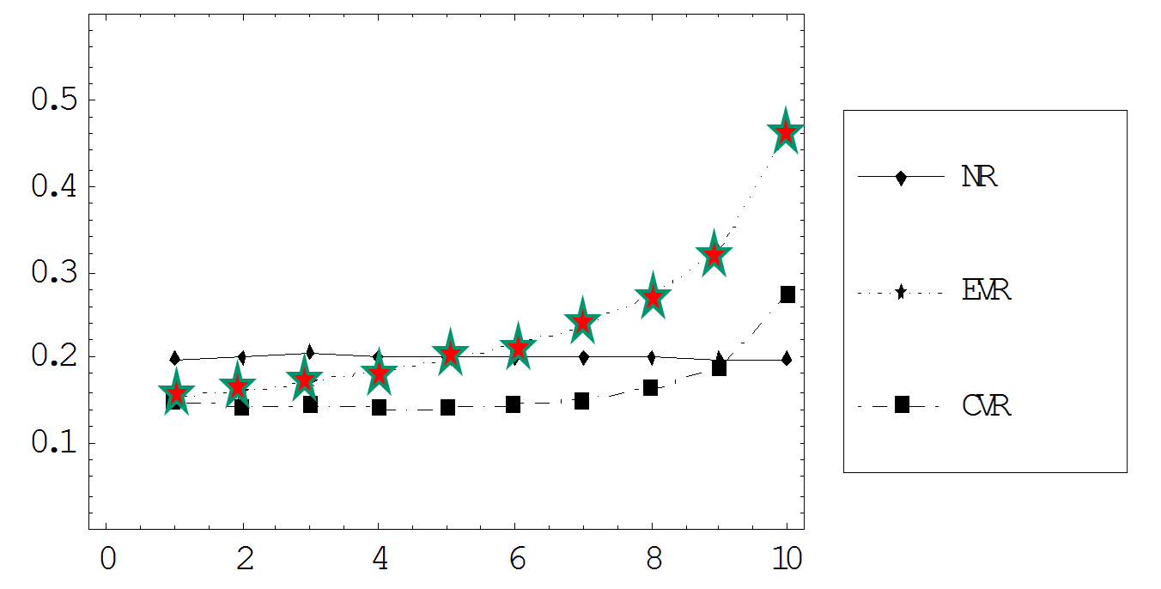

Interim conclusions
EVR increases the error of measurement!
[CVR is preferable]
Similar results obtain for other error distributions

Slide 21
The Third Rater Fallacy
The (wrong) belief that Extreme Value Replacement reduces the error of measurement in case of large inter-rater gap.
This wrong belief leads us to invest resources (third rater) for increasing the error of measurement

Slide 22
Similar results obtain when the 3rd rater is an expert rater whose ratings are more accurate.

Slide 23
A caveat:
EVR can increase reliability (reduce the error of measurement) when the error distribution is extremely platykurtic.

Slide 24
To what extent is reality represented by the simulation?
What happens in the real world?
What is the shape of the error distribution?
Do all raters have the same error distribution?
The problem:
In the real world we only have information about the observed score. We do not know what the true score is, hence, we do not know what the error component in each score is.

Slide 25
The answer:
According to CTT, the true score is the expected value of the observed scores. The mean of a large number of repeated measurements approximates the true score.
As Guilford (1965) expressed it:
  “The true measure is …the mean value we should obtain for the object if we measured it a large number of times.”
If we can get a ‘true score’, then we can estimate the error associated with each observed score.
And that’s what we did….

Slide 26
The study
500 essays written by university candidates for the writing section of the PET
The written essays were randomly divided into two groups of 250 essays each
Each set of essays was rated by a group of 15 (14) raters working independently
The final rating given by a rater to an essay is the sum of two intermediate ratings on a scale of 1 to 6. Therefore the final rating for each rater is on a scale of 2 to 12.

Slide 27
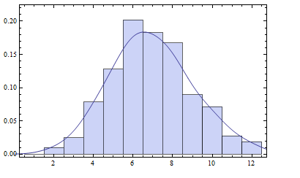
The distribution of all ratings:
N=7,250, m=6.9, sd=2.04

Slide 28
Distribution of Rating errors
Mean of 0, SD of 1.54
The density histogram of 7,250 rating errors in intervals of 0.5 score-points, together with its smooth approximation (blue) and the corresponding Normal Density function (red).

Slide 29
Personal error distributions

Slide 30
Analysis
There are 14 or 15 ratings per essay
From these we can select two ratings designated the “first” and “second” ratings (there are 91 or 105 ways to do this for each essay), and then 12 or 13 ways to select a “third” rating
The mean of the remaining 11 (12) ratings serves as the estimate of the true score of the essay
Now we can calculate D - the inter-rater gap, and also the measurement error before and after application of the replacement procedure (EVR or CVR)
D
True score
3 | 2 | 1
t | t | t | t | t | t | t | t | t | t | t

Slide 31

t | t | t | t | t | t | t | t | t | t | t | t
This procedure can be applied
times to each essay in the first set of 250
and
times to each essay in the second set of 250

Slide 32
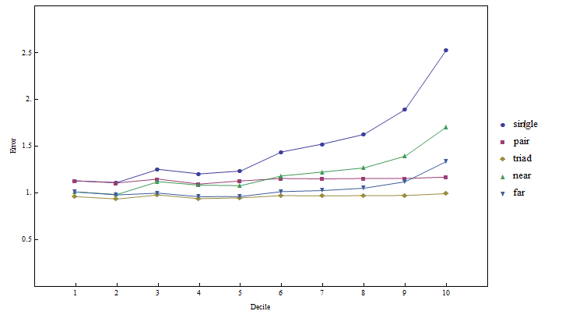
Averaged across all essays:
1
EVR
CVR
2
3

Slide 33
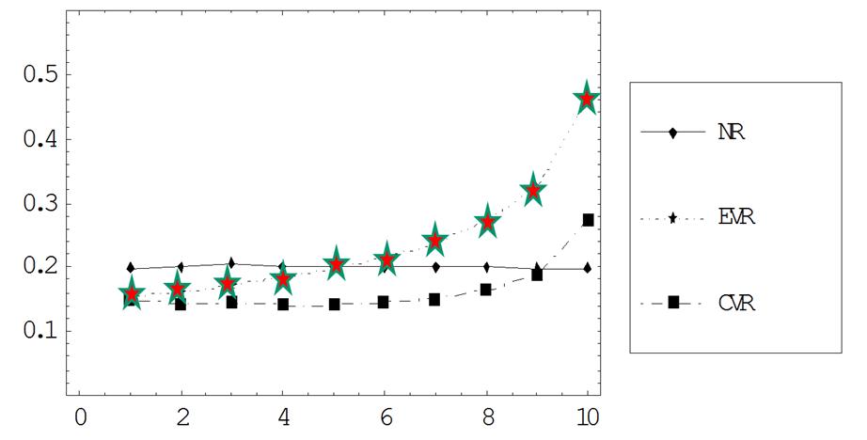
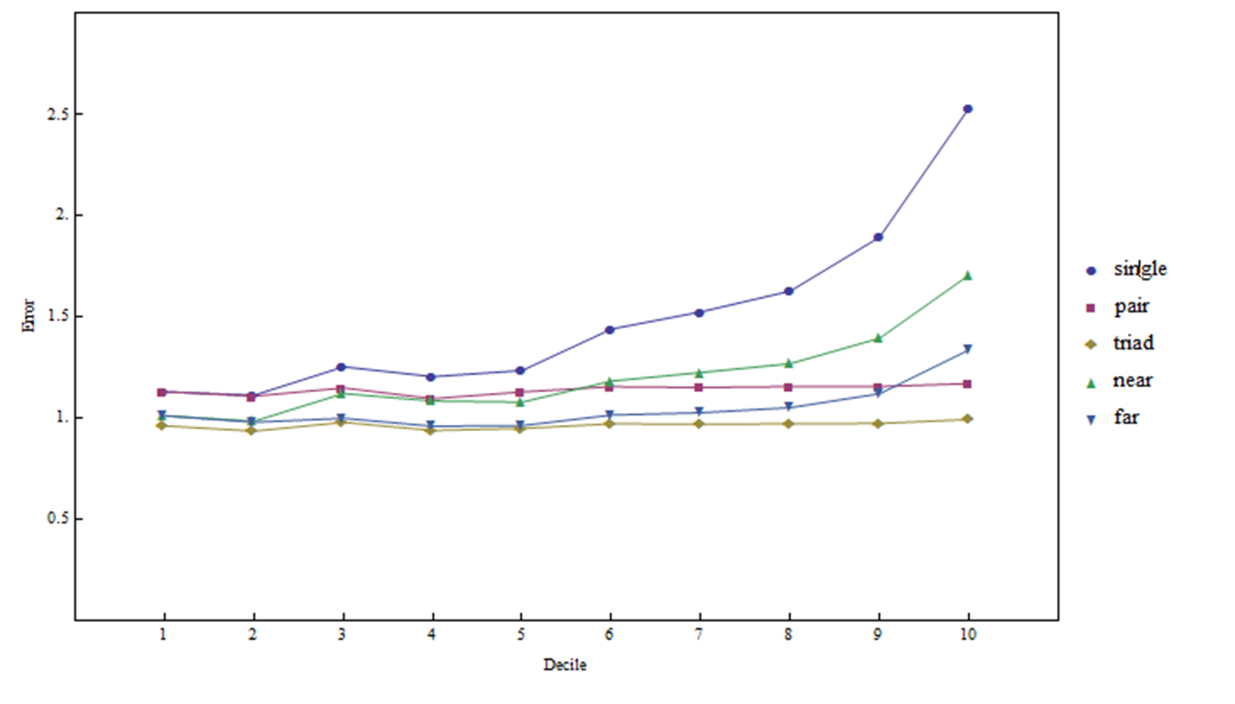
EVR
CVR
The simulation results fit well the empirical results !
2
EVR
CVR
2

Slide 34
The marking errors
Are indeed normally distributed,
within each rater!
and hence: also across raters!

Slide 35
Implications for our practice:
The replacement procedure is wrong! Testing agencies spend money on increasing the error of measurement.
If we want to add a third rater then this should be done whenever the inter-rater difference is small!
(Do not estimate reliability of ratings either before or following replacement on the basis of inter-rater correlations!)

Slide 36
Explaining the conundrum:
When two ratings are similar, the underlying errors of measurement are probably in the same direction – both negative or both positive; hence, the average of the two ratings errs in the same direction.
When the two ratings are discrepant, the underlying errors probably have opposite signs, and therefore they compensate each other.

Slide 37
Retroactive Quality Assurance: Calibration of markers
Raters are not all equal
Some are more consistent than others
Some are more lenient than others
Some use center grades, others use the full scale
(And there are other tendencies/biases:
  Halo effect
  Order effects
  Gender/race bias
  …)

Slide 38





Slide 40



Slide 41


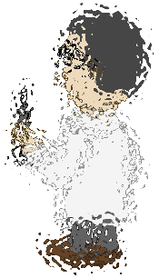

Slide 43
true even after they have undergone a long training period.
reflected in the final numerical ratings.
Acceptable in classroom assessment.
Acceptable in a panel review.
But not acceptable in standardized/objective assessment programs.

Slide 44
Calibration → Fairness
Within the context of high-stakes testing, where many raters score essays, the diversity among the raters has to be minimized in order to report fair and accurate essay scores.
One way to achieve this is by numerical adjustment of the scores given by different raters, a process which is usually referred to as “score calibration”. (interchangeable with “rater calibration” )

Slide 46
Goal of the current study:
To compare the accuracy of several methods for calibrating essay raters.
  Many raters; two raters per essay. Hence: any two examinees are not necessarily rated by the same raters
  All the methods are of the linear calibration type, i.e., they adjust the scales of the raters (mean and sd)
  By computer simulation
  Under different schemes of allocating essays to raters

Slide 47
General plan
Linear calibration methods
Allocation schemes
Method (simulation)
Results & Recommendations

Slide 48
Mean/SD calibration
“Mean/Sigma” method
Standardize all raters.
(Assumption: the allocation of essays to raters is random).

Slide 49
Calibration by an external criterion
Assume that there exists a reliable external criterion, which is linearly related to the essay ratings.
Each rater is scaled separately
Use the ratees mean and SD on the external criterion
Notes:
2nd bullet – I like ratees as a synonym for people whose essays were rated… but I think you meant raters

Slide 50
MLC - Multiple Linear Calibration
The idea behind MLC is that the pair calibration of particular rater scales to a “global scale” can be found by using local calibration functions: the pairwise calibration functions between raters.

Slide 51
Method (simulation) 1
Fixed parameters
  500 essays –a true score for each
  10 raters – each with a “personal” mean and SD
  External criterion reliability of 0.9
20 study conditions
  5 levels of intra-rater error 0.4 – 0.8
  4 allocation schemes
10 replications for each condition

Slide 52
Method (simulation) 2
Criterion measure (dependent variable):
  Mean calibration error for each method in each condition
  How far the set of calibrated scores is from the true scores

Slide 53
Results
MSE of the calibrated ratings for each of the allocation methods, as a function of the
Calibration method
The intra-rater reliability

Slide 54
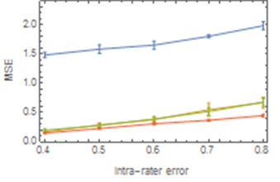
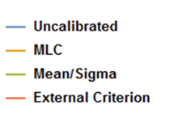
Random allocation
Calibration efficiency: 90% - 77%

Slide 55
Conclusions
Calibrated ratings are always better than raw ratings, irrespective of the calibration method.
Calibration is more effective at higher-reliability situations
Calibration by an external criterion is superior to other methods provided that the external criterion is reliable/valid
In the absence of a valid external criterion – use MLC

Slide 56
Calibration of raters
→ Fairer assessment

Slide 57
Thank you for your attention.
yoav@nite.org.il

