Slide 1
Price Duration Equivalence Research Pack
International evidence review for DECC
August 2015

Slide 2
This work aims to support DECC’s consideration of whether and how to implement a PDE methodology
Context
DECC issued a consultation on a price duration equivalence methodology in 2014 but, based on stakeholder responses, decided that further thinking was needed.
It plans to consult further on the issue in 2015 and for this consultation to inform any decisions on whether to implement a PDC in the future, for example in the 2016 capacity auction.
Project objectives
This pack
Build on the analysis DECC has already undertaken.
Review stakeholder responses to DECC’s 2014 consultation.
Examine experience in other countries and in other sectors to identify potential alternative approaches and any suitable lessons learned.
Analysis pack
Set out potential PDE options for DECC to consider, and identify wider options that may be relevant.
Test these options with a limited set of stakeholders.
Develop those options which are consistent with the current design of the capacity market, and could therefore be implemented in time for the 2016 auction.
Carefully discuss and agree on a set of evaluation criteria with DECC and evaluate the options against these criteria.
This work is available in a separate pack (titled “Price Duration Equivalence in the GB Capacity Market”)

Slide 3
Our research methodology has involved a review of four main areas…
Stakeholder responses:
We have examined these in detail to understand stakeholder concerns
International capacity & energy markets:
US, South American and European examples
Lessons learned for option development
VPP auctions
We examined in detail the French virtual power plant auctions
Other relevant sectors:
We have looked at, for example, waste, transport and financial markets.
… in each we have looked to identify any relevant learning for the design of a PDE methodology

Slide 4
When investigating different markets we have been asking very specific research questions
This review is aimed at answering a very specific set of questions related to the treatment of products with different contract durations in a single auction/tender process. It is not a detailed review of any particular market.
We first identified through discussion with DECC a set of relevant markets, where there is good reason to believe that there is potential for learning.
Then answered the following questions:
Question 1: What is the product being traded in the market, including a brief background of the market/sector?
Question 2: Are different products traded in the same auction procurement process, i.e. are participants able to buy/sell contracts for different product terms, or do contracts vary in some other way?
Question 3: If the answer to question 2 is yes, then are bids compared on any basis other than price alone e.g. an indifference methodology? If so, what are the details?

Slide 5
Summary of key findings
Stakeholder responses
International capacity & energy markets
Proposed method risks inadvertently capping prices below the CONE, inflating CM costs, and embedding the modelled prices in market outcomes.
Although some international capacity markets do effectively issue different contract lengths, we did not find any examples where an indifference methodology has been implemented.
VPP auctions
Other sectors
  French VPP auctions seem to be most relevant because an indifference price methodology was applied (although estimating future prices was comparatively easy). Unlike DECC’s proposal, fixed price differentials were used.
We have investigated a range of auctions in other sectors such as financial markets, gas pipeline capacity and toll roads. In some, contract duration is an auction clearing criteria, but nowhere is a PDE methodology being used.

Slide 6
Stakeholder responses
International capacity & energy markets
VPP auctions
Other sectors
Lessons learned for option development

Slide 7
Stakeholders identified potential issues with DECC’s proposed PDE methodology
Our review of the stakeholder responses is in line with the potential issues that we identified in our proposal. They are summarised below:
Reduced investment incentive - the example methodology provided by DECC, based upon capacity price forecasts for the Impact Assessment, means an investor seeking a 15-year contract could at most achieve a capacity price of approximately £35/kW-yr by bidding at the price cap of £75/kW-yr. This is significantly less than DECC’s current estimate for the cost of new entry (CONE).
Potential to increase costs without achieving additional capacity - in the above example, if new build capacity is required and sets the price, the auction could clear at the price cap of £75/kW-yr, payable to all capacity contracts at a high cost, when the new developer was in fact willing to accept a price as low as £35/kW-yr. This effect is made more likely by the fact that the majority of existing plant are restricted to bid below £25/kW-yr and there is therefore likely to be less competition between different contract lengths at higher prices. The single year cost of this effect may greatly outweigh any benefits achieved through reduced risk.
Complexity for new investors - the fact that contracts are paid at a level different to their exit price complicates the auction process for investors and reduces their ability to respond to the auction as it progresses.
Difficulty of deriving modelled clearing prices - the difficulty in ensuring DECC forecast prices are accurate was widely criticized. Moreover the actual process of forecasting prices to set the auction parameters would become increasingly complex. The forecast would need to account for the fact that the forecast itself would form part of the market structure. This could potentially be simulated iteratively but this could lead to extreme or counter-intuitive results.
Potential security of supply risks - If PDE curves suggest that future prices are cheaper this could lead to a temporary capacity crunch in the short term.

Slide 8
Some stakeholders made alternative policy proposals
These included:
Limiting the amount of capacity that can be issued long-duration contracts;
Developing a PDE methodology using the Cost of New Entry (CONE) parameter already defined in the auction (as opposed to using capacity price projections); and,
Developing a PDE curve based on the risk premium that would be applied by a developer taking a string of one-year contracts, relative to that same developer taking a long-duration contract.
  Note that this option would imply equivalence to developers, as opposed to equivalence to the Counterparty (and by extension consumers).
  The respondent acknowledged that establishing this premium would itself be challenging, but suggested that this approach would be easier, more transparent and more predictable than attempting to forecast future capacity prices.
We have taken these proposals into account when developing options and followed up with the relevant stakeholders to clarify our understanding of their proposals and test alternatives.

Slide 9
Stakeholder responses
International capacity & energy markets
VPP auctions
Other sectors
Lessons learned for option development

Slide 10
We have reviewed capacity & energy markets internationally
USA – In north-eastern states there are examples of capacity auctions with different contract lengths, but not the application of an indifference methodology
Ireland – annual capacity payments
Sweden/Finland – strategic reserve auctions with single duration contracts offered – no need for indifference methodology
Italy – capacity auctions planned, but with fixed contract length
Colombia – capacity option auction with varying contract lengths for new/existing plant. No PDE methodology applied
France – decentralised auctions planned, no need for indifference methodology
Chile – decentralised auctions for long-term energy contracts with durations set outside the auction. No PDE methodology used
Spain – annual capacity payments made independent of contract length
Brazil – centralised auctions for long-term energy contracts with durations set outside the auction. No PDE methodology used
Capacity
Energy

Slide 11






Summary of key findings in EU capacity markets
Title
Question 1: What is the product being traded in the market, including a brief background of the market/sector? | Ireland - regulated payments based on the MW required and the cost of new entry to the market | France - proposing a decentralised capacity market, so there is not a role for a centralised agency to create an indifference methodology | Spain – capacity payments to incentivise investment (payment for the first 20 years of a plant’s life) and availability of service | Sweden/Finland – temporary reserve auctioned annually until 2020 | Italy – currently capacity payments, but proposing a centralised capacity market. Annual auctions with 4-year lead time
Question 2: Are contracts of different lengths auctioned or different payments for different durations offered? | x No, payments determined annually | x No, delivery period fixed to 12 months | ✔ Long-term contracts offer higher payments than 1-year contracts | x No, only five month contracts are auctioned | x No, only three year contracts are auctioned
Question 3: Are bids compared on any other basis than simply price e.g. an indifference methodology? | x No need for PDE methodology because of single duration | x No need for PDE methodology because of single duration | x No PDE used. Long-term prices set to incentivise investment. Short-term prices initially based on a cost model with annual adjustments | x No need for PDE methodology because of single duration | x No need for PDE methodology because of single duration
Conclusion | Not relevant | Not relevant | Not relevant | Not relevant | Not relevant

Slide 12

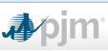



Summary of key findings in North and South American capacity markets
Title
Question 1: What is the product being traded in the market, including a brief background of the market/sector? | ISO-New England holds forward capacity market auctions three years in advance, procuring an annual capacity supply product | PJM holds forward capacity market auctions three years in advance, procuring an annual capacity supply product | New York ISO is running a spot capacity market procuring ICAP (and intentionally decided against a forward-looking approach) | In Colombia, capacity options are auctioned if a violation to reserve margin is expected over next 3-4 years
Question 2: Are contracts of different lengths auctioned or different payments for different durations offered? | ✔ One year contracts are auctioned. Seven year lock-in period available for new plant | ✔ One year contracts are auctioned. Seven year lock-in period available for new plant | x No, spot market with one month/season contracts only | ✔ Contract lengths of 1, 10 and 20 years are available for existing/ new plant
Question 3: Are bids compared on any other basis than simply price e.g. an indifference methodology? | x No PDE methodology used to compare bids for different durations | x No PDE methodology used to compare bids for different durations | x Spot market, no need for PDE methodology | x No PDE methodology used to compare bids for different durations
Conclusion | Not relevant | Not relevant | Not relevant | Not relevant

Slide 13


Summary of key findings in South American energy markets
Title
Question 1: What is the product being traded in the market, including a brief background of the market/sector? | Brazil – long-term energy contracts procured through auctions with varying starting dates. Separate auctions for new/existing plant | Chile – decentralised auction mechanism for long-term energy contracts operated by distributors. Same auction for new/existing plant
Question 2: Are contracts of different lengths auctioned or different payments for different durations offered? | x No, single contract duration specified before the auction takes place | x No, single contract duration specified before the auction takes place
Question 3: Are bids compared on any other basis than simply price e.g. an indifference methodology? | x No need for PDE methodology because of single duration | x No need for PDE methodology because of single duration
Conclusion | Not relevant | Not relevant

Slide 14
Stakeholder responses
International capacity & energy markets
VPP auctions
Other sectors
Lessons learned for option development

Slide 15
Virtual power plant (VPP) auctions were developed in response to market power concerns about EDF…
VPP auctions were designed to tackle market power…
…in the case of EDF, in response to its purchase of a controlling stake in EnBW
VPP auctions represent a ‘virtual’ divestment of power plants by a dominant firm in a market.
A VPP auction sells contracts which give the buyer the option to purchase the output, or a share of the output, of a plant.
VPPs are applied as a remedy for market power and are used as an alternative to ‘physical’ divestment of generation capacity.
The European Commission was concerned that EDF would be gaining control of one of its potential competitors, which was well-placed to enter the French market.
As a result, the European Commission wanted EDF to make available generating capacity to potential competitors in the French market.
A physical divestment was not favoured given EDF’s successful track record in safely managing the largest nuclear generating fleet in the world.
A VPP was therefore the favoured approach.
…and have subsequently been
implemented in a variety of places

Slide 16
The EDF VPP auction involved the simultaneous sale of multiple products and product durations
EDF initially sold option contracts for 5,000MW of capacity, split between baseload (4,000MW, rising later to 4,400MW) and peak (1000MW).
Option contract: the owner has the right to purchase power from EDF at a specified ‘strike price’. There is an incentive to call the option when the wholesale price exceeds the strike price. There were auctions for:
Baseload products: strike price set based on marginal cost of nuclear generation. In reality this price was low enough that it was almost always called, making it like a baseload strip. The optionality had little value.
Peak products: strike price based on marginal cost of plant generating at peak. Significant option value as can be used out of peak, and refused in peak periods as prices dictate.
In the auction, several different contract durations were sold in each product group, each with the same initial start date. The auction cleared based on the total quantity sold, with no pre-conditions on the quantity of different durations sold.
The rationale for this was that the buyers would know best what contract durations they needed to match their retail contracts i.e. the composition of durations should be market driven.
Contract durations on offer
Added later in the baseload product group
3-month
6-month
12-month
2-year
3-year
4-year

Slide 17
The auction uses an ascending clock format and in each round a menu of prices for contracts of different durations is offered
Ascending
clock
auction
Bidders confirm they will demand capacity at a particular price, with further rounds being held at higher and higher prices until the auction discovers the maximum price at which all the capacity is sold.
Pay-as-clear auction – all bidders remaining in the auction will pay the clearing price set by the marginal bidder.
The demand curve is revealed as the auction progresses, formed by ranking the ‘exit bids’ of participants.
This is the reverse of descending clock auction adopted by the GB capacity market.
Menu of prices
(Price duration
Equivalence)
As the prices rise through each round the bidders are presented with a menu of prices. The differentials between the prices are effectively fixed, so as the price rises in the auction, the prices for all the contract durations increase in lock-step.
The auction clears when the total supply of capacity is purchased. In this example 480MW. The final prices show the price differentials which were fixed prior to the auction, and reflect the prices at which EDF was indifferent between different durations.
June 2009 EDF VPP auction
Duration | 3-month | 6-month | 12-month | 24-month | 36-month | 48-month | Total capacity
Quantity sold | 95MW | 40MW | 70MW | 125MW | 50MW | 100MW | 480MW
Final price per month | €19.5 | €25.6 | €28.8 | €31.6 | €33.2 | €34.7
Source: Virtual power plant auctions, Ausubel and Cramton, 2010

Slide 18
The price duration equivalence curve was derived based on a reasonable (but not perfect) understanding of the term structure of prices
To enable the market to decide the quantities of different durations they wished to purchase, EDF needed to determine the prices at which they were indifferent between selling one duration or another.
Forward value
of energy
A good understanding of the forward curve for energy was required to value contracts over a longer duration. Forward liquidity in the French market at the time extended out to 2 years but not beyond. And there was no liquidity 4 years out when that product was introduced.
A proxy forward curve for electricity prices was constructed using German prices, where liquidity stretched out to 4 years. This was simply done by assuming the near-term differential in French and German prices was maintained out to 4 years.
Option value
in the contracts
Historic power prices provided a solid foundation on which to estimate power price variability and these historic estimates were then adjusted to account for expected trends in future volatility.
The value of the contract optionality was estimated on the basis of these reasonably well-understood parameters.
Importantly the price differentials between contract durations were fixed – so the shape of the indifference curve was fixed irrespective of the clearing price for 3-month contracts. This is in contrast to DECC’s proposed methodology in the GB capacity market.

Slide 19
Fixed differentials move the PDE curves in parallel
In the VPP auctions, PDE curves moved in parallel. As this was an ascending auction, they shifted upwards until the auction concluded.
This was a simplification. Theoretically the slope of the indifference curve should change depending on the current clearing price relative to future prices. This leads to indifference curves that ‘fan out’, like in DECC’s proposal.
Part of the justification for the use of fixed differentials was that seasonal price differentials were known with reasonable certainty, especially when compared with the clearing price of future auctions. A ‘fan’ of curves would require prejudging future clearing prices.
One of the implications of using fixed price differentials is that the range of prices that long-term contracts can take is wider than under DECC’s methodology. We explore the use of fixed price differentials further in the options pack.

Slide 20
Key features of the PDE methodology in the VPP auctions
VPP approach
Implications
Access to forward market data
The future value of a VPP was heavily dependent on future electricity prices and EDF had reasonably good forward price data on which to make estimates. Future capacity prices are less deterministically linked to power prices.
Estimates of forward market prices
Forward price data was missing for longer durations, but estimates were developed using a reasonable proxy. Finding a suitable proxy would be harder in this case given the length of time involved.
Modelling of markets
An analytical/modelling approach was adopted to determine the option value of the contract. However, this was a simpler, less controversial modelling exercise than use of the DDM.
Fixed price differentials
Theoretically the price difference between short- and long-term contracts should vary with the short-term price. The VPP’s approach is a simplification which gives some shape to the indifference curve and allows long-term contracts to take on a wide range of prices.

Slide 21
Stakeholder responses
International capacity & energy markets
VPP auctions
Other sectors
Lessons learned for option development

Slide 22






Overview of sectors we researched
Radio spectrum auctions
UK transport sectors (rail and bus)
UK waste treatment
We consider potential lessons learned from auctions in other sectors
Bank of England liquidity auctions
Toll roads
US gas pipelines

Slide 23






Summary of key findings in other markets
Title
Question 1: What is the product being traded in the market, including a brief background of the market/sector? | During the financial crisis, the Bank of England held auctions to provide commercial banks with liquidity | Interstate natural gas pipeline capacity in the United States is usually sold off via competitive “open seasons” | Auctions of toll roads have had a variety of criteria, some implicitly including contract duration and trade-offs relative to price | Auctions are a commonly used tool by governments around the world to award licenses for the use of radio frequencies | In the UK, rail franchise contracts and London bus routes are awarded via public tender | In the UK local authorities award contract for waste treatment plants through PFI (Private Funding Initiative) contracts
Question 2: Are contracts of different lengths auctioned or different payments for different durations offered? | ✔ Single tenor auctions, but different clearing prices for less/more risky collateral | ✔ Bidders can offer different contract lengths | ✔ Bidders can offer different contract lengths | x No, single license duration determined before the auction takes place | x No, single license duration determined before the tender takes place | x No, single license duration determined before the tender takes place
Question 3: Are bids compared on any other basis than simply price e.g. an indifference methodology? | ~ Trade-off is not over duration (but collateral) and approach is undisclosed | ~ NPV method used (similar to DECC) but limited learning | ~ NPV method sometimes used (similar to DECC) but limited learning | x No, bids are only compared on the basis of price | x Price is only one of many criteria but no evidence of PDE methodology | x Price is only one of many criteria but no evidence of PDE methodology
Conclusion | Not directly relevant, some limited learning |  |  | Not relevant, discussed in Annexe

Slide 24
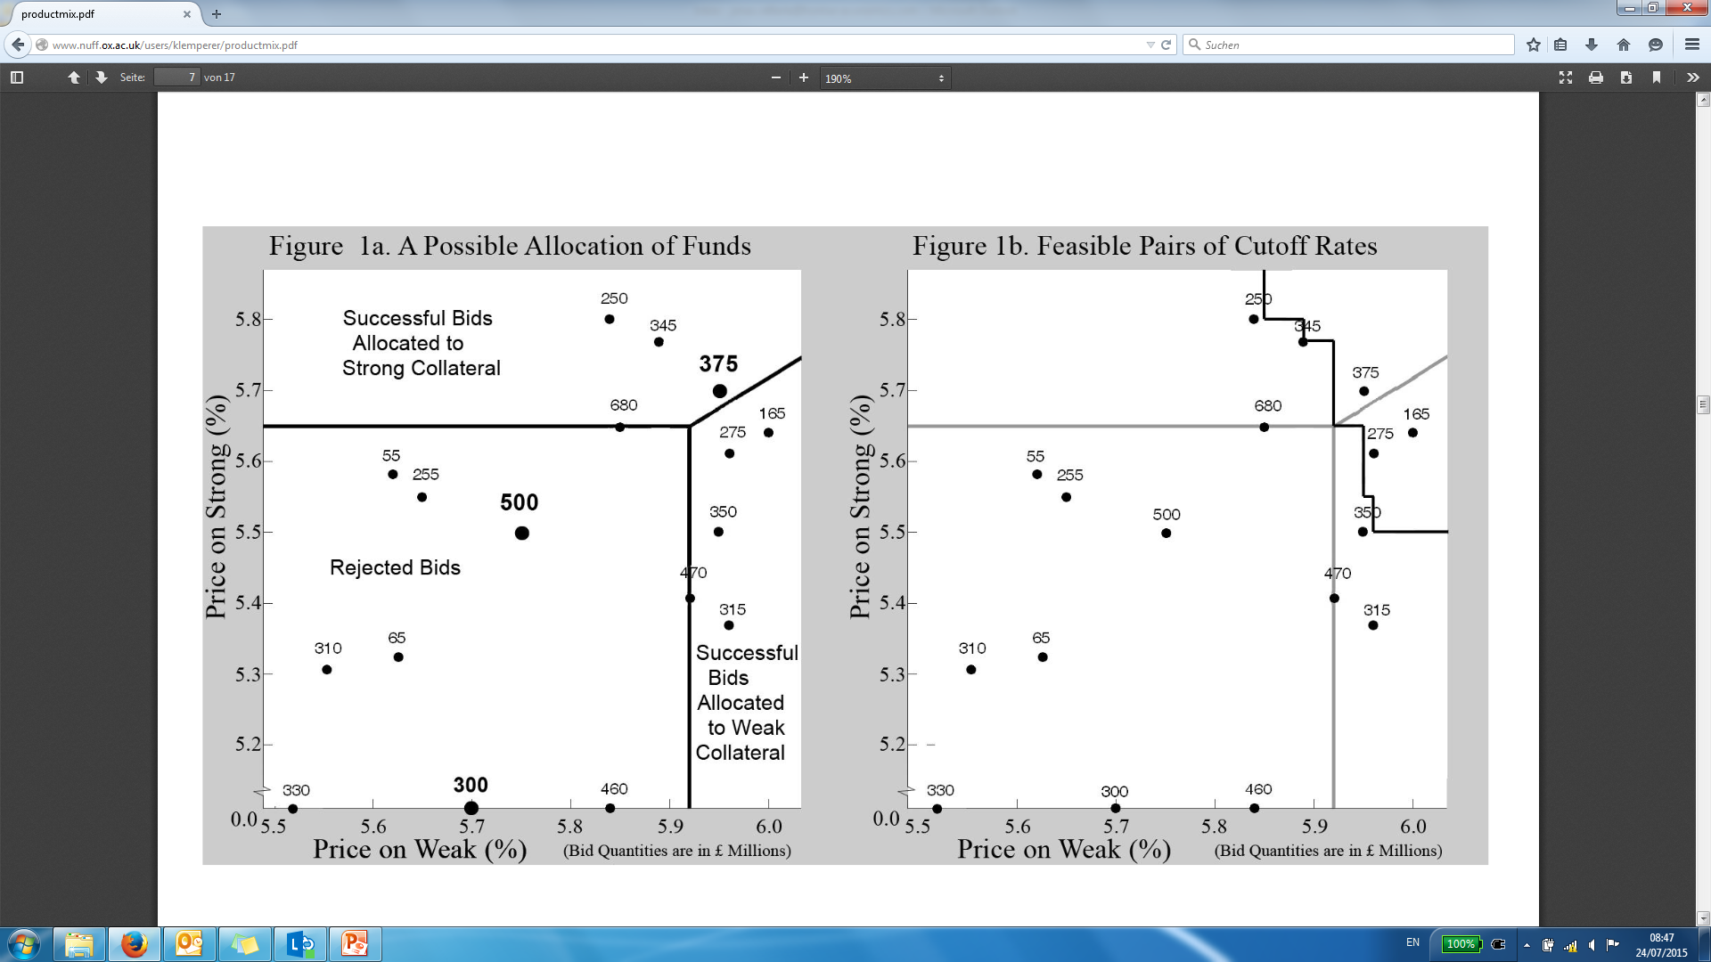
Financial markets – BoE liquidity auctions (1)
Bank of England liquidity auctions took place during the financial crisis and followed a novel procedure developed by Prof. Paul Klemperer.
The contract length was specified before the auction, but commercial banks could enter the auction offering collateral of different quality. Banks had to submit all their bids at once, which could consist of combinations of high- or low-quality collateral. For example a bid could take the form of £100m at 7% interest and weak collateral or 5% interest and strong collateral.
Once all bids were collected, the Bank of England determined the winning bids and which variety of collateral to accept for each. It would do so by determining cut-off interest rates for weak and strong collateral, subject to distributing the allocated amount of liquidity. Those cut-off interest rates applied to all successful bidders regardless of their actual bids (pay as clear).
There is not a unique set of interest rates for which the liquidity auction clears. By varying the interest rate differential, the Bank can allocate a different share of liquidity to strong/weak collateral bids depending on its risk preferences.
Clearing price for strong collateral: 5.65%
Clearing price for weak collateral: 5.92%
Source: The Product-Mix Auction: a New Auction Design for Differentiated Goods, Paul Klemperer (2008)
A range of different interest rates can be chosen

Slide 25
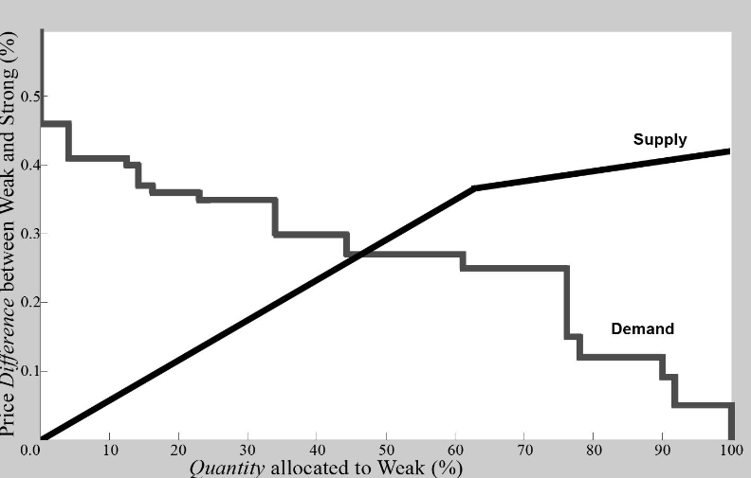
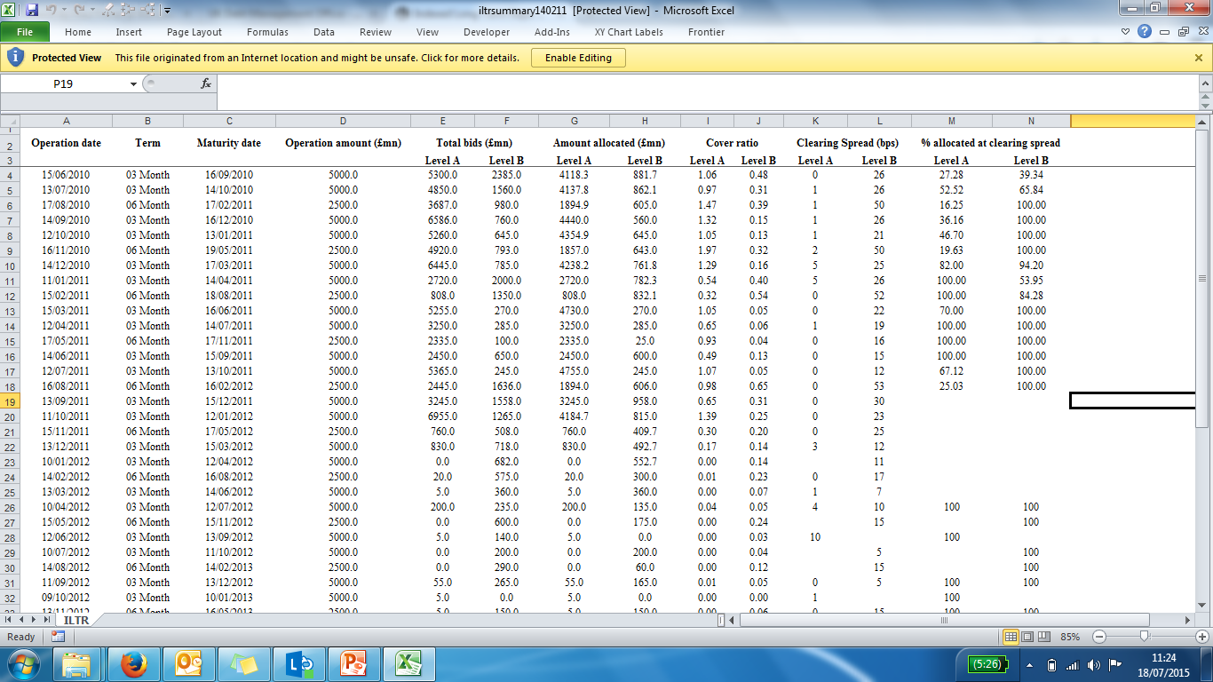
Financial markets – BoE liquidity auctions (2)
By changing the cut-off rates for strong and weak collateral as discussed on the previous slide, the bank can trace out a demand curve that distributes its desired level of the liquidity. The larger the interest rate differential between weak and strong, the smaller the share of liquidity allocated to weak collateral.
The Bank commits to a supply curve before the auction, but doesn’t publicly disclose those preferences.
Source: The Product-Mix Auction: a New Auction Design for Differentiated Goods, Paul Klemperer (2008)
Actual outcomes of some liquidity auctions
Although the contract duration (tenor) is fixed, the example of liquidity auctions is interesting because two different goods (with different associated risks) are sold in the same auction. A similar auction could be used for contracts of different lengths, but the BOE’s indifference method isn’t disclosed (and may not be relevant in any case).

Slide 26
US gas pipelines
Overview
  Interstate pipeline capacity in the United States is privately-owned but regulated. FERC requires competitive solicitation to allocate capacity - it favors the use of open seasons.
  Pipelines are not required to hold open seasons, but many do. A pipeline’s open season process is an open and transparent procedure that is set forth in the pipeline’s tariff. During the open season, FERC requires pipelines to sell all available capacity to shippers willing to pay the pipeline’s maximum recourse rate.
  NPV is a standard method of evaluating bids for capacity received during open season. The highest bidder, based on the NPV of the bid, receives the capacity.
  Factors determining NPV are price, maximum daily quantity of gas, and term (duration) of the contract. The price of pipeline’s capacity is not fixed, but it cannot exceed the maximum recourse rate stated in its tariff. Therefore much of the variation in bidding revolves around capacity and duration of commitment.
Current contracts on Algonquin Pipeline
Source: SNL, from FERC Index of Shippers
The NPV methodology used in these auctions is similar to DECC’s proposal. One of the key differences compared to DECC’s current methodology is that in the gas pipeline auctions, the marginal bid doesn’t impact the price paid by all the previous bidders. The outcome of the allocation process is determined by which bids maximise expected revenues (in NPV terms) rather than a trade-off between price and contract duration.

Slide 27
Toll road auctions sometimes, but not always, use contract duration as an auction-clearing criteria
Chile
Brazil
Mexico
  In 1998 Chile became the first country to use a Present Value of Revenues (“PVR”) auction to award toll road contracts.
  In a PVR auction, the regulator sets the maximum toll. The winner is chosen based on lowest present value of toll revenue over life of contract; the contract ends when the present value of toll revenue equals the winner’s PVR bid.
  Advantage to franchise holder is reduced investment risk, because PVR is guaranteed.
  Disadvantage to consumers is that an investment that makes the road more attractive to users (and thus increases demand) will increase revenue and thus lower the contract duration, so the franchise holder may avoid making investments in road improvements.
  Brazil’s 2013 auction of roads linking capital Brasilia to Rio de Janeiro and Belo Horizonte, the winner was selected based on lowest toll offered.
  In preparing the terms of the auction, the government extended the concession period, set higher maximum tolls, and made more conservative estimates of future road traffic than it had in previous auctions.
  The concession period was set at 30 years, and was not a biddable component.
  Mexico has trialled a number of different toll road auction types since 1989, in which contract duration was sometimes a winning criteria.
  In the first toll road program, contract duration was the main awarding criteria, but resulted in a short term contract with very high tolls.
  In 2003, a new program was launched in which the regulator set the maximum average toll, and the contract duration (up to 30 years).
  In 2006 yet another approach was taken by which the winning bid was determined on the basis of who offered the highest upfront fee to the state.
There are some examples of toll road auctions (e.g. Brazil) where the contract duration was set before the auction and was therefore not a biddable component. In other cases (e.g. Chile), an NPV methodology was used in which the contract duration is an auction-clearing criteria. Lessons learned from toll-road auctions are limited however, because no PDE methodology is used to compare bids. In all cases, the auction is for a single contract, so there is no scope for the bid on a marginal unit to affect prices for inframarginal units (since there aren’t any).

Slide 28
Stakeholder responses
International capacity & energy markets
VPP auctions
Other sectors
Lessons learned for option development

Slide 29
Summary conclusions from the research
Our research suggests that…
Conclusions
Stakeholders identified several concerns with regard to the proposed methodology.
The risk of inadvertently capping prices (below the CONE) for long-term contracts, inflating CM costs, and embedding modelled prices in market outcomes were all noted in the consultation responses.
When evaluating options it will be important to consider their ability to overcome or avoid the concerns raised.
There are no international examples where a PDE approach is used in capacity auctions.
We reviewed capacity auctions in various American markets, where contracts of different lengths are sometimes available in the same auction. However, no PDE methodology is used to compare those bids.
Our review of capacity auctions in Europe suggests that a PDE methodology is not currently applied elsewhere.
A PDE methodology was used in the French VPP auctions.
French VPP auctions seem to be the most relevant comparator because price indifference curves were applied.
A simplified methodology based on fixed price differentials was used.
Further thinking is needed to assess the implications of a fixed price differentials approach and whether it could be a sensible alternative for UK CM auctions.
There is no evidence of PDE curves being applied in a similar fashion in other areas.
In BoE liquidity auctions, different products are auctioned in the same process and there is a trade-off made between price and riskiness. Although this is a potentially relevant auction format, there is no information as to how this trade-off is made and it may not be useful anyway for establishing duration equivalences.
There are some examples of contract duration being an award criteria for US gas pipeline capacity and toll roads in South America. However, there is no evidence of the application of a PDE methodology.

Slide 30
Annexe 1: International capacity auctions – detail
Annexe 2: Other markets – detail

Slide 31
Colombian capacity auctions involve different contract lengths, but no trade-off between price and duration
Aspect | Colombia
Mechanism | Capacity options
Motivation | Energy scarcity due to ENSO phenomenon in a hydro-dominated electricity market
Trigger for use of mechanism | Capacity auction if violation to reserve margin is expected over next 3-4 years
Qualification of plant | Plant capable of firm energy during dry period
Scope of mechanisms | All capacities
Contract duration
- new plant | 20 years
- existing plant | 1-10 years
Lead time
- new plant | 3-4 years (primary auction) 4-10 years (residual auction)
- existing plant | Short term
Capacity price determination | Auction (descending clock)
Volume determination | By artificial kinked demand curve
Variation in capacity price | No variation during the delivery. Auction determines price for out-of-contract plants
Further features | Complemented by energy option contracts to limit price volatility and mitigate market power

Slide 32

Sweden/Finland hold strategic reserve auctions to procure capacity in winter months...
Regulator forecasts capacity and demand
TSO contracts annual peak load reserve for winter period (Nov-Mar)
Peak load reserve needs to be available within 12 hours
Product
Reserve only used when electricity spot auction fails to clear
Reserve is bid for the price of the last commercial bid + 0.01 €/MWh
Costs for peak load reserve (capacity payment + energy payment) are distributed through a levy
Call-off
  Targeted mechanism that explicitly pays for peak load capacity

Slide 33
…but only one contract length is offered so the auction does not involve trading off price and duration
Aspect | Sweden/Finland
Mechanism | Strategic reserve (Last resort peak reserve dispatch)
Motivation | High uncertainty for peak investments to rely on extreme spikes during winters; initially planned as temporary solution, extended in March 2011
Trigger for use of mechanism | Risk of supply shortage in winter
Qualification of plant | Plant with start-up <12h, held in reserve
Scope of mechansims | only fraction of all capacity
Contract duration
- new plant | 5 months (one winter)
- existing plant | 5 months (one winter)
Lead time
- new plant | Short
- existing plant | Short
Capacity price determination | Bid process
Volume determination | Sweden max 2,000 MW, Finland max 600 MW
Variation in capacity price | -
Further features | Demand is included in mechanism (e.g. in Sweden in 2009: 633 out of 1,919 MW total contracted reserve was demand response)

Slide 34

Spain has had a system of capacity payments in place since 1997, with important reforms following 2007…
1997-2007
Capacity payments were introduced in Spain in 1997, when the generation sector was liberalised.
  The objective was to provide an economic signal for the permanence of existing plants (which faced increased risks due to the beginning of competition) and installation of generating capacity in the electrical system.
  Payments were based on technology, real investments, cost of capital and operating and maintenance costs.
2007-2014
In 2007 legislation provided for capacity payments to be split into two complementary payments:
  Investment incentive: to provide sufficient capacity for demand in the long-run.
  Availability service: to ensure capacity is available in the medium term
A plant can in theory receive both types of payments simultaneously.

Slide 35
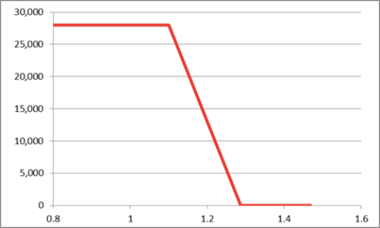
…but there is no evidence to suggest that a PDE methodology is used to trade off price and duration
Investment incentive: ensure installed capacity does not fall below the safety level determined by the system operator (SO)
Availability service: ensure that sufficient installed capacity is available during the year
Payments are paid for the first 10 years of a plant’s life. They were set at:
  € 20,000/MW/year for existing plants; and,
  for new plants were linked to the Coverage Ratio (CR) starting at € 28,000/MW/year, although this has never occurred in practice.
It has been modified several times following negotiations between the government and the companies to reduce the €30 billion tariff deficit¹:
  To 26,000€/MW/year in 2011 and 23,400€/MW/year in 2012. In 2013 the payment was reduced to 10,000 €/MW/year but the payment period increased from 10 to 20 years.
In 2007 the SO was instructed to propose the availability service, but the formula was not approved until 2011.
Plants willing to offer the availability service during a given year are entiteld to an annual payment (AP) of:
  AP = fixed value for all plants* availability index which is technology specific * net installed capacity of the plant
The parameters for 2012 were:
  Fixed value for all plants: 5,150€/MW
  Availability index is based on historical figures: fuel-oil (0.877), CCGT (0.913), coal plants (0.912) and some hydro stations (0.237 -pure pumping, mixed pumping and damming)
The resulting payments by technology are as follows
Link between payments and Coverage Ratio
The CR (ratio of “firm” capacity to peak demand) should be at least 1.1, with payments falling thereafter.
Technology | Maximum remuneration
CCGT | 4,702 €/MW/year
Coal | 4,697€/MW/year
Fuel-oil | 4,517€/MW/year
Hydro | 1,221€/MW/year
¹ The difference between the regulated tariffs paid by consumers and the costs of supply

Slide 36

Italy is planning to move from capacity payments to reliability options…
Status Quo
Consultation process on capacity mechanisms since 2011; the Draft regulation for the implementation of a capacity market has been approved by the regulator (AEEG) in September 2013 and submitted to Economic Dev. Ministry.
Capacity payments have been introduced as a temporary mechanism (until new mechanism is introduced):
  Plants receive a basic remuneration based on hourly day-ahead supply and demand forecasts, supplemented by an additional payment if the weighted average market price is lower than 20% of a reference price and if the plant is located in a low price area.
Currently there is overcapacity in the system. Therefore the reliability options system is not planned to start before 2017.
Planned System
TERNA (TSO) will organise annual auctions (of up to 10 GW), awarding three years of premium payments, four years in advance
  First auctions were originally planned to take place in 2013: payments for period 2017-2020
  Auctions open to new and existing plants
  Auctions for each relevant network area (aim: fostering investments at locations where it is most needed)
But no auction has taken place yet

Slide 37
…but there is no evidence to suggest that a PDE methodology is/ will be applied
TERNA (TSO)
Producer
Annual Premium (€/MW)
Organizes annual actions (pay-as-bid, descending-clock-auction), awarding three years of premium payments
Complementary auctions, worth 1-2 yrs of premiums are possible
Possibility to hold longer-term auction still under investigation
Sells option contract to TSO (is then obliged to keep the contracted capacity online)
Difference between spot price (and price for ancillary services) and strike price (if >0)
The strike price should correspond to standard variable costs of an efficient peak plant (TERNA will define, which marginal technology is used for back-up power)

Slide 38
Annexe 1: International capacity auctions – detail
Annexe 2: Other markets – detail

Slide 39
UK waste sector procurement does not involve a PDE methodology
Policy change
In 1999, the EU introduced a Directive requiring all member states to reduce the amount of waste sent to landfill. DEFRA established a programme in 2006 to encourage the development of local authority waste infrastructure by providing support, guidance and funding to local authorities undertaking waste projects through PFI (Private Funding Initiative) contracts
Resulted in long-term contracts
In recent years Councils have attracted private funding for waste treatment plants through public tenders. This has resulted in long-term contracts such as:
In 2013 the West London Waste Authority signed a Public Private Partnership (PPP) contract with a consortium led by SITA UK Ltd to recover energy from residual waste over a 25 year period.
In 2014, the North Yorkshire County Council signed the project agreement with AmeyCespa for the Allerton Waste Recovery Park (AWRP) project lasting 25 years.
In 2015, the Isle of Wight Council selected AmeyCespa as the preferred bidder for the contract to deliver waste collection and treatment services for the Isle of Wight for the next 25 years
In 2014 the Public Accounts Committee found that the current approach may result in long-term contracts that are too inflexible, given that technology is constantly evolving and the amount of waste produced can be hard to predict
There is no indication that an indifference price methodology is used in the procurement of UK waste treatment contracts.

Slide 40
UK transport sector doesn’t feature a PDE methodology because contract lengths are set outside the auction
London Bus routes
UK Rail Franchising
  London Buses (part of TfL) has a continuous programme of tendering with Invitations to Tender (ITT) being issued throughout the year. Roughly 15-20% of London bus routes are tendered each year.
  Bids are evaluated based on price, ability to deliver minimum quality, financial status and other criteria.
  All contracts are awarded for an initial period of 5 years. There is the possibility of a 2-year performance related extension.
  Britain's railway system is operated as a network of over 20 franchises. DfT uses a public tendering process to award franchise contracts.
  Bids are evaluated based on price and a range of policy goals which will differ across franchises and weights that DfT attaches to each of these goals.
  Contract lengths differ across franchises but are pre-specified in the ITT. They usually range from between 8 to 15 years, with a possibility for the Secretary of State to request an extension.
In both cases the contract length is fixed before the tendering. There is no evidence that a price-duration indifference methodology is applied

Slide 41
Spectrum auctions are decided strictly on a price bid
Overview
  Auctions are a commonly used tool by governments around to world to award licenses for the use of radio frequencies (spectrum). Spectrum is a scarce resource and a key input of mobile networks. The amount being auctioned is usually smaller than the quantity demanded so auctions usually clear above the reserve prices.
  New frequency bands are constantly being freed up for the use of mobile technologies. One example is the so-called ‘digital dividend’ in Europe, which saw frequencies in the 800 MHz bands becoming available after the transition from analogue to digital television broadcasting.
  The duration of licenses is decided before the auction and tends to be between 15-20 years in Europe. In the US, the latest AWS-3 auction offered licenses of 12 years, renewable in 10-year increments. The rationale for long license durations is that carriers must make large technology-specific and location-specific investments in networks. This kind of investment is better supported with a long-term license for spectrum.
Commonly used auction types
  Simultaneous multi-round ascending auctions (“SMRA”): Often spectrum in multiple frequency bands are auctioned in the same process. In this auction format, bids can be placed on individual blocks of spectrum in different bands. Provisional winners are announced after each round until no one wants to increase their bid. An activity usually ensures that bidders have to bid continuously to avoid ‘bid sniping’.
  Combinatorial clock auctions (“CCA”): Similar to the SMRA, this format is often used when multiple frequency bands are auctioned. It is particularly well suited when the frequency bands are complements, because bidders can make package bids rather than bidding on individual lots. CCA are also less susceptible to collusive behaviour. A downside is that the auction process and, in particular, the determination of payments are a lot more difficult than the SMRA.
Spectrum auctions are decided based strictly on the price bid. The duration of the contract is a condition of the license (set outside the auction). Spectrum auctions are therefore not relevant as an example of where a price indifference methodology is used.

Slide 42
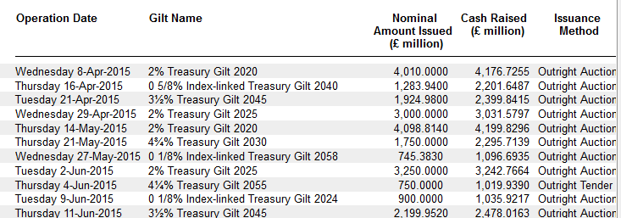
Sovereign debt auctions do not involve a price-duration trade-off because each tenor is auctioned separately
Auctions in financial markets are commonplace. For example, governments constantly issue bonds with different maturities through public tender. Below is an excerpt of UK gilts that were issued by HM Treasury in 2015.
In the case of UK gilt auctions (and other countries we examined) the contract length is fixed before the auction and each tenor is auctioned separately. They are therefore not examples of where a price-duration indifference methodology is applied.

Slide 43

Frontier Economics Limited in Europe is a member of the Frontier Economics network, which consists of separate companies based in Europe (Brussels, Cologne, London and Madrid) and Australia (Melbourne & Sydney). The companies are independently owned, and legal commitments entered into by any one company do not impose any obligations on other companies in the network. All views expressed in this document are the views of Frontier Economics Limited.

Slide 44
FRONTIER ECONOMICS EUROPE LTD.
BRUSSELS | COLOGNE | LONDON | MADRID
Frontier Economics Ltd, 71 High Holborn, London, WC1V 6DA
Tel. +44 (0)20 7031 7000 Fax. +44 (0)20 7031 7001 www.frontier-economics.com

