Slide 1
Working with the UK Commission for Employment and Skills
Information for potential research suppliers
July 2014

Slide 2
What will you find out?
This presentation provides information on:
  What the Commission does
  How we work
  Our objectives and deliverables for 2014-15
  What types of support you can provide
    What you need to do
    How you can best demonstrate your expertise when bidding
More detailed information is provided in the notes pages

Slide 3
About the UK Commission: our remit and our ambition

Slide 4
About the UK Commission for Employment and Skills (UKCES)
UKCES works with industry and government to help achieve better outcomes in how people get in and on in work and how businesses succeed through the skills and talents of their people.
Our priorities for 2014 to 2015 are to:
create more opportunities for all young people to get in and on in work
improve the skills, productivity and progression of those in work
build stronger vocational pathways into higher level skills and jobs.
Notes:
We believe that it is the talents and skills of people that drive business competitiveness and economic growth. Our unique contribution and ability to create impact comes through the insights of Commissioners, our authoritative research and our approach of working with key industry sectors and wider networks of business leadership to galvanise action.

Slide 5
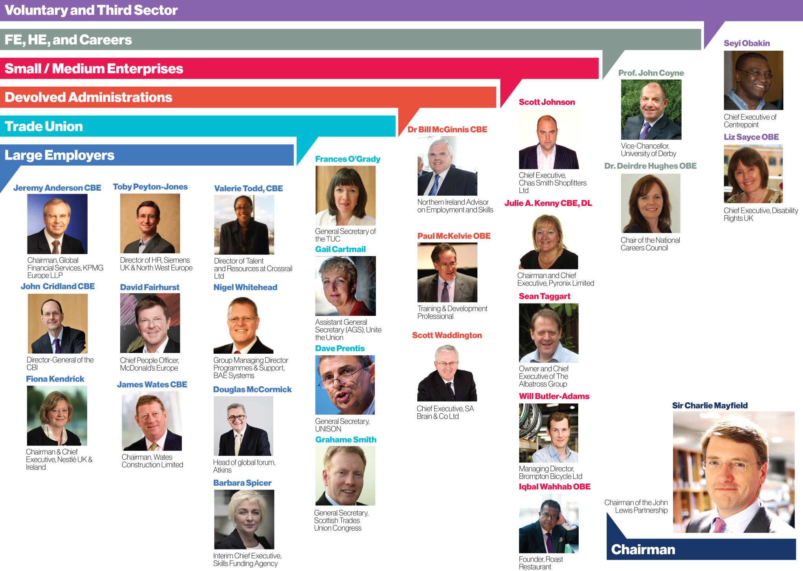
Our Commissioners
Notes:
UKCES is a social partnership led by 30 Commissioners who are senior leaders of large and small enterprises, (including non-profits), further and higher education institutions from across the UK.
UKCES is funded by government as a UK non-departmental public body and Commissioners are appointed by government ministers.

Slide 6
Research at the UK Commission

Slide 7
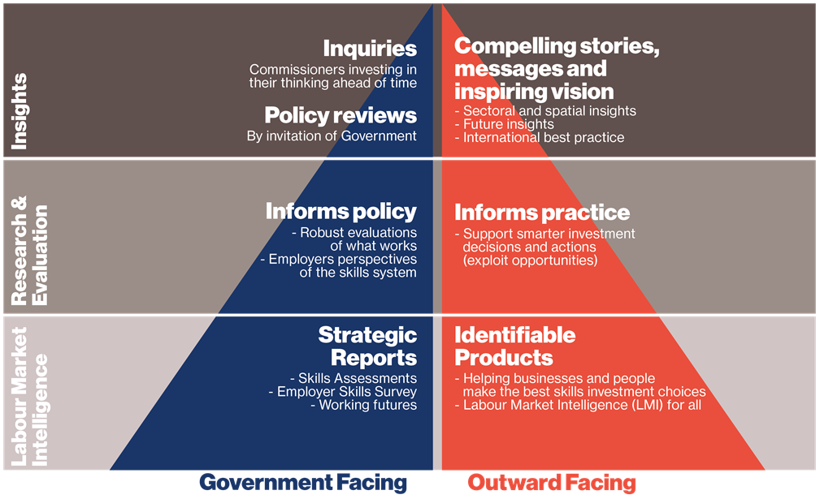
Our research
Notes:
Our research is aimed at informing and shaping skills and employment policy, helping employers to make better and more informed decisions, and helping individuals to develop the skills they need to succeed.
Our employer survey data and future projections underpin our messages and help us inform policy. We draw on the expertise and knowledge of our Commissioners, who lead inquiries on specific topics or challenges.
Our research products are aimed at Government and a wider audience of employers, researchers, individuals and academics.

Slide 8
Core principles
Our research is high quality, objective and robust
We are Commissioner-led and draw on leading-edge insights
We are outward focused: our research is action-orientated and informs our activities
We are interested in policy innovation based on evaluative assessments of ‘what works’, including internationally
We are apolitical and our work considers the long term as well as immediate issues

Slide 9
How we work
We use in-house expertise (members of the research and technical team) to design, manager and deliver programmes of work
We commission a wide range of external suppliers to deliver specific projects, ranging from fieldwork for the UK Commission’s Employer Skills Survey of over 80,000 employers to small-scale literature reviews
We use a pool of Associates for targeted pieces of work
We work with strategic partners (such as the OECD and ESRC) to gain policy insights.

Slide 10
Our objectives
For 2014-17 we have four objectives:
Lead the debate with industry to drive better outcomes for skills, jobs and growth
Work with industrial partnerships and wider networks to push forward employer ownership of skills
Test out employer-led innovation to address persistent skills challenges
Help businesses realise the potential of their people through Investors in People
Our research work supports objectives 1-3. Each objective is underpinned by detailed deliverables.

Slide 11
Objective 1 - deliverables
Lead the debate with industry to drive better outcomes for skills, jobs and growth.
1.1 In key policy areas of youth employment, progression in work and pathways to higher level skills, Commissioners will promote inspiring insights from our networks and research
1.2 Produce and promote robust business intelligence to ensure that skills development supports choice, competitiveness and growth for local and industrial strategies
Notes:
Objective 1 is supported by two deliverables. It encompasses analysis/insight and our core research products, including the UK Commission’s Employer Skills Survey.
Our work under deliverable 1.1 includes:
understanding what works in creating more opportunities for young people through work experience and apprenticeships, improving productivity and progression in work and creating pathways to higher level skills
using Commissioner leadership and industry networks to promote key messages and change policy and practice.
Our work under deliverable 1.2 includes:
delivering core business intelligence across the UK which is recognised, and shapes future choice, policy and practice (including the UK Commission Employer Perspectives Survey and Employer Skills Survey; our sector insights; working futures series and Listening to Business)
delivering ‘LMI for All’ and related products which enhances wider access to intelligence and stimulates use in the market
working with Local Enterprise Partnerships and wider partners to help ensure that labour market intelligence supports skills development
working with strategic partnerships such as the Organisation for Economic Co-operation and Development, to extend the UKCES research portfolio and strengthen evidence based decision making concerning skills.

Slide 12
Objective 1 - research
In this area we will be commissioning:
Analysis to inform a skills audit (July/August 2014)
Analysis to support Commissioner Inquiries (timing and specification will depend upon the nature of the inquiry and reporting dates)
The UK Commission’s Employer Skills Survey 2015 (October 2014)
Supporting partnership activity (e.g. events with Local Enterprise Partnerships and FE Colleges to promote use of UKCES data, timing tbc)
Procuring Research Associates to support a range of research activity (July 2014)

Slide 13
Objective 2 - deliverables
Work with industrial partnerships and wider networks to push forward employer ownership of skills
2.1 Establish and coordinate an industry led occupational standards programme that underpins Apprenticeships and vocational qualifications across the UK
2.2. Work with industrial partnerships and networks to galvanise action on skills in line with national industrial strategies
2.3 Manage the performance and evaluate our existing employer investment programmes projects
Notes:
Objective 2 is supported by three deliverables.
Our work under deliverable 2.1 includes:
managing the effective delivery of the Standards and Framework programme during 2014 – 2015, and plan for transition to the new technical function
agreeing and trialling a new approach to developing Occupational Standards that are based on labour market requirements and participating in the feasibility study to explore linking the National Occupational Standards database with other external qualifications databases, including those of Ofqual and the SFA .
Our work under deliverable 2.2 includes:
working with SFA/BIS on the completion of grant negotiations to establish industrial partnerships to drive growth through skills
working with industrial partnerships and networks to build their effectiveness, encourage successful collaboration and knowledge transfer and supporting the key policy areas of youth employment, progression in work and pathways to higher level skills
highlighting best practice through Commissioner-led promotional activity and make an early assessment of progress and what works.
Our work under deliverable 2.3 includes:
managing the Employer Investment Fund (EIF) and Growth and Innovation Fund (GIF) projects to effective completion including financial reconciliations, reporting of outputs/outcome data, reviewing evaluation and project closure reports and developing compelling stories of impact.

Slide 14
Objective 2 - research
In this area we will be commissioning:
Sector insight work, including research to inform the development of occupational standards. This could include labour market intelligence projects focusing on specific sector skill needs and occupational pathways in priority sectors (August 2014)
Formative evaluation and impact measures for new National Occupational Standards (Autumn 2014)
We do not currently anticipate procuring additional work to support the evaluation of the EIF and GIF programmes

Slide 15
Objective 3 - deliverables
Test out employer-led innovation to address persistent skills challenges
3.1 Establish and pilot a UK Futures Programme which supports projects against skills challenge rounds
Existing competitions include off site construction; and leadership and management in supply chains.
Notes:
Objective 3 is supported by one deliverable.
Our work under deliverable 3.1 includes:
establishing a UK-wide futures programme co-investing with collaborations of business and wider partners to research, prototype and scale genuinely innovative solutions to tackling market/system failures
issuing challenges over the year in relation to youth employment, progression and productivity in work and pathways to higher level skills
supporting effective knowledge transfer and continuous learning to identify what works and to stimulate changes in policy and practice.

Slide 16
Objective 3 - research
In this area ‘research’ may be a type of project we are looking to invest in (see guidance documents here) within our thematic competitions
Evaluation – we are undertaking a largely ‘developmental evaluation’ approach to the evaluation of Futures Programme and will be seeking Facilitators for Innovation Labs plus commissioning an evaluation of the Futures Programme as a whole (July 2014).

Slide 17
Working with us

Slide 18
What can you provide?
We use external experts to:
  Provide additional support to the team
  Provide external expertise
  Provide challenge to our thinking
Short-term support on smaller pieces of work
High level, intellectually rigorous challenge and support
Links to latest research and emerging methodological approaches

Slide 19
What are we looking for?
Technical expertise including data analysis and modelling
Understanding and experience of skills policy and how it relates to the wider economy
In-depth understanding of particular sectors or types of skills intervention
Ability to draw together evidence and present results to a range of audiences
Understanding of policy context and ways in which to shape it

Slide 20
How can you best demonstrate your expertise?
Clear, succinct bids welcomed
Think about our wider remit and how this project supports our work
Consider collaborative bids where each party brings specific and demonstrable expertise
Think about the audiences for the work and how you can support dissemination
Bids need to demonstrate value for money - value for money does not necessarily mean the cheapest bid

Slide 21
Tips for bidders
Project methodology should be clearly linked to the aims and objectives set out in the ITT
Many bids fail because contractors have not read the ITT closely and considered weighting of the criteria
Previous experience of working together cannot be taken into account
All evidence to be taken into account must be explicitly stated in the tender document

Slide 22
01709 774 800
info@ukces.org.uk
https://twitter.com/ukces

