Slide 1
M25 DBFO – Achieving and Maintaining Service Excellence
Bev Waugh, Programme Director, Connect Plus

Slide 2
Agenda
The Contract
The First Year
Drive to Excellence
Examples of Excellence
Removing the Barriers to Service Excellence

Slide 3
The M25 DBFO Contract
The largest ever contract with the HA (£6.2bn) - awarded to Connect Plus (May 2009) covering 125 miles of M25, plus 125 miles of ‘stubs and tails’
The HA procured widening (capital c £2bn) through PFI, with benefits of combining maintenance and operations with the capital works
Contract
to widen the motorway (Sections 1 & 4) and refurbish Hatfield Tunnel
Operate and maintain the network for 30 years
Contract Award in uncertain financial markets
Designed to meet the demand and plan for growth – working towards journey time reliability

Slide 4
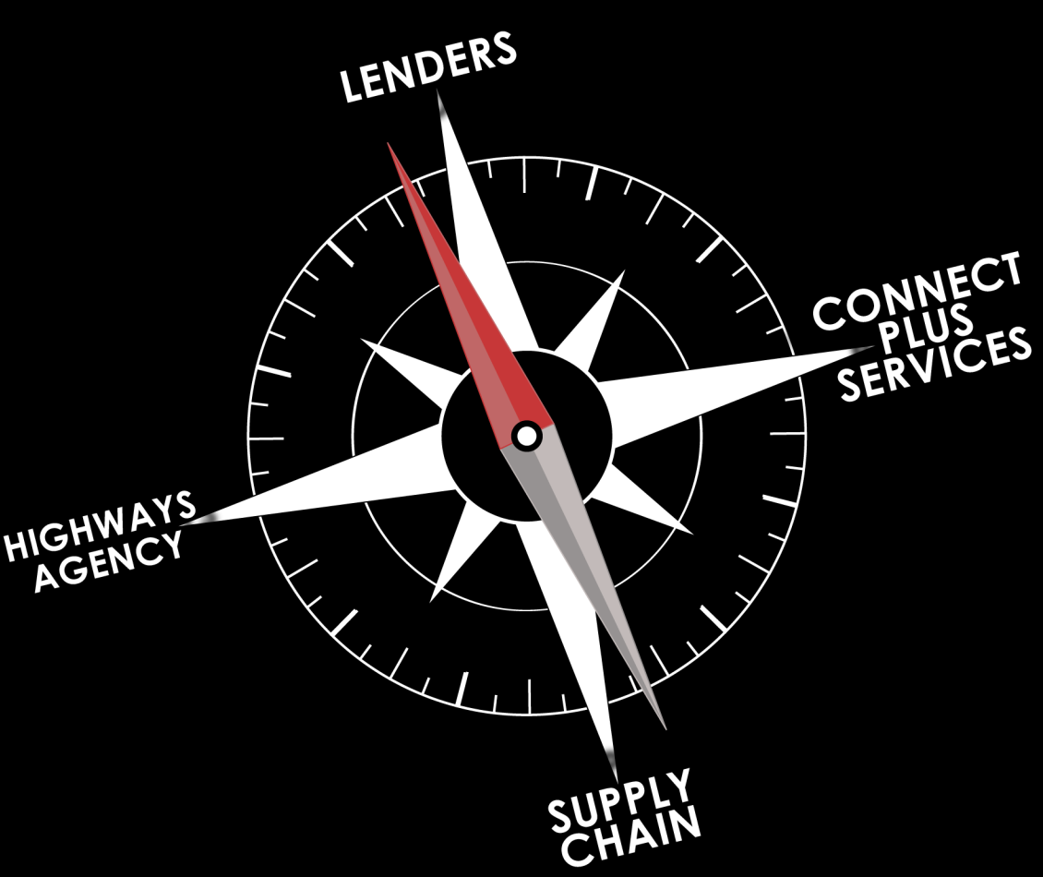
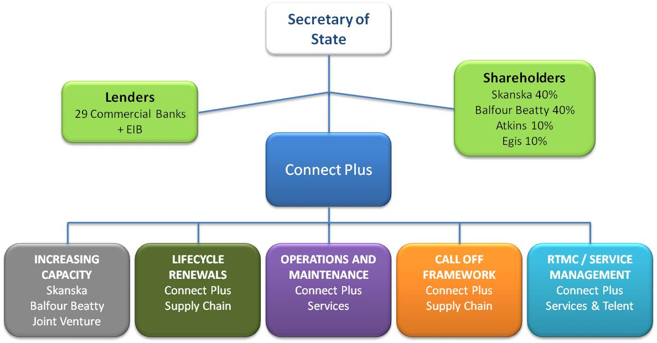

Slide 5
What we must deliver Requirements are not static

Slide 6
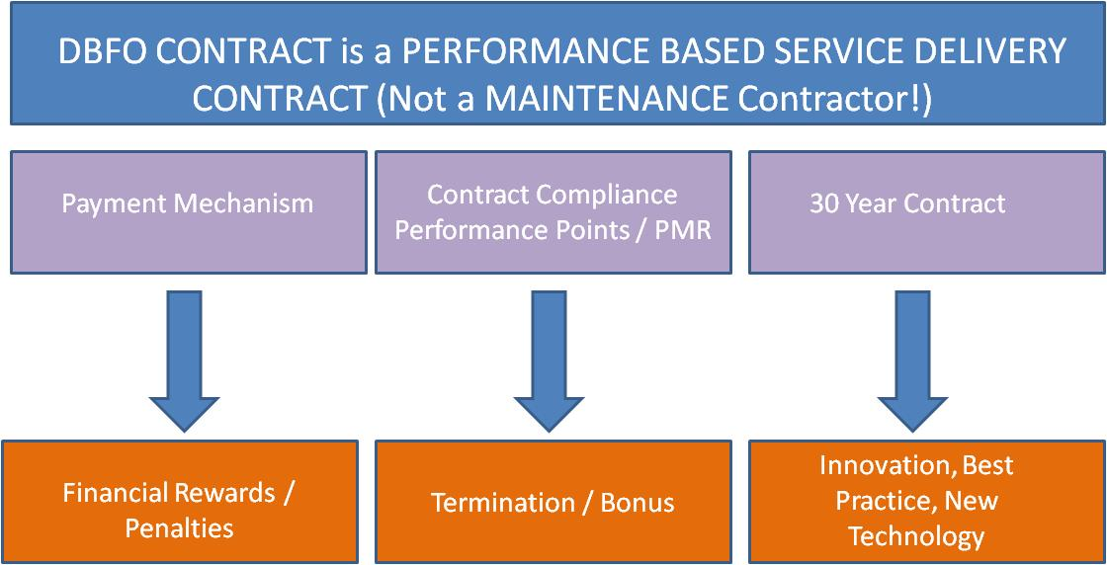
Incentives

Slide 7
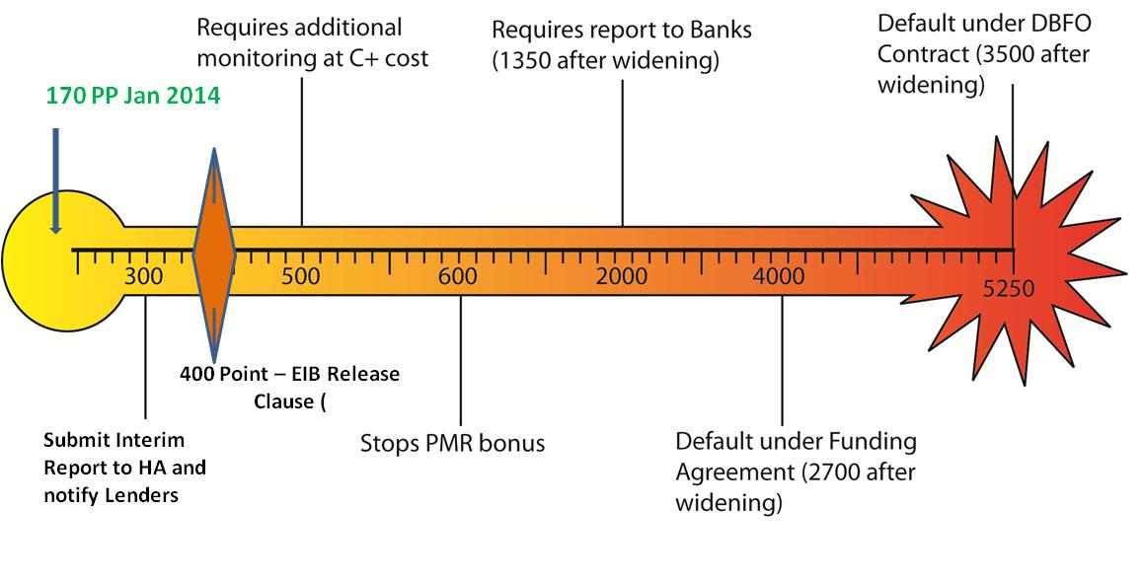
Performance Points - Thresholds
Notes:
The Performance Point Event system is Comprehensive and has some major consequences – such as additional monitoring that we have to pay for, writing to the banks to inform them of our poor performance and eventually Contract Default
A PPE is a failure to perform contract obligation or remedy existing failure in time
‘material breach’ leads to Warning Notice
HA discretion to issue Performance Points based on category of failure
Repeat failures lead to ‘ramping’ of points
Trigger levels (per rolling 12 months)

Slide 8
The First Year
We were reactive
It was exhausting often frustrating
It was difficult and often demoralising
Mobilisation took more than one year
The Contract was frightening – precedents were avoided
The organisation structure was changed more than once
Defensive
Were we ever going to be ‘good’ enough ???
A picture tells a thousand words................

Slide 9
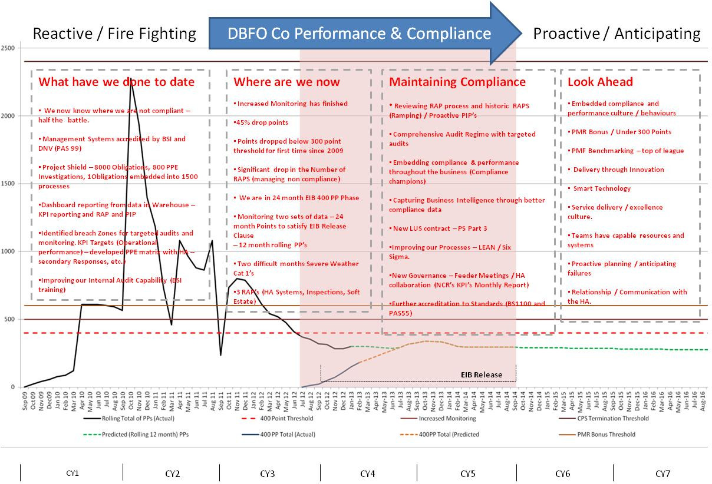

Slide 10
Drive to Excellence
Assurance to the HA we were self policing the Contract
Compliance Culture embedded throughout the Organisation
New tool kits to address root cause issues
Early detection of issues through effective audits and reporting
Aiming for 200 Performance Points
Robust Processes and Procedures to continually deliver compliance
All LUS and Dartford FFC contract changes embedded within processes
Communicate what we needed, wanted and had to deliver
Investigate Potential Breaches – 880 PPE Investigations

Slide 11
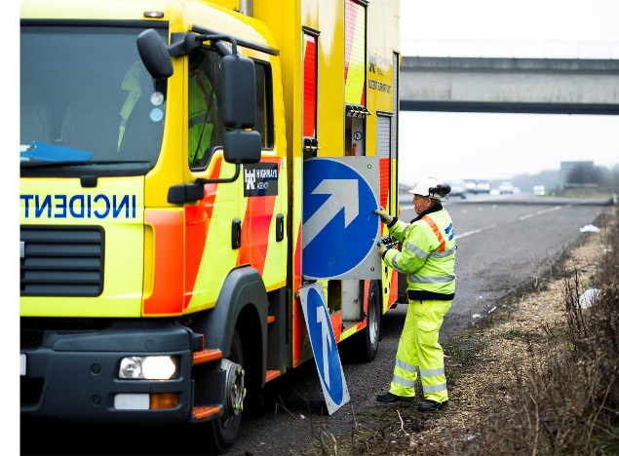
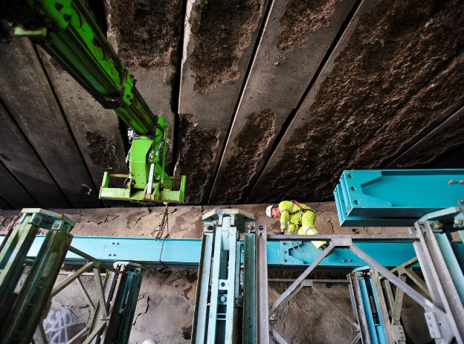
Examples of our Excellence
Permanent repairs of Cat 1 consistently exceeding KPI targets
HAILs relating to the appearance of the network (litter / soft estate) on a reducing trend and at an all time low.
Successfully managed a number of high profile events to ensure minimum disruption to the network (London 2012, Ride London etc..)
Collaborative working with the Emergency Services (eg Operation Viking – flytipping)
Effective mitigation of the effects of severe weather on the operation of the network
Major incidents (Deansbrook Viaduct, Jct 7 gantry, Jct 21 lorry fire, Boston Manor Viaduct ) dealt with speedily

Slide 12
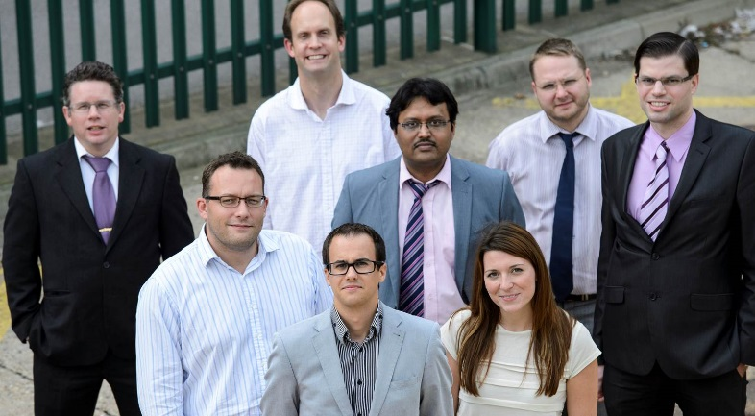
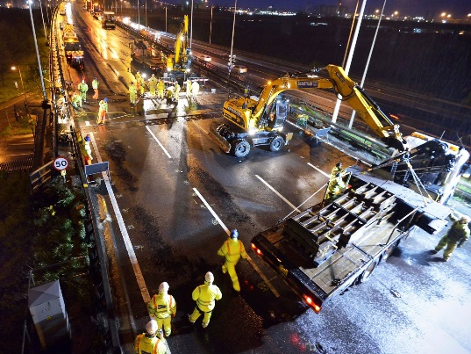
Examples of Proactive Management
Shared use of Traffic Management
Introduction of a Behavioural Safety programme
Operational Readiness
Improved facilities in each of the depots, including the provision of Lean Visual Management briefing rooms.
Working with the Princes Trust taking on 2 of the 11 apprentices
Built a collaborative community with the supply chain

Slide 13
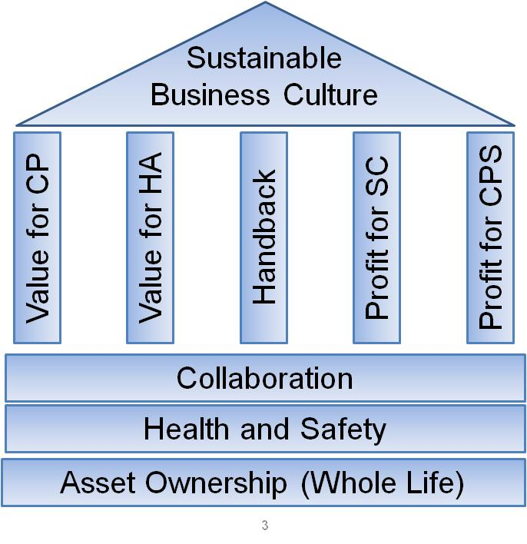
Fairness, Value and Efficiency

Slide 14
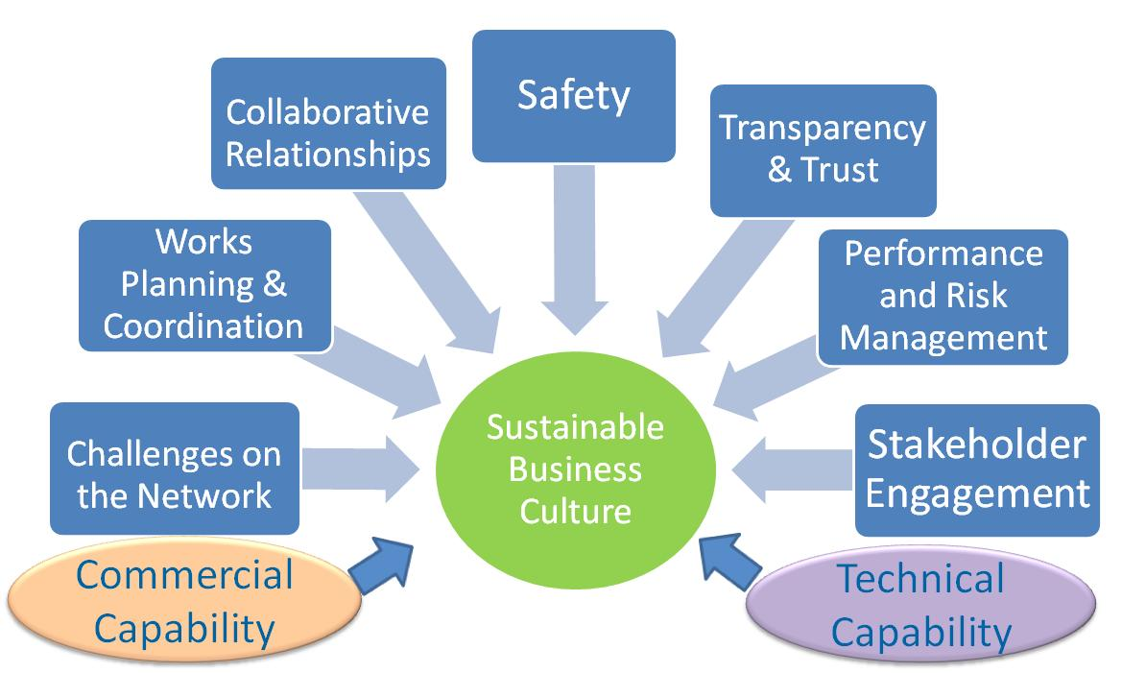
Sustainable Business Culture

Slide 15
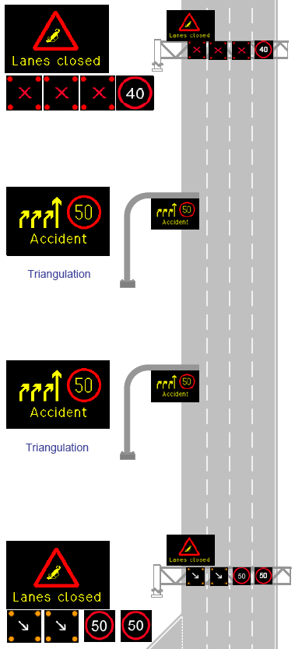
Innovation Realised
Replacement of Maurer Joints on QEII Bridge
Concrete Bay replacement in 7hrs
Resurfacing & Waterproofing of Dartford West Tunnel
Strategic Safety Forum for M25 Community
Wavetronics used in LUS to replace loops
All Lane Running Section went live safely
Roadspace Forum used to managed TM
Lean Facilitators trained – Drive out waste with positive challenge
BS11000 Accreditation – the supply chain understands our Strategy

Slide 16
Where we are now
Year 1
We were reactive
It was exhausting often frustrating
It was difficult and often demoralising
Mobilisation took more than one year
The Contract was frightening – precedents were avoided
The organisation structure was changed more than once
Defensive
Were we ever going to be ‘good’ enough ???
Year 5
We balance reactivity and proactivity
It is exhausting but often rewarding
We pull together to achieve goals, we achieve success together
We are compliant but we do challenge the Contract to achieve best value
The organisation structure continues to change
Open Culture
We know we have to work hard to maintain our standards
We plan with the HA for the future

Slide 17
Head – What we need to do and why

Slide 18
Heart - The drive

Slide 19
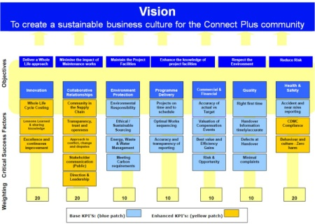
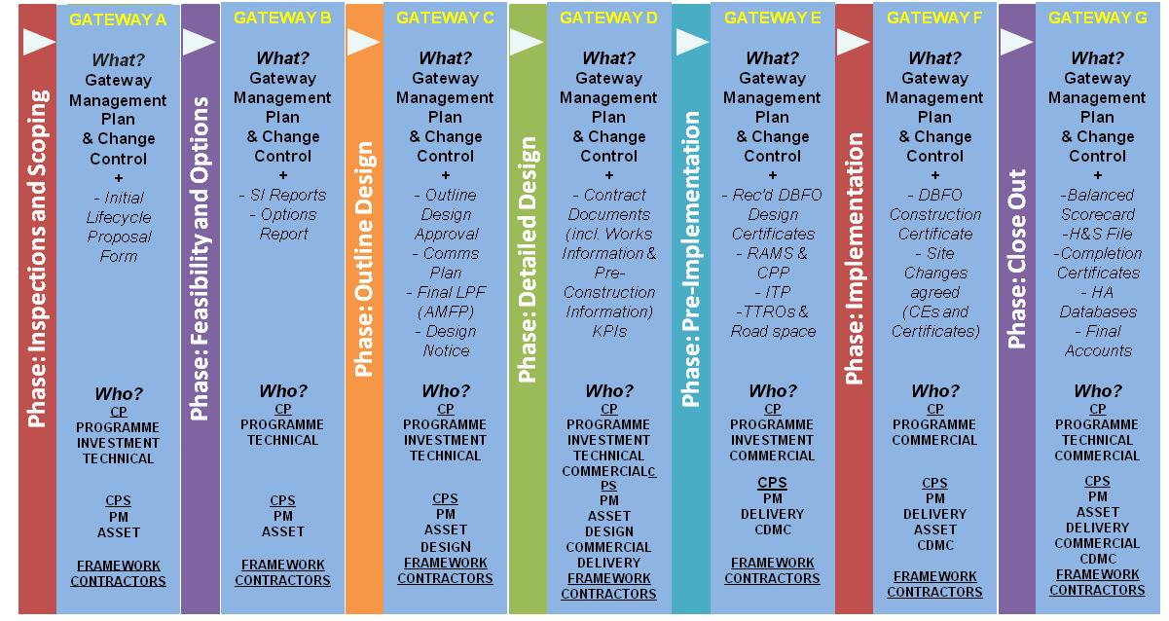
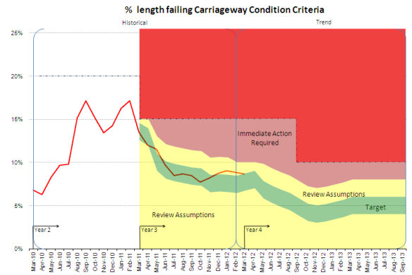
Hands – The tools to make it happen

Slide 20
Removing the barriers to Service Excellence
The HA needs to be part of creating the right environment for Service Excellence - The Contract is not enough
Collaboration is key and you can’t do it at arms length – it takes at least two to collaborate.
Work with your contractors to deliver innovation – it often feels very difficult
Trust us enough to meet your stakeholders and allow us to understand their issues
Be realistic with your programmes – Plan to succeed

