Slide 1
Access Rights Workshop 17th March 2014

Slide 2
Access Rights The Existing Framework James Clarke, OUGO
Policy Development Workshop

Slide 3
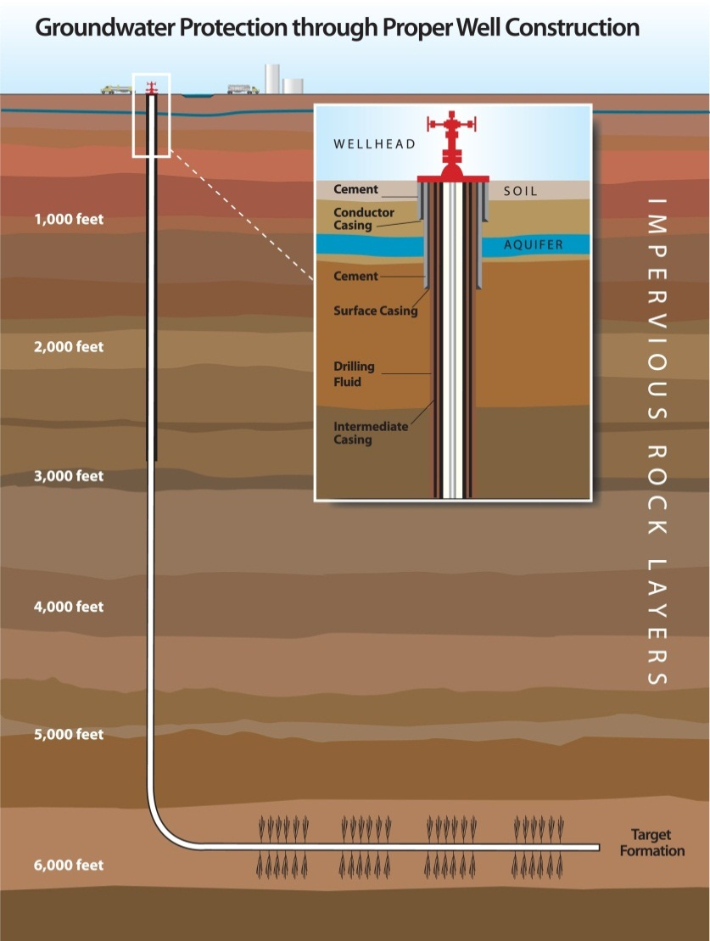
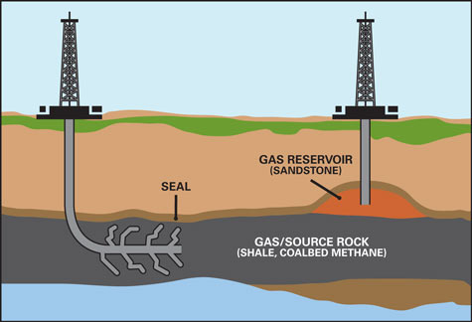
Conventional vs. Unconventional Oil and Gas
Unconventional
Conventional
Energy-Daily.com
Conventional drilling has to date mostly involved vertical drilling: few landowners affected.
New drilling techniques involve horizontal well creation over a mile below the surface.
Each vertical well may have many horizontals (up to 2 miles long): more landowners affected
SME.org

Slide 4
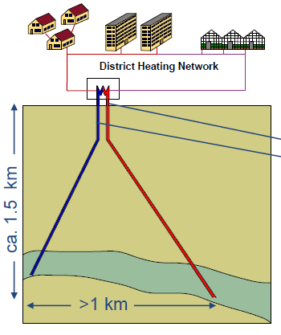
Geothermal
Deep geothermal schemes typically require two boreholes: one for abstraction and one for re-injection
Drilling depths are usually greater than 1.5km (and can be up to 5 km for deep geothermal power schemes)
The horizontal distance between the points of abstraction and re-injection is usually between 1-2 km (though less for deep geothermal power schemes)

Slide 5
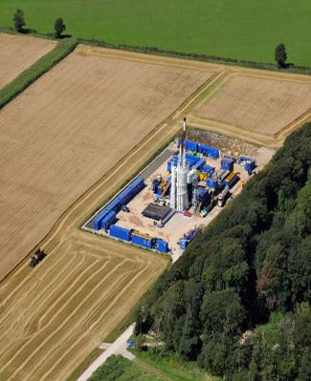
Legal position
The Crown owns the Mineral rights to oil and gas in the UK.
However, landowners own land rights on the surface, and underground with no defined depth limit.
Currently, operators must identify & negotiate with landowners for both surface and underground access, or risk charges of trespass.
Focus in this workshop is on underground access.
Surface access involves only a small surface area and fewer landowners.

Slide 6
Existing Procedure for Underground Access (Oil and Gas)
Identify Landowners
Arrange compensation if needed
Successful
Individual Negotiations
Unsuccessful
Operator refers to Secretary of State
Access Granted
Successful
Taken through the courts
Unsuccessful
Access Denied

Slide 7
Possible concerns with current process - Unconventional Gas & Oil
Could skew industries and their associated economic benefits towards areas with fewer landowners.
Investment could be delayed and some investment lost to other markets, depending on the length of court cases.
Individual negotiations with landowners are lengthy and costs are unpredictable.
Administration involved is disproportionate, if impact of underground activities is considered negligible.

Slide 8
Possible concerns with current process - Geothermal
Leaving issue unresolved would prevent projects currently in planning or proposed from going ahead
Deep geothermal heat schemes need to be sited in or near dense urban areas that offer the necessary heat loads. Heat networks, supplied with renewable heat, are a key plank of the Government’s heat strategy.
No legal route available where any one landowner refuses access.
Negotiating access rights with every single landowner in a dense urban environment (where these could number thousands) would be a huge administrative burden.

Slide 9
Questions
What impact do you believe subsurface activities deeper than 100 metres have upon the landowner?
Is the current situation with subsurface access rights acceptable or problematic in your view? Consider potential costs and issues arising from the existing procedure, and impacts on shale and geothermal development.
How do you think this situation could best be improved, if at all?
Is any such action urgent, and if so why?

Slide 10
Access Rights
Options James Clarke, OUGO
Policy Development Workshop

Slide 11
Options
Legislate for Automatic Access Rights
Do Nothing
Refine Existing Procedure
?

Slide 12
Options Continued
Refine Existing Procedure
Fix or cap compensation payments for individual negotiations.
Consider possibility of group negotiation/notification.
Note: NO existing procedure to refine for Geothermal
Legislate for Automatic Access
Primary legislation to grant automatic rights of access – under certain conditions.
Grant relevant operators automatic access (under a certain depth) to land
Operators can commence operations following notification, without need for negotiation, subject to necessary permissions.
May require some payment mechanism in return for the right of access (as per existing process).

Slide 13
Potential Payment Options
Voluntary vs. Statutory
Voluntary: Industry commits to providing a voluntary payment, sets appropriate limits and mechanism.
Statutory: Payment mechanism is defined in primary or secondary legislation
Individual vs. Community
Individual: Payments are given to each affected landowner or resident. Would require locating and notifying individuals and setting payment level.
Community: Payment is channelled through some local authority or body as a lump sum to distribute. Could determine how payment is to be spent.
How to set payment level
Could base on similar underground cases e.g. deep tunnels, pipelines, cables.
Could ask third party to determine payment.
Needs to reflect both value of the access rights and be considered a reasonable sum.

Slide 14
Questions
Is ‘do nothing’ a practical option?
Do you think there are other options we could consider?
How could we streamline the existing procedure whilst allowing geothermal to develop?
Would some form of payment be appropriate, in the case of legislation for automatic access?
If so, what features (such as those outlined above) do you think such a payment should have and why?
When would be an appropriate time to provide payment?

